Slide 1
FREIA – Tollgate 2
NSS status and meeting objectives
Shane Kennedy
NSS Project Leader
European Spallation Source ERIC
www.europeanspallationsource.se
31st January 2018

Slide 2
The 15 NSS Project Instruments
All are funded to be world leading in 2023
Instrument Class | Instrument | Costbook Value (M€) | Performance targets (@ 2MW)
Large Scale Structures | LOKI (Broad band SANS) | 12.19 | 5 x D22 & 20 x SANS2D
 | SKADI (General Purpose SANS) (+SONDE funds) | 11.50 | 4 x D22
 | ESTIA (Focusing Reflectometer) | 11.80 | Conventional mode: ~ 100 x D17 High intensity mode: 1cm² samples = seconds
 | FREIA (Liquids Reflectometer) | 13.2 | 30 x FIGARO, INTER
Diffraction | DREAM (Bispectral powder diffractometer) | 13.66 | > 10 x POWGEN or WISH
 | HEIMDAL (Hybrid diffractometer) | 13.55 | ~ 50 x GEM, ~ 8 x new POLARIS
 | MAGIC (magnetism single crystal diffractometer) | 13.10 | Cold: > 100 x worlds best, Thermal: 1mm³ crystals = 10 min
 | NMX (Macromolecular crystallography) | 11.67 | > 10 x LADI & Biodiff
Engineering & Industrial | BEER (Engineering diffractometer) | 14.99 | world leading in strain scanning, unique flexibility
 | ODIN (multi-purpose imaging) | 11.60 | world leading for high resolution, > 10 x best for TOF methods
Spectroscopy | BIFROST (extreme environment spectrometer) | 13.45 | > 10 x THALES & MACS
 | C-SPEC (cold chopper spectrometer) | 16.50 | 100 x IN5 (w RRM)
 | T-REX (bispectral chopper spectrometer) | 16.85 | 3 x 4-SEASONS, 3 x IN5
 | VESPA (vibrational spectroscopy) | 12.0 | 10 x VISION (ΔE = 130 meV)
 | MIRACLES (backscattering spectrometer) | 13.53 | 2 x BASIS and DNA
Total cost book value |  | 199.59
With a further ~ 56 M€ investment ESS will more than double the performance of these instruments:
ESS has submitted proposals to ESS/ERIC Council to fund or part/fund these upgrades

Slide 3
Planned order of commencement of operation of first 8 instruments (August 2023)
Matching early success in delivery of scientific outputs with the capacity of Lead In-Kind partners to deliver on schedule (ISIS, PSI, FZJ, LLB, HZG/NPI, TUM/PSI, TUM/LLB & DTU lead consortium).
Instrument Class | Sub-class | Candidates
Large Scale Structures | Small Angle Scattering | LOKI (ISIS) or SKADI (FZJ)
 | Reflectometry | ESTIA (PSI) or FREIA (ISIS)
Diffraction | Powder Diffraction | DREAM (FZJ) or HEIMDAL (ÅU)
 | Single crystal diffraction | MAGIC (LLB) or NMX (ESS)
Engineering | Strain scanning | BEER (HZG/NPI)
 | Imaging and tomography | ODIN (TUM/PSI)
Spectroscopy | Direct Geometry | C-SPEC (TUM) or T-REX (FZJ)
 | Indirect Geometry | BIFROST (DTU), MIRACLES (Bilbao), VESPA (CNR)
Instruments in bold type to be operational by start of user program
Italic:
backups in case of delays

Slide 4

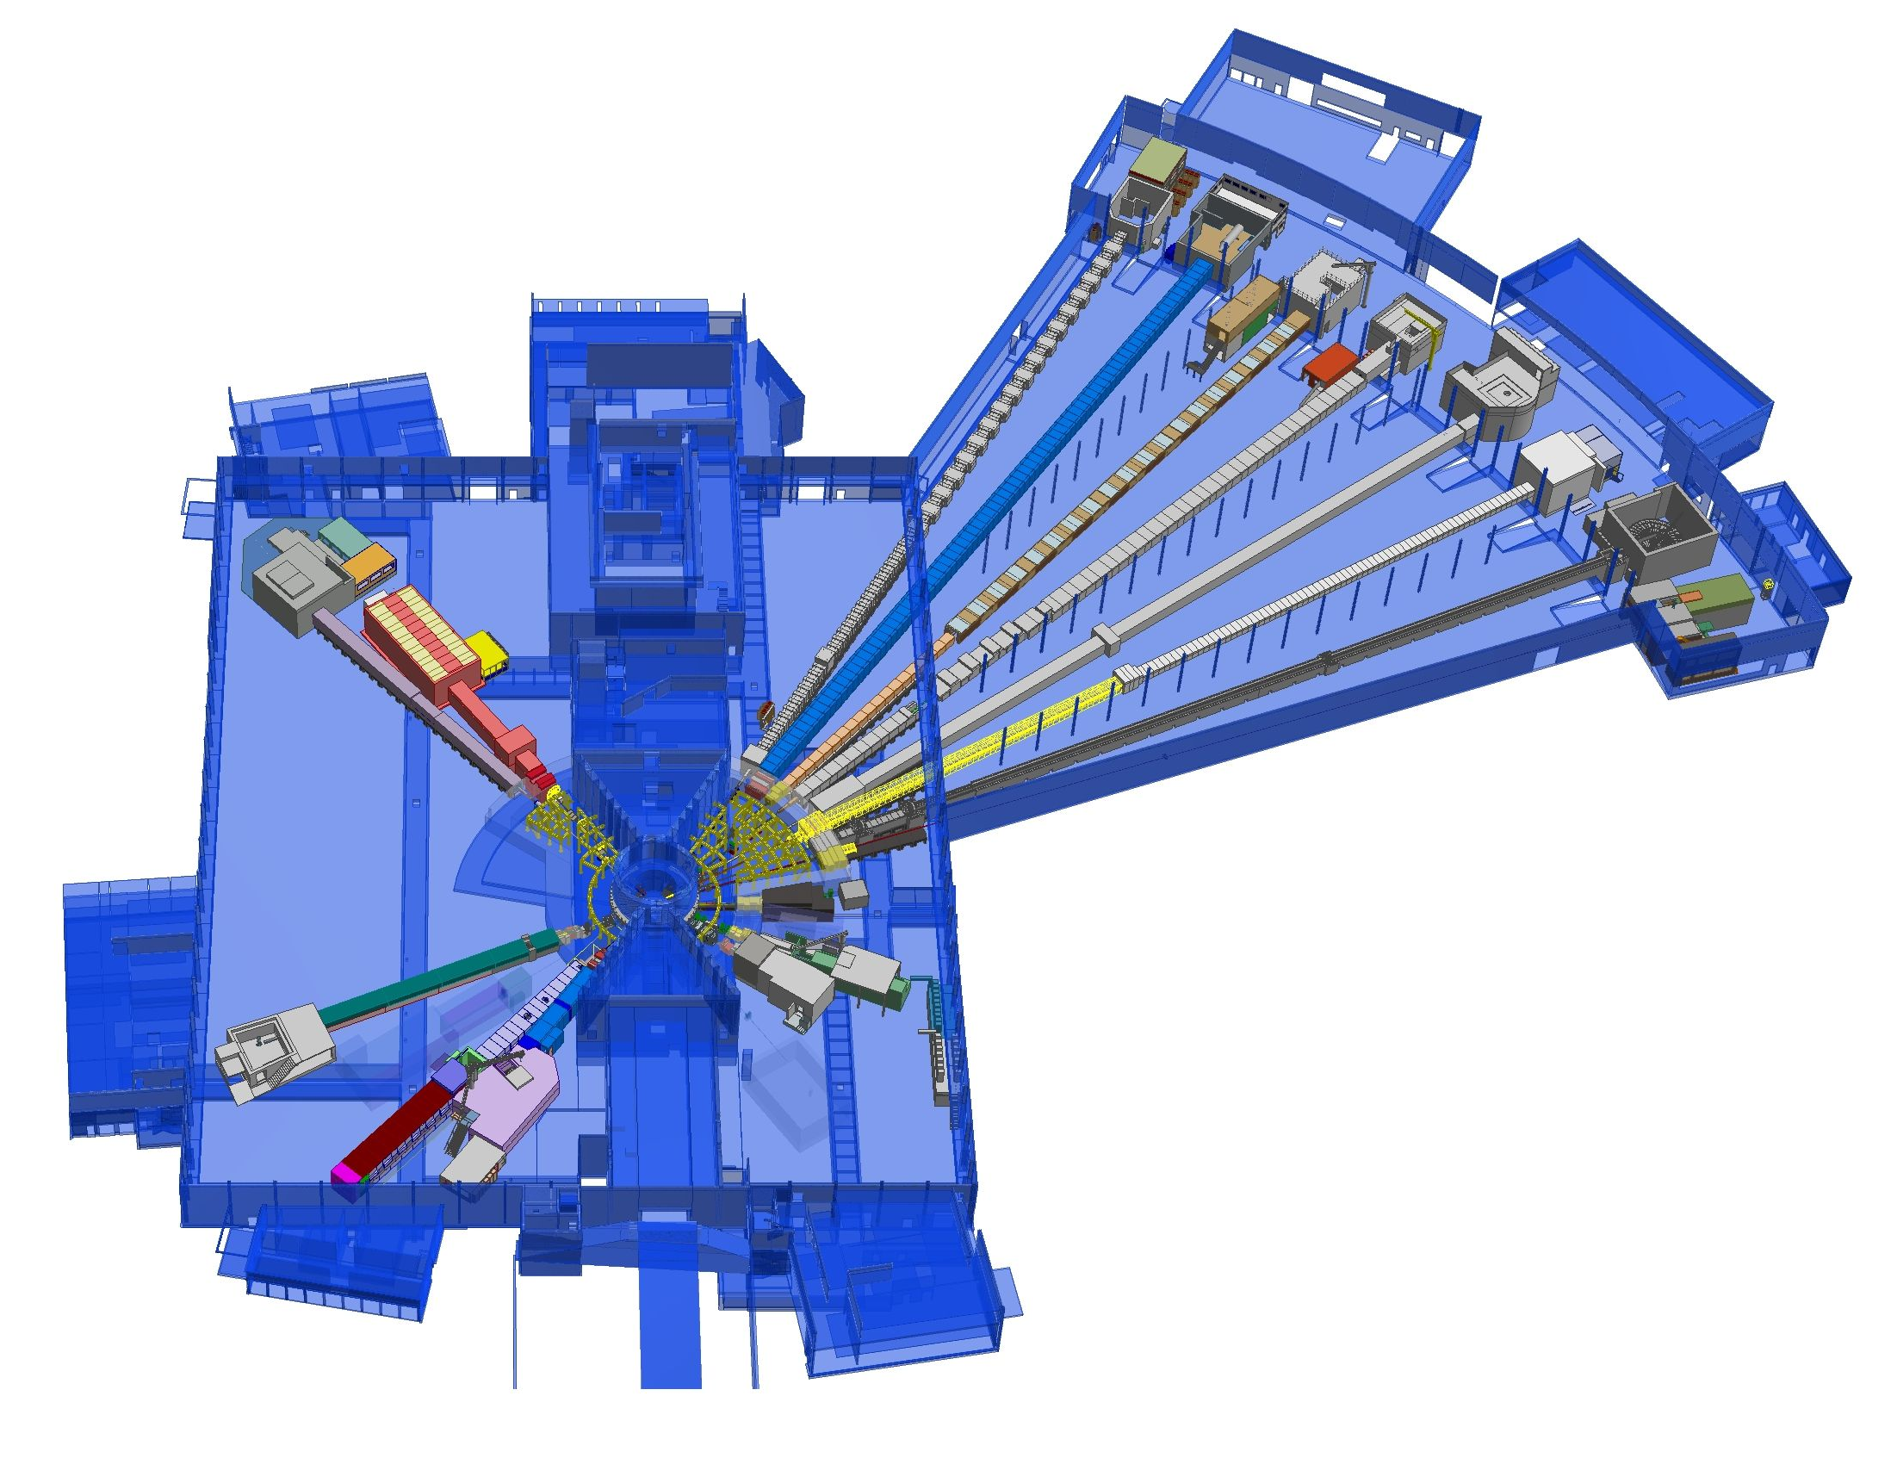











NSS Neutron Instruments:
Project scope -15 instruments + test beamline
ESS Lead Partners for instrument construction
+
Nuclear Physics Institute
NMX
+
BEER
C-SPEC
BIFROST
MIRACLES
MAGIC
ODIN
T-REX
DREAM
HEIMDAL
Test Beam Line
VESPA
LOKI
FREIA
SKADI
ESTIA
+
ESS In-Kind Partners also collaborate on sample environment, data management systems etc.
ESS Instrument Layout (September 2017)

Slide 5
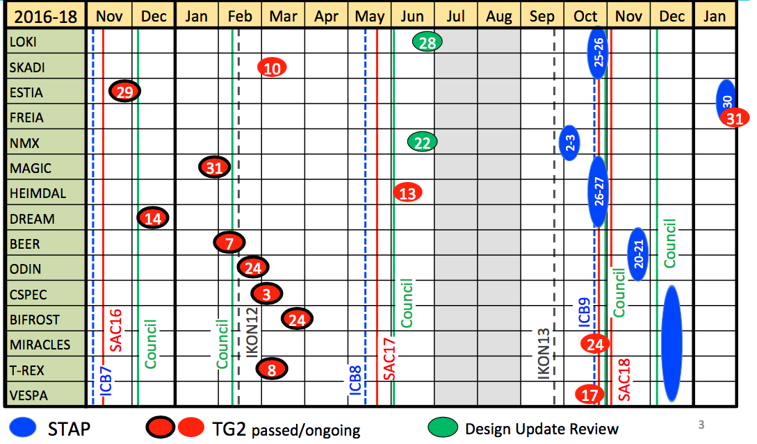
Instrument Milestones
Phase 1 schedule

Slide 6
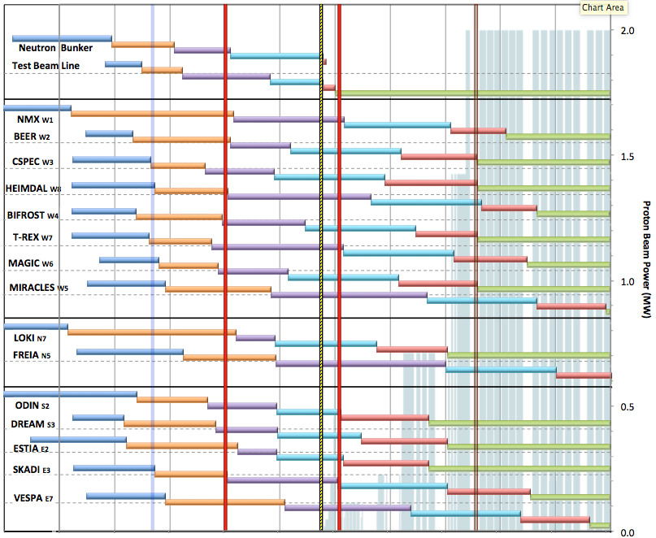

Internal* Neutron Beam Instrument Schedule
Draft for Discussion V3.4, 25th October 2017
Current date
First access
to NSS areas
Beam on Target
Hot Comm.
instruments
Start User Program
* still under discussion with ESS-ERIC Council
NOTES:
Assumes 2MW maximum power until end 2025
Phases aligned with TG2 reviews on 1st 10 NBIs
Installation & Integration (TG4) + Hot Commissioning (TG5) for first 8 NBIs aligned with draft BOI plan (schedule match typically within 1 month)
West sector
Current baseline – to be updated Q2 2018
North sector
East and South sectors
Preliminary Design
Detailed Design
Manufacturing & Procurement
Installation & Integration
Hot Commissioning/Early science
Operation
2016 2017 2018 2019 2020 2021 2022 2023 2024 2025
Notes:
This schedule assumes
obtaining the radiological licenses in a timely fashion from SSM. A trigger ‘first optical instrument component outside the monolith’ and a 6 months period from submission of the application to obtaining the SSM license - have been assumed (pending formal confirmation from ESH).
an initial hot commissioning of Accelerator and Target (A&T) to establish reliable beam on target at design frequency and pulse width.
In 2021, commissioning of the first (4-5) neutron instruments is to be conducted at low power, where possible, in order to minimize activation of in-bunker components of the neutron instruments. In the current plan, the duration of this initial commissioning period is 10-12 weeks.
Over 2022 and 2023 beam power and availability will increase, as the first 8 or more neutron instruments start hot commissioning, with a goal of reaching 2 MW source power by the start of the user program and maintaining that level until 2026.
Commencement of hot commissioning for the first 8 neutron instruments (TG5 in Table 1) is closely aligned with the schedules presented by those instrument build teams at TG2. This order matches well with the NSS “Early Science Success” strategy, and distributes responsibility for delivery widely among our experienced In-Kind partners. Changes to this order will be made if necessary to mitigate effects of delays to individual neutron instrument projects.
TG5 dates for neutron instruments 9-15 will be delayed to concentrate on-site resources for installation and commissioning (both cold commission and hot commissioning) on the first eight instruments to facilitate early science success for those instruments. This is discussed further below and illustrated in the NSS Installation and Commissioning schedule (Fig. 3).
TG3 dates refer to “final” approval of detailed design, when the integrated design of all major components is judged to be complete, and beyond which no further approval from NSS management is required for manufacturing. At this point in time these TG3 dates are not fixed, but NSS management plans for this to occur in staged manner. “Early procurement” approval dates for in-monolith optics and other critical path procurements (such as in-bunker components for the first instruments) are not shown in the figure

Slide 7
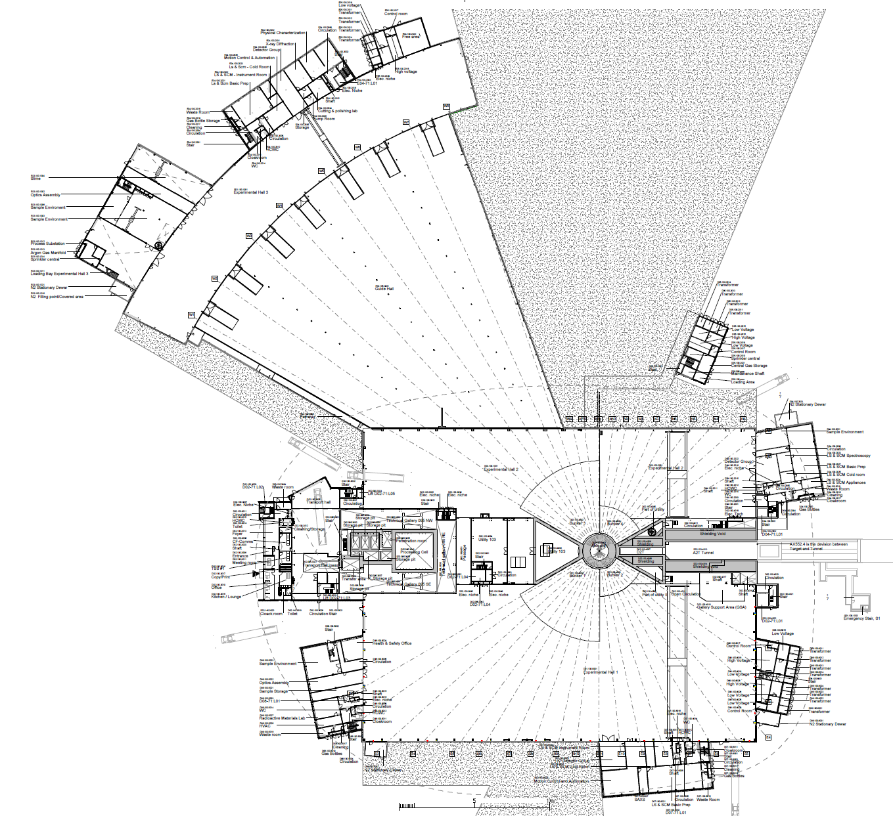
Access Dates for NSS IK partners
Hand-over dates from NSS Project to Instrument teams
E05
1a
E01 – Full Access 27-May-19 (incl. Crane)
E04
1b
E02 Area 1 – Partial Access 27-May-19
2
E02 Area 2 – Partial Access 15-Nov-19
E01
1a
3
D03 Main Hall – Partial Access 01-Dec-19 (incl. Cranes)
E03
1b
4
D01 Area 1 Main Hall – Partial Access 06-Feb-20
(incl. Cranes)
E02
5
D01 Area 2 Main Hall – Partial Access 02-April-20
(incl. Crane)
Exact Location of Final De-Lineation Point TBC
2
D05
Current baseline – to be updated Q2 2018 after the ESS rebaseline
D04
3
D03
D02
D06
D08
5
D01
4
Based on NSS –MS V3.4 (15 September 2017)
D07

Slide 8
First out-of-bunker access dates for
Instrument Installation
Dec 2019
Current estimation 30th Jan 2018
E04
Jan 2020
May 2019
E03
E01
Sep 2019
✓
Re-baseline dates due
from CF/SEC late Feb -18
E02 (1)
Nov 2019
E02 (2)
Jan-Jun 2021
December 2019
D03
Jan-Jun 2021
D02
D01
April 2020
February 2020
May –Nov 2021 (full D01 same date range)

Slide 9
First in-bunker access dates for Instrument Installation
Current estimation 30th Jan 2018
1.
2.
Start of joint work with Target in D02 (R6, NBOA & LS etc.) and start of bunker construction in D01 & D03
Start of first in-bunker access for Neutron Instrument construction
Dates to be looked into further! Depends on TD and NSS!
D03
Jun 2019
Feb - Aug 2020
D03
Dec 2019 Sep 2021
D02 Feb 2019 Jan 2020
D02
D02
D02 Mar 2019 Jan 2020
D01
Dec 2019 June 2021
D01
Aug 2019
May – Nov 2020
12-17 months delay from CF/SEC plus 3-4 months extra time needed in bunker for joint TD/NSS work (i.e. NBOA, LS, plugs)
12-17 months delay
from CF/SEC

Slide 10
NSS Floor loading limits:
Reduced in D01 & D03 in February 17
E05
E04
Under the bunker (D02 & inner parts of D01 & D03); 30 t/m²
In the rest of D01 & D03
      In general (under guides & instrument caves); 14 t/m²
      Around perimeter (3 metres from wall); 10 t/m²
      Staging areas (near truck access doors); 20 t/m²
In E01 & E02 (long instruments in west sector); 20 t/m²
E03
D04
D06
D08
D07

Slide 11
NSS provisions for FREIA (p. 1/2)
Local workshops and workshop support for on-site installation from early 2019
  Some workshops are likely to be off-site (in Lund) initially
Chemistry laboratories and sample handling facilities includes RML in D08 from 2020

Slide 12
NSS provisions for FREIA (p. 2/2)
Sample Environment: NSS Sample Environment pool to include
https://1drv.ms/x/s!AuCQb_HPf3b9g8g2HHqvybpQKix-Lg
  Gas Processing #1-2 (Q1/23)
  Julabo-type chiller/heater #1-3 (Q1/23)
  Injection system, syringe pump (Q1/23)
  Stopped flow systems (Q1/23)
  Rheometer (Q1/23)
  Solid-liquid & liquid-liquid cells (Q1/23)
  IR Furnace LATER
  Portable Laser heating LATER
  2.5T warm bore Cryomagnet #2 LATER
  5T warm bore Cryomagnet LATER
  Vacuum box LATER
  Stress/strain rig (generic) (possible)
Initial-Operations budget request to include:
  Julabo-type chiller/heater #4 (specific)
  Langmuir troughs (specific)
  Air-liquid troughs (specific)
  Overflow cylinder (specific)
  Laser interferometer alignment (specific)
  HPLC pump, 4 channel, switch (specific)
  Injection system, syringe pump (specific)
  Humidity Chamber (possible)
Notes:
Also in SAD list: flagged as externally funded:
Reaction cells (Q1/25)
In-situ light scattering (Q1/25)
In-situ gas absorption (Q1/25)
In-situ thermal analysis (Q1/25)

Slide 13
NSS Project; Neutron Instrument project phases
Proposal and Planning
Design and Construction
Installation and Commissioning
Instrument Proposal
Phase 0
Preparation for Design
Phase 1
Preliminary Design
Phase 2
Detailed Design
Phase 3
Manufacturing and Procurement
Phase 4
Installation and Integration
Phase 5
Hot Commissioning
Deliverables
Science case covering scientific relevance, impact and usage
Conceptual design with credible estimates of performance
Preliminary costing.
Deliverables
Conceptual design updates
Prototyping
Definition of facility requirements and interfaces
Clarification of institutional responsibilities
Resource planning
Deliverables
Scientific and technical requirements
Technical design concept
Delivery plan for all phases (including hot commissioning)
Delivery Schedule covering all phases
Resource plan
Staging plan for later enhancements
Budget with contingency at 10% of cost to complete
Deliverables
Complete definition of all major technical components
Completion of detailed plan for Phase 3
Refined plan for phase 4
Refined Resource plan
Refined delivery schedule, with critical path items and dependencies
Refined budget with contingency at 10% of cost to complete
Deliverables
Procurement and manufacture of all major technical components
Completion of detailed plan for phase 4
Site preparation
Refined plans for phase 5 and for staging
Refined Resource plan
Refine instrument delivery schedule
Maintain budget with contingency at 10% of cost to complete
Deliverables
Construction of physical infrastructure on site.
Assembly and installation of technical components
Integration and testing of technical components
Installation, integration and testing of Personnel Safety System
Submission of application for approval to hot commission
Formal project completion
Deliverables
Verification of performance of Personnel Safety System
Proof of compliance with radiation dose limits
Critical performance demonstration of basic functionality
Scientific performance demonstration
Friendly user experiments
Completion of technical and user manuals
Tollgate 1
STAP review
SAC recommendation
NSS recommendation
STC approval
Tollgate 2 (PDR)
Preliminary Design Review
STAP review
NSS
scope review
assign cost book value
Approval by SD
Tollgate 3 (CDR)
Critical Design Review
STAP review
ICB review
NSS approval
Tollgate 4 (IRR)
Installation Readiness Review
ICB review
NSS approval
Tollgate 5 (SAR)
Safety systems acceptance review
NSS approval
Tollgate 6 (ORR)
Operations readiness review
NSS approval

Slide 14
Tollgate 2 Process
TOLLGATE 2 MEETING: evaluation of
final technical design concept,
scientific scope,
project budget,
schedule and
resource plan
TOLLGATE 2 REVIEW possible outcomes:
No major problems: implement recommended changes and revise baseline documents, before moving instrument project into Phase 2 (< 3 months allowed).
Major problems: continue in Phase 1 and prepare for a second TG2 review (< 6 months allowed).
Review committee report submitted to Science Director within two weeks of TG2 meeting

Slide 15
Objectives for this meeting
• scientific parameters -that it will meet the stated performance criteria,
• engineering -that it is feasible to build with all of the appropriate interfaces,
• safety and licensing -that it meets the requirements for safe operations and licensing
• budget -that it can be built within the budget,
• schedule -that it can be built and made ready for hot commissioning in the required timeframe
• management -that the instrument consortium has the capability and sufficient resources to deliver according to their plan.
• operation and maintenance – that it can be operated (incl. performing experiments using samples and sample environment) and maintained.
(ESS-0051706)

Slide 16
Phase 2: detailed design (1/2)
Aim: To bring the design of the Neutron Instrument components to a state of readiness for Manufacturing and Procurement (M&P).
Essential achievements:
Complete detailed design of all major components coherently so as to minimize risk of incompatibilities and need for redesign work as the Project moves into Phase 3: M&P.
Detailed planning for M&P. Note Phase 2 does not include M&P.
Exception: where long lead-time procurements add considerable risk to project schedule.
Approval to begin early M&P: by NSS Project via Neutron Instruments Lead Engineer (Gabor Laszlo).
Detailed planning for Phase 4: Installation and Integration.
Technical Annex for whole of project to be completed within 3 months of Phase 2
Draft Template for the TA is available

Slide 17
Phase 2: detailed design (2/2)
Notes on Phase 2:
Careful scheduling of Phases 3 & 4 ensures resource planning for M&P processes (e.g. FAT & SAT), site preparation, installation and system integration, cold commissioning activities and licensing processes.
Critical dependencies should be identified and a critical path analysis should be performed in this phase.
The NSS Construction Engineer will develop and maintain an integrated installation plan that takes into account the procurement schedules for all Neutron Instruments, CF building schedules, and resource allocation.
Current dates based on MS 3.4
Instrument | Order | TG3 date (provisional) | First access to D/E | First Access to bunker | Priority access to bunker | TG5 – Hot Commissioning
FREIA | 15 | Dec-2019 | Jan-23 | Jun-23 | Jun-24 | Jan-25
to be updated Q2 2018 after the ESS rebaseline

Slide 18
NSS Project management
Director for Science
Andreas Schreyer
ESS Technical Board
Chair: Roland Garoby
Project Leader: Shane Kennedy
Deputy Project Leader: Oliver Kirstein
Instrument Collaboration Board
Chair: Andreas Schreyer
Safety and Licensing:
Lead: Arno Hiess
Neutron Instruments:
Lead Scientist: Ken Andersen
Lead Engineer: Gabor Laszlo
In-Kind Office:
Lead: Michela Del’Anno Boulton
Integration Activities:
Lead: Zvonko Lazic
Planning:
Lead: Sofie Ossowski
SSM application
Partner coordination
Neutron Bunker
Budgets & workflow
LOKI (ISIS)
ODIN (TUM/PSI)
Safety Systems analysis & design
Requirements & Standards
Schedule
SKADI (FRJ)
BEER (HZG/NPI)
Memoranda of Understanding
ESTIA (PSI)
Risk Management
Systems Engineering
Four Instrument Classes
Large scale structures
Engineering & imaging
Spectroscopy
Diffraction
C-SPEC (TUM)
Technical Annexes
FREIA (ISIS)
T-REX (FZJ)
In-Kind Collaboration Agreements
Conventional Facilities
DREAM (FRJ)
BIFROST (DTU)
Target Project
HEIMDAL (ÅU)
MIRACLES (ESS Bilbao)
Instrument Class Co-ordinator (scientist) assigned to each instrument
NMX (ESS)
VESPA(CNR)
MAGIC (LLB)

Slide 19
NSS Project: Engineering Integration and Interface Management
External i/f:
In Kind
External i/f:
ESH
- Bunker integration to instruments
- Bunker Design PM
- Design standards
- PIM alignment
- EPL alignment
Bunker
Co-ordinate:
Instruments i/f to ESS, during construction
Physical installation & integration on site
Michela Dell’Anno B
In-Kind
Mgmt
Helena Ramsing
Safety & Licensing
Zvonko Lazic
PM Bunker
External i/f:
Site Infra-
structure
Antonio Bianchi
Construction
Co-ord
Co-ordinate:
Instruments i/f to ESS, in design (Instruments=“Black boxes”
Ensuring consistency in information flow to Instrument Teams
Neutron Instruments
Gabor Laszlo
Instrument Co-ord
Shane Kennedy
NSS Project Leader
Peter Sångberg
Systems Engineering
SE process & methodologies
Documents structure/consistency
Design Reviews (in acc. to SE)
Sofie Ossowski
Project Co-ord
Iain Sutton
Technical
Co-ord
Jörgen A/ Clement M
Planning
External
i/f:
ICS
Neutron
Technologies
Phil Bentley
Neutron Optics and
Shielding
Schedule Integration
Co-ordinate NT:
Gen. of Requirements
Prep. of Specifications
Ensure Parts commonality
Ensure Robust design
Ensure RAMI is implemented
Operations perspective
External
i/f:
Target
External
i/f:
PSS

Slide 20
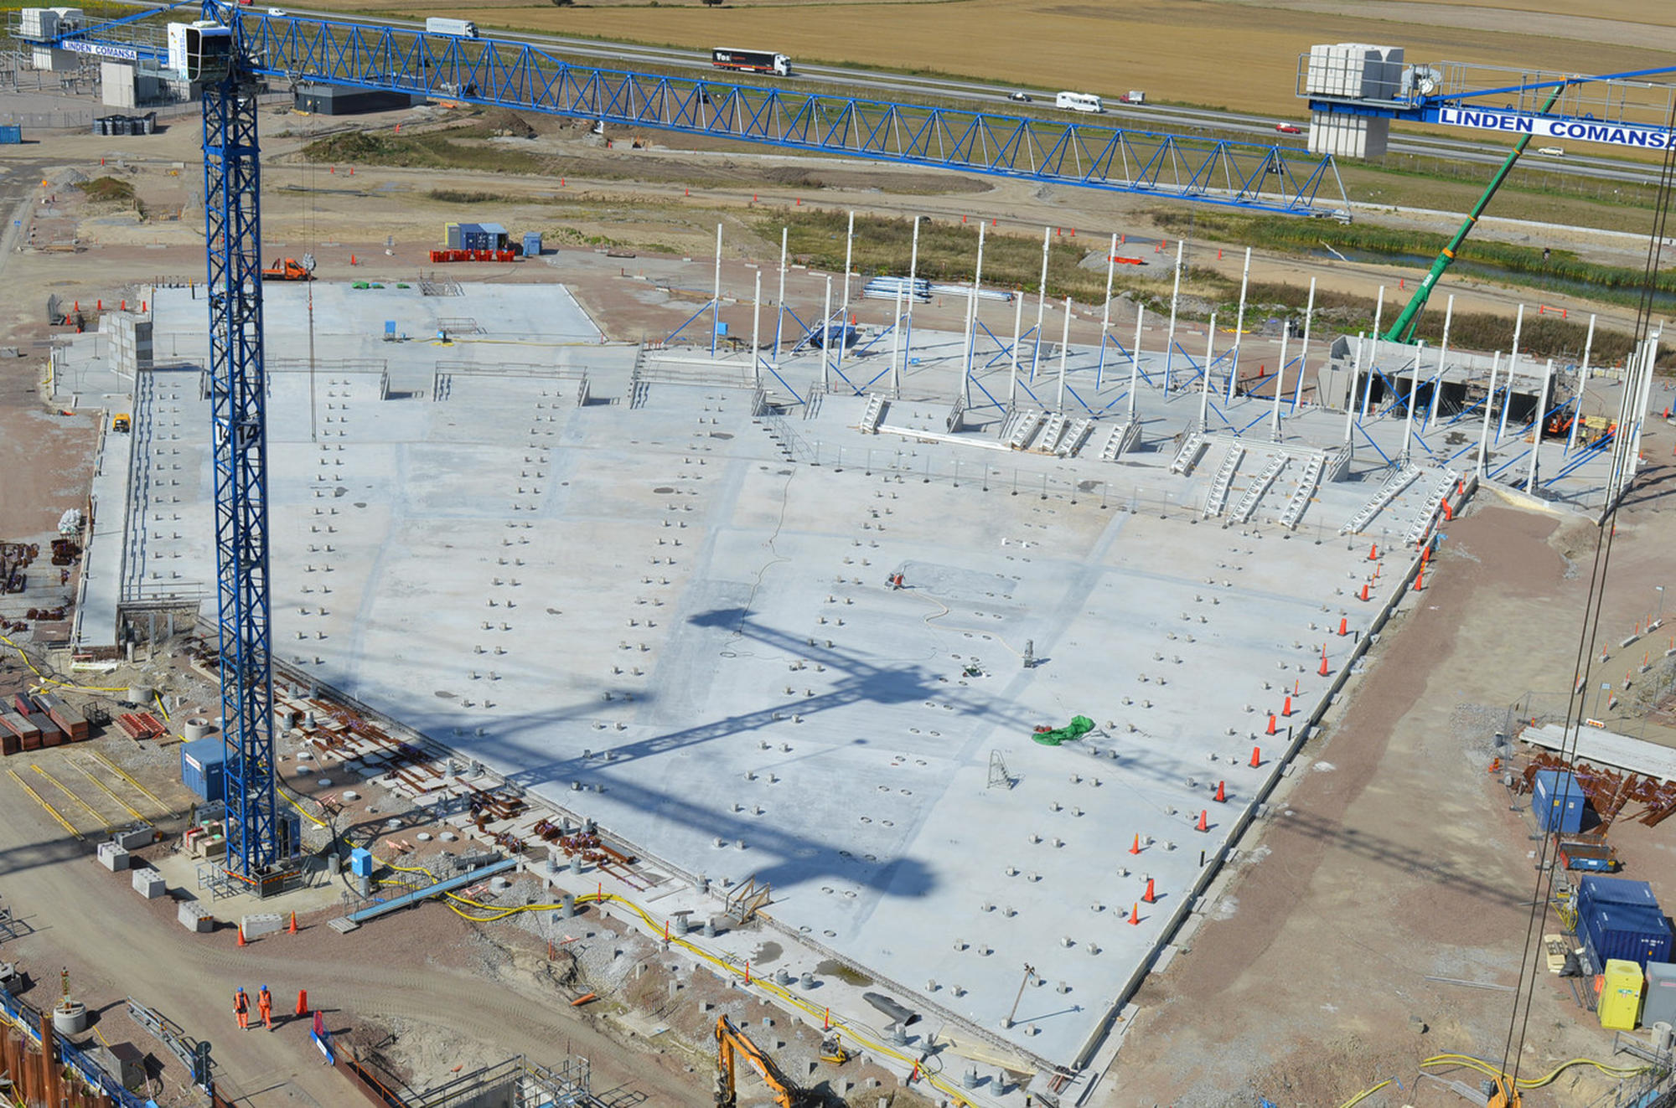
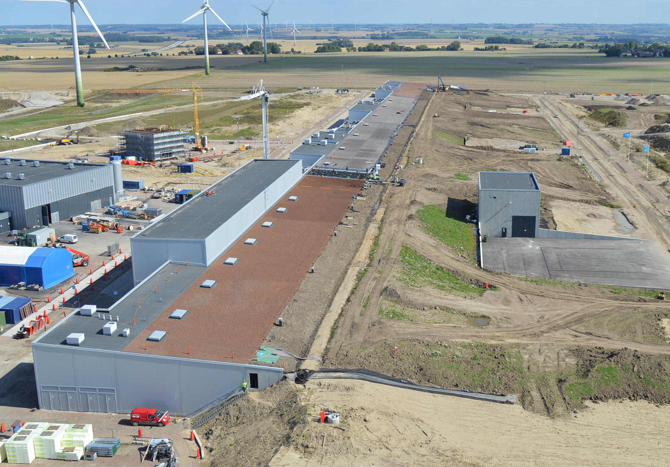
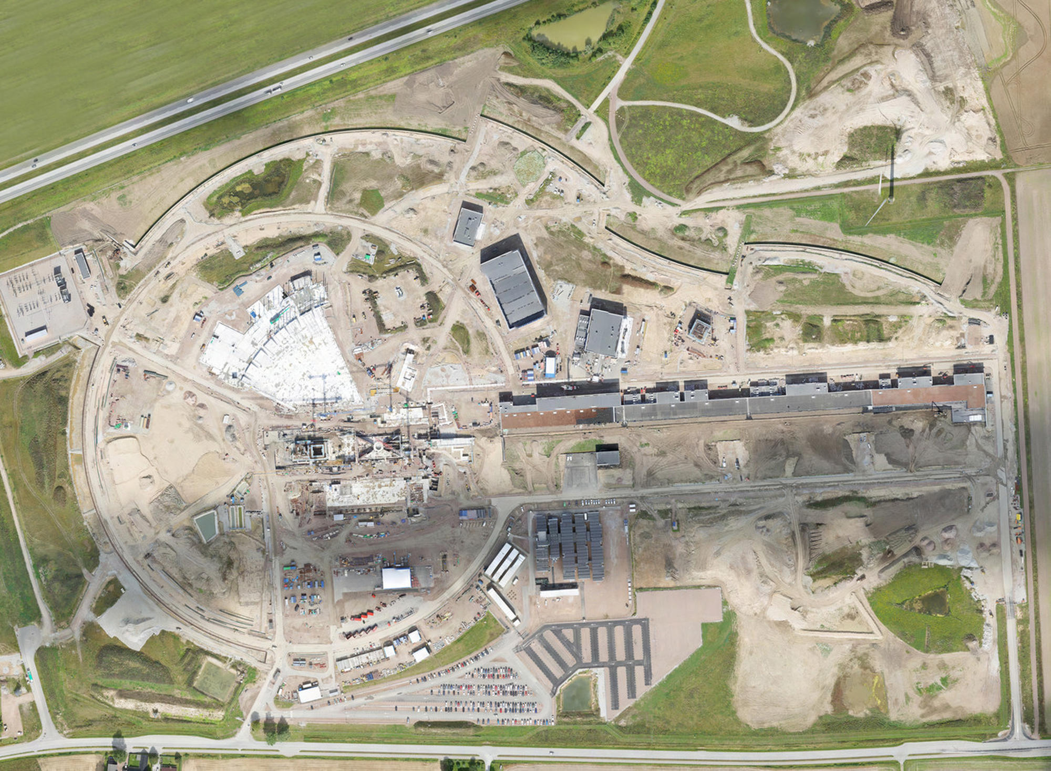
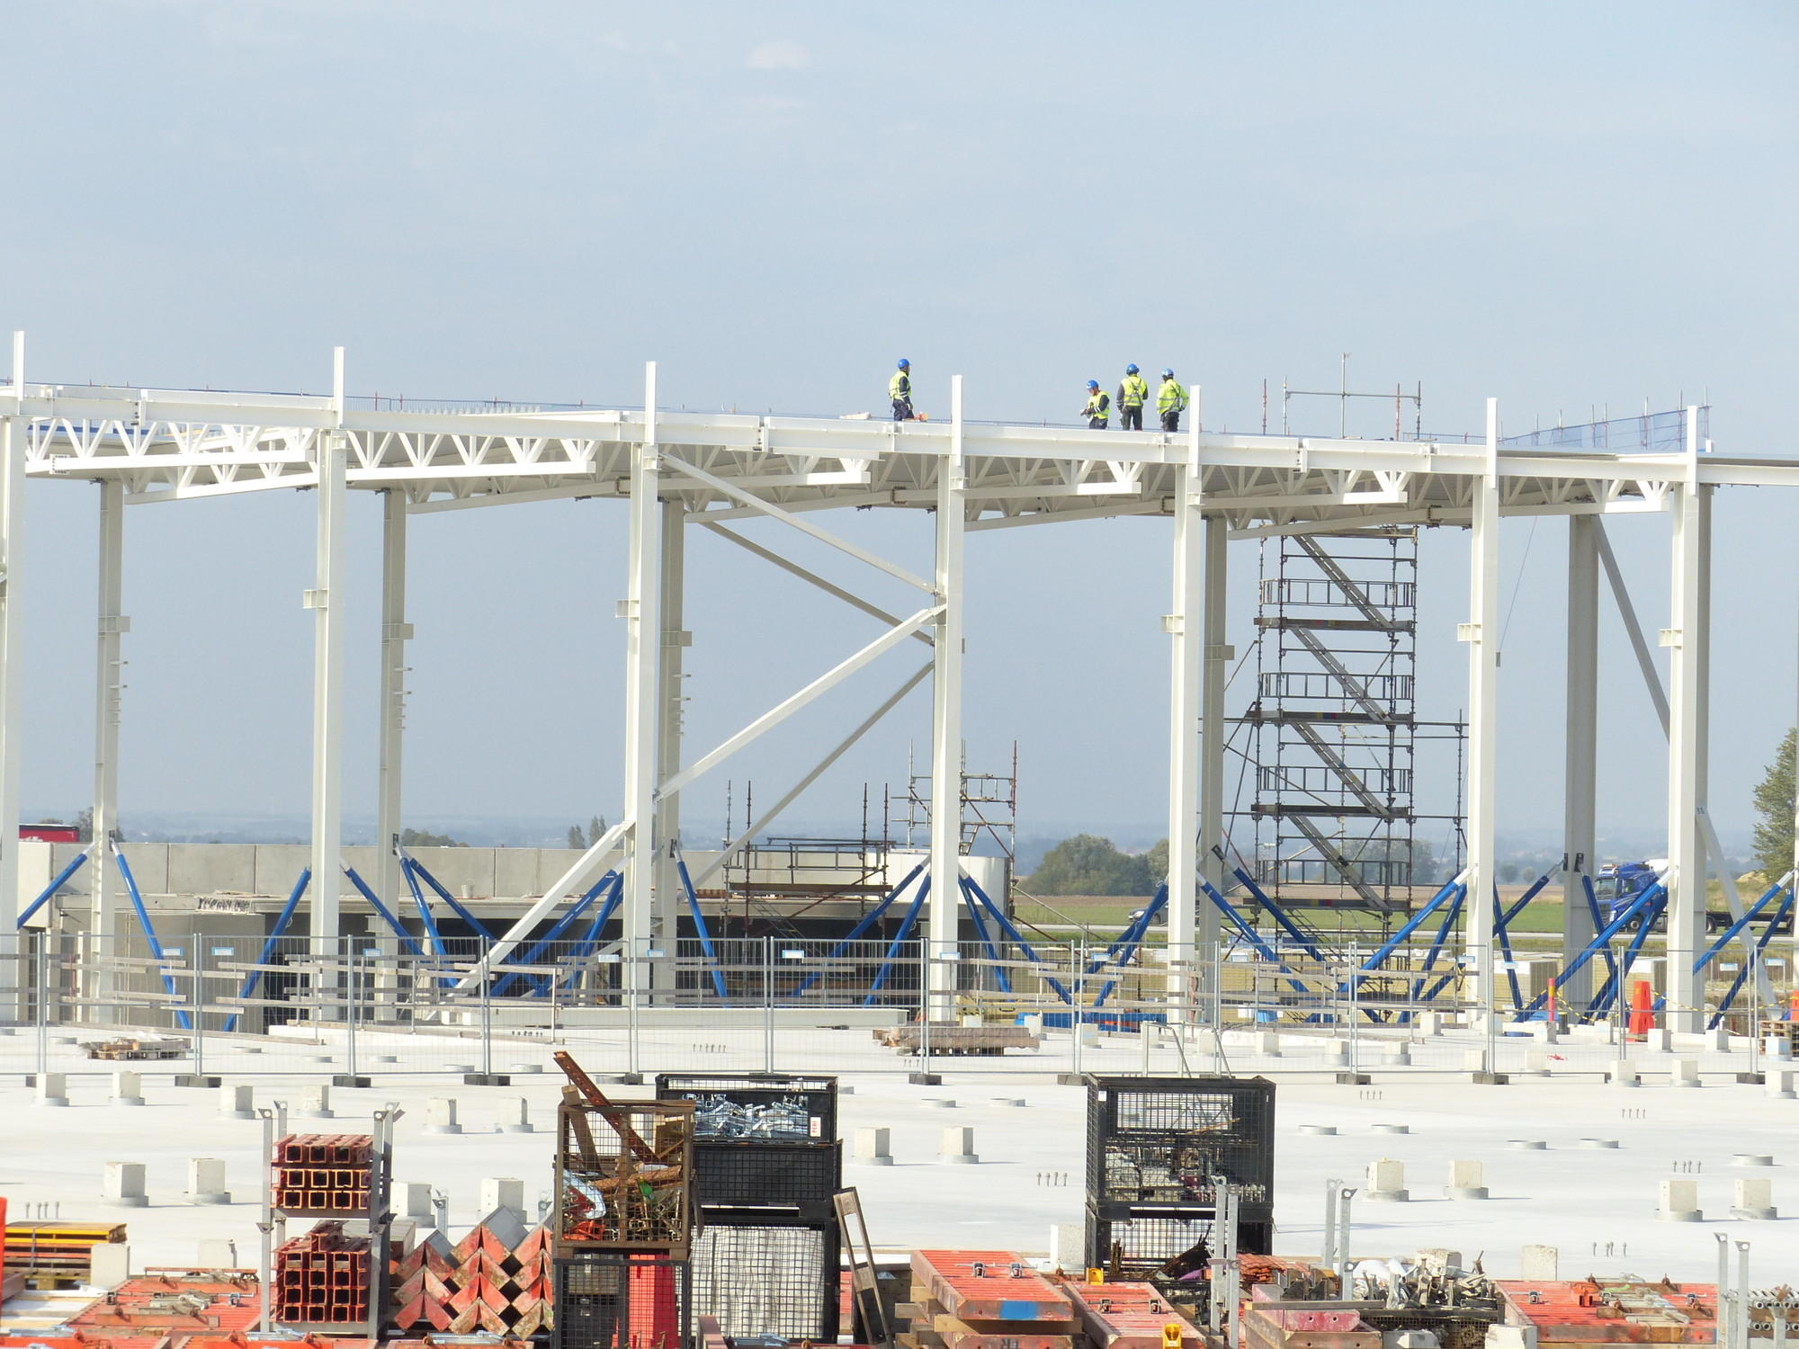
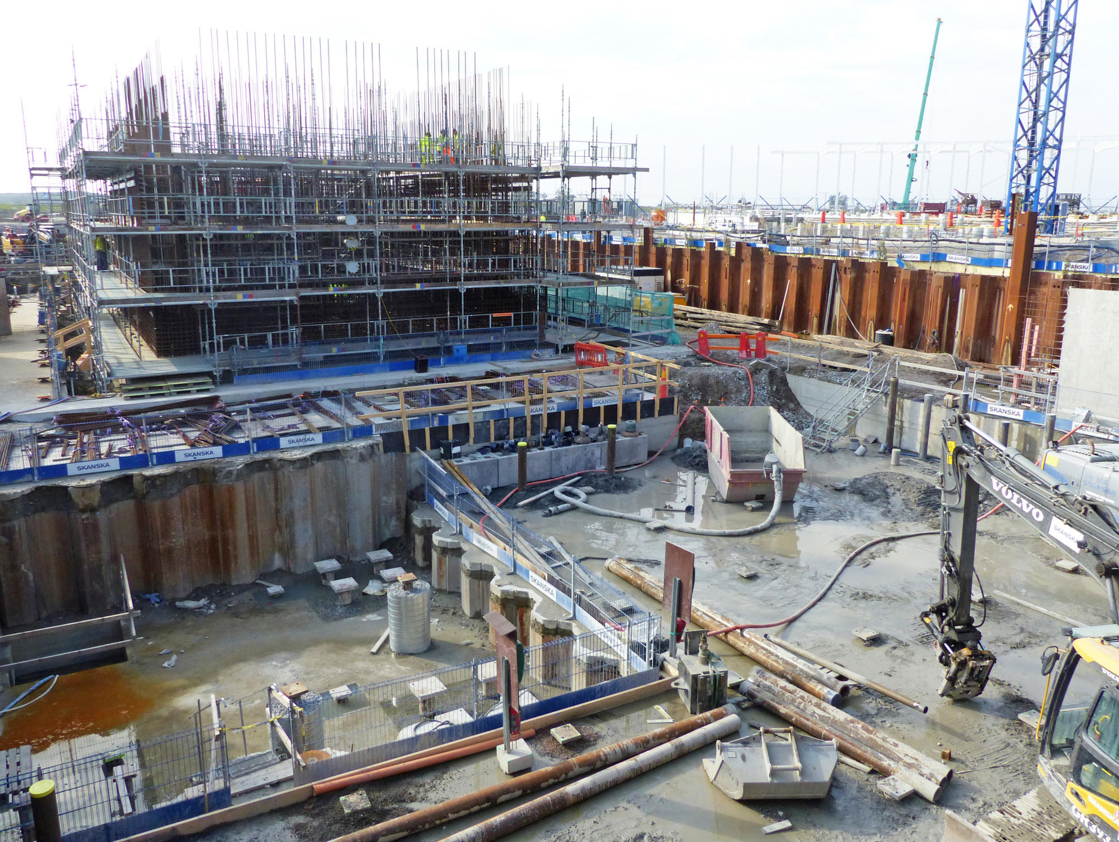
September/October 2017
West sector (160 m) Instruments
LINAC
Target
East sector Instruments
South sector Instruments

Slide 21
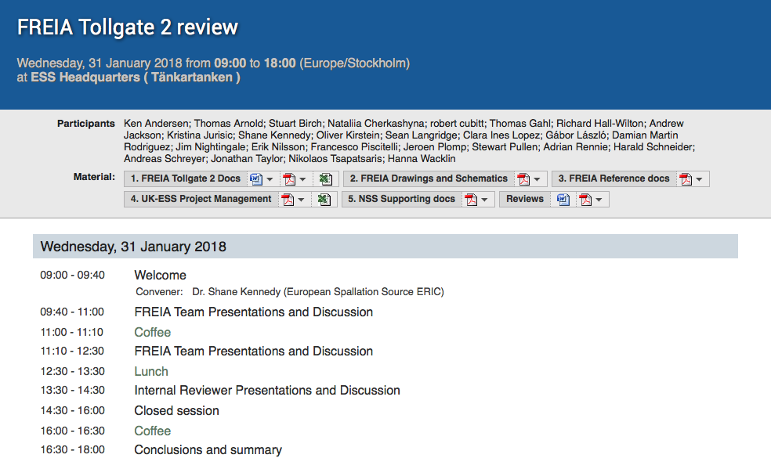
Agenda for FREIA TG2 meeting

