Slide 1
FREIA Toll-gate 2
Tom Arnold
FREIA Instrument Scientist
www.europeanspallationsource.se
31 January, 2018

Slide 2
Outline
Conops, System Requirements and Staging & Upgrade Options
  Brief summary of the science case
  Scope setting reductions
  Incorporation of upgrades into TG2 Documentation
Update on expected performance (simulation results)
Key project risks & mitigation strategy
  Choppers
  Sample Environment & Sample Prep Area: Coordination with SAD
  Fast Slits or Shutter
  Monitors
Preliminary System Design (Jim Nightingale)
Work Package Specification & Project schedule (Tom Arnold)
  “TG2+” approx. 1 year extension before ISIS commitment
  Impact of the ESS delay

Slide 3
FREIA team members
& organisation within UK-ESS project

Slide 4
Concept of Operations
Tom Arnold
FREIA Instrument Scientist

Slide 5
FREIA Science Case and derived requirements
Electrochemistry
Inorganic templating
Batteries and hydrogen storage
Science case from Instrument Proposal
Ionic liquids
Biosensors
Different sample/experiment types:
Free liquids (including liquid-liquid)
Time resolved experiments
Solid interfaces & in-situ techniques
Wide range of sample film thickness
In plane structure (GISANS)
Magnetic reference layers
Sustainable
Biomaterials
FREIA
Organic Photovoltaics
Lipids &
Proteins
Magnetism &
electronic phenomena
Lubrication Tribology
Surfactants & Polymers
Drug delivery
ESTIA

Slide 6
FREIA Science Case and derived requirements
Instrument requirements:
No sample movement
Horizontal sample geometry
Inverted beam geometry
Broad simultaneous Q range
Different sample/experiment types:
Free liquids (including liquid-liquid)
Time resolved experiments
Solid interfaces & in-situ techniques
Wide range of sample film thickness
In plane structure (GISANS)
Magnetic reference layers
Extensive range of
Sample Environments
High-count rate detector
Large area detector
Flexible collimation
Variable resolution
Polarisation

Slide 7
Outcome of Scope Setting (Oct 2016)
High-Intensity Specular and Off-specular Reflection
Sample Environment
High-resolution Specular and Off-Specular Reflection
Grazing Incidence SANS
Inverted Beam Geometry at least
Fast kinetic measurements (ms-s) with broad Q-range
Polarized time-of-flight (TOF) neutron reflection
50% of experiments
ALL experiments
~50%
30-40%?
25%
~50%
15% but could grow

Slide 8
Outcome of Scope Setting (Oct 2016)
High-Intensity Specular and Off-specular Reflection
Sample Environment
  Essential sample environments for commissioning
  Day 1 sample environments for minimal user programme
  Full suite of specialized sample environments
High-resolution Specular and Off-Specular Reflection
Grazing Incidence SANS
Inverted Beam Geometry at least
Fast kinetic measurements (ms-s) with broad Q-range
  Very fast kinetics: millisecond to second timescale
  Fast kinetics: seconds to 10s of seconds timescale
Polarized time-of-flight (TOF) neutron reflection
50% of experiments
ALL experiments
To be provided from operations
~50%
30-40%?
Upgrade
25%
~10-15%
Upgrade
~35-40%
15% but could grow
Upgrade

Slide 9
Outcome of Scope Setting (Oct 2016)
Other significant scope reductions
Reduction of WBC1-3 from double-disk to single disks.
Detector Electronics reduced to cover minimum essential area
ESS staff and travel costs beyond phase 1 (excluding Lead Scientist)
In Scope (key components) | Out of Scope
Elliptical Guide 3 Bandwidth & Frame-Overlap Choppers 2 WFM Choppers 3 Frame-Overlap Choppers for WFM Collimation system Standard system 3-slit system deflection mirror Sample Stack Detector (with reduced electronics) Shielding and infrastructure | Essential for Day 1 Sample Environment Sample Preparation Area Software (user interface, data reduction & analysis) Potential Upgrades Fast Shutter Detector Electronics enhancement Polarisation Double disk for pulse-skipping chopper Unlikely Upgrades GISANS Double disks for other choppers

Slide 10
Operational modes from TG2 CONOPS
The Day 1 operational modes are:
  High-Intensity Specular and Off-specular Reflection from thin films (< 150Å) at i) solid and (ii) liquid interfaces.
  High-resolution Specular and Off-Specular Reflection from thicker films (150 - 1000Å) at i) solid and (ii)) liquid interfaces.
  Fast time-resolved measurements over a broad simultaneous Q-range without moving the sample for both liquid and solid interfaces.
  Inverted Beam Geometry for reflection from below the surface at i) liquid-liquid and other buried interfaces and ii) in-situ experiments requiring this geometry for sample environments or complementary measurements (e.g. rheometry, microscopy).
The full-scope operational modes include:
  Polarized time-of-flight (TOF) neutron reflection for the investigation of magnetic thin films and magnetic contrast variation.
  Grazing Incidence SANS from horizontal samples for 2D thin film structures.
We consider that these specified modes cover all of the measurement requirements from the science case

Slide 11
Scientific requirements from CONOPS
Day-1 requirements:
  Rapid specular reflectivity measurements over a broad Q-range for liquid surfaces and time-resolved experiments.
  Probe a broad range of film thicknesses and sample sizes to examine wide range of materials.
  Inverted geometry experiments at liquid-liquid interfaces and other buried interfaces.
  Fast time-resolved reflectometry over the full Q-range simultaneously
  Provide simplicity of operation to allow users to focus on science
Full-scope requirements:
  Provide integrated, flexible sample environments to allow for high through-put and time-resolved studies
  Very fast time-resolved reflectometry over the full Q-range simultaneously
  Measure time-resolved polarized tof-neutron reflectometry for magnetic contrast variation experiments.
  A GISANS option with sufficient collimation and detector distance options to investigate the broadest range of materials in 2D and 3D.

Slide 12
Scientific requirements updated after TG2 internal review?
Day-1 requirements:
  Rapid specular reflectivity measurements over a broad and continuous Q-range for liquid surfaces and time-resolved experiments.
  Probe a broad range of film thicknesses and sample sizes to examine wide range of materials.
  Inverted geometry experiments at liquid-liquid interfaces and other buried interfaces.
  Fast time-resolved reflectometry over the full Q-range simultaneously
  Provide simplicity of operation to allow users to focus on science
  Allow for upgradeability to full-scope requirements
  Be compatible with all sample environment equipment required by the science case
Full-scope requirements:
  Provide integrated, flexible sample environments to allow for high through-put and time-resolved studies
  Very fast time-resolved reflectometry over the full Q-range simultaneously
  Measure time-resolved polarized tof-neutron reflectometry for magnetic contrast variation experiments.
  A GISANS option with sufficient collimation and detector distance options to investigate the broadest range of materials in 2D and 3D.

Slide 13
High-level system requirements from CONOPS
Day-1 requirements:
  The instrument shall be capable of measuring specular reflection on free liquid surfaces without moving the sample or detector between Qmin = 0.0035 Å⁻¹ and Qmax = 0.44 Å⁻¹.
  The instrument shall be capable of measuring specular reflection from solid samples in the range of Qmin = 0.005 and Qmax = 1Å⁻¹
  The instrument shall be capable of providing a momentum transfer resolution of dQ/Q = 10.5%.
  The instrument should have a high-resolution option with dQ/Q = 1-2%.
  The instrument shall allow the illumination of horizontal sample areas between 1cm(w) x 1cm(l) and 4cm (w) x 8cm (l).
  The instrument shall have a minimum wavelength band Δλ of 7Å without frame-overlap or contamination from the prompt pulse.

Slide 14
High-level system requirements updated after TG2 internal review?
Day-1 requirements:
  The instrument shall be capable of measuring specular reflection on free liquid surfaces without moving the sample or detector over a continuous range of Qmin = 0.0035 Å⁻¹ to Qmax = 0.44 Å⁻¹.
  The instrument shall be capable of measuring specular reflection from solid samples in the range of Qmin = 0.005 and Qmax = 1Å⁻¹
  The instrument shall be capable of providing a momentum transfer resolution in the range dQ/Q = 4-12% (depending on incident angle & wavelength).
  The instrument should have a high-resolution option with dQ/Q < 3%.
  The instrument shall allow the illumination of horizontal sample areas between 1cm(w) x 1cm(l) and 4cm (w) x 8cm (l) including the beam penumbra.
  The instrument shall have a minimum wavelength band Δλ of 7Å without frame-overlap or contamination from the prompt pulse.

Slide 15
High-level system requirements from CONOPS
Day-1 requirements continued:
  The instrument shall be able to skip every second source pulse (pulse-skipping)
  The instrument should allow fast collimation changes for time-resolved experiments
  The instrument shall be able to measure specular reflection from below liquid sample interfaces up to Q = 0.2Å⁻¹
  The instrument should maximise the signal-to-background (S/B) ratio to improve the detection of specular and off-specular reflection signals at high Q. Background levels should allow the measurement of reflectivity to R = 1x10⁻⁸.
  The instrument should provide software and data handling that allows convenient data reduction and handling during an experiment and include a user interface (both graphical and command-line based) that is simple to understand and capable of saving data in formats appropriate to a range of analysis software.

Slide 16
High-level system requirements updated after TG2 internal review?
Day-1 requirements continued:
  The instrument shall be able to skip every second source pulse (pulse-skipping)
  The instrument should allow fast collimation changes for time-resolved experiments
  The instrument shall be able to measure specular reflection from below liquid sample interfaces from Qmin = 0.0035 Å⁻¹ to Q = 0.2Å⁻¹
  The instrument should maximise the signal-to-background (S/B) ratio to improve the detection of specular and off-specular reflection signals at high Q. Background levels should allow the measurement of reflectivity to R = 1x10⁻⁸.
  The instrument shall be designed to be upgradeable to the full scope, as defined in the Preliminary System Design (PSD).
  The instrument shall be compatible with all sample environment equipment required by the science case.
We do not necessarily agree that a software requirement should be removed – it is not clear how the software requirements are to be captured?

Slide 17
High-level system requirements from CONOPS
Full-scope requirements:
  The instrument shall provide essential temperature-controlled sample environments for liquid and solid samples and mechanisms for changing samples automatically.
  The instrument shall be able to polarise the full wavelength band of 7Å.
  The instrument should provide a GISANS option for horizontal samples that is capable of detecting length scales of up to 190nm with resolution δQy/Qy = 5%.

Slide 18
High-level system requirements after TG2 internal review
Full-scope requirements:
  The instrument shall provide essential temperature-controlled sample environments for liquid and solid samples and mechanisms for changing samples automatically.
  The instrument shall be able to polarise the full wavelength band for either standard or pulse-skipping operation modes (wavelengths in the range 2Å and 25Å).
  The instrument should provide a GISANS option for horizontal samples that is capable of detecting length scales of up to 190nm with resolution δQy/Qy = 5%.
We have not included a specific requirement for the full-divergence and RAINBOWS modes since these are potential mitigation strategies for requirements 4 & 8 and additional nice-to-have options in certain cases

Slide 19
Sample Environment
Sample Environments to be provided from Operations budget
  A provisional list of Essential Day 1 SE has been given to SAD but the details are likely to change depending on the budget available.
    Solid samples, controlled atmosphere, Solid-liquid, liquid-liquid & free liquid troughs.
    Sample changers, HPLC pumps, Chillers & temperature/humidity control.
    Other future upgrades for in-situ measurements (e.g. Rheology)
  Not standard large or shared equipment –means dedicated solutions for control & integration
  Will require some significant development to maximise the potential of the instrument
  SE Labyrinth will be considered but is unlikely to be a priority

Slide 20
Sample Preparation Area
Sample Preparation Area are to be provided from Operations budget
  Space for sample preparation area has been left in the design, but the details of this need to be confirmed and we think that the services should be supplied during construction.
Working with SAD to clarify a way forward with this because this does not seem like a cost effective approach.

Slide 21
Other issues with CONOPS?
Section 5.2 Operational Scenarios
  Inclusion of full divergence and RAINBOWS modes (with clarification that these options are only possibilities at this stage)
  Clarification of Off-Specular & GISANS description

Slide 22
Initial Operations & Staging
Tom Arnold
FREIA Instrument Scientist

Slide 23
Upgrade Priorities
Potentially In Scope | Priority list for upgrades
Alternative operation modes Full-divergence mode RAINBOWS mode Sample Preparation Area | Essential for Day 1 Sample Environment Sample Preparation Area Software (user interface, data reduction & analysis) Potential Upgrades Fast Shutter Detector Electronics enhancement Polarisation Double disk for pulse-skipping chopper Unlikely Upgrades GISANS Double disks for other choppers

Slide 24
Upgrade Priorities
  Suggested modification of text in section 2.2 Staging options:
The various options are of varying degrees of importance to the overall science case and during detailed design their requirements may result in conflicts or lead to prohibitive costs. We therefor provide a reasoned priority list of these developments below.
Sample Environment Equipment: Fundamental to the effective performance of the instrument. Provision is limited by operational funding to be determined.
Alternative operation modes (full-divergence and RAINBOWS modes): These are likely to be fairly cheap options and can act as contingency options for other elements of the design. Provided these do not cause difficulty with other aspects of the instrument it is likely that they will be included from the construction budget.
Capability to upgrade with a fast-shutter system: This is potentially very important to a significant part of the science case and needs to be considered in full during the design of the three-slit collimation system. If this proves to be a cost-effective solution then it may be included within the construction budget.
Capability to expand the detector electronics to full 30cm x 30cm coverage: Relatively cheap and should not affect any other parts of the instrument
Capability to upgrade with polariser & spin flipper: This requires space to be left and imposes some non-magnetic requirements. It is not a critical part of the science case as it will be possible on ESTIA so will be compromised in favour of other instrument components
Capability to upgrade the bandwidth, frame overlap and pulse-skipping choppers to double-disk choppers: The removal of double-disk choppers at scope-setting has meant the optimum positions of the choppers (except pulse-skipping) are not the same as for single disk choppers. Therefore, only the final pulse skipping chopper (outside the bunker) will be designed with this upgrade in mind.
Capability to upgrade collimation for full GISANS capability, an additional 1m² ¹⁰B GISANS detector at 8m from sample and associated modifications to the cave and shielding: This upgrade is likely to be very expensive and disruptive and given the likelihood of a future proposal for a specific GISANS instrument it is the lowest priority.

Slide 25
System Requirements Specification
Tom Arnold
FREIA Instrument Scientist

Slide 26
Beam Transport and Conditioning System after TG2 internal review
Id | Text | Trace up to
1 | Broad Bandwidth The BTCS shall transport from the moderator to the sample a beam of neutrons to the sample with a minimum wavelength bandwidth of 7 Å, without frame-overlap or contamination from the prompt pulse. | SciReq I, IV, VII HLSR 1, 6, 10
2 | Bandwidth Selection The BTCS shall transport from the moderator to the sample a beam of neutrons to the sample with selectable wavelength bandwidth up to 20 Å (for pulse-skipping), so that the accessible Q range can be controlled and the `transport of unwanted neutrons minimised in order to maximise the signal-to-background ratio. | SciReq I, II, III, IV, VII HLSR: 1,2,7, 10
3 | Wavelength Selection The BTCS should transport from the moderator to the sample a beam of neutrons with wavelengths that lie in the range 2 Å to 25 Å, so that the accessible Q range can be controlled. | SciReq I, II, III, IV, VII HLSR: 1,2,6,7
4 | Wavelength Transport The BTCS should transport the full wavelength range with comparable efficiency, to ensure high neutron flux over the full divergence and therefore Q range. | SciReq I, II, III, IV, VII HLSR 1, 7, 10
5 | Wavelength Resolution The BTCS should transport from the moderator to sample a beam with wavelength resolution selectable between either a high-resolution option (1.5 ≤ δλ/λ ≤ 2.5% FWHM) or a low-resolution option (variable over the range 4 ≤ δλ/λ ≤ 12% FWHM). | SciReq II, IX HLSR 3,4
6 | Beam Size Selection The BTCS shall transport from the moderator to the sample a beam of neutrons with selectable dimensions. The absolute beam size (including the penumbra) shall be able to project a sample beam footprint onto a horizontal sample surface of between 0 mm x 0 mm and 80 mm (beam direction) x 40 mm (across beam) (full width), for all possible incident angles relative to the sample surface. This allows the size of the beam to be matched to the size required by the experiment. | SciReq I, II, V, VI HLSR 5

Slide 27
Beam Transport and Conditioning System after TG2 internal review
7 | Incident angle selection The BTCS shall allow the incident angle impinged on the sample to be selected over a range of: 0.3° to 4.8° above a free liquid interface 0.5 to 2.5° below a free liquid interface 2.5° below to 12° above a solid surface | SciReq I, II, III, IV, VIII HLSR 1, 2, 9
8 | Incident angle resolution The BTCS shall allow the incident angle to be defined with a resolution of 0.01°. | SciReq I, II, III, IX HLSR 3, 4
9 | Beam Divergence The BTCS shall transport from the moderator to the sample a beam of neutrons with divergence between 0.3° and 4.8° relative to the horizontal, so that the selectable incident angles are able to cover the full Q range for free liquid surfaces. | SciReq I, IV, VII HLSR 1, 8
10 | Divergence profile The BTCS should transport from the moderator to the sample a beam of neutrons with a divergence profile that is consistent over the full sample footprint, so that the incident angles accessible are independent of the sample size. | SciReq I, II HLSR 3, 4, 5
11 | Rapid angle changes The BTCS should allow for incident angles to be changed at speeds of the order of the pulse frequency (72ms) and without the need for sample or detector movement. | SciReq I, IV, VII HLSR 8
12 | Line-of-sight avoidance The BTCS shall be constructed such that the line-of-sight from the guide entrance is closed twice before the exit of the bunker wall. | SciReq I, II, III, IV, VII, VIII, IX HLSR 10 ConOps §3.4.8

Slide 28
Beam Transport and Conditioning System after TG2 internal review
13 | Neutron beam cut-off When the experimental cave is not interlocked, the BTCS shall block radiation from the target to a level required by safety regulations so that the user of the instrument can access the cave to change samples or sample equipment. | ConOps §3.4.7 & §3.4.14.
14 | Brilliance transfer The BTCS should transport from the moderator to the sample a beam of neutrons with 100% brilliance transfer within the selected wavelength and divergence range, so that the scattering signal from the sample is maximised. | SciReq I, II, III, IV, VII, VIII, IX HLSR 11
15 | Monitors The BTCS shall allow for the incident neutron flux to be measured after major optical components and at the end of the guide/prior to the sample, without causing significant reduction in neutron flux or increased background scattering. | SciReq I, II, III, V, HLSR 1, 2
16 | Polarisation The BTCS shall allow for the polarisation of the neutron beam | SciReq VIII HLSR 13
17 | Rapid polarisation changes The BTCS should allow the polarisation of the neutron beam to be changed on at least the same timescale as the angle changes. | SciReq IV, VII, VIII HLSR 9,13
18 | GISANS Collimation The BTCS shall transport from the moderator to the sample a beam of neutrons with horizontal collimation appropriate to allow δQy/Qy resolution of 5% | SciReq IX HLSR 14
19 | Wavelength rejection The BTCS should transport from the moderator to the sample a beam of neutrons where the total brilliance outside the selected wavelength band is zero, so that the signal-to-background level can be maximised. | SciReq I, II, III, IV, VII, VIII, IX HLSR 11

Slide 29
Sample Exposure System after TG2 internal review
20 | Horizontal and Vertical Positioning The SES shall position the sample in the beam of neutrons with an accuracy of +/- 0.1mm and a precision of +/- 0.05 mm, so that the sample is in the beam of neutrons and correctly illuminated. | SciReq I, II HLSR 1,2
21 | Rotational Positioning The SES shall position the sample in the beam of neutrons with an accuracy of +/- 0.1 degrees and a precision of +/- 0.01 degrees so that the sample orientation is controlled and known. | SciReq II HLSR 2
22 | Sample Environment Equipment The SES shall permit the installation and positioning of sample environment equipment up to 1.2m² and up to 750 kg in mass, so that experimental equipment required to control the physical and chemical environment of the sample can be installed. | SciReq I, II, III, VI HLSR 1,2,12
23 | Vibration Isolation The SES shall provide vibration transmissibility of <0.05 for frequencies >10Hz and <0.1 for frequencies >5Hz , to enable studies of free liquid interfaces. | SciReq I, VI HLSR 1,12
24 | Automatic Sample Changing Where possible, the SES should allow for certain samples to be automatically changed without physical user intervention, so that the use of available beam time is optimised and radiological exposure is maintained ALARA. | SciReq VI HLSR 12

Slide 30
Sample Scattering Characterisation System after TG2 internal review
25 | Detection Efficiency The SCS shall detect the scattered neutrons with an efficiency greater than 45% at 2.5 Å and with an efficiency of greater than 50% at wavelengths greater than 4 Å. | SciReq I, II, IX HLSR 1,2,6,7 Conops 5.
26 | Spatial Resolution The SCS shall provide a detector spatial resolution 0.5mm (v) x 2.5mm (h). | SciReq II HLSR 3,4
27 | Time-of-flight Resolution The SCS shall determine the neutron time-of-flight with a precision of < 10 µs. | SciReq II HLSR 3,4
28 | Angular Resolution The SCS shall provide an angular resolution of dθ ≤ 0.01° (v) and dθ ≤ 0.05° (h) | SciReq I, II, IX HLSR 3,4
29 | Angular Coverage The SCS should be able to detect neutrons scattered by the sample covering an angular range 5° (v & h). | SciReq I, IV, VII, IX HLSR 1,2,9,14
30 | Detector Positioning Range The SCS shall be able to position the detector to cover angles of -3° to +21° relative to horizontal, so that the detector can be appropriately positioned for both upward and downward reflecting experiments. | SciReq II ConOps §5.**.

Slide 31
Sample Scattering Characterisation System after TG2 internal review
31 | Detector Positioning The SCS shall position the detector with an accuracy and precision of +/- 0.05 mm, so that value of Q can be correctly calculated. | SciReq I, II, III, IX HLSR 1,2,9
32 | Neutron Selectivity The SCS should detect radiation incident to the detector system other than cold or thermal neutrons with at most 1 x 10⁻⁸ efficiency for gammas and 1 x 10⁻⁵ for fast neutrons. | SciReq I, II, III, IX HLSR 1,2,10
33 | Rate Capability The SCS should be able to distinguish events at instantaneous rates of 450 kHz/mm², without either significant dead time effects or double counting | SciReq I, II, III, IV, VII HLSR 1, 2, 10, 14
34 | Detector Noise The SCS should record less than 0.1 counts/s/mm² in the absence of incoming radiation. | SciReq I, II, III, IV, VII HLSR 10
35 | Secondary Scattering The SCS should not cause additional scattering of the neutrons scattered by the sample. | SciReq I, II, III, IV, VII, IX HLSR 10
36 | Beam Centre Determination The SCS shall allow the determination of the position of the un-scattered neutron beam so that the zero point for scattering angle calculation can be determined. | SciReq I, II, III, IX

Slide 32
Some other potentially contentious requirements after TG2 internal review
42 | Sample environment footprint The experimental cave should allow the mounting of permanent and removable sample environment devices as defined by the science case in CONOPS and ≤ 750 kg in weight. The experimental cave should also permit additional space around the sample position (on both sides of the sample position) for two users to change samples (>1m²) and additional space for out-of-beam sample changing or ancillary equipment (>1m²) | SciReq I, II, III, VI HLSR 12 ConOps §3.4, §3.5 & §5.2.
48 | Area for basic sample preparation According to ESS-0038078 Mechanical interfaces and allowing for a rapid change over between experiments, the instrument shall assign a space of 3.5m x 6m close to the instrument. | ConOps §3.5.5. & §5.2.1.2
49 | Area for soft-matter sample preparation The instrument should provide, within the basic sample preparation area, facilities appropriate to the preparation and assembly of soft-matter sample environments. | ConOps §3.5.5. & §5.2.1.2
67 | Spares The system shall include spares critical to meet Operation Schedule requirement. | ConOps §5.3.3

Slide 33
Integrated Control and Monitoring where should these requirements go?
54 | Instrument control GUI The integrated control and monitoring system shall allow the user to control the experimental parameters through a graphical user interface | SciReq V HLSR 11 ConOps §3.4.13 & §3.5.4 & §5.2.
55 | Instrument control CLI The integrated control and monitoring system shall allow the user to control the experimental parameters through a scriptable command line interface | SciReq V HLSR 11 ConOps §3.4.13 & §3.5.4 & §5.2.
56 | Scattering pattern visualisation The integrated control and monitoring system shall allow the user to visualise the scattered neutron intensity as a function of detector coordinates and time-of-flight with user selectable binning. | SciReq V HLSR 11 ConOps §3.4.13 & §3.5.4 & §5.2.
57 | Data processing GUI The Integrated control and monitoring system shall allow the user to process the recorded data through a graphical user interface to corrected intensities as a function of momentum transfer. | SciReq V HLSR 11 ConOps §3.4.13 §3.5.4 & §5.2.
58 | Data processing CLI The Integrated control and monitoring system shall allow the user to process the recorded data through a scriptable command line interface to corrected intensities as a function of momentum transfer. | SciReq V HLSR 11 ConOps §3.4.13 & §3.5.4 & §5.2.
59 | Hazard detection The Integrated control and monitoring system shall detect hazards that may compromise safety for personnel or equipment | ConOps §3.4.13 & §3.5.4 & §5.2.

Slide 34
Additional Requirements in scope
Id | Text | Trace up to
 | Pool Sample Environments The Cave should provide a labyrinth compatible with the use of standard ESS pool sample environments
 | Optional Full-divergence mode The BTCS should be able to allow the full divergent beam to be transmitted to the sample.
 | Optional RAINBOWS mode The BTCS should be able to allow for the option of using a prism between the sample and detector to spatially separate neutron wavelengths at the detector.
 | Chopper Disc and Slit transmission. Neutron transmission by the closed choppers and slits should be 1x10⁻⁶ at 2Å
 | Monitor efficiency Diagnostic monitors can have low efficiency Normalisation monitors need different efficiencies for short (ms-s) kinetic measurements and standard (10s of seconds to minutes and longer)measurements
 | Monitor attenuation or removability The monitor should have zero attenuation when measuring samples
 | Monitor resolution Wavelength resolution should be 1.5 ≤ δλ/λ ≤ 2.5%. This imposes variable TOF resolution requirements depending on the distance from the source.
 | Monitor stability and maintainability Not sure how to define this
 | Monitor gamma-sensitivity Same as detector? at most 1 x 10⁻⁸ efficiency for gammas and 1 x 10⁻⁵ for fast neutrons.

Slide 35
Additional section on requirements for upgrades: “Constraint requirements”
Id | Text | Trace up to
 | Polarisation Upgradability The BTCS, Cave, SES and SSCS design shall allow for the inclusion of an upgrade to enable polarisation of the neutron beam
 | Polarisation Upgrade The BTCS shall allow for the polarisation of the neutron beam | SciReq VIII HLSR 13
 | Rapid polarisation changes Upgrade The BTCS should allow the polarisation of the neutron beam to be changed on at least the same timescale as the angle changes. | SciReq IV, VII, VIII HLSR 9,13
 | GISANS upgradability The BTCS, Cave, SES and SSCS design should allow for the instrument to be upgraded to enable measurement of GISANS.
 | GISANS Collimation Upgrade The BTCS shall transport from the moderator to the sample a beam of neutrons with horizontal collimation appropriate to allow δQy/Qy resolution of 5% | SciReq IX HLSR 14
 | GISANS Detector Upgrade Ths SSCS should provide a detector that meets all the specifications of the reflectometry detector but allow a Q-range

Slide 36
Additional section on requirements for upgrades: “Constraint requirements”
Id | Text | Trace up to
 | Pulse-skipping chopper upgradeability The BTCS shall allow the pulse-skipping chopper to be upgraded from a single-disk to a double-disk system
 | Detector Electronics upgradeability The Detector should be straightforwardly upgradeable to cover an area of 300x300mm²
 | Sample environment compatibility The instrument shall be compatible with all sample environment equipment required by the science case.
 | Area for soft-matter sample preparation The instrument should provide, within the basic sample preparation area, facilities appropriate to the preparation and assembly of soft-matter sample environments. | ConOps §3.5.5. & §5.2.1.2
Is anything else missing?

Slide 37
Instrument Performance
Tom Arnold
FREIA Instrument Scientist

Slide 38
Instrument Performance
Caveats
  Andrew Jackson has combined Hanna Wacklin-Knecht’s models for the guide and choppers to obtain a model for the whole instrument.
  The new simulations account for modified chopper positions defined by space constraints in the bunker
  But they were done with chopper gaps optimised for the previous chopper positions
  This means the TOF separation is not perfect
  There wasn’t time to check all variations such as pulse-skipping or cross-frame contamination

Slide 39
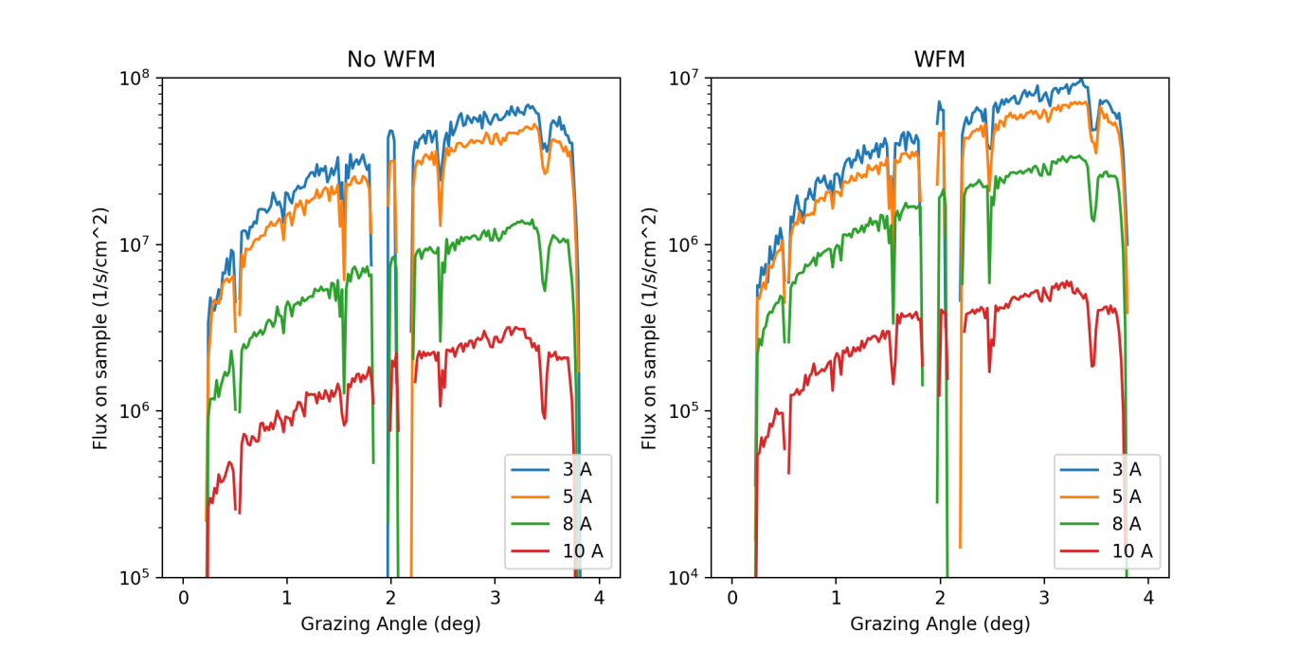
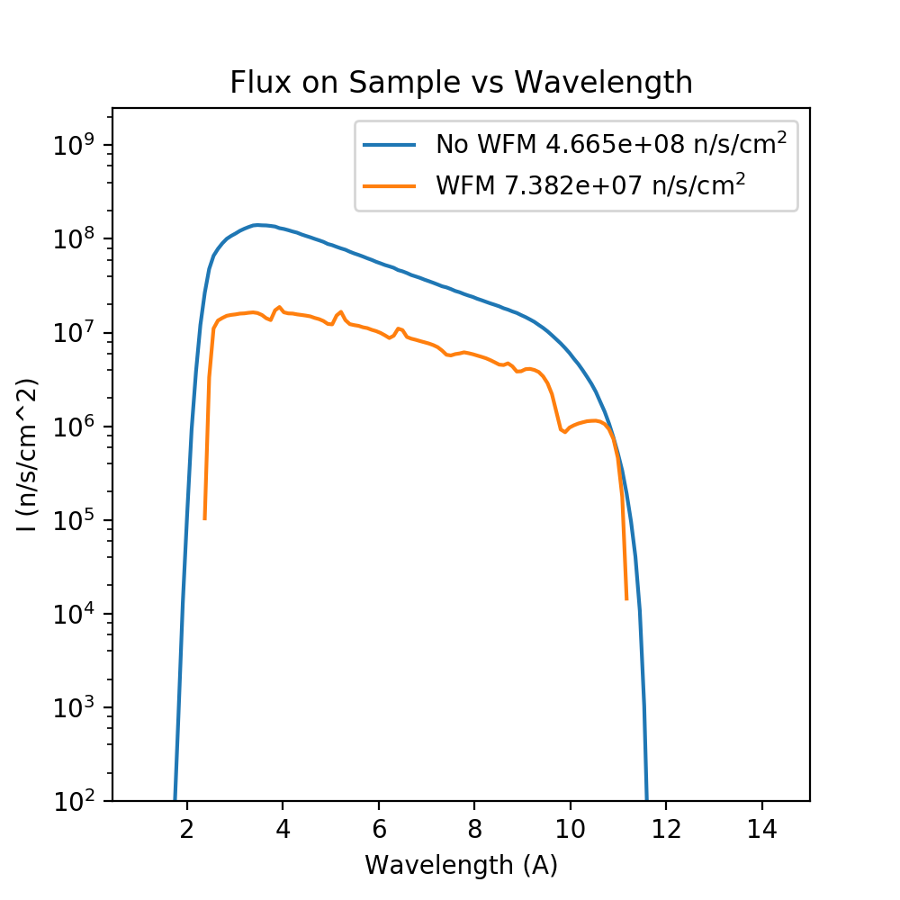
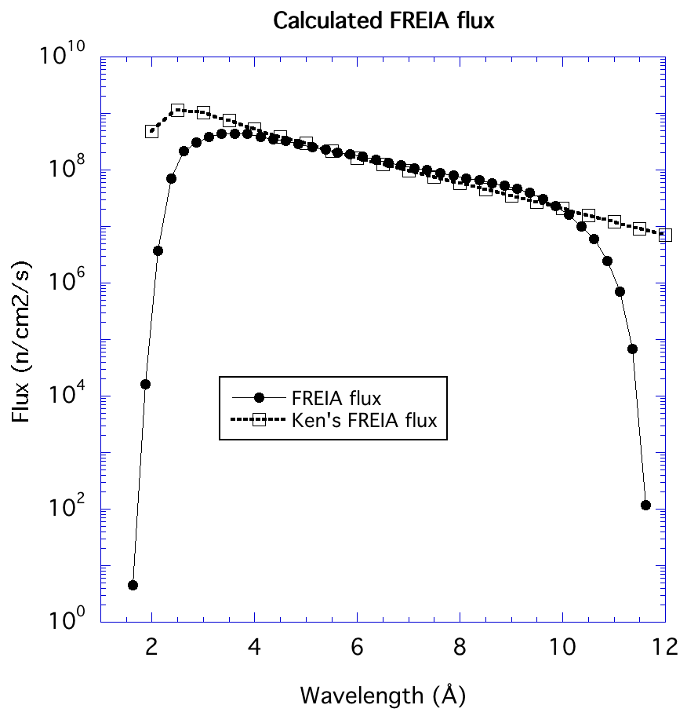
Instrument Performance
Flux on sample

Slide 40
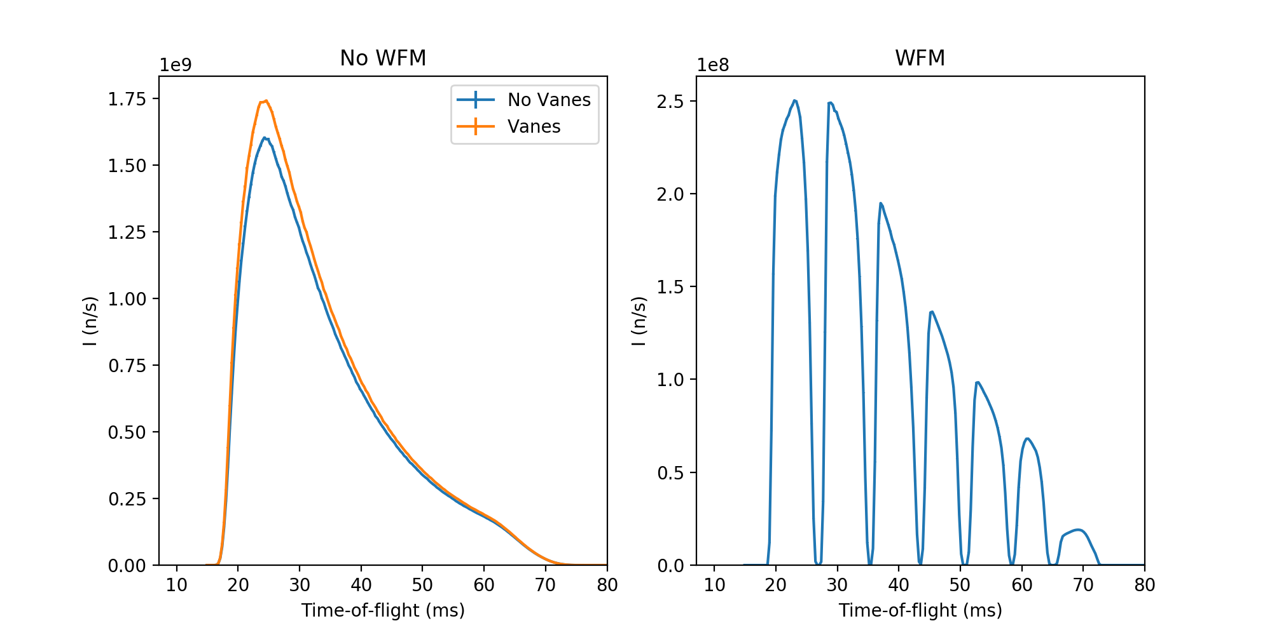
Instrument Performance
WFM: TOF resolution

Slide 41
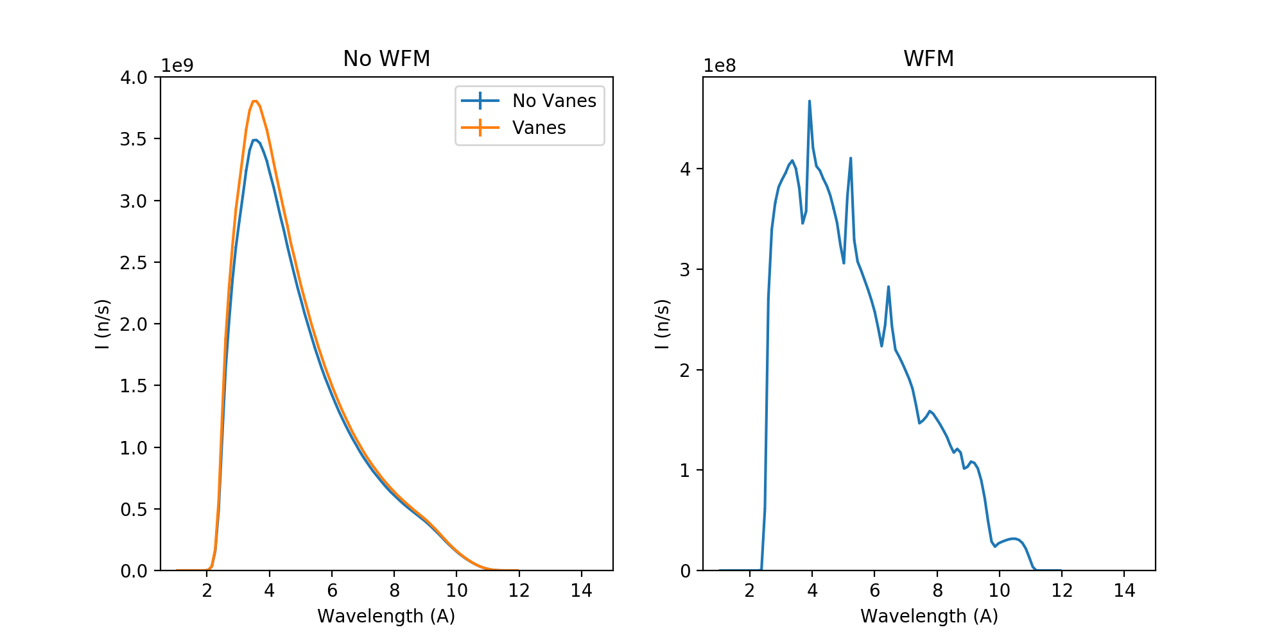
Instrument Performance
WFM: Wavelength coverage

Slide 42
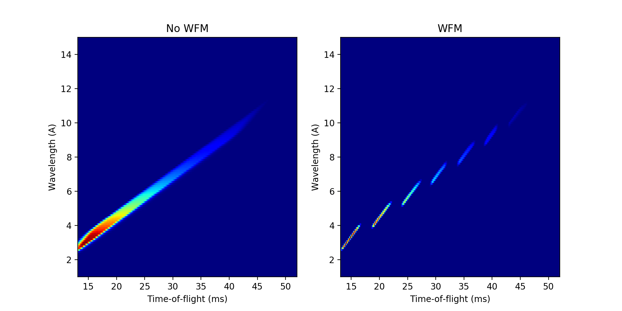
Instrument Performance
Wavelength/TOF Resolution

Slide 43
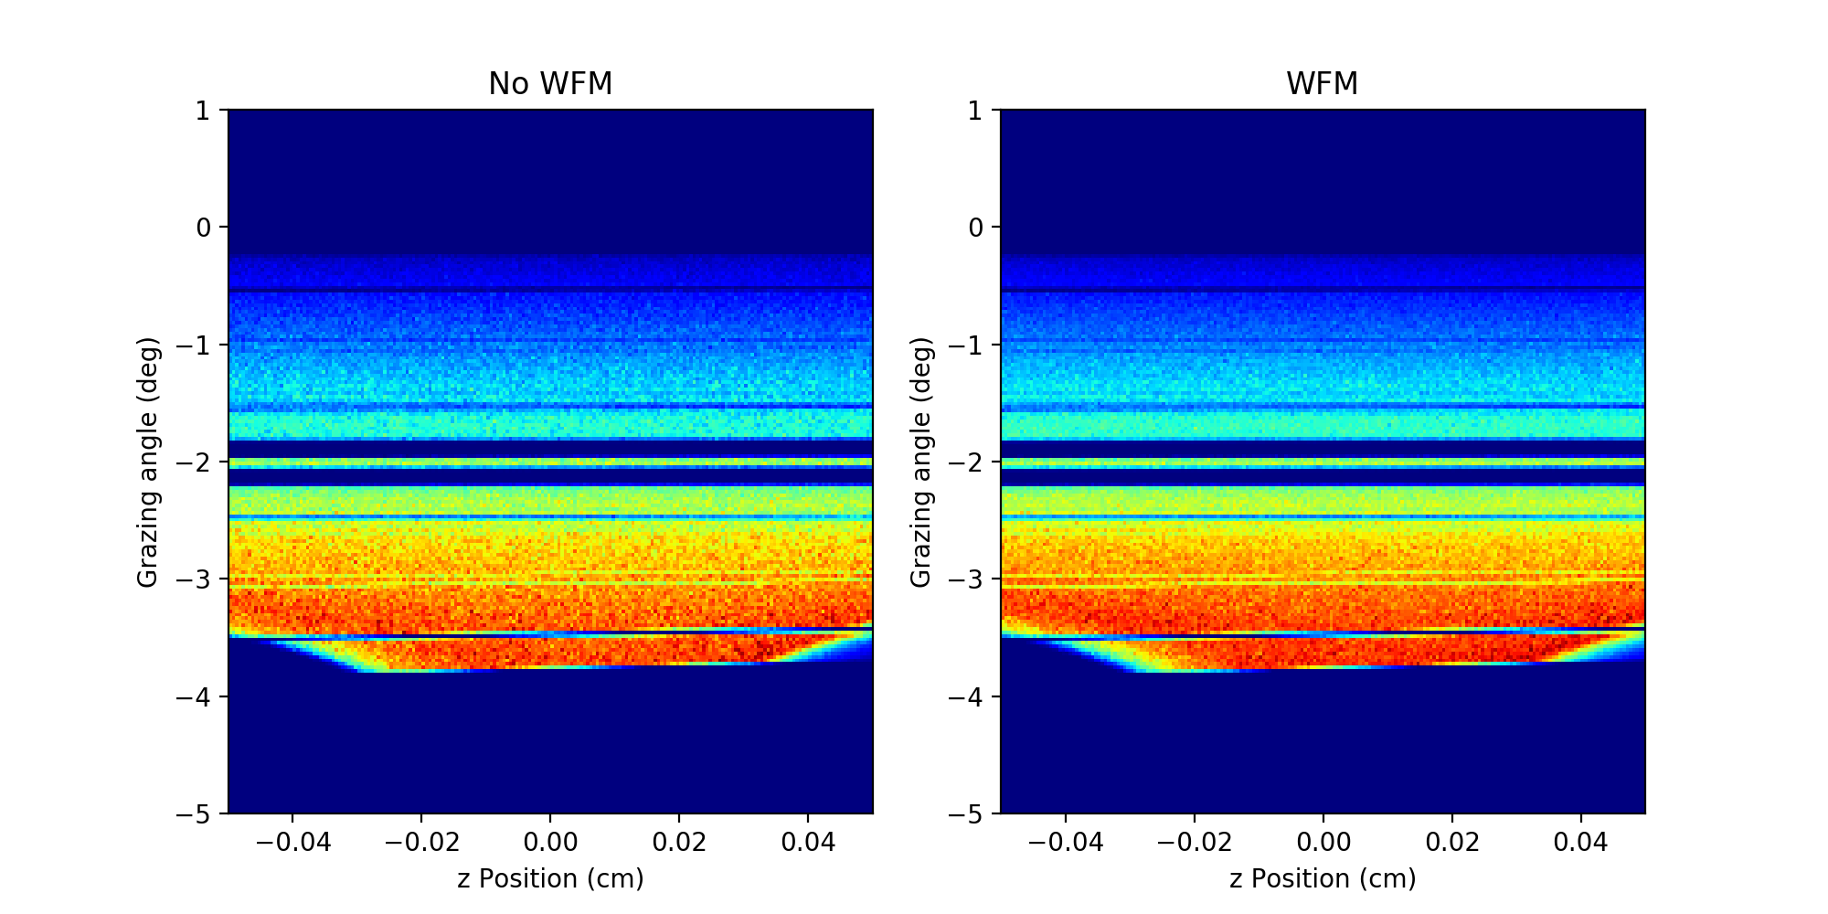
Instrument Performance
Angle of incidence vs position on sample

Slide 44
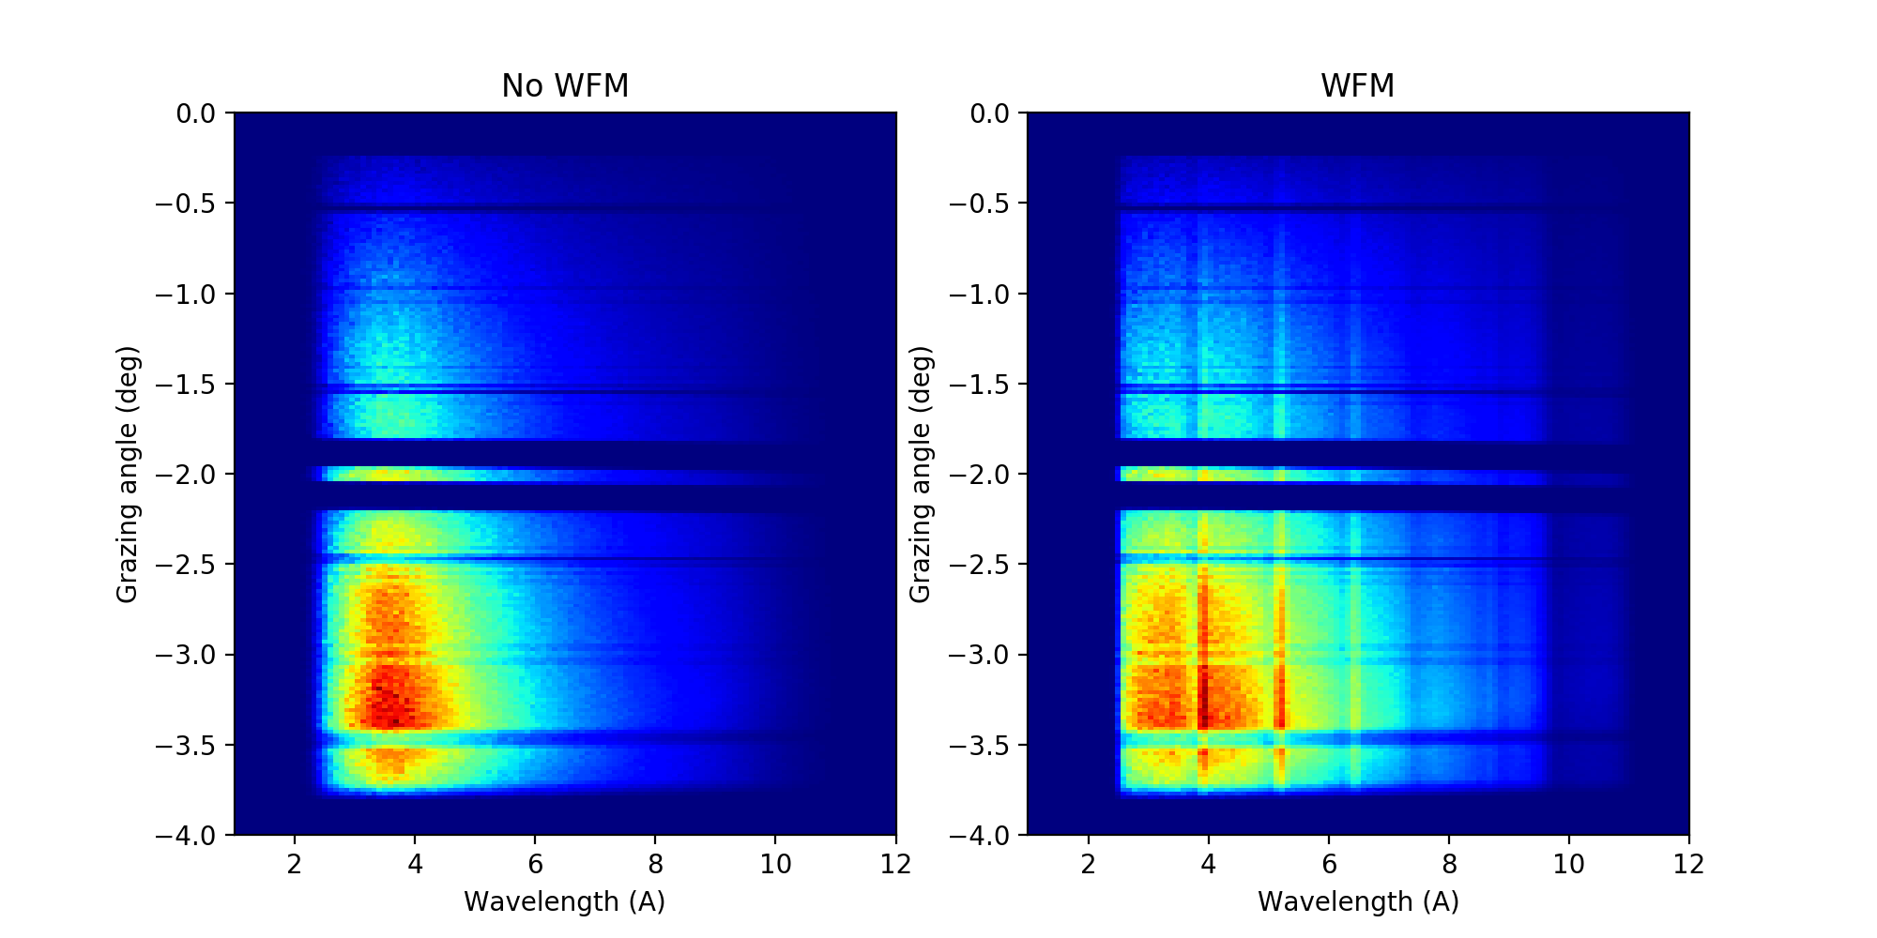
Instrument Performance
Wavelength transmission vs angle

Slide 45
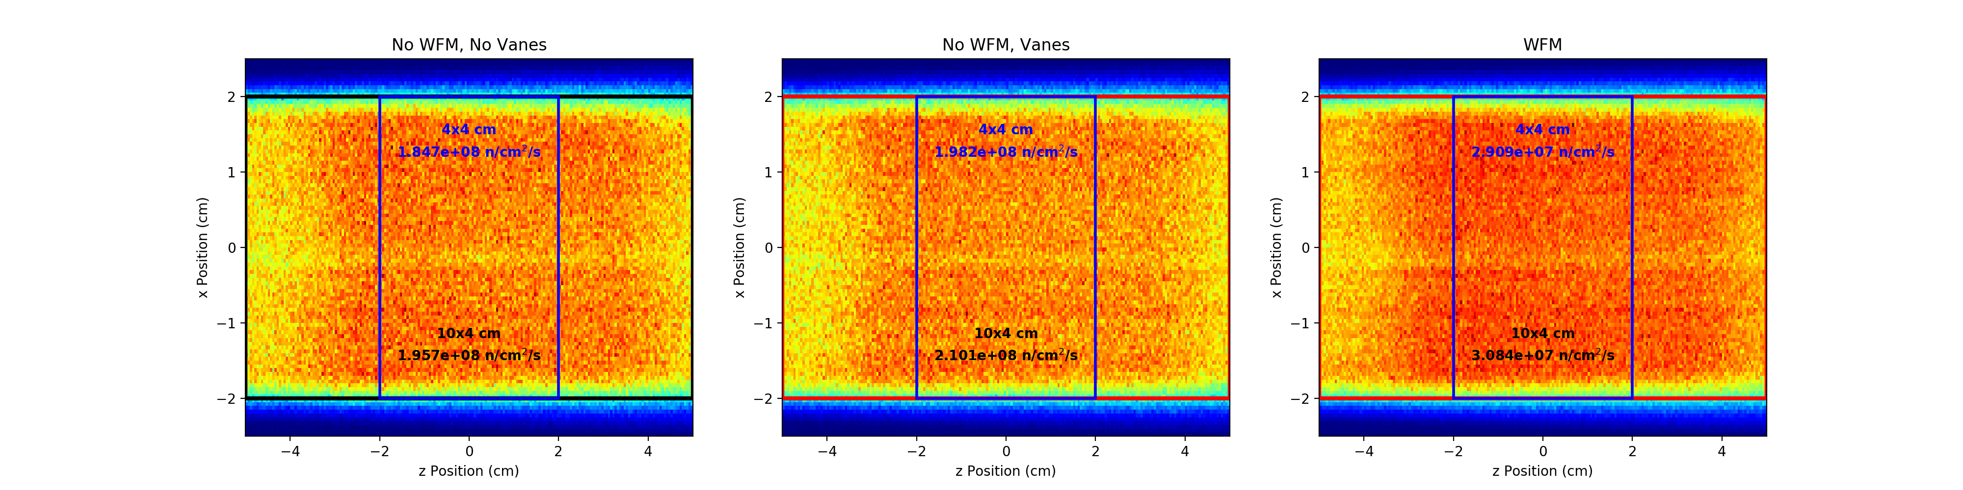
Instrument Performance
Flux distribution over sample surface

Slide 46
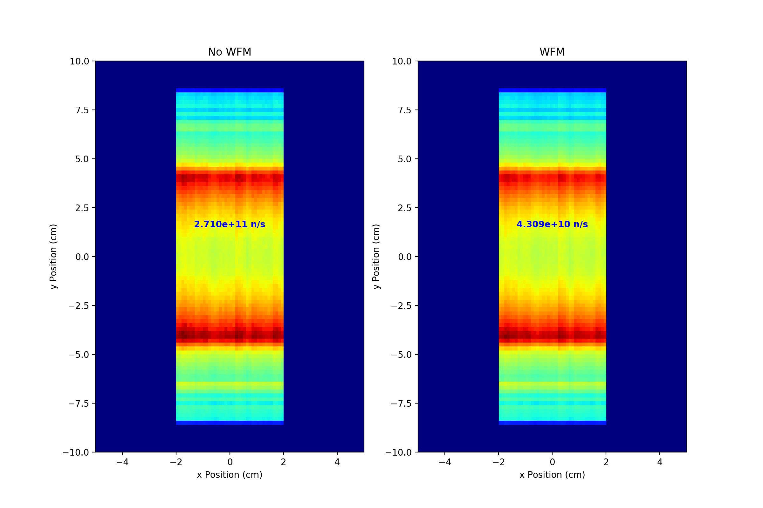
Instrument Performance
Flux at guide exit
Shielding Calculations:

Slide 47
Justification of Chopper design
Contamination is predominantly short wavelengths from the tail of the pulse
This is not apparent from TOF diagram using ideal chopper gaps – simulation with optimised gaps to confirm details
              Simulation shows that this number of choppers is required in order to avoid wavelength band contamination

Slide 48
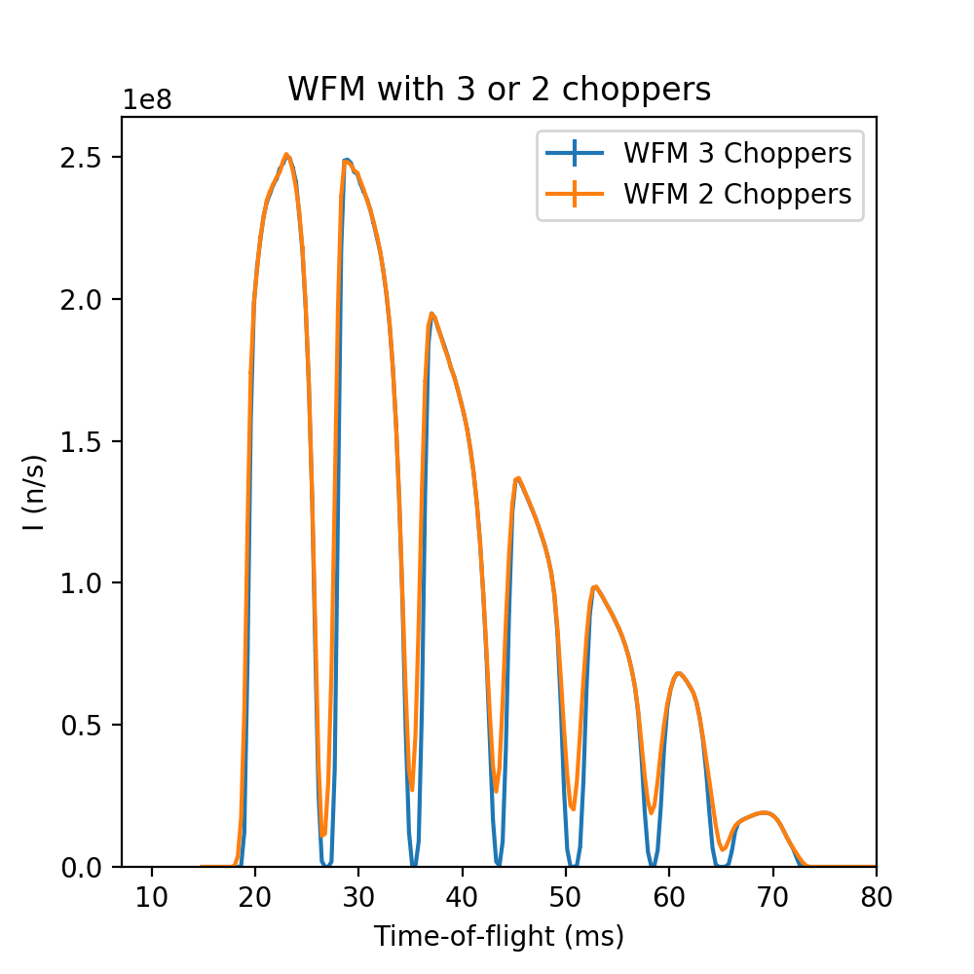
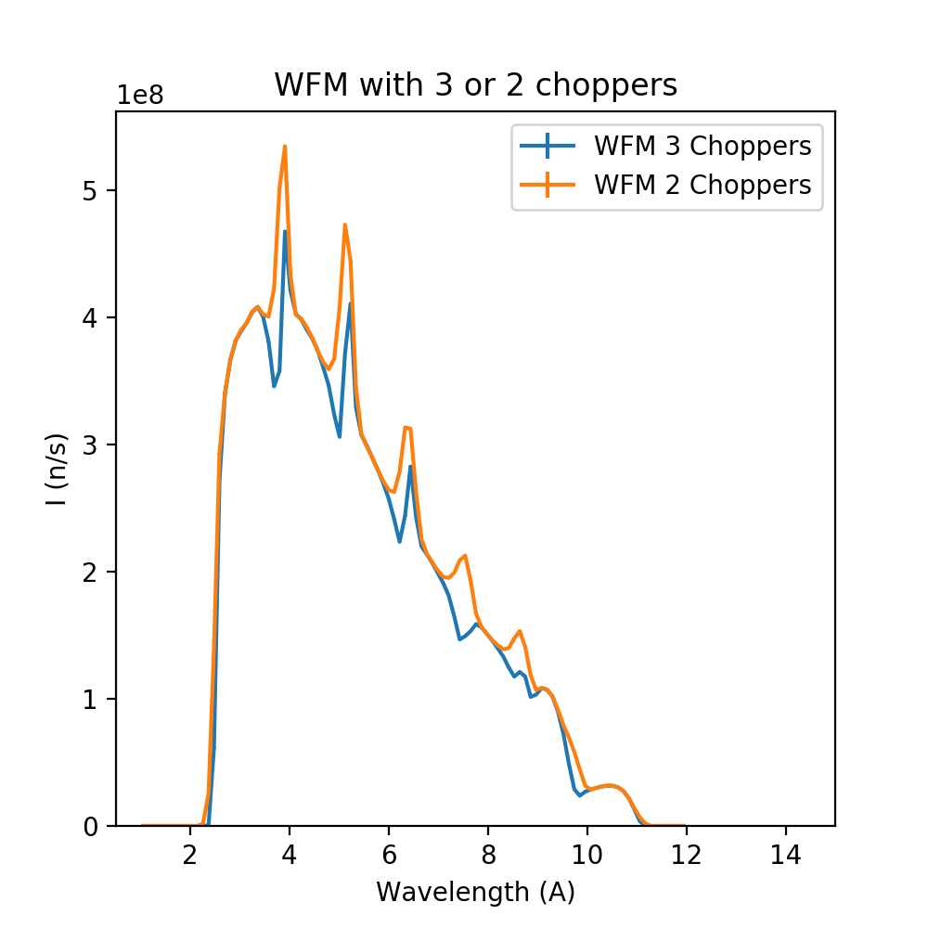
Frame contamination

Slide 52
Preliminary Design
Jim Nightingale
FREIA Lead Engineer

Slide 53
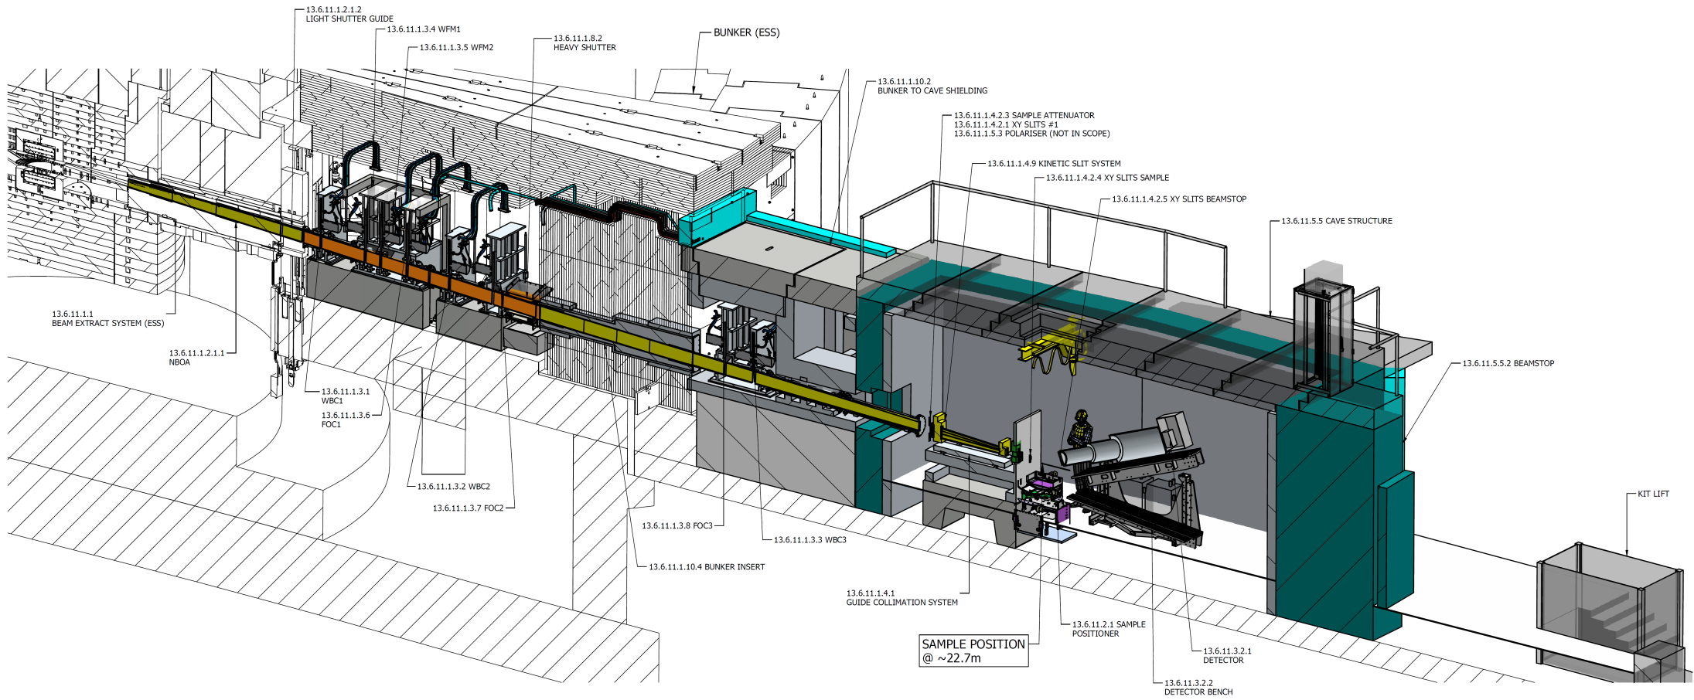
Freia Instrument Layout

Slide 54
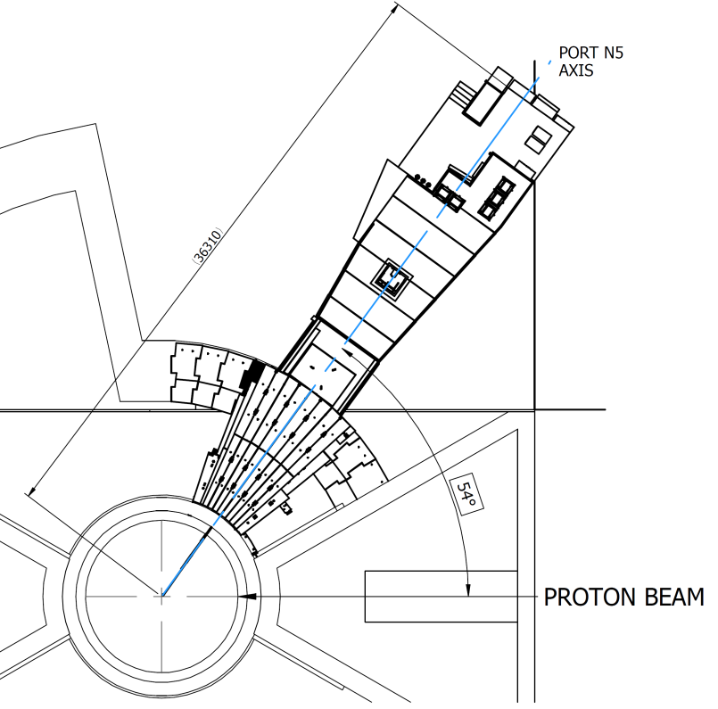
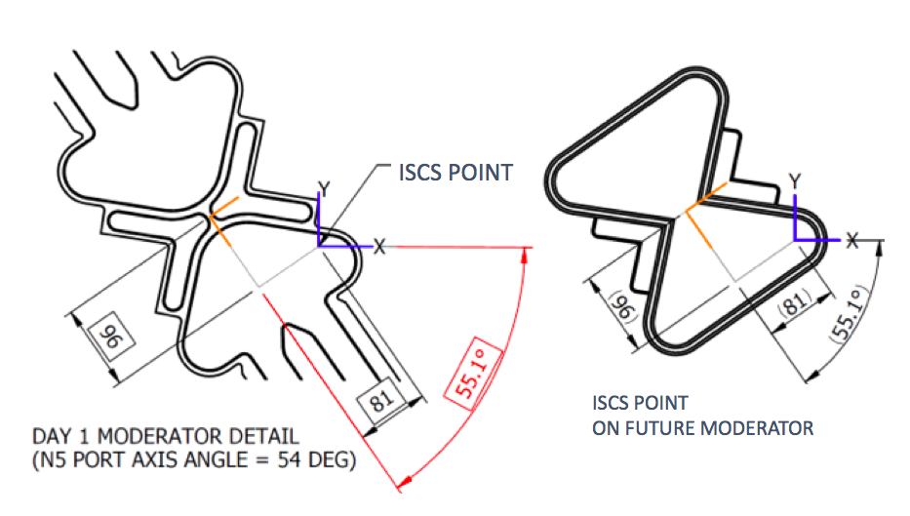
Instrument Source Co-ordinate System
Freia ISCS is optimised for cold neutron view of future moderator.

Slide 55
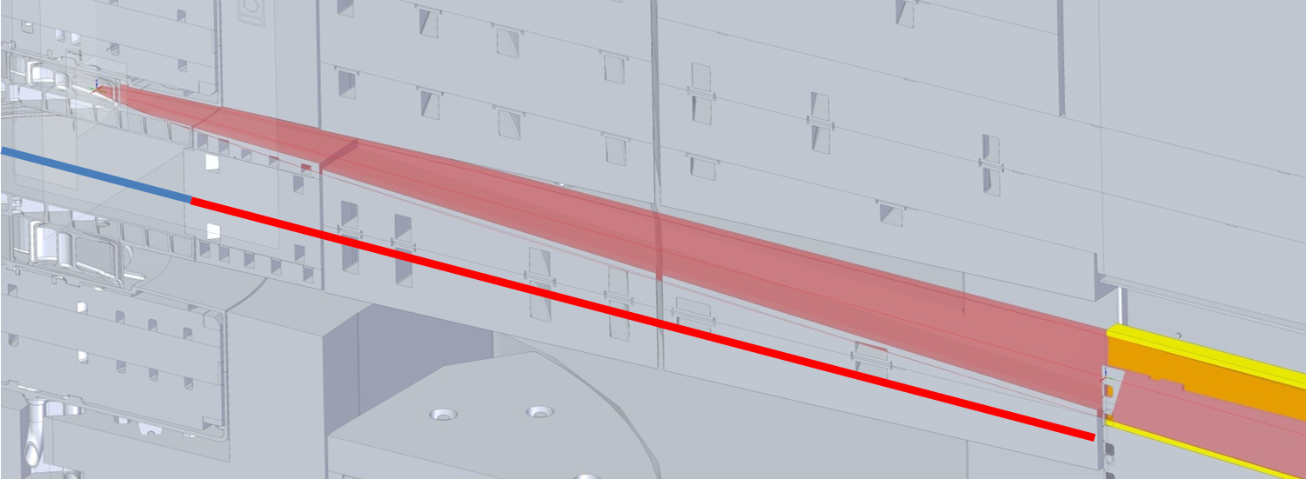
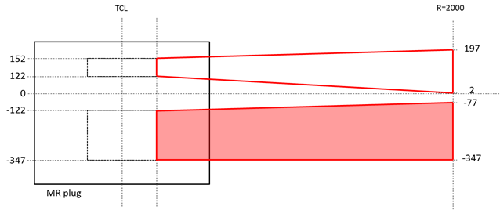
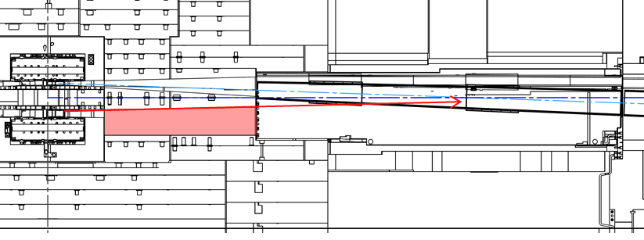
Monolith Design
Moderator modification incorporated
Target shielding modification change request being handled by Iain Sutton
Lower moderator cut-out a concern for high energy neutrons entering bunker and instrument background – neutronics required

Slide 56
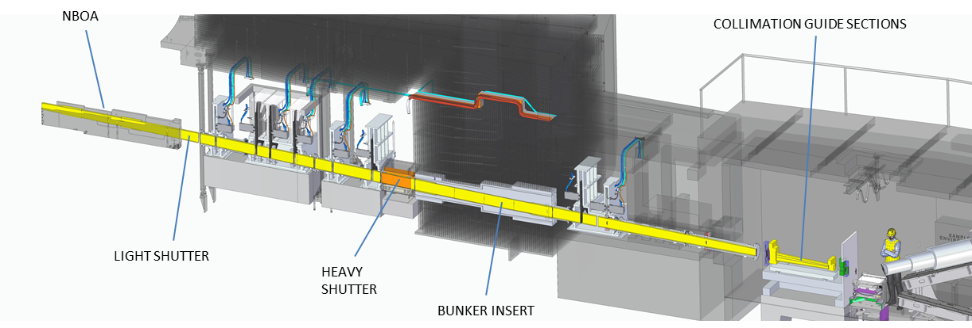
Neutron Optics

Slide 57
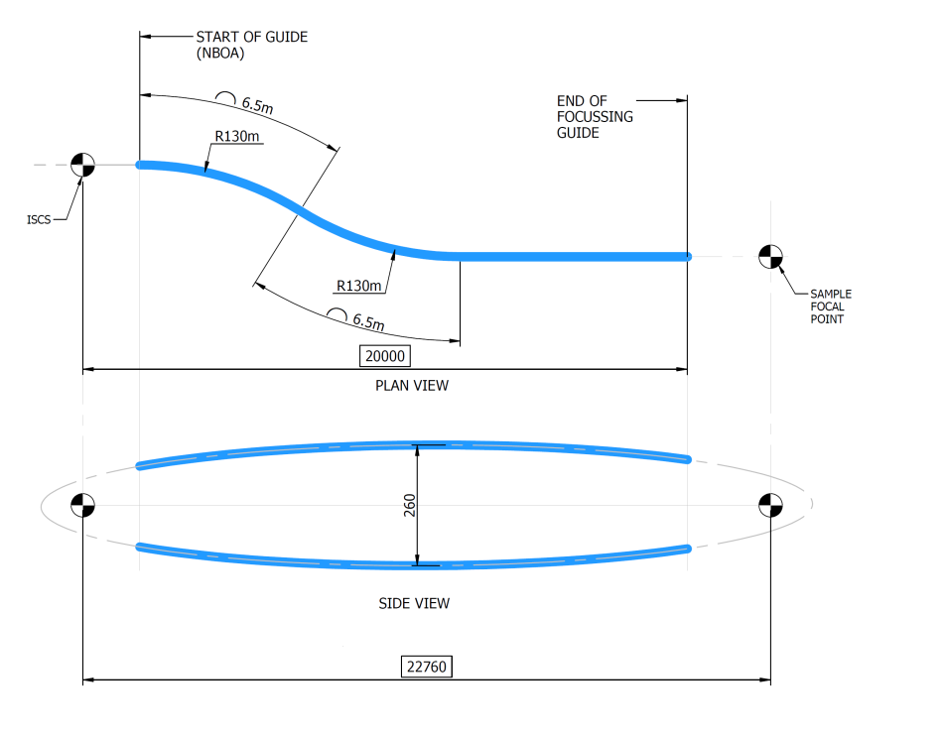
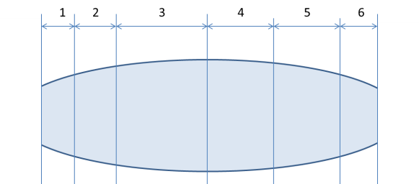
Neutron Optics
 | Distance from ISCS (mm) |  | Supermirror Coating (m value)
 | From | To | Top surface | Bottom Surface | Side Walls | Vanes
 | 0 | 1887ª | No guide
1 | 1887ª | 3000 | 6 | 6 | 3 | 3
2 | 3000 | 4500 | 5 | 5 | 3 | 3
3 | 4500 | 10000 | 4 | 4 | 3 | 3
4 | 10000 | 14500 | 3 | 3 | 3 | 3
5 | 14500 | 19000 | 4 | 4 | 3 | 3^{b}
6 | 19000 | 20000 | 5 | 5 | 3 | -
3 channel multi-vane S-bend – ends at 15m
M=6 in NBOA
Neutronics beneficial to determining effects of high m values at sample position

Slide 58
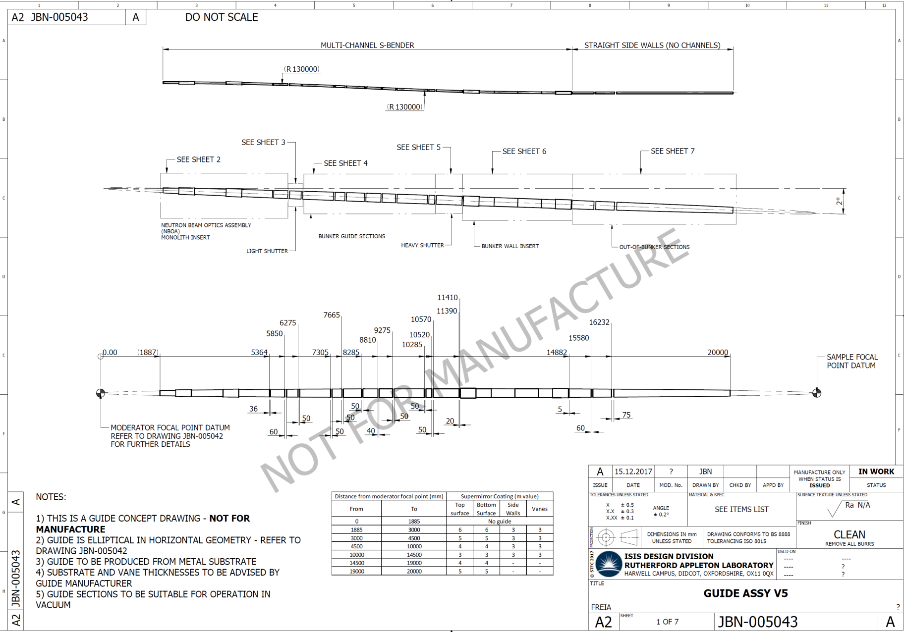
Neutron Optics

Slide 59
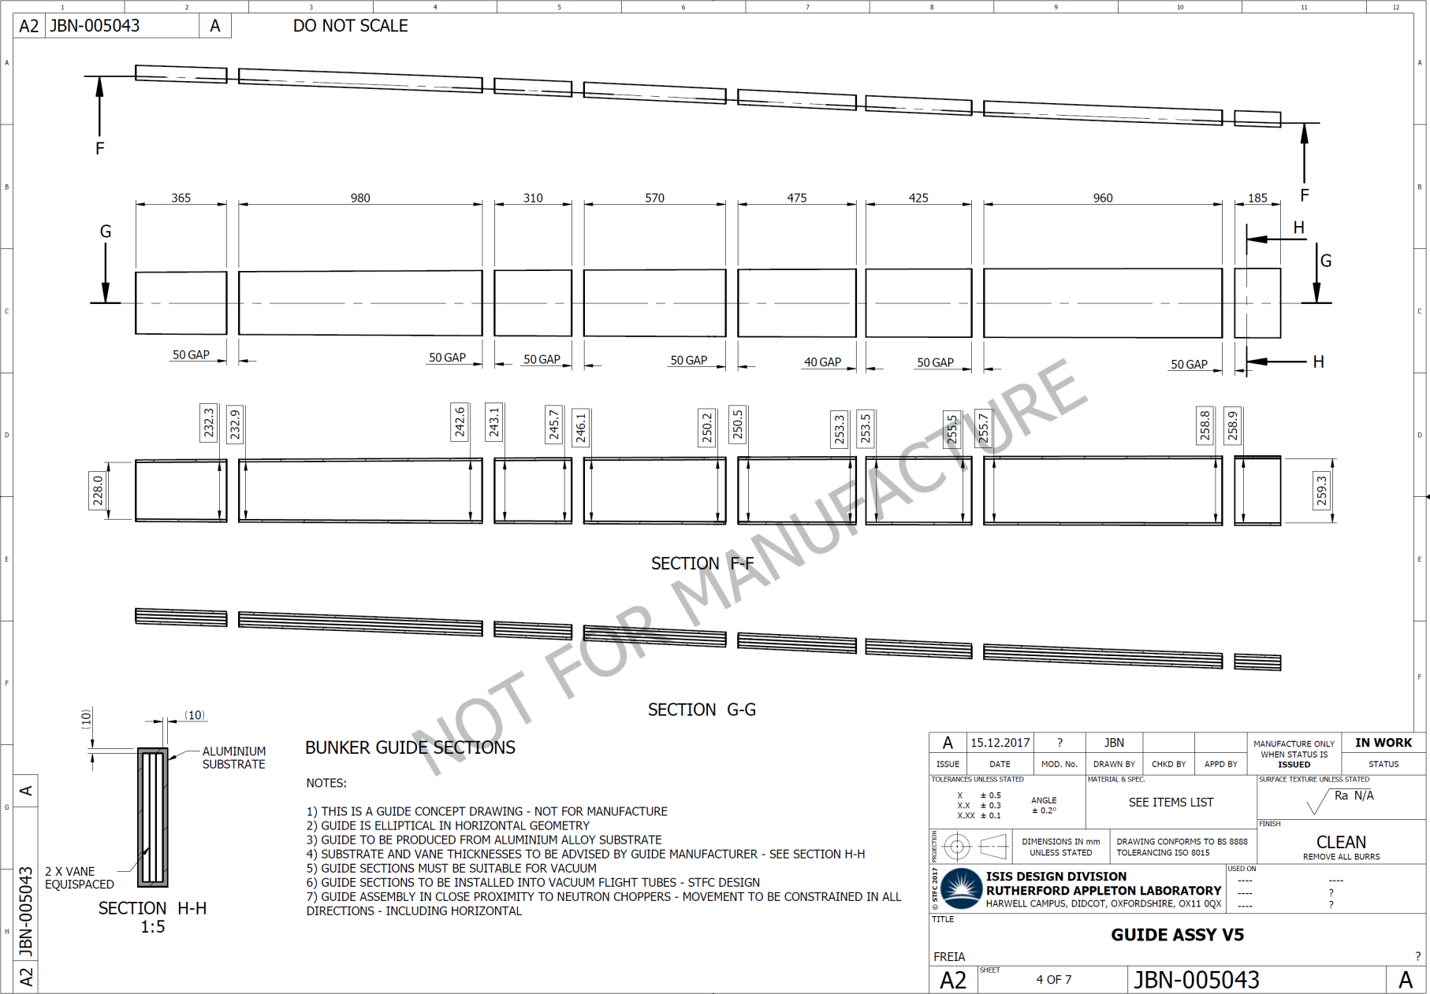
Neutron Optics

Slide 60
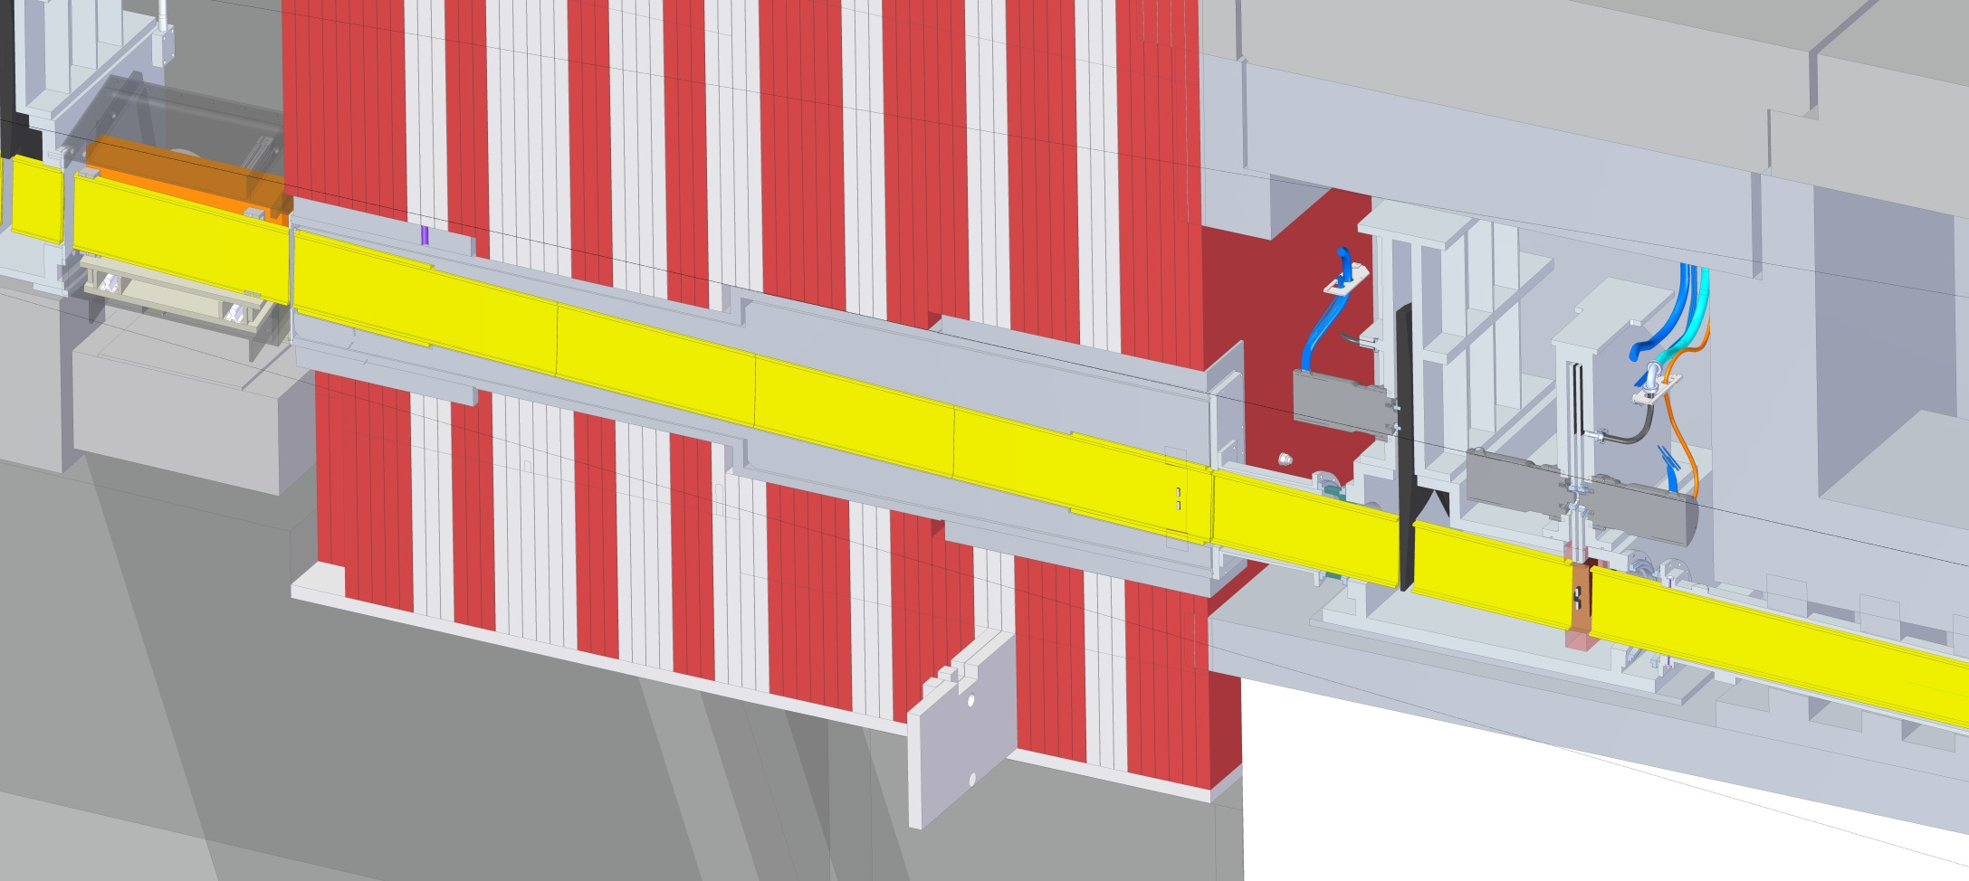
Bunker Feedthrough

Slide 61
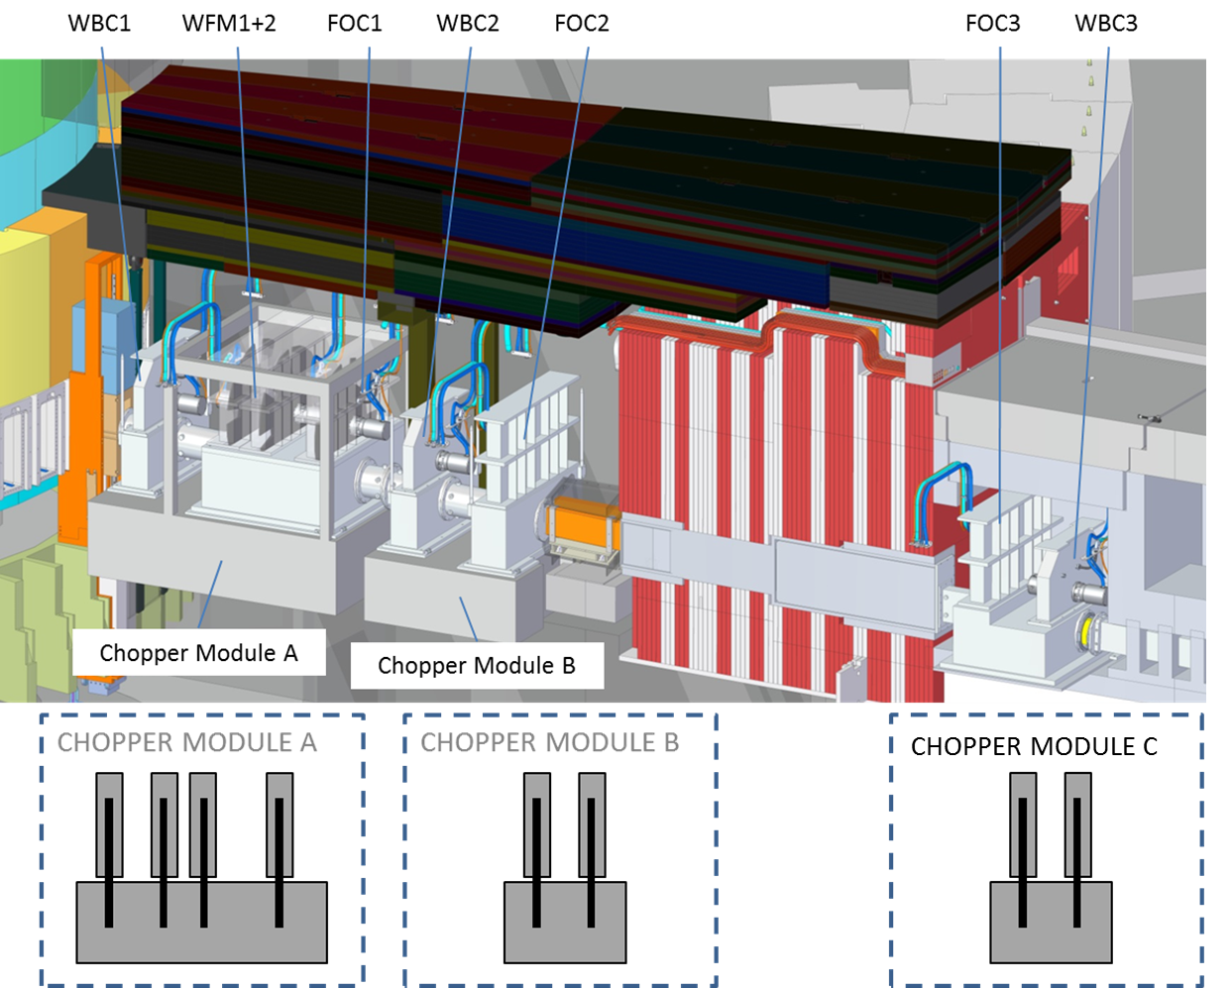
Choppers
Ø1m
14Hz
Ø1.3m
56Hz
Ø1.3m
56Hz
Ø1m
14Hz
Ø1.3m
42Hz
Ø1.3m
28Hz
Ø1m
14Hz

Slide 62
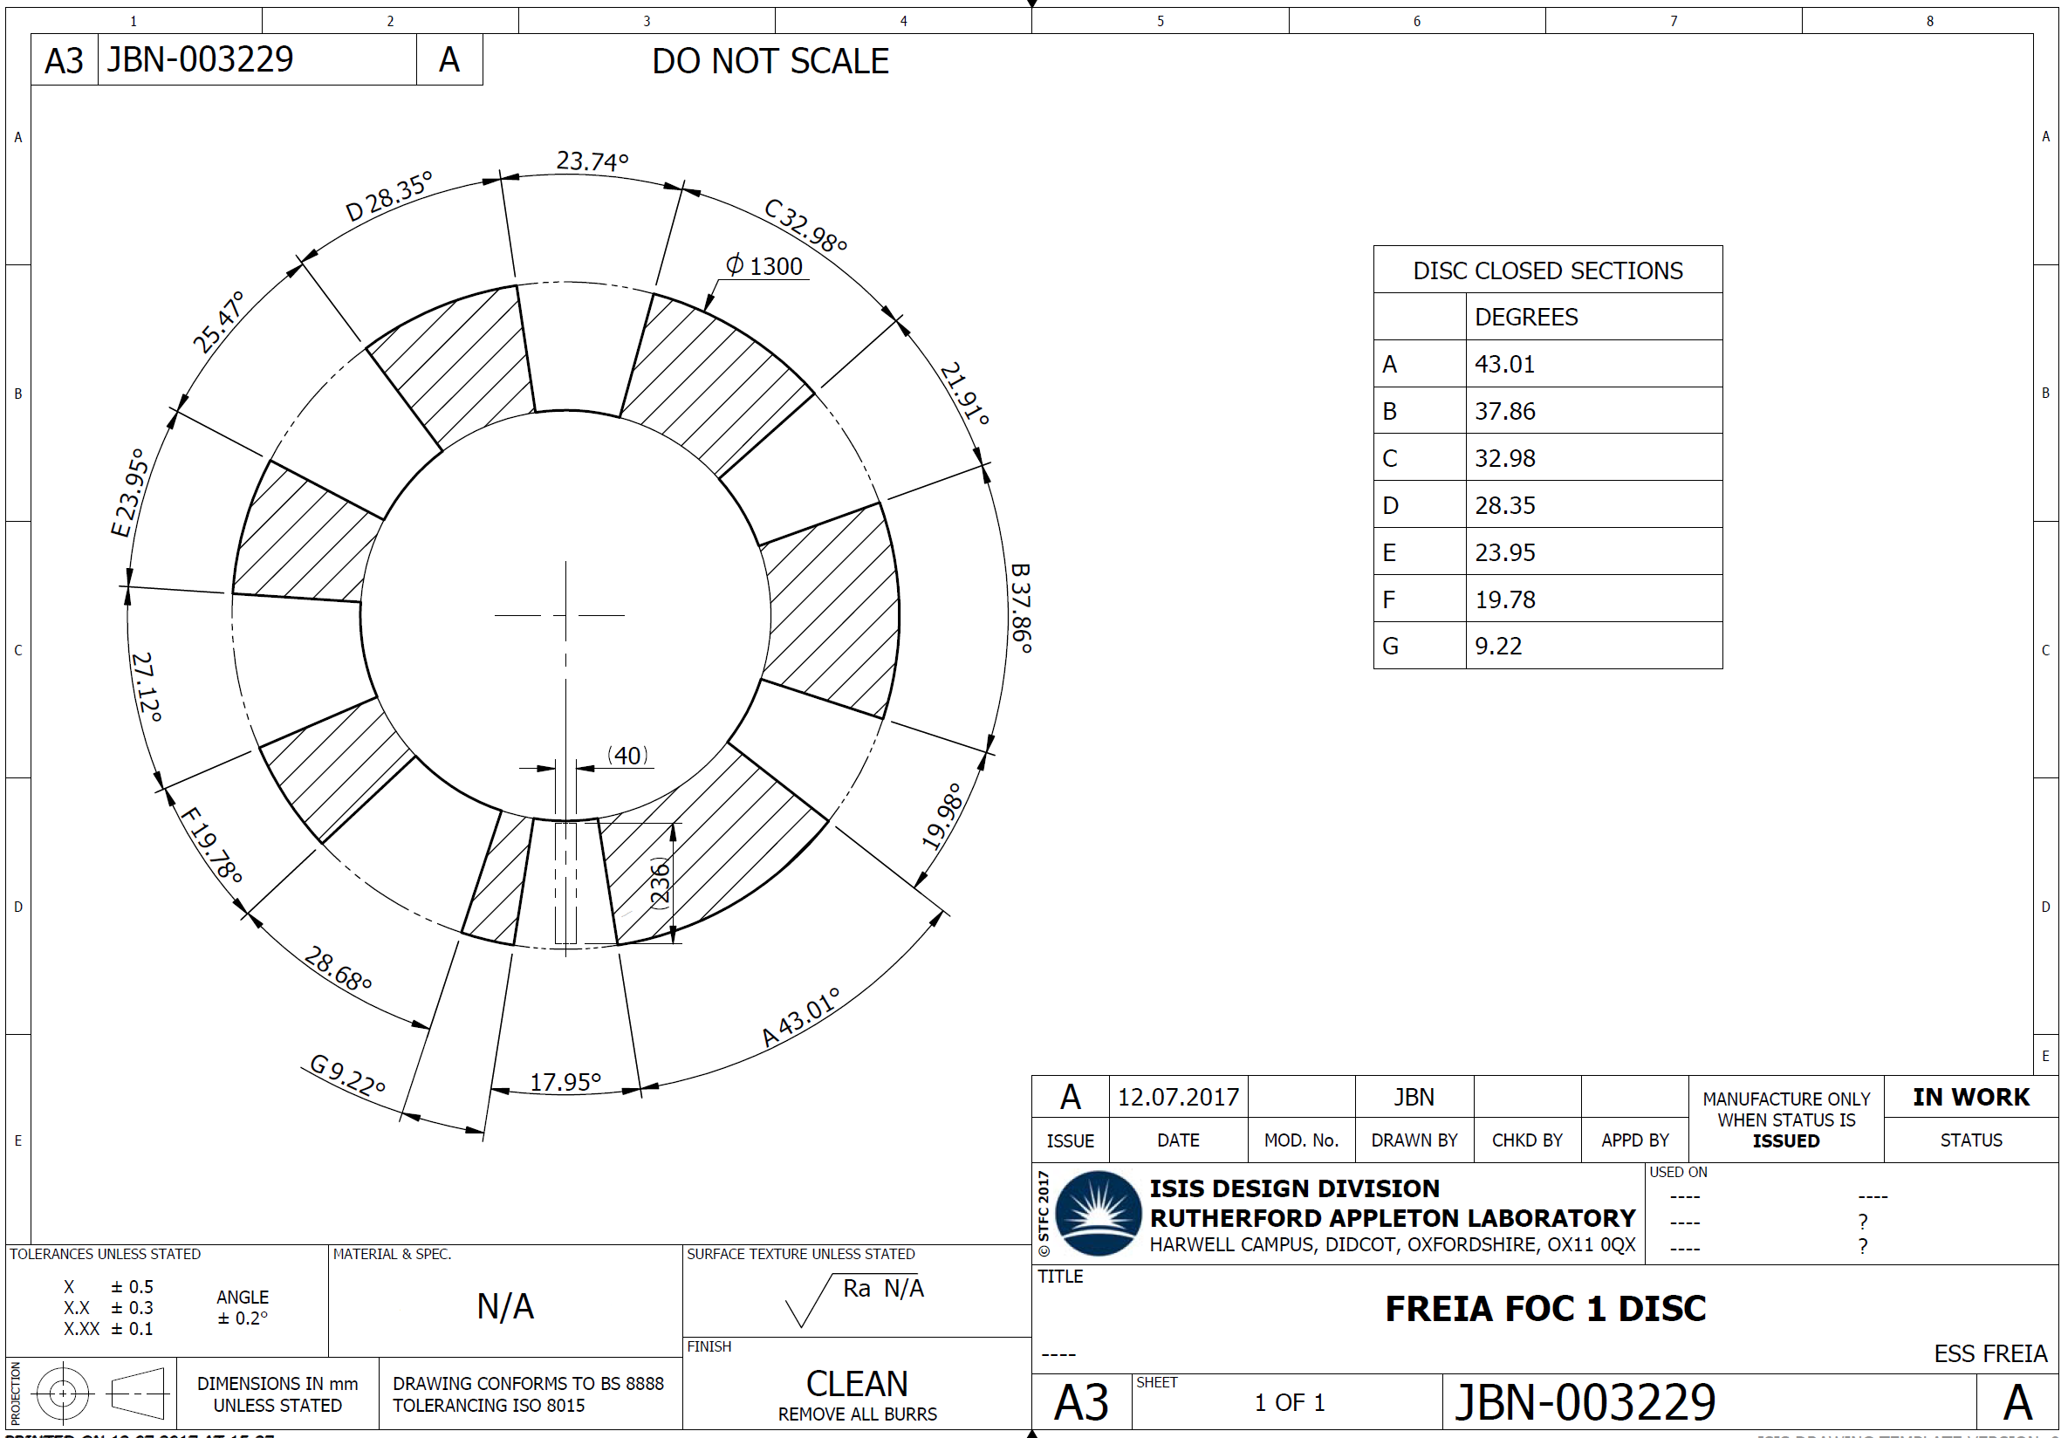
Chopper Feasibility
1. Diameter (1.3m)
2. Speed (56Hz)
3. Geometry

Slide 63
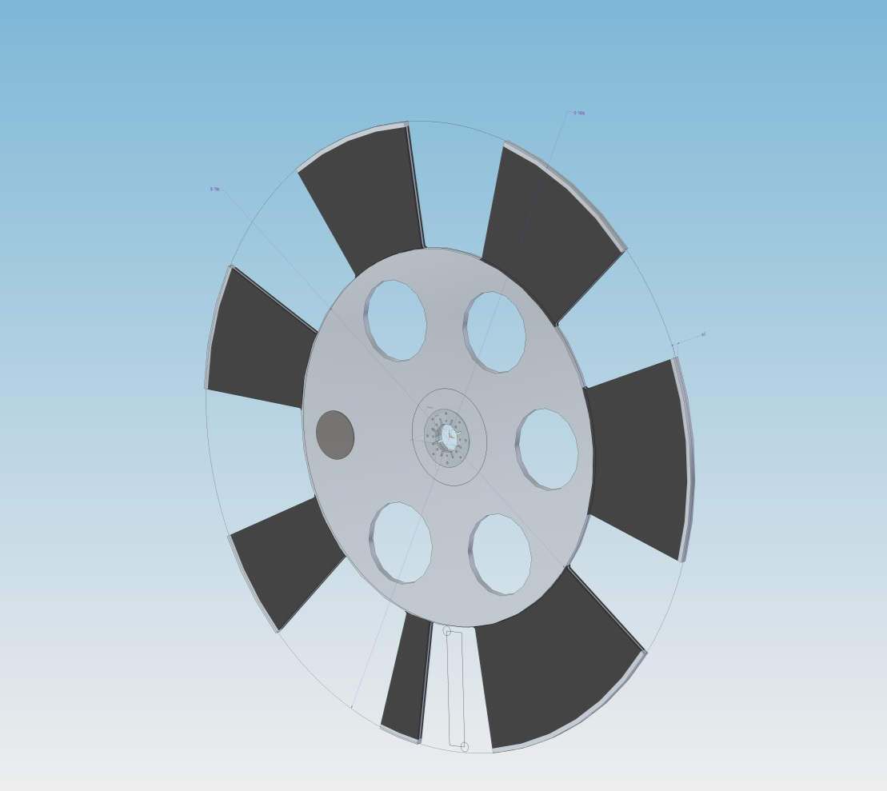
Chopper Feasibility
Conventional disc of single thickness and boron s-dough sandwich
Disc material = Aluminium Alloy
Disc dia = 1300mm
Disc thickness = 16.5mm
Boron thickness = 11.5mm
Total disc mass = 36 kg
Speed = 56Hz
Maximum load capacity of SKF G5 = 40Kg

Slide 64
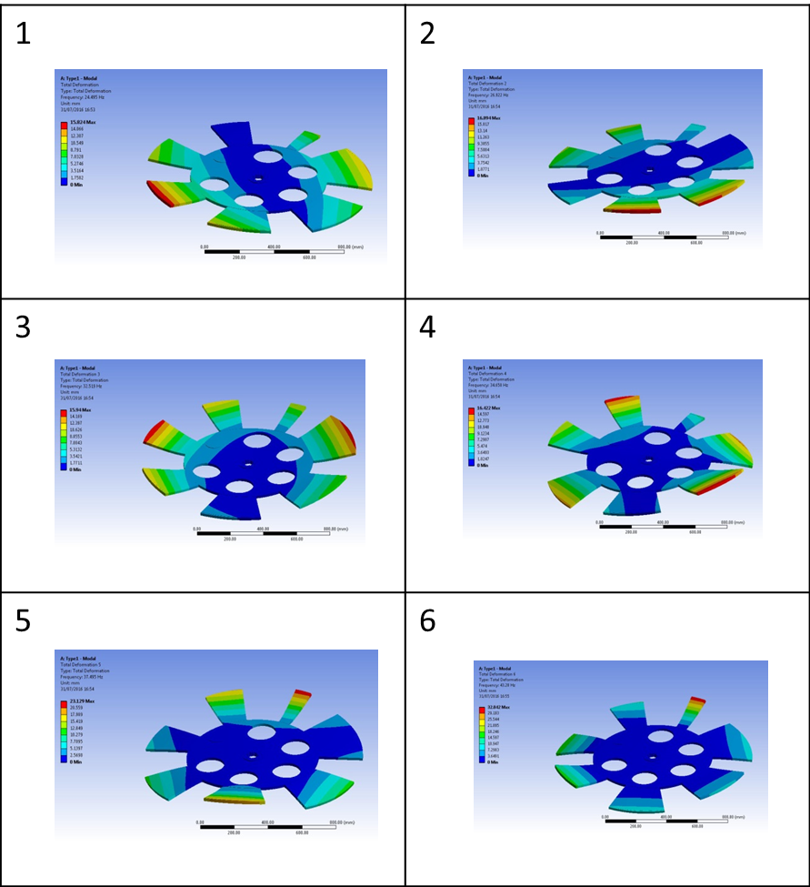
Chopper Feasibility
Mode | Hz
1 | 24.495
2 | 26.922
3 | 32.519
4 | 34.658
5 | 37.495
6 | 43.28
7 | 45.24
8 | 45.407
9 | 72.52
10 | 81.465

Slide 65
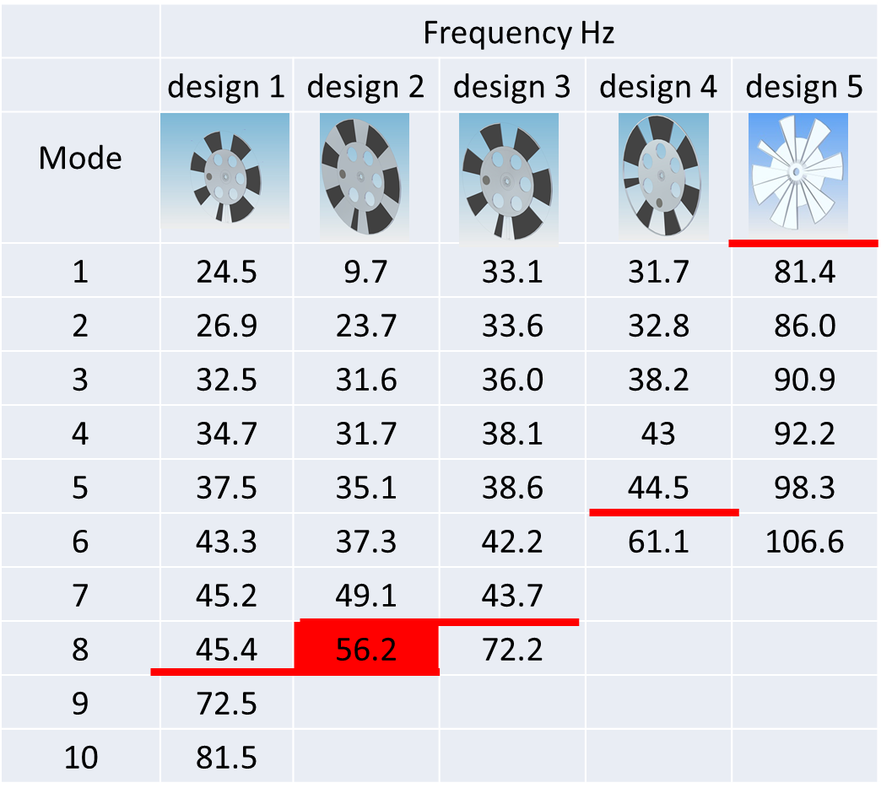

Chopper Feasibility
56 Hz
Operating Frequency

Slide 66
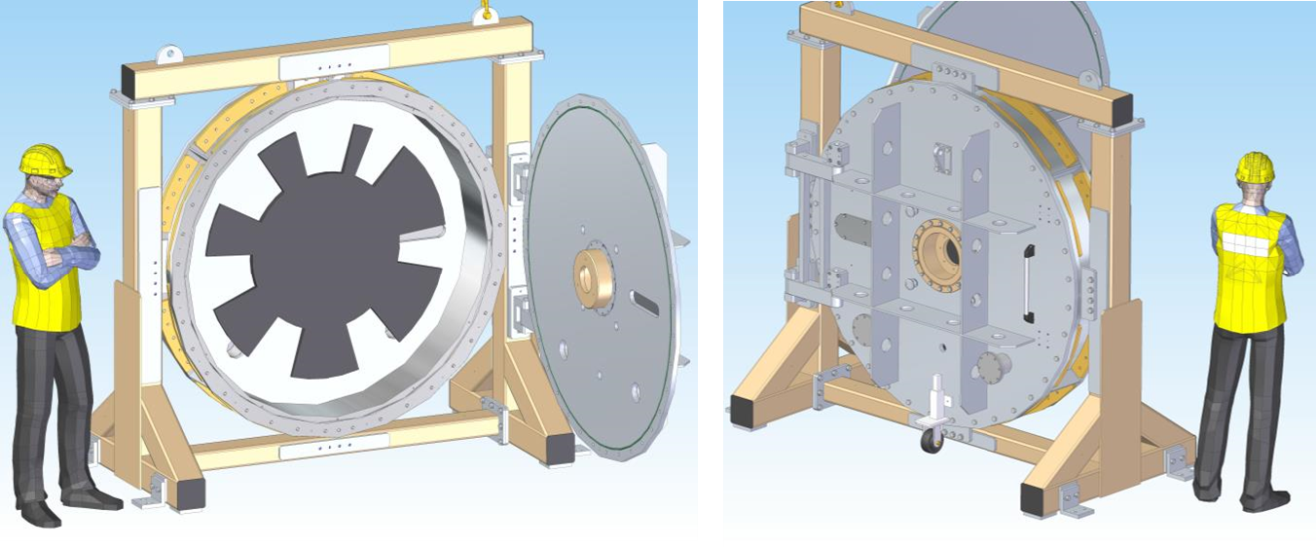
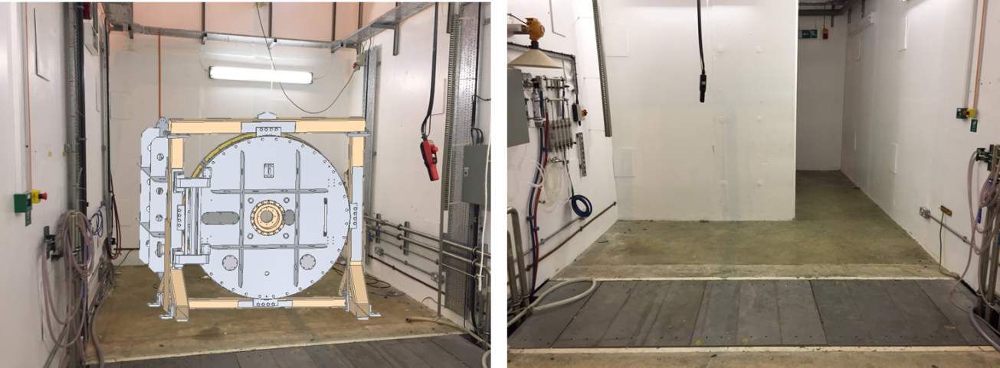
Chopper Feasibility
Large Over-speed Disc Test Chamber
ISIS Bunker test facility investigated

Slide 67
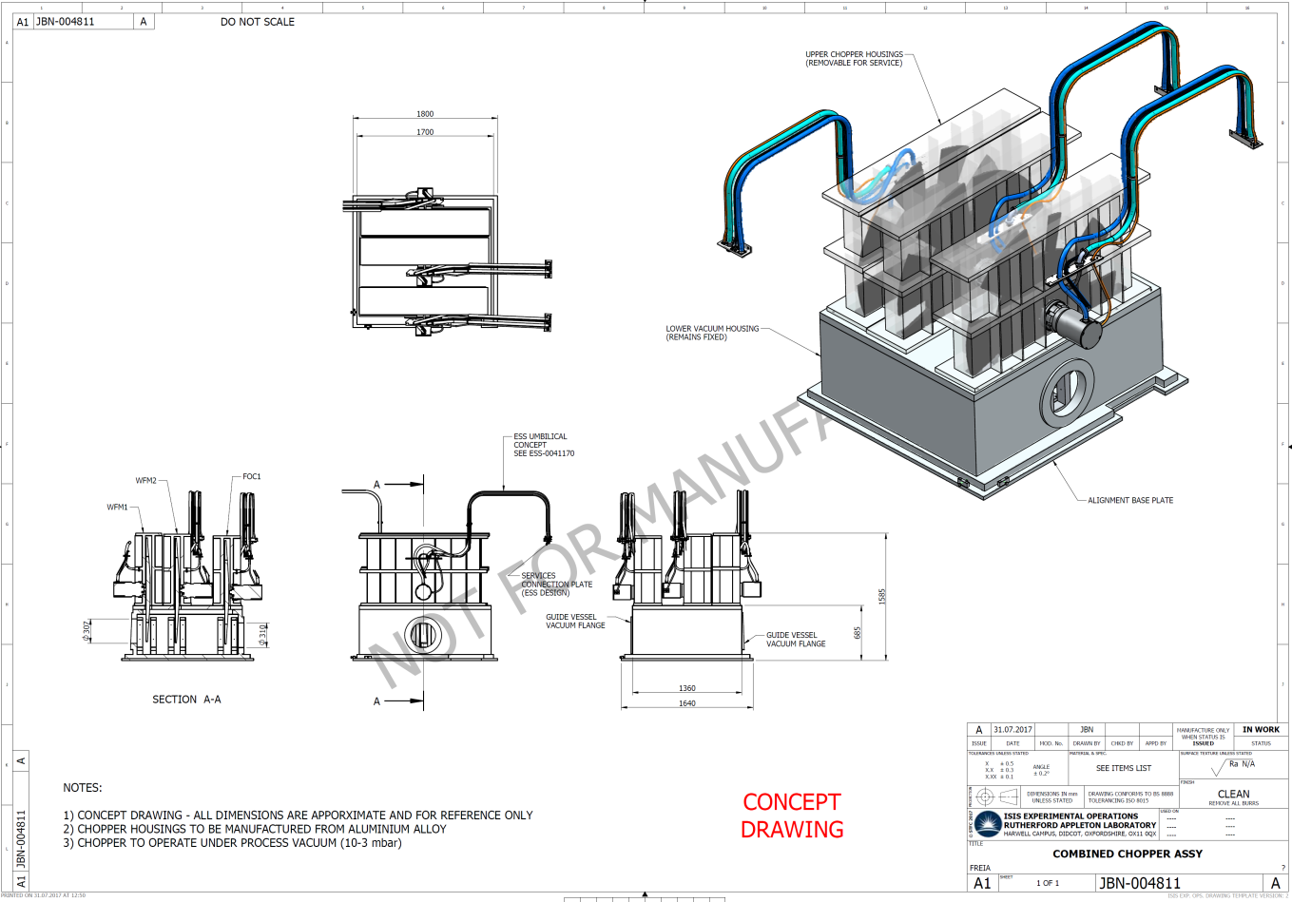
Chopper Feasibility
Further development of aluminium design proved problematic with overly high stresses at high speeds.
Carbon Fibre construction deemed as only practical solution. ISIS have no experience of CF disc design so suppliers were approached
Mirrotron and Airbus both agreed discs are technically challenging and feasibility study required.

Slide 68
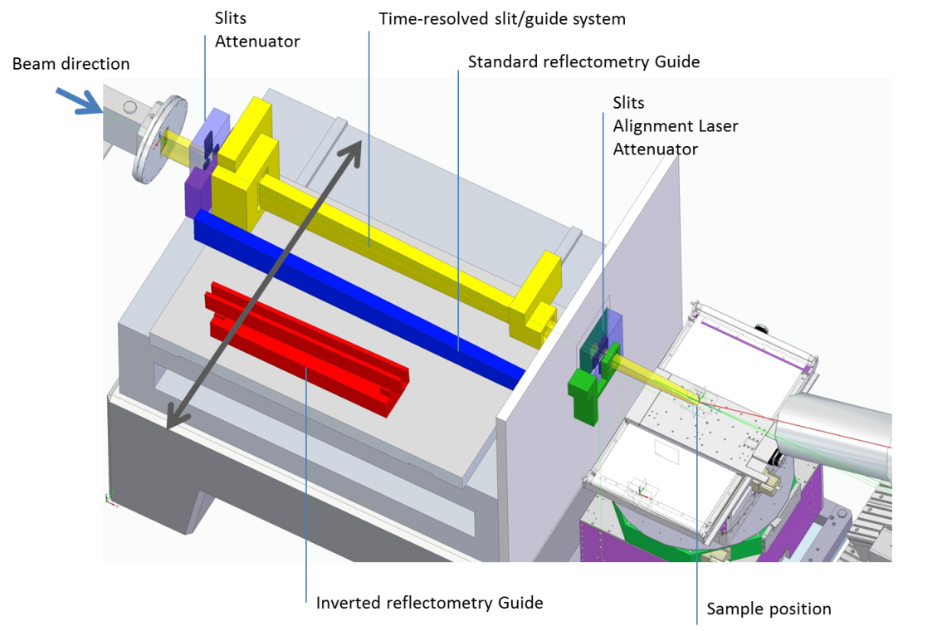
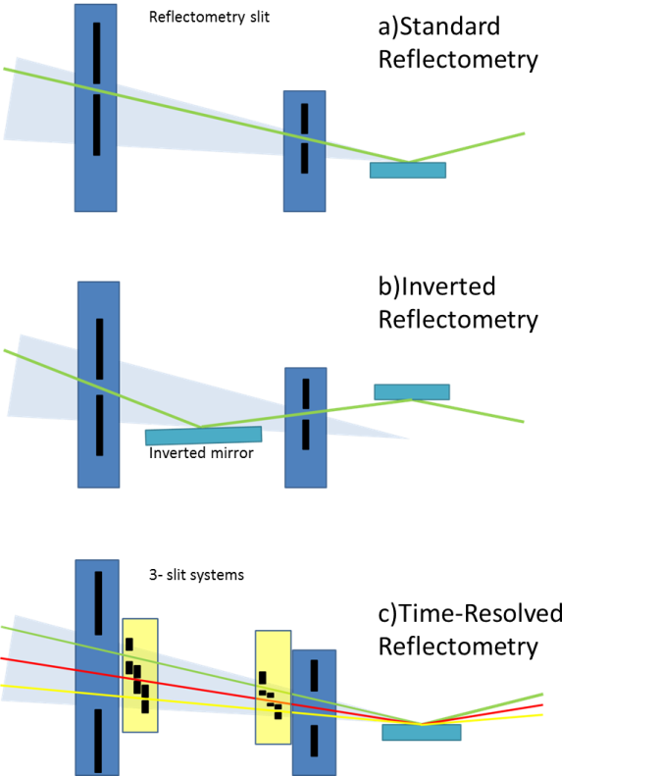

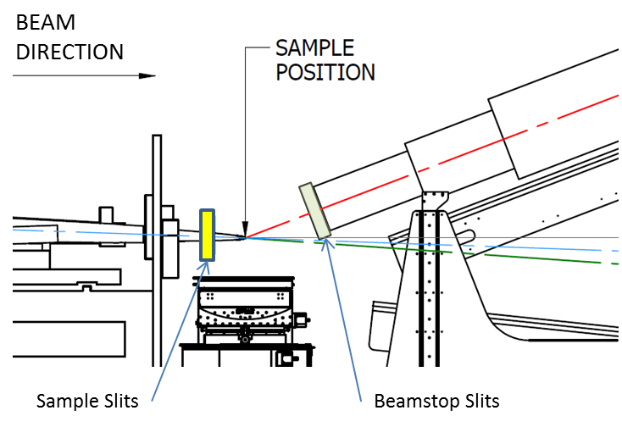
Collimation Options

Slide 69



Time-resolved Slits
rotary
Oscillating fixed apertures
rotary

Slide 70
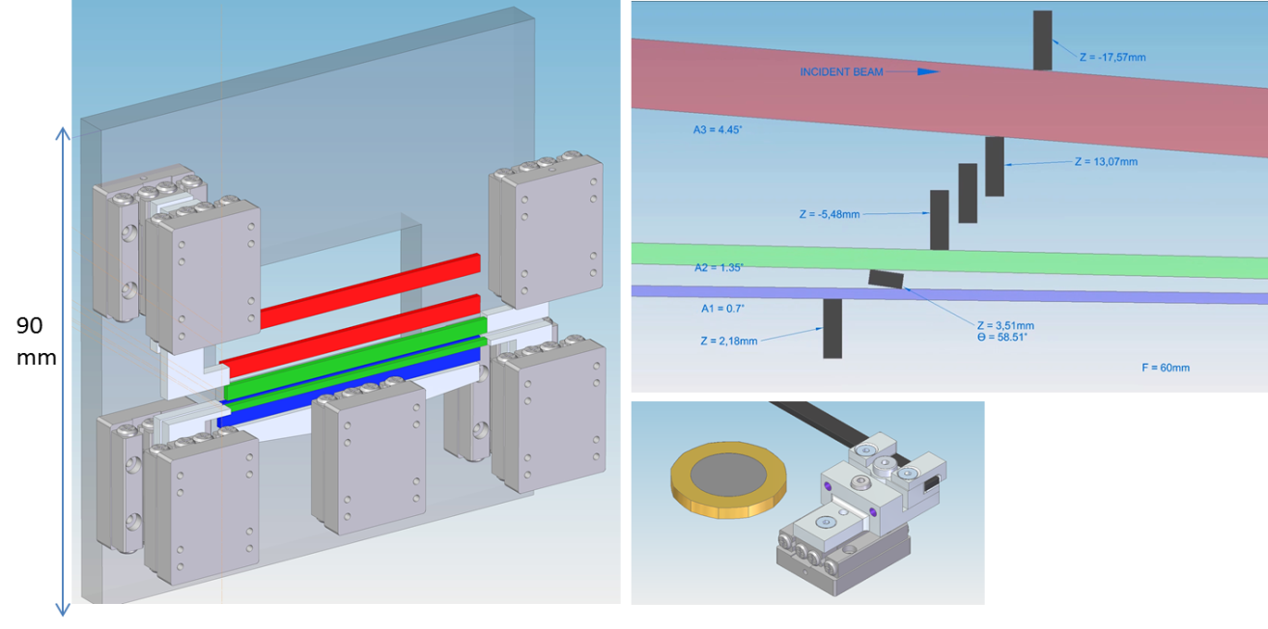
Time-resolved Slits
Credit: Jon Elmer
Miniature piezo stages with precision Angle selection 1-3 seconds
Feasibility study to test:
Accuracy and repeatability with high acceleration/ deceleration
Stability of thin blades
Internal thermal effects
Operational reliability and component life

Slide 71
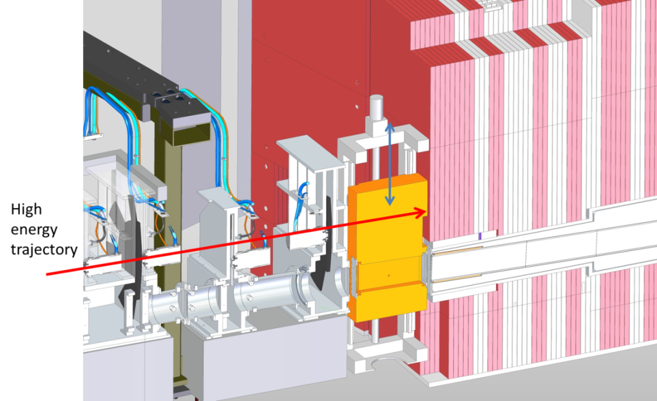
Heavy Shutter
Option 1 - Vertical Operation
+ Provides large mass of shielding, including high energy
- May be difficult to install with crane limitations

Slide 72
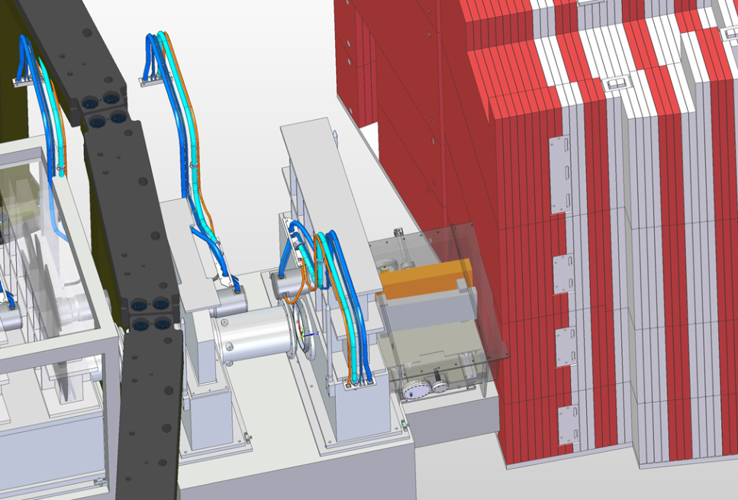
Heavy Shutter
Option 2 - Horizontal Operation
+ ESS standard
- Less mass = less shielding

Slide 73
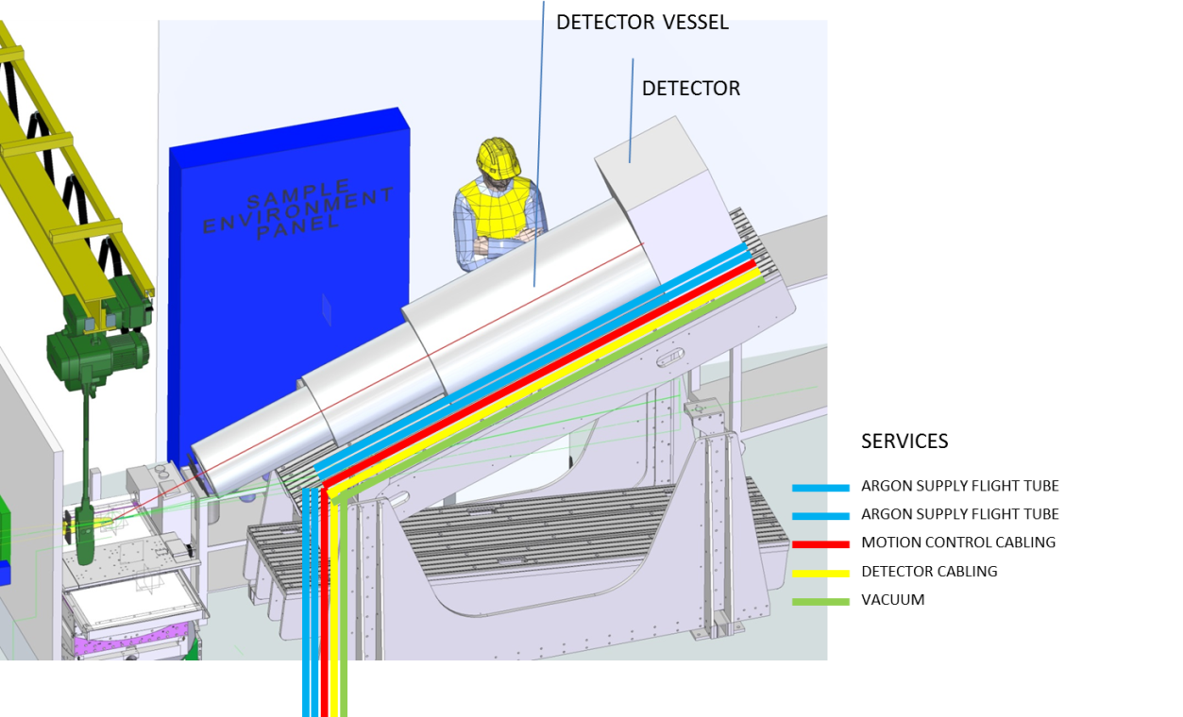
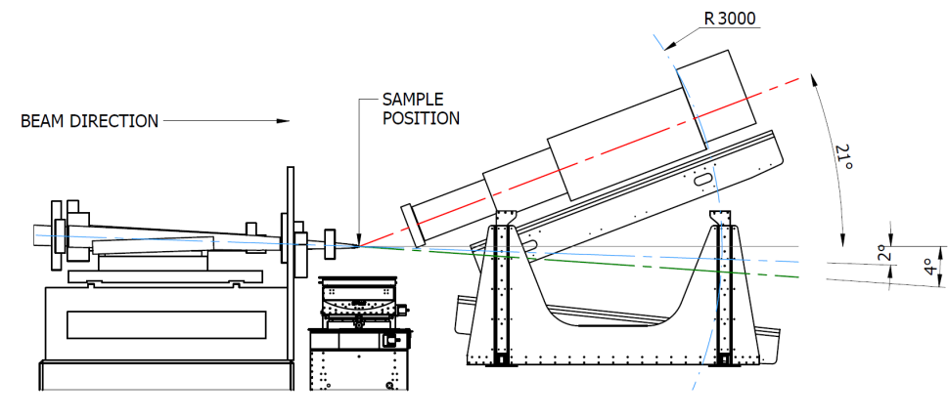
Detector Layout

Slide 74
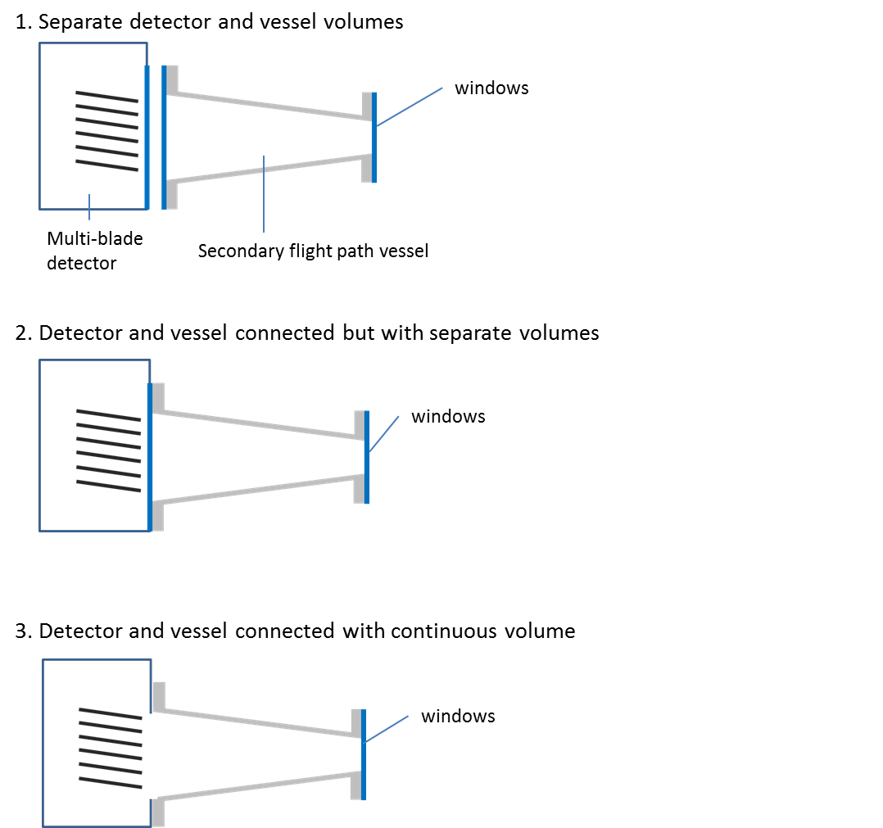
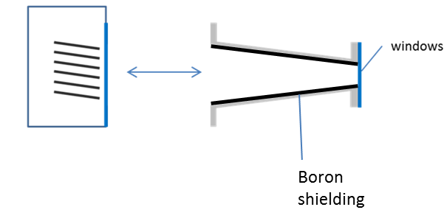
Detector Layout
Secondary flight path vessel designed to accommodate vacuum and/or gas filling
Vessel designed with same mounting features as detector window such that it can be employed in all 3 options

Slide 75
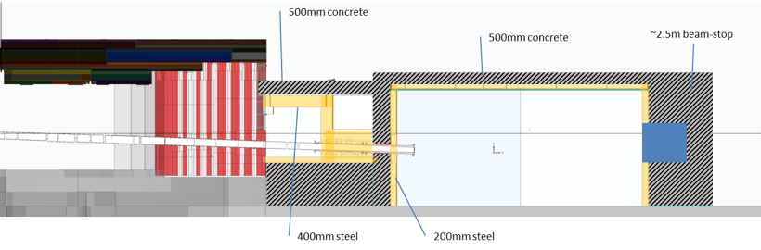
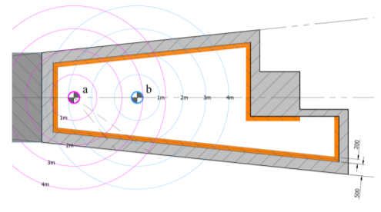
Shielding
Cave internally lined with boron
a
b
Beam-stop to reduce background on sample
Massive shielding to reduce high energy streaming and background
Cave shielding to achieve allowable dose rates
Space envelope created
Neutronics needed to optimise shielding design

Slide 76
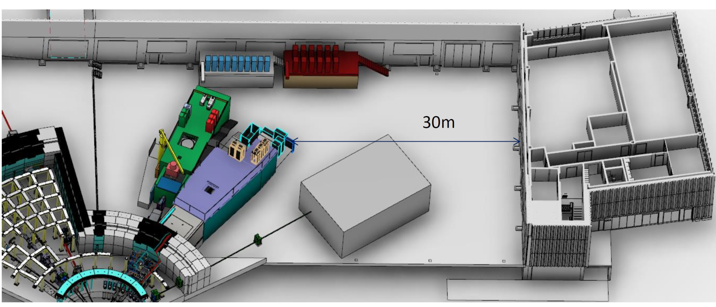
Instrument Access & Services
Freia Hutch
Sample Prep Area
Chemistry labs

Slide 77
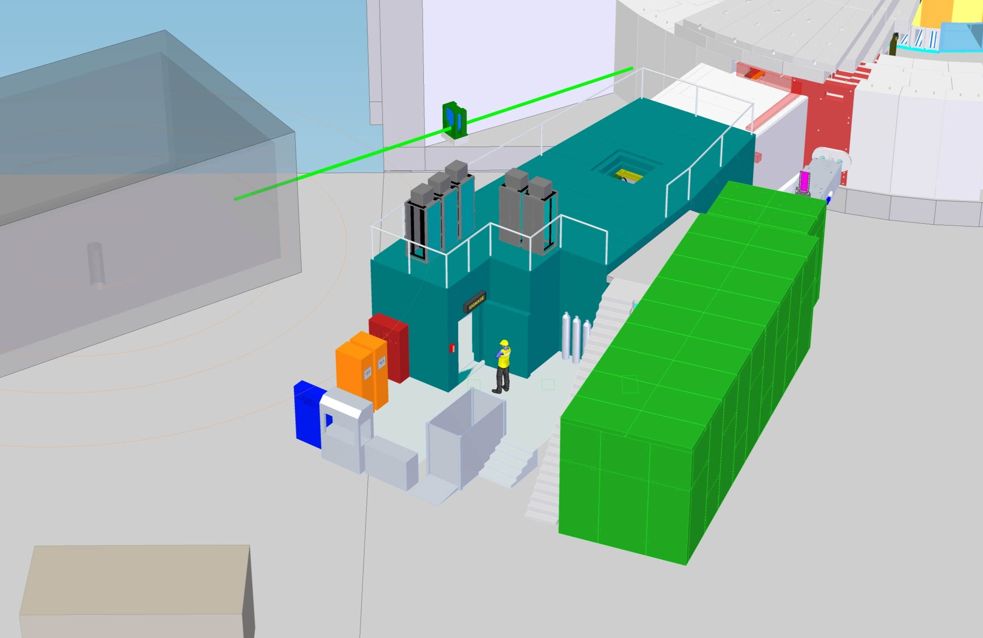
Instrument Access & Services
Cave access hatch
Area for racks
Cave access door

Slide 78
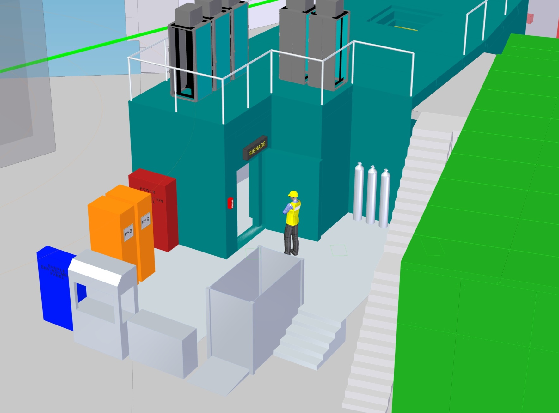
Instrument Access & Services
Power distribution
PSS Racks
PSS Key exchange
Gas supply
SE panel
SE kit lift

Slide 79
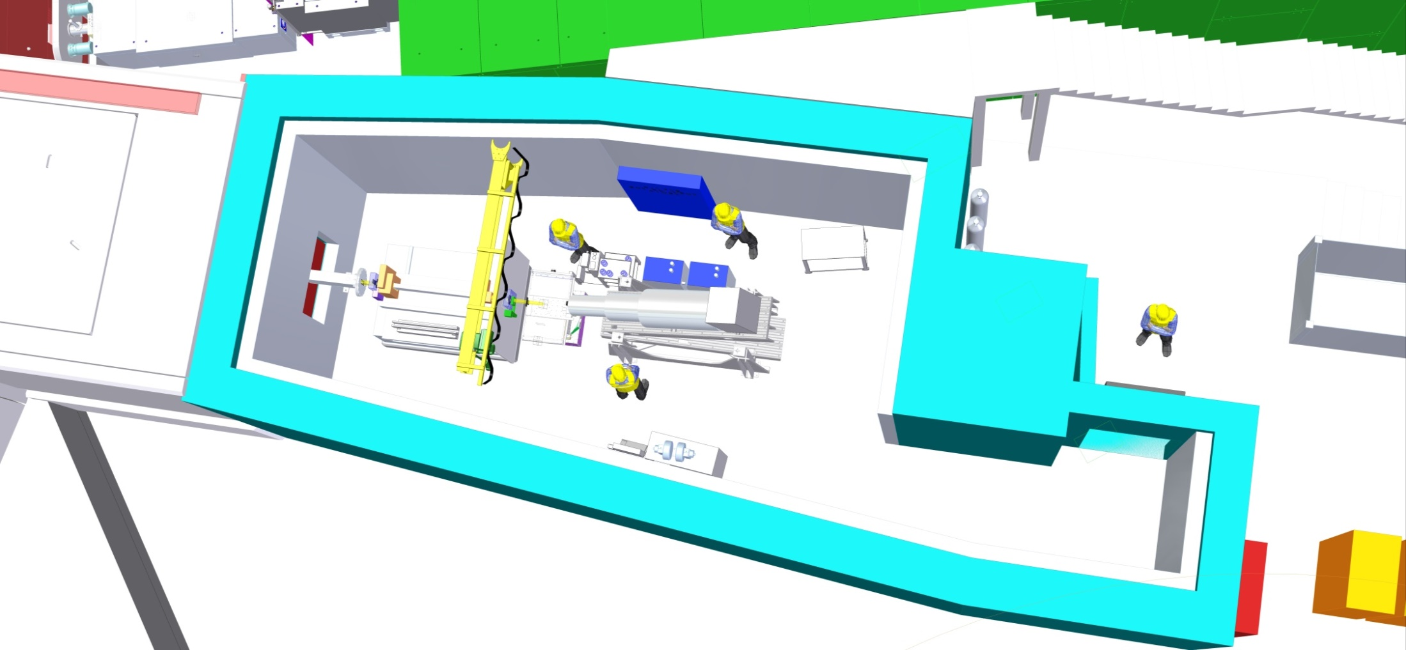
Instrument Access & Services
Overhead crane (1t)
SE panel

Slide 80
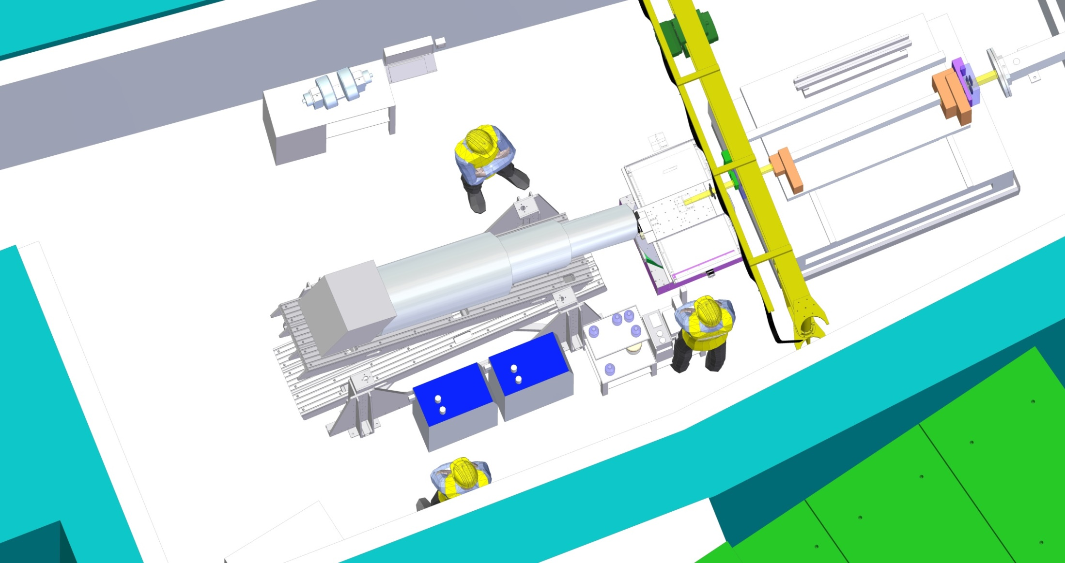
Instrument Access & Services

Slide 81
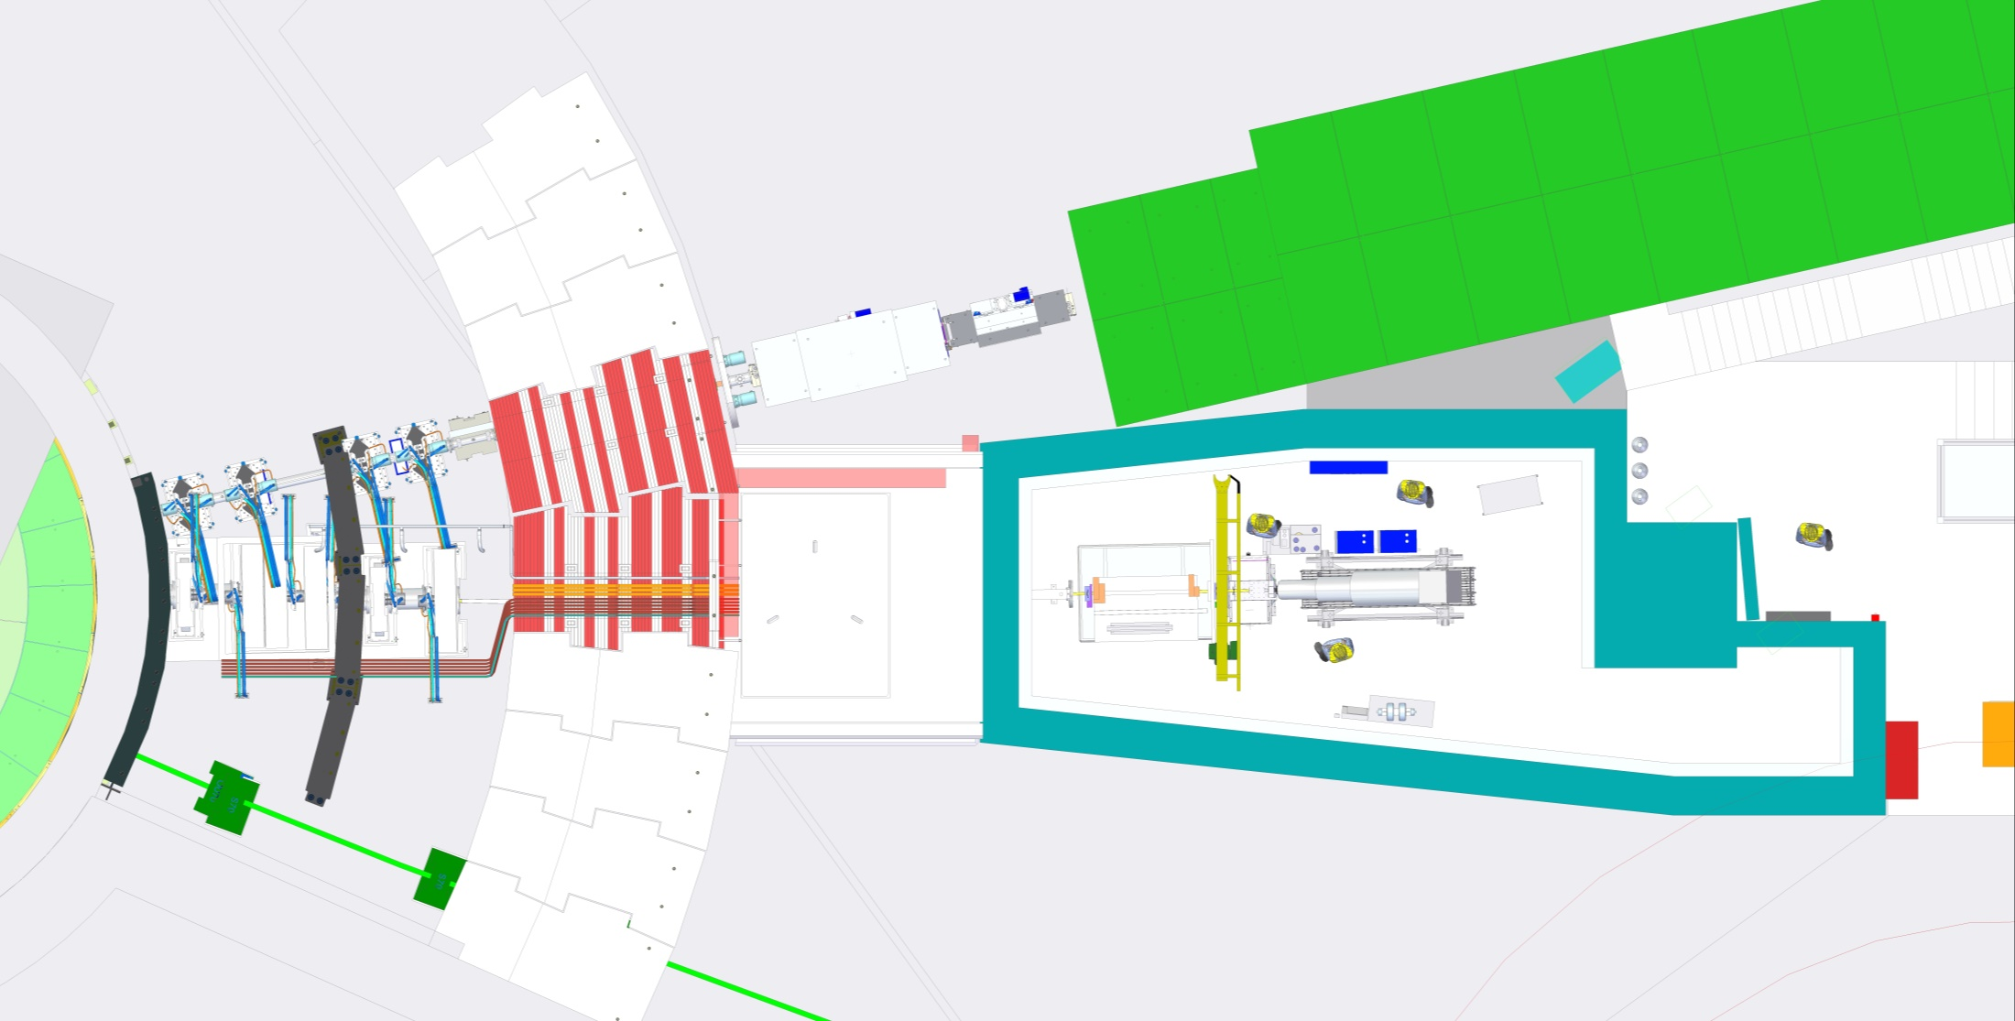
Instrument Integration
Gallery services route

Slide 82

Instrument Integration
Vacuum services
Chopper services
PSS

Slide 83

Instrument Integration

Slide 84

Instrument Integration
Areas highlighted in red are outside of 12 degree wedge.
Freia will work with Loki to integrate/combine shielding
Formal ESS approval required

Slide 85

Diagnostic Monitors
Diagnostic monitors

Slide 86


Diagnostic Monitors
ISIS LET Diagnostic Detector
Scintillator bead on optic fibre in ~Ø5mm aluminium protective canister
A possible solution
Detector PMT located outside of bunker in accessible location
Detector PMT
Vacuum connection

Slide 87
Work Package Specification
Tom Arnold
FREIA Instrument Scientist

Slide 88
Project Schedule - Submitted

Slide 89

Project Schedule - Updated

Slide 90
Freia TG2+ Summary
There are a number of areas that require further investigation to reduce/mitigate risks before ISIS full commitment to the project:
  Choppers: no one has practical experience of choppers of the size/design required for Freia. We propose a feasibility study with a disk manufacturer to assess this.
  Freia has 3-slits system to enable kinetic studies. Given space constraints we need to progress a study of the feasibility of such slits and the associated fast shutter system
  Freia has a very large opening in the target. We need to asses the neutronic implications for Freia, adjacent beamlines (Loki) and operations
  Provide the new lead scientist time and scope to assess the current design tested against the Freia science case
Notes:
Current estimate is £150K(capital and staff) and ~12months to complete
This will be presented at the STAP and TG2 end of Jan for comment
Approach supported by lead scientist and PM
We have shared this approach with ESS and we will discuss further at STAP/tg2
We propose to write this up as TA with ESS
Our new neutronics hire (Gabor Nafradi) will be working on the neutronics

Slide 91
TG2 + Freia Instrument
Full STFC delivery decision plan.
Simulation of instrument mitigation strategies.
Feb – Aug 2018
Neutronics validation of guide and shielding design
Jan – Dec 2018
Conceptual time resolved slit development.
(3 sec timescale likely)
Feb – Apr 2018
Airbus Chopper disc feasibility study
Jan – Jun 2018
Time resolved slit technology demonstrator
May – Jul 2018
STFC Decision on Full Freia delivery.
Autumn 2018

Slide 92
Risk Register – updated

Slide 93
Risk Register – updated

Slide 94
Risk Register – updated

Slide 95
Budget
FREIA Budget Summary
Shielding | €k 1,738
Neutron Optics | €k 1,850
Choppers | €k 2,566
Sample Environment | ESS supply free of charge
Detector and Beam Monitors | €k 832
Data Acquisition and Analysis | ESS supply free of charge
Motion Control and Automation | €k 816
Instrument Specific Technical Equipment | €k 144
Instrument Infrastructure | €k 901
Vacuum | ESS supply free of charge
PSS | €k 133
ESS Labour & travel | ESS supply free of charge
Labour, Travel, Installation, Tom Arnold | €k 2,983
TOTAL | €k 11,963
TOTAL + 10% contingency | €k 13,159
ESS Cost Book Value | €k 13.2
Particular issue has been raised with ESS Labour & travel supplied free of charge
This was an outcome of the scope-setting
This is inconsistent with LOKI

Slide 96
Scope setting outcome
From the report on the scope-setting meeting:
“NSS has established a core engineering support team for the instrument projects. This team provides support for design integration, neutron technologies, systems engineering and co-ordination of on-site assembly and installation, at no cost to the instrument projects. Therefore, assuming that ISIS recruits a Lead Instrument Scientist before TG2, the ESS staff and travel costs beyond phase 1 can be removed from the instrument budget, in line with other instrument projects.”

