Slide 1
Controls Infrastructure
Future ICS EPICS and FPGA support
Timo Korhonen
ICS Chief Engineer
www.europeanspallationsource.se
20 October 2017

Slide 2
Overview
Control system infrastructure components
MTCA base infrastructure
  Timing system
  Digital platforms, status and support
Procurement status and issues
Support from ICS
Summary

Slide 3
Control system infrastructure components
MTCA.4
  Crates, MCH, Cooling Units, PSU
I/O and processing
  Digital platforms
Timing System
  EVG, EVR, Distribution System
Motion control
  EtherCAT/Beckhoff
  EtherCAT master in (MTCA) EPICS IOC, no extra (Beckhoff) PLC required for simple (no complicated coordination) axes.

Slide 4
MTCA base infrastructure
MTCA.4 crates in two variants
  6-slot, 3U crate
    For smaller, more distributed systems (saves rack space)
    Cooling and airflow issues with first prototype
      Front-to-rear cooling is challenging due to small air inlet area
      Added one fan to improve airflow (loud!)
  12-slot, 9U crate
    For systems that can utilize many slots
    Has been in use, stable configuration
  MCH (Micro Channel Hub) from N.A.T.
Specification-wise ready for series procurement

Slide 5
MTCA Crate variants
3U, 6-slot crate
4 slots with place for rear transition module
CPU, EVR in remaining slots
9U, 12-slot crate
12 slots with place for rear transition module
2 MCH slots (redundancy)
4 PSU slots

Slide 6
Timing system
MRF Event System
  Tree-topology trigger and data distribution
    Master node, synchronized to RF (88 MHz)
    Arbitrary number of receivers
  MTCA.4 receiver with backplane trigger and clock support
    Supports also backplane triggers and clocks. Also standalone operation
RF Master Oscillator
88 MHz
Master Event Generator
fanout
Event
receiver
Event
receiver
fanout
Event
receiver
Event
receiver
Event
receiver
Event
receiver
Event
receiver
Event
receiver

Slide 7
IFC_1410 AMC: FMC carrier with CPU
Two High-Pin Count FMC slots
  80xLVDS, GTHx4 (x2 with KU060)
Kintex UltraScale FPGA (KU040 or KU060)
  1 GByte of SDRAM directly attached
    2 banks – for dual buffering
  4-lane PCIe Gen3 to MTCA backplane
Freescale QoriQ T2081 CPU
  4 cores hyperthreaded (8 virtual)
  E6500 core with dual-precision FPU and Altivec
TOSCA-III Firmware library
  Full source code available
  PCI Express switch (non-transparent)
  Supports all features of the card

Slide 8
Digital platforms, status and support
IFC_1410 (and IFC_1420)
  In-kind contribution from PSI (boards + firmware + software)
    Generic packages of firmware, drivers, EPICS support
  Project had delays due to slow start of in-kind
    Also ramp-up of internal resources
  Development done with ICS cash injections
    Not optimal but hardware is now in good shape
    Tried to shuffle with a 10-unit initial batch between developers and users
    PSI support was limited until full approval
  But now: strong support from PSI
    1 FPGA engineer, 1 SW engineer full time
    Part-time support of 7 more people (controls, LLRF, instrumentation)
    Use of PSI resources for ADC performance characterization, etc.
    Production-quality kernel drivers (initial) release
  Series production has started
    First batch (25+25 IFC_1410 units) mid-November

Slide 9
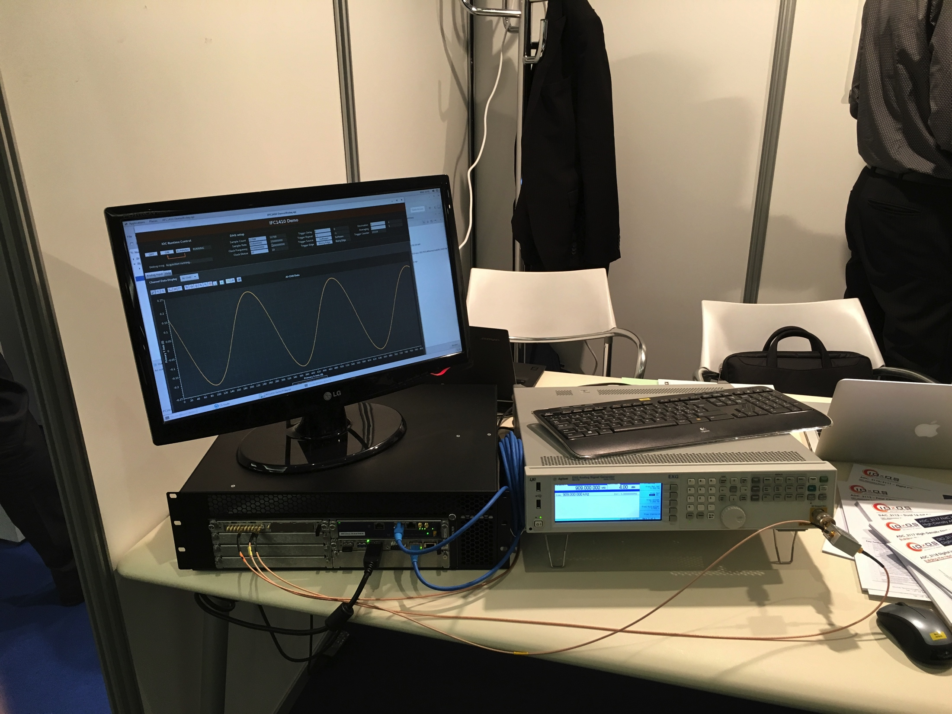
Digital platforms, status and support
IFC_1410 (and IFC_1420)
  Firmware status
    Generic applications (“oscilloscope”) running since a while
    ICS has been working on RF support (RF-LPS firmware), highest priority
  Drivers (Linux, kernel)
    Worked so far on a version from the commercial partner
    This had a number of issues: thread safety, etc.
    A new, production-quality driver, supported by PSI and commercial partner released (yesterday)
      Few details to be finalized
  EPICS
    Moving support to the new driver
    Area Detector will be the main driver for ESS
    Also a generic driver from PSI will be supported (regDev). This is primarily for prototyping but has also been used in production.
      Like “streamDevice” but for register-based, memory-mapped devices
      No programming needed
IFC_1410 demo at ICALEPCS ‘17 conference in Barcelona, two weeks ago
Generic “oscilloscope” firmware
250 MSPS ADC
Running EPICS (3.15.4)
CS-Studio GUI

Slide 10
Procurement issues
Several issues in procurement of MTCA.4 equipment
  Recurrent delays in delivery
3U Crate was expected in June (new backplane, “custom”)
  Delivered mid-October, bigger lot delayed even more
Crate infrastructure is technically ready
  As far as specifications go
Timing system components procurement in progress
  Framework agreement with Micro-Research Finland
    We already have a small stock of MTCA.4 Event Receivers (20x)
      but also a lot of users wanting hardware

Slide 11
EPICS support
ESS EPICS Environment
  Based on a concept that has been successfully used at PSI for >10 years
    Pre-compiled drivers dynamically loaded at IOC start
    Enables better management of driver base
  ESS version has suffered from a few issues
    Dependency handling caused problems
      Over-ambitious in trying to automatize – got too complex
    Upstream modules (from EPICS community) do not always follow same versioning rules
      Sometimes API changes between minor versions
    Issues with version tagging and continuous integration
      Triggered un-intended updates
  Project was orphaned for a while (personnel changes)
    Effort has now been put in support – still new though
    Problem causes have been understood and fixes found – WIP
Even with the above issues, this got us successfully through the PS&LEBT commissioning in Catania
  With remote development and some support visits

Slide 12
Support resources for Oslo
Delivery of standard MTCA platform planned
  MTCA Crate
    3U version (loud!)
  IFC_1410 board, from the first production lot
    With generic firm- and software package
    CameraLink FMC support firmware needs to be done
      Has not been in the plan, or nobody told me
  EPICS support
    Final software structure (API), few minor updates may still come
  Firmware library (TOSCA) introductory training
    Organized as/if needed
As of now, no ICS manpower allocated specifically for this project
  support of generic tools is available, “best effort”
  Is there need for more?
  I have to point out this: ICS is not mentioned in the Technical Annex (ESS-0044049). Maybe this is the reason this has been below my (and other person’s radar)?

Slide 13
Summary
MTCA base infrastructure defined
  Working on procurement
  Timing system component procurement in preparation
Digital platforms maturizing
  Development speeded up after a slow start
  Procurements started
EPICS support baseline
  EPICS (7), AreaDetector, EEE + development (VM)
  CS-Studio, Archiver Appliance, etc. services

