Slide 1
FPGA video processing
David Michael Bang-Hauge
Head Engineer - Electronics workshop
Department of Physics UiO
d.m.bang@fys.uio.no

Slide 2
FPGA video processing
Processing for the synchronous beam imaging system
Explore using FPGA for video processing
Benefits: Deterministic time and parallel processes
35 ms to do processing, assuming 28 Hz frame rate
Functionality looked into:
Centroid position
Median filtering
Geometrical distortion correction
Percentage of beam outside defined footprint
Peak density of the beam

Slide 3
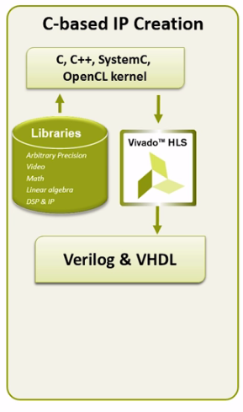

Development tools

Slide 4
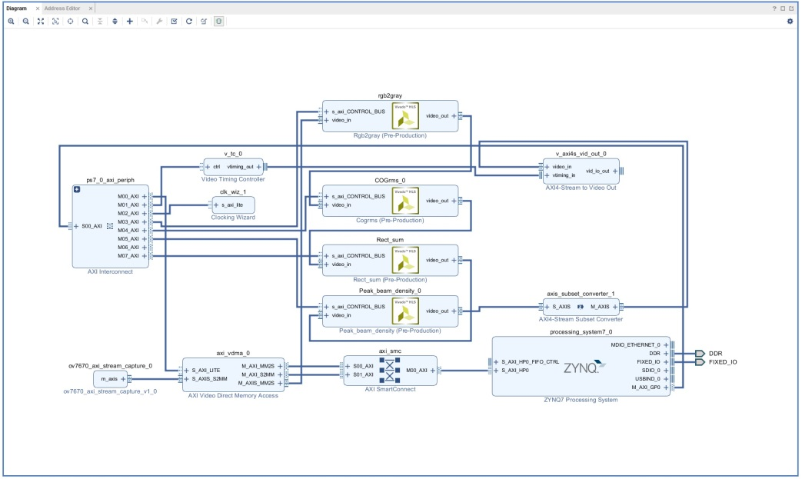
Design flow
Vivado HLS
Vivado IDE
C, C++, System C…
FAIL
C-Simulation
C-testbench
Pass
C-Synthesis
(RTL generation)
FAIL
C/RTL co-simulation
Pass
Change Device.
Change target clock period….
Export generated RTL as IP.
NO
Evaluate generated RTL for synthesis, place and route.
Timing and utilization ok?
IP CATALOG
YES

Slide 5
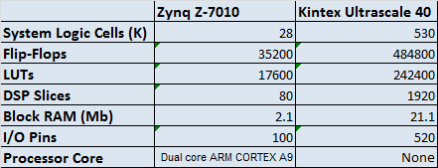
ESS final platform
ESS final platform FPGA: Kintex Ultrascale 40
Test Platform FPGA: Zynq-7010 (XC7Z010-1CLG400C)
Resource Comparison

Slide 6
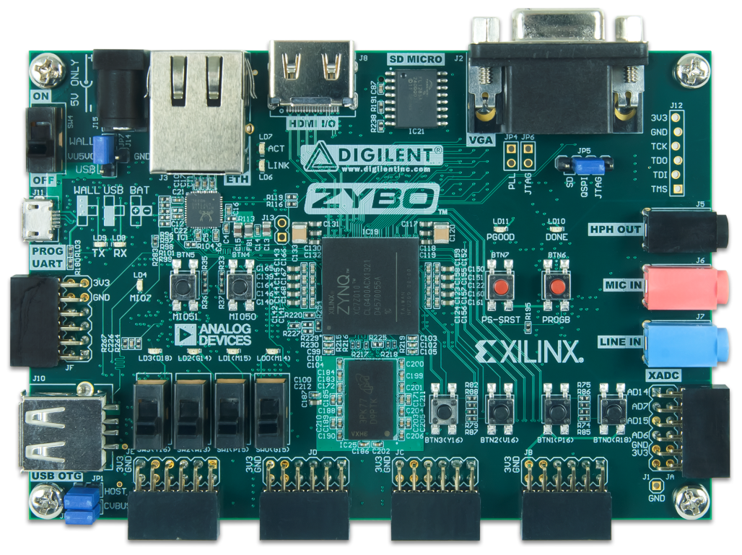
Test Platform
Zybo Zynq-7000 ARM/FPGA SoC Trainer Board
Key Features
Xilinx Zynq-7000 (XC7Z010-1CLG400C)
512 MB x32 DDR3 w/ 1050Mbps bandwidth
16-bits per pixel VGA output port
High-bandwith peripheral controllers: 1G Ethernet, USB 2.0, SDIO
ZYNQ 7000 XC7Z010-1CLG400C
28,000 logic cells
2.1Mb Block RAM
650 MHz dual-core Cortex™-A9 processor

Slide 7
Test Platform
Zybo Zynq-7000 ARM/FPGA SoC Trainer Board
Serial transmission of test image from PC to ZYNQ stored on DDR3 SDRAM
Bare metal program running on processing system used for controlling and configuring FPGA IP cores
VDMA creates a video stream from stored test image
VGA output for displaying processed video stream

Slide 8
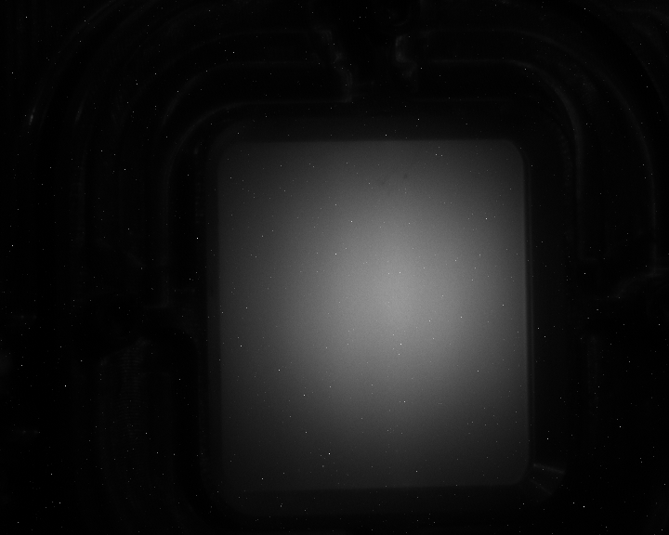




Centroid position
Test Frame 720x576

Slide 9
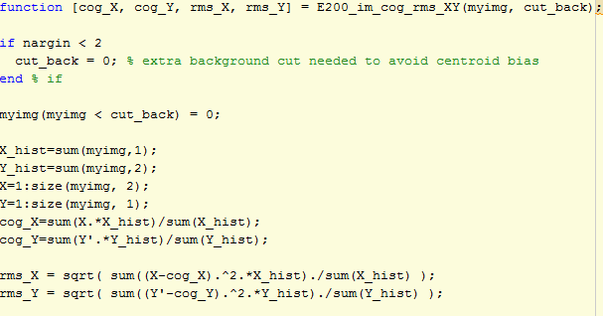
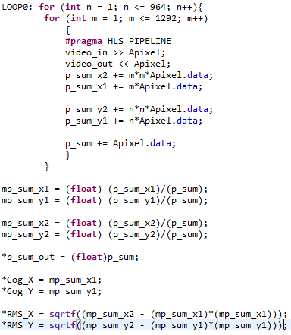
Centroid position
Matlab Implementation
HLS Implementation

Slide 10
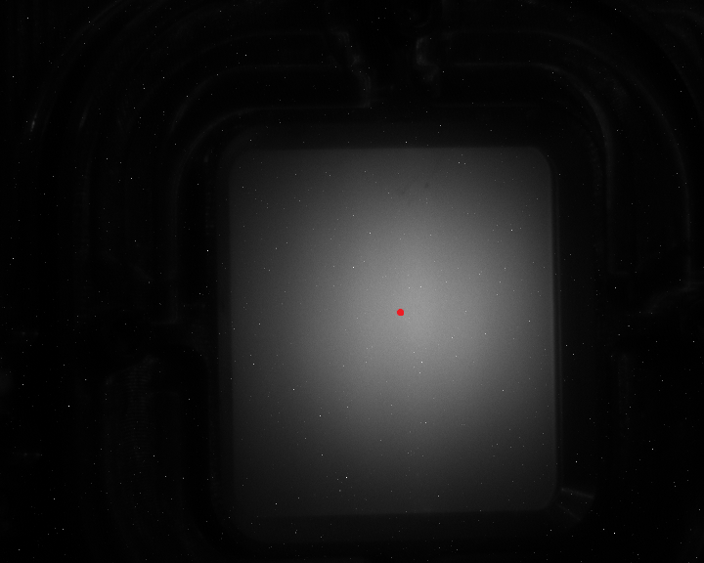
Centroid position
Matlab, HLS comparison
 | Matlab | HLS C/RTL co-simulation
Centroid X | 408.7179 | 408.717896
Centroid Y | 318.8381 | 318.838104
RMS X | 106.1724 | 106.172401
RMS Y | 106.0952 | 106.095215

Slide 11
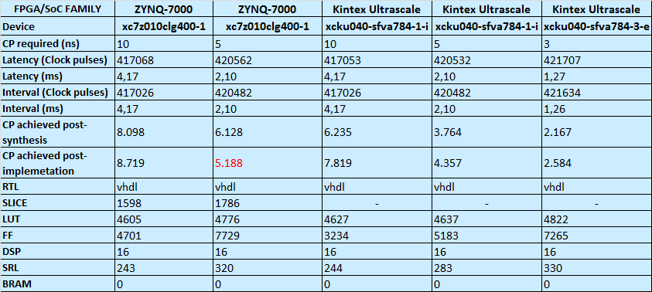
Vivado HLS Report Comparison
Resolution = 720x576 = 414720 pixels
CP required = Clock Period required
Latency and interval estimation is post RTL generation
Acheived timing and resource utilization is from evaluation of the RTL for Vivado synthesis, implementation
The latency is the number of clock pulses it takes to produce the output.
The interval is the number of clock pulses before new data can be presented
Latency (ms) = Clock pulses * Clock period required

Slide 12
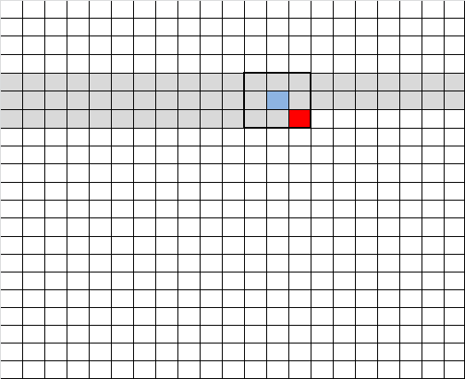


Median filter
NEW PIXEL FROM INPUT STREAM
LINE BUFFER
FRAME
NEW PIXEL TO OUTPUT STREAM
WINDOW BUFFER
SORTING

Slide 13


Median filter
C/RTL co-simulation
Median
Filter
Added salt and pepper noise
Resolution 720x576
Window = 3x3

Slide 14
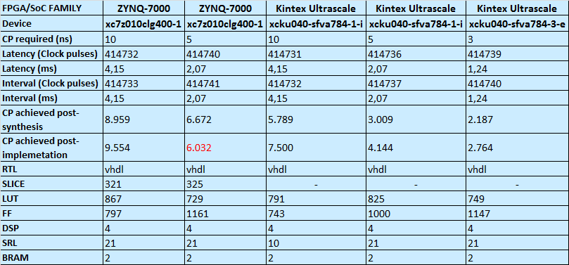
Vivado HLS Report Comparison
Resolution = 720x576 = 414720 pixels

Slide 15

Geometrical distortion correction
May use the Remap function in HLS video library
Remaps the source image to the destination image according to the given remapping
Contains a linebuffer that buffers the required amount of rows
needed for vertical displacement

Slide 16
Geometrical distortion correction
C/RTL cosimulation
Image resolution: 585x585 LineBuffer: 128 Lines
Remap
Original image
Rotation

Slide 17
Geometrical distortion correction
C/RTL cosimulation
Image resolution: 585x585 LineBuffer: 128 Lines
Remap
Original image
Rotation and distortion correction

Slide 18
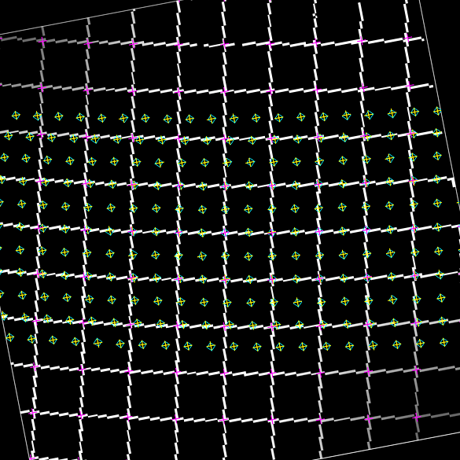
Geometrical distortion correction
C/RTL cosimulation
Image resolution: 585x585 LineBuffer: 128 Lines
Remap
Original image, pre-rotated
Distortion correction

Slide 19
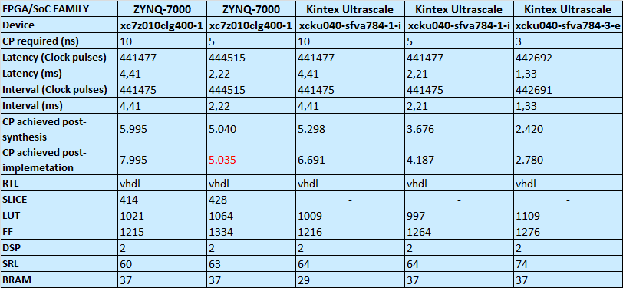
Vivado HLS Report Comparison
Resolution = 720x576 = 414720 pixels

Slide 20
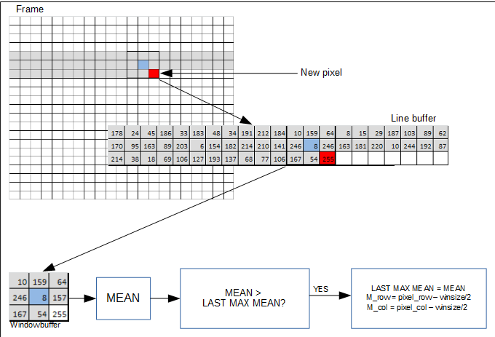
Peak Density of the Beam

Slide 21
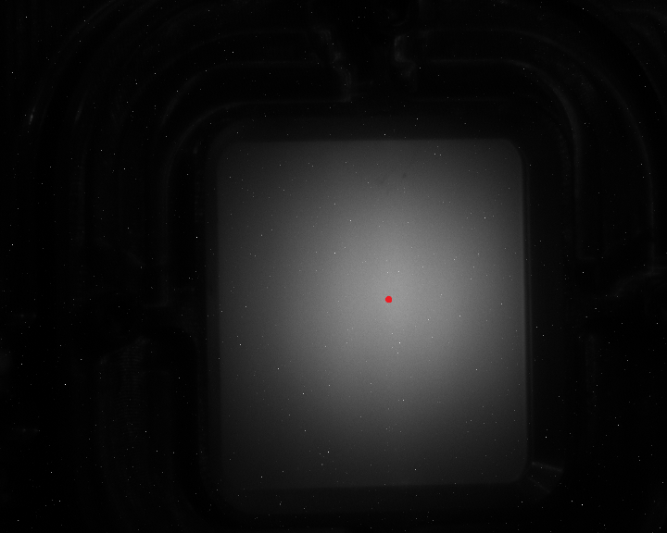
Peak Density of the Beam
Matlab, HLS comparison
 | Matlab | HLS C/RTL co-simulation
Peak Density | 149.3900 | 149.389999
Row | 321 | 320
Column | 423 | 422

Slide 22
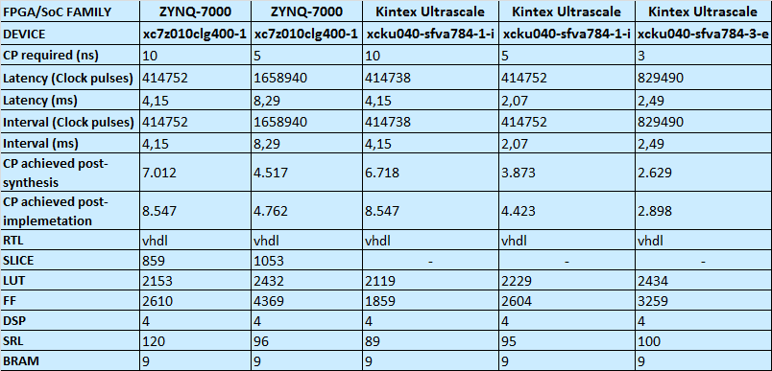
Vivado HLS Report Comparison
Resolution = 720x576 = 414720 pixels

Slide 23
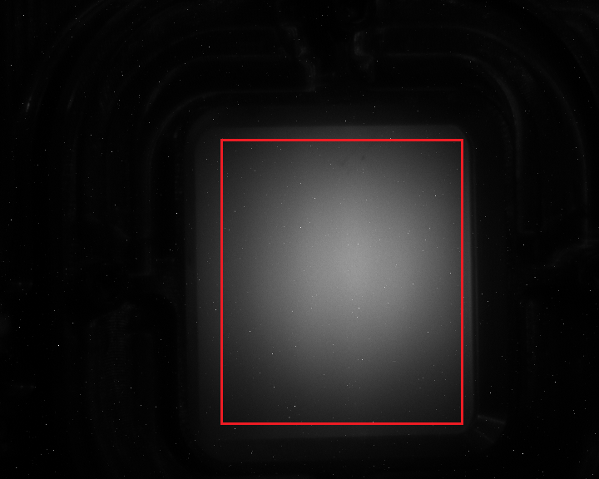
Percentage of beam outside defined footprints

Slide 24
Percentage of beam outside defined footprints
Matlab, HLS comparison
top border = 200 bottom border = 400 left border = 300
right border = 500
 | Matlab | HLS C/RTL co-simulation
Total pixel sum | 9508224 | 9508224
Sum outside rectangle | 5230963 | 5230963
Sum inside rectangle | 4277261 | 4277261

Slide 25
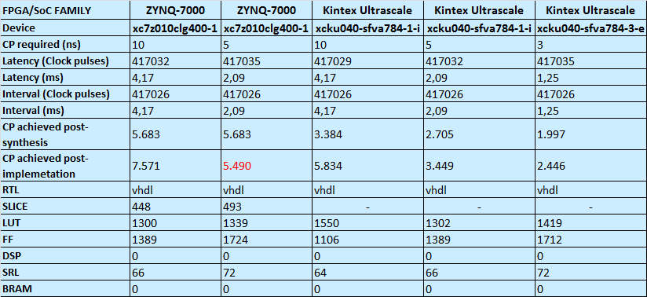
Vivado HLS Report Comparison
Resolution = 720x576 = 414720 pixels

Slide 26
Total estimated resource usage
 | xcku040-sfva784-1-i |  | xcku040-sfva784-1-i |  | xcku040-sfva784-3-i |  | Available
CP required | 10 |  | 5 |  | 3
LUT | 10096 | 4,17 % | 9990 | 4,12 % | 10533 | 4,35 % | 242400
FF | 8158 | 1,68 % | 11440 | 2,36 % | 14659 | 3,02 % | 484800
DSP | 26 | 1,35 % | 26 | 1,35 % | 26 | 1,35 % | 1920
BRAM | 40 | 3,33 % | 48 | 4,00 % | 48 | 4,00 % | 1200 18Kb + 600 36Kb
Total estimated resource usage for the Kintex Ultrascale 40
 | xc7z010clg400-1 |  | xc7z010clg400-1 |  | Available
CP required | 10 |  | 5
LUT | 9946 | 56,51 % | 10340 | 58,75 % | 17600
FF | 10712 | 30,43 % | 16317 | 46,36 % | 35200
DSP | 26 | 32,50 % | 26 | 32,50 % | 80
BRAM | 48 | 40,00 % | 48 | 40,00 % | 120
Total estimated resource usage for the Zynq-7z010

Slide 27
Conclusion
Reduced development time using Vivado HLS
Latency dominated by streaming time
Kintex UltraScale FPGA allows faster and/or less resources compared to ZYNQ-7000 series
All estimates for Kintex Ultrascale show that the implementations can run with a clock speed of at least 200 MHz
To early to conclude about absolute timing

Slide 28
Further work
Deconvolution of motion
Fixed point instead of floating numbers may reduce latency and resource usage.
Full algorithmic pipelining test
Hardware implementation on final ESS platform

