Slide 1
Protective coating:
Experience at SNS
W. Blokland

Slide 2
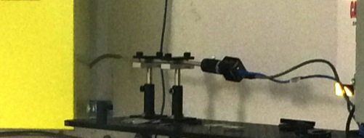
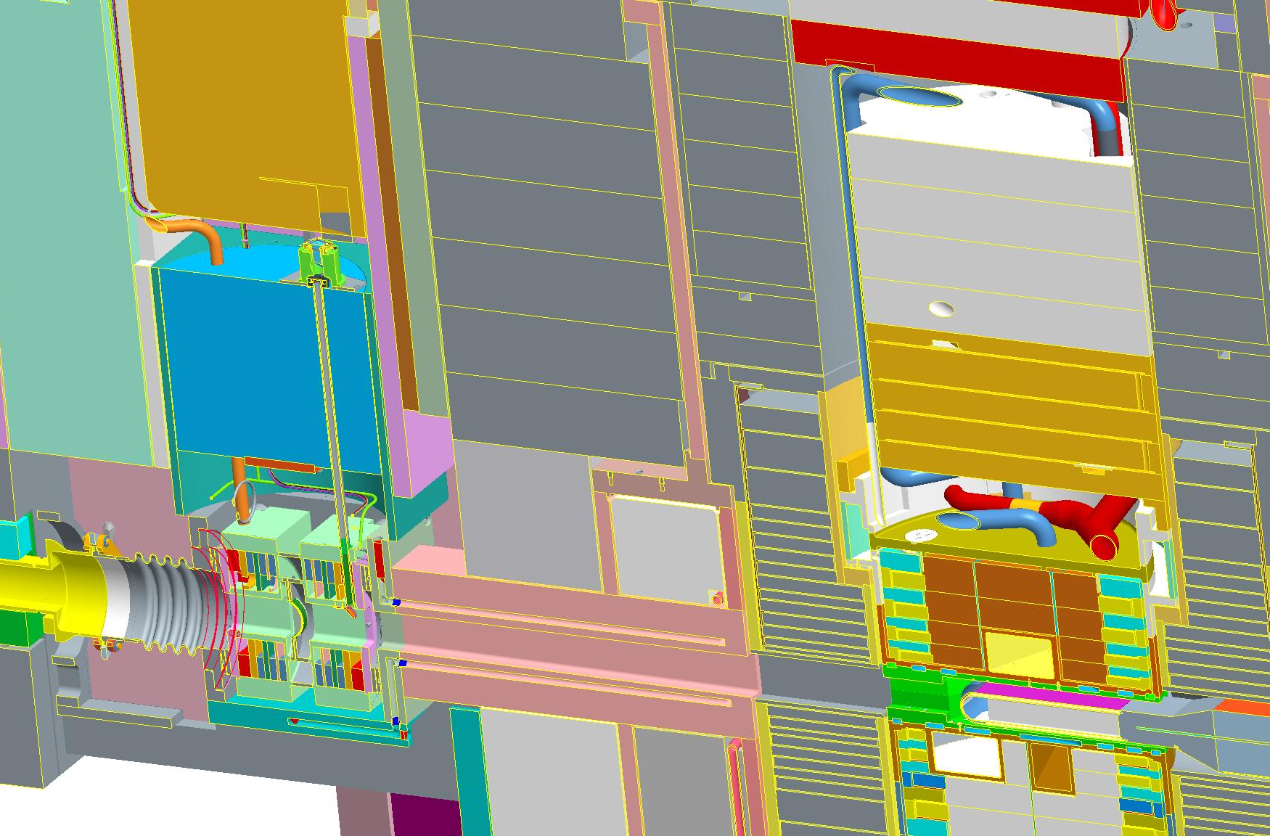
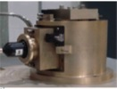

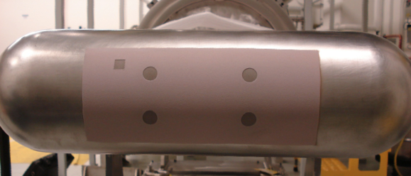
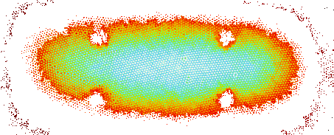

SNS TIS Layout
Camera
Fiber Bundle
Turning Mirror
Luminescent Coating
PBW
Assembly
Parabolic Mirror
Target
Beam Pipe
Layout of the target Imaging System

Slide 3
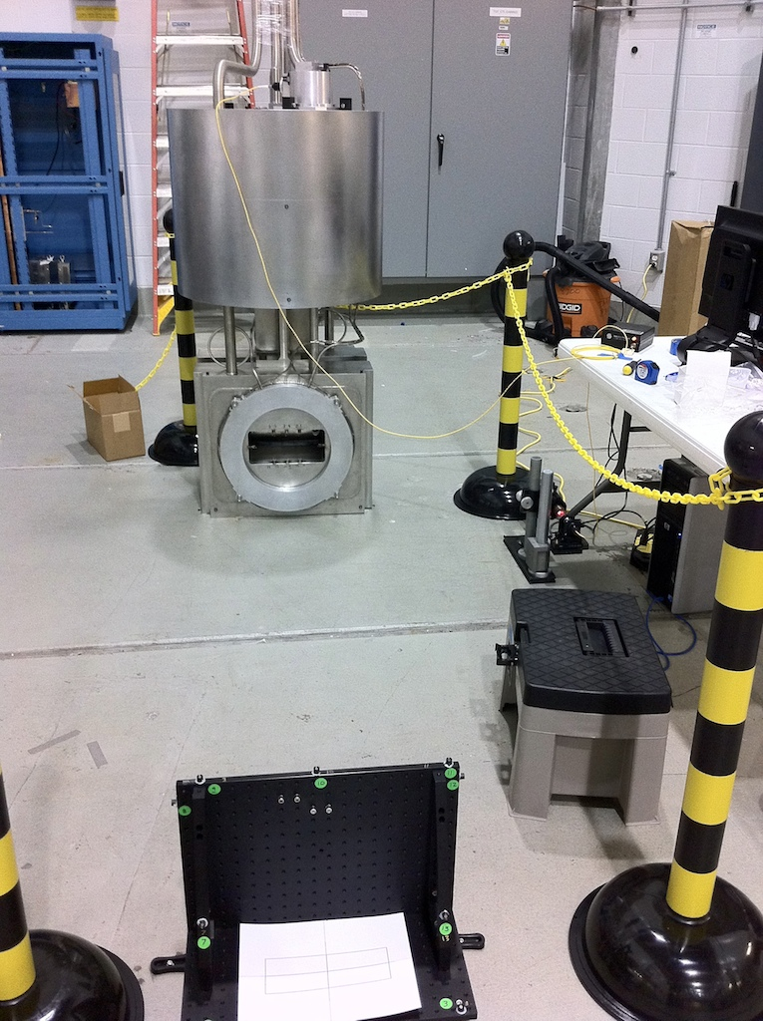
Proton Beam Window
TIS Mirror
Proton beam

Slide 4
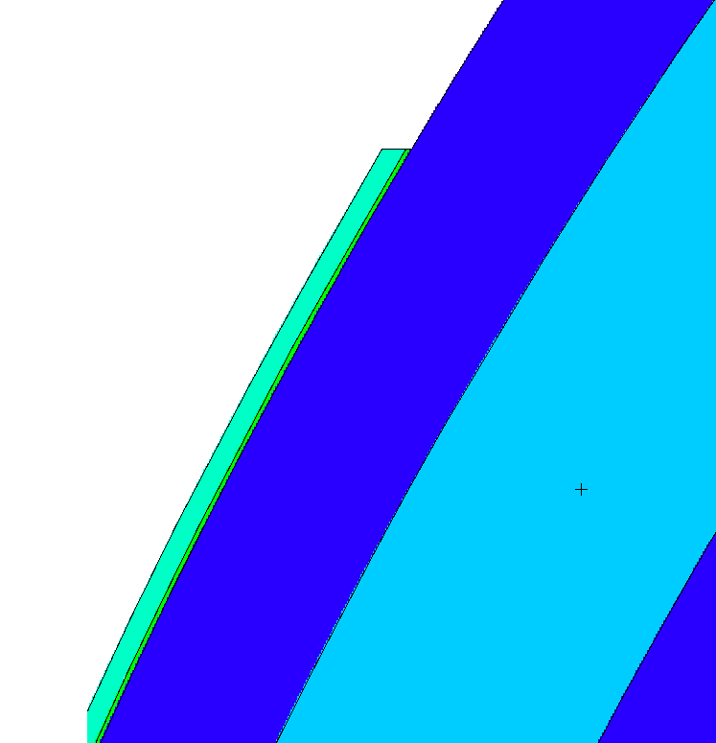
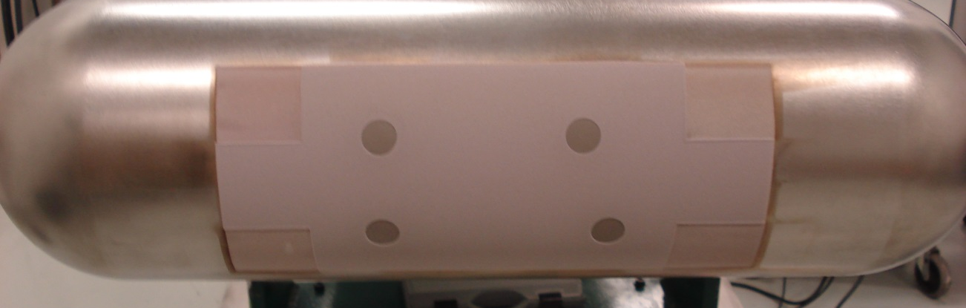
Coating
Alumina
  3.1 g/cm3
  0.0229 mm
  97.5 wt% Al2O3
  2.5 wt% Cr2O3
Al-Ni substrate
  8.9 g/cm3
  0.0051 mm
  95 wt% Ni
  5 wt% Al
α-Alumina
steel
Al-Ni substrate
Decay of brightness versus MWHrs of beam on target
Test Patches

Slide 5
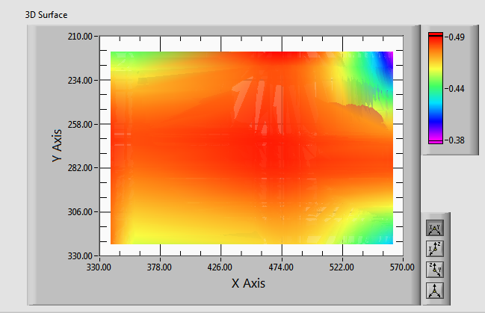
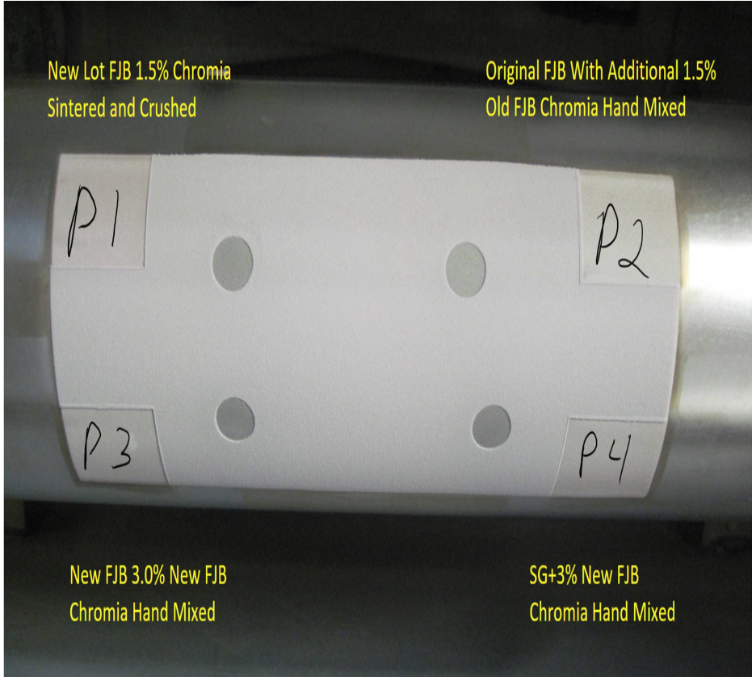
Scan of corners
It is not a very accurate scan to begin with (low signal to noise) but it looks like the P3 and P1 are the brightest and the P2, the least bright. The scan goes a little off the coating so at the edges we typically see a bit of a drop in intensity. This measurement is done on the fitted amplitude in the vertical direction.
It looks like the New FJB performed best with 1.5% and 3% Chromia

Slide 6
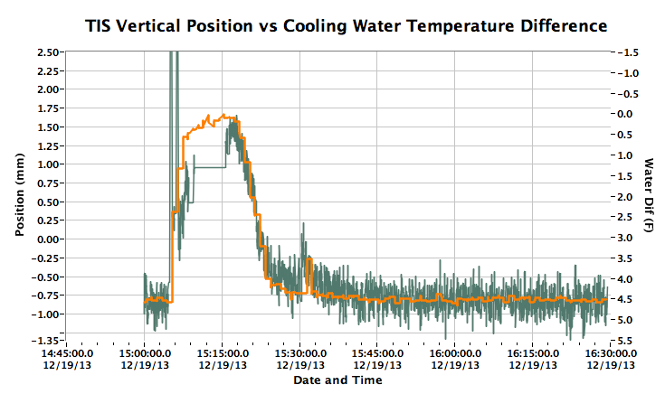
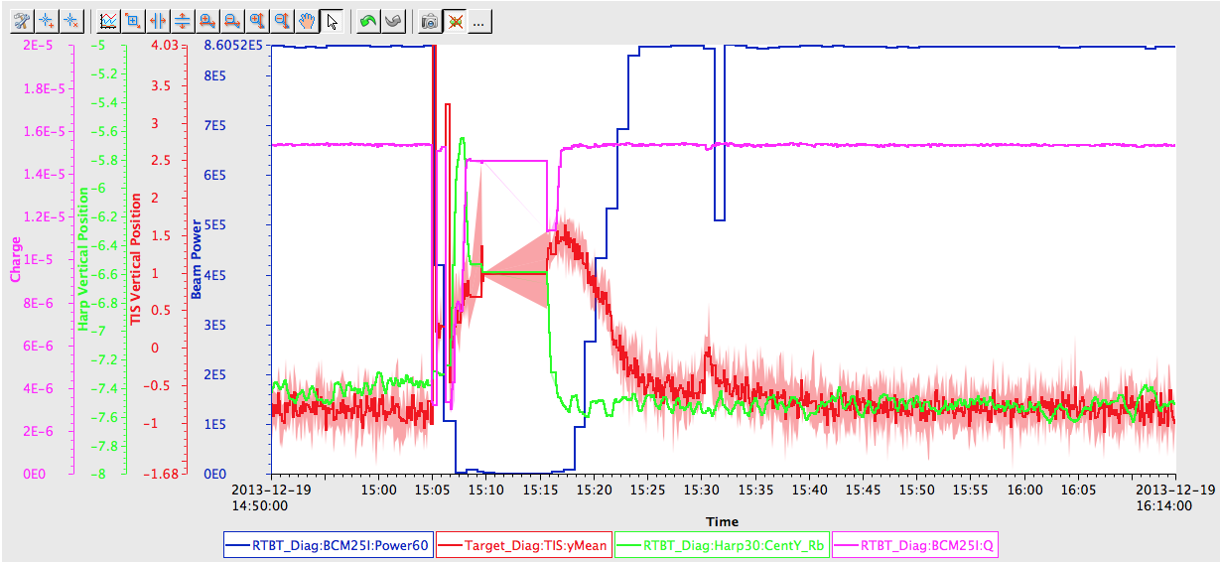
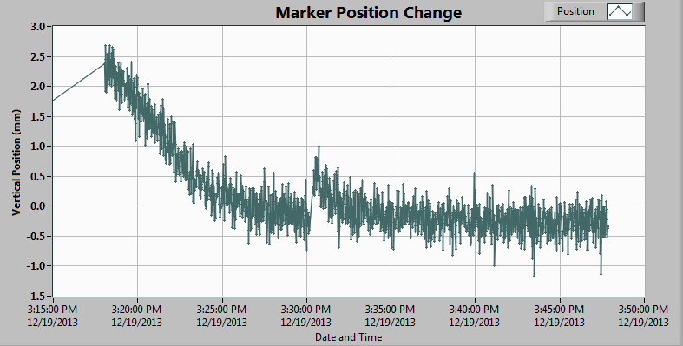
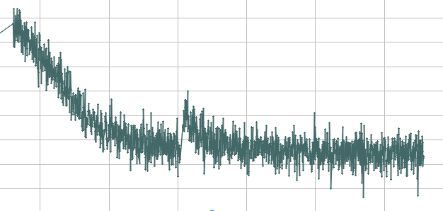
Position Analysis
Compare marker changes with observed position
Movement of markers correlates with position movement! → most likely due to movement of the mirrors and correlates with heating of proton beam window.

Slide 7
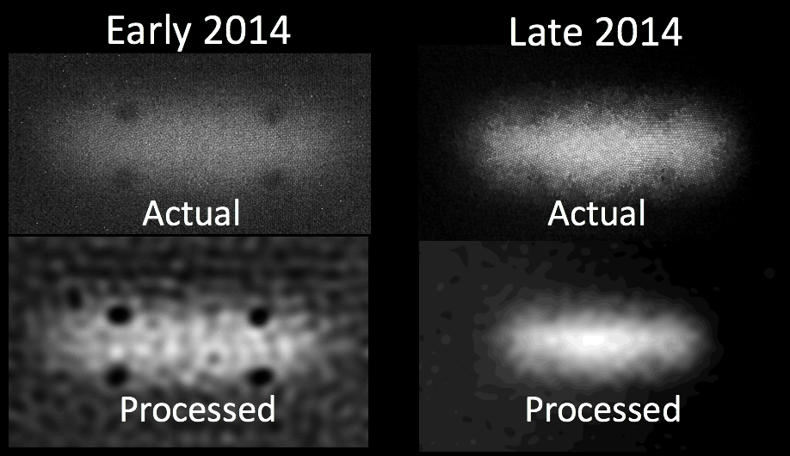
First issues: fiber bundle
Different manufacturing process delivered lower contrast in the fiber bundle
Lowered quality excludes auto-calibration

Slide 8
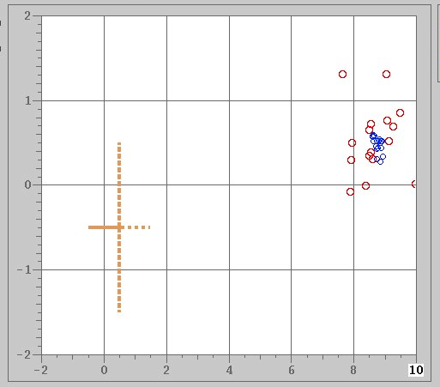
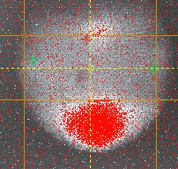
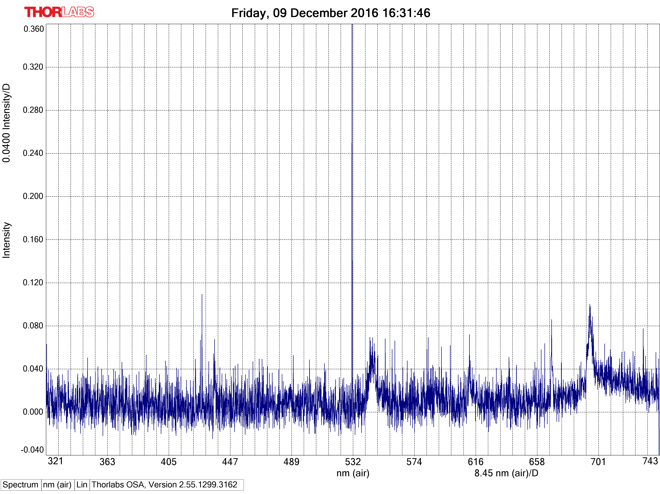
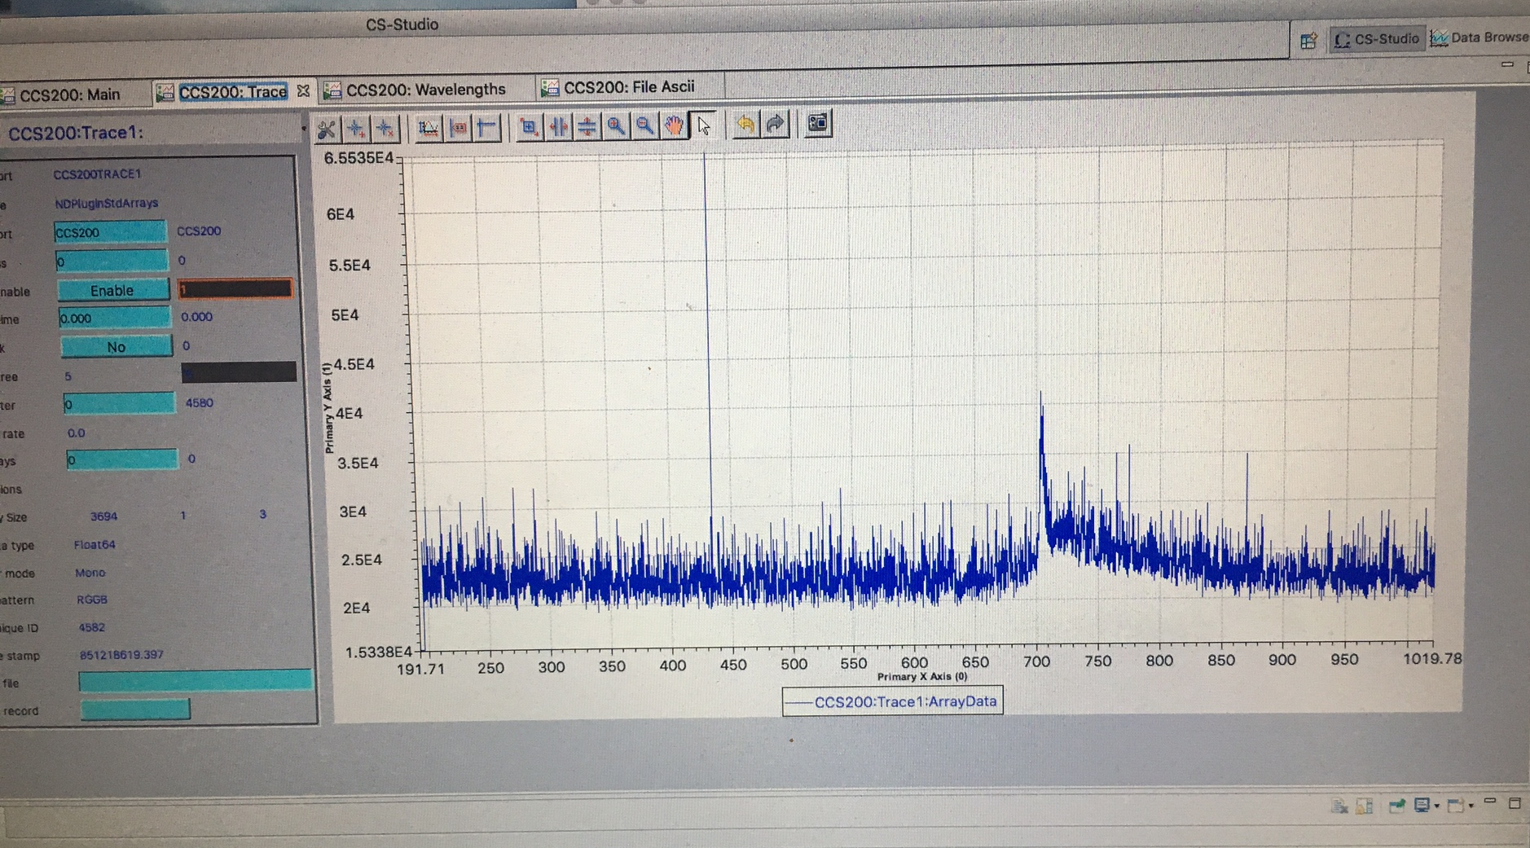
TIS did operate during water leak
2016 Nov 8:TIS jumped 8mm. Manually corrected using fiducials (mount problem? PBW leak?, camera bump?)
2016 Dec: spectrum measurements, use of optical box, and averaging of image to improve measurements
Something is wrong but near end of run and replacement planned
Defect?
2016-11-08 position
2016-11-29 (lamp)
Ruby
2016-12-09
2016-12-21

Slide 9
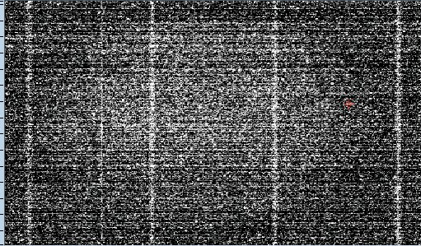
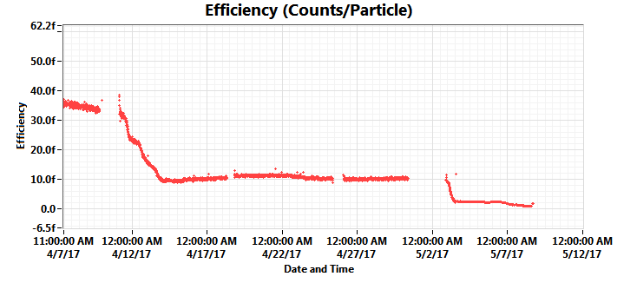
TIS did operate during water leak
2017 Jan new proton beam window installed with new mirror
  Attempt to fix core vessel leak was made, water leak redirected
After new install of proton beam window the TIS operated from Feb 23rd to May 3rd 2017, a maintenance day
  TIS starts decaying afterwards and succumbs
  Previous drop after April 10th
We don’t know (yet) if each incident of light decay is due to mirror or target coating!
outages
Post corrosion image
(most likely mirror corrosion as the whole aperture is filled with light)
Sudden drops in light collected

Slide 10
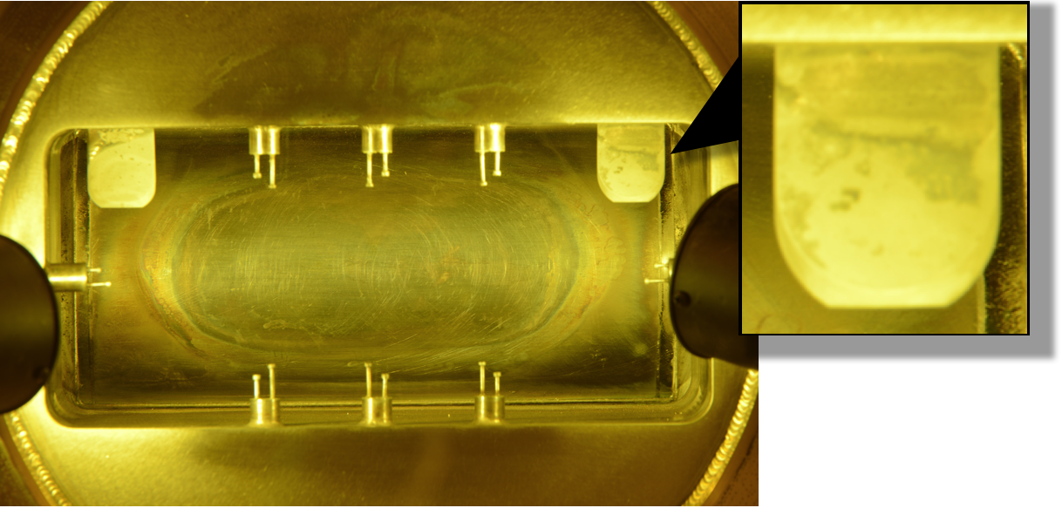
Picture of proton beam window
Corrosion on mirror and perhaps PBW

Slide 11
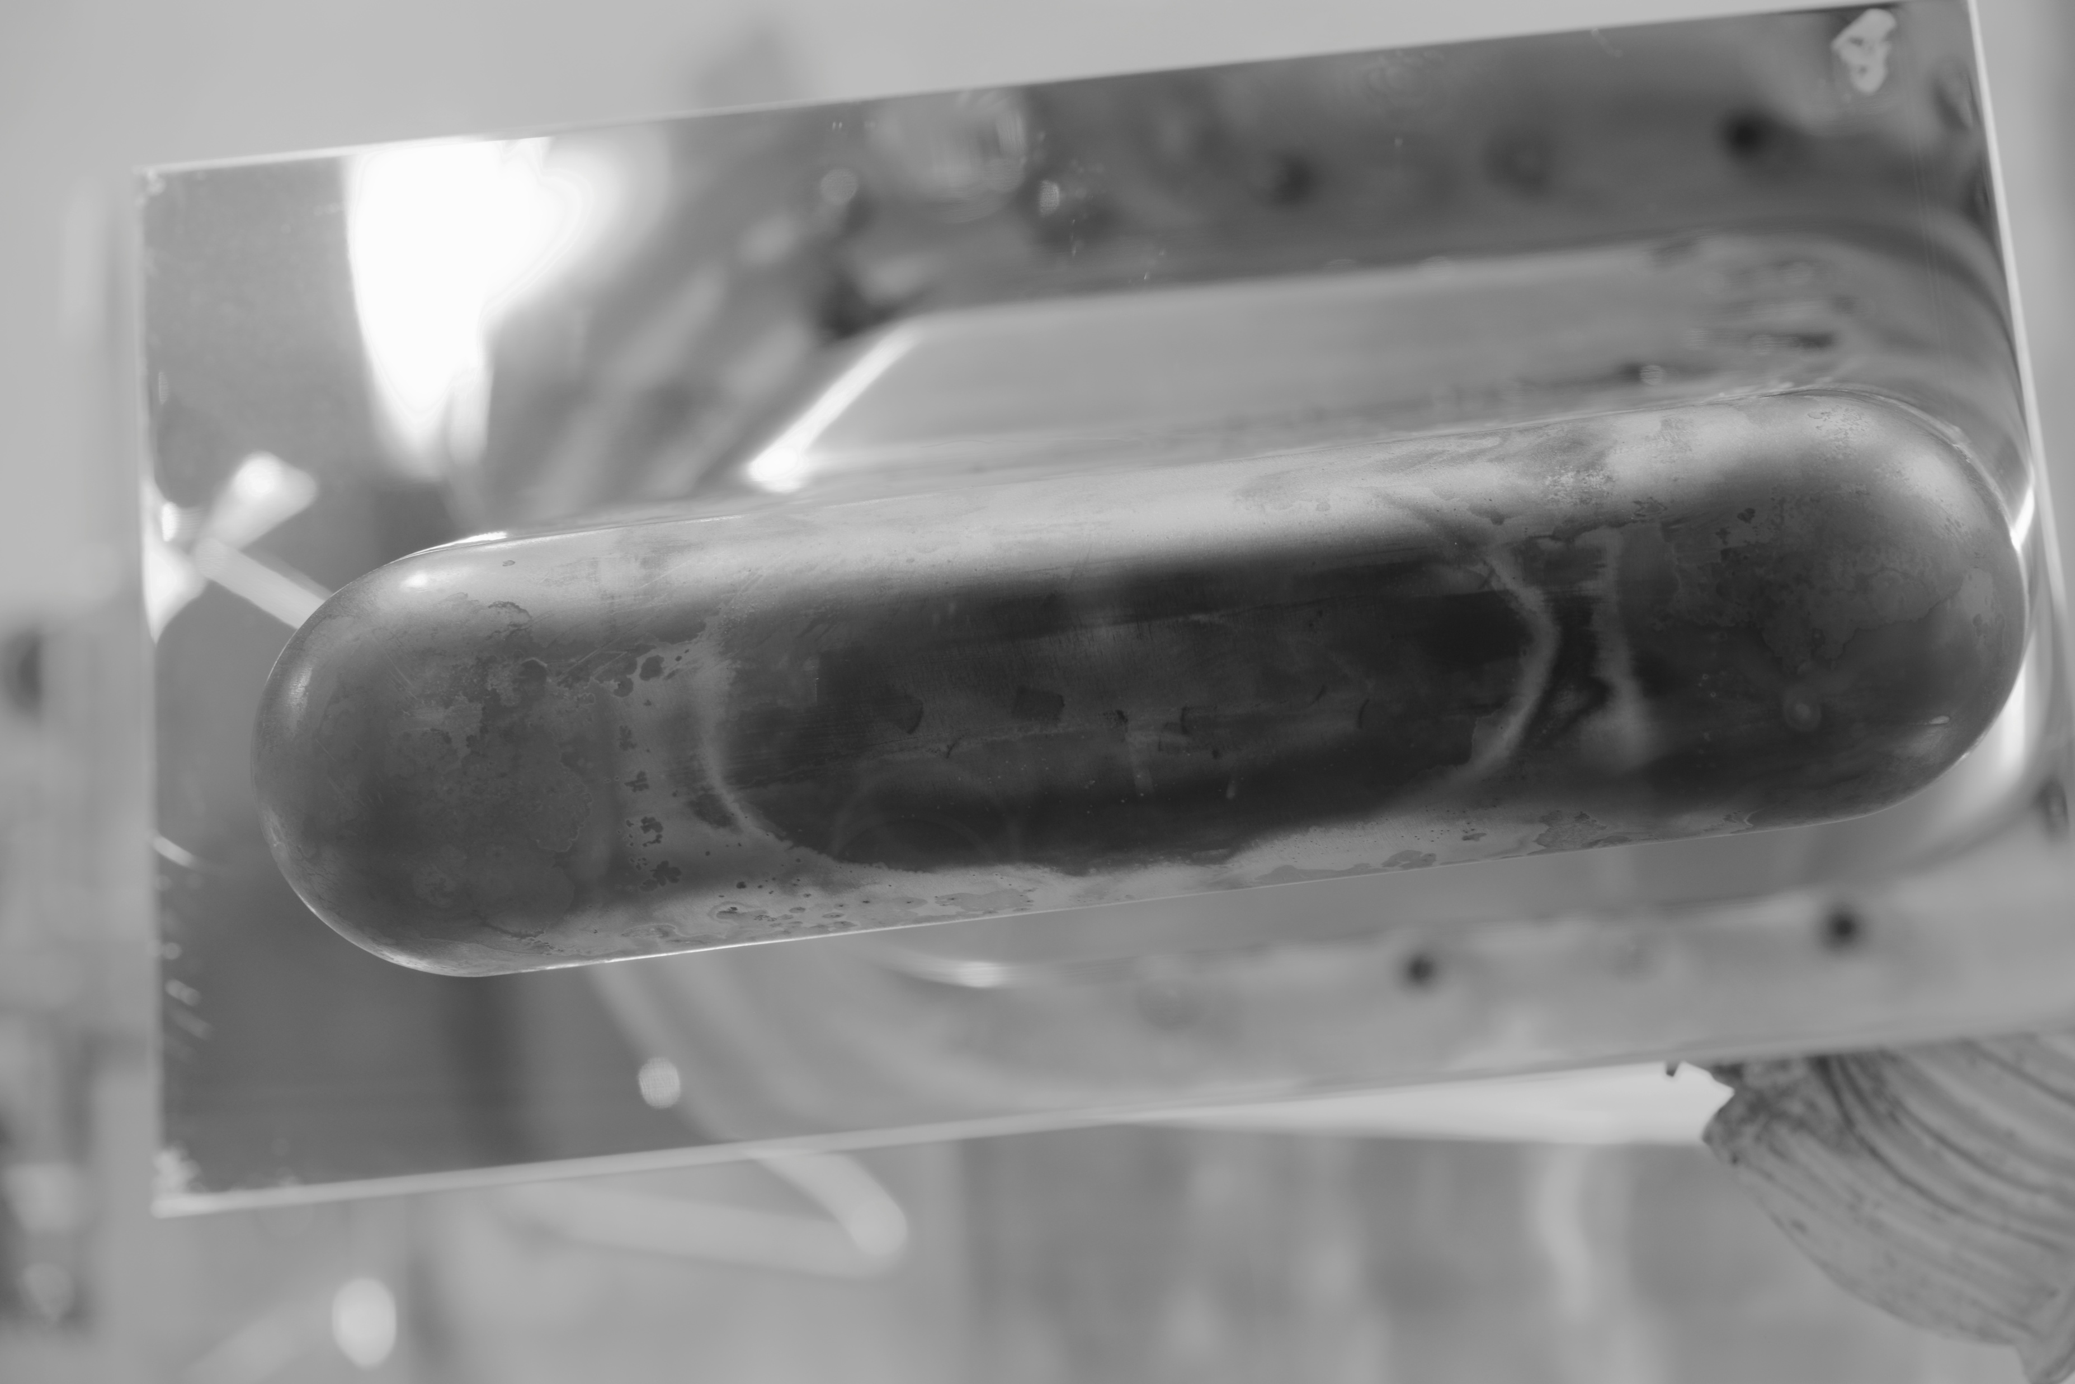
Target nose cone
Coating is gone

Slide 12
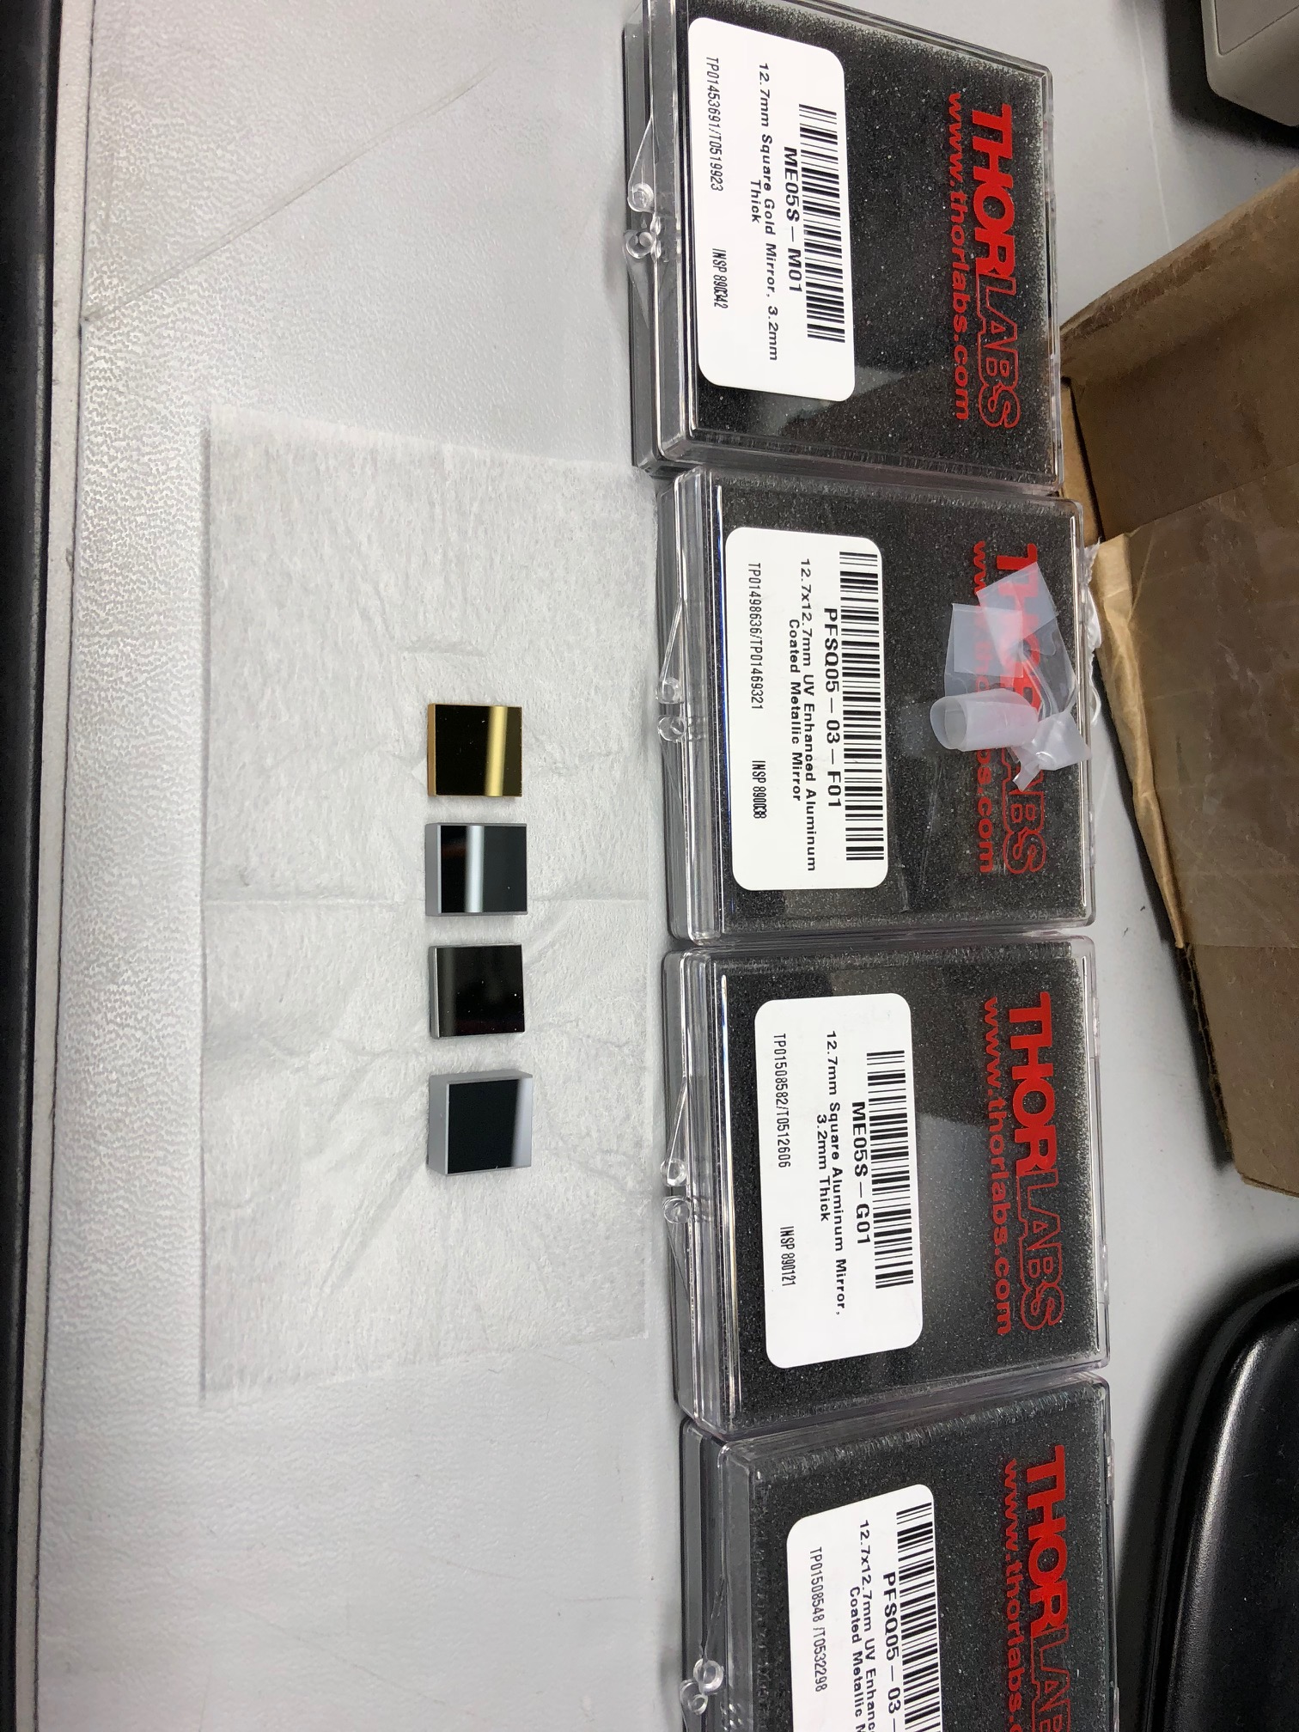
Summary
Targets
  Leaks are inevitable
Effect of water on TIS
  Target coating disappears
    Prevention: do not leak water on target!!!
  Mirror corrodes
    Prevention: protective coating, different metal
  Water and optics can co-exist for a while
    We don’t know yet what the exact condition for mirror corrosion is
Corrosion test of different mirrors
  Radiate collaboration: exposure at Fermilab
  Perhaps local exposure near injection area but not quite the same particle mix (10⁴ Rad/hr)

Slide 13
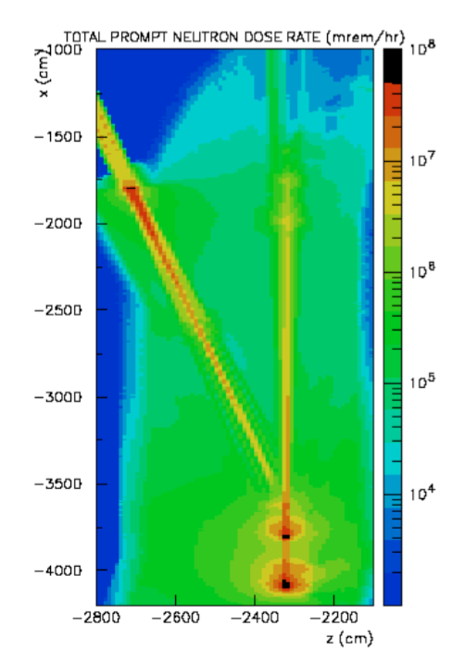
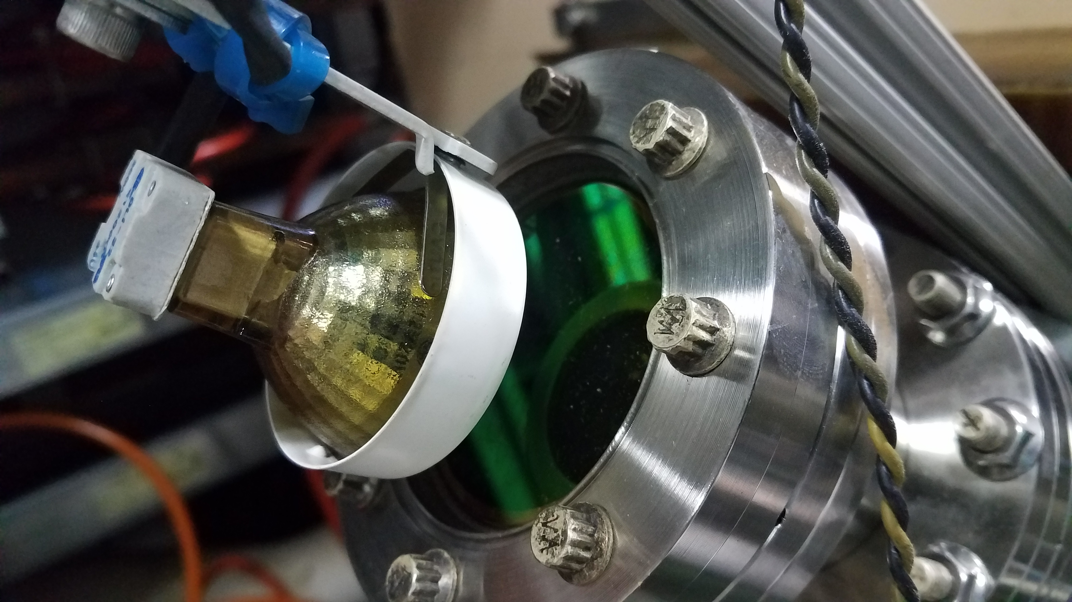
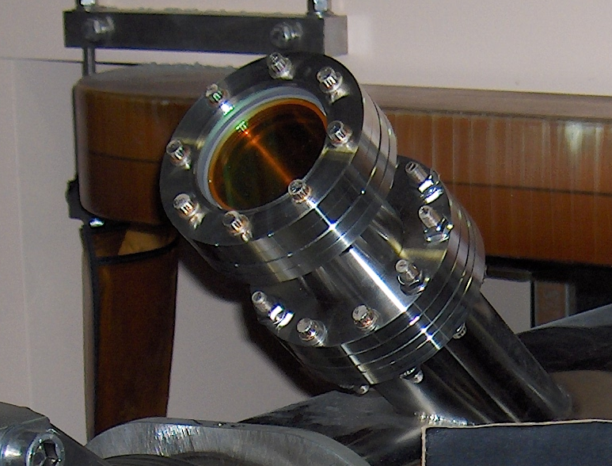
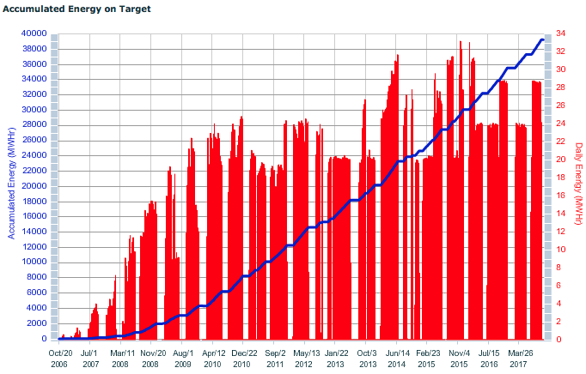
ZnSe vacuum window at stripper foil
Prompt radiation dose:
At 1.4 MW, we get 10^8 mrem/hr or about 10^7 mRad/hr or about 10^4 Rad/hr
We have this window in place for ~9 years 36000 MWhr
→ 36000*10^4/1.4 = 257 MRad
Window is now green (coating damage?)

