Slide 1


ESS Target Proton Beam Imaging Systems CDR
Charge covered
Erik Adli
Department of Physics, University of Oslo, Norway
University of Oslo, October 23, 2017

Slide 2
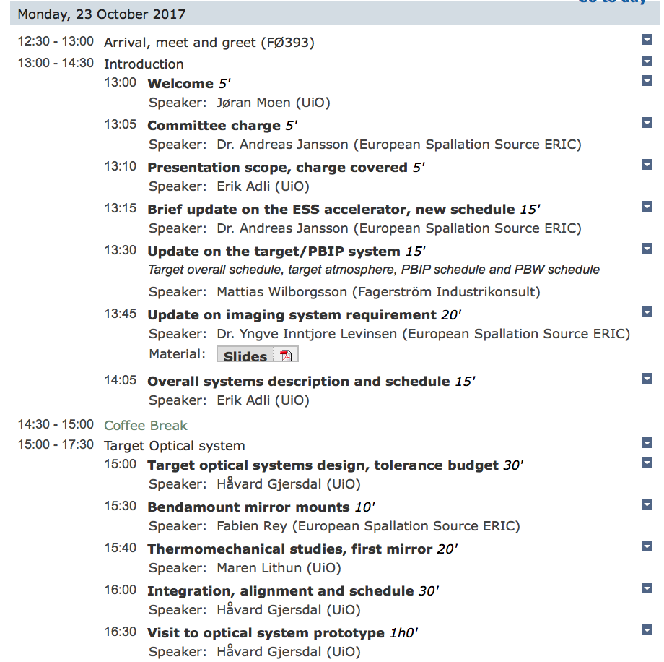
System wide requirements,
System overview
Target optical system

Slide 3
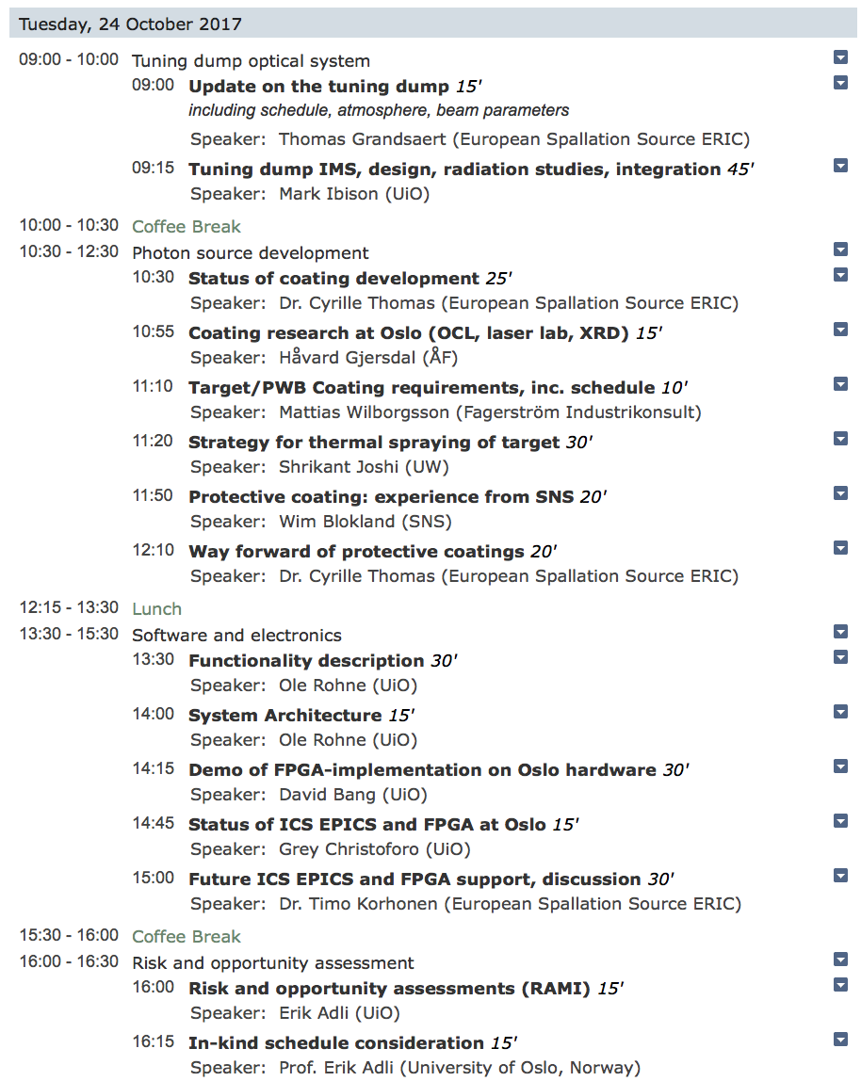
Tuning dump optical system
Photon source,
coating development
Electronics
Risk, schedule

Slide 4
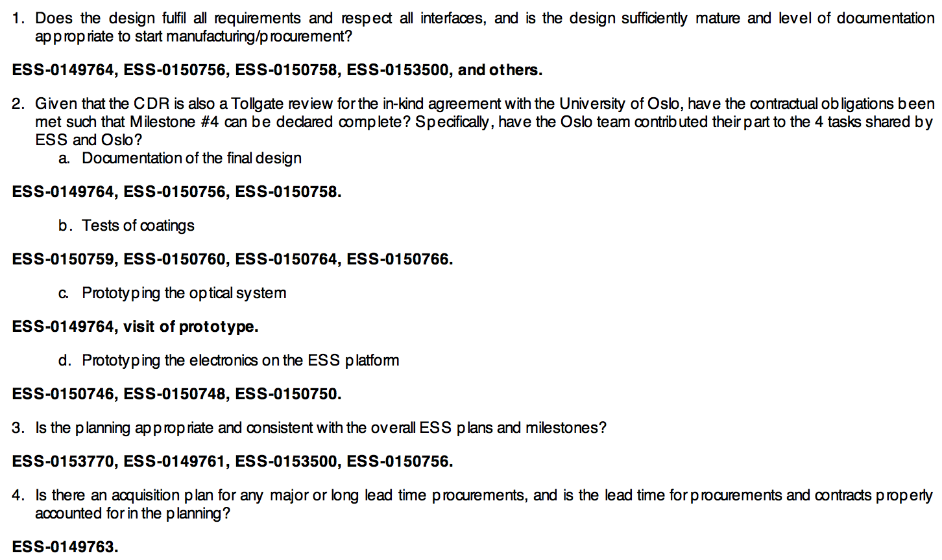
Guide to CDR documents covering the CDR charge

Slide 5
