Slide 1
ESS Project Update
Andreas Jansson
Group Leader,
Beam Physics, Operation and Beam Diagnsotics
www.europeanspallationsource.se
23 October, 2017

Slide 2
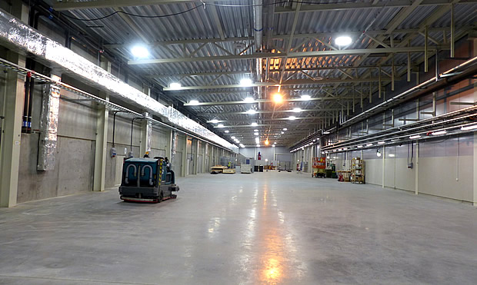
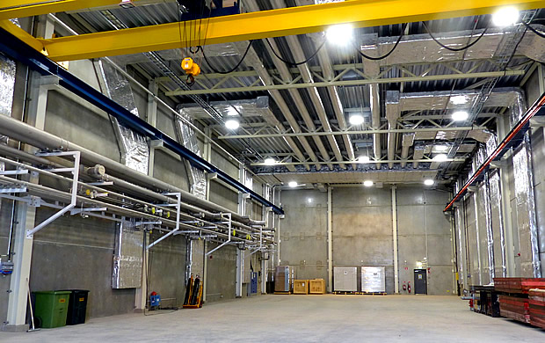
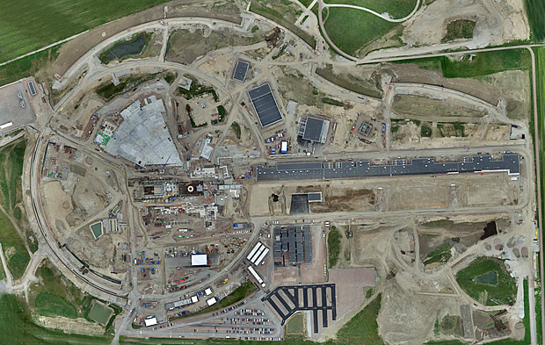
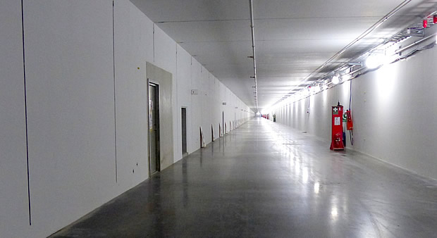
ESS Progress - Buildings
Notes:
Current status image – just before summer
Tklystron gallery building, tunnel and klystron gallery ready to start installation
Cryo buildind, shown empty (see next slide for content)
Target puck and target building
Base slab for experimental hall

Slide 3
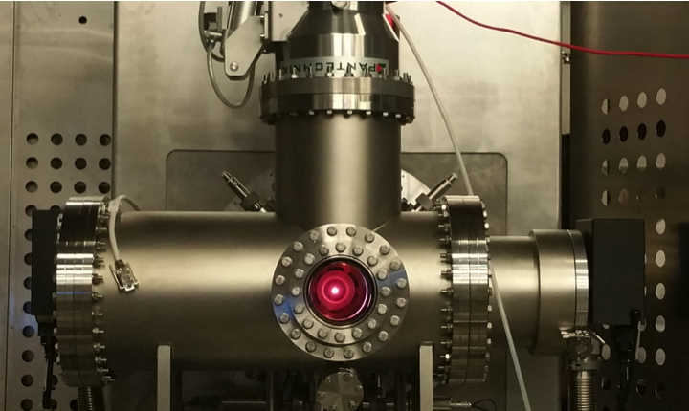
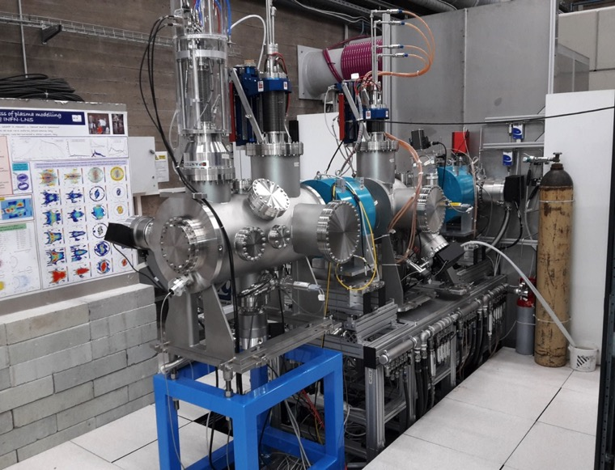
Ion Source & LEBT
Notes:
Disassembly and packing will start in October
Installation Readiness Review held at ESS on September 15

Slide 4
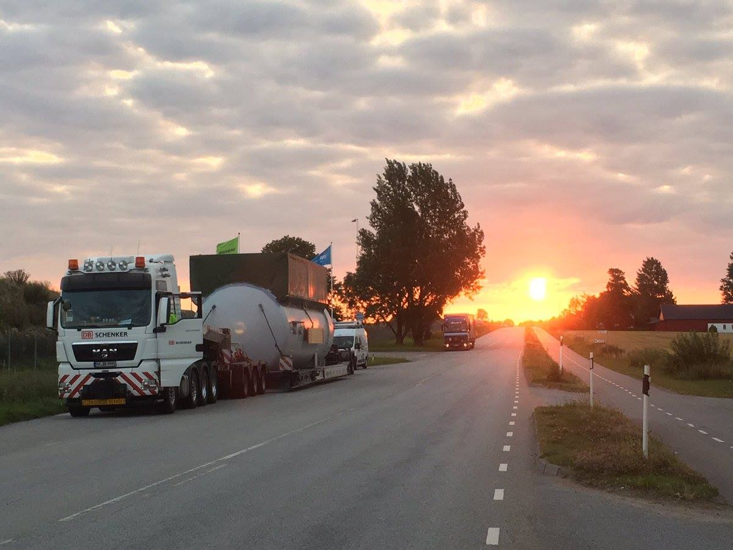
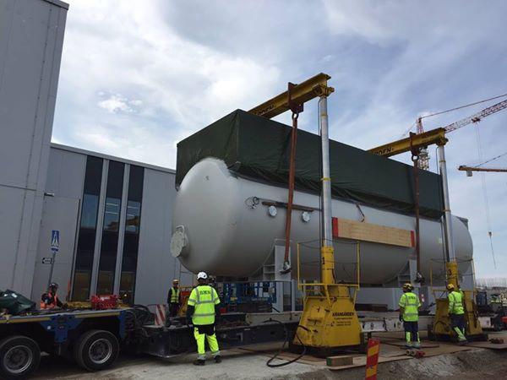
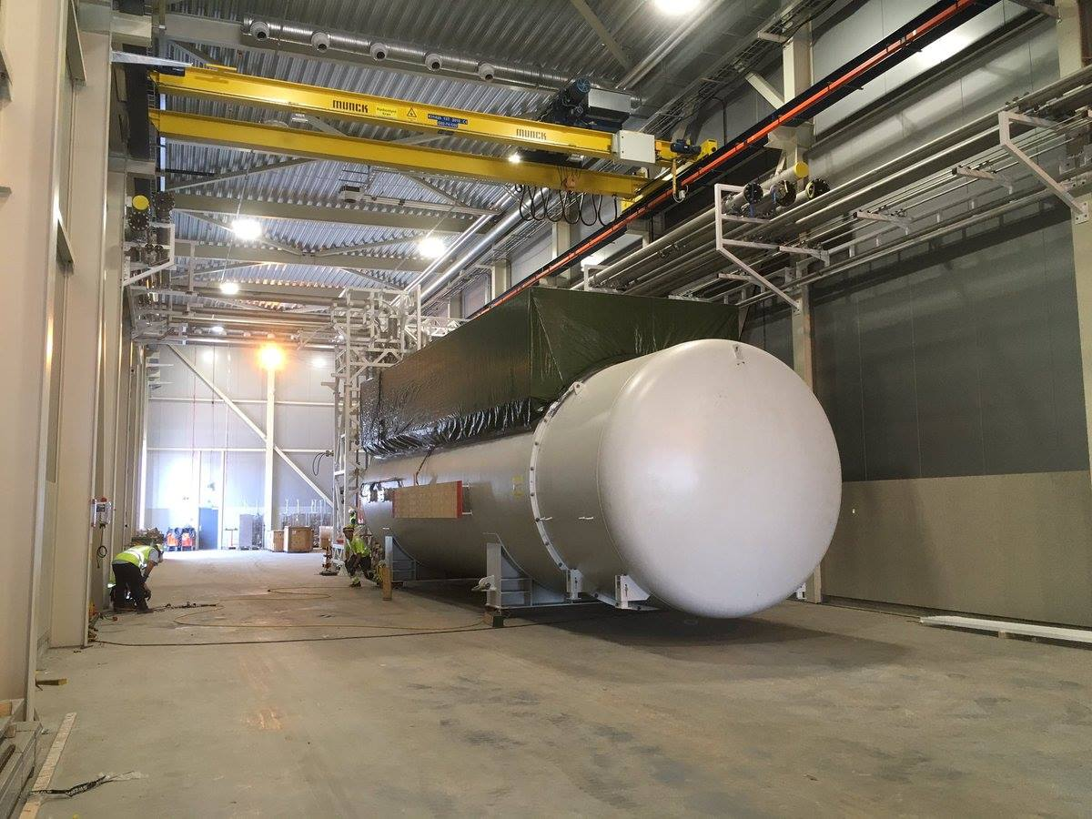
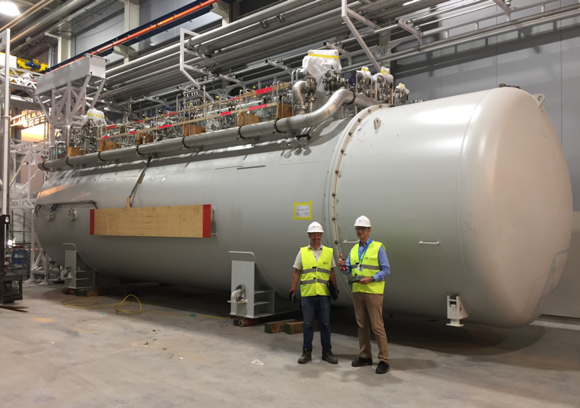
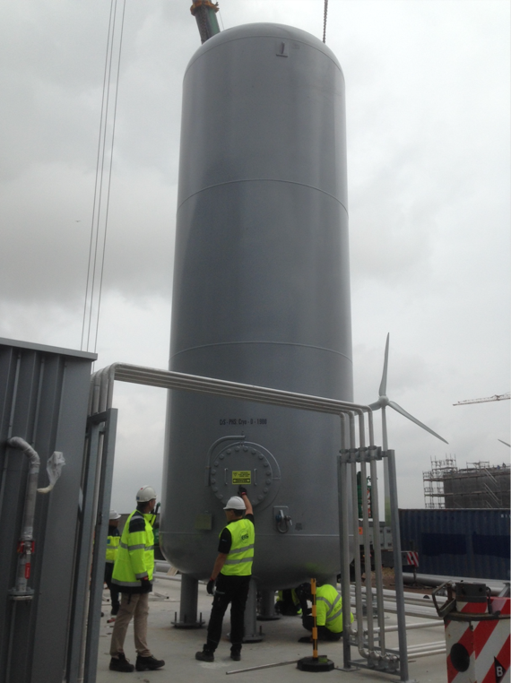
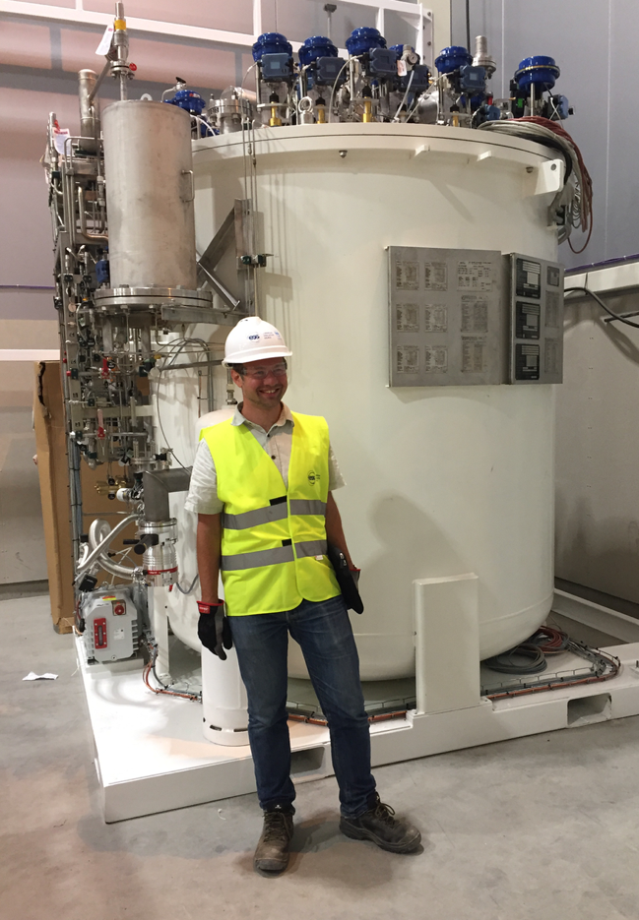
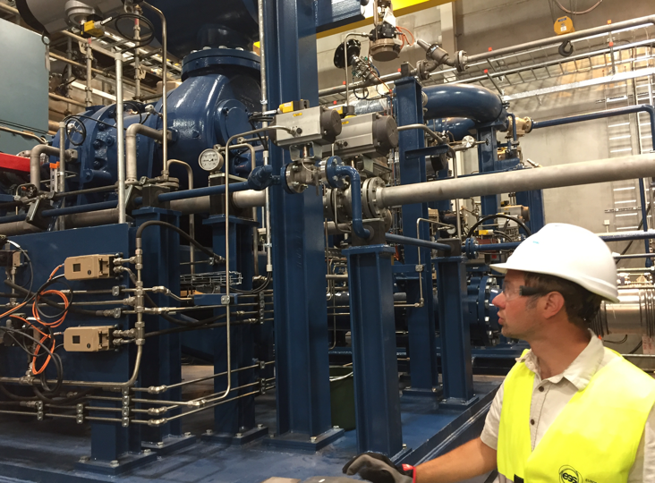
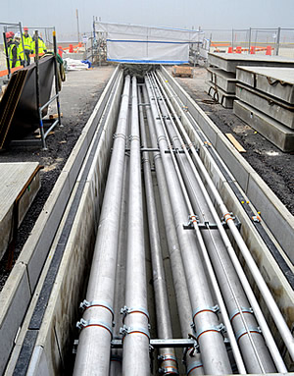
Installation of Cryogenic Plant Components

Slide 5
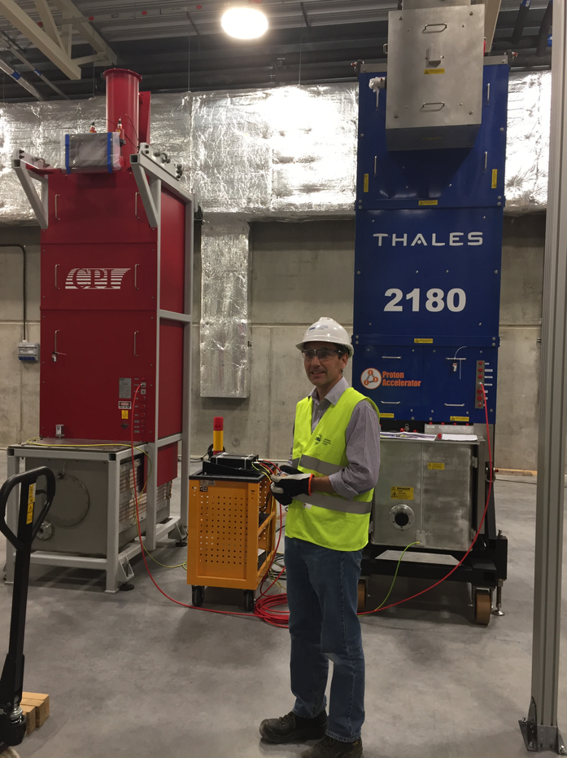
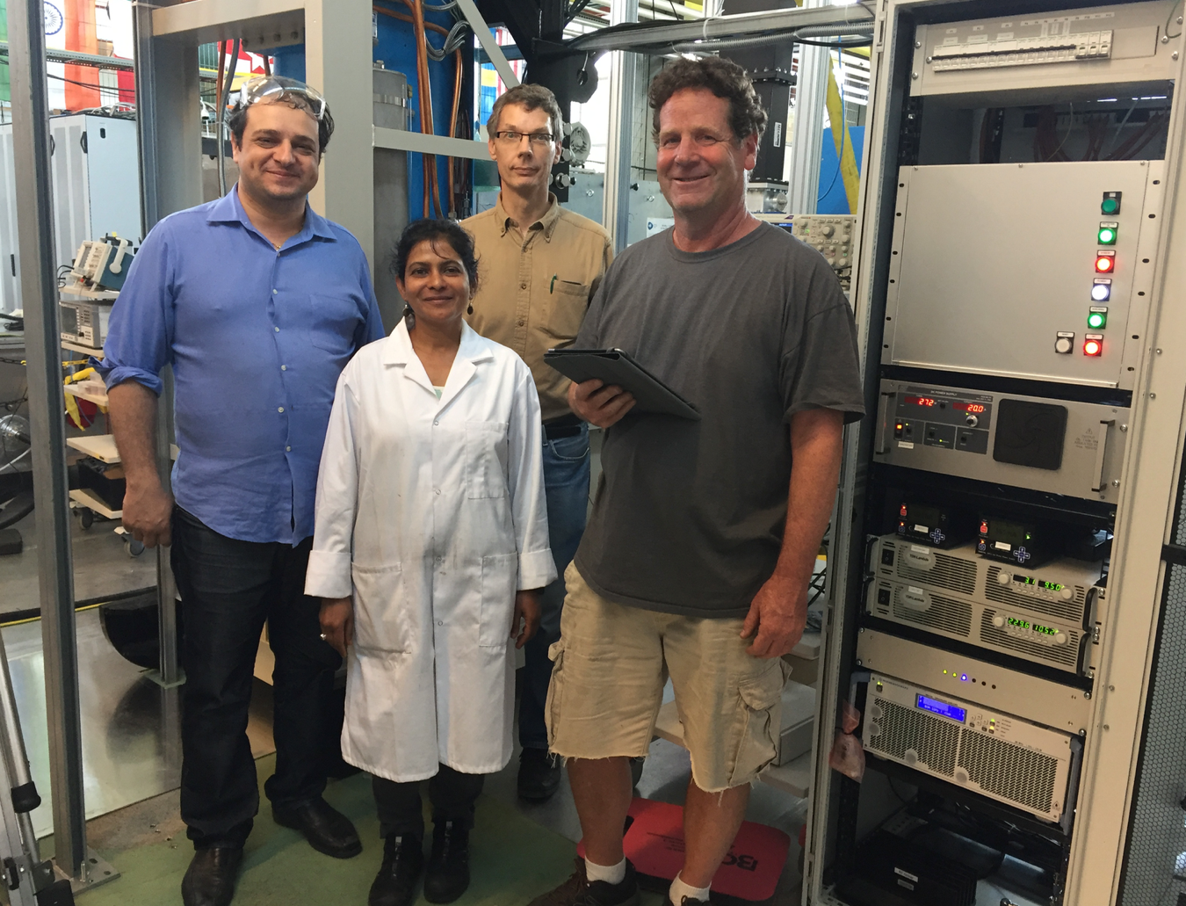
Test stand 1 and 2

Slide 6
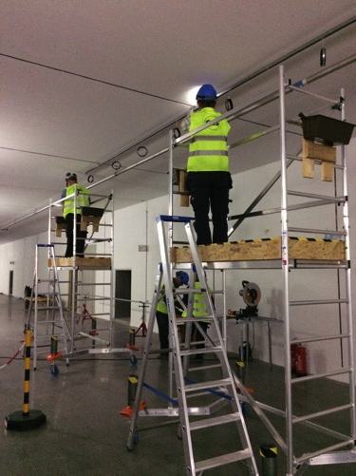
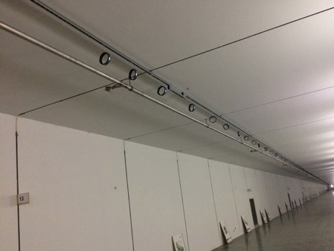
WP8 Radio Frequency Systems

Slide 7
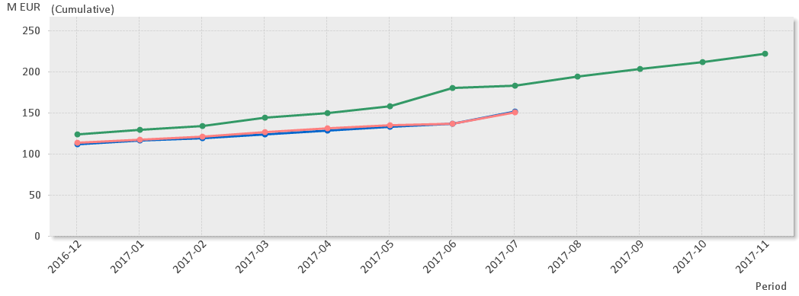
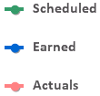

EV Graph
(* No InKind included)
Notes:
Current Status
Cost Variance is by end of July +710 k€.
Main contributors to the CV are: Beam Physics and Operation, Electrical Support and Cooling Support.
Schedule variance is by end of July -31 M€ (improved by 12 M€ from previous month!).
Main contributors to the SV are: NCFE, Spoke Cavities & Cryomodules, Beam Diagnostics, RF Systems, Vacuum and Cryogenics.

Slide 8
The Big Picture

Slide 9
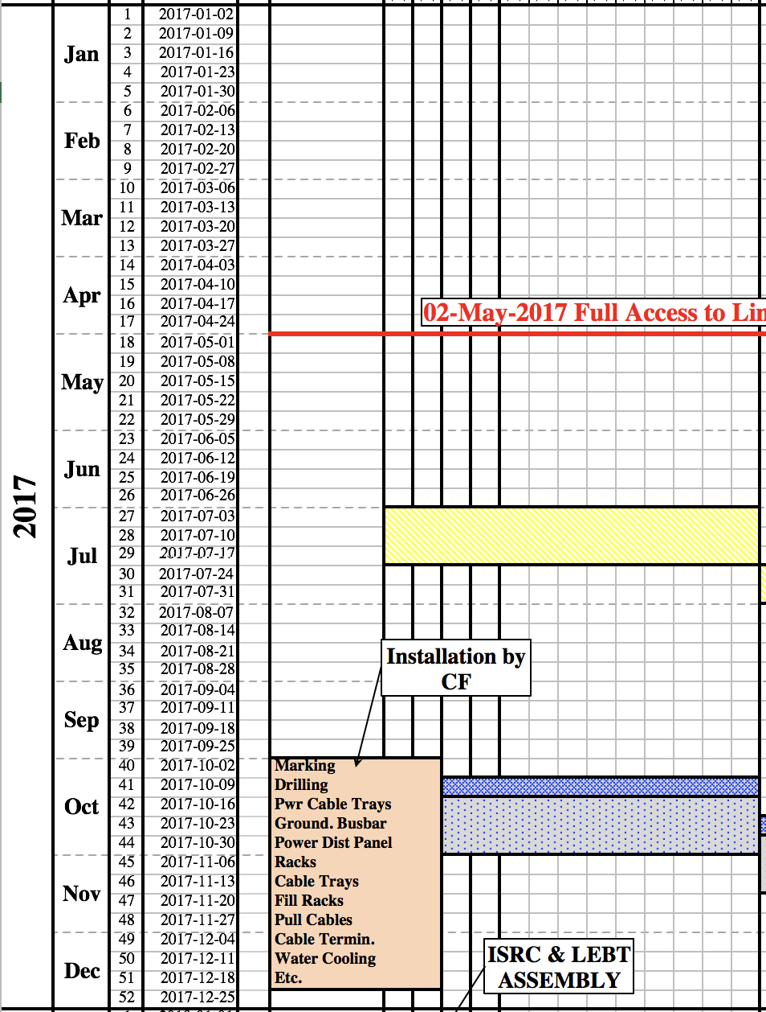
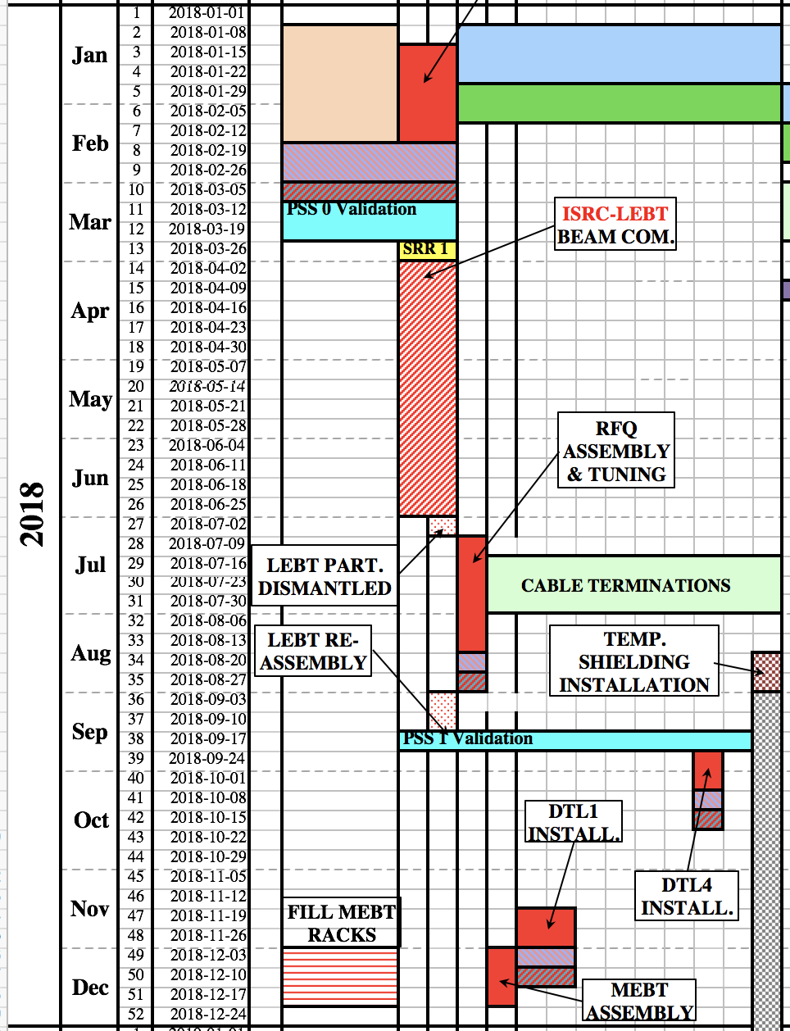
2017 - 2018
https://confluence.esss.lu.se/display/AI/AD+Installation+Plan

Slide 10
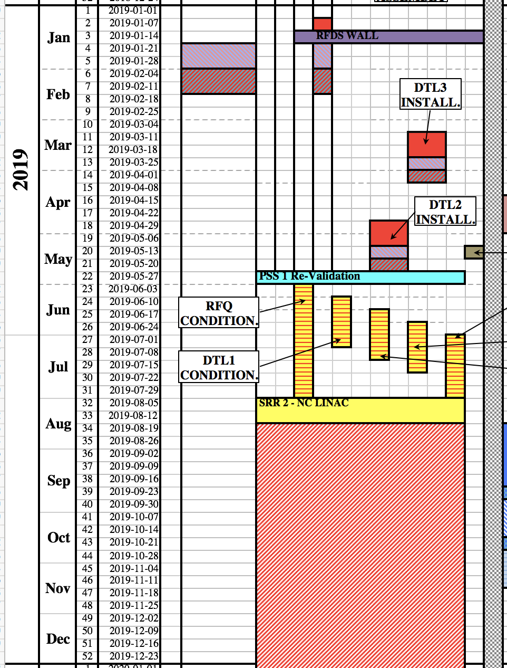
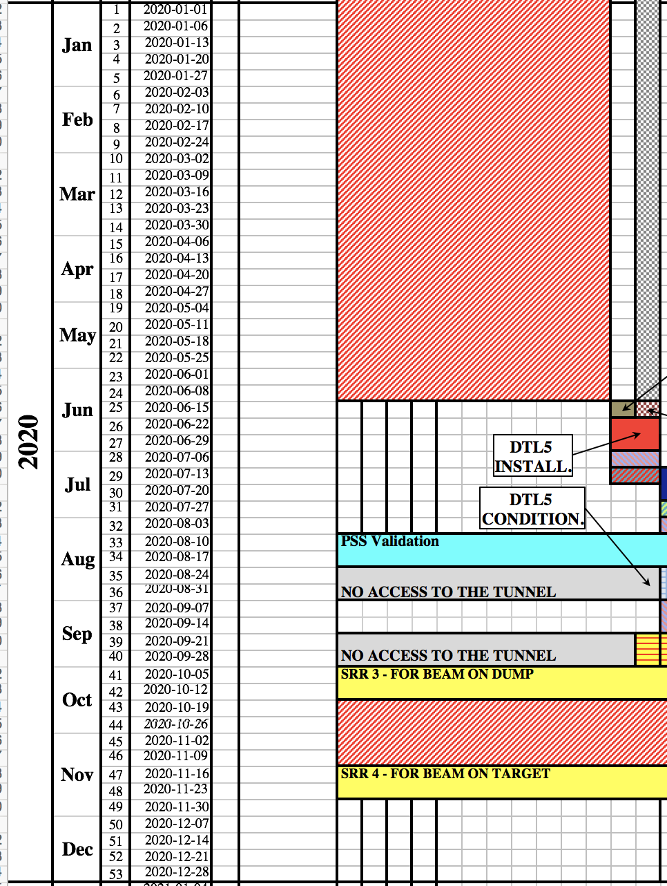
2019 - 2020
https://confluence.esss.lu.se/display/AI/AD+Installation+Plan

Slide 11
Cold Linac
Cryomodule installation can only start after the complete CDS has been commissioned:
  As of today, the earliest installation date of the first cryomodule is end of the 2019.
  LWUs will be installed after the cryomodule installation.

Slide 12
HEBT, DogLeg and Dump Line
Vacuum and LWUs installation can take place as soon as magnets become available.
Tuning Beam Dump:
  Shielding to be delivered March 2018
  Beam Dump System: November 2018

Slide 13
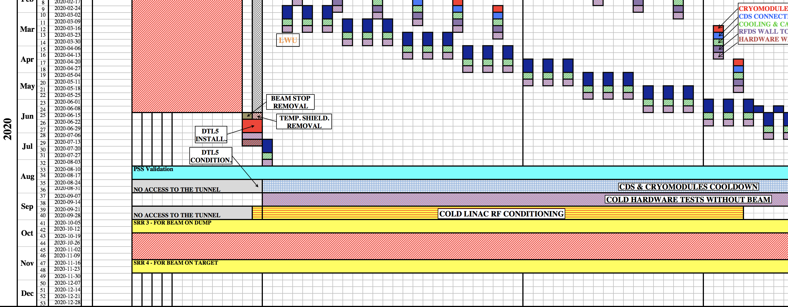
Cold Linac Comissioning
Imaging systems should see beam for the first time in 3 years from now.

