Slide 1

TARGET IMAGING CDR
BENDAMOUNT
MIRROR ADJUSTABLE MOUNT
Fabien Rey
2017 10 24

Slide 2
Content
Function & Requirements
Design and Manufacturing
Tests and Qualifications
Integration

Slide 3
FUNCTION and REQUIREMENTS
Function
Optical Transport for Target Inner Monolith Systems
Initial Requirements
6 dof mirror mount
External size : 100*100*100 max.
Minimizing coupling/crosstalk
Maximal rigidity
Clamping capabilities
Range : Tx=Ty=Tz= ± 5mm
σx=σy=σz= ± 5 deg (a lot !!!)
Rough pre alignment possibility
Size/weight of mirror : 100*100*10 + holder
400 g
Minimize effect from environment ( Temperature, radiation)
Minimize effect of change in gravity orientation
Simple and elegant
Conceptual design developed by BENJAMIN DAVIDGE (ESS EIS division)

Slide 4
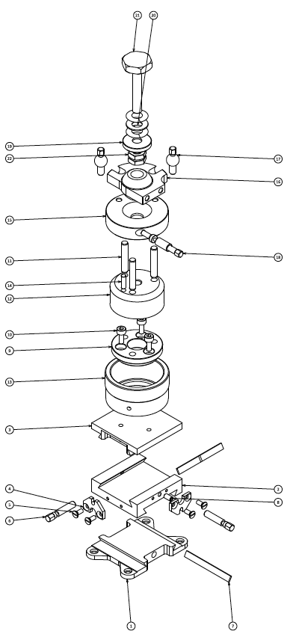
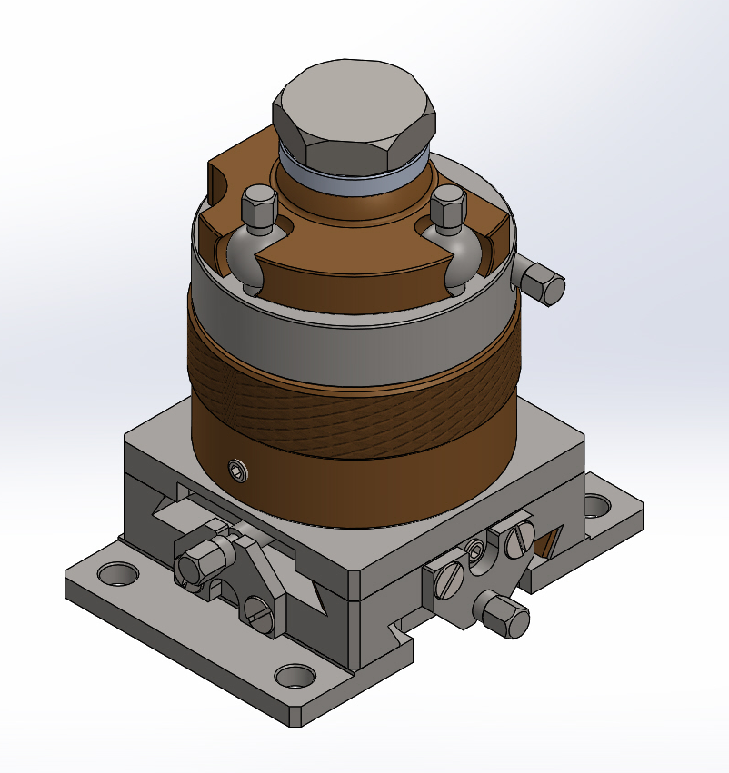
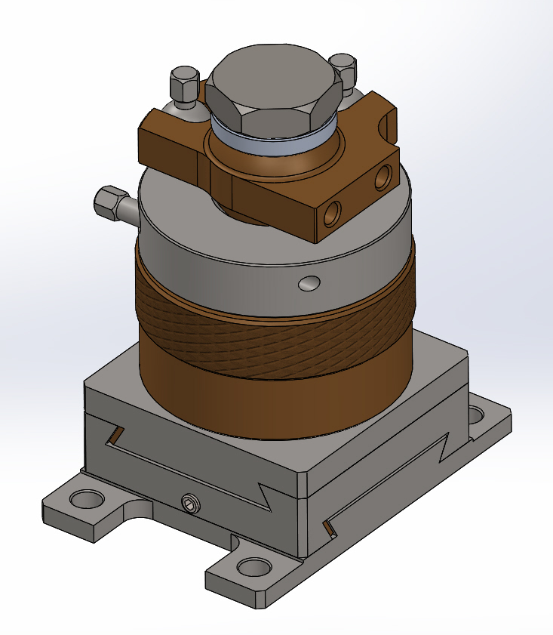
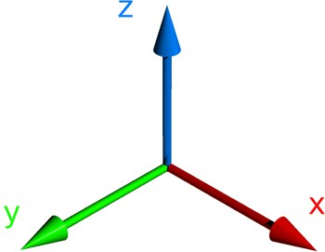
DESIGN and MANUFACTURING
Clamping
Initial Design 6DOF
Ry
Holder fixation
Rx
Rz
Tz
Tx
Tz
Ty
Rz
Rx
Ty
Ry
Tx
Credits: Benjamin Davidge
4

Slide 5
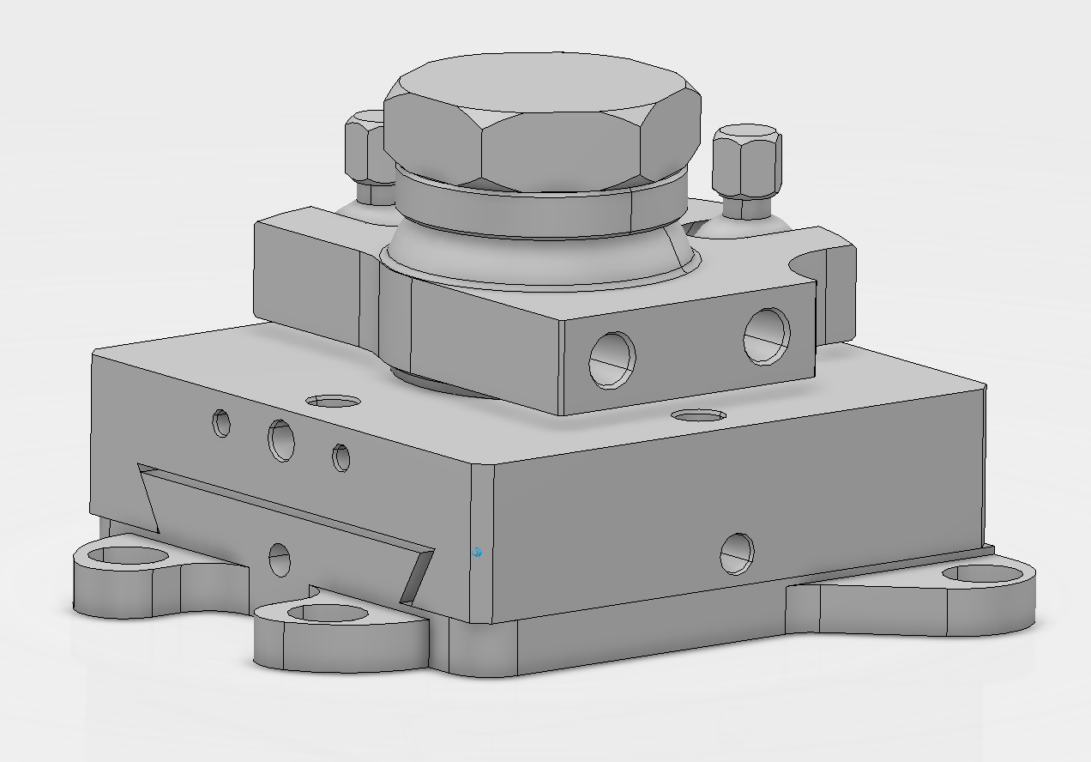
DESIGN and MANUFACTURING
Initial Design 6DOF
Only Design 3 DOF ( 1T, 2 R) needed
Decision on first fixed mirror
Prototype 4 DOF
(1T,3T)

Slide 6
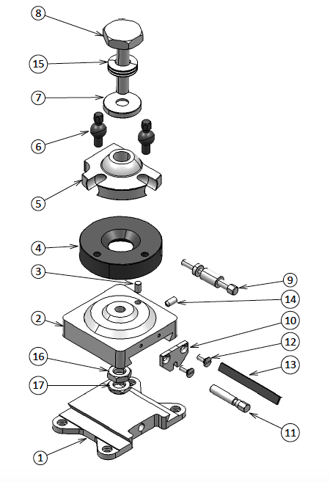
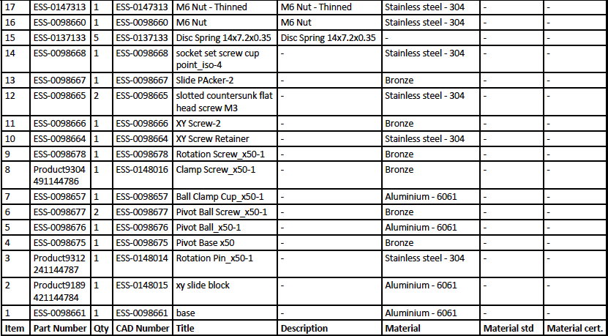
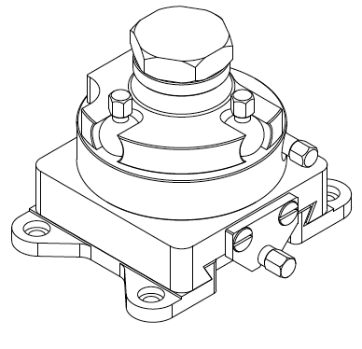
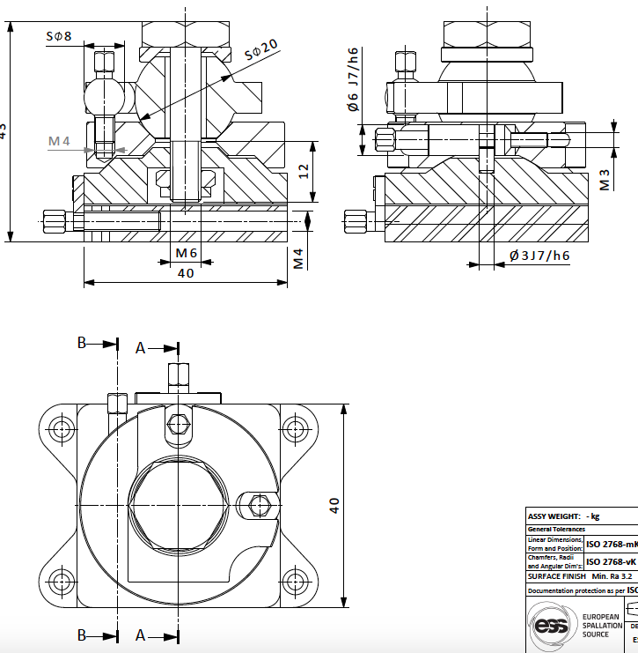
DESIGN and MANUFACTURING
Prototype 4 DOF
(1T,3T)

Slide 7
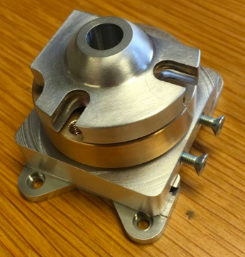
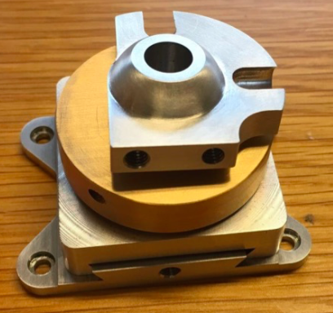
DESIGN and MANUFACTURING

Slide 8
TESTS and QUALIFICATIONS
Mounting / Dismounting / Fitting / Accessibility
Mirror Holder Fiducialization and Dummy Mirror
Laser Tracker / Autocollimation
Range
Stability / Vibration
Repeatability
Clamping
Design Changes?

Slide 9
INTEGRATION
3D Integration inside Slide
Volume clash
Accessibility
Implementation of Alignment features
2x M4 ( depth 10mm)

Slide 10
CONCLUSION
Simple and Robust Design that still needs to be qualified
Series Manufacturing
Full Assembly and Alignment Process
(mock-up and reality)

Slide 11
Thank you

