Slide 1
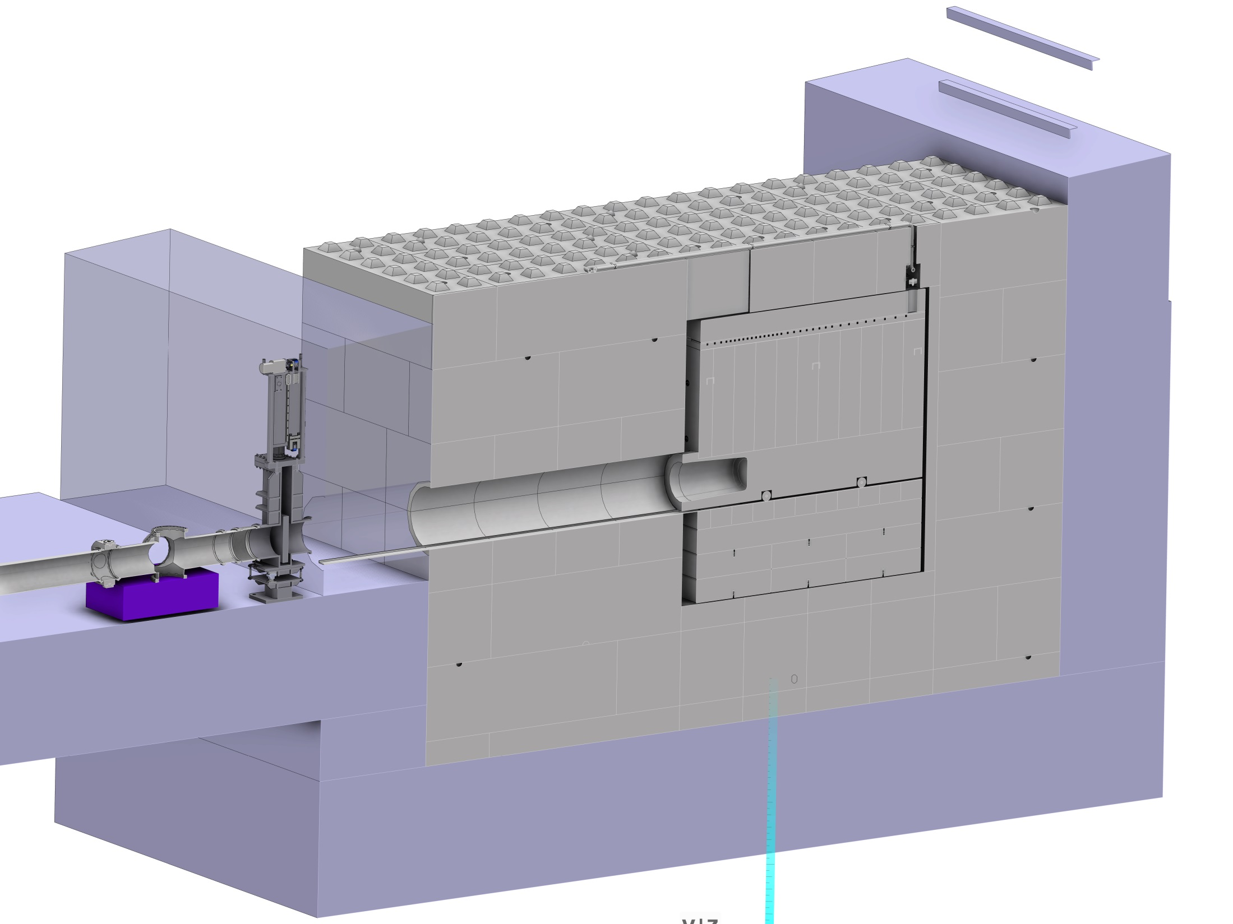
Distance from IMG system to surface: 5448,836mm
Dump aperture: 160mm radius

Slide 2
