Slide 1




ESS Imaging Systems CDR Meeting
Tuning Dump Imaging:
System Design & Radiation Assessment
including Interfaces
Dr Mark Ibison
University of Liverpool
Attached to the University of Oslo team
Notes:
I will describe the work carried out so far to develop a design for the Tuning Dump Imaging System.
The talk includes a description of the radiation dose assessment studies using Monte-Carlo modelling, and a brief overview of the main interfaces to the system.

Slide 2
Outline of Presentation
Background and Objectives
Design Stages and Concept
System Components
Optics and Performance
Maintenance Issues
Radiation Modelling: in-Beam and Decay
Interface Definitions
Conclusions
Notes:
My talk will cover the background and will follow on from the introduction to the Tuning Dump as given by Thomas (Thank you!)
An outline of the stages through which the design has developed will be described.
The principal components of the system as they are currently envisaged will be detailed.
An indication of the performance will be given, and some of the issues associated with maintenance in service.
Some detail will be presented of the process of Monte-Carlo modelling for radiation dose calculation, with a summary of results.
In conclusion, I will list the next steps to move the design forwards into the implementation phase.

Slide 3
Objectives – Tuning Dump Imaging
Objectives
  Complete all actions arising from Imaging Systems PDR (Sept 2016)
  Assess radiation levels at Imaging Position in Dump Tunnel
    Build FLUKA model of Beam-Line to obtain dose-rates
    Select camera for acceptable lifetime
    Modify shielding location & design, if necessary
  Complete optical design for mirror and camera system
  Confirm that system meets performance requirements
  Document design for CDR
Notes:
The design objectives reflect those defined at the PDR last year, which have been the drivers in preparing for the CDR.
These points have now all been addressed.

Slide 4
Development of Design
Principal Stages
Refine Imaging Vessel configuration
Complete Monte-Carlo investigations
Consult camera radiosensitivity references
Finalise camera locations for radiation dose
Address maintenance & access issues
Define interfaces/power/data
Confirm optical system performance
Notes:
The main stages in developing the design fell into a logical sequence, with some obvious dependencies between stages.
For example, as the vessel configuration became more complex, the Monte-Carlo model had to be revised and its output in turn influenced the camera doses, and therefore the choice of location for the cameras.
For such a relatively simple system, however, the optical performance was not heavily dependent on earlier design choices and changes were mainly limited to straightforward mirror rearrangements.

Slide 5
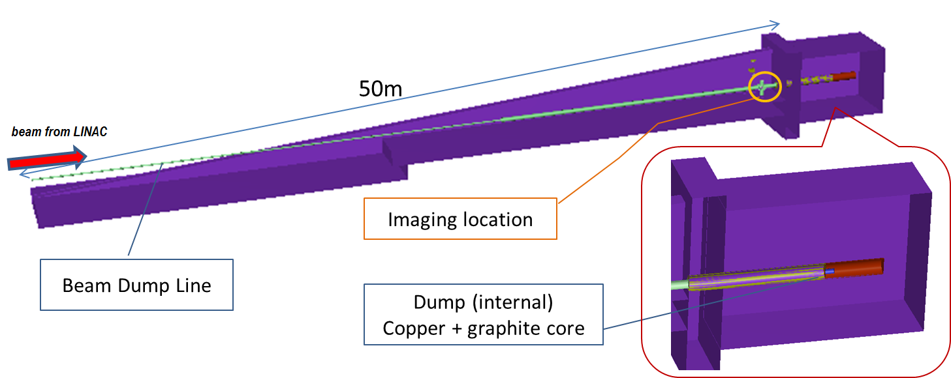
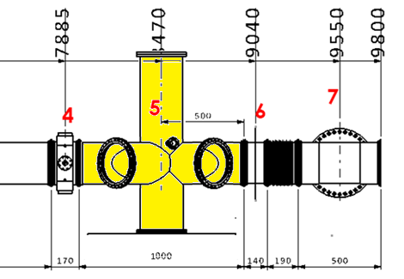
Location in Dump Beam-Line
Adjacent Systems
  BPMs (4)
  aperture monitor (6)
  gamma-blocker (7)
Notes:
As already described in the earlier presentation, the dump tunnel is an extension of the main beam-line, beyond the LINAC and the point where dipole magnets divert the beam onto the target (see slide).
The beam imaging station is near the end of the dump line, before the beam enters the dump shielding, which is 3-4 m of thick concrete. The heart of the dump itself is a copper cylinder about 170 cm long, with a graphite central core. The dump must survive exposure to the beam without active cooling, for the lifetime of the facility, at least 40 years.
The imaging vessel (in yellow) fits between other diagnostics, the BPMs and an aperture monitor.

Slide 6
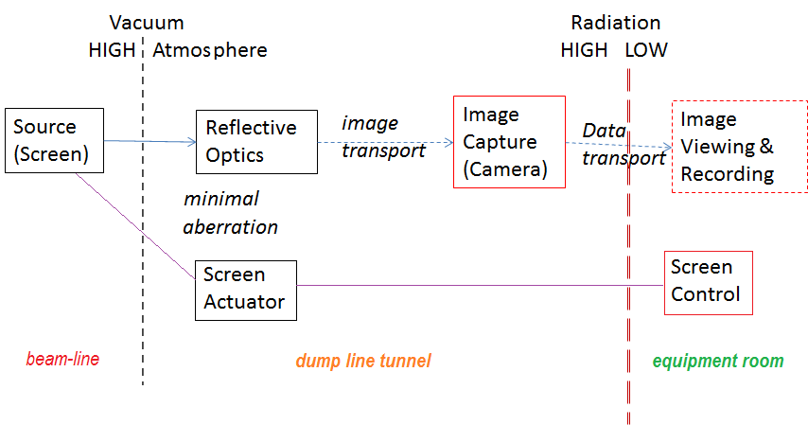
System Environment and Data Flows
decision to locate the cameras in tunnel, close to the beam-line
Image transport simplified, max optical path length < 8m. BUT
lifetime for standard digital cameras limited in high radiation environment
  → maintenance access for regular camera changes
Notes:
The decision to locate the imaging system close to the source has led to a simple optical design, but with implications for the survival of the cameras in particular, given the radiation environment close to the dump itself.

Slide 7
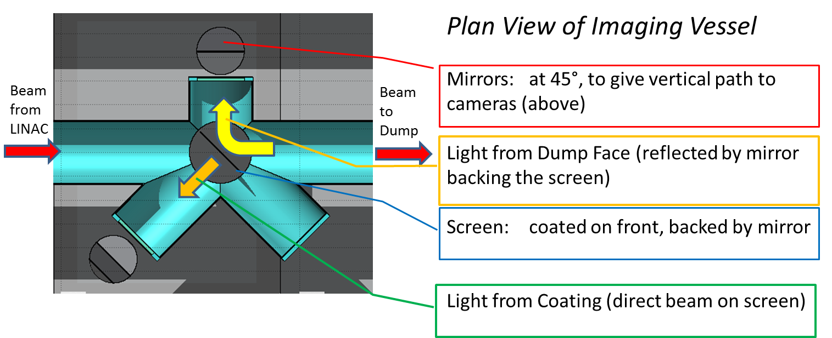
Imaging Concept
Dump/Window and Screen Viewing - at same time
Wish to image beam at screen and at dump entrance
Conventional 45° screen for beam profile – but view face-on
  Avoid Depth-of-Field issues with large image
Make use of 45° screen as a ‘rear-view’ mirror for the dump
Notes:
Given the constraints of the Dump tunnel and the location of the imaging vessel close to the end of the beam-line, a dual-function screen, acting as a scintillation light source and simultaneously as a mirror to give a downstream view, offered an effective solution.
A risk factor is in the need to produce a relatively complex screen which performs well optically as well as in radiation resistance.
The 45° angle for the screen viewport arises from the wide field of view; it has to be viewed face-on to avoid the defocussing at the edges which would occur if viewed obliquely.
This does not apply to its use as a viewing mirror for the dump itself, where the mirror side acts only to fold the light path and does not affect the depth of field.

Slide 8
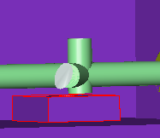
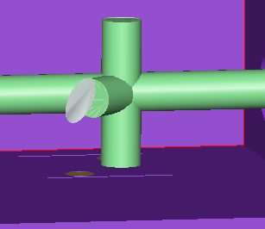
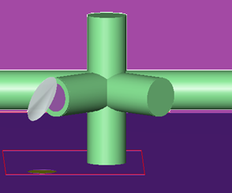
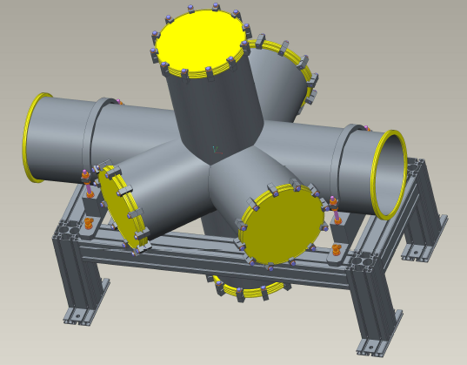
Imaging Vessel: Evolution of Design
A
Initial Concept
B
C
D
1
2
Current Design
  Ports
  2, 4 Viewports
  1, 3 Actuator Flanges
4
3
Notes:
The vessel design has changed to accommodate the need for alternative screen insertion, both horizontally and vertically, in the restricted space of the Dump line tunnel, as well as two separate viewports. The second 45 arm was added to take a single screen, giving a total of 3 screens, as only 2 may be vertically mounted due to the limited floor clearance.
The vessel must also take account of adjacent equipment such as other beam monitoring devices, e.g. there are BPMs, an aperture monitor, and a ‘gamma-blocker’ which can be closed to reduce dose from the activated dump after irradiation by the beam.

Slide 9
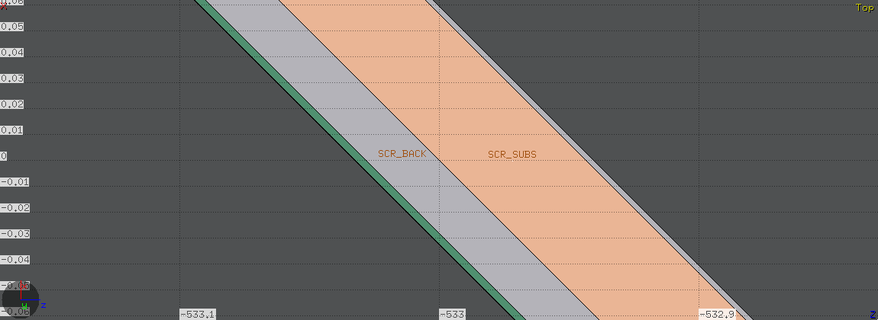
Screen Composition
Desirable Attributes
Clear diameter > 200 mm, (option up to 230 mm)
Resistance to radiation damage from 2 GeV protons
Good mechanical strength for mounting and movement
Vibration-damped against possible beam-pulse induced resonances
Good thermal conductivity, avoid local overheating by beam spot
High MP, to resist beam burning and thermal-spray coating process
Optical flatness across full aperture
Available in thin sheets of thickness 0.5 – 1.0 mm
Good adhesion for scintillating coating on front side
Able to accept polishing, or to receive mirror coating on rear side
front beam-facing coating 30 μm
aluminium backing plate 200 μm
silicon wafer substrate 400 μm
mirror coating on the rear 20 μm
beam
Total Thickness 650μm
Notes:
The layered screen is intended to provide a good compromise of thermal, optical, mechanical and radiation-hard properties.
It must be kept thin to reduce proton scatter and therefore dose to surroundings, also to minimise beam heating
It must remain optically flat (especially the mirror surface) even when heated
It must accept the scintillant coating
It must resist radiation damage from the beam
It should contain light elements only, to avoid long-lived activation products
The screen composition has been run through FLUKA to assess dose from scatter. Some checks have also been made of beam heating; however, the mechanical and thermal properties will require further investigation before fabrication.

Slide 10
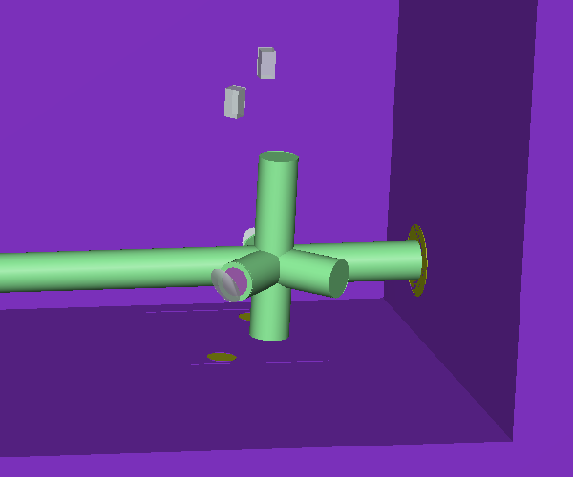

Screen Actuators
Screen-in-beam selection permutations
  Vertical = 2 screens
  Horizontal = 1 screen
vertical screens
Orientation | Max Travel required
Vertical | 600 mm
Horizontal | 300 mm
beam
Horizontal screen
Notes:
Up to 3 screens can be accommodated at one time. Because of space limitations, a dual changer system has been devised.
Either of the 2 vertical screens, or the horizontal screen, or none, can be moved into the beam.
The horizontal actuator must be at 45°, in a side arm, because of the plane of the screen.
The actuators will be standard ‘long-travel’ components whose capabilities have been checked with the potential supplier. Either stepper or DC motors may be used, with linear encoders for positioning.

Slide 11
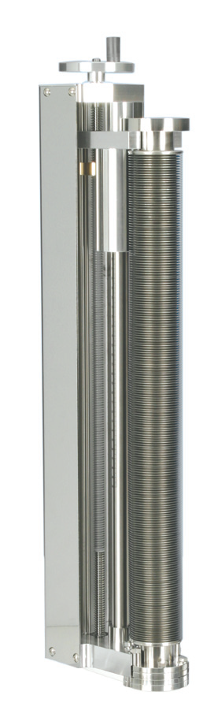
Screen Actuators
Further Details
Supplier UHV Design (UK)
Lead Times <= 14 weeks (bellows)
Expected Lifetime >= 10,000 cycles (supplier)
Motors Stepper/DC
Radiation Issues Controllers/Encoders only
  Lubrication Special grease advised
Notes:
Discussions have already been held with the potential supplier, and satisfactory answers given. STFC Design team will perform the necessary integration with the screen assemblies and the imaging vessel.

Slide 12
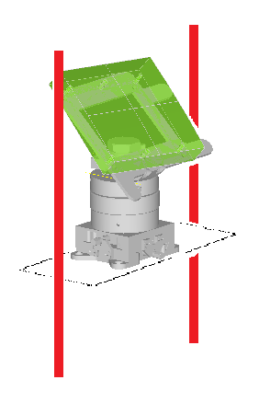
Other Components
Ports, Mirrors and Mounts
Viewports
Mirror on Mount
‘BendaMount’ versatile mirror mounting
Mirror platform with vertical motion
viewports on two vessel flanges
DN-200 size available as standard
fused silica avoids radiation darkening
frames with pairs of vertical posts built on tunnel floor
braced at top and mid-height by wall brackets
frame mountings for the 1st and 2nd mirrors, adjust for alignment
mirror on ‘BendaMount’ (ESS) secured to platform for vertical motion
First mirrors move clear for access to the viewports
Notes:
Viewports are listed up to 200mm diameter, in fused silica for radiation hardness. This ensures no loss of light when 200mm screens are used.
After leaving the viewports, light is directed by plane mirrors. Each of these is held in a ‘Bendamount’ as already described earlier (by Fabien).
These in turn are attached to platforms which are themselves supported on vertical frames, shared by the 1st and 2nd mirrors. This allows for up and down adjustment during mirror alignment, and gives clear access to the viewports in case of maintenance.

Slide 13
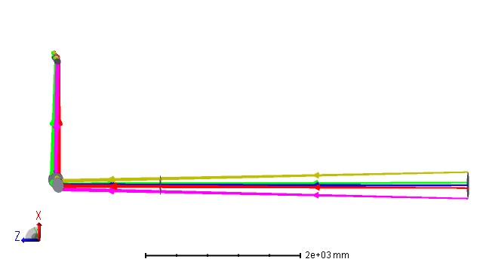
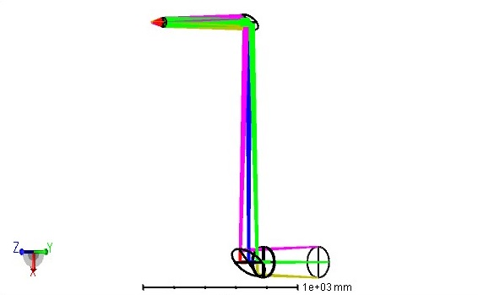
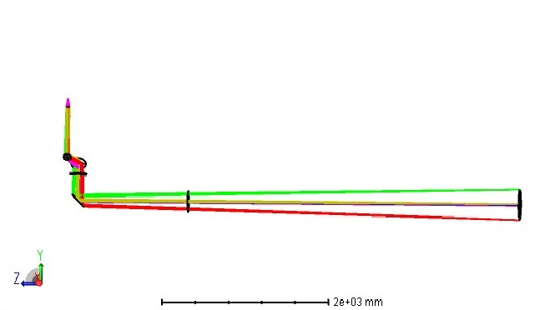
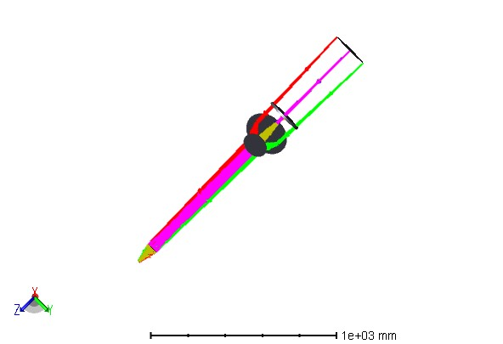
Optical System Models
Ray diagrams
Dump/window system Screen system
Ray Diagrams
camera
camera
Plan views
Notes:
The Dump/window viewing system and the Screen viewing system are optically entirely separate.
The two optical systems resemble each other closely, although the working distances to the objects are different. Each has a pair of plane folding mirrors to take the light path up to about 150cm above the beam centre-line and into the cameras. The only elements with optical power are the camera lenses themselves.
Mirror apertures are determined by the need to maximise light for imaging, and for the screen system, the 1st mirror must be almost the same diameter as the screen (and the viewport).

Slide 14
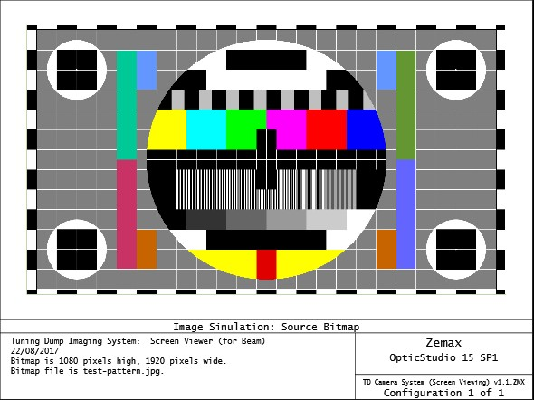
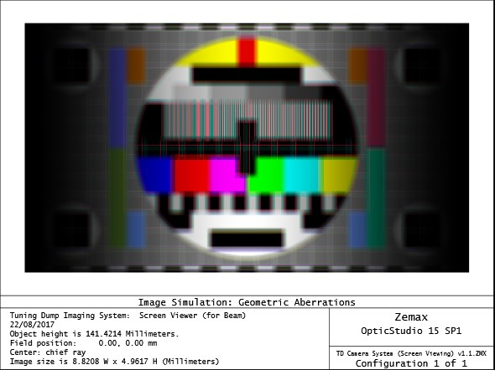
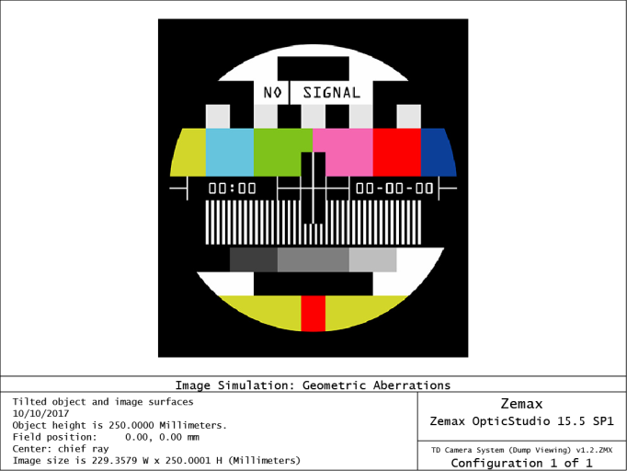
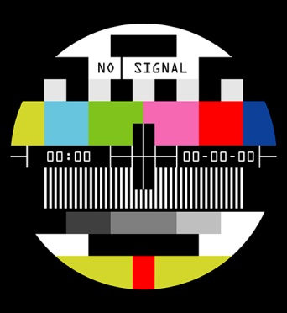
Performance of Optics
Simulated Images
Source Bitmap Image Simulation
Screen Viewing
Dump/Window Viewing
Notes:
In the simulated images, the only significant aberration is spherical.
This can be largely removed by appropriate choice of lens assembly to suit the cameras.
In the images shown for the Dump/window viewing system (only) the effect of the lens has been ignored.

Slide 15
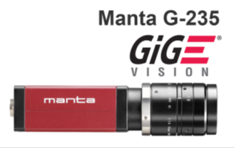
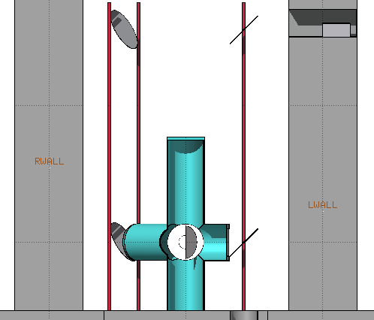
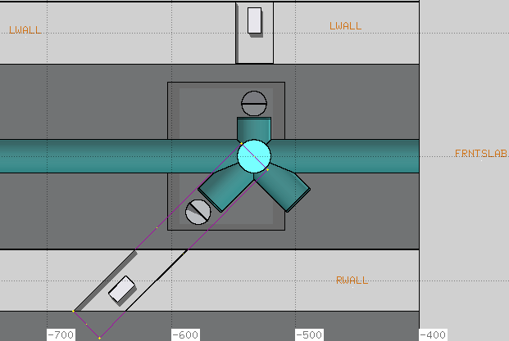
Cameras and Housings
Selection
Preferred
standard machine-vision CMOS cameras
Support for GiG-E data interface adopted on ESS
availability, choice of vendor, support, relatively cheap
good image quality and off-the-shelf lens options
Alternatives – Radiation-hard types
Make | Lifetime Dose | Imaging Dose-Rate | Sensor
Thermo Scientific | 3 x 10⁴ Gy | 1 x 10³ Gy/hr | CID
Mirion | 2 x 10⁶ Gy | 3 x 10⁴ Gy/hr | Vidicon tube
Location
155 cm high above beam
‘niches’ cut in tunnel walls
Screen imaging mirrors supports
Dump imaging mirrors supports
cameras
Plan View
Elevation
cameras
Notes:
The decision to use standard CMOS cameras opens up a choice of suppliers of which the Allied Vision Manta is just one model.
However, other types specifically having intrinsic radiation hardness have been researched, and these have lifetime doses far exceeding the required range.
The final selection of location is elevated above beam level at about 2m from the tunnel floor. The housings are cut out from the tunnel walls, sized to allow room for cabling, mounting plates and access for adjustment and lens changes.
Although full-depth cut-outs are specified, there is no significant shielding implication given their elevation above the beam-line.

Slide 16
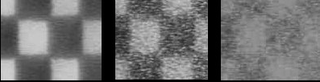
Maintenance Considerations
Cameras
Require changing due to accumulation of radiation damage to CCD pixels
Planned lifetime ~ 1 year or more
Easy access from tunnel
Degradation with radiation: 0, 25 & 73Gy †
Screens
Fall-off in image intensity indicates change needed
Probably more efficient to replace 3 screens at once
Access time limited due to the radiation/screen activation
0 Gy 25 Gy 73 Gy
†RADIATION TESTS ON SOLID STATE CAMERAS FOR INSTRUMENTATION (CERN, Proc DIPAC 2005)
Actuators
Fairly robust, but bellows subject to fatigue
Lifetime estimated >10,000 operations‡
Special grease recommended for radiation
Encoder electronics are the most sensitive component
[‡supplier figure]
Notes:
For the cameras, previous referenced studies clearly show that a gradual degradation of image quality is to be expected with cumulative dose, whether from high-energy gamma rays or from particles such as neutrons or protons.
At 25 Grays there is significant pixel damage causing contrast loss, and the planned lifetime has been set at a level of about half of this dose.
For the screens, it is known that proton exposure causes a noticeable fall in light intensity

Slide 17
Monte-Carlo Modelling Process
FLUKA Data – Inputs & Outputs
Input Specification
1077 465.0870056 -0.043026902 -0.00552787 0.0258819 0.00519156 877.8430176 324.6799927
1077 465.0870056 -0.044309299 -0.00570002 0.023271799 0.00463426 888.0440063 322.4060059
BEAM, BEAMPOS,Particles
Geometry Editor
External Geometry Viewer*
Source particle input
SOURCE Routine
Bodies, Regions, Materials
link
FLUKA Executable
Modify to suit input and problem
Geometry Plots
CAD File Output
RuntimeOutput
Dose-rates to Regions
Particle tracks
Data plots
Notes:
The Monte-Carlo code FLUKA was selected for radiation dose assessment because it is well supported (at CERN), handles high-energy protons, and has a mature user interface for building the geometry of the model. This allows for export of the model for integration with other existing CAD models.
FLUKA has an advanced toolset for specifying and visualising the geometry of the problem, including the relationship between different shapes and the Regions of space, with appropriate Materials assigned to them.
For input of particles, FLUKA can use either (i) Built-in BEAM parameters or (ii) User-written SOURCE routine, with Input data-files.
Both methods are used in the Tuning Dump simulation:
Beam on Dump, during tuning of the Linac
Beam on Target, beam losses from Linac enter the Dump Tunnel
Ultimately, the output of a FLUKA run is an estimate of the Energy Deposited by Region, per Primary Particle. This is converted to Dose, and scaled up to the Beam parameters expected.
Other optional outputs allow secondary particle tracks to be visualised, through an external program (SimpleGeo). This also supports advanced viewing of the geometry, including the creation of CAD files for import by design software.

Slide 18
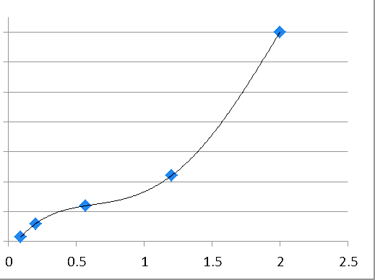
Parameters of the Model
Geometry and Beam
Parameter | Value | Notes
Maximum Beam Power | 12.5 kW | Slow Tuning Beam (1 Hz)
Peak Average Current | 6.3 μA
Beam Energy (maximum) | 2.0 GeV | Lower energy also used
Study Time (beam available to Dump) | 500 h
Fraction of Study Time (beam on Dump) | 0.5
beam radius 4.5 cm
to fit 10 cm diam beam-pipe
Dose vs. Proton Energy (GeV)
0 1 2
Notes:
Beam parameters have been taken from the document ‘Tuning Dump Utilization’ by Tom Shea, with recent amendments.
These represent average conditions and it has been assumed that the maximum beam energy will be available during Study periods.
The Dose was found to increase monotonically with Energy, indicating that applying E=2.0Gev is a pessimistic assumption.
The beam size was selected to suit the smaller 100mm beam-pipe at the start of the Dump line, without assuming any divergence or significant losses between the dipole and the dump itself.

Slide 19
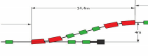
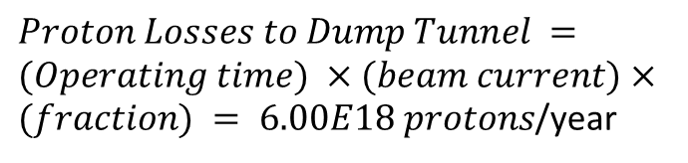
Dose from Beam Losses
Schematic of Dump and Target Line
Dog-leg
Dipoles
Quadrupoles
Tuning Dump
Beam losses
beam directed onto target by dipole magnets in 1st bend of ‘dog-leg’
particles lost here enter dump tunnel, adding to total dose to cameras
earlier modelling work provides input data = (position, direction, energy) per particle
build/link customised module SOURCE to read pre-processed particle data into FLUKA
$Proton Losses to Dump Tunnel =(Operating time) ×(beam current)×(fraction) = 6.00E18 protons$/year
Camera Dose from Particle Losses
<= 7.2 Gy per year
Notes:
When the beam is on Target, it is diverted by dipole magnets into the ‘dog-leg’ section; however, there are inevitable losses in this region. Fractional beam loss estimations have previously been published by ESS.
In the Dump tunnel region, they are dominated by losses at the first dipole of the ‘dog-leg’, where halo and off-momentum particles escape from the physical aperture of the beam-pipe.
Full positional (x,y,z), directional and energy data is available for these protons, which may then be transported by the FLUKA model down the Dump tunnel, where resulting doses at the cameras may be assessed.

Slide 20
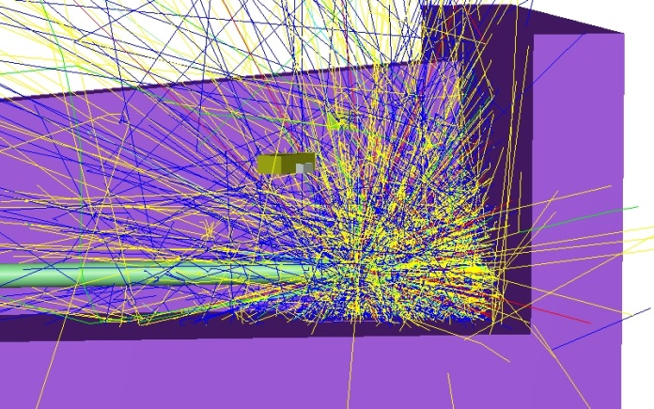
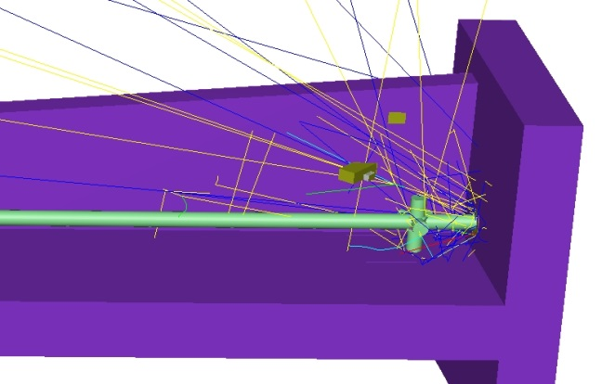
Dose from Beam on Dump
Origins of Radiation
In studies ‘on dump’, beam not deflected to target -> enters dump beam-line
  Passes through imaging vessel, stopped in dump
Radiation from particles back-scattered through dump entrance
  Primary protons and secondaries (e.g. neutrons and gamma-rays)
Scattering in scintillation screen contributes strongly to ambient dose
Methodology
Beam energy taken as 2.0 GeV throughout (pessimistic)
Raw FLUKA output gives ENERGY in GeV per particle per cm³ in each ‘region’
Absorbed Dose per particle (in Grays) derived specifically for ‘camera’ regions
Tuning Dump Utilization and Average Beam Current gives Dose per Year
FLUKA Particle tracks showing scattering by screen
Camera 3
Camera 4
Dose (Gy/yr) | IN | OUT
CAMERA 3 | 45 | 5
CAMERA 4 | 15 | 3
Imaging Screen
Screen IN
Screen OUT
Notes:
Contributions to the radiation field come from losses in the beam-line; from prompt and decay radiation emerging from the dump, both during and after irradiation; and from scatter caused by interceptive diagnostics such as the imaging screens.
The effect of screen insertion into the proton beam has been studied in FLUKA, and is shown qualitatively in the particle tracking plots (see slide); corresponding doses are listed in the Table.
All analysis of camera doses is on the basis that the screen will be in use whenever there is beam to the dump, which is a conservative assumption.

Slide 21
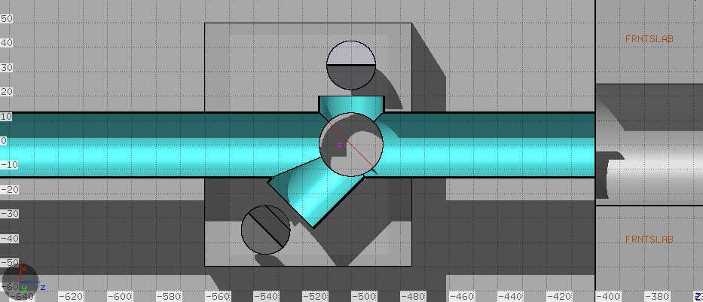
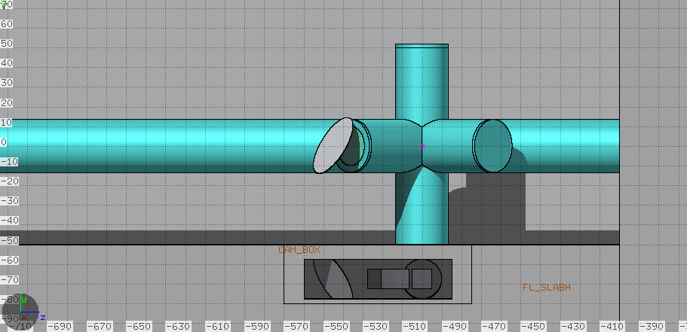
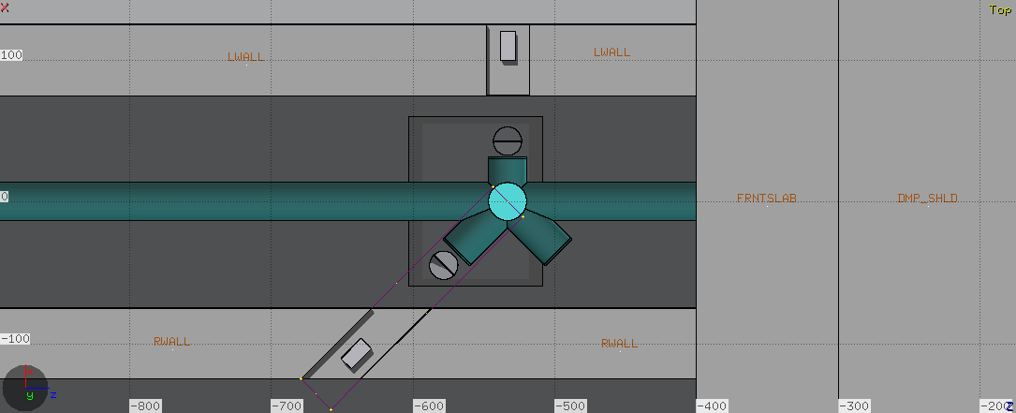
Camera Location Selection
Progressive refinement of camera locations
Location Camera: LH RH
On tunnel floor, shielded ‘bunker’ 740 940
Below floor, shielded by slab 350 74
At high level, above vessel 100 39
Moved into tunnel wall ‘niches’ 15 12
(Doses {typical) in Grays/year are for
LH (‘Dump’) and RH (‘Screen’) cameras
Notes:
The imaging concept required 2 cameras and initially these were to be sited close to the beam-line, but inside a concrete shielding bunker. A light path was provided through an aperture and 90° fold mirror.
Camera locations were investigated in FLUKA, simulating doses (derived from Energy Deposited in each Region of the geometry).
Doses per particle were scaled by the expected number of protons per year received at the dump.
High-level locations were examined when it became clear that there were limitations to the practicable shielding thickness, and access difficulties with the ‘bunker’ concept. Doses away from the beam axis fall fairly quickly, but for maintenance and installation, height also becomes a factor.

Slide 22
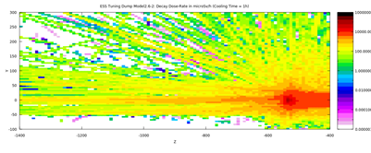
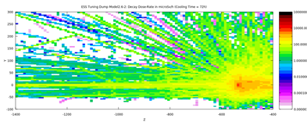
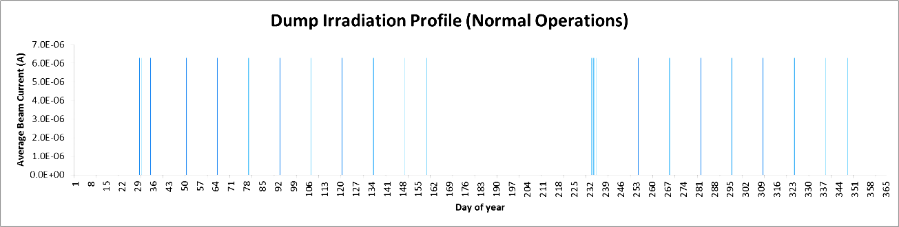
Doses from Decay
FLUKA - Monte-Carlo
Screen location
t=1h
t=72h
Irradiation Profile
Analytical Approach
1. Predict Proton Reactions + p⁺ fluence
Apply Bateman equations
Derive Nuclides + Activity
2. Use Activities + Decay data
Look-up γ-rays + Geometry Factor
Apply Linear Absorption Coefficient
Calculate Dose-Rates
Comparison
Decay | FLUKA | Analytical
1 h | 10-100 | 51.3
72 h | 1-10 | 20.6
Units: mSv/hr
Notes:
FLUKA has a built-in decay calculation capability which allows an irradiation profile to be entered before a run. It can output directly the dose-rate distributions at any time, either during beaming or at any time after the beam is off.
Plots show vertical Y-Z profiles (beam from L to R).
An alternative approach from the analytical Bateman equations for activation by nuclear reactions has been used, as a project for Summer ‘A’ level students at Cockcroft. The method has 2 steps:
Calculate the activity of all major radionuclides from proton interactions in the dump, using cross-section data at 2 GeV
Derive the dose-rate (on-axis) for this activity in the dump geometry at a specified distance, summing over all nuclides
EXCEL spreadsheets were prepared for this task, which the students completed by researching the nuclear data and implementing the equations given in selected references.
Even ignoring the effect of the screen activation, which shows as a hot-spot in the FLUKA plots, the agreement is very good for the on-axis dose-rate after 1 hr (and reasonable after 72 hr decay).
This data is very relevant for maintenance access to the dump tunnel, e.g for screen or camera changing during shutdowns.

Slide 23
Screen Heating Estimation
Method
imaging screens heated by energy absorbed from beam
calculate the temperature rise from FLUKA Absorbed Dose
exposed area of screen (only), due to a single proton pulse
Results
Screen Layer | Material | Density | Layer Thickness | Energy Deposited | Temp Rise (°C) | Temp Rise (°C)
 |  |  | (cm) | (J) | R_{Beam} = 4.5cm | R_{Beam} = 1.0cm
Mirror | Al | 2.699 | 0.002 | 2.5 | 5.9 | 118.6
Substrate | Si | 2.329 | 0.04 | 44.6 | 7.8 | 158.5
Backing | Al | 2.699 | 0.02 | 24.8 | 5.8 | 117.6
Coating | Al₂O₃ | 3.98 | 0.003 | 5.4 | 7.0 | 141.6
full thermal analysis not undertaken
no account of heat transfer to surroundings
indicates only peak transient temp, for beam-size (R=4.5cm or R=1cm)
Notes:
To estimate the expected heating of the screen, FLUKA results for Deposited Energy have been used, considering only the local area exposed to the beam directly, and taking only a single full proton pulse.
The temperature rise is the predicted instantaneous peak, ignoring conduction processes.
Two beam sizes are considered, with the 1cm beam being abnormally small.
Although the temperatures reached do not suggest a major problem with serious damage, they could be sufficient to thermally distort the aluminium, degrading the image quality.
Further thermo-mechanical studies may be justified before screens are fabricated.

Slide 24
Interfaces to the Imaging System
Responsibilities
Vessel design and supply STFC ASteC Group (DL), UK
Dump physical configuration ESS Engineering
Power and signals ESS Beam Instrumentation
Dump beam conditions ESS Accelerator Group
Operational profiles ESS Operations
Control software and Alarms ESS ICS Group
Interfaces - Physical
Vacuum Vessel Design – Procurement – Integration - Test
Environment Tunnel + Rack Room
Power and Data Supplies to Cameras + Actuators
Notes:
A number of groups are responsible for designing, procuring, installing and testing the Tuning Dump imaging system, and have already had significant input to the CDR up to this point.
Physical interfaces apply to the vessel itself which is integral to the beam-line; to the dump tunnel environment, including housing for the data acquisition and control hardware racks; and to the electrical power supplies (mains voltage only).

Slide 25
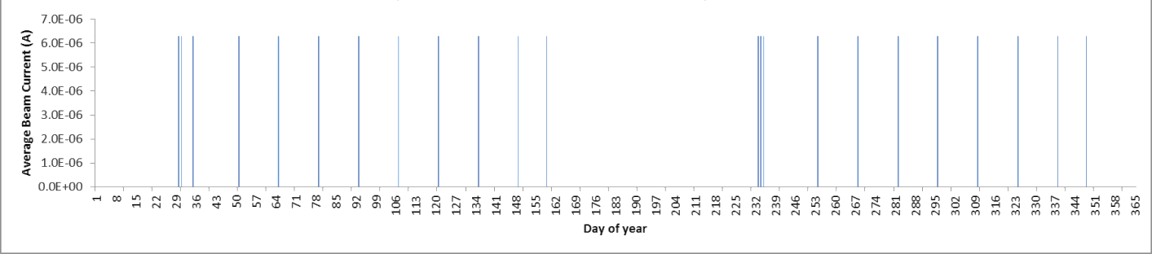
Interfaces (2)
Parameters and Processes
Beam Delivery
Beam Size on Dump - Maximum ~350mm (FoV)
- Minimum (Heating limited)
Operational Profiles
ESS Modes of Operation - ‘Studies’ (Days/year)
Maintenance
‘Hands-on’ Access - Cameras/Screens/Actuators
Radiation Levels - Estimates made
Notes:
Beam parameters are current estimates by Accelerator Group and may be subject to change.
Documented Operational profiles have been used as references for the Total Days of beam-on-dump, as inputs to irradiation and decay studies.
For Maintenance access, the Dump area is classed as ‘hands-on’ and dose limits apply to manned entry and handling.

Slide 26
Planning and Scheduling - Outline
Milestone | Date | Action
CDR | Oct 2017 | Oslo/ESS
Vessel Specification issued to manufacturer | Jan 2018 | STFC Daresbury (DL)
Vessel Delivered to DL | April 2018 | Supplier/STFC
Actuators integrated and Tested at DL | July 2018 | STFC
Mirror Supports designed | Aug 2018 | STFC
Camera Housings prepared in walls | Sept 2018 | ESS
Dump installed at ESS | Nov 2018 | Bilbao
Beam-line completed (upstream of Vessel) | April 2019 | ESS
Vessel Integrated to Beam-Line | May 2019 | ESS
Mirror Supports installed | June 2019 | ESS
Mirrors fitted, System aligned and tested | July 2019 | Oslo
First Beam-on-Dump | Oct 2020 | ESS
Notes:
The current schedule is not confirmed as some dates are speculative at this time.
One of the constraints is design manpower at Daresbury, but this will not affect final delivery on current estimates.
Clearly, dump installation is critical, as beam-line installation cannot be completed without it in place.
Although this plan refers to the recently-revised date for Beam-on-Dump, delivery of Imaging Systems will proceed to planned dates.

Slide 27
Conclusion
Next Steps
Refine design and prepare specifications
  Vessel, Actuators, Mirror supports
Define details of imaging screens
  Structure/materials/fabrication process
Confirm optical design performance
  Camera lenses for minimum aberration
Radiation dose assessment
  Maintain model; rerun as necessary
Notes:
Thanks for your attention.
Any Questions?

