Slide 1


Slide 2
Development of Luminescent Coatings for High Power Target by Thermal Spraying

Slide 3
  Outline
About University West
Tasks undertaken so far to evolve a coating solution for the initial working of the imaging system
Motivation for prioritizing the above tasks
Results from experiments carried out
Possibilities for implementation of the process(es) for coating the target

Slide 4
  Thermal Spray @ Production Technology West
Most active thermal spray R&D group in Sweden
Equipped with coating facilities that are unique in the national context
Extensive work in the novel fields of Suspension Plasma Spray (SPS) and High Velocity Air Fuel (HVAF) spraying…technology forefront
Expertise in diverse functional areas
Globally recognized, particularly for contributions in the field of suspension plasma spraying of thermal barrier coatings (TBCs)
Associated Researchers:
Prof. Sanjay Sampath
Prof. Robert Vassen
Prof. Ping Xiao
Senior Researchers:
Prof. Per Nylén
Prof. Shrikant Joshi
Prof. Nicolaie Markocsan
Lecturer Dr. Mohit Kumar Gupta
Doctoral Students:
Ashish Ganvir
Satyapal Mahade
Esmail Sadeghimeresht
Wellington Uczak de Goes
Research Engineers:
Stefan Björklund
Jonas Olsson

Slide 5
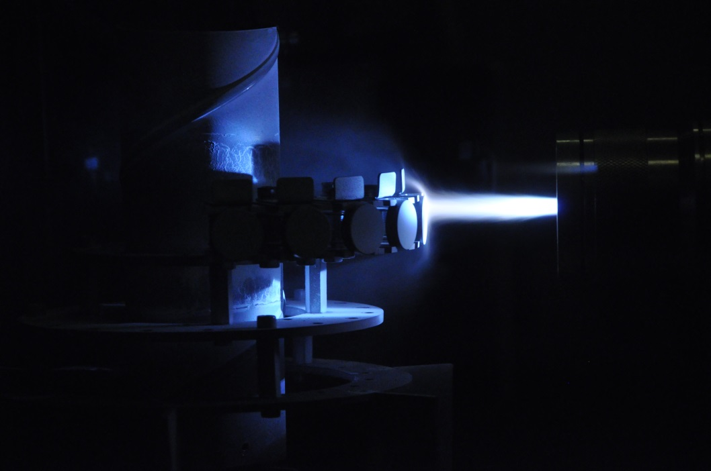
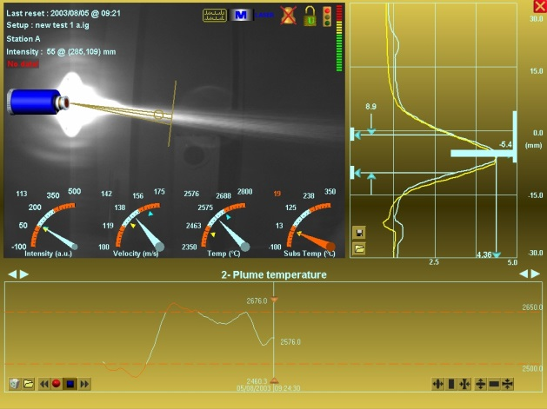
  Wide-ranging thermal spray activities @ HV
Process development
Spray parameter optimization to tailor coating properties, quality and process productivity
Measurement and Control
Linking spray system input data to coating properties
Application development
Demonstrating suitability for varied applications
Functional coatings investigated at HV
Thermal barrier
Wear & corrosion resistant
Repair
Biocompatible
Luminescent…..

Slide 6
  Unique Plasma Spray Facility
State-of-the-art axial-feed plasma spray gun
Such axial-feed plasma spray equipment available only in two groups in Europe and none other in Sweden
Considerable knowledge in powder and suspension plasma spraying….as well as their combination!

Slide 7
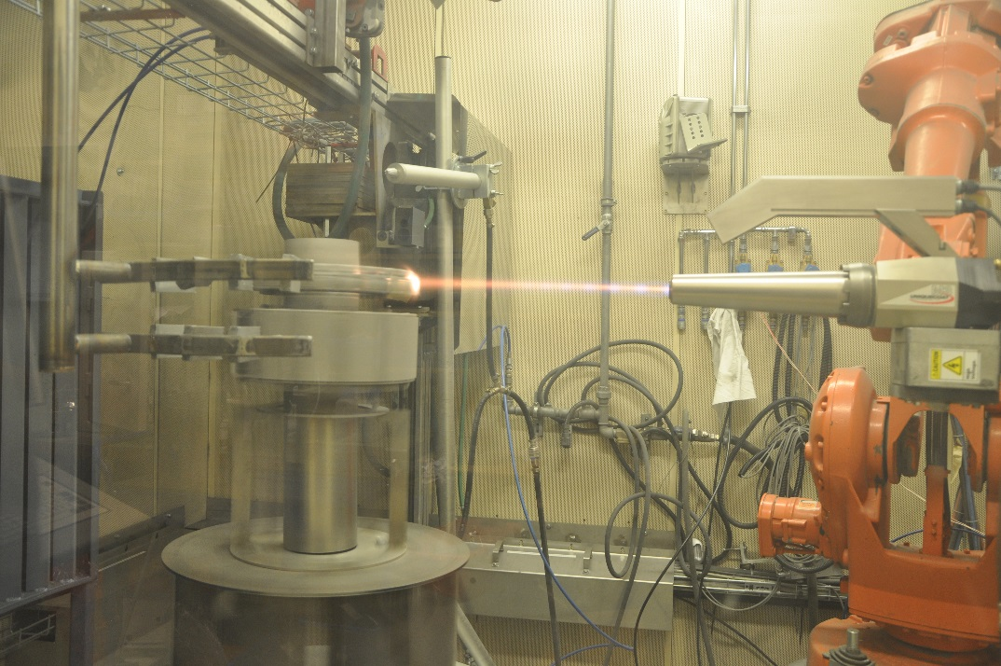
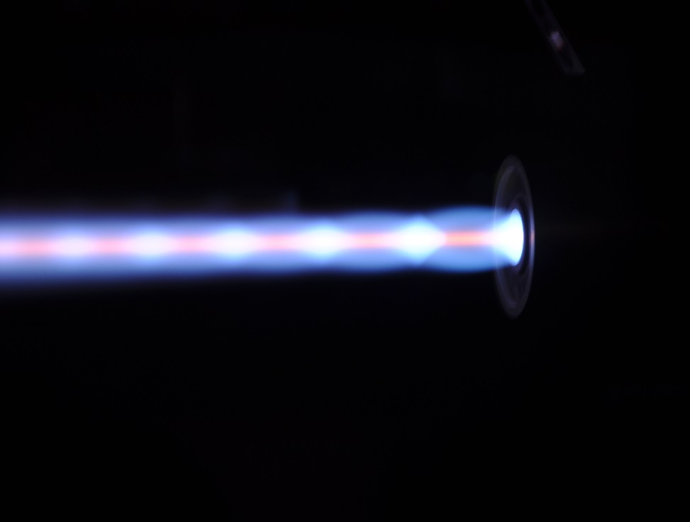
  Unique HVAF Facility
University West’s HVAF facility also among the first in Europe
Still one of only few such facilities in the region

Slide 8
  Other Facilities
Also equipped with other tools:
Characterization
  Optical microscopes
  SEM/EDX
  XRD
  Macro- / micro hardness
  Adhesion testing
  Tensile testing
  In flight diagnostics (DPV2000)
  In-situ Coating Property (ICP) diagnostics
Performance assessment
  TCF
  Corrosion testing
  Erosion testing

Slide 9
Development of Luminescent Coatings for High Power Target
HV-ESS-U. Oslo Collaboration
Phase I
  Start date: May 1, 2016
  End date: March 31, 2017
Phase II
  Start date: March 2017
  End date: April 2018

Slide 10
BASIS: Prior work done (SNS / Stony Brook University)
Several Al₂O₃ - Cr₂O₃ powders tried; only powder from F.J. Brodmann & Co.L.L.C., Louisiana, USA found promising
Best results obtained with approximately 1 wt.% Cr₂O₃
SNS coating light yield has also been seen to decrease strongly with irradiation

Slide 11
Phase I: Coating development by plasma spraying
Objectives
Spray deposition using the existing plasma spray facility at University West and testing of selected luminescent materials, with specific focus on the Brodmann Al₂O₃ - Cr₂O₃ powder
Preliminary spray trials with other feedstock (e.g., Al₂O₃ - Cr₂O₃ suspension) and other material chemistries (Y₂O₃, ZrO₂-Y₂O₃, Al₂O₃)
Supply of coated specimens to ESS and University of Oslo for further qualifying tests.

Slide 12
“New” lot of Brodmann powder
Alumina powder used in the lot supplied to Stony Brook earlier was unavailable; replaced with a densified 99.99% pure alpha alumina powder.
99.94% pigment grade Cr₂O₃ used
Particle size for the Cr₂O₃ powder is 1-7 microns; Al₂O₃ (Alpha) powder size is 20-63 microns.
Supply specs as follows:
  FloMaster Oxide Powder
  Physical Mixture
  98.5wt% Al2O3 (99.99%) 1.5wt% Cr2O3(99.9%)
  -63/+20 micron (-230/+635 mesh)

Slide 13
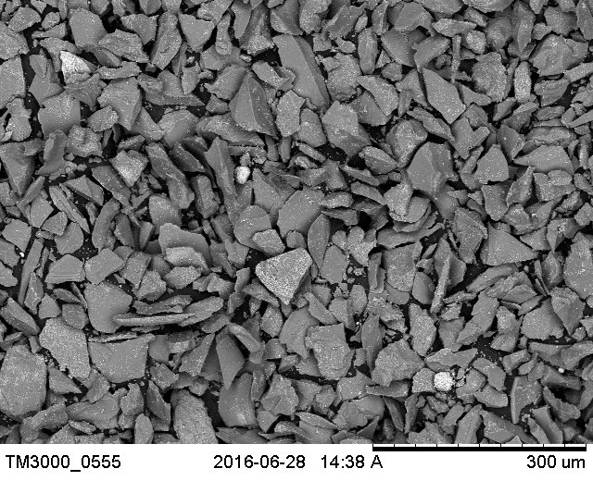
Morphology (SEM) - Brodmann powder
Cr₂O₃ particles

Slide 14
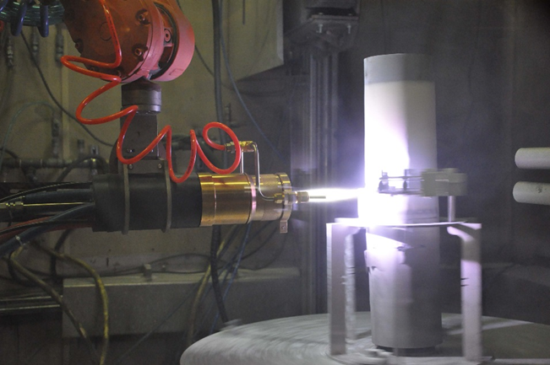
Plasma spraying of Brodmann powder
Effort to span widest possible processing window with the axial feed MetTech torch available at University West
Parameters varied
Powder feed rate
Total gas flow
Plasma gas (Ar/N2/H2) composition
Carrier gas flow
Arc current
Surface speed (gun-specimen)

Slide 15
Plasma spray trials with Brodmann powder
Varied parameters over a wide plasma power, enthalpy window

Slide 16
Preliminary evaluation of luminescence
Lab kit provided by ESS; measures photo-excitation response; characteristic ‘R lines’ around 693-695 mm

Slide 17
Reference sample
Prelim (i)
Prelim (ii)
Characteristic peak for promising Al₂O₃-Cr₂O₃ coatings
Response from lab kit, to identify ‘good’ and ‘bad’ coatings
Sample # 0
Sample # 1
Sample # 2
Sample # 3
Sample # 4
Sample # 5

Slide 18
Reference sample
Sample # 6
Sample # 7
Sample # 8
Sample # 9
Sample # 10
Evidence of luminescence in coatings over a wide spray parameter window !!!

Slide 19
Plasma spray trials with Al₂O₃-1 wt. % Cr₂O₃ suspension
Suspensions from Treibacher Industrie AG, Austria

Slide 20
Reference sample
Sample # 1
Sample # 4
Sample # 5
Sample # 6
Sample # 7
Sample # 6
Sample # 7
SPS coated sample shows some activity – but not yet ”optimized” !!!
Sample # 8
Sample # 9
Sample # 8
Sample # 9
Sample # 16 SPS

Slide 21
Need to also look beyond plasma spraying
Original thinking: Target wheel would be coated in segments, to fit into the existing spray booth at HV
Recent update: Target wheel will be coated in integrated manner or at most in two pieces
  Cannot be accommodated at HV
  No identical plasma spray facility, with suitable handling capability exists in Sweden
  The axial plasma spray system not readily ‘portable’

Slide 22
Other considerations to look beyond plasma spraying
Coatings tested at the Oslo Cyclotron
Also investigated at CERN HiRadMat
However, coated samples have not yet been tested for high irradiation dose
Outcome of these tests remains unavailable to fully confirm suitability of the above plasma sprayed coating for the first target
Desirable: (a) ‘Nearly identical process’ & ‘nearly identical powder’ as SNS as a good (comforting?) baseline process and material for the first target; (b) portability to spray on site OR at alternate location; (c) portability also to provide option to delay coating as late as possible, to assist Target timeline

Slide 23
Phase II: Coating development by combustion flame spraying
Objectives
Procurement of a robot mountable combustion flame spray gun with manual ignition, a manual gas controller and a stand-alone powder feeder
Assembly and integration with an existing robot
Spray deposition and testing with the “new” Al₂O₃ - Cr₂O₃ powder from Brodmann
Identification of a parametric window that will yield coatings with optimum luminescent behaviour
Provide substrates to ESS and University of Oslo for further evaluation
Robot programming to combustion flame spray coating on a simulated ESS target

Slide 24
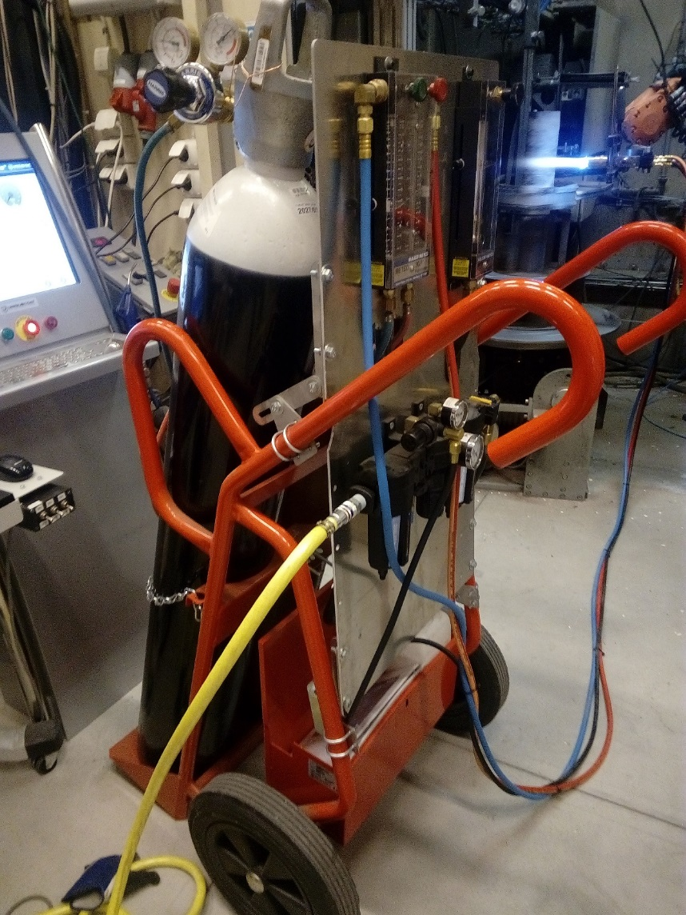
Established combustion flame spray set-up
Manual ignition
Robot mountable
Manual gas controller
Stand-alone powder feeder
Assembled and integrated with an existing robot at University West

Slide 25
Combustion flame spraying with Brodmann powder
Sample | O₂ l/min | Fuel l/min | Powder Feed Rate g/min | Traverse speed m/min | Step size mm/rev | # Strokes | Stand-off mm | Carrier gas l/min
1 | 38 | 22 | 35 | 100 | 5 | 2 | 75 | 6
1.2 | 38 | 22 | 15 | 100 | 5 | 2 | 75 | 6
2 | 43 | 26 | 35 | 100 | 5 | 2 | 75 | 6
3 | 40 | 22 | 35 | 100 | 5 | 2 | 75 | 6
4 | 38 | 22 | 35 | 100 | 5 | 2 | 75 | 6
Varied parameters over a reasonable window (for oxy-fuel ratio only)

Slide 26
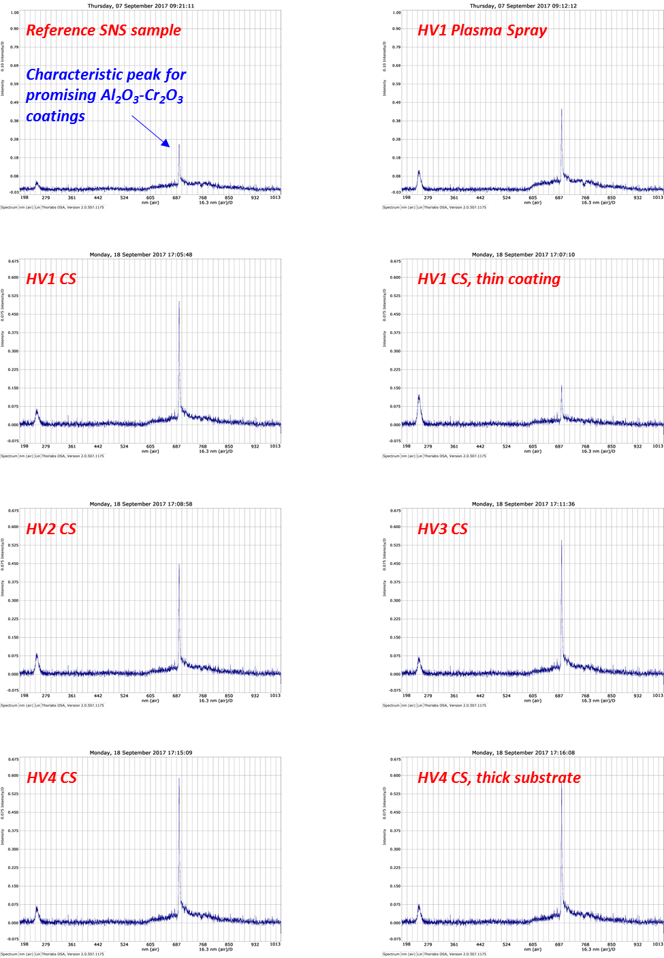
Response of combustion flame sprayed coatings during testing using a PLS assembly

Slide 27
Implementation
Both plasma and combustion spray processes evaluated at HV appear prima facie capable of depositing luminescent coatings based on Brodmann Al₂O₃ - Cr₂O₃
Qualification of coatings by exposing them to high power radiation pending
However, in general, both techniques amenable to ‘scale up’ to coat the ESS target... challenges largely associated with aspects related to job handling, masking, spray gun-job maneuverability etc.
Logistics associated with the actual hardware can play an important role (at present) in choice of process
Choice could also vary based on other materials that emerge as part of the continuous development to seek superior luminescent coatings

Slide 28
Approach
Meaningful to evolve a baseline plan that is most likely to succeed in time for target installation
  Combustion flame spray of Brodmann Al₂O₃ - Cr₂O₃
  Greater confidence level (based on prior SNS work) … very similar process and material!
  Possibility to coat late…in Lund!
Continue coating development in parallel
  Y2WO6 as the next step
  Doping with Eu?

Slide 29
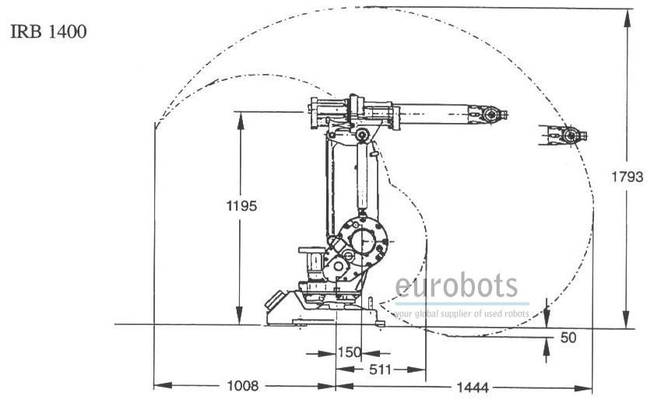
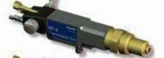
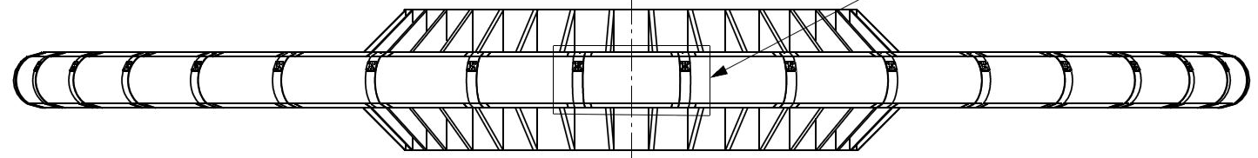
Coating the target wheel
Base, Target rests stationary on base
Laser pointer fix on robot base

Slide 30
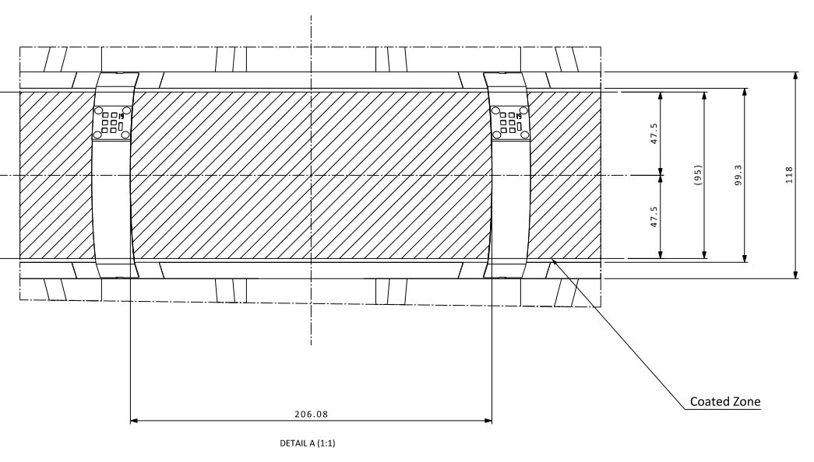
Alignment & limits
Laser pointer dots to align the area on target to be coated

Slide 31
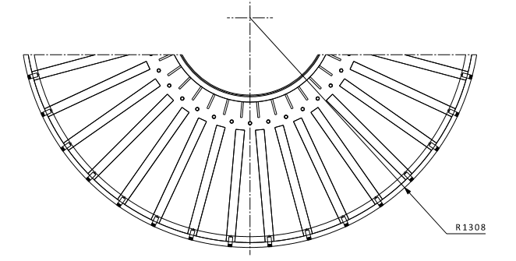
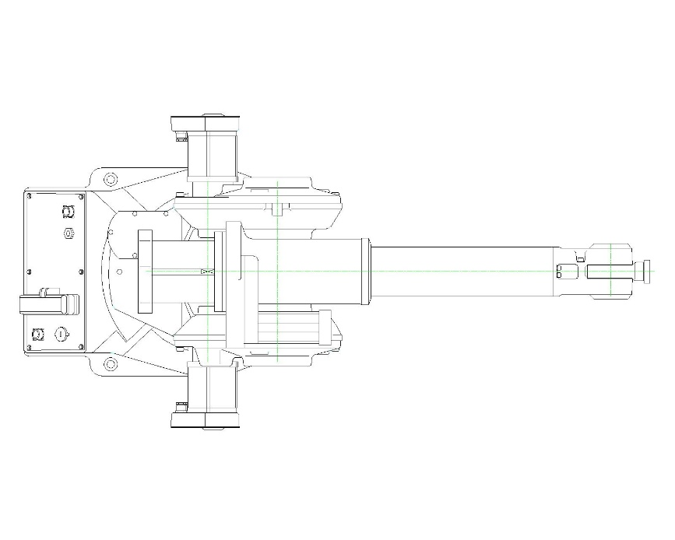
Gun-target wheel manoeuvring
We manufacture a robot base that can be rotated around the target base and locked in position when laser pointers are aimed at correct target position

Slide 32
Sheet metal masking of surfaces that should not be coated

Slide 33
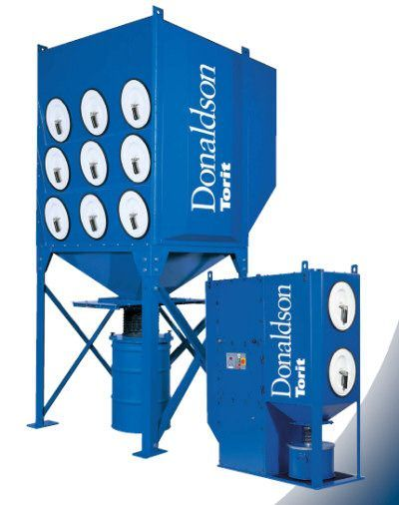
Safety etc.
Arrange dust extraction system that is placed outside and use ducting and hoses to connect that to dust extraction hoods mounted on the robot base that extracts more or less all dust from the Thermal Spray process.

Slide 34
Technical issues to be addressed prior to implementation
Influence of coating thickness ( How thick a coating do we need? For performance? For durability?)
Need for a bond coat (How do we test? Do we put one on, just to be safe? Are there any restrictions on bond coat chemistry…for target wheel, for PBW?)
Substrate temperature during coating of actual hardware (What is the maximum allowable substrate temperature? Will we need auxiliary cooling?)
Ideally coat dummy hardware for both target wheel and PBW of identical dimensions (important to resolve substrate temperature & cooling issues, fixtures & masking needs, complete and prove out robot / part programming)

Slide 35
Essential Pre-implementation Steps
Detailed drawings of ALL hardware to be coated
Evaluation of site where coating is to be performed, including potential for contamination
Assessment of
  Design of platform/podium on which the target wheel (and PBW) will be placed
  Specifications of required robot
  De-dusting arrangements
  Masking requirements
Sourcing of local partner(s) to provide support in terms of (a) Construction of platform/podium (b) on-site preparation in terms of health & safety, including regulations and permits (c) leasing grit blasting systems (d) arranging robot of required specs (e) fabrication of metals masks….

Slide 36
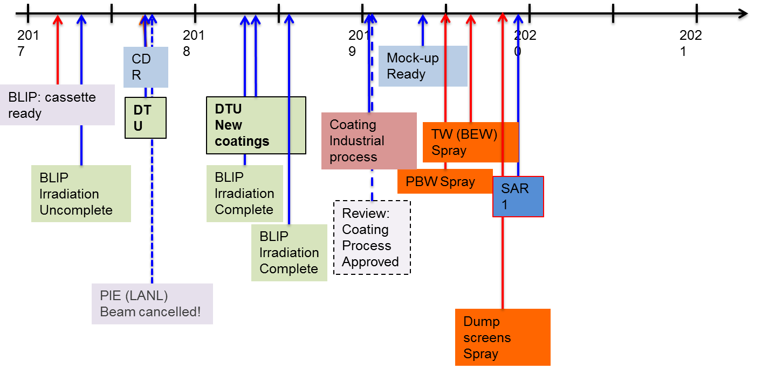
ESS-proposed schedule for coating development
Achievable schedule from a coating standpoint
8-12 month lead time mandatory if the coating is to be done on site
While we deliberate on various existing & evolving coating process-material options, NEED TO BUY BRODMANN POWDER – to avoid additional uncertainties. URGENT!!!

Slide 37
shrikant.joshi@hv.se

