Slide 1
Thermal simulations of DTL FC, dumps and Target coating
Thomas Grandsaert
Mechanical Engineer
www.europeanspallationsource.se
16 November, 2017

Slide 2
Thermal simulations of DTL FC, dumps and Target coating
Thomas Grandsaert
Mechanical Engineer
www.europeanspallationsource.se
16 November, 2017

Slide 3
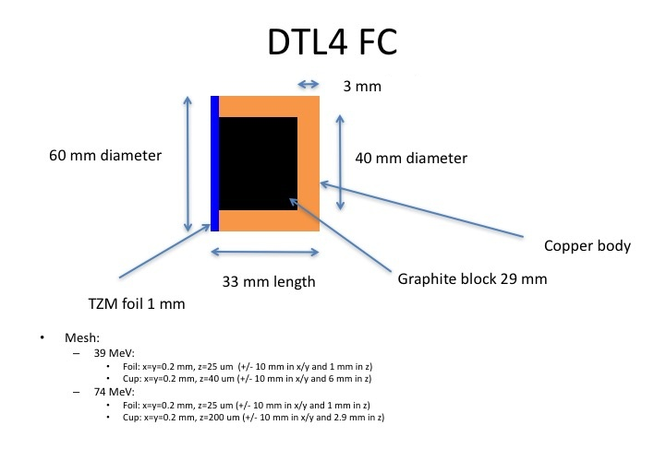
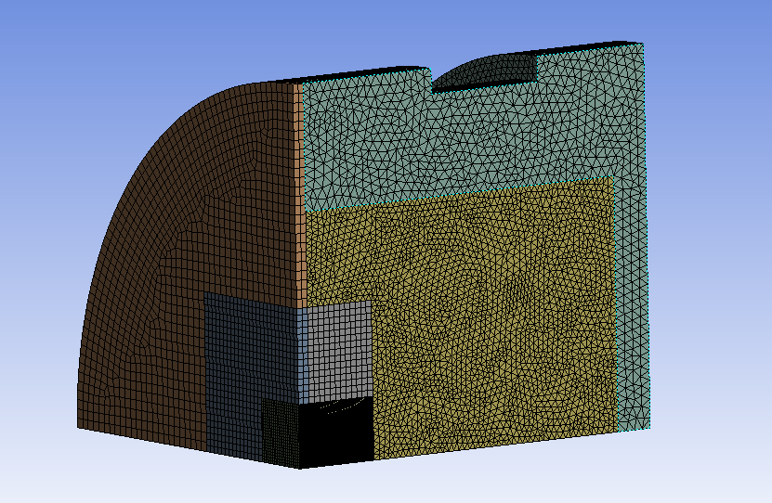
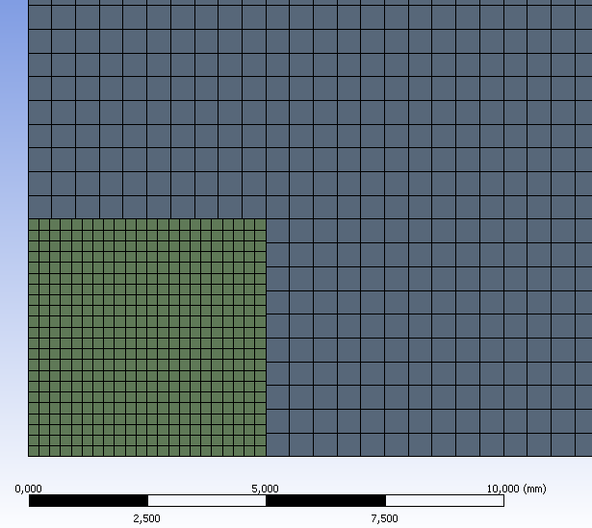
An example: DTL4 FC
Materials
Cu
Graphite
TZM

Slide 4
DTL4 FC
Assumptions
Symmetric distribution of beam
Heat sink at rim of FC (room temperature)
Workflow
Fluka
ANSYS
Drift tube Linac
Faraday cups

Slide 5
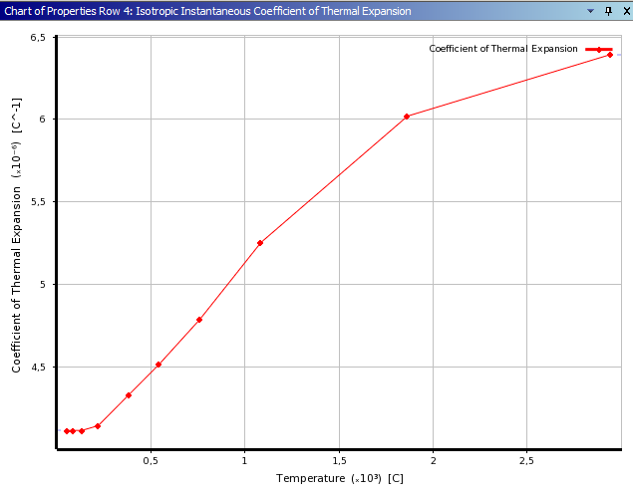
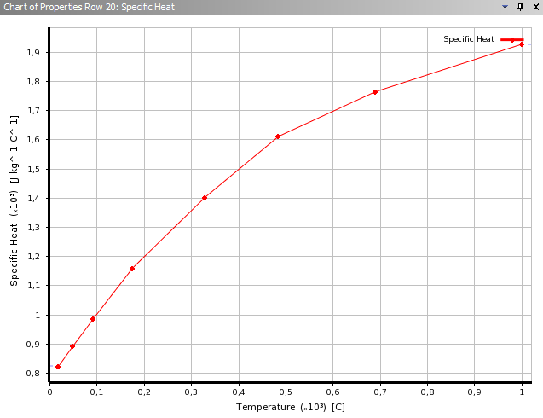
Graphite Properties (courtesy of CERN)
Graphite α – thermal expansion
Graphite C – specific heat

Slide 6
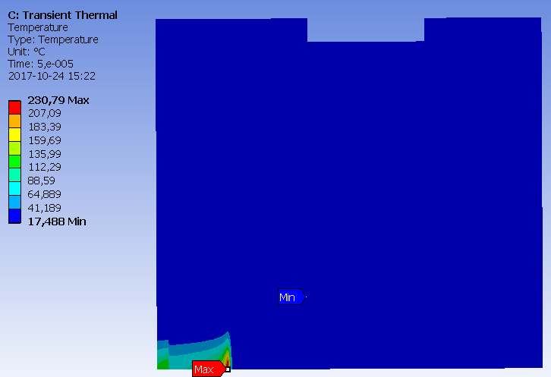
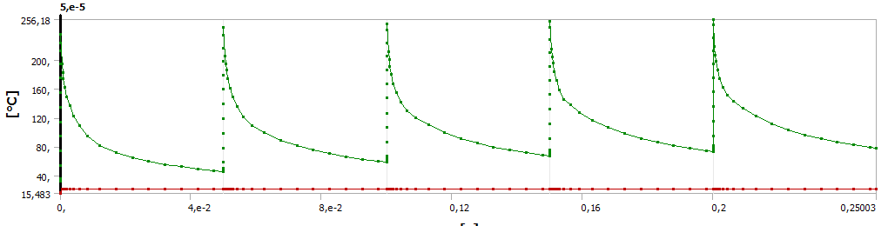
DTL4 : 39MeV : 5 us beam at 14 Hz

Slide 7
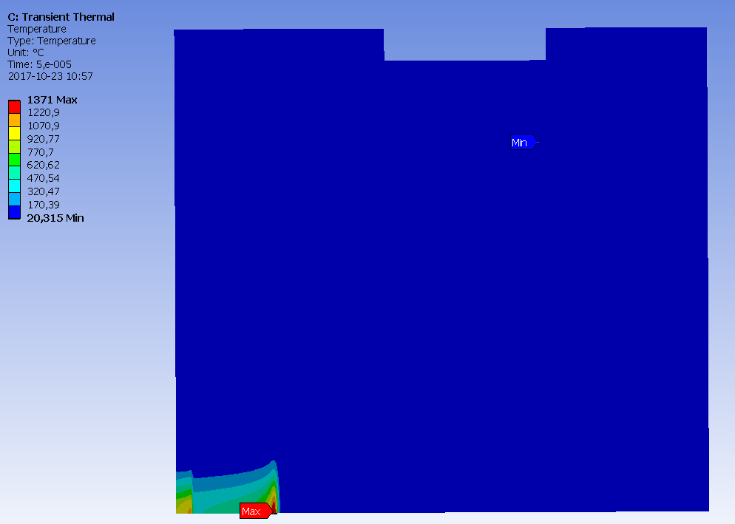
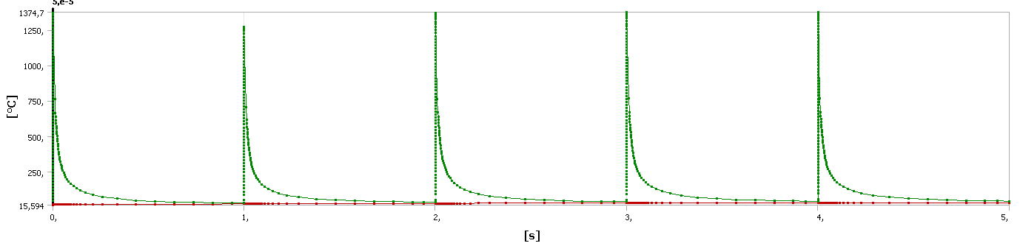
DTL4 : 39MeV : 50 us beam at 1 Hz

Slide 8
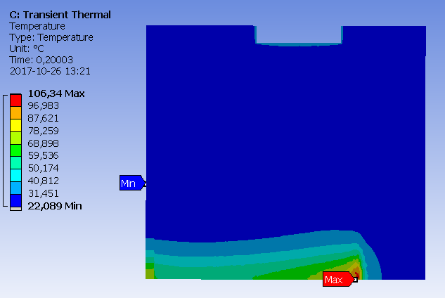
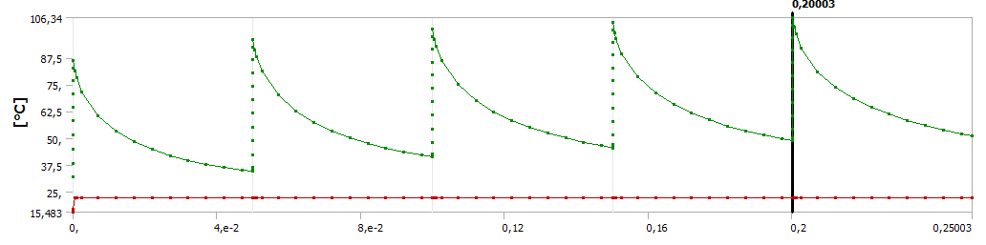
DTL4 : 74MeV : 5 us beam at 14 Hz

Slide 9
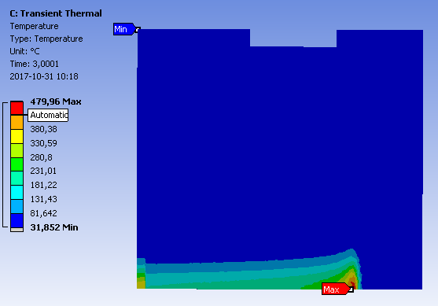
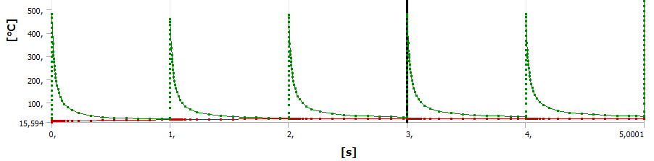
DTL4 : 74MeV : 50 us beam at 1 Hz

Slide 10
Irradiation at DTU (ANSYS)
Assumptions
7Mev protons @ µA
Aluminum oxide coating 0.1mm on Aluminum
Gaussian beam distribution σ = 4.25mm
Heat sink at back of sample (room temperature)
Workflow
SRIM
python
ANSYS
Luminescent Coating Development

Slide 11
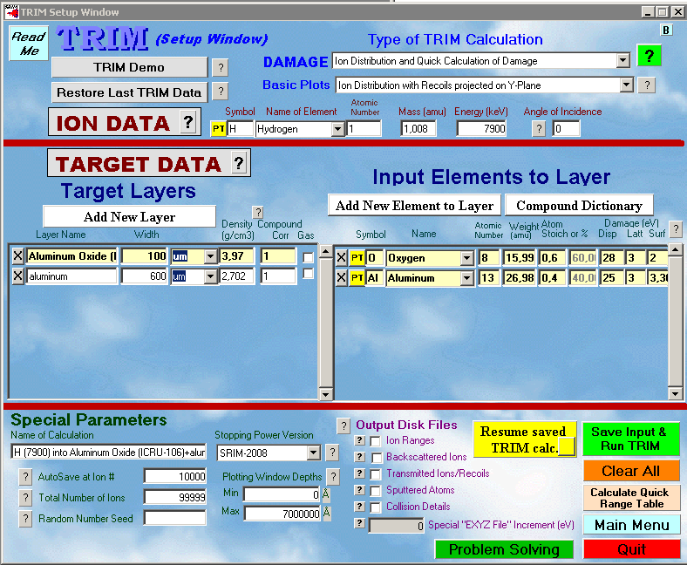
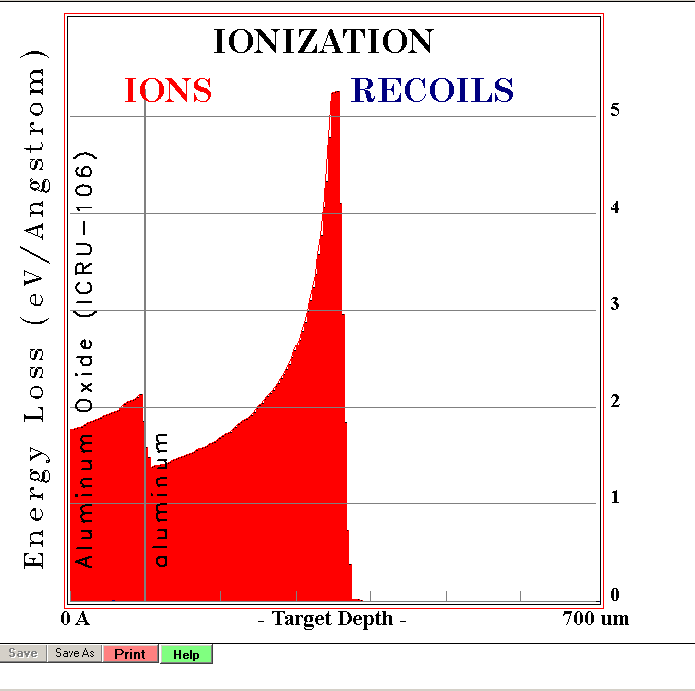
Irradiation at DTU (ANSYS)
SRIM

Slide 12
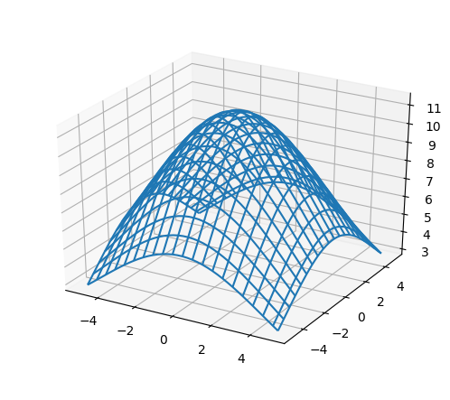
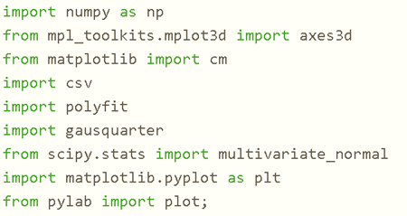
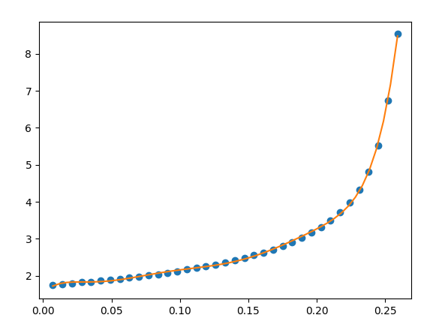
Irradiation at DTU (ANSYS)
python

Slide 13
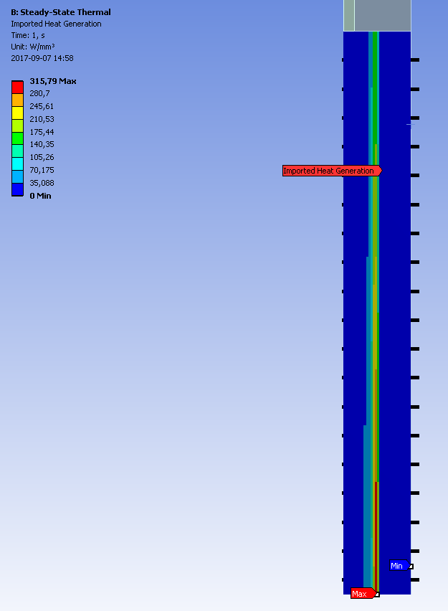
Irradiation at DTU (ANSYS)
ANSYS
Imported Heat Mesh:
250x, 250y, 20z micron resolution
Can verify power loss with probe

Slide 14
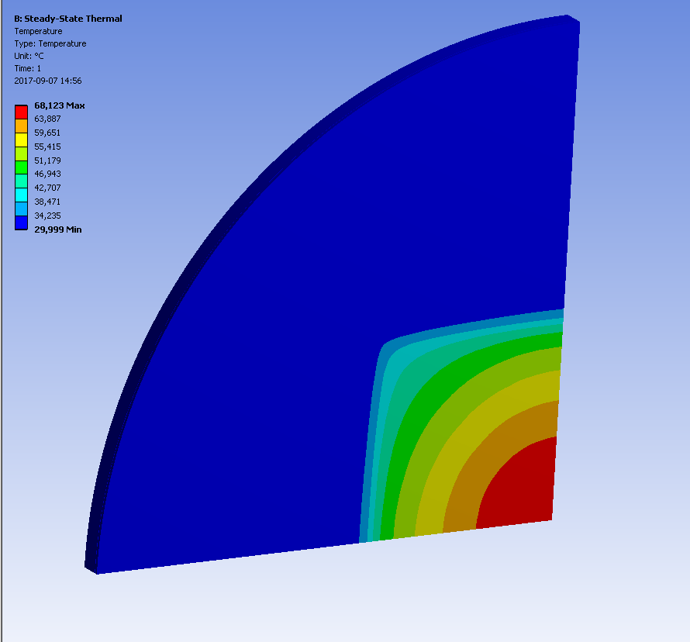
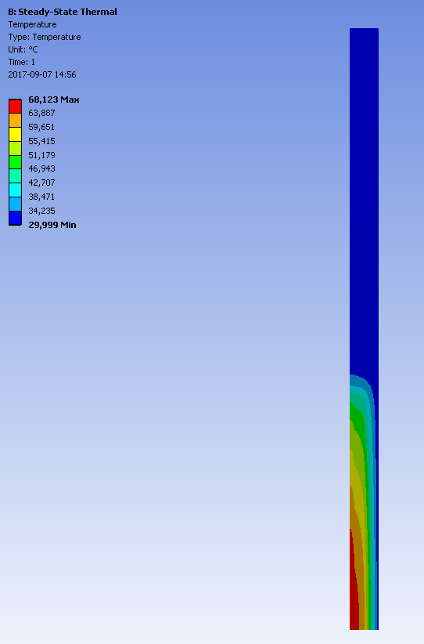
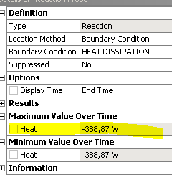
Irradiation at DTU (ANSYS)
Results:

Slide 15
The end :D

