Slide 1
icBLM electronics
Clement Derrez
Test Engineer
www.europeanspallationsource.se
15 November, 2017

Slide 2
Outline
Conceptual system design
Detectors
Electronics
High voltage unit
Signal acquisition unit
Conclusion & Outlook

Slide 3
Conceptual system design
BLM system: One of the most important diagnostic system of the ESS LINAC.
Keep the machine safe from beam-induced damage
Avoid excessive machine activation by providing critical input to the MPS
→ no blind spots & precise loss locations determination
System designed for maximum reliability
Redundancy
low latency
Challenges:
Complicated noise situation. Additionally, noise sources vary depending on the location within the accelerator.
Cabling: new requirement gives us cables length up to 100m

Slide 4
Conceptual system design
MPS
Post mortem
Timing
microTCA +/ custom CERN crate
Detectors: ICs
Timing receiver
User screens,
Archiver…
HV
FPGA processing,
interfacing
Signal acquisition
EPICS IOC
Tunnel
Gallery
ESS control room

Slide 5
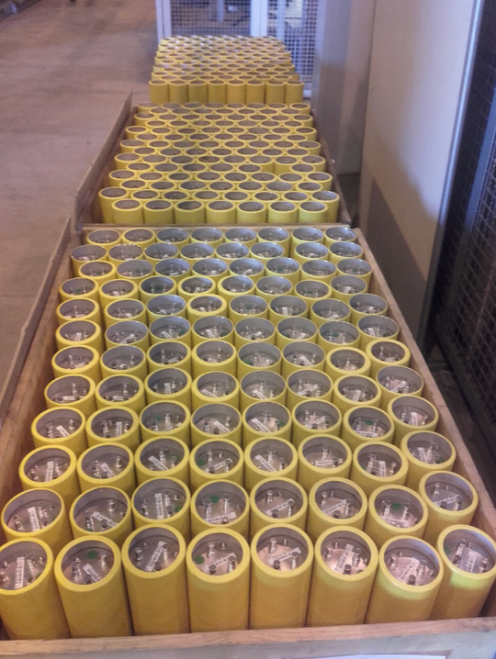
Detectors
LHC-type
Design criteria: signal speed & robustness against ageing
Operated at 1.5 kV
Low pass filter at HV input
285 ionization chambers received at ESS in Jul. 2017

Slide 6
Electronics: Signal acquisition unit specifications
Signal acquisition: Dynamic range | Input current dynamic range: 10 nA to 10 mA. | Two separate ranges shall be used: the low end set by the condition that the operators must be able to tune on beam loss measurements down to 10 mW/m, while the high end shall allow recording of total beam loss during faults and machine studies | BLM is required to be able to measure at least 1% of 1W/m loss during normal operation and up to 1% of the total beam loss.
Signal acquisition: Response time | NC LINAC: Calculated melting time values of 3-4 us SC LINAC: 10 us The signal acquisition card shall therefore feature a bandwidth of at least 300 KHz and a minimum sampling rate of 1MSPS | “Particle time” - PT: time between the onset of beam loss (the primary is lost) and the moment particle (primary or secondary) hits the detector. Detection time: time needed for the detector signal to develop and to collect enough hits/current Processing time: from the output of the detector to the BIS output on the FPGA
Signal acquisition: resolution | The signal acquisition card shall have a resolution of at least 20 bits
Signal acquisition: noise figure | The signal acquisition card shall have a typical noise better than 10 nA in its lowest range, including temperature induced noise
→ We need a 300 KHz Bandwidth
→ We want to be able to trigger on a 800 nA, 5 us pulse width, with 100m max cable length
Notes:
The response time of the BLM system is a sum of:
“Particle time” - PT: time between the onset of beam loss (the primary is lost) and the moment particle (primary or secondary) hits the detector.
Detection time: time needed for the detector signal to develop and to collect enough hits/current
Processing time: from the output of the detector to the BIS output on the FPGA
In a word: Dynamic range specs:
“BLM is required to be able to measure at least 1% of 1W/m loss during normal. operation and up to 1% of the total beam loss”.
Gave estimation on the ICLBM current range: ~800nA – few mA

Slide 7
Electronics: Data acquisition, 2 options
COTS solution: CAENels PICO-8
8-channel 20 bit Bipolar Floating Picoammeter with MTCA.4 REAR I/O
full-scale ranges of 10 mA and 500 uA
input bandwidth: 300 kHz
“manual” change between ranges
BLEDP: Current to Frequency Converter, fully differential integrator circuit.
Current to frequency converter, fully differential front end
Measurement of the current input is performed by two different techniques:
Advanced Current to Frequency Converter (ACFC) used in the range 10pA to 30mA
Direct ADC acquisition (DADC) used in the range 20.3µA to 200mA
Transition between ranges managed by an FPGA
Optical output to post processing unit
Bandwidth: 1 MHz

Slide 8
Electronics: Data acquisition
Noise levels, 250 KHz sampling rate (fits BLEDP):
Pico8 range: 500 uA
→ We need to find a lower capacitance cable if we go with the pico8
 | PICO8 | ESS testbench
2m triax | 10 nA | 100 nA
 | PICO8 | BLEDP
100m triax ( ~100pF/m) | 291 nA | 130nA
 | PICO8 | BLEDP
100m coax ( ~50 pF/m) | 190 nA | 130nA

Slide 9
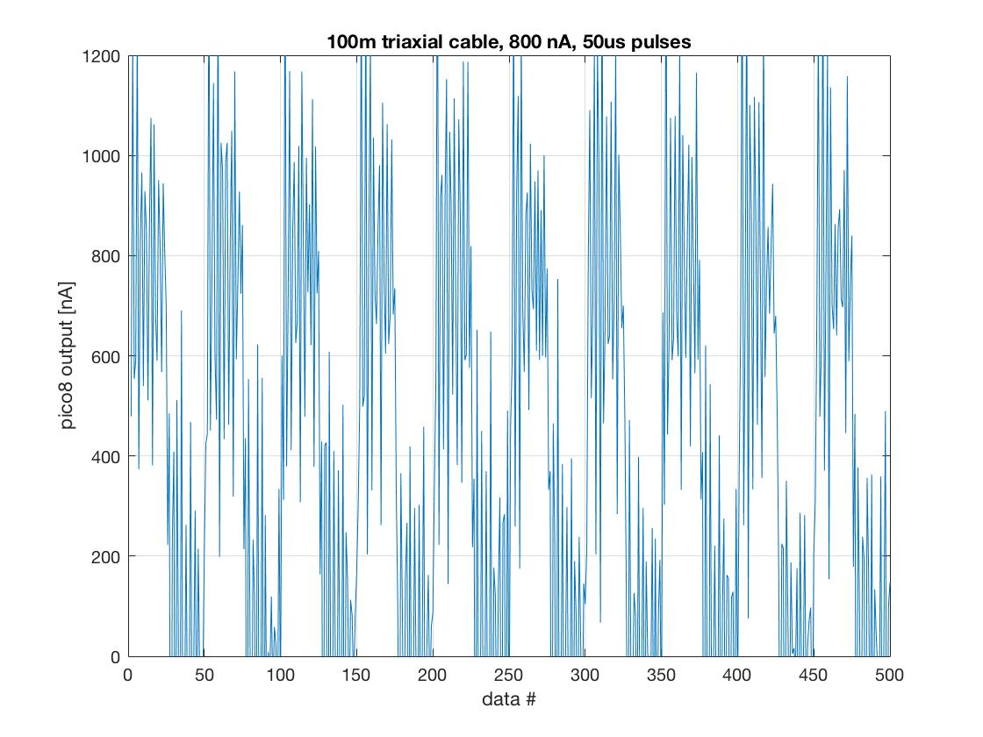
Electronics: Data acquisition, 2 options

Slide 10
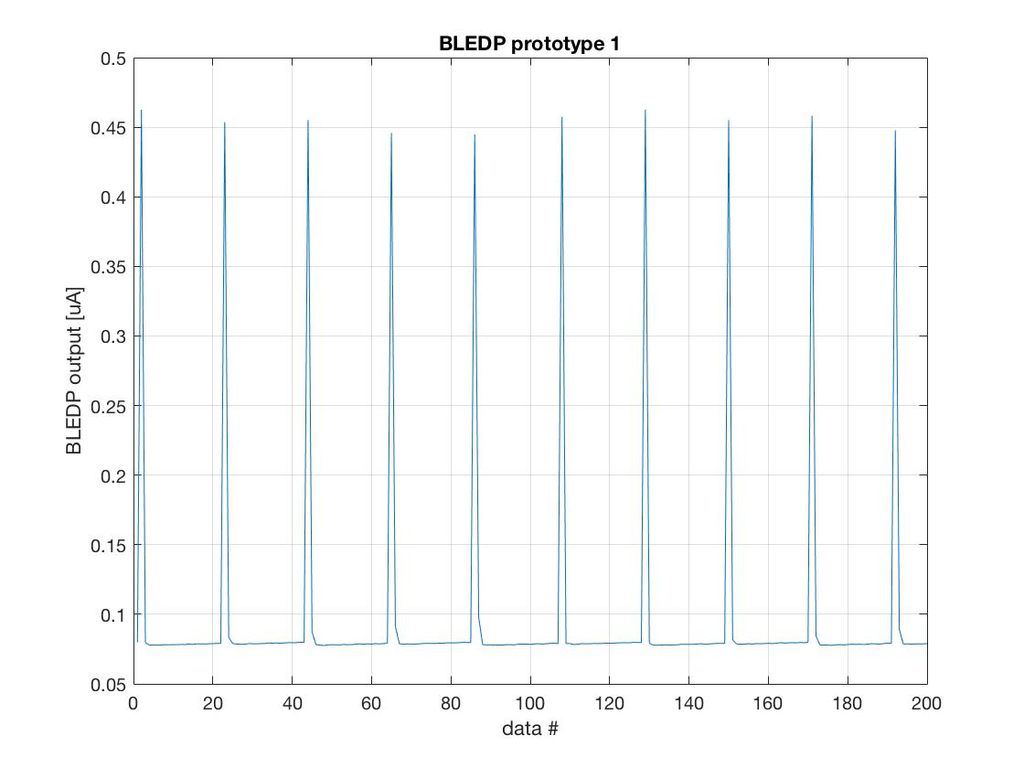
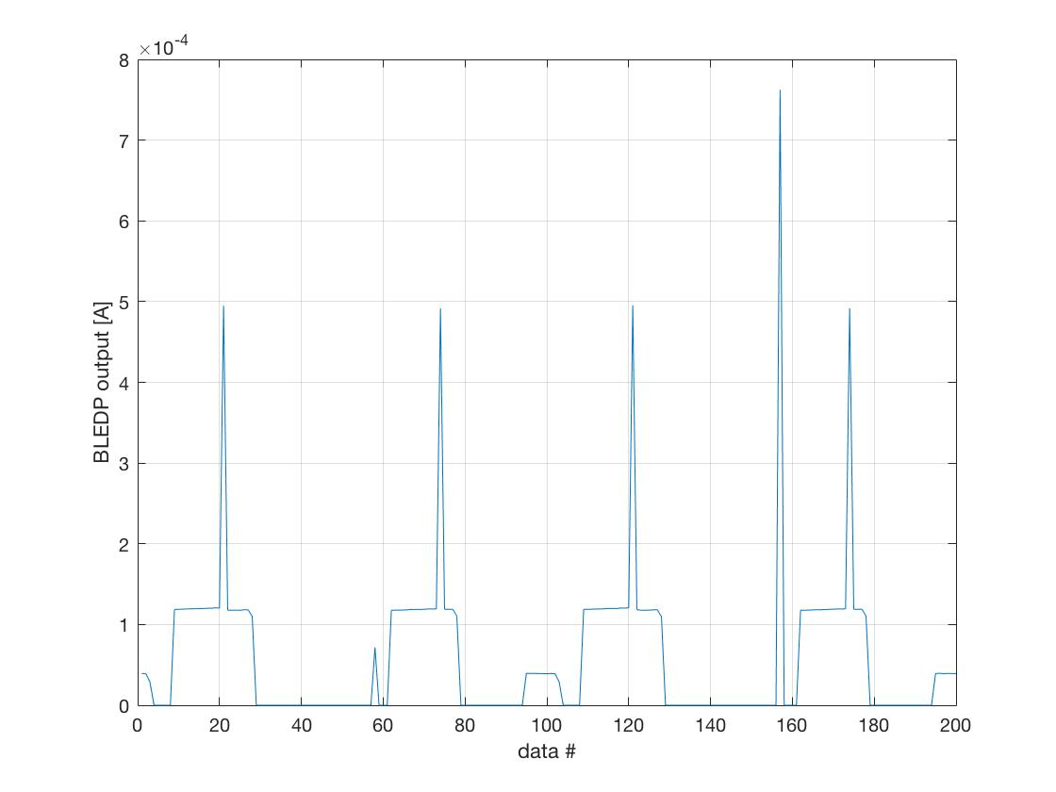
Debugging still needed on BLEDP
Spikes in data out at current levels > 10 uA
BLEDP only measures positive current.

Slide 11
Some more points to consider
BLEDP
Resources for support
Custom crate design
Reliability analysis available (10 years MTTF)
PICO8
Range needs to be changed “manually”

Slide 12
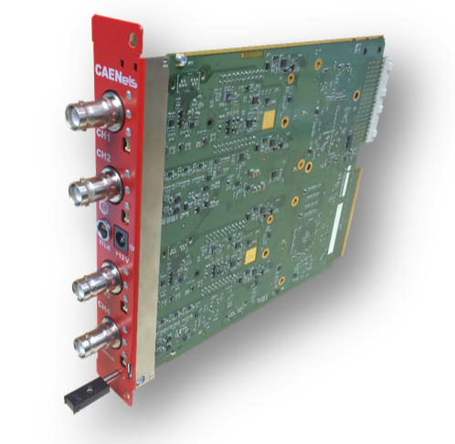
Electronics: HV unit
COTS solution: CAENels HV-PANDA
Double-width AMC with MTCA.4 Rear I/O
4 channels rated at 4kV at 7W
Configurable ramp rate
Nominal voltage accuracy better than 0.05% FS and a ppm-level peak-to-peak output voltage ripple
SHV type connectors

Slide 13
Electronics: HV unit
optimal freq: 0.2 Hz

Slide 14
Conclusions & Outlook
System design is moving forward quickly. 285 ICs received last week
FRU tests:
Perform a “long-term” measurement to check for possible drift, on HV and signal acquisition units
Software and Firmware

