Slide 1


ESS Target and Tuning Dump Imaging Systems
Prof. Erik Adli
Department of Physics, University of Oslo, Norway
CEA, Paris, November 20, 2017

Slide 2
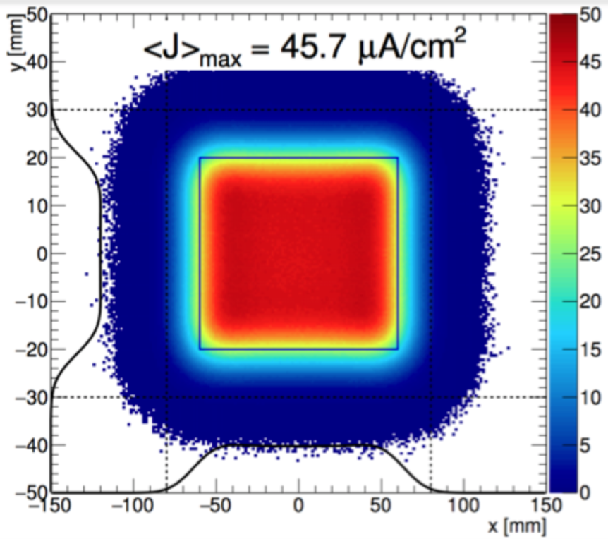
Outline
1) Target Imaging Systems
2) Tuning Dump Imaging Systems
"Imaging System"
= "Profile Monitor"

Slide 3
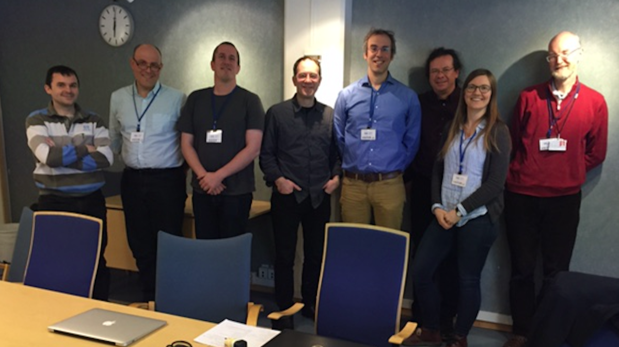
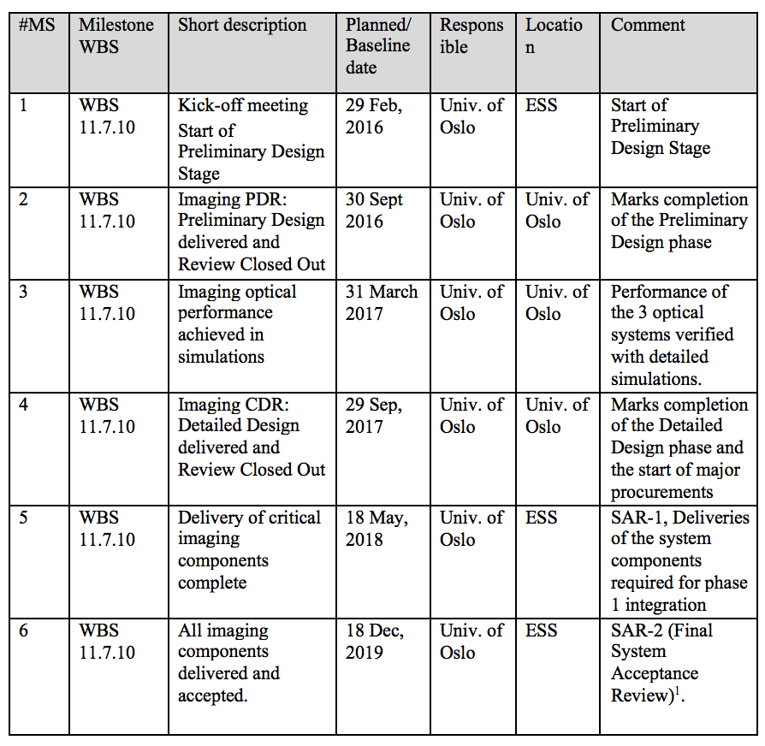

Schedule
Imaging system milestones
Delivery of
critical components
complete
2018-05 ?
Delivery of
all components
complete
2019-12
End of contract
Simulation
design frozen
2017-04
Kick-off, 2016-02
PDR
2016-09
CDR
2017-10
2016-01
2017-01
2018-01
2019-01
2019-12
ESS beam
on dump and target
late 2020
CDR held in Oslo (Oct 2017)
Currently implementing
recommentations from the CDR
( )

Slide 4
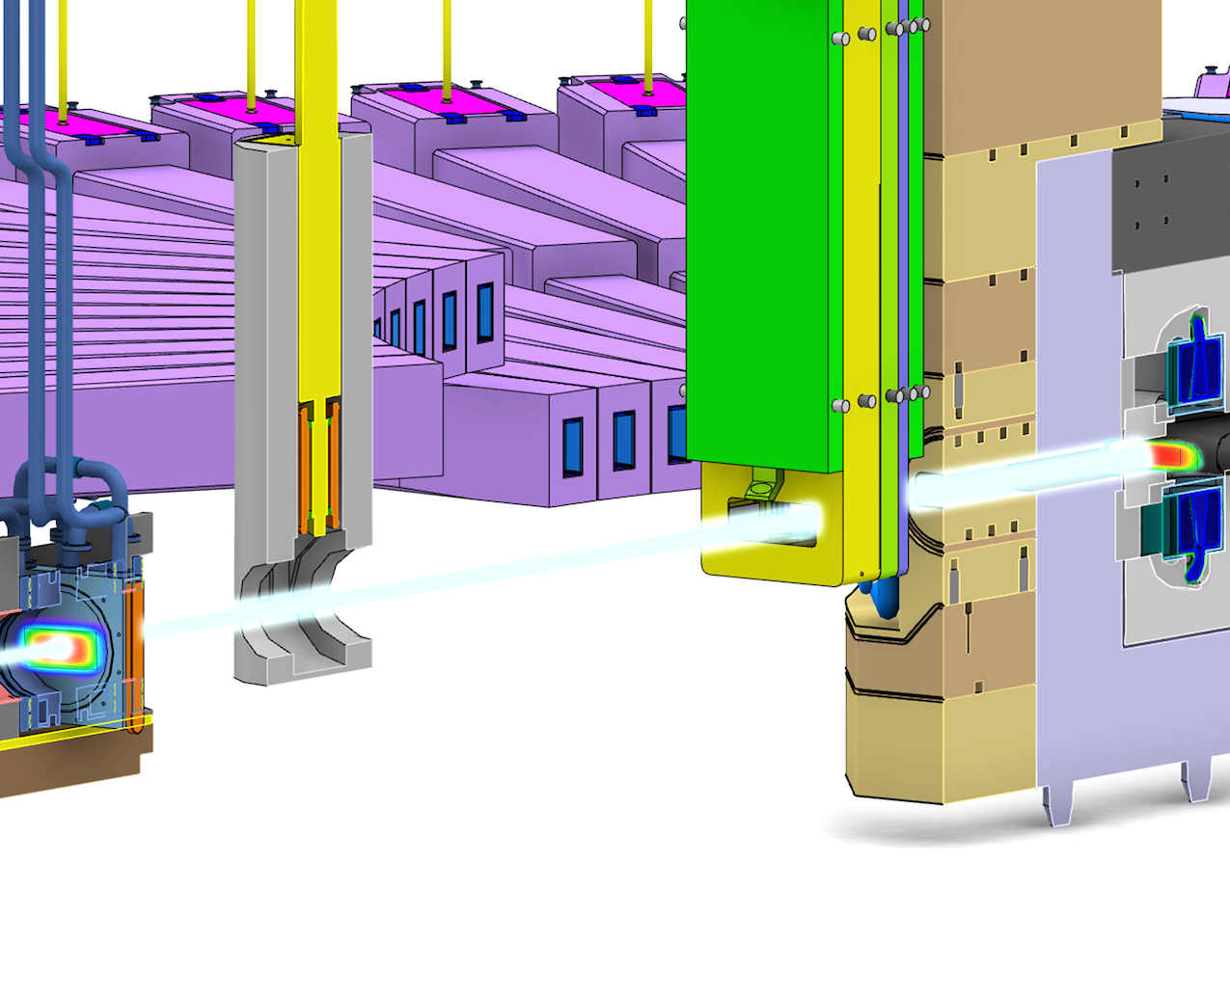
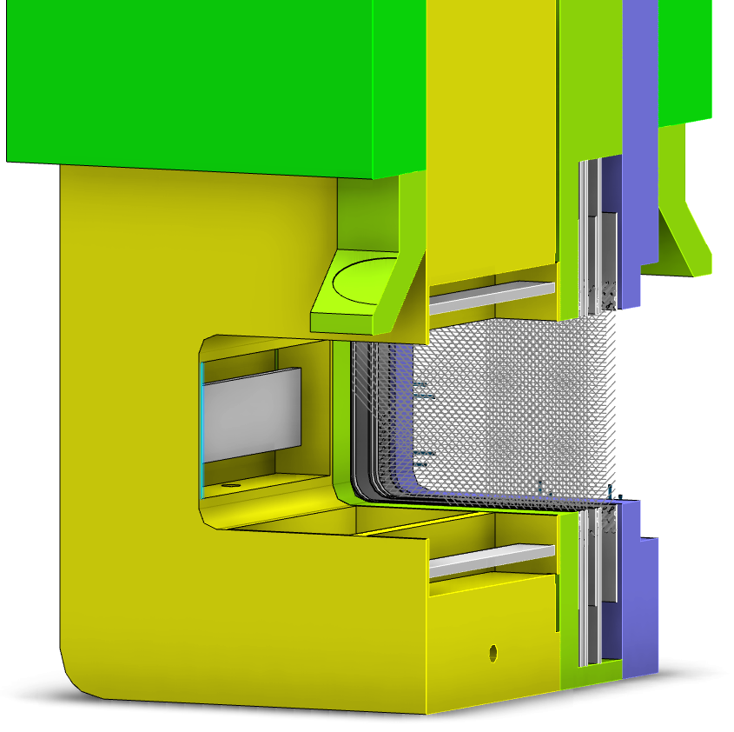
Target Systems: inside the monolith
Beam Profile Monitors inside a 5 MW target area
Two systems at the target :
Proton Beam Instrumentation Plug
Optics for Target imaging
Optics for Proton Beam Window imaging
Proton Beam WIndow
Rotating 33 sector tungsten target
Beam position monitor (BPM)
Aperturemonitor
Proton Beam Instrumentation Plug
Multi-wire grid
Upstream: position, current, aperture, and loss monitors

Slide 5
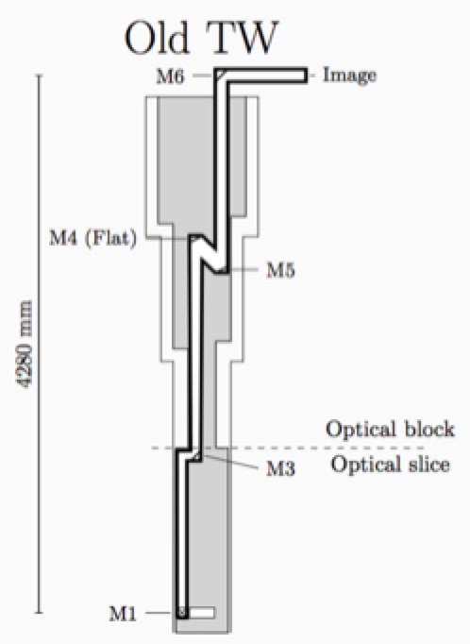
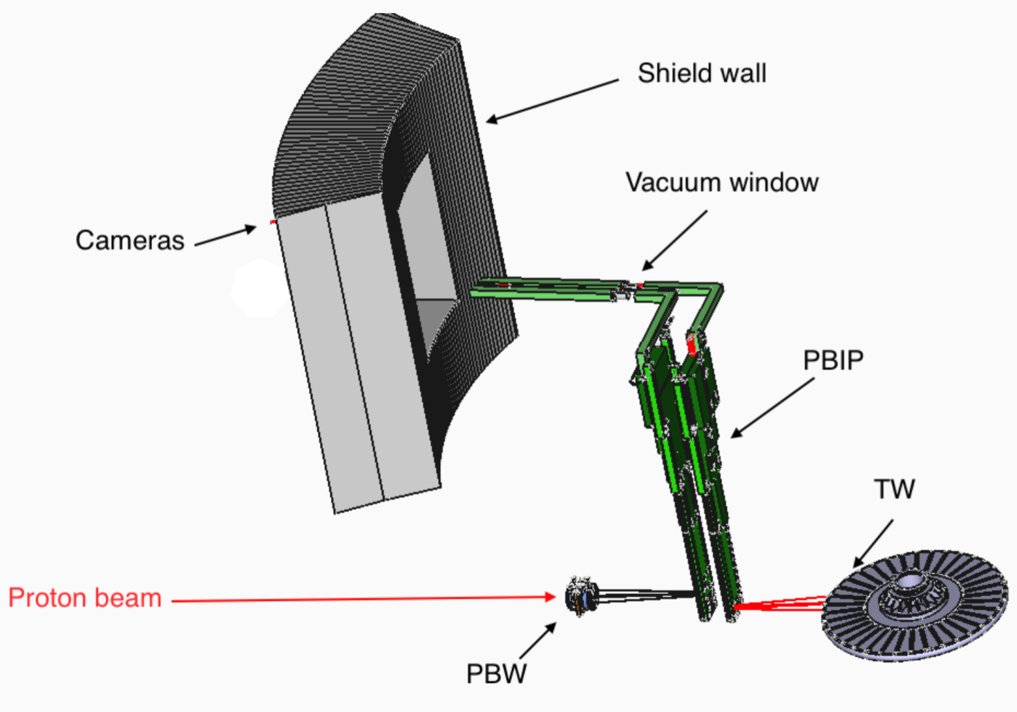
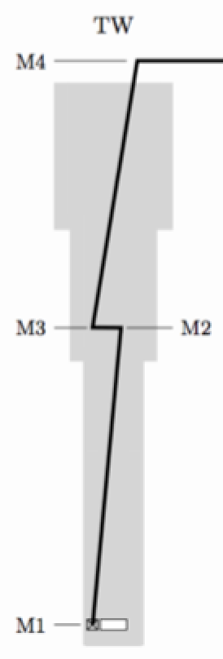
Target: Optical systems
Shielding integrity constraints: chicanes, narrow optical path (10 cm)
8 mirrors per system
First mirror curved for FOV (25 cm x 10 cm)
Final imaging by camera in an accessible area (accessible during operation)

Slide 6
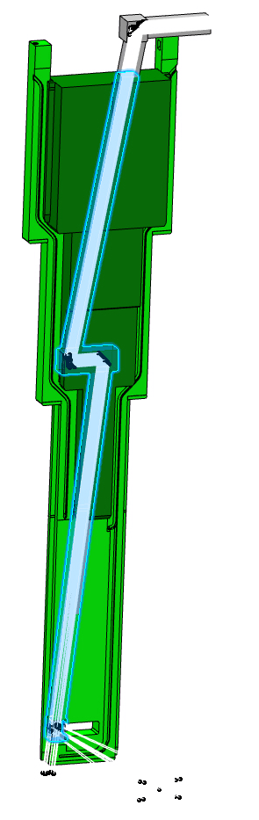
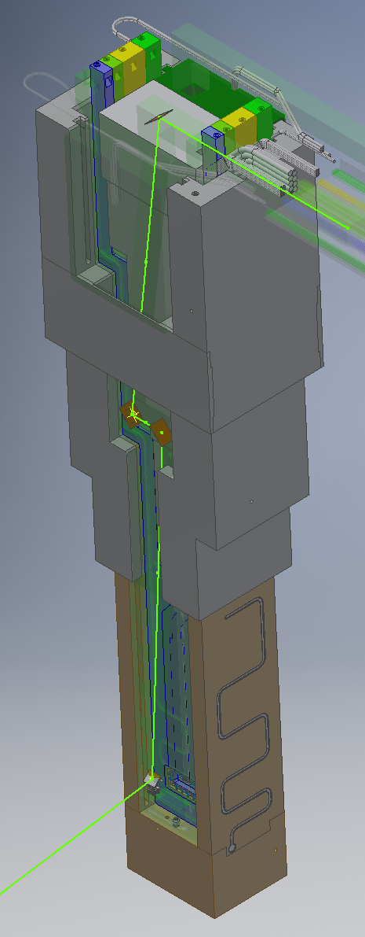
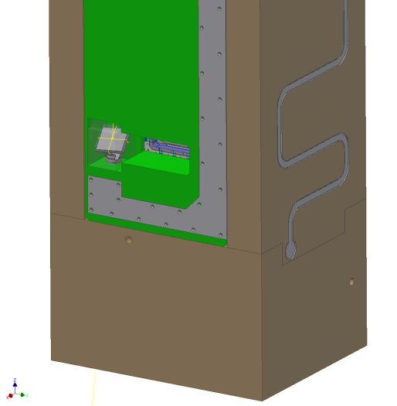
Integration into the
Proton Beam Instrumentation Plug ("PBIP")
Design and tolerancing in close collaboration with target (ESS, and ESS Bilbao)

Slide 7
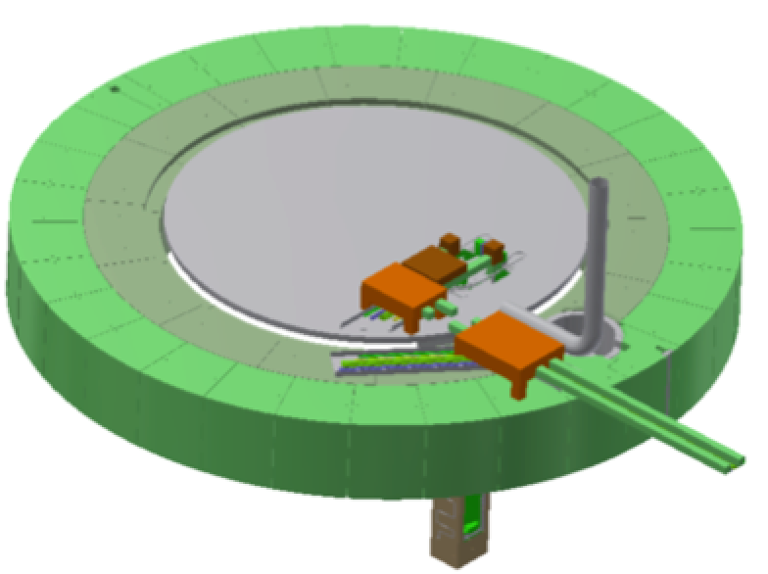
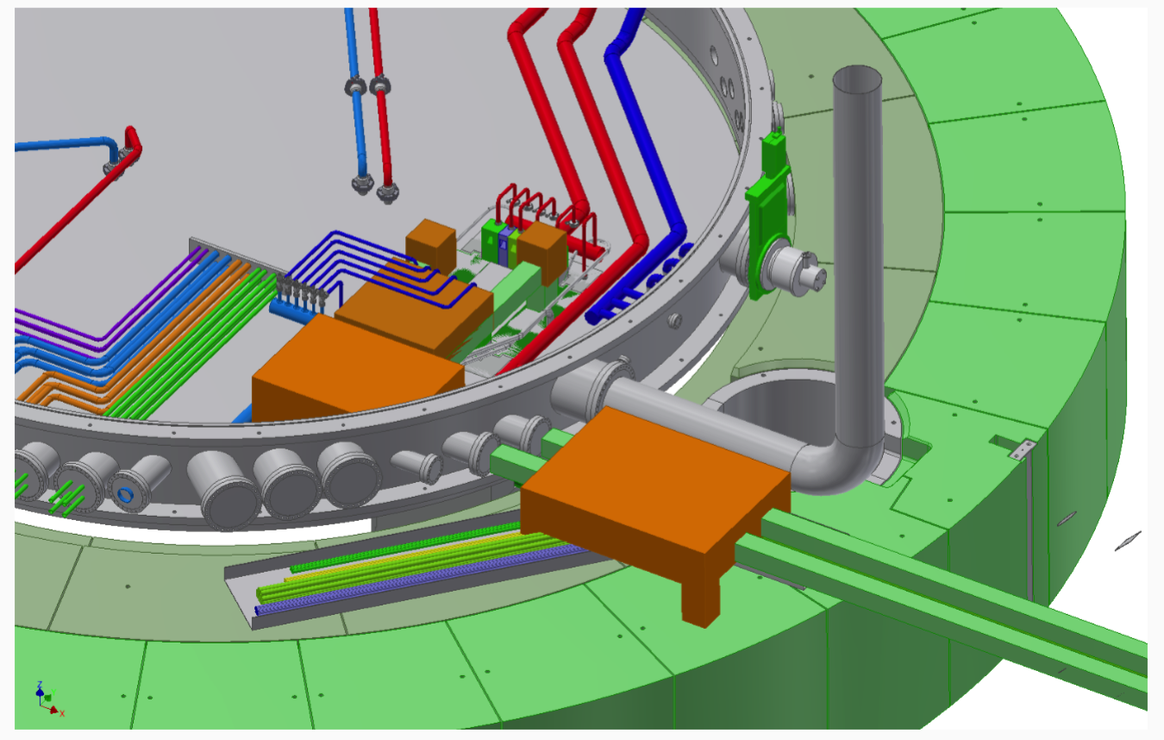
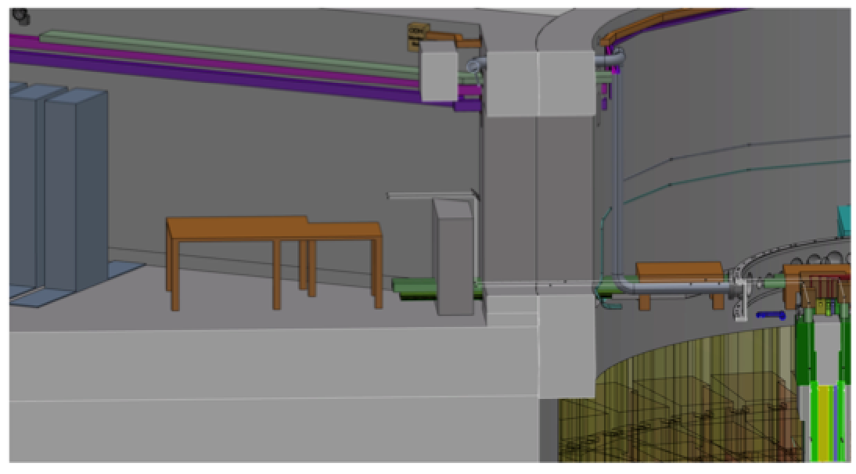
Transport to
connection cell
Mirrors 5 to 8 in the connection cell
CAD models in place and
space reserved in the
master ESS CAD model.
space around space reserved (for access)
still an issue

Slide 8
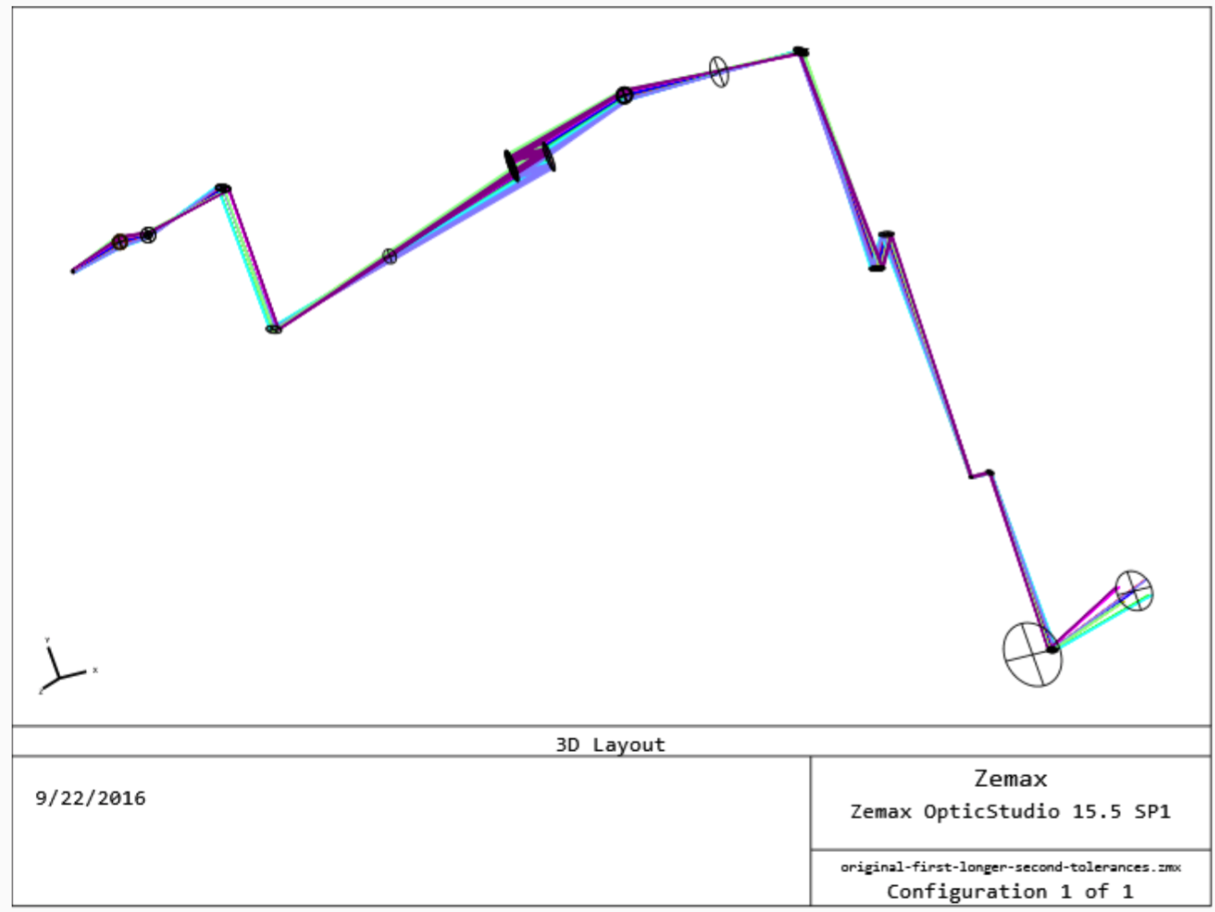
Modelling: ZEMAX
Design
Performance, resolution
Tolerancing

Slide 9
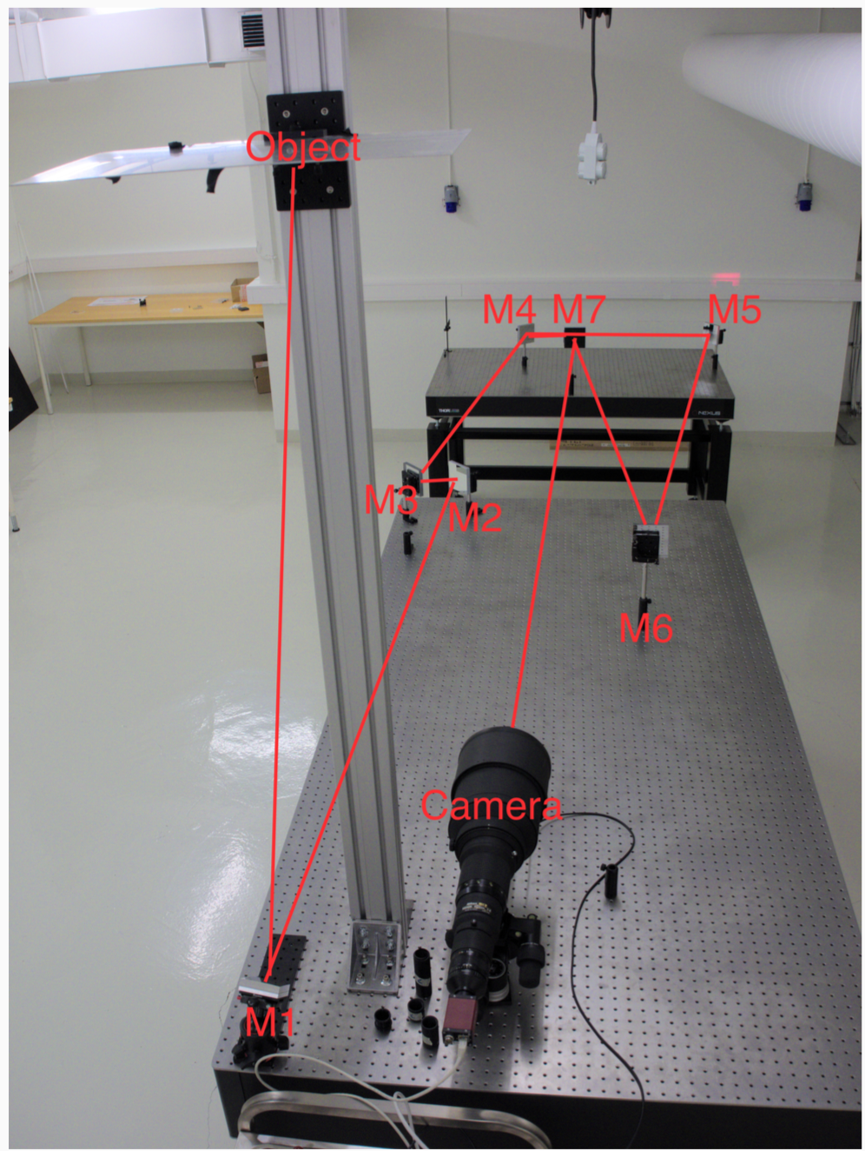
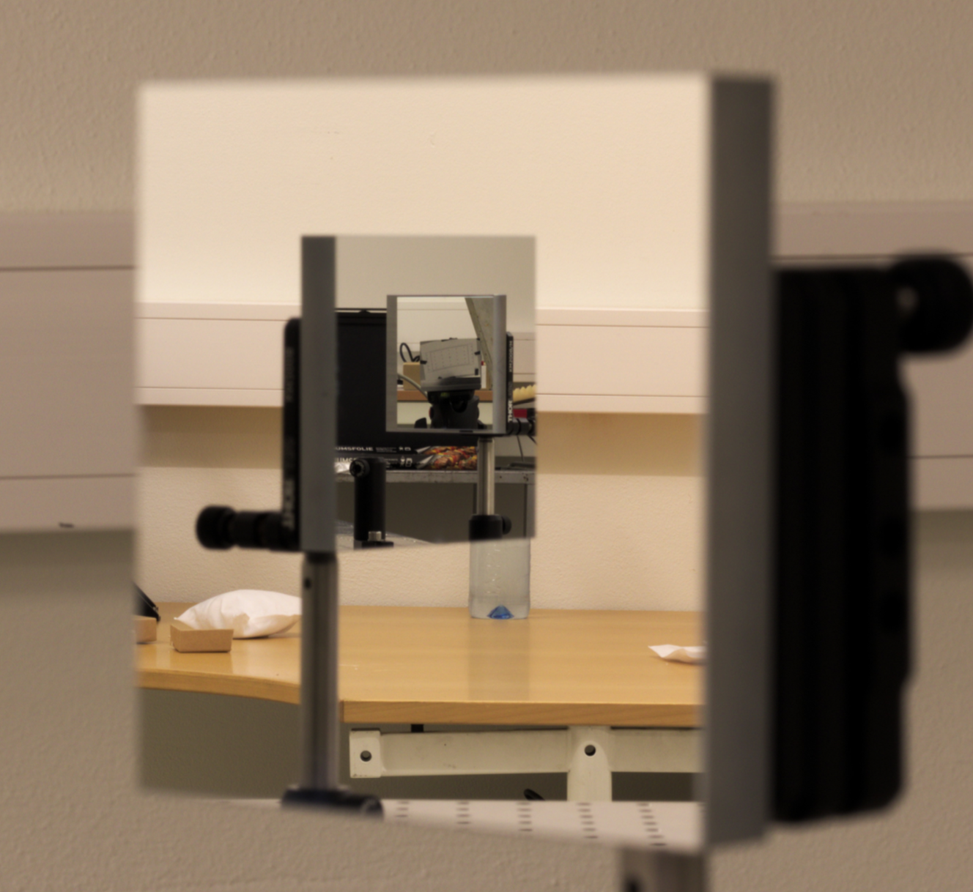
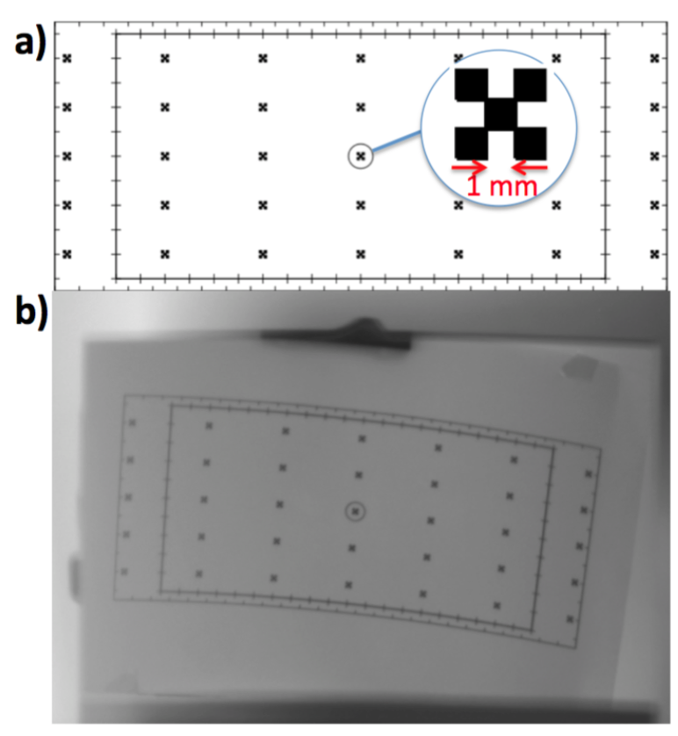
Prototype construction in Oslo
Prototype constructed at Oslo
Invaluable for tolerance and alignment studies
Performance assumptions verified (resolution of 1 mm)

Slide 10
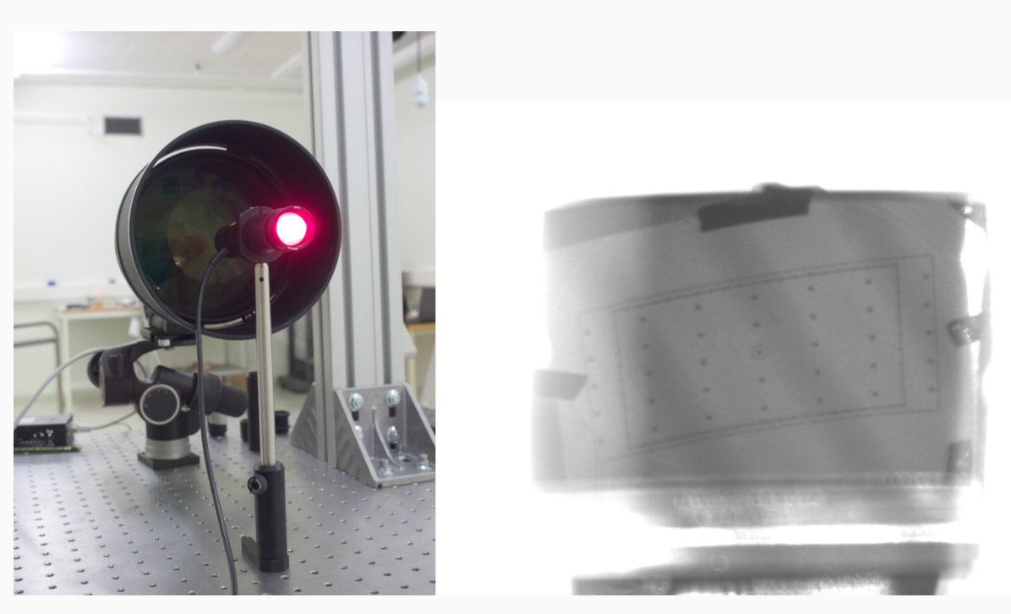
Prototype: Illumination system

Slide 11
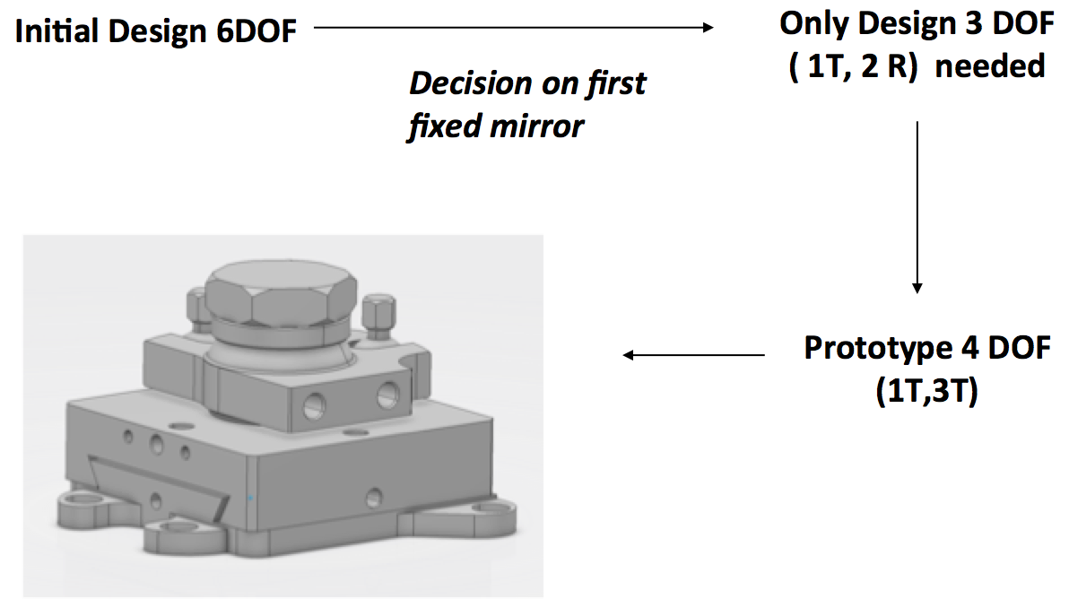
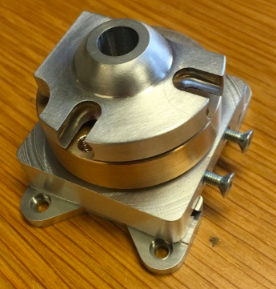
Integration and "bendamount"
Plan is to adopt
ESS-designed
"bendamount" for most of the imaging systems.
Fabian Rey (ESS)

Slide 12
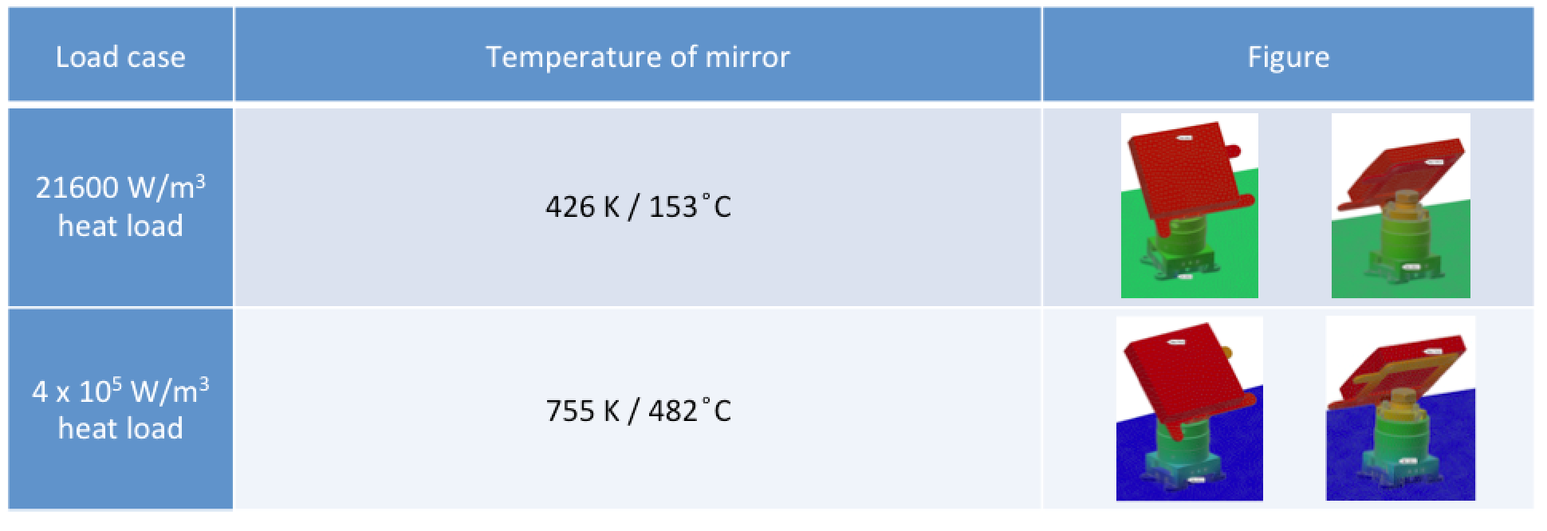
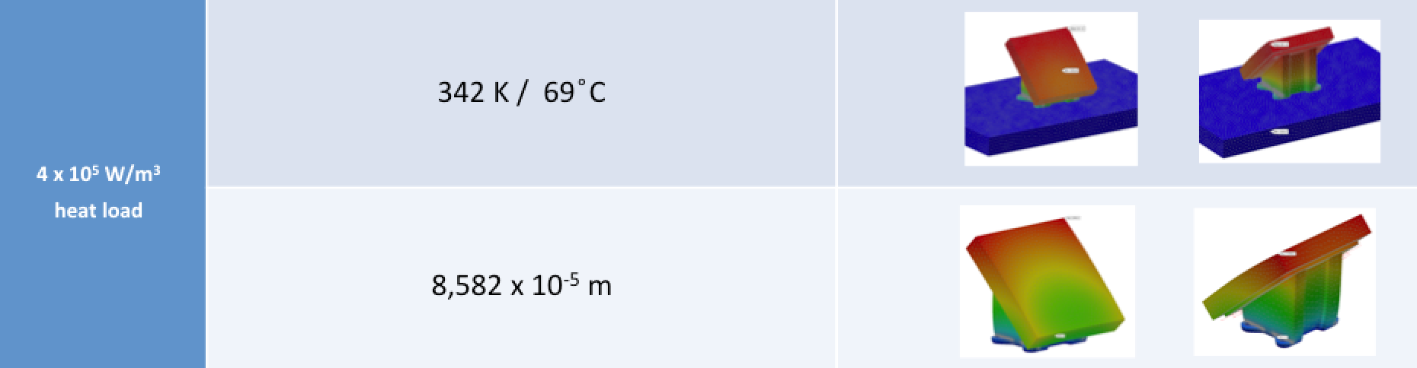
"Bendamount" for first mirror
Simplified, better contact, less DOF, for first mirror
Simplified solution required. Current plan: measure, manifacture and install on the spot.

Slide 13
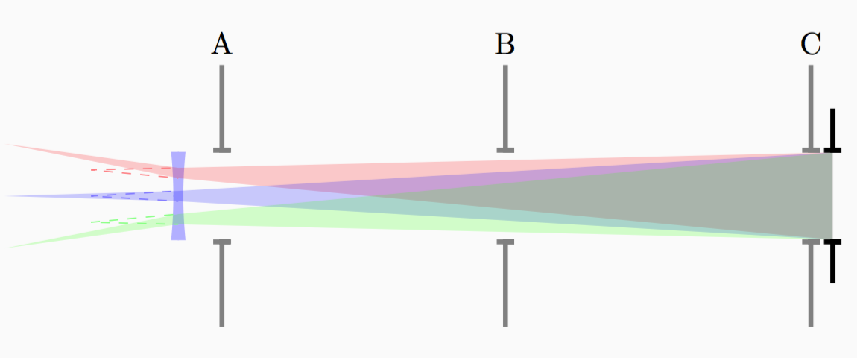
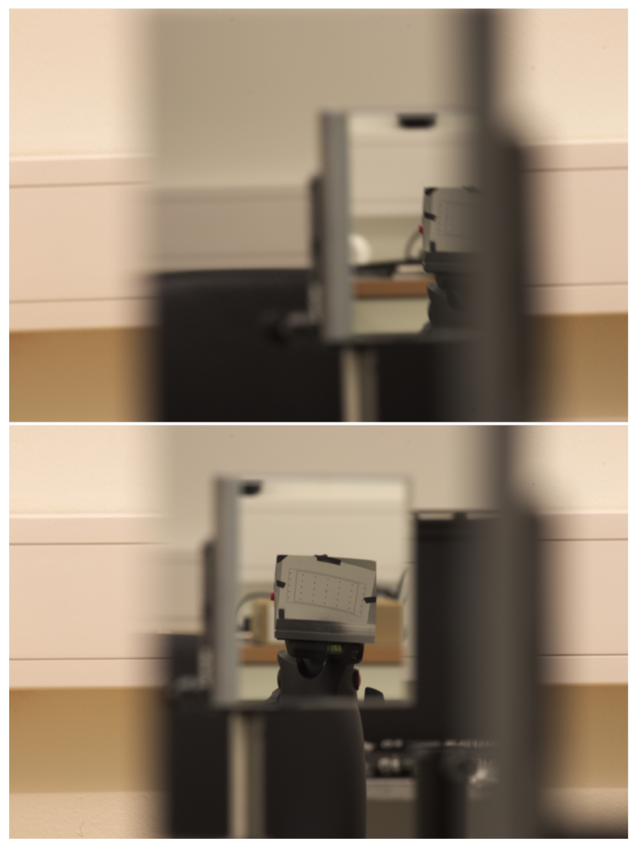
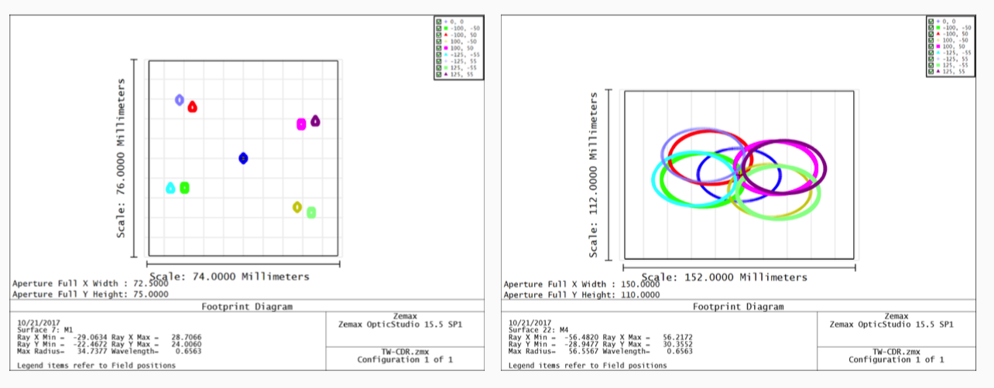
Tolerancing
Prototype: tolerancing
ZEMAX: tolerancing

Slide 14
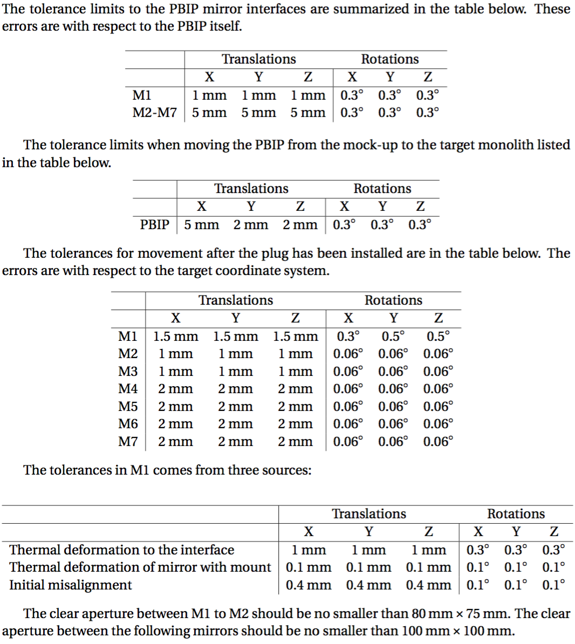
Tolerancing work lead
to tolerance limits
and also tolerances
budgets, developed
in collaboration
with target in-link
partners.
Final OK pending full
thermal analysis of
PBIP with components-

Slide 15
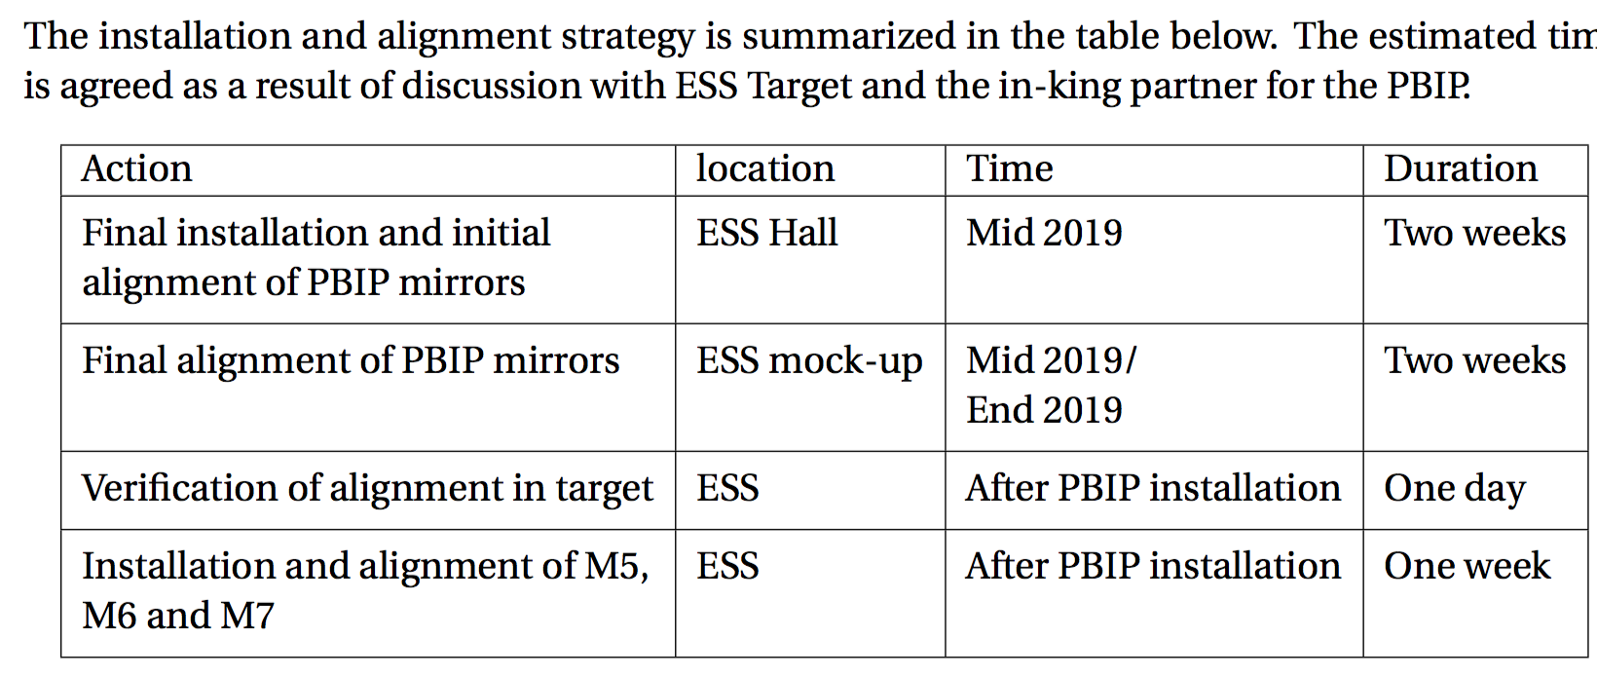
Installation and alignment plan is developing
Important to get sufficient time to install and align components at ESS.

Slide 16
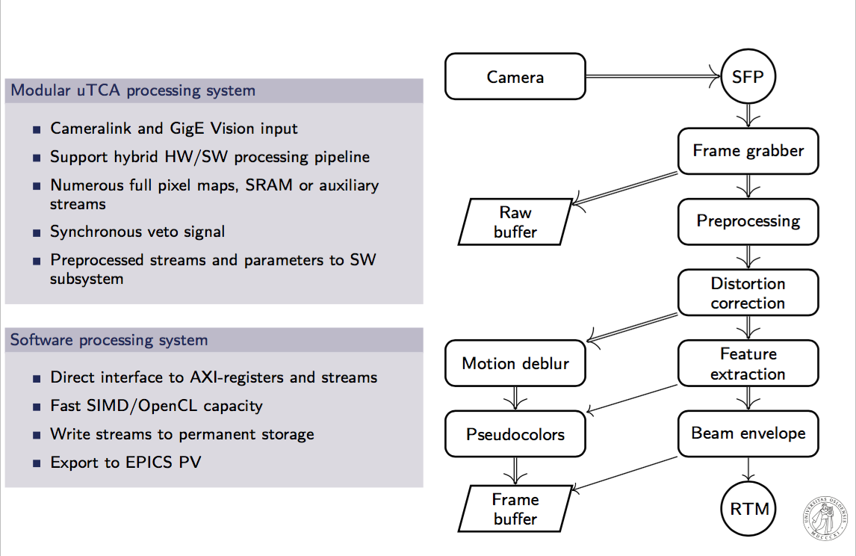
Electronics: system architecture
"software"
"hardware"
Ole Røhne
(RTM: rear transition modules)

Slide 17
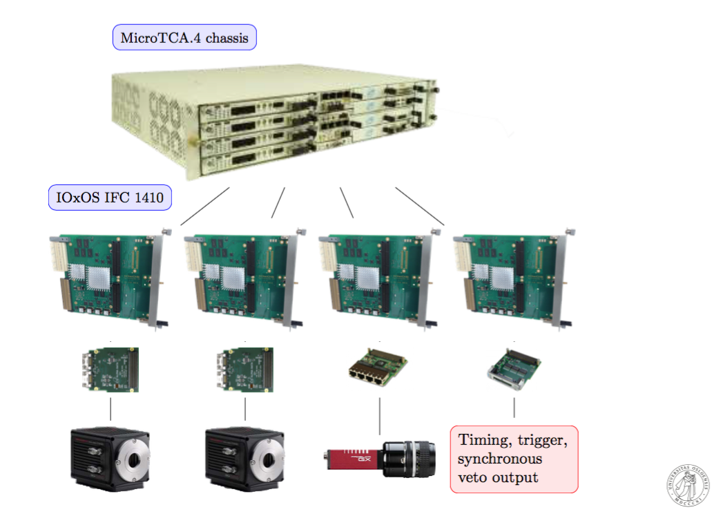
Electronics hardware: ESS selected solution
For the moment, we develop algorithms on "Oslo-hardware".
Awaiting ESS mTCA-hardware prototype to start development on "final hardware.
Critical to have hardware in place soon, however, preferable to wait until hardware has been well tested at ESS.

Slide 18
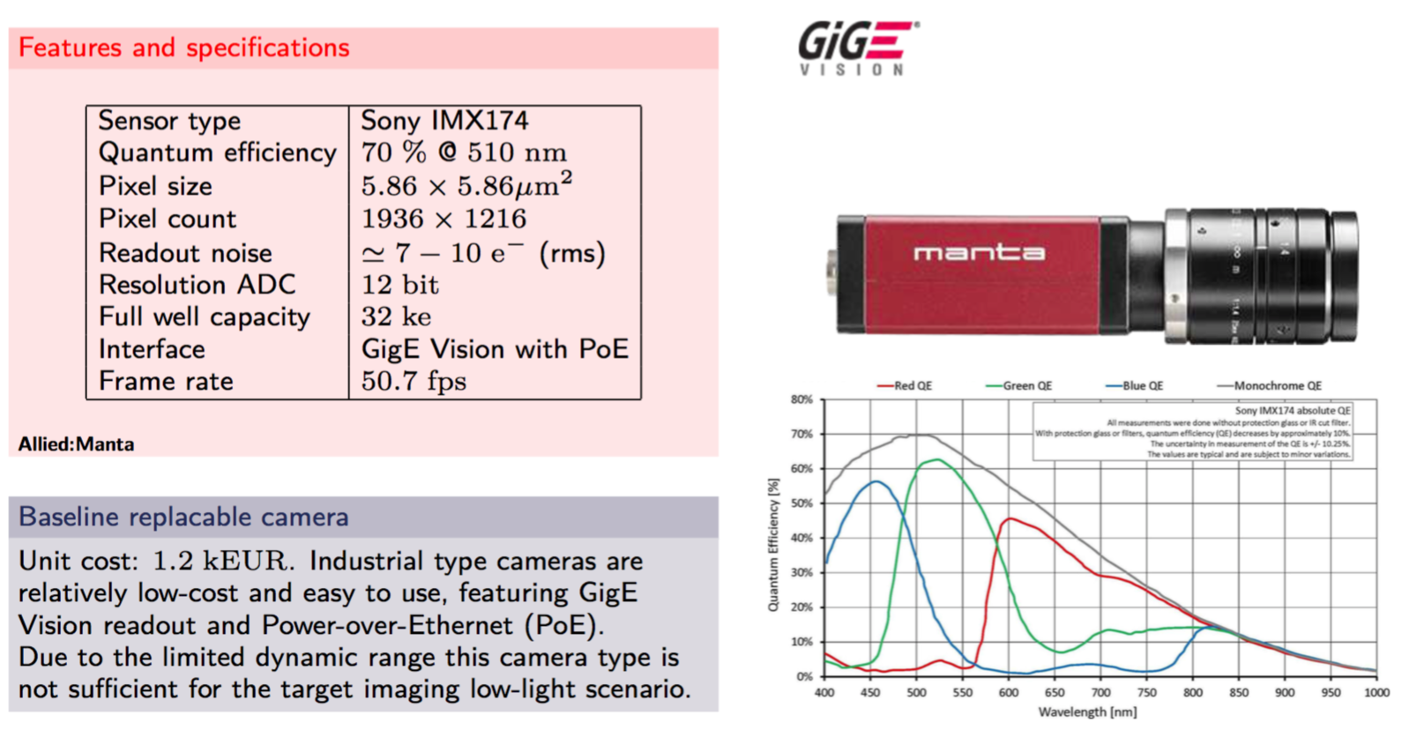
Studies and selection of optimal cameras: dump

Slide 19
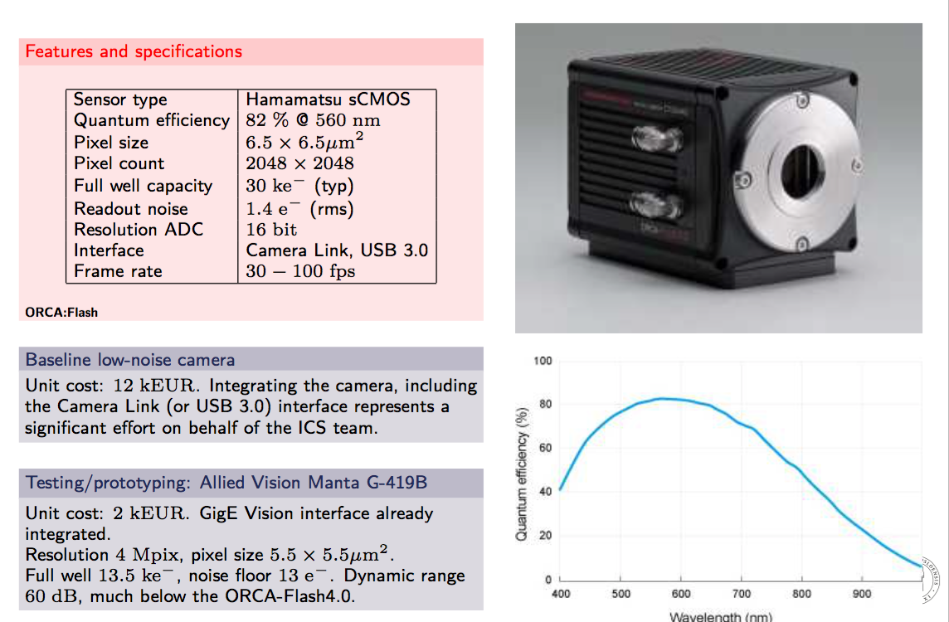
Studies and selection of optimal cameras: target
x 10 more expensive than for dump
several factors better sensitivity
different interface (CameraLink)
Main criterion for target systems: maximize sensitivity.

Slide 20
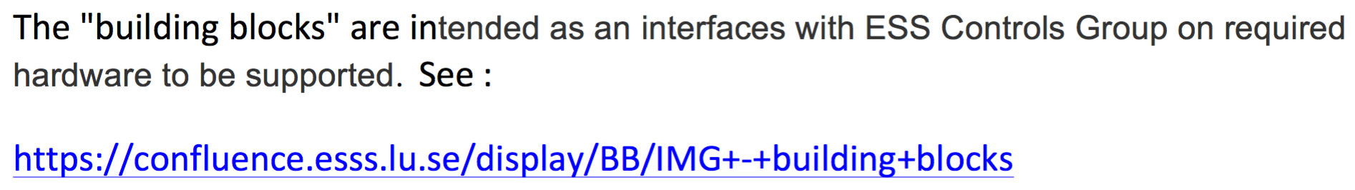
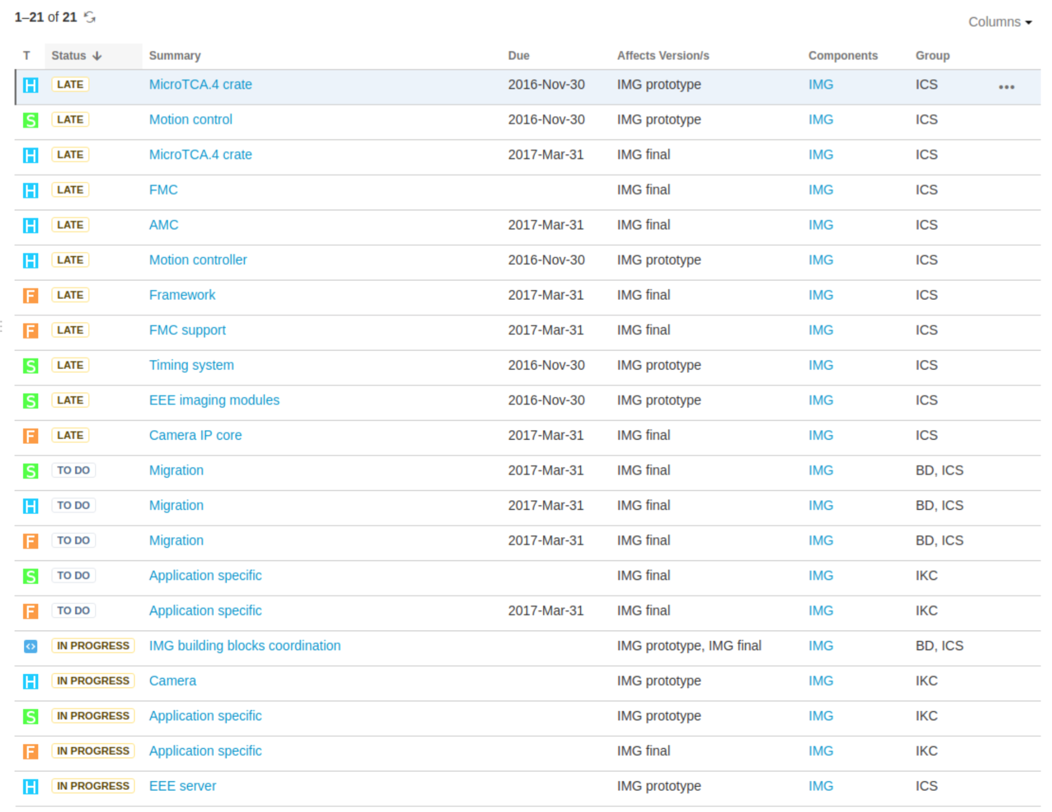
Imaging system: components to be integrated specified in "building blocks"
- require ICS support for integration, Oslo will start developing from there

Slide 21
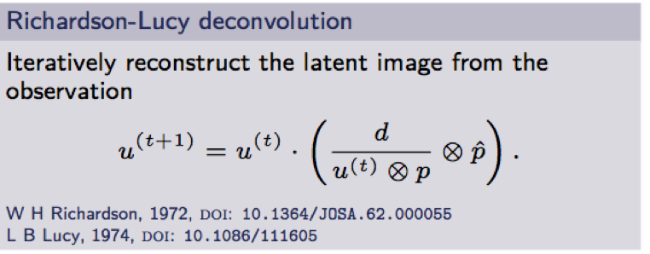
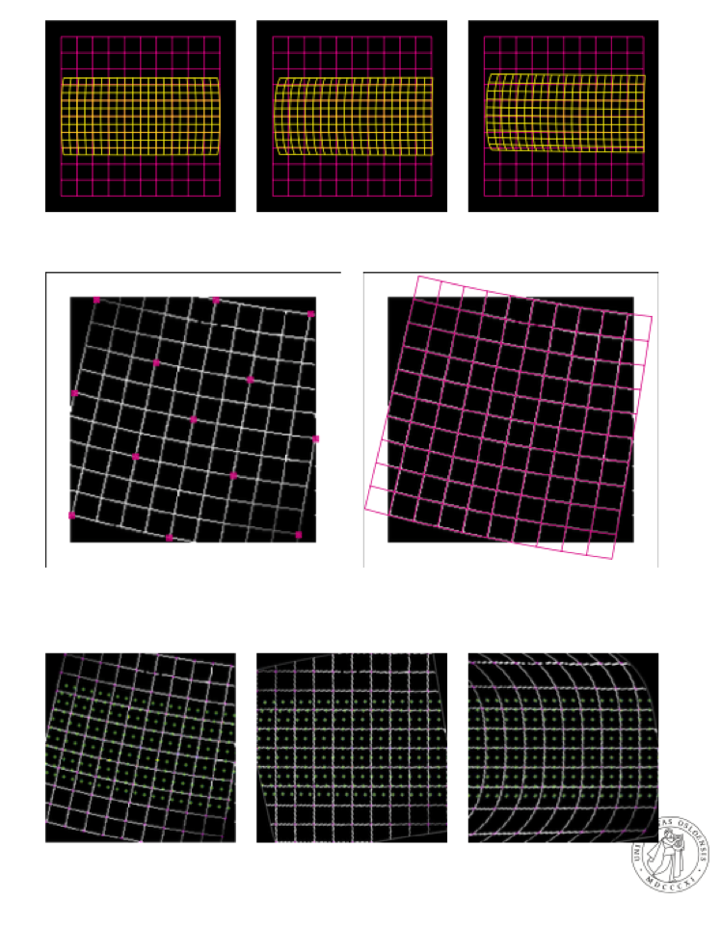
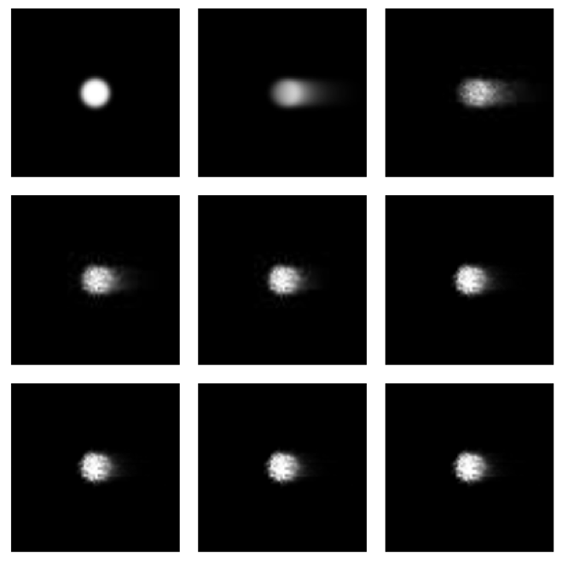
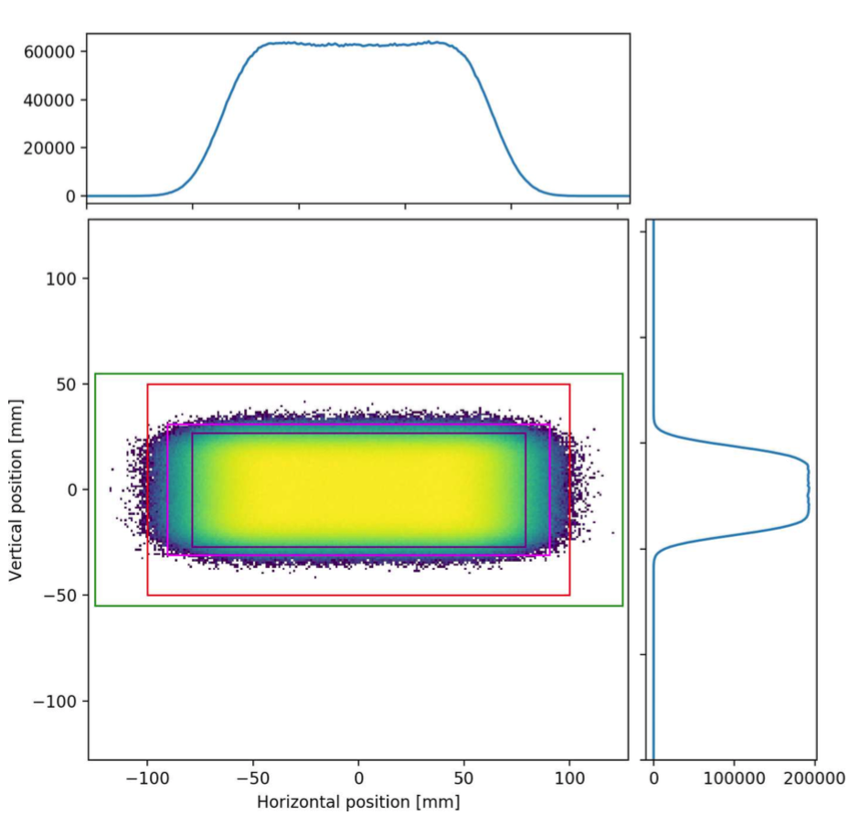
Implementation of algorithms at Oslo

Slide 22
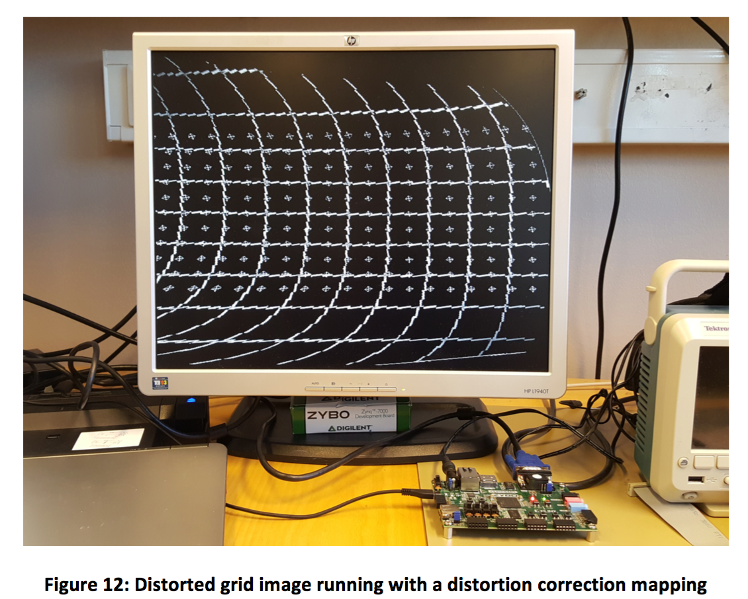
Implementation of FPGA at Oslo
FPGA-functionality should ensure beam-synchronous response
Core algorithms implemented and benchmarked on Oslo FPGA-platform
By having access to a prototype of the ESS FPGA-platform, more confidence in results can be obtained, and double work avoided

Slide 23
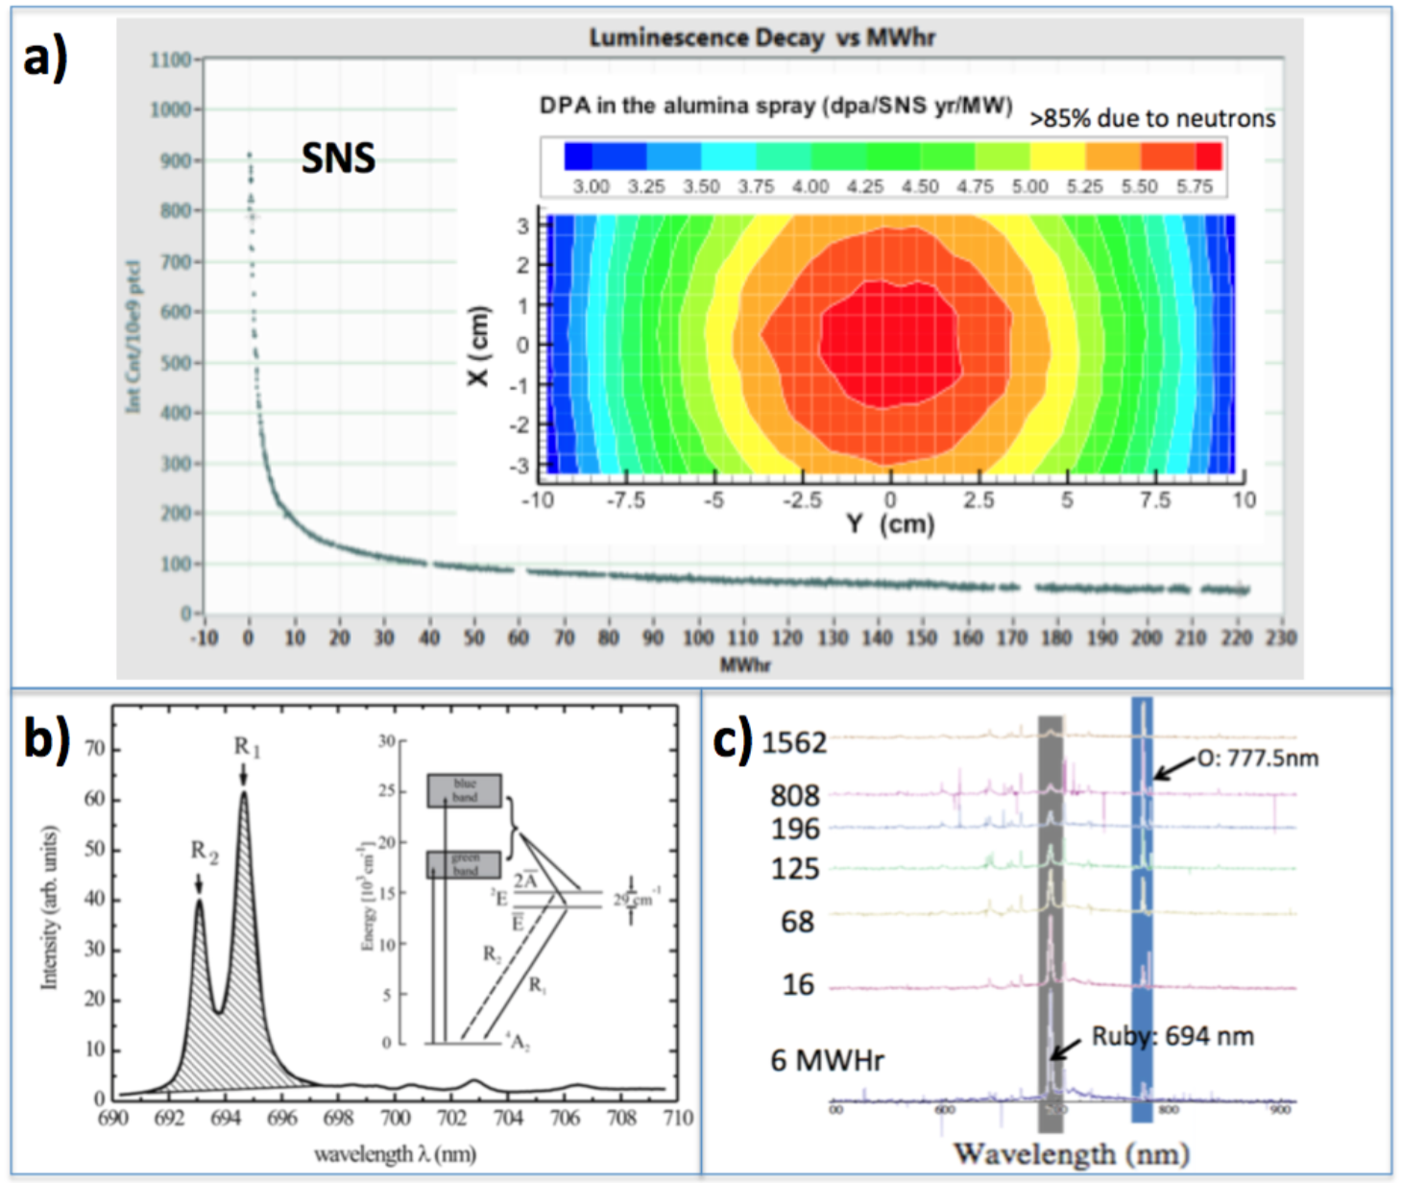
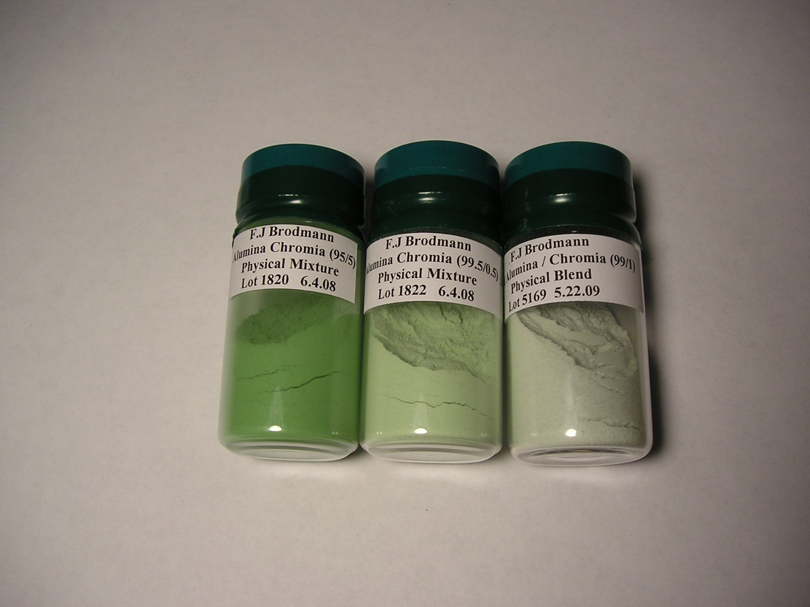
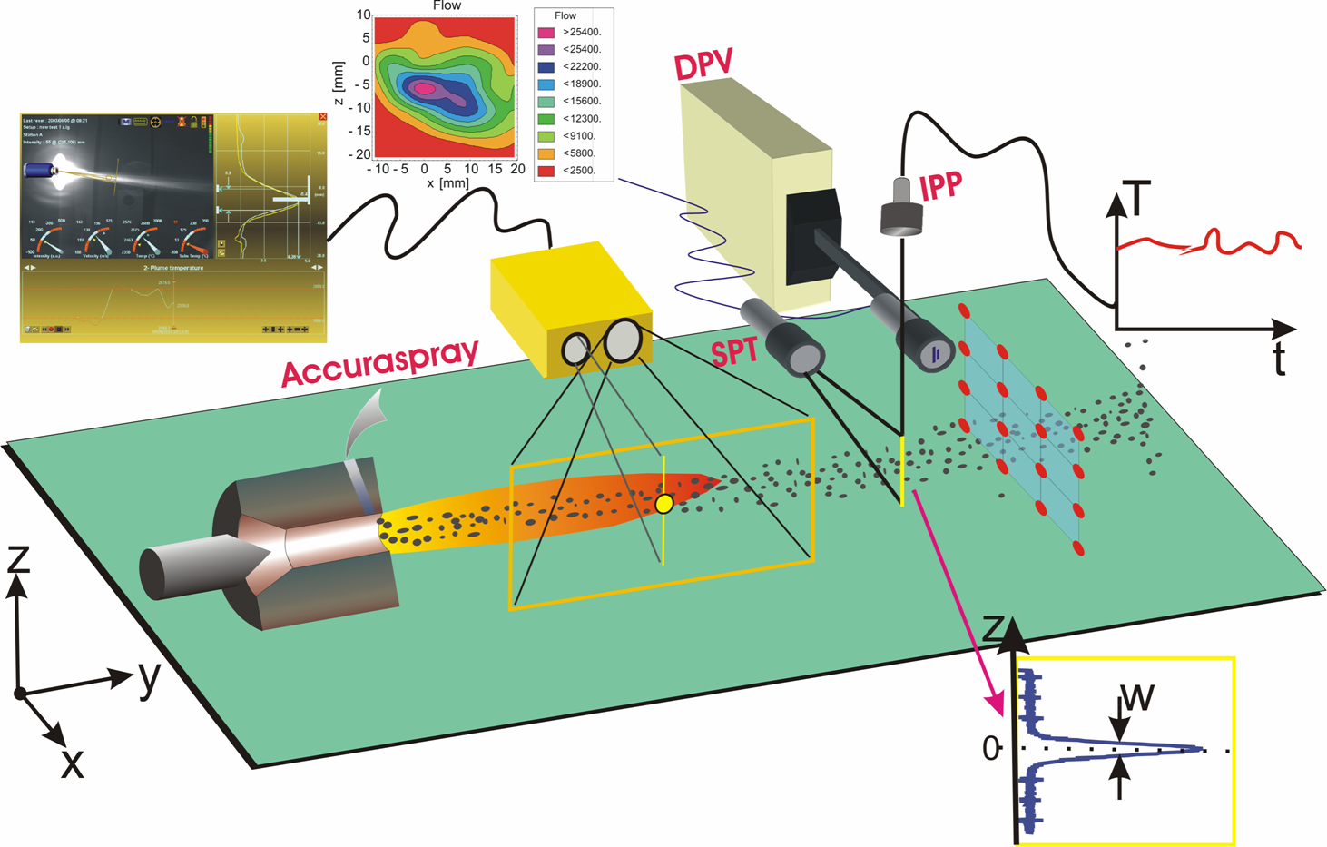
Photon source: luminoscent coating
No new materials/screens allowed inside the monotith. Thin luminoscent coatings must be applied to the proton beam window and beam entrance windows.
Same technique as SNS

Slide 24
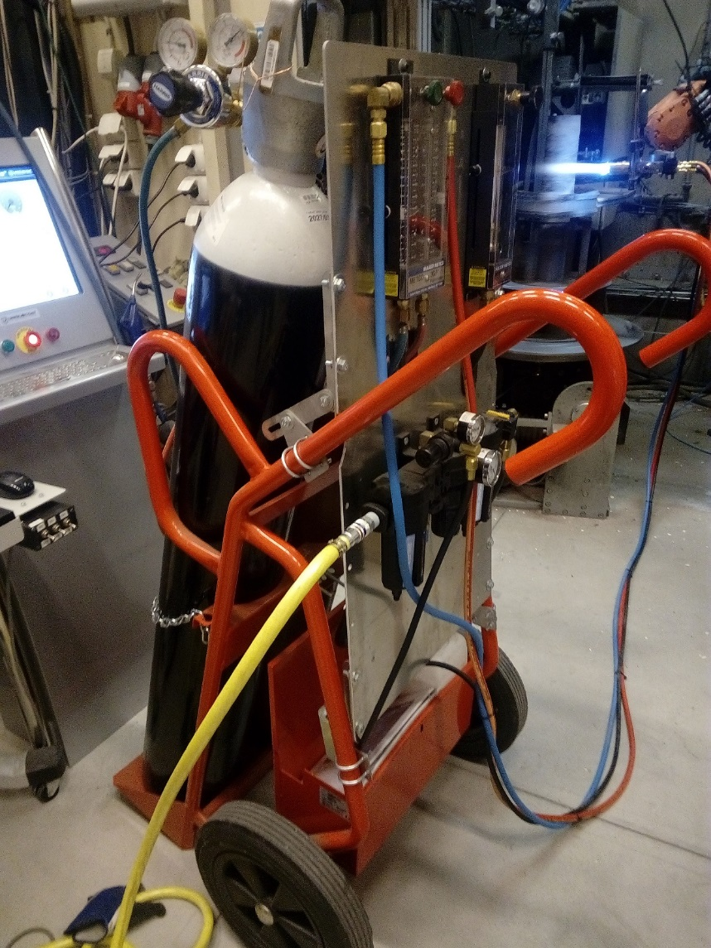
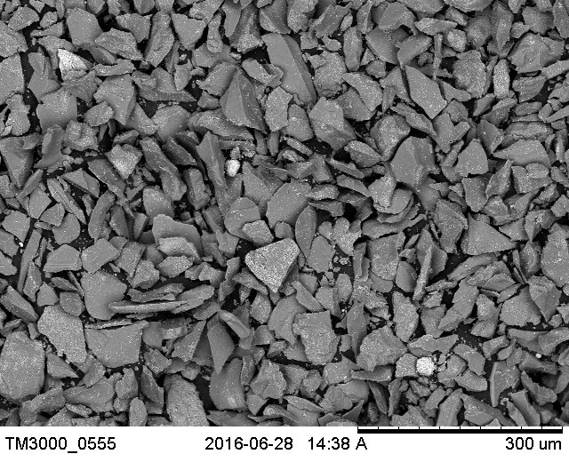
ESS baseline: SNS-like combustion spray
Contracted partner for ESS coating study: University West, Trollhattan
Robot mountable
Stand-alone powder feeder
Assembled and integrated with an existing robot at University West
Cr₂O₃ particles

Slide 25
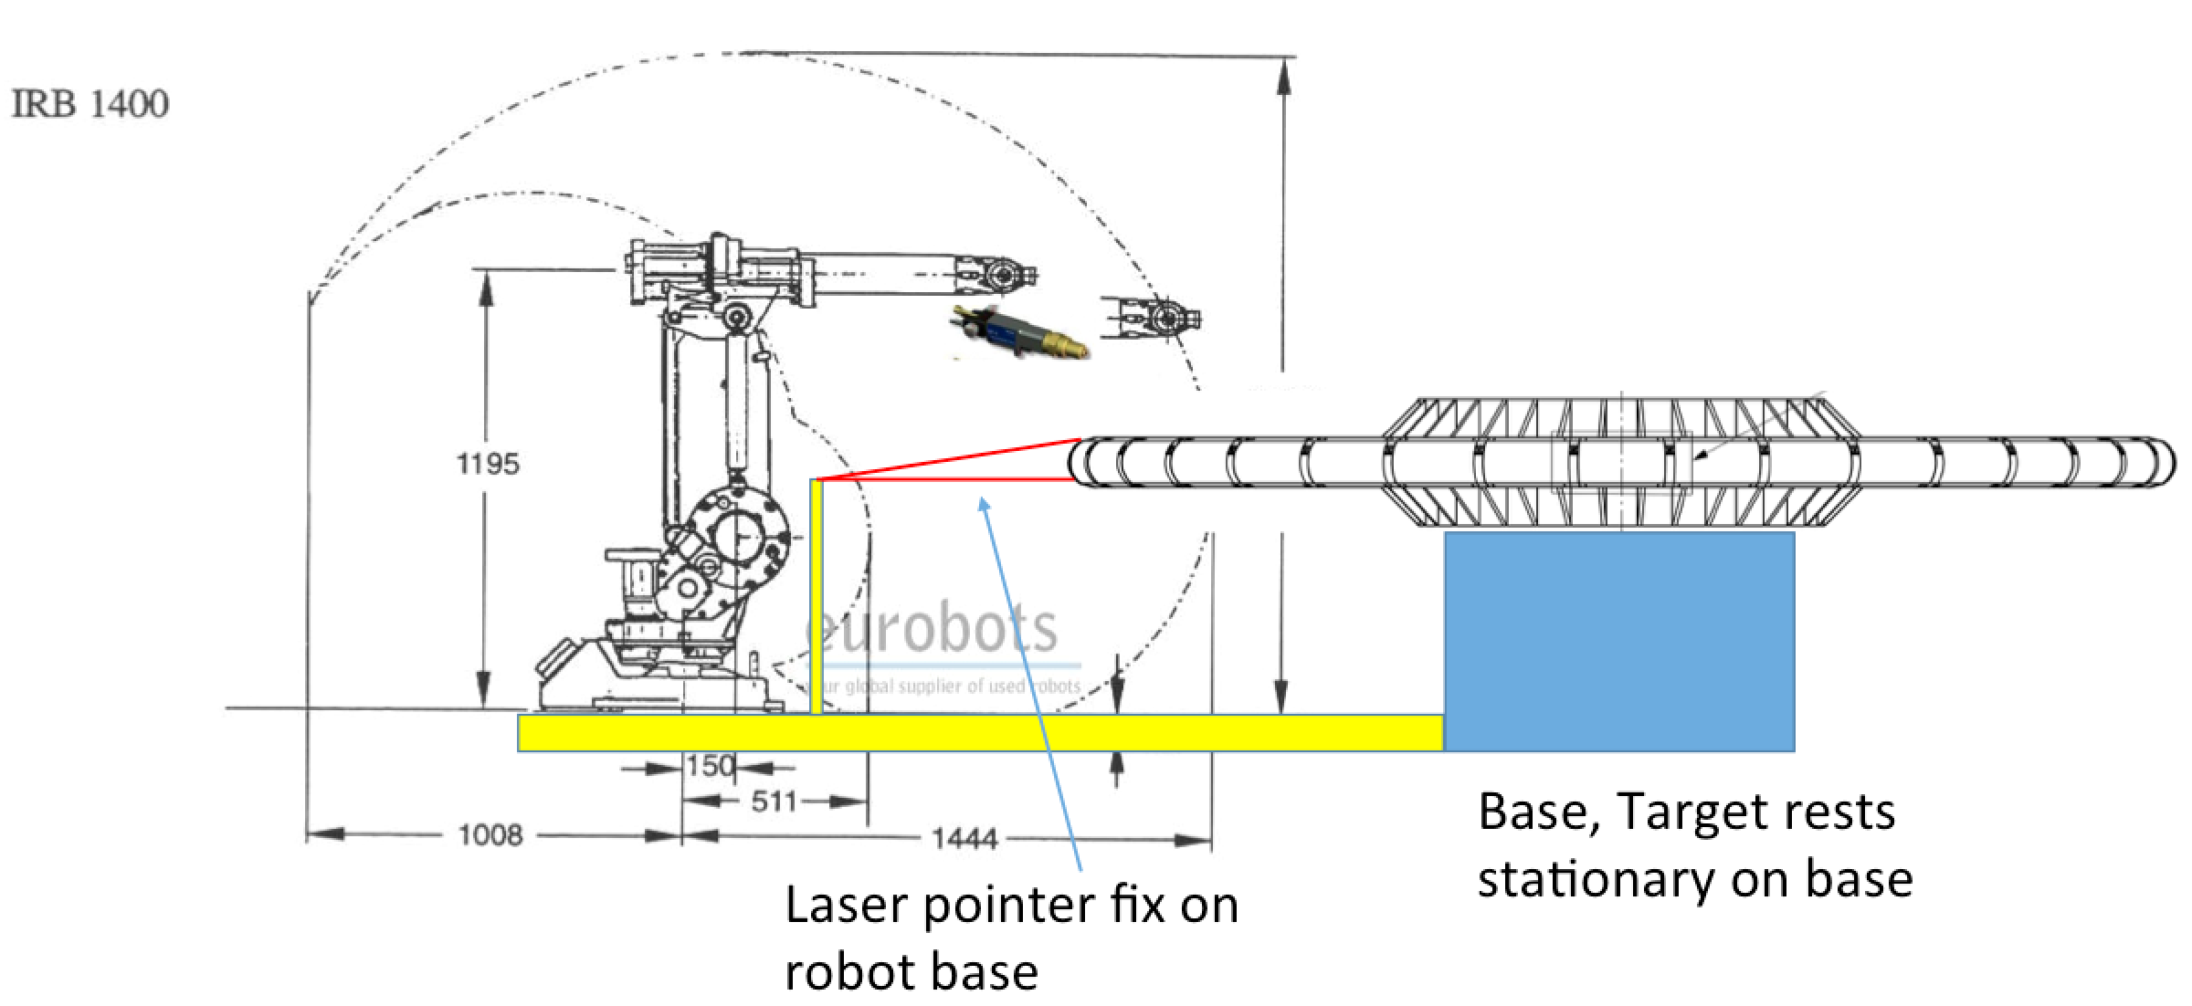
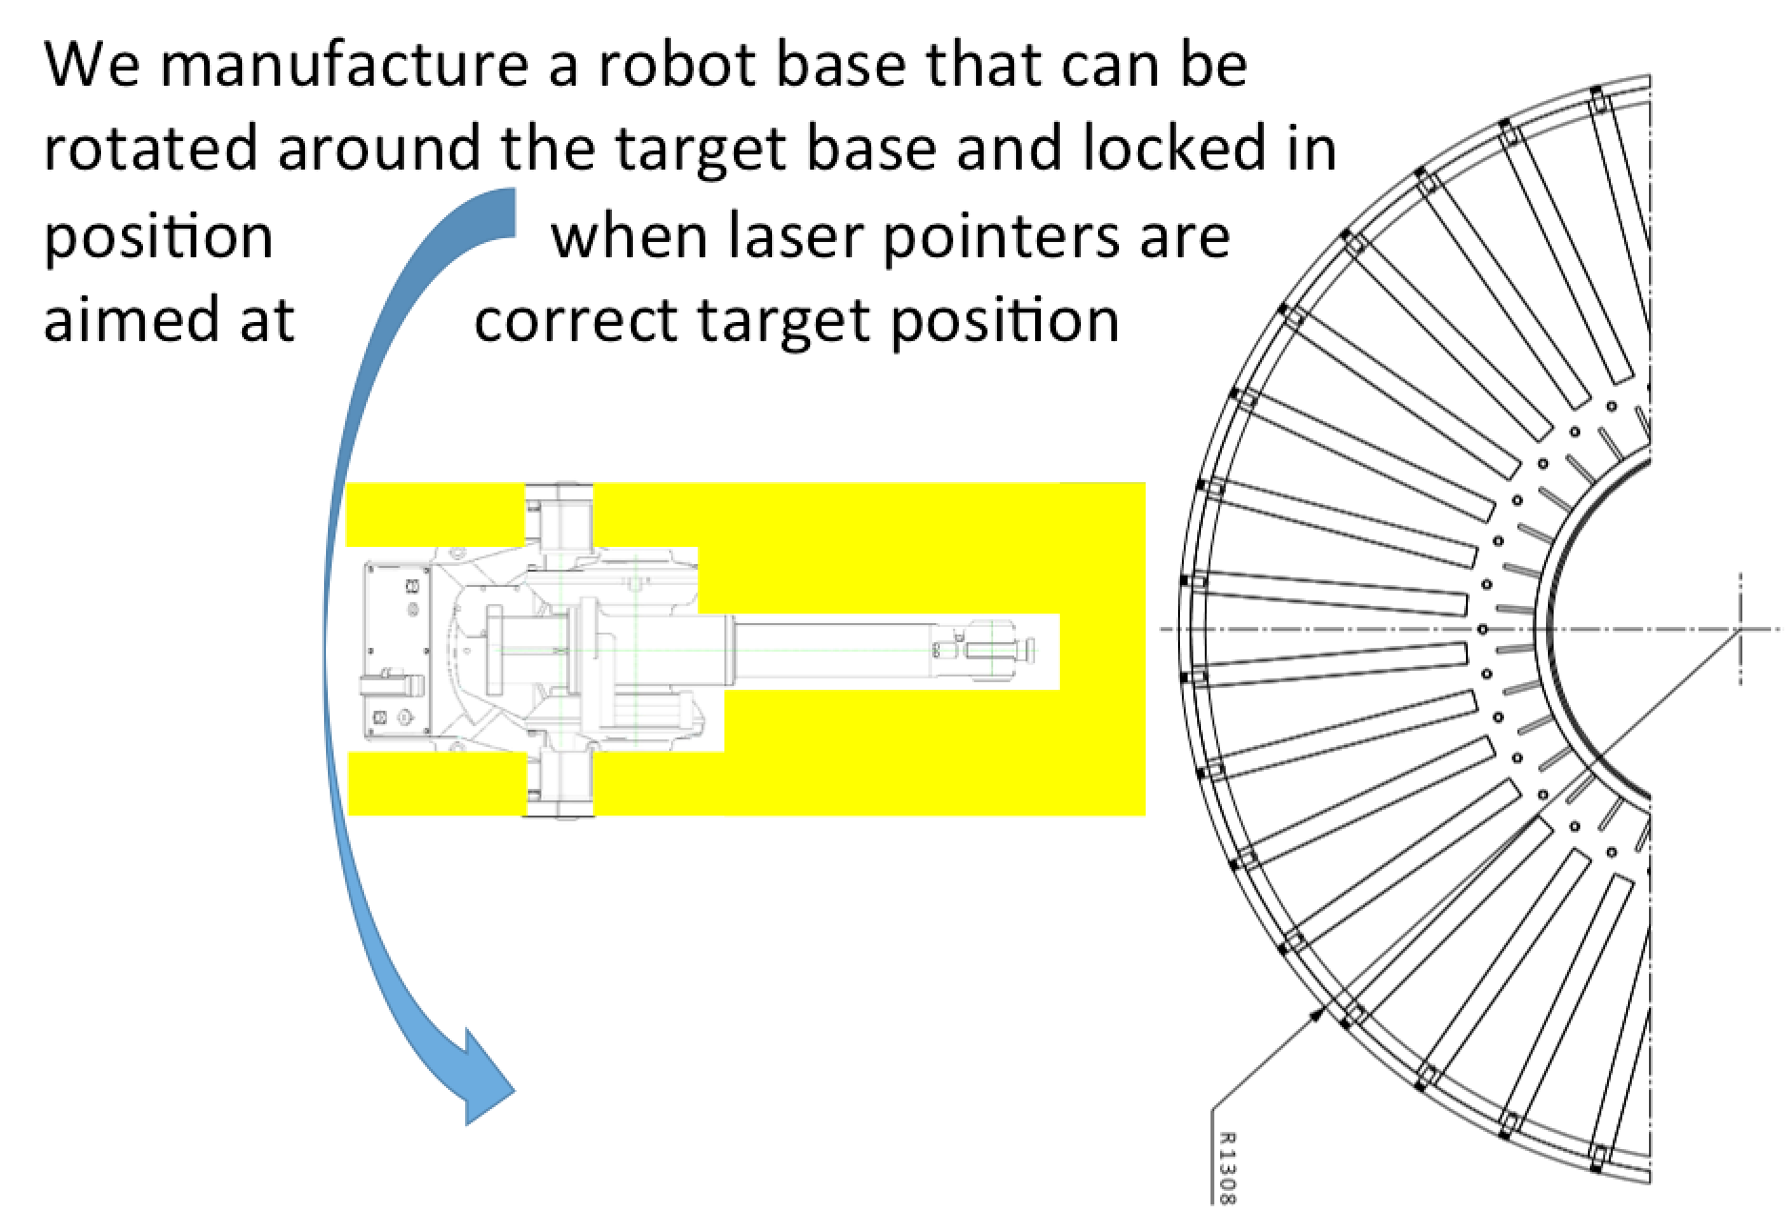
Update: target wheel needs to be coated in one, or two, pieces
As consequence, portable combustion spray solutions preferred
This suggests to use a SNS-like Cr:Al2O3 coating for first target
Coating can in principle be done at ESS Lund, but a complicated set-up needs to be put in place
Schedule discussed with target
Industrialization of process underways

Slide 26
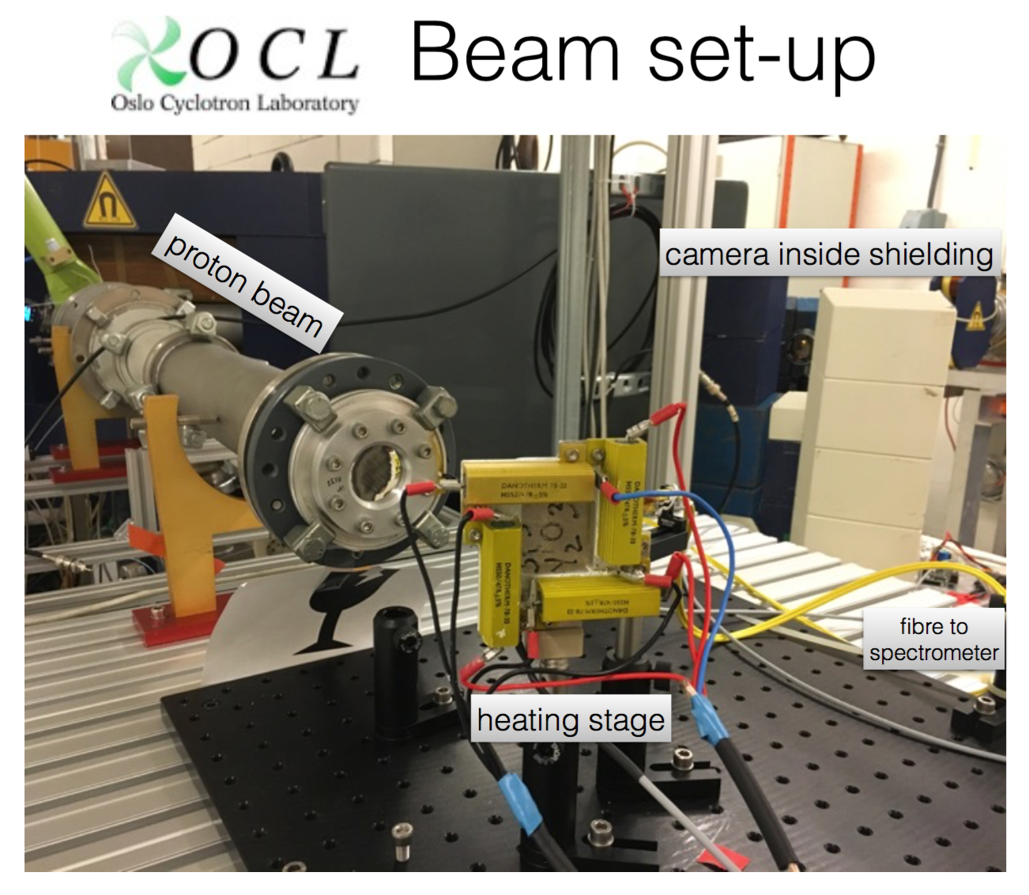
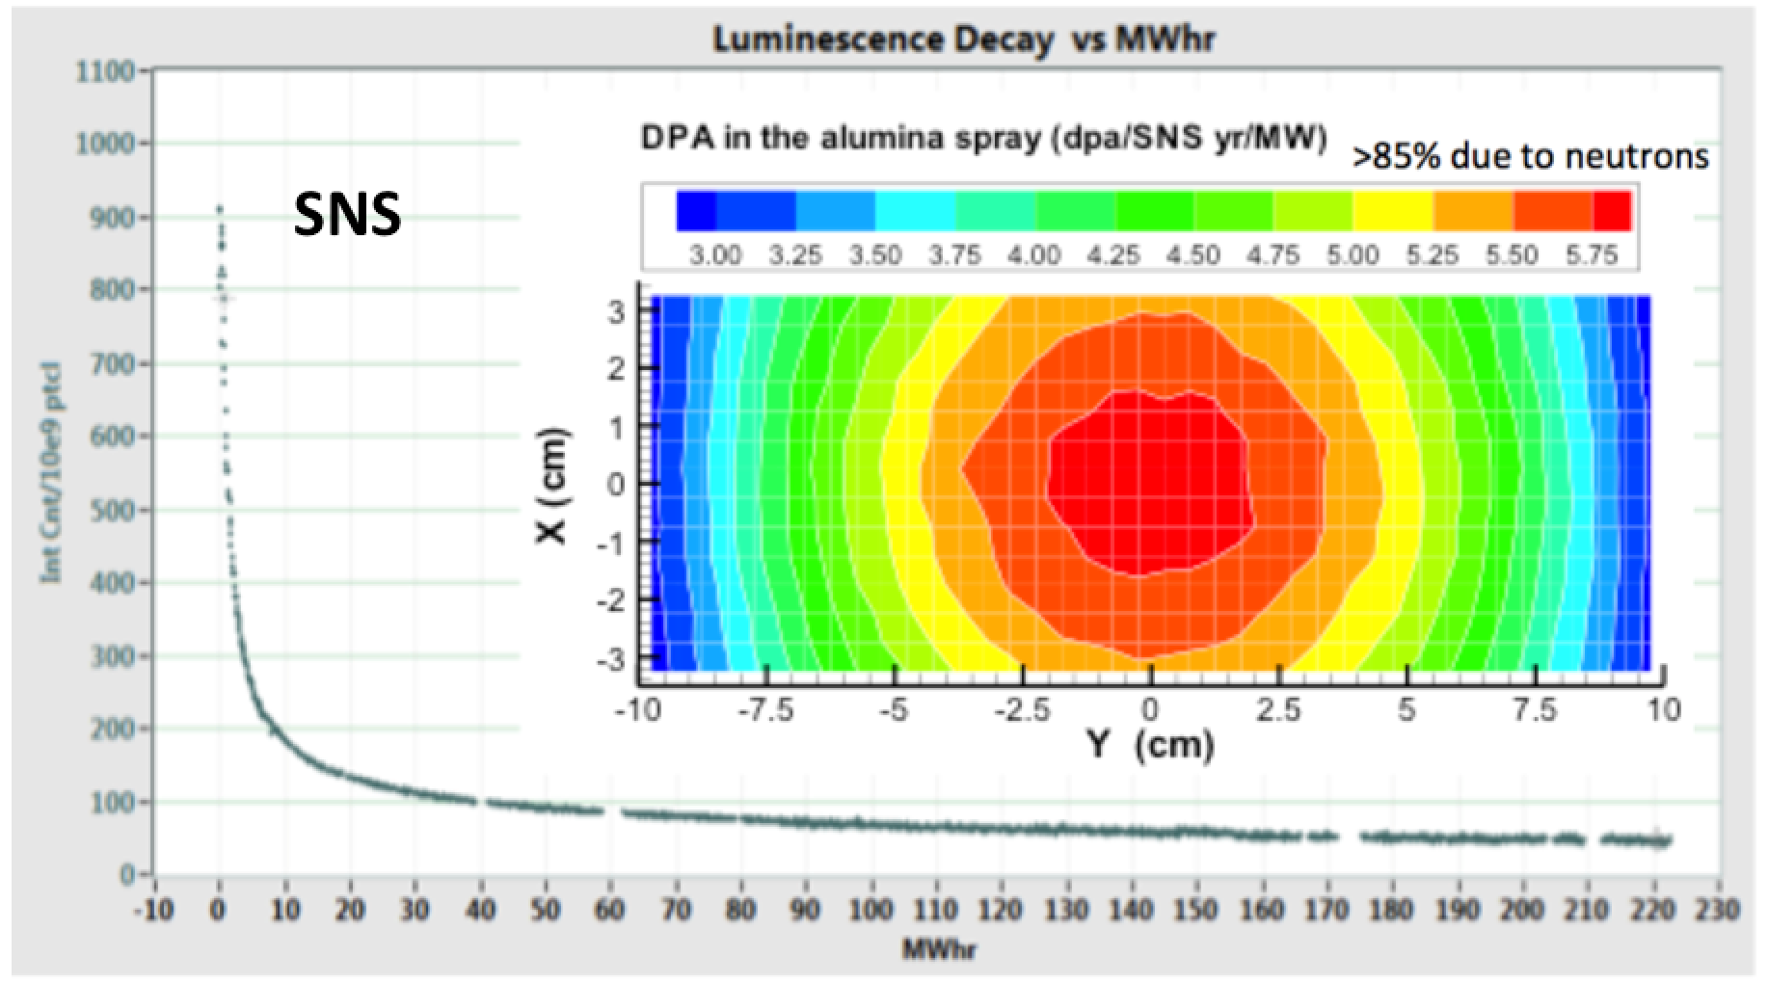
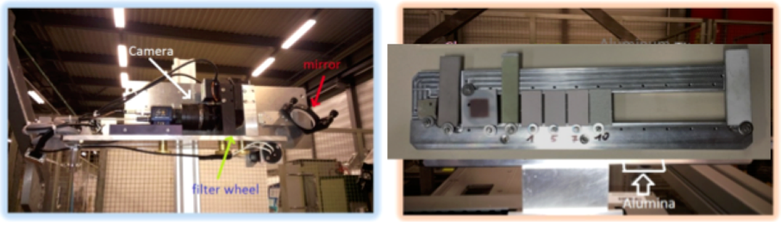
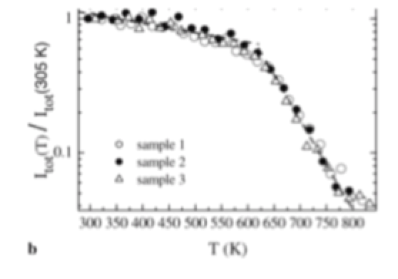
Coating R&D
Cr:Al2O3 coating used at SNS not expected to give sufficient luminosity for 5 MW ESS
See Cyrille's talk (next)
Oslo Cyclotron
test stand
Oslo Cyclotron test stand
Oslo aids ESS with R&D for novel,
more performing coatings (different chemistries, coating techniques studied).

Slide 27


Tuning Dump Imaging Systems

Slide 28


Simple optical system,
cameras in tunnel
Radiation studies points to optimal camera locations (high alcoves inside wall)
Keeps optical system simple.
Access to replace cameras and parts has been studied
Multiple-screen actuator system design, based on proven accelerator technology
Interfaces with vacuum vessel and dump well understood, due to continuous dialog Oslo (Ibison) and Cockcroft

Slide 29


Dose from Beam on Dump
Origins of Radiation
In studies ‘on dump’, beam not deflected to target -> enters dump beam-line
  Passes through imaging vessel, stopped in dump
Radiation from particles back-scattered through dump entrance
  Primary protons and secondaries (e.g. neutrons and gamma-rays)
Scattering in scintillation screen contributes strongly to ambient dose
Methodology
Beam energy taken as 2.0 GeV throughout (pessimistic)
Raw FLUKA output gives ENERGY in GeV per particle per cm³ in each ‘region’
Absorbed Dose per particle (in Grays) derived specifically for ‘camera’ regions
Tuning Dump Utilization and Average Beam Current gives Dose per Year
FLUKA Particle tracks showing scattering by screen
Camera 3
Camera 4
Dose (Gy/yr) | IN | OUT
CAMERA 3 | 45 | 5
CAMERA 4 | 15 | 3
Imaging Screen
Screen IN
Screen OUT

Slide 30


Screen Actuators
Screen-in-beam selection permutations
  Vertical = 2 screens
  Horizontal = 1 screen
vertical screens
Orientation | Max Travel required
Vertical | 600 mm
Horizontal | 300 mm
beam
Horizontal screen

Slide 31
Planning and Scheduling - Outline
Milestone | Date | Action
CDR | Oct 2017 | Oslo/ESS
Vessel Specification issued to manufacturer | Jan 2018 | STFC Daresbury (DL)
Vessel Delivered to DL | April 2018 | Supplier/STFC
Actuators integrated and Tested at DL | July 2018 | STFC
Mirror Supports designed | Aug 2018 | STFC
Camera Housings prepared in walls | Sept 2018 | ESS
Dump installed at ESS | Nov 2018 | Bilbao
Beam-line completed (upstream of Vessel) | April 2019 | ESS
Vessel Integrated to Beam-Line | May 2019 | ESS
Mirror Supports installed | June 2019 | ESS
Mirrors fitted, System aligned and tested | July 2019 | Oslo
First Beam-on-Dump | Oct 2020 | ESS
Notes:
The current schedule is not confirmed as some dates are speculative at this time.
One of the constraints is design manpower at Daresbury, but this will not affect final delivery on current estimates.
Clearly, dump installation is critical, as beam-line installation cannot be completed without it in place.
Although this plan refers to the recently-revised date for Beam-on-Dump, delivery of Imaging Systems will proceed to planned dates.

Slide 32

Other risks to the system
Target atmosphere specifications changed (or, concretized) from 1 atm He, to "0.1 – 1 mbar air". Not received any formal specification document (still under discussion?)
Poor vacuum has seemingly lead to corrosion at SNS and KEK
At SNS the corrosion has lead to critical failure of their imaging system
Protective coating may help, however, risk for schedule delay
Strategy: tests of protective coating (acid, radiation) together with SNS

Slide 33
Summary
The imaging system is a challenging system, and should be considered an experiment until fully commissioned
Design for the imaging systems completed, verified by the CDR
Currently implementing recommendations from CDR before going into production
Imaging systems in principle on original schedule (commissioning end-2019). Oslo work scheduled currently being aligned to the updated ESS schedule
Collaboration and communication with ESS, Cockcroft, Bilbao... crucial. Has been good in the CDR phase

Slide 34






Thank you for listening!
Slide shows Oslo personnel involved in the
ESS IK-delivery.
The ESS project:
Utilizing a broad spectrum of
Oslo resources. Increasing Oslo competence for future participation in accelerator projects.

Slide 35
Extra

Slide 36

Note, the baseline solution : same chemistry for scintillators as used at CERN ("Chromox")
Cr:Al₂O₃
The accelerator community, worldwide, seems to have not pushed scintillator development the last few decades. Opportunity to make progress?

Slide 37




Older version of the designs
Older versions of the PBIP optical design, before Oslo entered the project.

Slide 38




ESS: Norwegian accelerator involvement
Oslo: currently involved in the development of a novel and robust Machine Protection System with one PhD student (located at ESS).
The accelerator will be the world’s most powerful proton driver (5 MW). Superconducting part: 310 m of Niobium Cavities in 2.1 K (liquid) He bath.
Norway: 2.5% of construction cost, of which “In-Kind” will be 150 MNOK (18 MEUR).
Accelerator initiatives :
Univ. of Oslo: in-kind project for imaging systems
Univ. of Bergen: 2 man-years at the Univ. of Agder: expert on ion sources

Slide 39
Plasma spray trials with baseline powder
Varied parameters over a wide plasma power, enthalpy window

