Slide 1
THE STATE OF BEAM DIAGNOSTICS
Tom Shea
and the ESS Beam Diagnostics Team
Input from: C. Thomas, B. Cheymol, S. Molloy, R. Baron, H. Hassanzdegan, I. Kittelmann, T. Grandsaert, H. Kocevor, C. Derrez,
A. Jansson, M. Eshraqi, E. Adli, M. Poggi, M. Ferianis, I. Bustinduy, P. Aden, T. Papaevangenlou, J. Marroncle, L. Segui, S. Vilcins, A J. Johannson

Slide 2
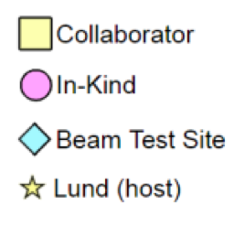
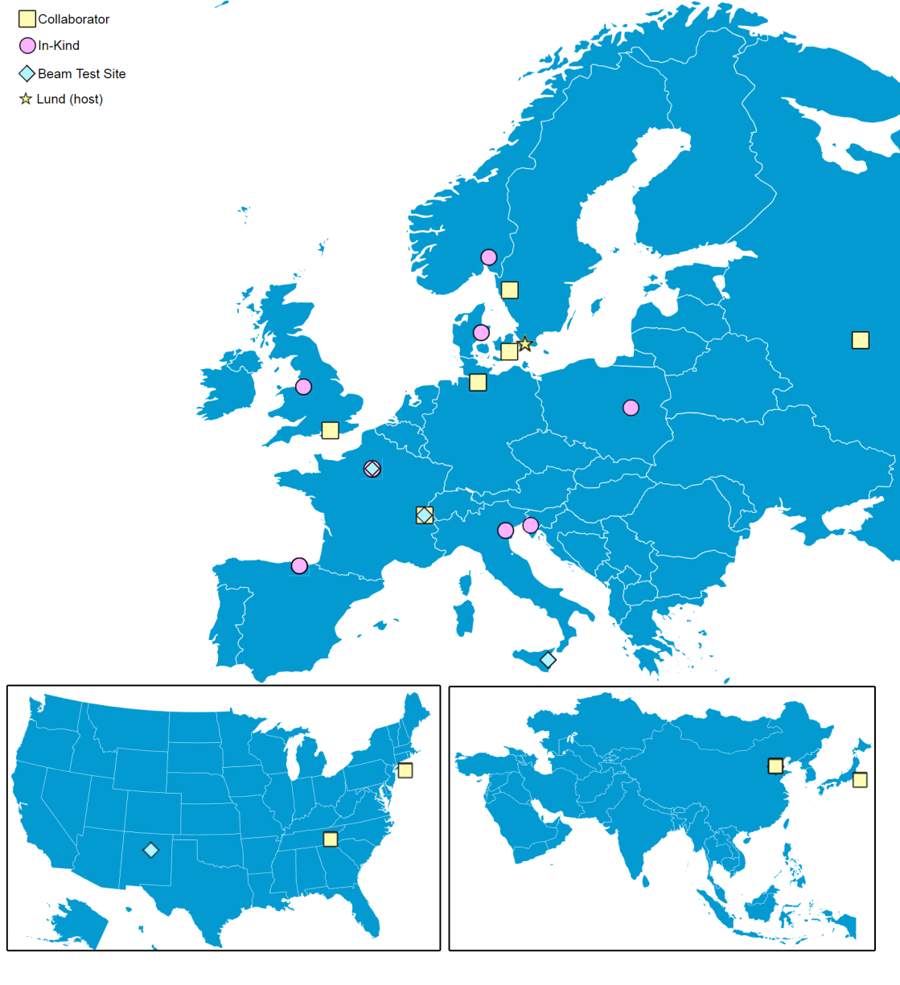


ESS Diagnostics:
20 Partners and Collaborators
Aarhus University
CEA Saclay, Paris
CERN, Geneva
Cockcroft Institute, Daresbury
DESY, Hamburg
Elettra – Sincrotrone Trieste
ESS Bilbao
INFN, Catania
INFN, Legnaro
Lund University
University of Oslo
Technical University of Denmark
Science and Technology Facilities Council, Daresbury
Warsaw University of Technology
Chinese ADS
J-PARC, Japan
Oak Ridge National Laboratory
Los Alamos National Laboratory
INR, Moscow
Högskola Väst, Trollhättan

Slide 3
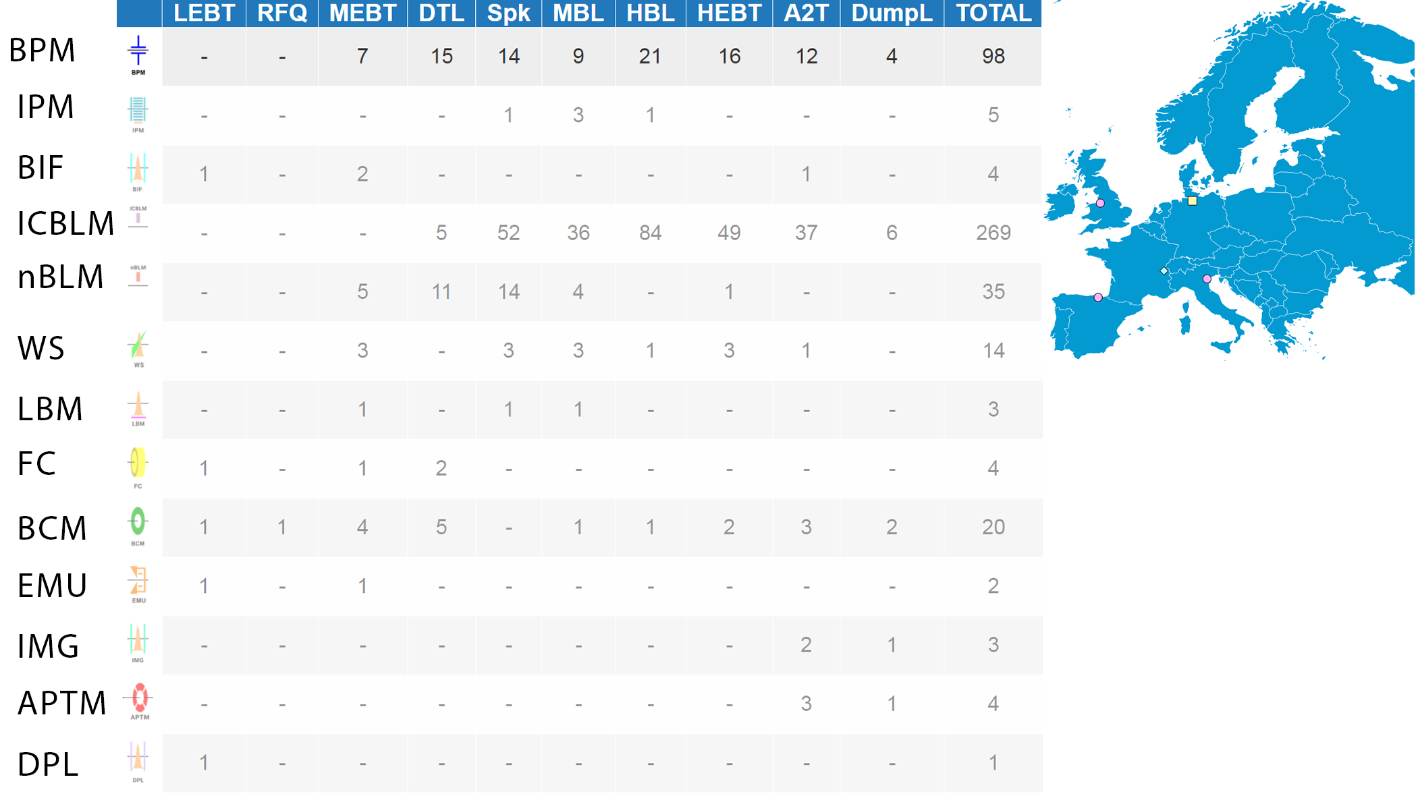
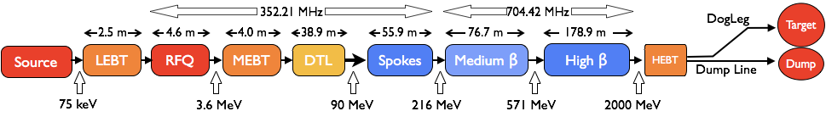
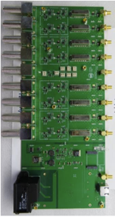
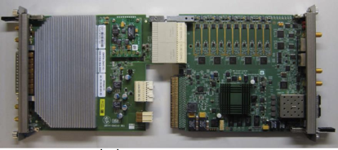
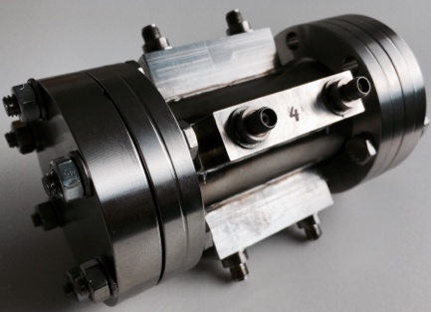
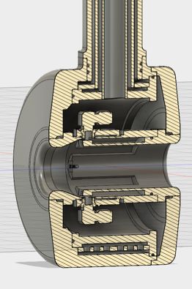
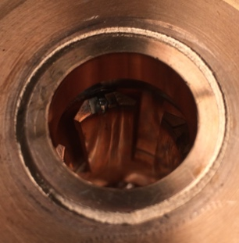
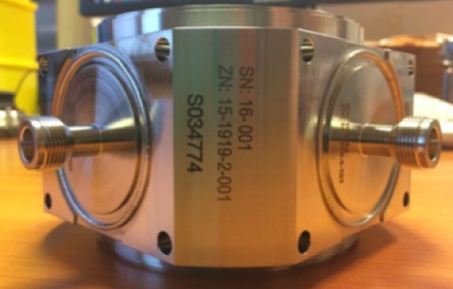
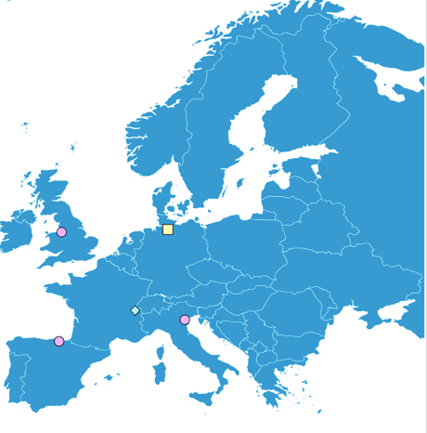
Position Monitors
Electronics
from ESS-Lund
Button BPMs
from DESY,
Daresbury
Striplines
from Bilbao
Striplines
from Legnaro

Slide 4
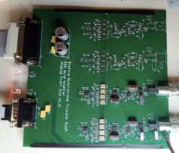
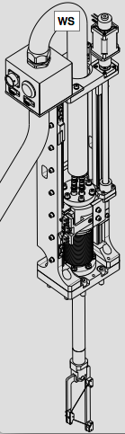


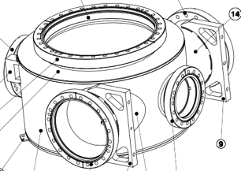
Wire Scanners
Electronics
from Trieste
Scanning
Actuators
from Århus
Fast Wire Scanners
from CERN
Scanning
Actuators
from Bilbao

Slide 5
The Big Picture
Keeping track of what we are building

Slide 6
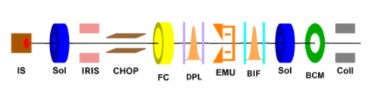
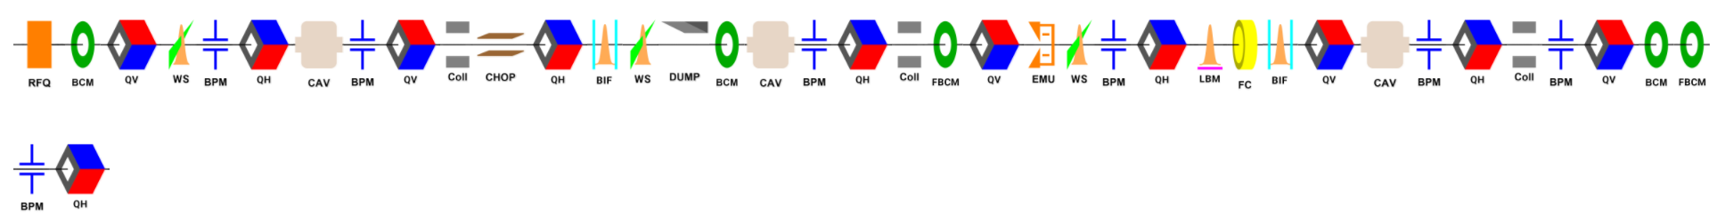
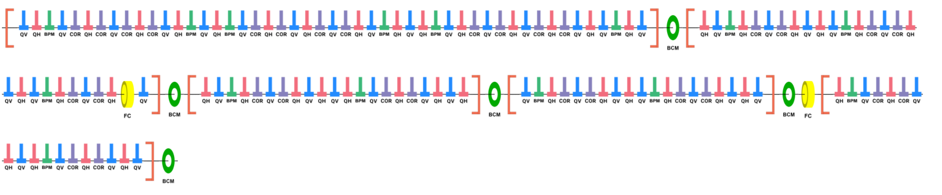
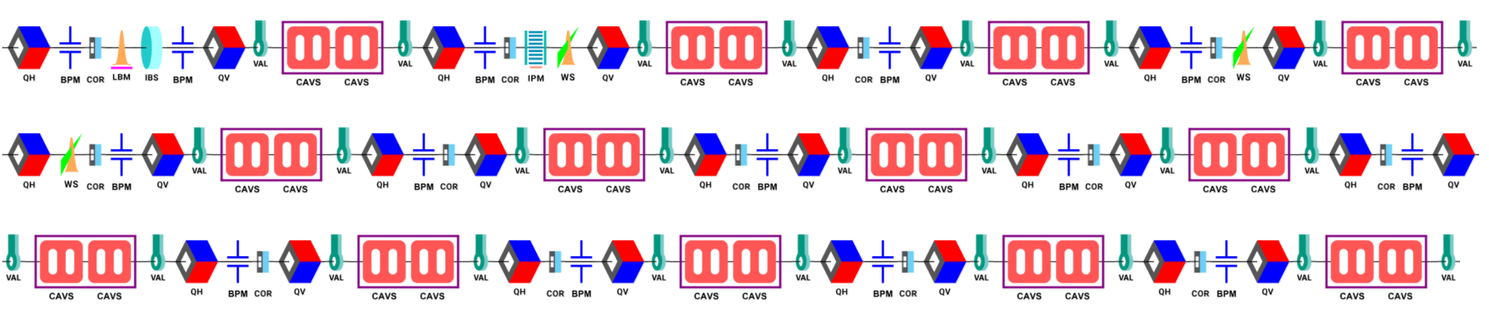
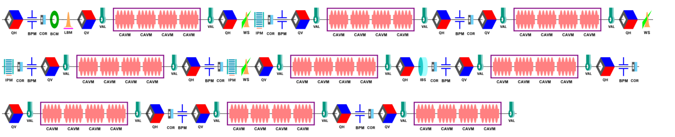
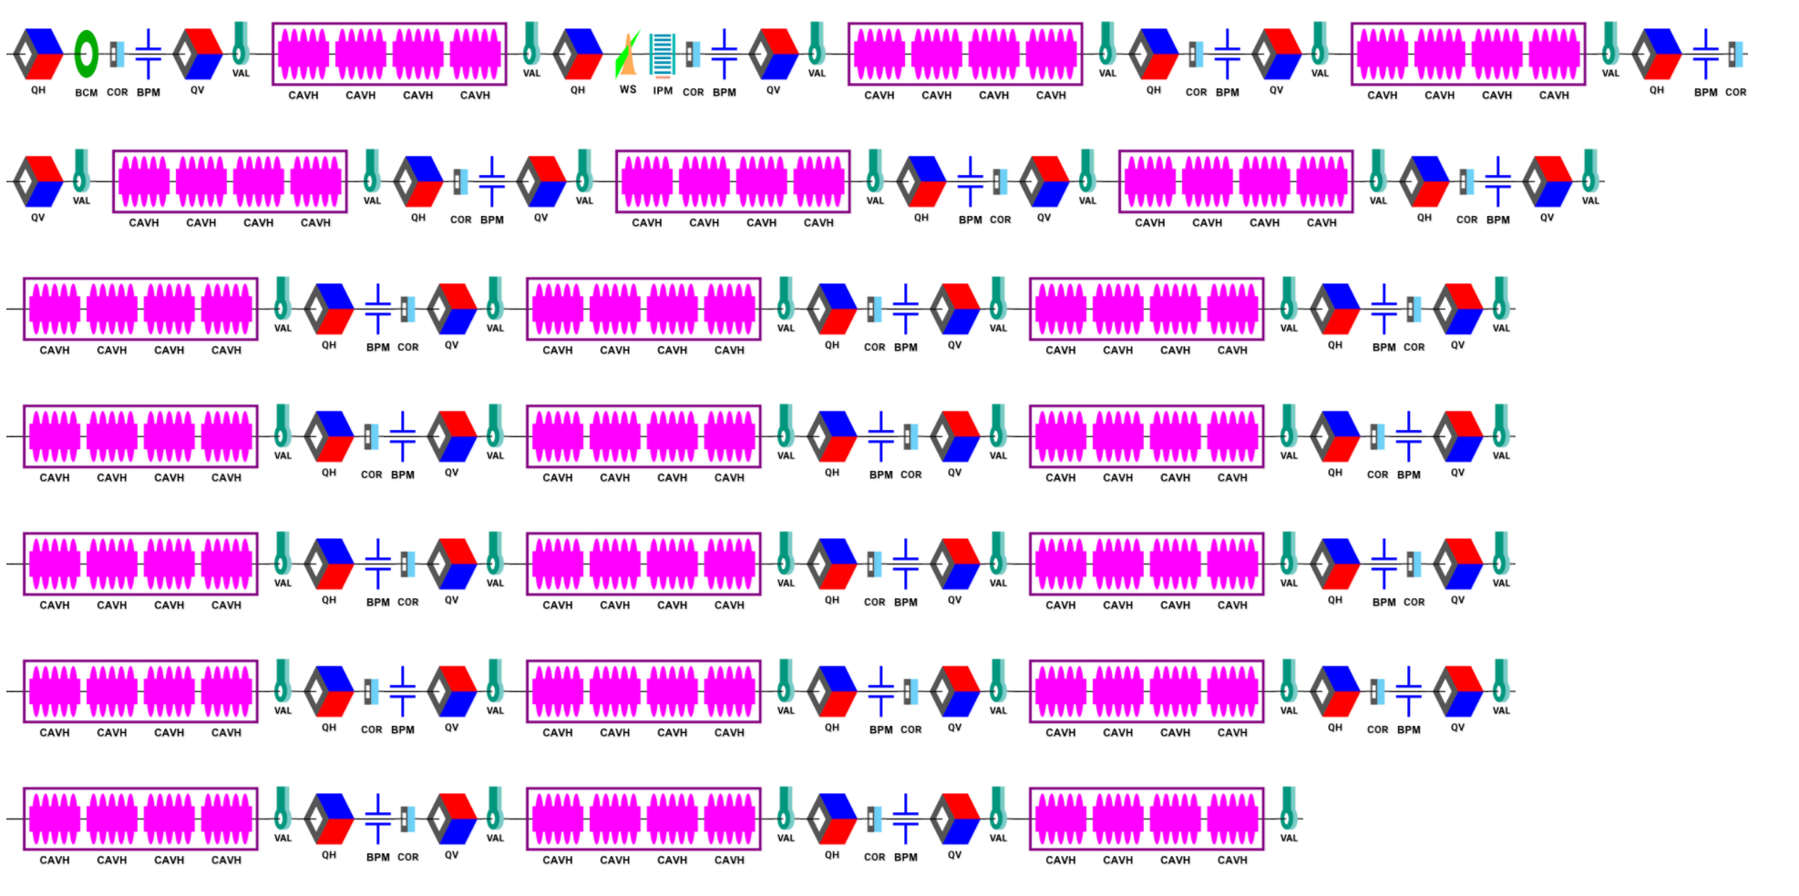
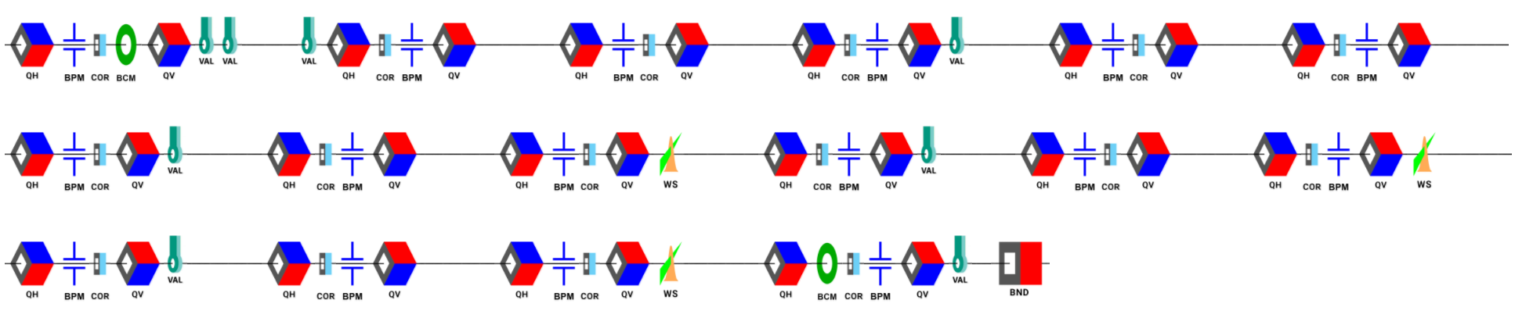
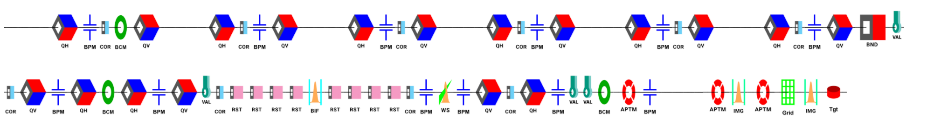
Accelerator Lattice
Synoptic Viewer
LEBT
MEBT
DTL
Features:
Over 1000 Elements
3D (and VR) views of components
Energies
Apertures
Locations
ESS IDs
Links to insight
... And more?
Spokes
Medium Beta
High Beta
HEBT
Dump Line
A2T

Slide 7
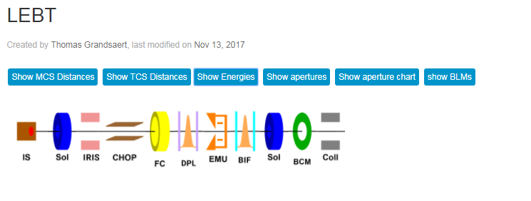
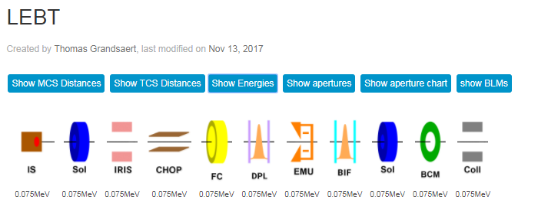
Display Lattice Data
Energy

Slide 8
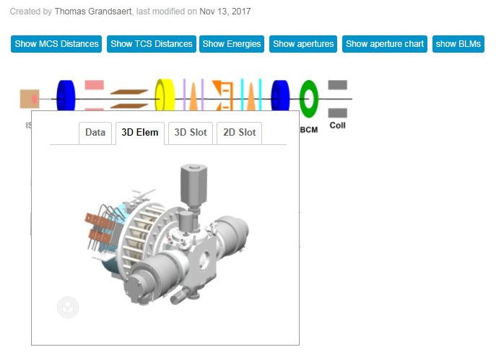
3D Element

Slide 9
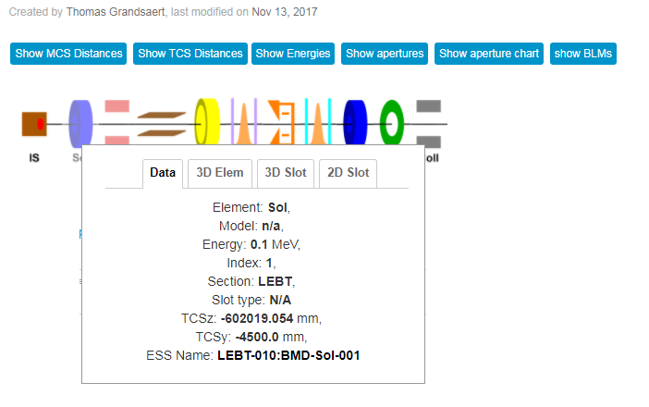
Data

Slide 10
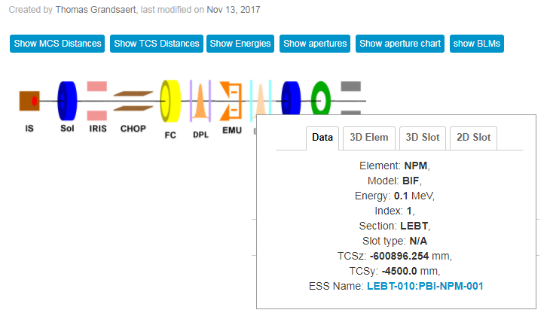
Link to More Data
Link to insight
(other data sources to come)

Slide 11
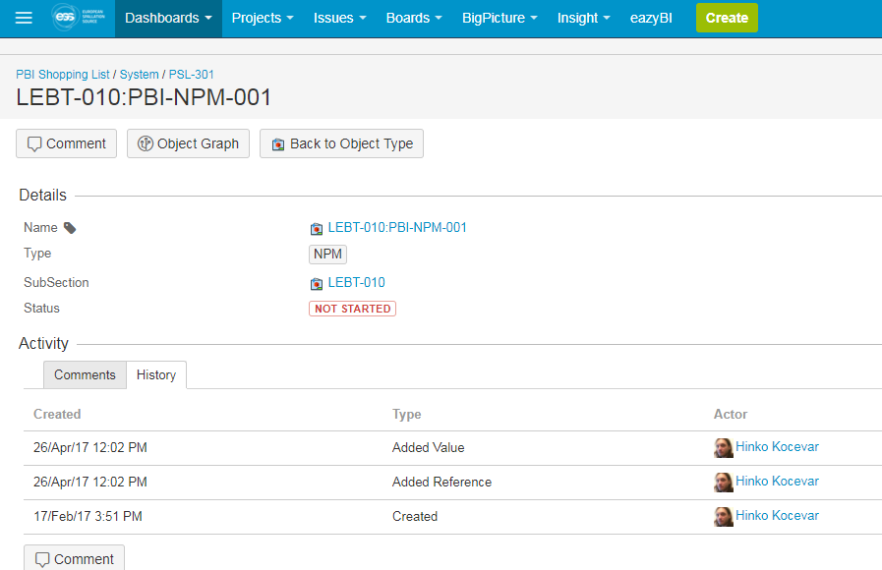
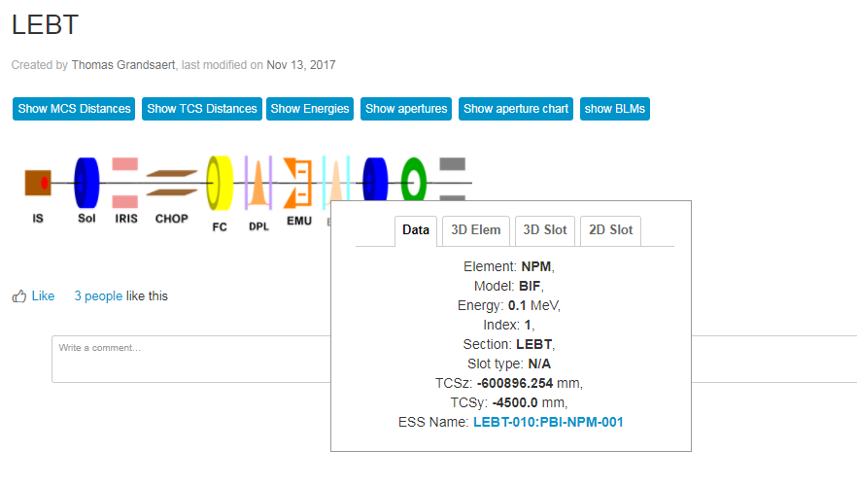
Data in Insight

Slide 12
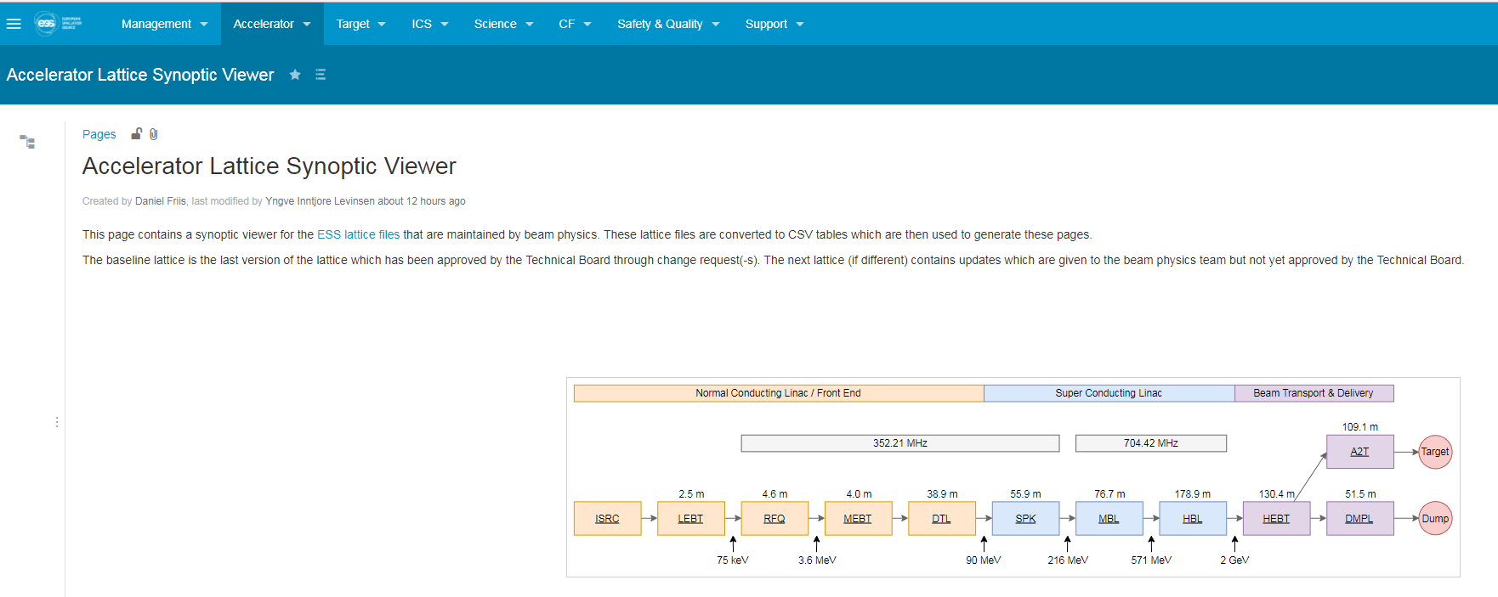
Accessible on Confluence
The entire lattice is under version control, including scripts that transform, verify and display the data
We verified the locations of devices in the lattice and 3D model to micron accuracy
Effort of the Beam Physics and Beam Diagnostics Sections
Official Link: Accelerator Linac Synoptic Viewer
https://confluence.esss.lu.se/display/ALSV/Accelerator+Lattice+Synoptic+Viewer

Slide 13
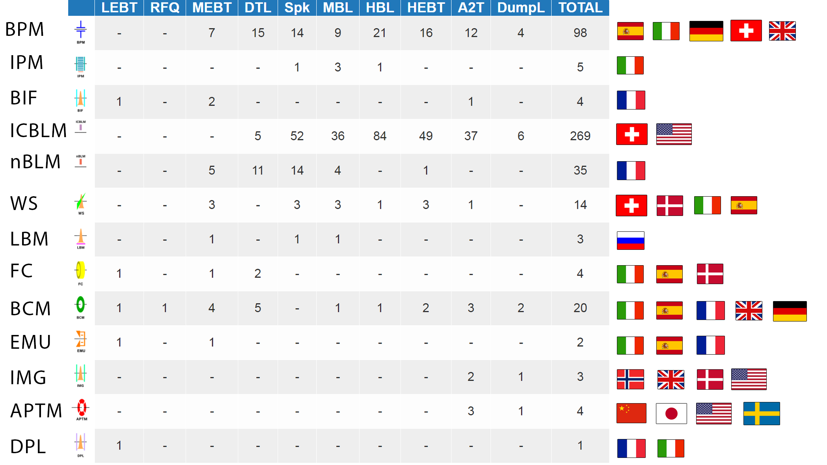





Slide 14
News from Lund

Slide 15
People Changes
Irena returns
Johan returns
Slava arrives
Maurizio departs
  Mehdi arrives
Benjamin will depart
Staff positions opening
  2 Technicians
  1 Engineer (plus 1 term appointment)
  1 Scientist
Lali “arrives” as Head of Operations Section

Slide 16
Schedule Changes
New installation, testing and commissioning plan
Ion Source and LEBT commissioning begins in April 2018
  Components arriving now through December
  Repairs needed
Beam through entire linac now planned for late 2020
Contract issue
  We want our partners to remain engaged through commissioning
  Many systems will see first beam after 2019
And we are considering additional scope:
  Scraper systems
  X-ray/gamma spectroscopy
  23 unique system types

Slide 17
Recent and Near Term Schedule
January
2016
January
2017
January
2018
Ready for
First Protons
January
2019
Ready for
Bunched
Beam
Today
Imaging
kickoff
Wire
PDR
nBLM
2nd Proto
ICBLM
Proto
Imaging Final,
Beam tests
In one year:
Deploy 15 of 21 instrumentation systems
(technology for 19 of 21)
25 days
Imaging Proto, BPM Proto
BPM
Final
9 days
BLM
ElectronicsFinal
6 days
Normal Conducting Linac Activities
15 days
Preliminary Design – Technology prototypes
20 days
20 days
Detailed Design – Final prototypes
5 days
Production
10 days
Deployment
50 days
50 days
20 days
Operations

Slide 18
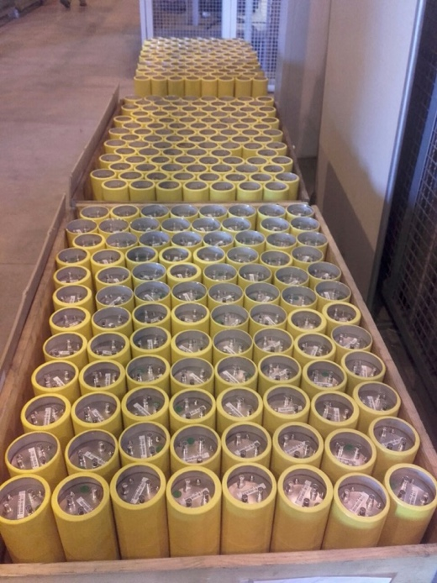
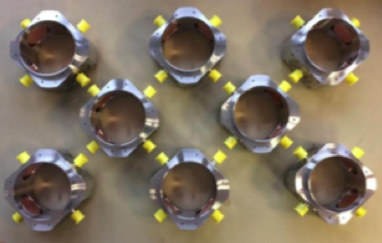
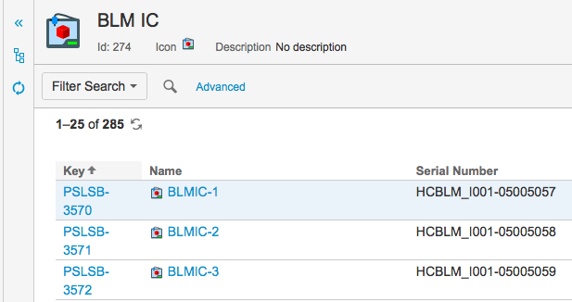
Outlook
Supply chain metrics:
500 Systems
10,000 tracked components
Test, install, integrate
~25 components per day
Example near term challenges
(what keeps me up at night):
Readiness for LEBT commissioning
Cabling and infrastructure
Controls integration
Etc…
Approach:
Leverage the capabilities of this large BI team
Data driven approach to deployment
Inclusive team: beam diagnostics, beam physics, operations, and controls

Slide 19
Thank you

