Slide 1


Control Integration of PBI for MEBT
ESS-Bilbao
Control & Beam Instrumentation Group
imazkiaran@essbilbao.org
November – 2017

Slide 2
Summary
Introduction
General HW
General SW
Faraday Cup
Emittance Meter Unit
Scrapers
2

Slide 3
Summary
Introduction
General HW
General SW
Faraday Cup
Emittance Meter Unit
Scrapers
3

Slide 4
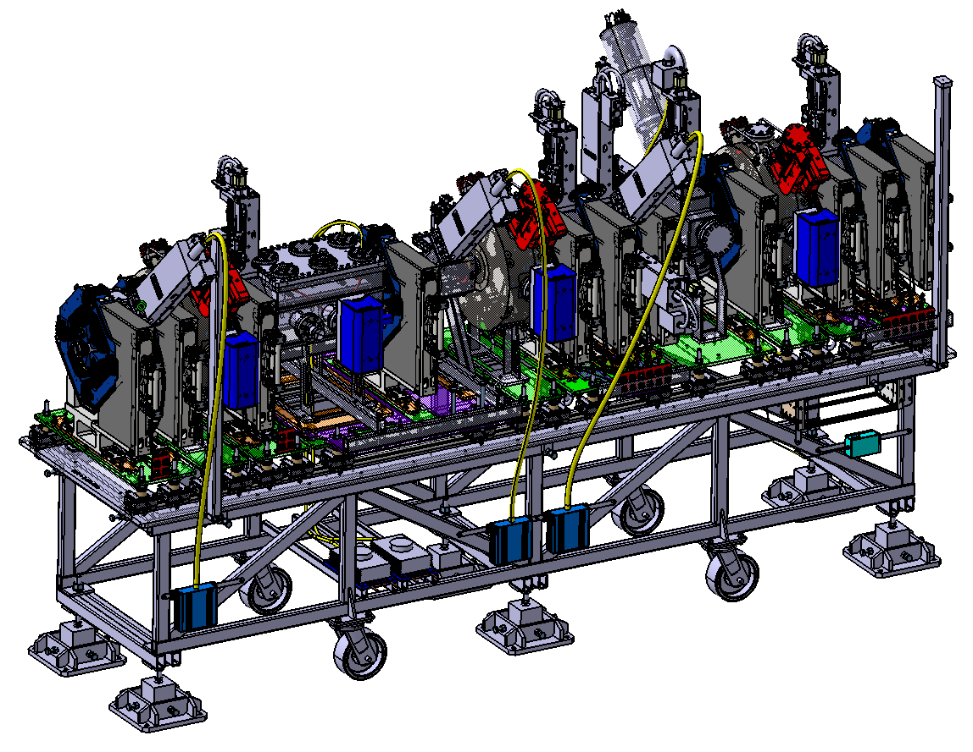
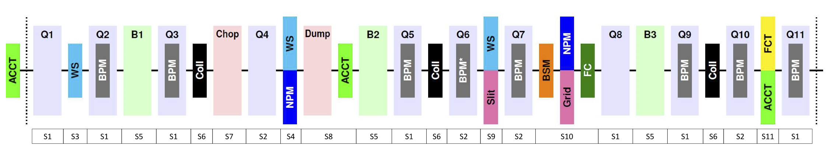
ESS MEBT
4

Slide 5
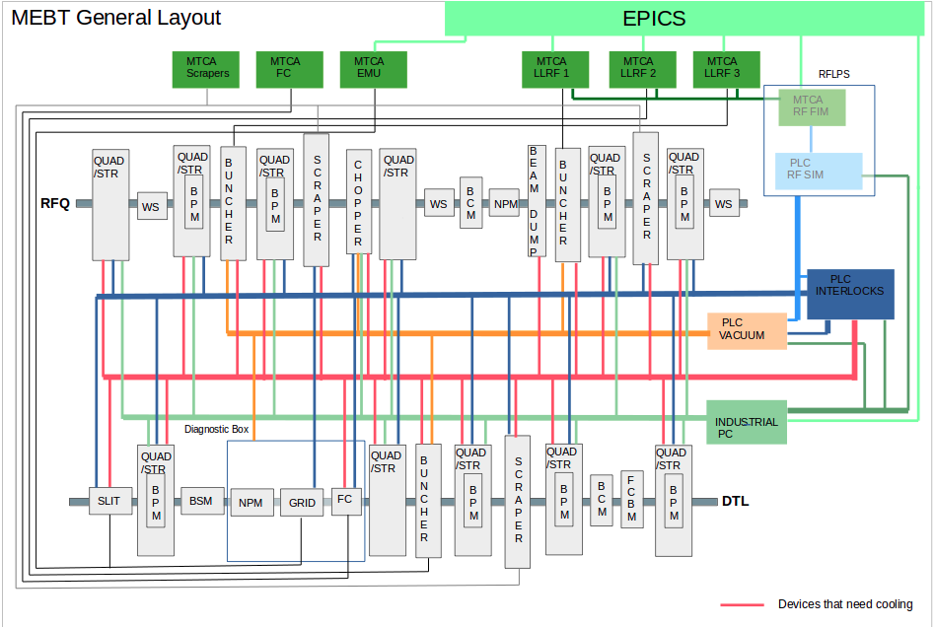
MEBT General Layout
5

Slide 6
ESS MEBT Beam Instruments
Beam Instrumentation is required in order to characterize beam current, size, emittance, etc
Medium proton beam energy: 3.62 MeV.
11 Quadrupoles: match the RFQ transverse plane to DTL input.
11 Steerers: Correct the trajectory of the beam.
Control system of the accelerator components and beam instruments.
Cooling system.
Vacuum system.
Interlock system.
6

Slide 7
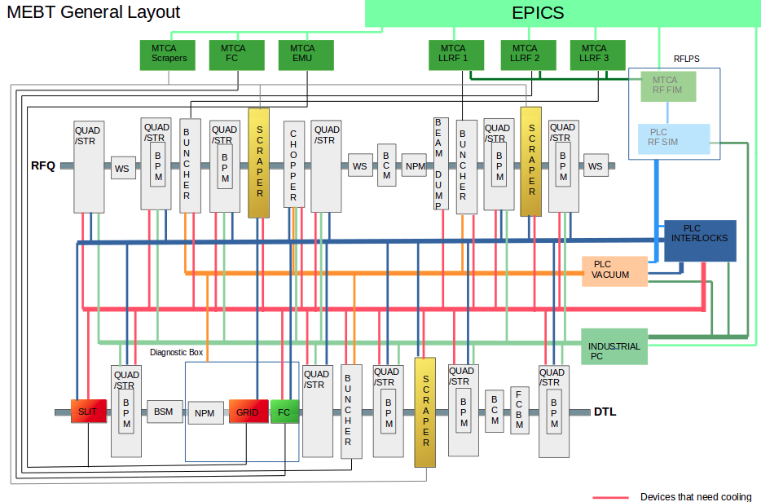
FC, EMU & Scrapers in General Layout
7

Slide 8
Summary
Introduction
General HW
General SW
Faraday Cup
Emittance Meter Unit
Scrappers
8

Slide 9
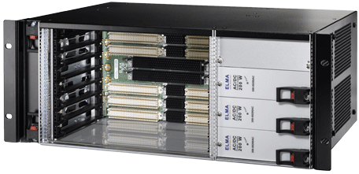
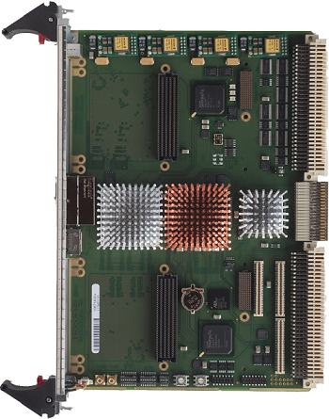
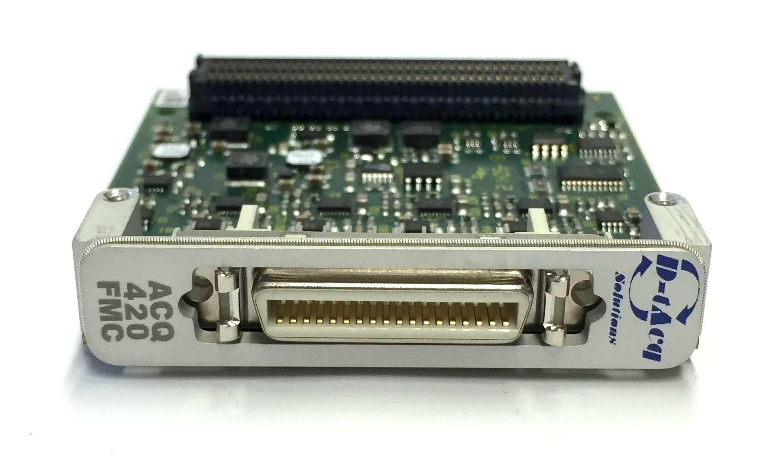
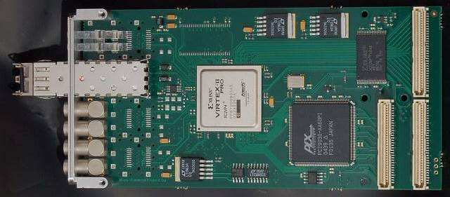
HW for initial developments (I)
VME crate shared for testing FC and EMU.
Actual developments based on VME platform.
VME crate: ELMA Type 39 Horizontal, 4U, 84HP.
CPU: IFC1210-Intelligent FPGA Controller P2020 VME64x by IOxOS.
Digitizer board: D-Tacq ACQ420FMC-4-2000-16: 4 analog channels, 2 MSPS, 16 bits.
Event Receiver Board PMC-EVR-230 by MRF.
VME Board added in testing commitments:
Event Generator VME-EVG-230 by MRF.
Beckhoff test stand for EMU movement:
Beckhoff test stand for Digital/Analog I/O for EMU & FC.
9

Slide 10
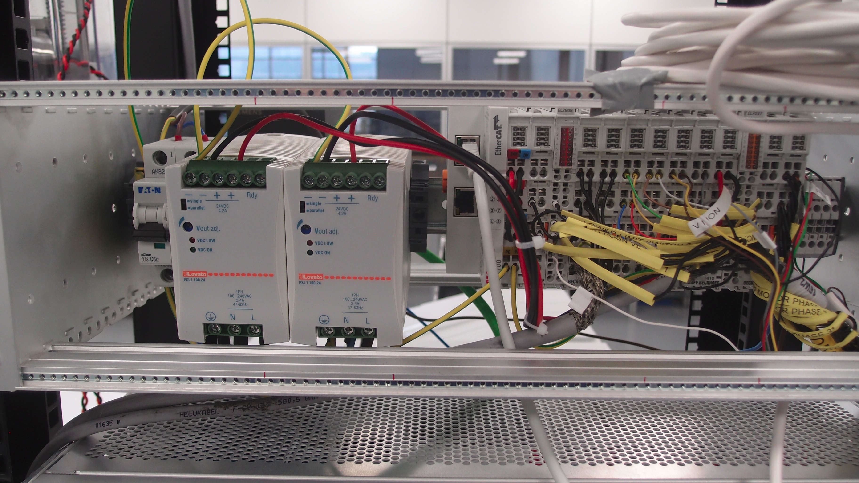
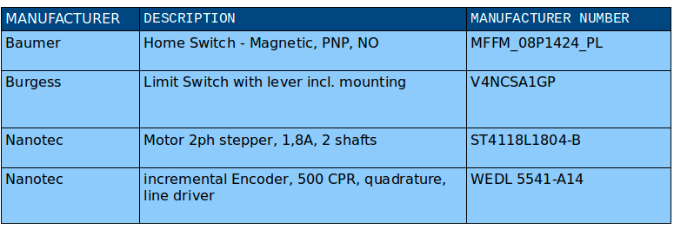
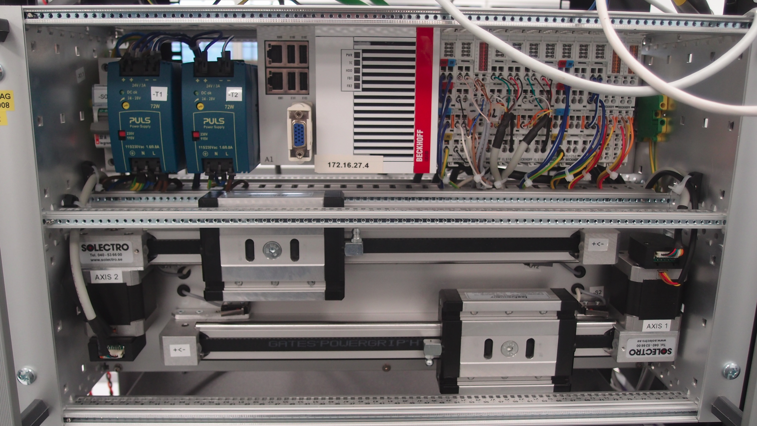
HW for initial developments (II)
Beckhoff test stands:
Analog I/O & Digital I/O modules test stand:
Repeller power supplies Supplies control
Switches
I/Os for general controls: auxiliar power supplies, functions multiplexors...
Linear movement test stand
Stepper motors modules
Absolute encoders modules
10

Slide 11
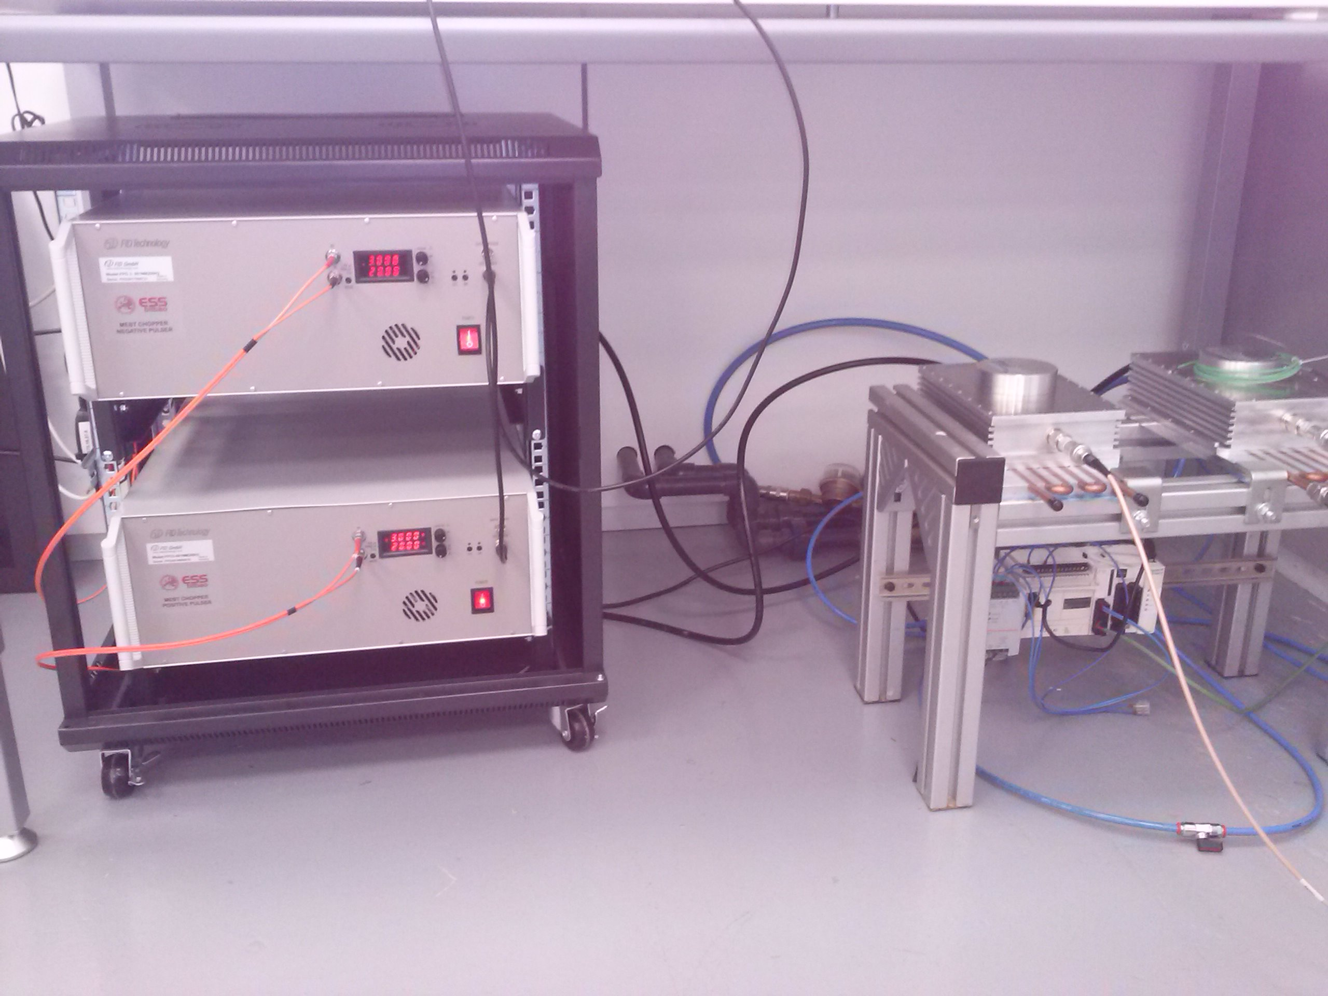
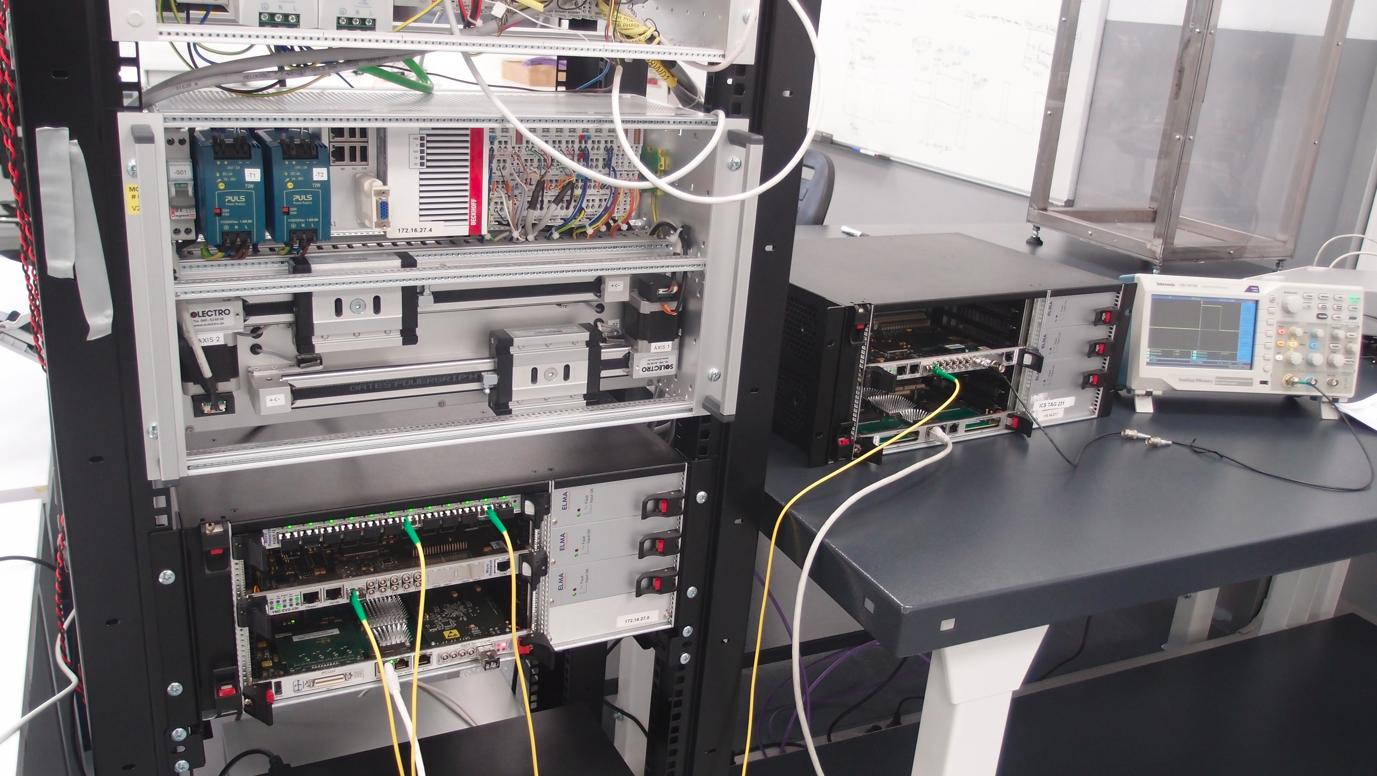
HW for initial developments (III)
Test Rack and accessories:
FC and EMU crate.
General MRF event generator VME-EVG-230.
MRF VME Optical Fan-Out Board: VME-FOUT-12.
Chopper: Synchronizing for Pulsers triggering.
11

Slide 12
Definitive HW (I)
MicroTCA crate for each FC, EMU and Scrappers.
mTCA crate: Schroff custom 3U crate up to 6 AMC cards, 4 RTMS, redundant Power Supplies, 1 MCH slot.
MCH: NAT-MCH-PHYS-R1
CPUs:
  IFC_1410 QorIQ T2081 & Kintex UltraScale AMC by IOxOS.
  AM 900/412-99 by Concurrent Technologies.
  Digitizer boards:
    IOxOS FMC ADC 3111, 8 analog channels, 250 MSPS, 16 bits for FC.
    2 IOxOS FMC ADC 3117, 20 analog channels, 5 MSPS, 16 bits for EMU.
  Event Receiver board: MTCA EVR-300U by MRF.
VME Board in VME crate added for testing commitments:
    Event Generator VME-EVG-230 by MRF.
    CPU: IFC1210-Intelligent FPGA Controller P2020 VME64x from IOxOS.
Beckhoff test stand for EMU movement
Beckhoff test stand for Digital/Analog I/O for EMU & FC.
12

Slide 13
Summary
Introduction
General HW
General SW
Faraday Cup
Emittance Meter Unit
Scrappers
13

Slide 14
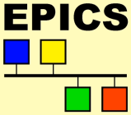

General SW (I)
BI control developed in EPICS
EPICS V3:
Actual EEE version 3.15.4 Previewed last V3 version Base 3.16.
Communication protocol: Channel Access.
EPICS V4:
New capabilities to improve data quality:
  Better handling of measurement data.
  Rich metadata, synchronous data.
  Handling complex and large data.
Communication protocol: PvAccess.
  Streaming.
  Complex structures.
EPICS V7: EPICS V3 + EPICS V4
EPICS specific network protocols Channel Access and pvAccess.
pvAccess for all control system applications.
  IOC development is not (much) affected
  CS-Studio needs some additional work
  Archiver Appliance will/does support V4 structures
pvAccess Gateway Alpha version
pvAccess Database links 2018 Q2
14

Slide 15
General SW (II)
VME SW developments:
VME crate for each instrument application (sharing crate for tests)
Main IOC running over CPU IFC1210-Intelligent FPGA
Controller P2020 VME64x by IOxOS.
Motion IOC running over either PC or Beckhoff CPU for
Beckhoff system control.
Definitive SW:
mTCA crate for each instrument application.
Main IOC running over IFC_1410 QorIQ T2081 & Kintex
UltraScale AMC by IOxOS
1st approximation: Motion IOC running over PC for Beckhoff
system control.
2nd approximation: Motion IOC running over CPU AM 900/412-99
by Concurrent Technologies for Beckhoff system control.
15

Slide 16
Summary
Introduction
General HW
General SW
Faraday Cup
Emittance Meter Unit
Scrappers
16

Slide 17
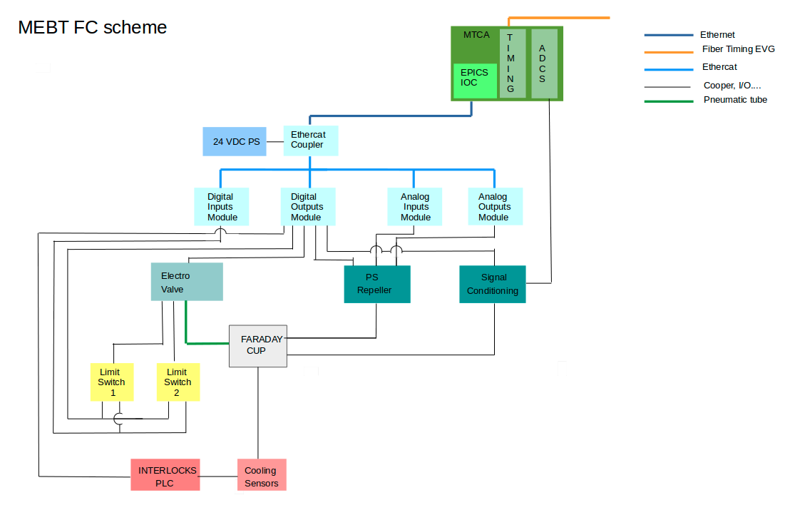
HW descripiton FC General interface layout
17
Notes:
17

Slide 18
ESS Requirements for FC Acquistion
L4_Requirements_MEBT_PBI_2016-11-09
User Defined ID | DOORS-ID | Name | Description
MEBT-L4-PBI-010 | MEBT.PBI-44 | MEBT PBI peak current range | Proton beam instrumentation in the MEBT section shall function over a peak beam current range of 3 mA to 65 mA.
MEBT-L4-PBI-340 | MEBT.PBI-77 | MEBT invasive measurements beam modes | All invasive measurements in the MEBT section shall be possible for beam pulse lengths of 5 microseconds at 14 Hz and 50 microseconds at 1 Hz.
 |  | MEBT beam current invasive calibration measurement | There shall be a possibility to measure beam current with higher accuracy for calibration purposes in the MEBT section. This measurement can be invasive.
 |  | MEBT beam current invasive calibration measurement error | The high accuracy beam current measurement shall have a total measurement error of less than ±0.1 mA.
 |  | MEBT beam current invasive calibration measurement precision | The high accuracy beam current measurement shall have a precision of sigma ≤ 0.01 mA.
 |  | MEBT beam current invasive calibration measurement integration time | The high accuracy beam current measurement time resolution, defined as the interval between independent reported measurement readouts, shall be ≤ 1 µs.
18

Slide 19
Design Parameters related to control
Design steps
Front End gain amplifier stage: 100
Sample frequency > 400 KHz
Sample frequency > 40 KHz
ADC Sample frequency: IOxOS FMC ADC3111 20 channels ADC 16-bit 5 Msps.
Calibration procedure.
Front End design.
Front End Components tolerance and features.
“Environment”.
Parameter | Value
Min Intensity | 3 mA
Max Intensity | 62.5 mA
Mode I: Fast Tuning | 5 µs - 14 Hz - 16 W
Mode II: Slow Tuning | 50 µs - 1 Hz - 11 W
Sample Frequency (Integration time ≤1 usec) | >= 2 MHz
Measurement Error | < 0.1 mA
Measurement Precision | < 0.01 mA
19

Slide 20
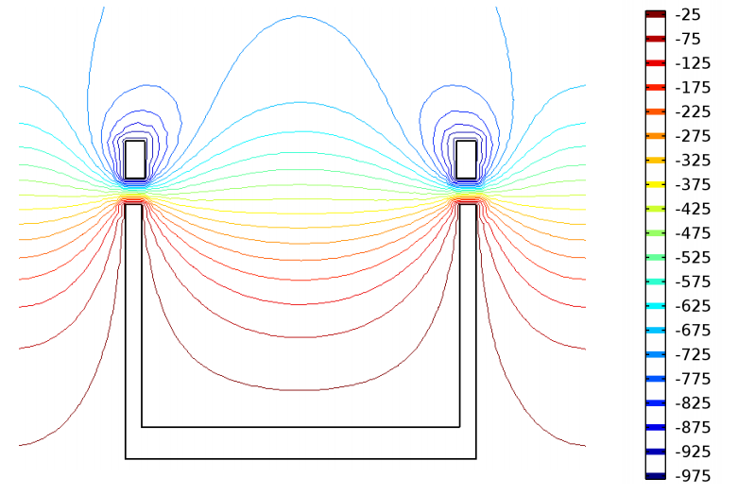
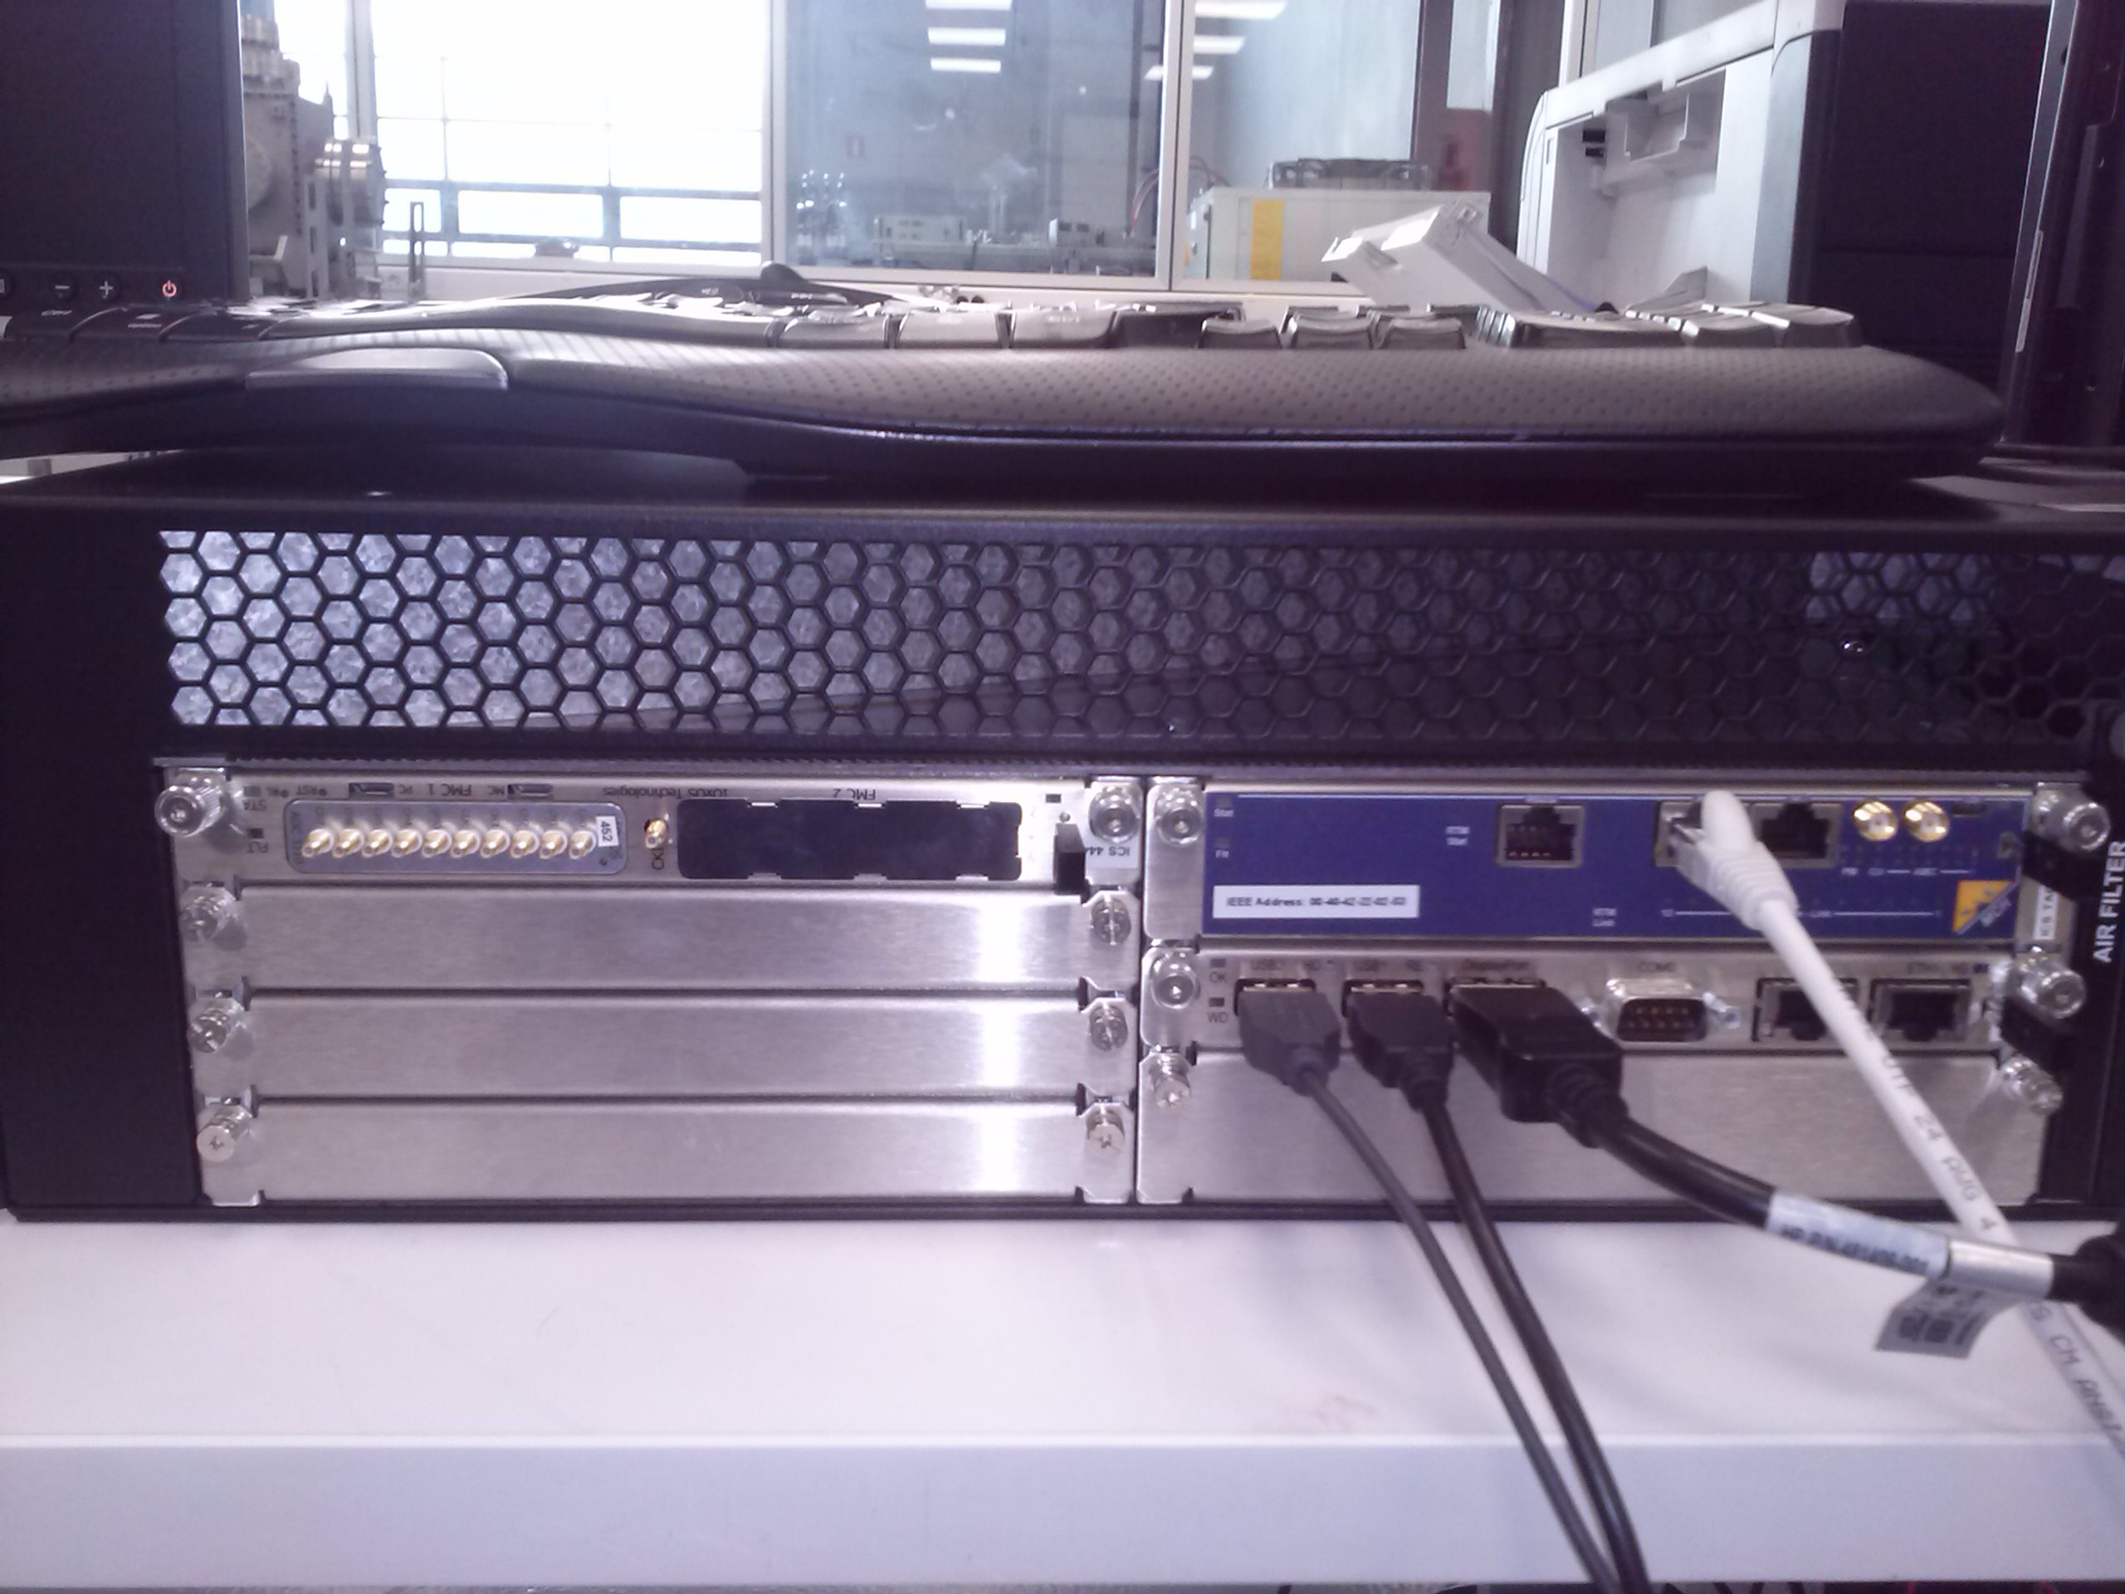
FC HW: mTCA platform
Main control IOC and signal acquisition.
mTCA crate: Schroff custom 3U crate up to 6 AMC cards, 4 RTMS, redundant Power Supplies, 1 MCH slot.
MCH: NAT-MCH-PHYS-R1
CPUs:
  IFC_1410 QorIQ T2081 & Kintex UltraScale AMC by IOxOS.
  AM 900/412-99 by Concurrent Technologies.
  Digitizer board:
    IOxOS FMC ADC 3111, 8 analog channels, 250 MSPS, 16 bits. (not yet in Bilbao).
    IOxOS FMC ADC 3110, 8 analog channels, 250 MSPS, 16 bits. (provided to Bilbao).
  Event Receiver board: MTCA EVR-300U by MRF. (not yet in Bilbao)
External integrated systems controlled from the
previous crate HW:
  FC insert/retraction: solenoid valve.
  Repeller control.
  Interlocks interface.
Interlocks Siemens PLC for cooling and slow interlocks functions.

Slide 21
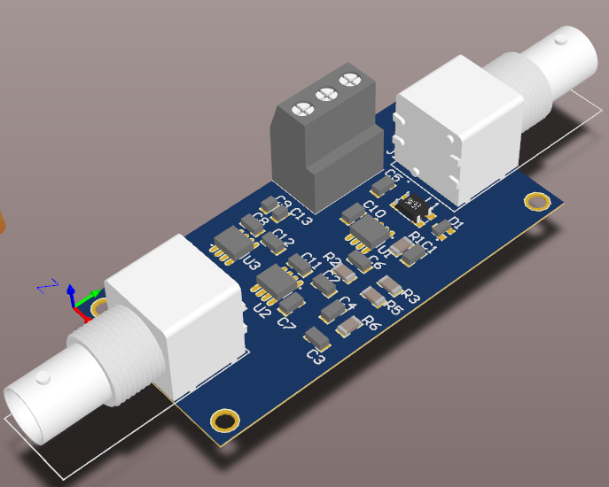
Front End
Front End:
cdelacruz@essbilbao.org
Min beam current | 3 mA
Max beam current | 62.5 mA
Banwidth | >=2 MHz
Total measurement error | ±0.1 mA
Measurement | < 0.01 mA
Output voltage Differential | ±10 V
ADC resolution | 16 bits
21

Slide 22
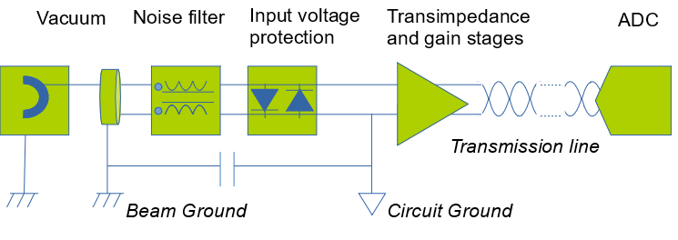
Front End (II)
Front End
22

Slide 23
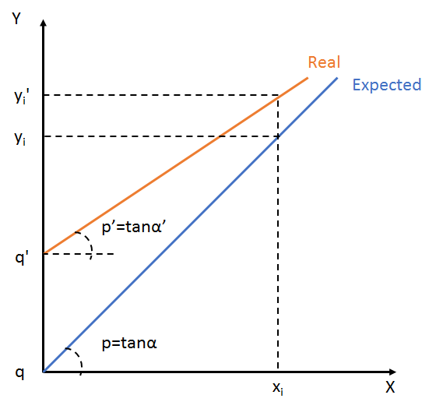
Calibration & Validation
Calibration method
  Find calibration factors
  p’: gain and q’: offset.
  Defined as Process Variables
Validation plan
Standalone FE (input = current source, output = oscilloscope)
    Step response
    Linearity
    AC response
    Noise analysis
Vertical Test (input = current source, output = µTCA, final cables)
23

Slide 24
SW general control
FC SW based in EPICS
Two IOCs running. Installed as services.
Main IOC:
Modules specifically developed:
  FC_MEBT module: general control and flow of the FC
  ISEGPS module: Repeller control.
Another Required modules:
  System and device support related modules: environment, pevdrv, nds3epics, nds3, asyn. Still nds modules.
  Specific digitizer hardware related modules: ifcdaq changed to new HW device driver and module.
  Event receiver related module: mrfioc2.
Ethercat IOC:
  ecmc module: Beckhoff ethercat modules control.
Drivers: Directly installed in Kernel.
24
Notes:
24

Slide 25
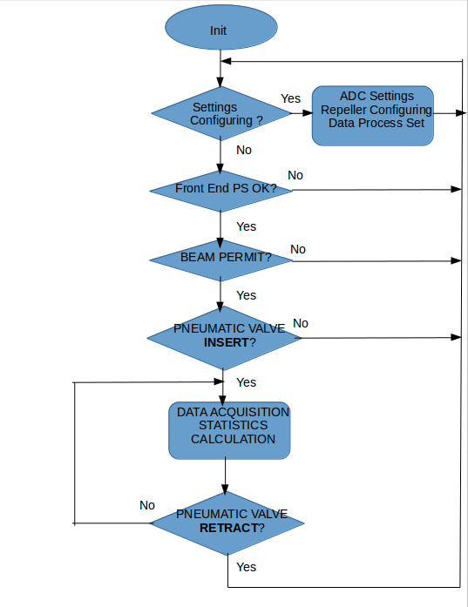
FC SW Flow Diagram
Application flow:
1. Settings configuration
ADC control settings.
Repeller configuration and activation.
Data acquisition settings.
2. Push Insert in the menu of Position
3. Application running
Data acquisition
Background subtraction calculation.
Statistics calculation.
4. Push Retract in the menu of Position
25
Notes:
25

Slide 26
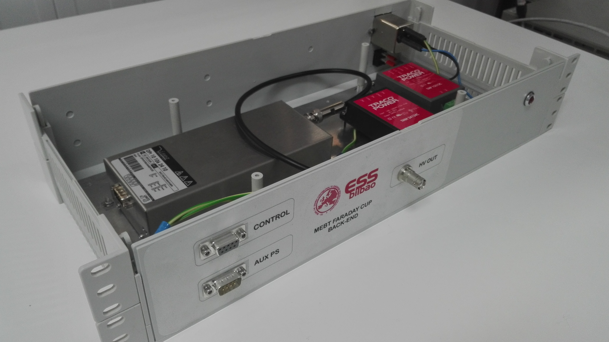
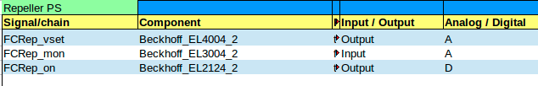
FC Repeller
FC Repeller.
ISEG DPR 10 106 24 10 ESH
Vout: 0 to –1000 V
Imax: 10 mA
Vin/Iin: 24 V/0.8 A
Control Signal 0-10 V
Ripple/Noice: 2/7 mV
SHV output
DB9 control signal
Controlled by digital outputs module, analog outputs module and analog input module
26

Slide 27
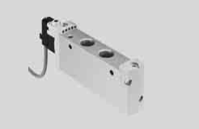
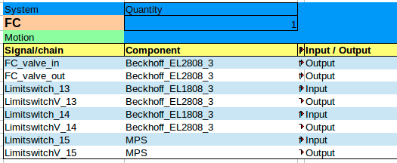
FC Pneumatic valve
FC insert/retraction: pneumatic valve.
Model: Solenoid valve 5/2 Monostable - FESTO – VUVG-L18-M52-MT-G14-U-1K7L
Controled through Beckhoff digital outputs module: 24 V
Home and end of run switches: digital outputs: 24 V, digital inputs modules: 24 V.
Local Switches: Proximity Sensor - Festo - SME-8-K-24-S6 (161756)
MPS switch: digital input, digital output module.
MPS Switches: Crouzet - 83 133 035

Slide 28
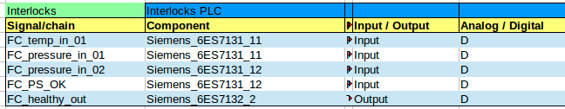
SW: Interlocks
Cooling and interlocks control on Interlocks PLC.
Inputs to interlocks PLC:
Water cooling temperature.
Water pressure at input/output.
Power supplies behaviour.
Interlocks PLC calculations:
Temperature is within normal operational limits.
Pressure within normal operational limits.
Power supplies are healthy.
Output from interlocks PLC to MPS:
FC status.
Input from MPS to IOC through Beckhoff EtherCAT system:
FC permitted to insert: BEAM PERMIT.
28
Notes:
28

Slide 29
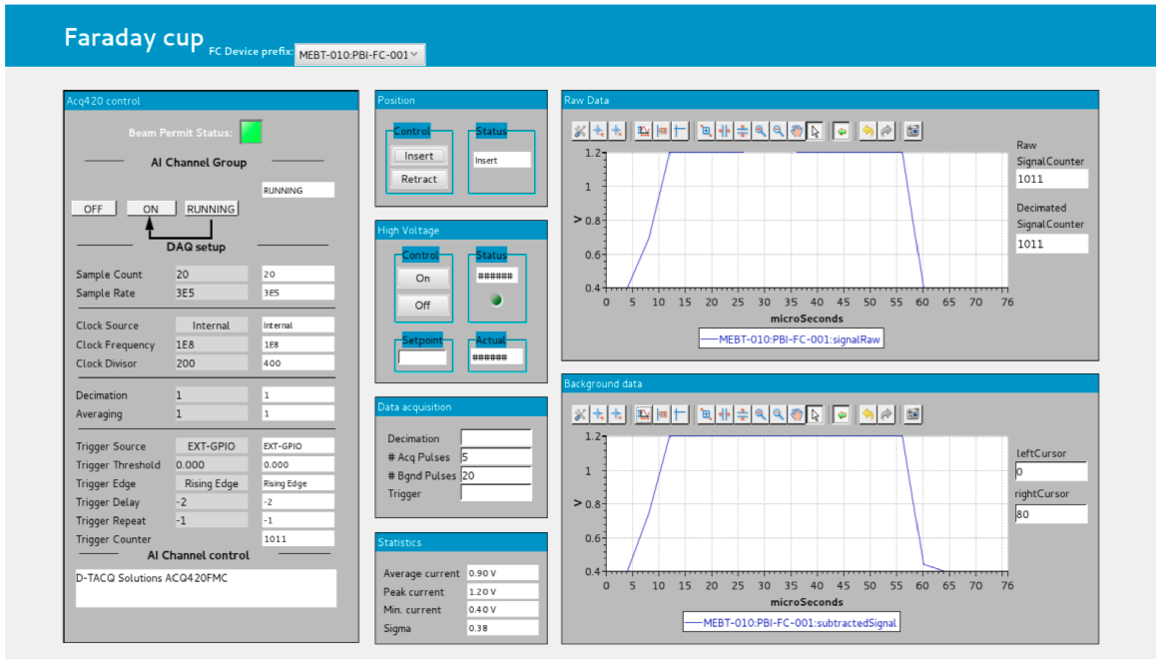
SW: Engineering GUI
29
Notes:
29

Slide 30
SW: Engineering GUI menus
Acq420 control: Settings from ifcdaq module to control ADC.
Position: Insert / Retract the FC.
High Voltage: Repeller control.
Data acquisition: Settings to additional functions.
Statistics: Result values.
Raw data: Raw pulse monitoring.
Background data: Background applied to pulse.
30
Notes:
30

Slide 31
Summary
Introduction
General HW
General SW
Faraday Cup
Emittance Meter Unit
Scrapers
31

Slide 32
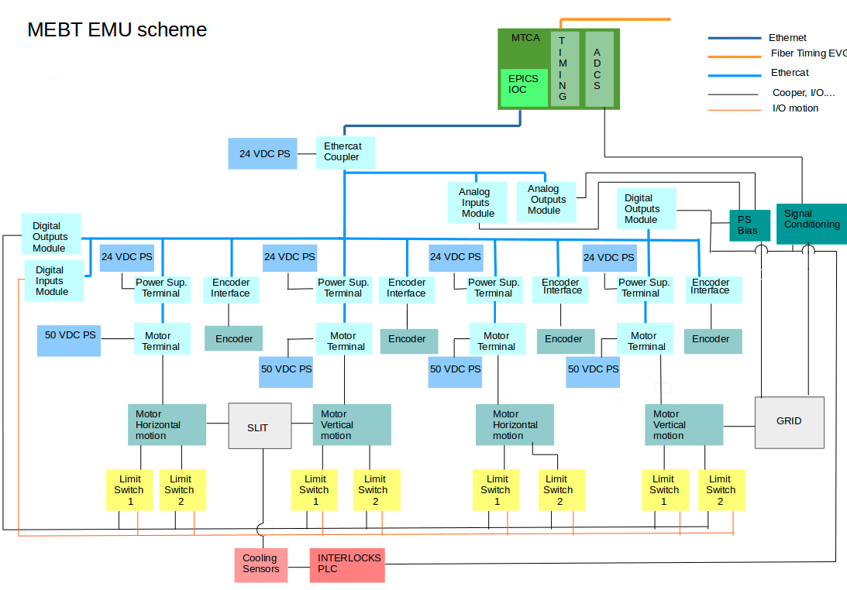
Summary
Introduction
General HW
General SW
FC
EMU
Scrappers
Conclusions
32

Slide 33
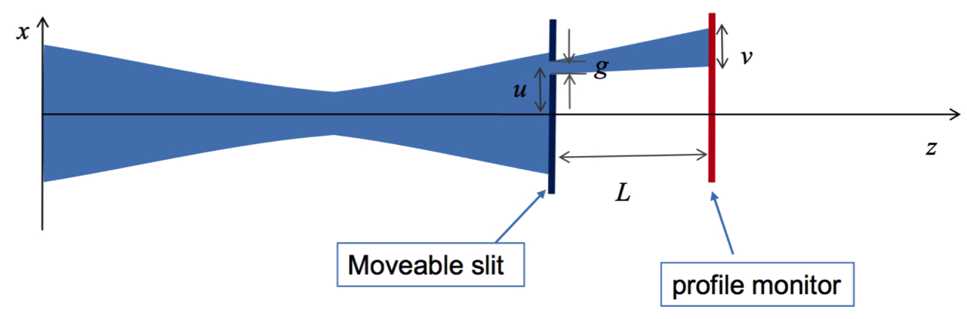
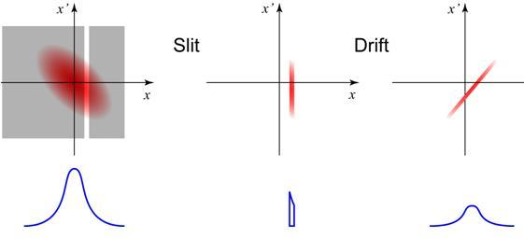
Slit & Grid system schematics
33

Slide 34
ESS Requirements for EMU Acquistion
L4_Requirements_MEBT_PBI_2016-11-09
User Defined ID | DOORS-ID | Name | Description
MEBT-L4-PBI-150 | MEBT.PBI-58 | MEBT transverse beam profile RMS measurement error | The transverse beam profile shall be measured with a total measurement error in the RMS extension of the beam of less than ±10%.
 |  | MEBT transverse beam profile 95% measurement error | The transverse beam profile shall be measured with a total measurement error in the 95% extension of the beam of less than ±10%.
 |  | MEBT transverse beam profile measurement dynamic range | The transverse beam profile measurement shall have a dynamic range of 1000.
34

Slide 35
EMU HW (I)
MTCA platform for EMU (not yet in Bilbao)
Main control IOC and signal acquisition.
mTCA crate: Schroff custom 3U crate up to 6 AMC cards, 4 RTMS, redundant Power Supplies, 1 MCH slot.
MCH: NAT-MCH-PHYS-R1
CPUs:
  IFC_1410 QorIQ T2081 & Kintex UltraScale AMC by IOxOS.
  AM 900/412-99 by Concurrent Technologies.
  Digitizer boards:
    2 IOxOS FMC ADC 3117, 20 analog channels, 5 MSPS, 16 bits 250 MSPS.
  Event Receiver board: MTCA EVR-300U by MRF.
External integrated systems controlled from the previous crate HW:
  Motion Control: Bus ethercat, linear motion.
  Power supply control for BIAS voltage supplying.
  Analogue front-end interrelation for signal conditioning.
  Interlocks interface.
Interlocks Siemens PLC for cooling and slow interlocks functions.
35

Slide 36
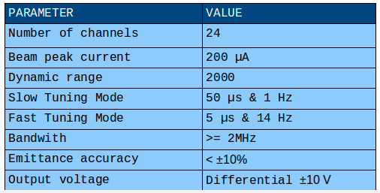
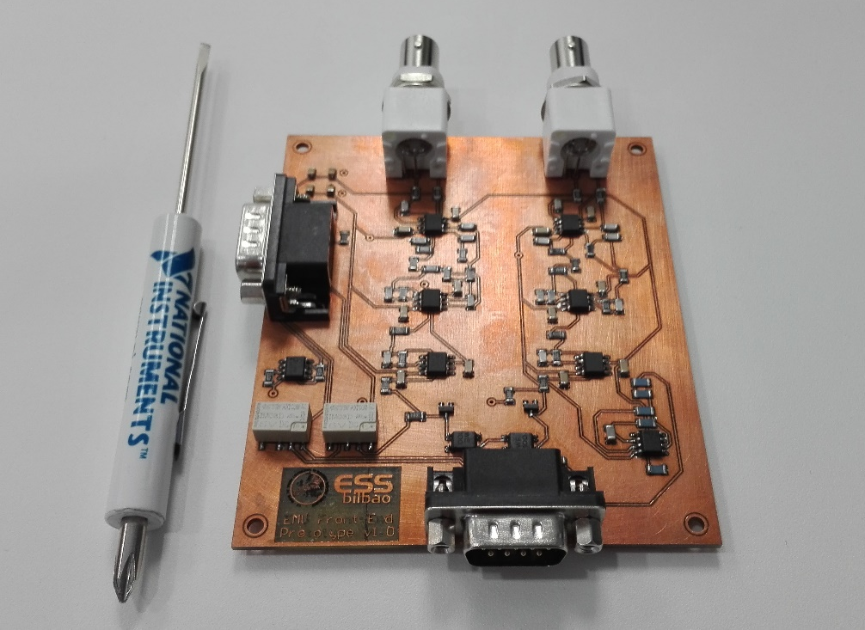
EMU HW (II)
Front End: cdelacruz@essbilbao.org
Preliminar design: 2 wires
Definitive design: 24 wires
36

Slide 37
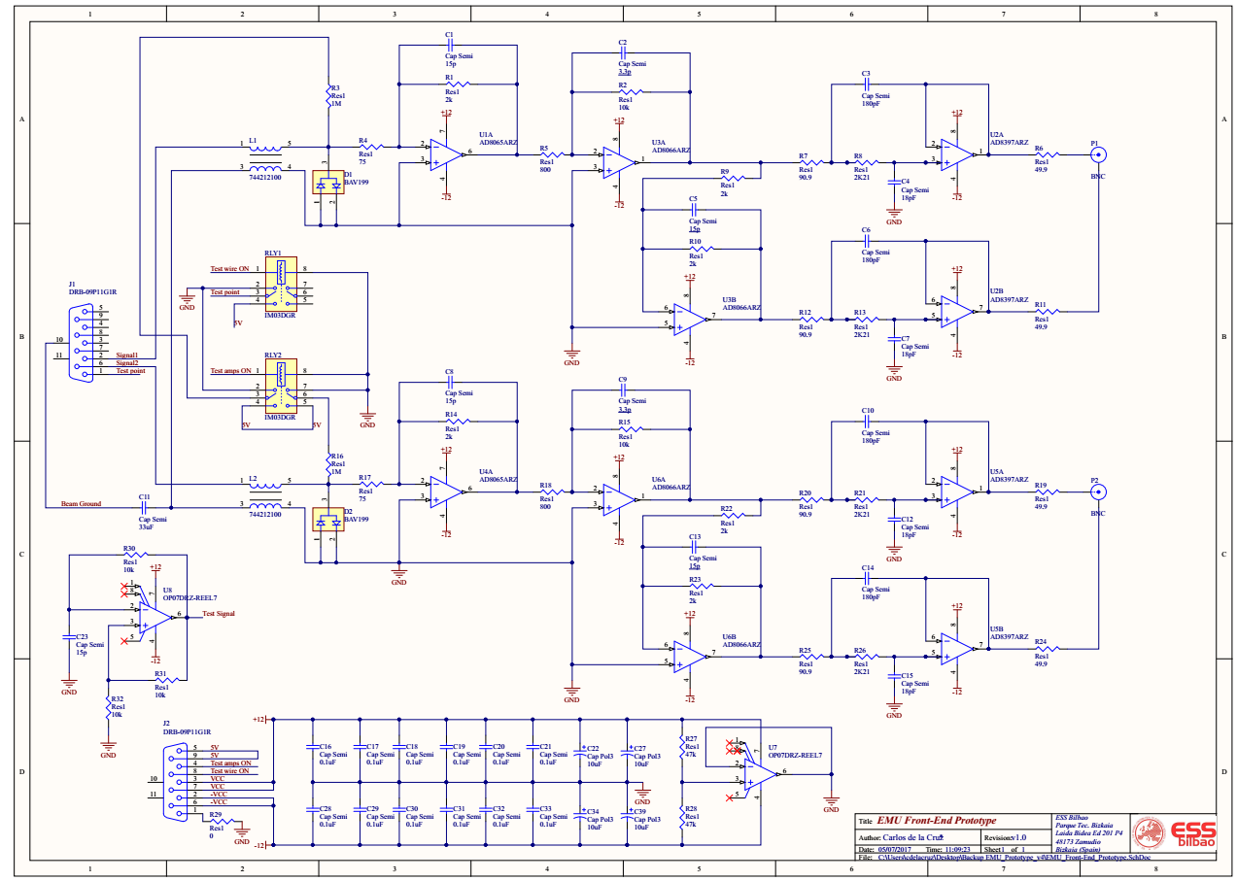
EMU Front-End Schematic
37
Notes:
The aims of the studies are:
To determine the geometrical shape that favors a more
efficient recapture.
To study the electron recapture map (in case some parts
need protection).
To evaluate the voltage level needs of the repeller.
Electrostatic field simulations made with Comsol, particle
dynamics studies performed with GPT.
A considerable effort was made to create an accurate secondary electron beam (beam footprint, collector angle, emission angle probability and energy distribution, etc).
The video below, created from the results of a typical simulation, allows to observe the electron trajectories, impact position and recapture time.

Slide 38
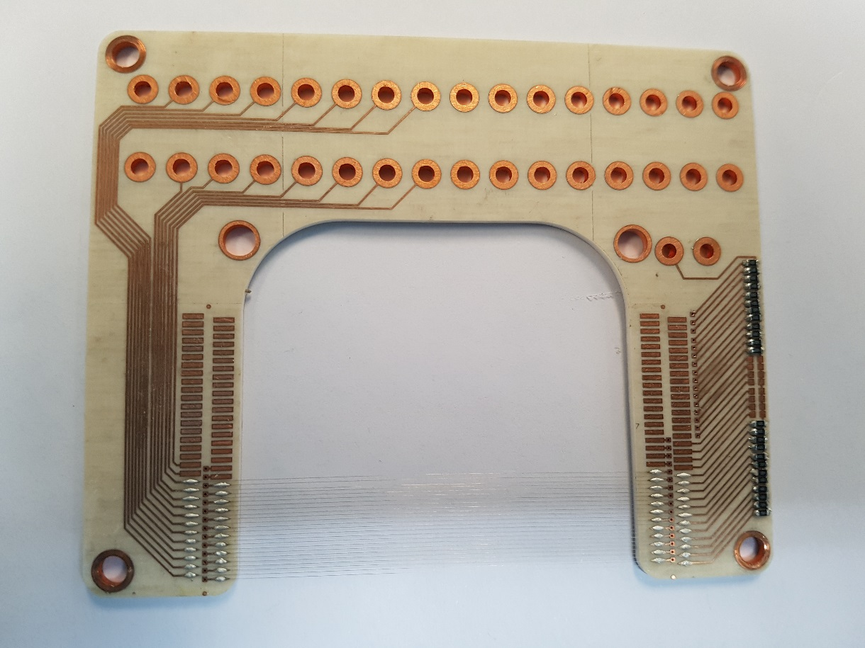
Front-End Wire Checking
Test_opamp 1
Test_opamp 2
Test_opamp n
OPAMP n
Vacuum
test n
OPAMP 2
OPAMP 1
test 2
test 1
Test_ wire 2
Test_wire n
Test_ wire 1
Test voltage
38
Notes:
The aims of the studies are:
To determine the geometrical shape that favors a more
efficient recapture.
To study the electron recapture map (in case some parts
need protection).
To evaluate the voltage level needs of the repeller.
Electrostatic field simulations made with Comsol, particle
dynamics studies performed with GPT.
A considerable effort was made to create an accurate secondary electron beam (beam footprint, collector angle, emission angle probability and energy distribution, etc).
The video below, created from the results of a typical simulation, allows to observe the electron trajectories, impact position and recapture time.

Slide 39
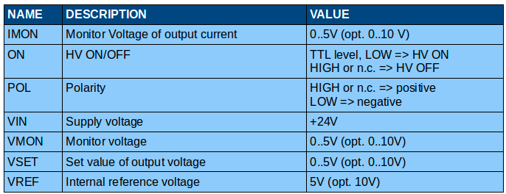
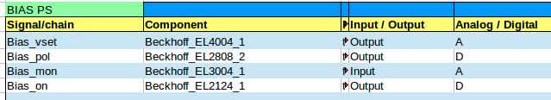
EMU BIAS
EMU BIAS, same model as FC Repeller
ISEG DPR 10 106 24 10 ESH
Vout: 0 to –1000 V
Imax: 10 mA
Vin/Iin: 24 V/0.8 A
Control Signal 0-10 V
Ripple/Noice: 2/7 mV
SHV output
DB9 control signal
Controled by:
digital outputs module
analog outputs module
analog input module
39

Slide 40
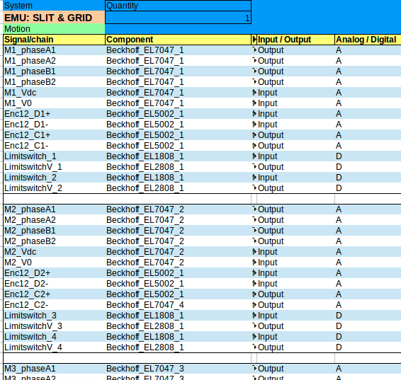

EMU Motion Control
4 motors: Stepper Bipolar 2 Phase.
4 linear absolute encoders.
4 motor stepper drivers.
4 SSI absolute encoder interfaces.
8 limit switches for 4 axis
4 limit switches for MPS
4 linear incremental encoders.
4 incremental encoder interfaces.
40

Slide 41
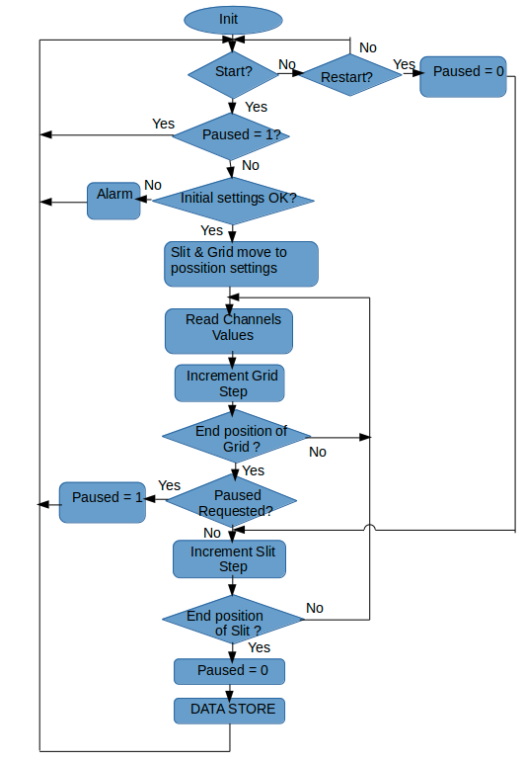
EMU SW Flow Diagram
41

Slide 42
Motion related SW
Features:
  2 planes.
  4 motors: 2 slit blades, 2 grids.
  Grid recursive movement over slit movement.
Init:
Slit and grid positioners.
Motor acceleration and velocity.
ADC:
ON state: ready to receive settings
external trigger.
Set number of sample reads at each movement.
Before slit movement:
EMU flag busy activated.
Charge of slit positions.
After slit scanning:
EMU is not busy: flag busy deactivated.
Emittance parameters calculation.
Before grid movement:
Charge of grid positions.
On Grid scanning:
Take the movement positions for next grid scan.
After all points of Grid scanned for an specific slit position:
Collecting data
42

Slide 43
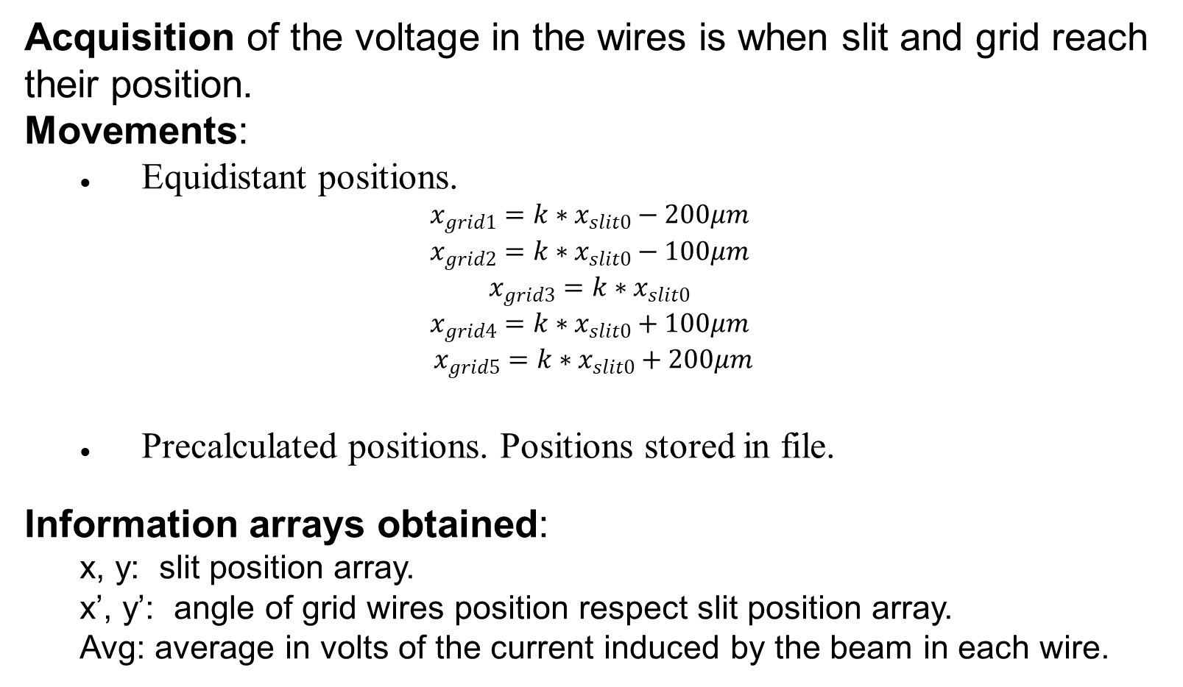
SW: Acquisition
Acquisition of the voltage in the wires is when slit and grid reach their position.
Movements:
  Equidistant positions.
$$x_{grid1}={k∗x}_{slit0}−200μm$$
$$x_{grid2}={k∗x}_{slit0}−100μm$$
$$x_{grid3}={k∗x}_{slit0}$$
$$x_{grid4}={k∗x}_{slit0}+100μm$$
              $x_{grid5}={k∗x}_{slit0}+200μm$
  Precalculated positions. Positions stored in file.
Information arrays obtained:
  x, y: slit position array.
  x’, y’: angle of grid wires position respect slit position array.
  Avg: average in volts of the current induced by the beam in each wire.
43
Notes:
43

Slide 44
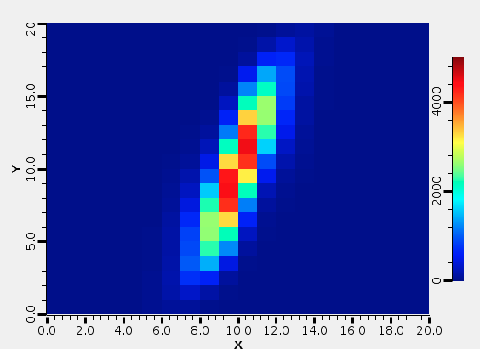
SW: Data analysis
Magnitudes:
  Emittance RMS.
  Twiss parameters: alpha, beta and gamma.
  Input for those magnitudes calculation:
Samples from ROI delimited by user limit settings.
Background subtraction applied to samples on ROI.
Threshold: percentage of the maximum in ROI.
Tests with precalculated samples
44
Notes:
44

Slide 45
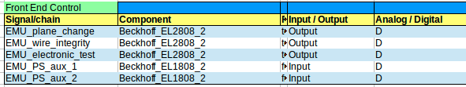
SW: Data analysis (2)
Bias voltage
  Voltage configurable from the GUI.
  Bias power supply status flag status.
Wire integrity
  Checking at beginning of measurement/disabled.
  Power supply applies 10 V to each wires.
  Wire integrity flag status.
Calibration
Analog calibration for the FE electronic and digitizer board ADC.
  Calibration is made at least once at manufacturer facilities.
  Optional connection for calibration power supply
45
Notes:
45

Slide 46
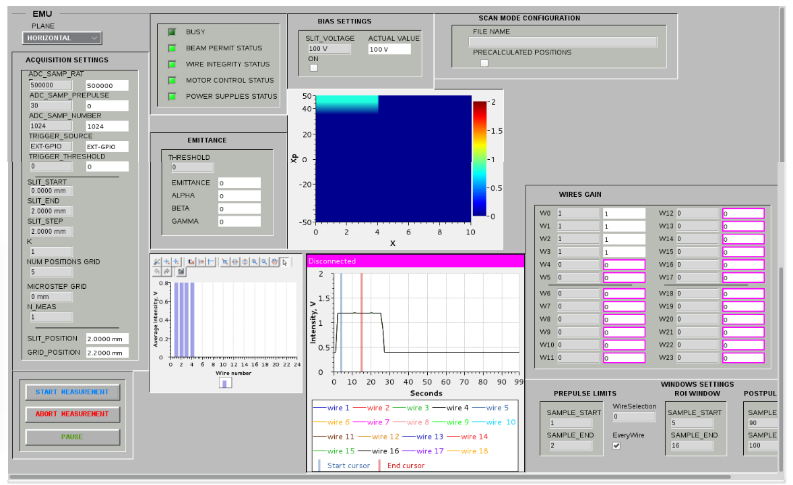
SW: Engineering GUI
46
Notes:
46

Slide 47
SW: Engineering GUI fields
Settings of motion control, data acquisition, bias voltage, ADC gain.
Screen of wire average voltage.
Screen of voltage pulse measurement per wire.
Screen of intensity phase space surface.
Several Status flags
RMS Emittance and Twiss parameters.
Precalculated positions motion configuration file.
47
Notes:
47

Slide 48
SW: EPICS Data Base
EMUFunctions.template:
  BEAM permitted checking, status of the power supplies, wire integrity and configuration of bias voltage. Flags status.
EMUSlit.template:
  PVs associated to the Slit.
EMUGrid.template:
  PVs associated in general GRID motion calculation.
EMUGridProcess.template:
  PVs associated to the acquisition in the wires.
EMUMotionMode.template:
  PVs associated to the motion modes.
EMU_Switches.template:
PVs associated to switches.
EMU_PSAux.template:
PVs associated to Bias PS.
EMU_BinSignal.template:
PVs associated to general control signals.
48
Notes:
48

Slide 49
Summary
Introduction
General HW
General SW
Faraday Cup
Emittance Meter Unit
Scrapers
49

Slide 50
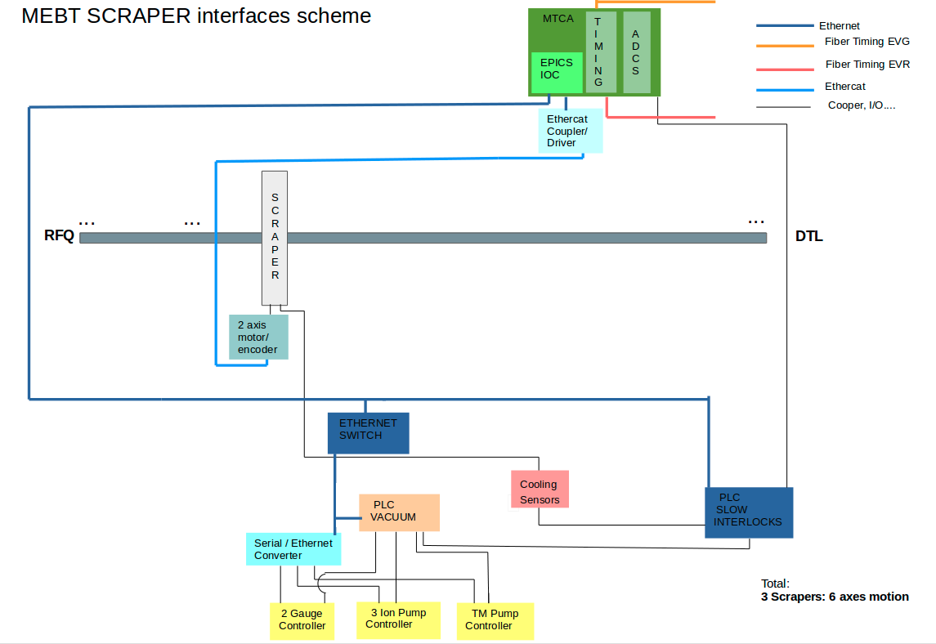
HW description Scraper general interface Layout

Slide 51
SW general control
SC SW modules:
EPICS module for Scraper control developed by ICS ESS ERIC.
EPICS module: Ethercat_MEBT basic motion developed by ESS Bilbao.
Cooling and slow interlocks developed by ESS Bilbao.
Some features:
Three set of scrapers: 2 blades each.
6 motion axes with stepper motors and incremental encoders.
6 analogue channels for charge measurement.
Provided functionality by Bilbao:
Motion tests.
Analog I/O, Digital I/O availability and control in BECKHOFF system.

Slide 52
Thank you for your attention
Merci beaucoup!
52

