Slide 1
ESS BEAM INSTRUMENTATION FORUM
Paris, 20th november 2017
Florence ARDELLIER

Slide 2
content
CEA and IRFU OVERVIEW
IRFU contributions to ESS accelerator realisation
Enjoy BI forum

Slide 3
CEA overview

Slide 4
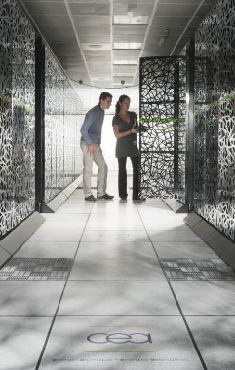
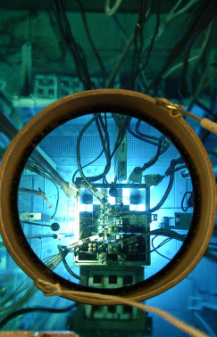
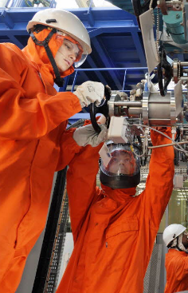
CEA missions
Defense
Nuclear Energy
Industry
FUNDAMENTAL RESEARCH

Slide 5
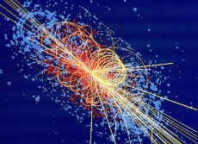

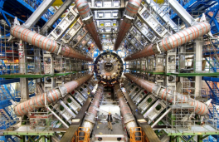
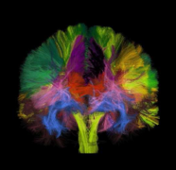
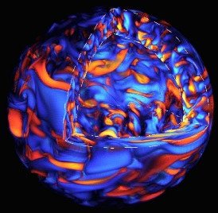


CEA missions
Fundamental Research
KNOWLEDGE
From basic research to applications
MISSIONS
OF THE CEA
Infrastructures and instrumentation
Physics (Nuclear physics, high energy physics, astro- or particle physics, fusion)
Material sciences, chemistry
Biology and biotechnologies, health
Climate & environmental studies
Energy
Cryotechnologies, accelerators, magnets, lasers, detectors
Radioisotopic tagging
Genomics, proteomics, radiobiology, bio-imaging
High performance computing
Micro and Nanotechnologies, material processes
KNOW-HOW

Slide 6
Fundamental research division
main figures
15 institutes
Nano, Materials & optics | fusion | Theoretical physics | Climate & environment sciences | Nuclear & particle physics, astrophysics | Medical imaging | Radiation biology | Biosciences Bio technology | Medical innovation genomics
IRAMIS H. Desvaux | IRFM A. Becoulet | IPhT M. Bauer | LSCE E. Cortijo | IRFU A.I. Etienvre | I2BM JM. Grognet | IRCM P.H. Romeo | BIG J. Garin | IMETI P. Leboulch
INAC Y. Samson |  |  |  | GANIL F. Staley |  |  | IBITECS M. Werner | IG P. Le Ber
 |  |  |  |  |  |  | IBS W. Weissenhorn
 |  |  |  |  |  |  | BIAM P. Chagvardieff
Common projects on accelerator and superconducting magnets within CEA
between Irfu, Ganil, INAC (SBT) and IRFM (fusion)

Slide 7
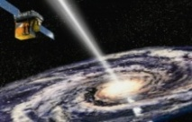

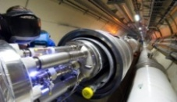
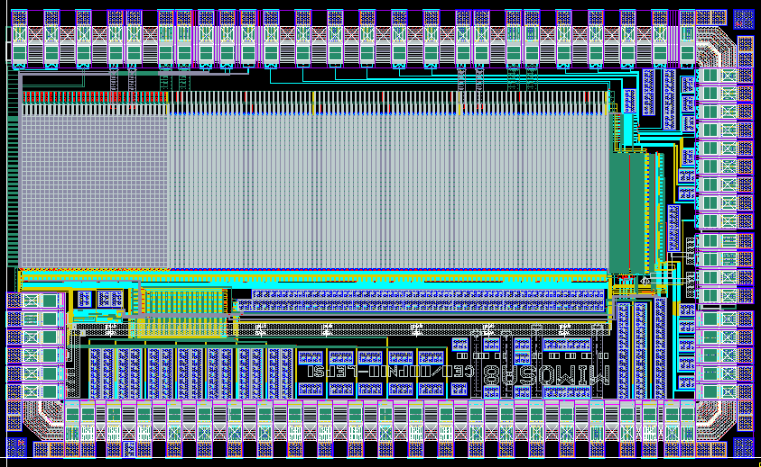
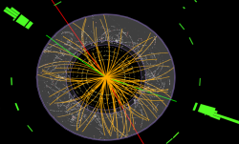
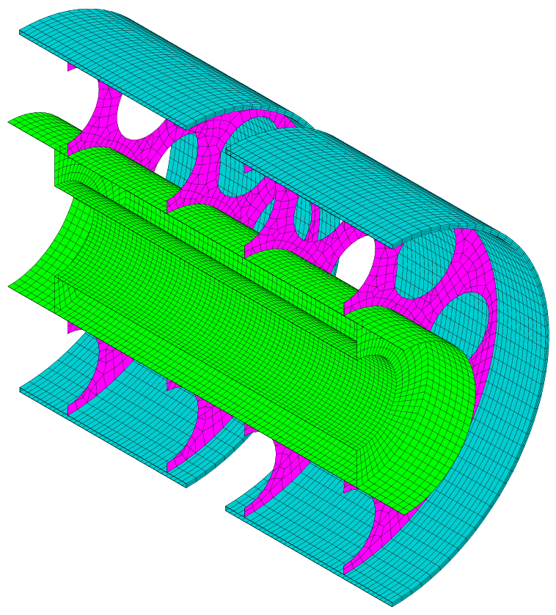
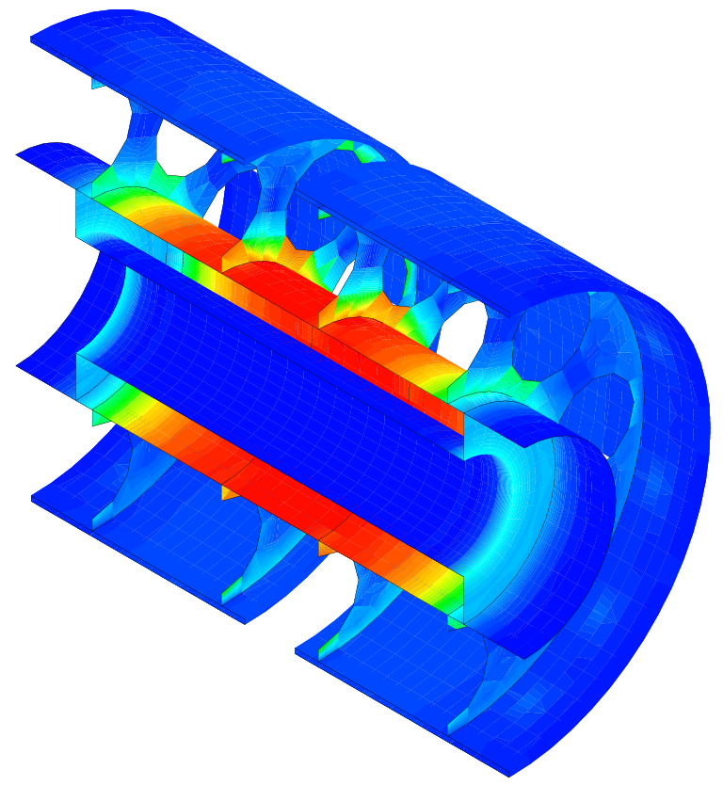
Irfu: overview
  Research & Technology
      Physics: Infinitely large & small
      Technology: Radiations
Institute of Research into the Fundamental laws of Universe
Astrophysics
Space technologies
Accelerators,
Supra. Magnets
Nuclear Physics
Detectors, electronic,
computing
Particle Physics
Systems engineering

Slide 8
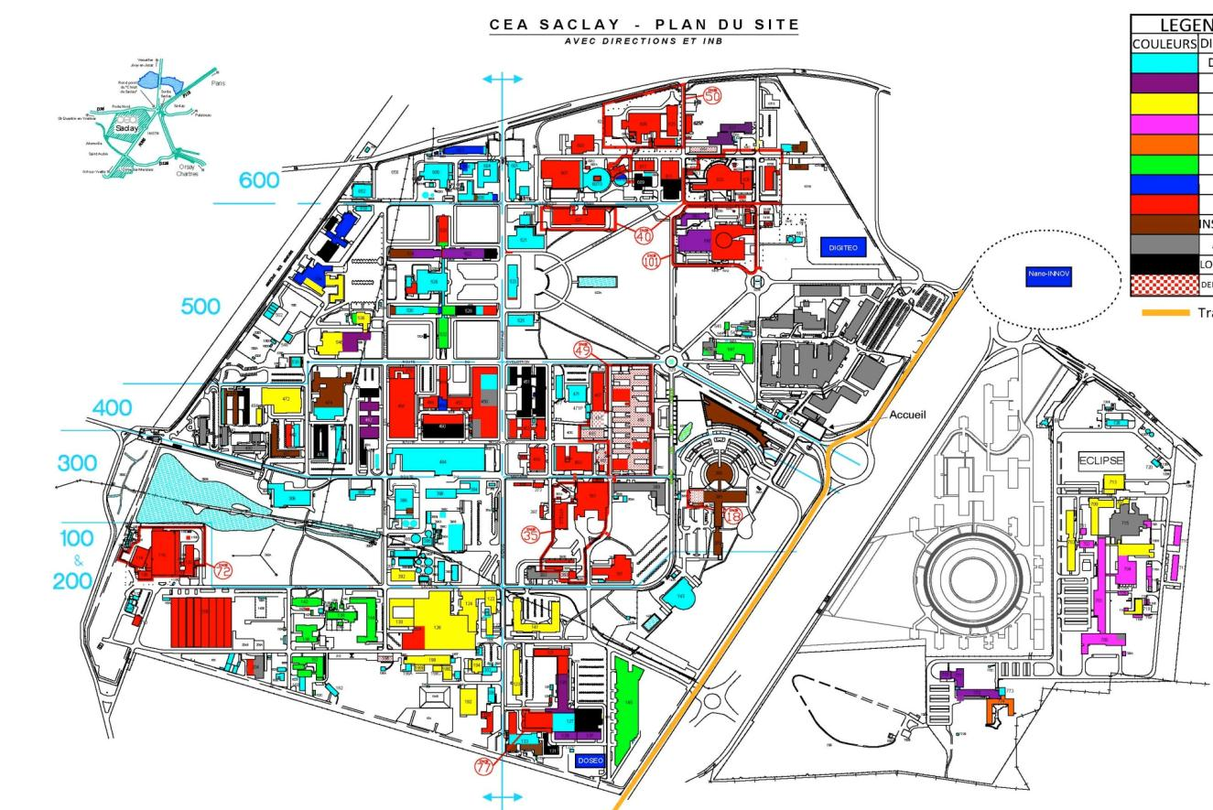
Large platforms
  Irfu Saclay&Orme
  50 000 m²

Slide 9
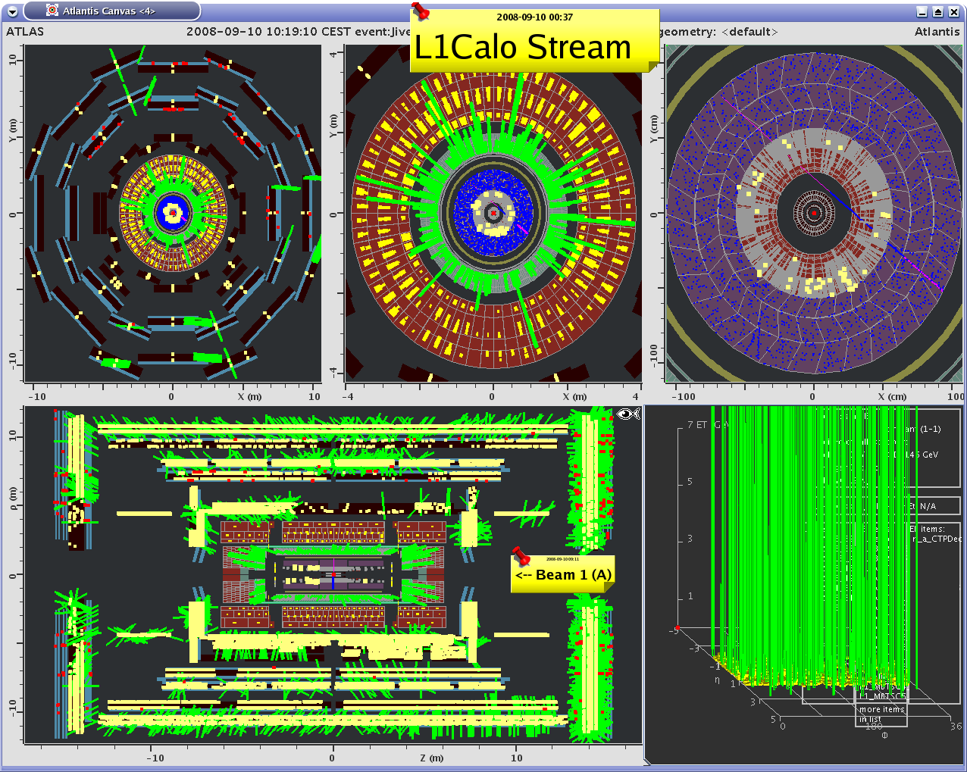
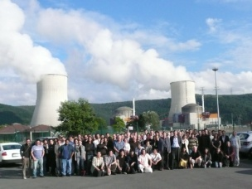
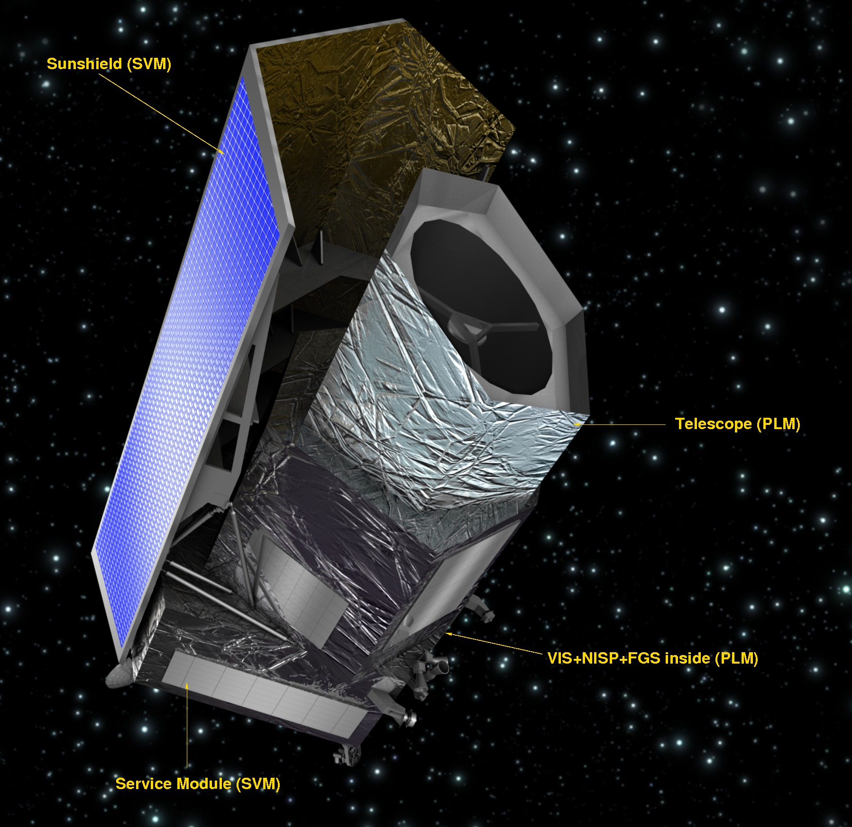
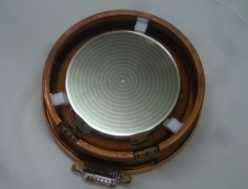
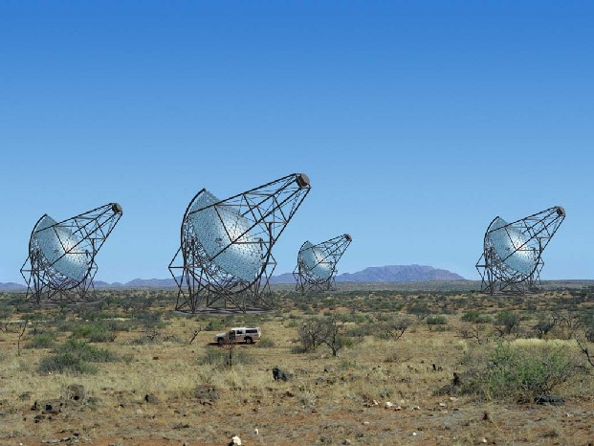
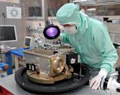
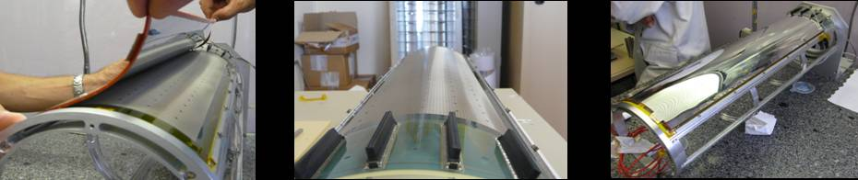
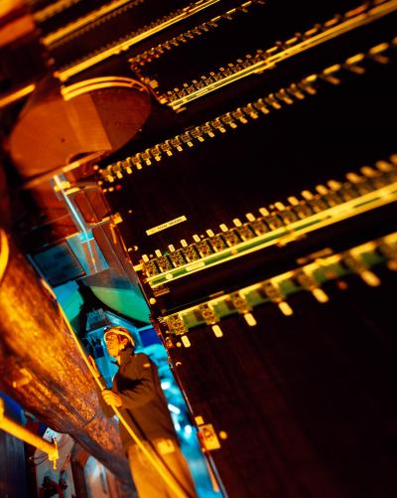
Scientific roadmap
Elementary constituents?
  Standard Model, BSM (ATLAS,CMS)
  Neutrinos oscillations (T2K, D-Chooz, Cesox, Stereo, Nucifer)
Energy content?
  Dark Universe (Edelweiss, Boss/Desi, Euclid …)
  Antimatter (Gbar)
Structures in the Universe?
  Cosmology (Planck)
  Formation of galaxies & stars (Hershel, JWST, ELT)
  Cosmic radiations (Fermi, Svom, Hess/CTA)
Origin of particles and nuclei?
  Plasma of quarks and gluons (ALICE)
  Structure of Hadrons (COMPASS, JLAB)
  Exotic nuclei (GANIL/SPIRAL2, FAIR)

Slide 10
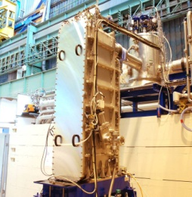
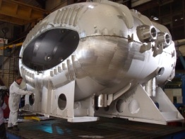
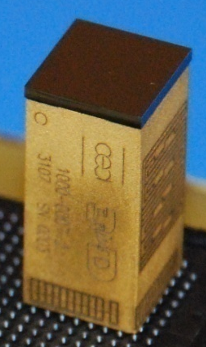
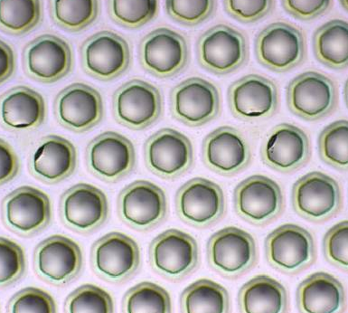
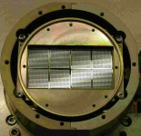
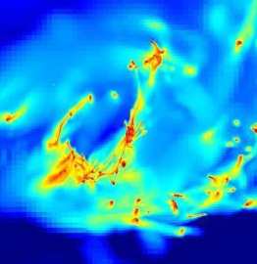
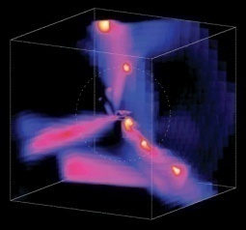
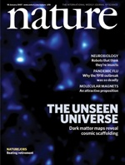
Technological ROADMAP
Production and manipulation of radiations
  Accelerators (Spiral2, XFeL, FAIR, CERN, IFMIF, ESS,
  SARAF)
  Magnets & Superconductivity (R3B, ISEULT, JT60SA)
Detecting radiation
  Microstructured detectors (RD51, CLAS12)
  Imaging device (ELT-METIS, APEX, CALIST)
  ASIC
Space technology
  Camera (PACS, MIRI, Éclair)
  Data center (Fermi, SWOM)
Simulation and data treatment
  Massively parallel calculations
  Grid
  Data processing

Slide 11
CEA IRFU
HIGHLIGHTS IN
ACCELERATOR
FIELDS

Slide 12
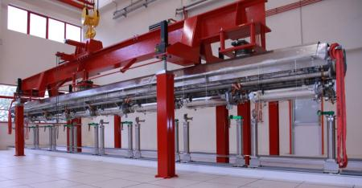
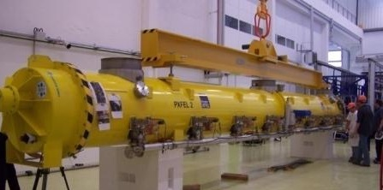
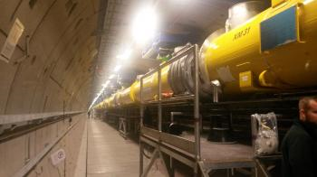
XFEL : 103 cryomodules assemblied at CEA-irfu

Slide 13
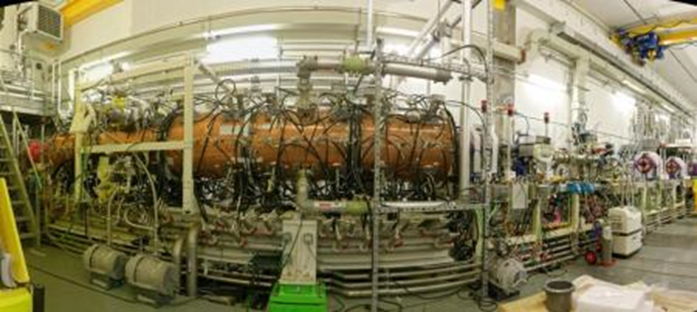
Spiral2
RFQ
    First beam in december 2016
Cryomodules
    12 cryomodules delivered and installed

Slide 14
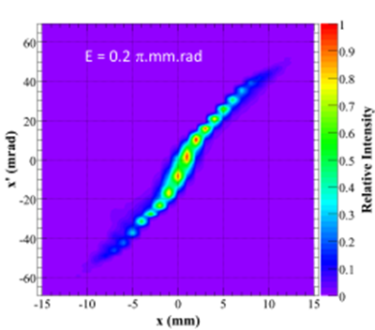
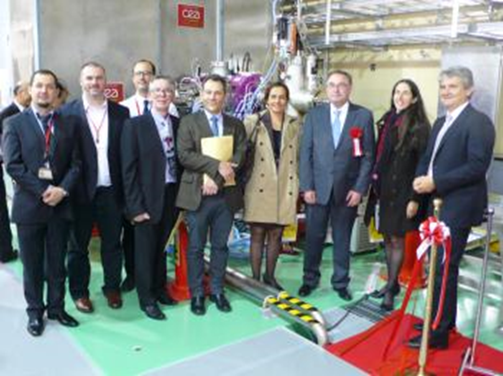
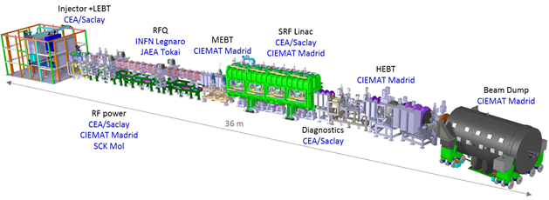
IFMIF- LIPAC
Source and injector delivered to Japan (Rokkasho)
  Commissioning ongoing
  (114 mA, emittance 0.26 pi.mm.mrad - protons)
Diagnostics delivered and installed
Cavities, couplers : production ongoing

Slide 15
CEA-IRFU CONTRIBUTIONS TO ESS

Slide 16
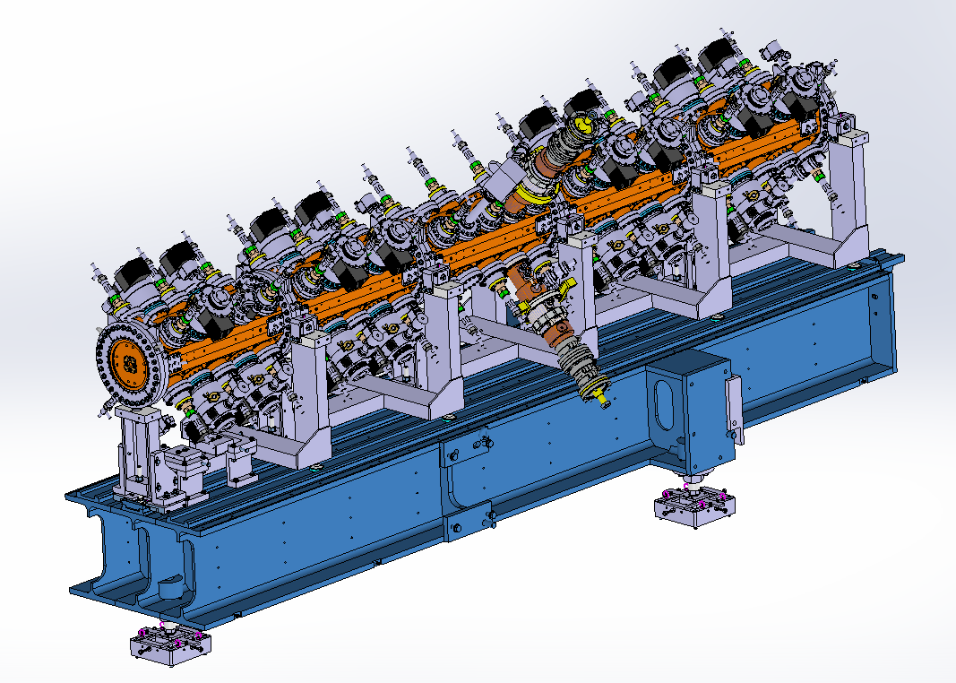

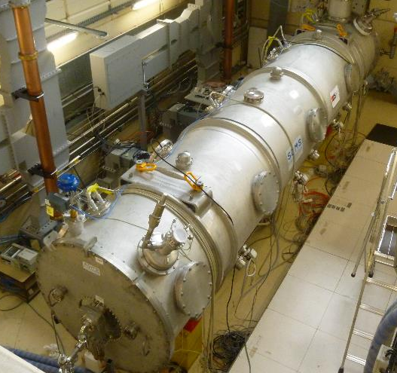

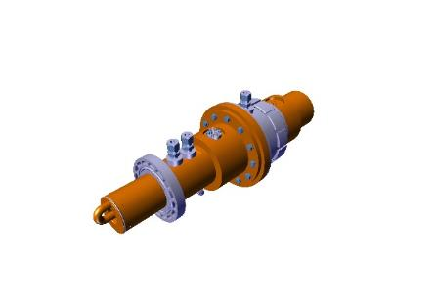
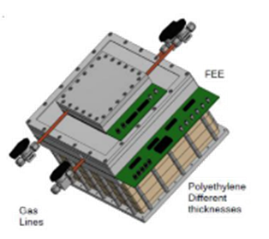
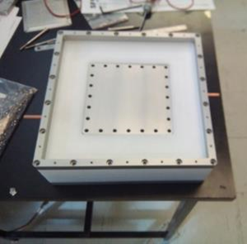
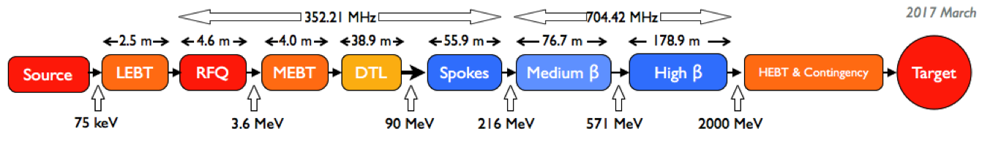
CEA-IRFU contributes to 4 ess main WP
RFQ (ACCSYS)
Elliptical Cryomodules (ACCSYS / WP5)
Control System (ICS)
Source proton & LEBT
Part of RFQ control
nBLMs Control Systel
NPM (? )
2 demonstrateurs (M-ECCTD & H-ECCTD)
30 Elliptical Cryomodules à
9 CM Medium β
21 CM High β
Diagnostics (ACCSYS):
Doppler & 2 EMU 42 nBLMs 5 NPM
Elliptical Cryomodules (Saclay visit point on the 22nd nov.)
RFQ (Saclay visit point on the 22nd nov.)
Diagnostics sub-systems all along the LINAC
Control System contributions for Source, LEBT, RFQ and nBLMs + NPM (tbc)?

Slide 17
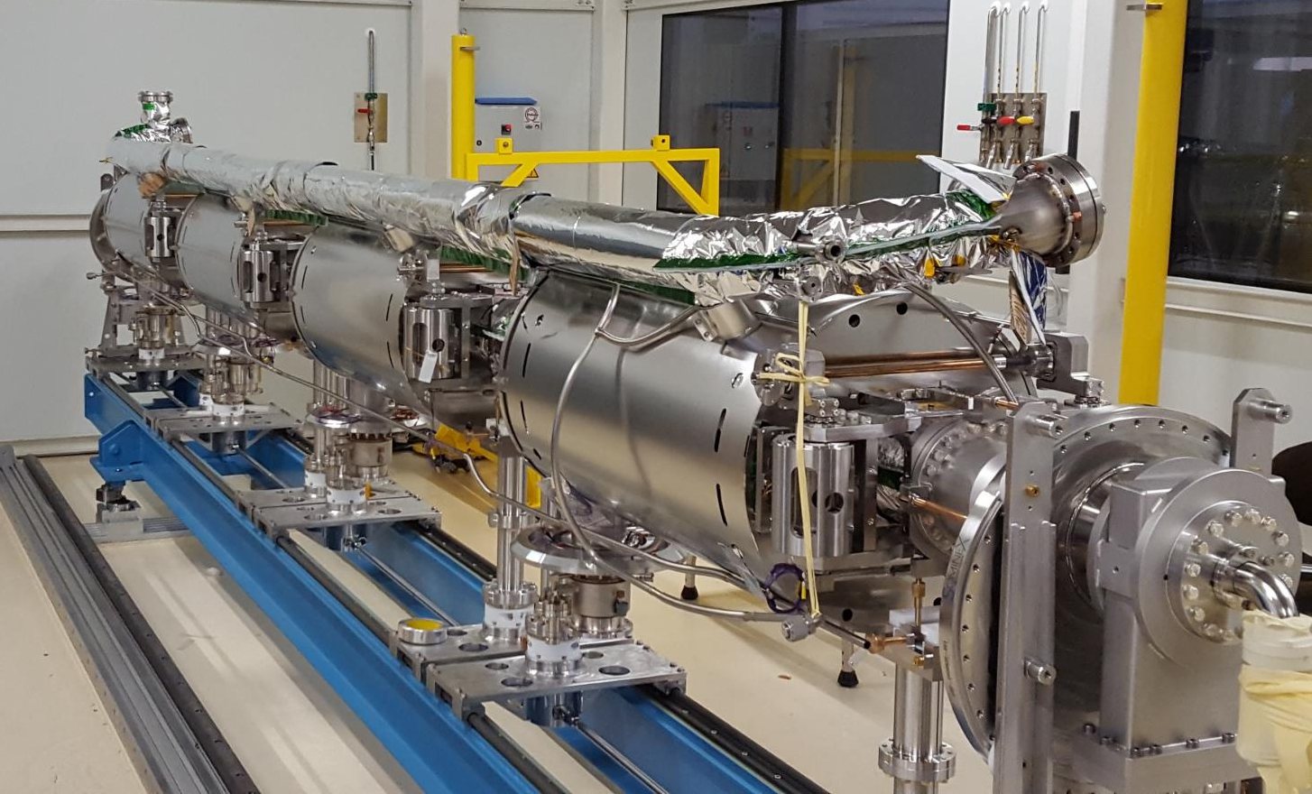
Cryomodules

Slide 18
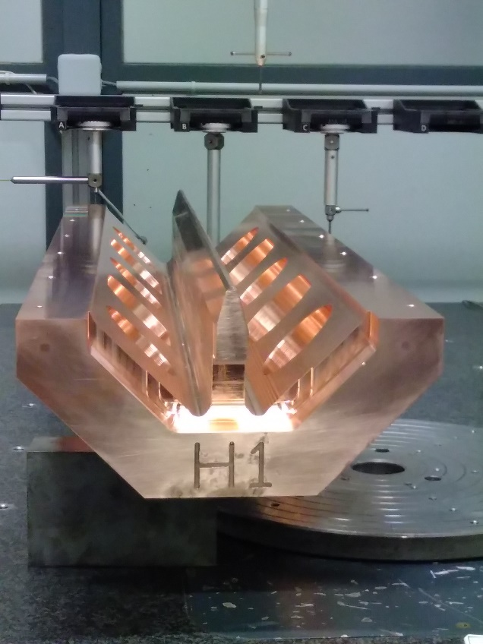
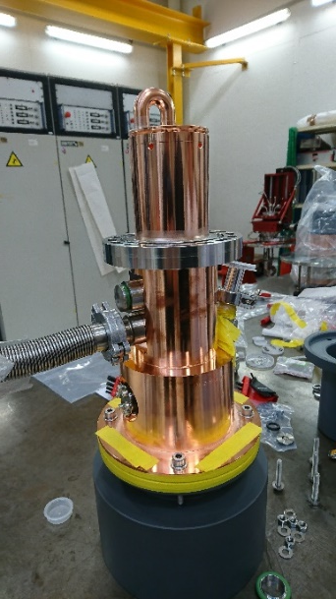
RFQ

Slide 19
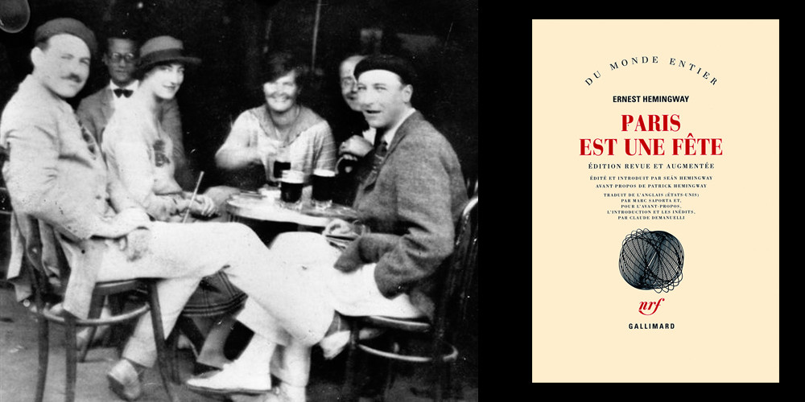
conclusion
Large portfolio of projects on accelerators
ESS is a priority for CEA
    Collaboration between ESS and CEA started since 2008
    In excellent continuity with repect to CEA long term involvement in European accelerator roadmap
I wish you an excellent
forum in Paris !
And an excellent visit of
Saclay site

