Slide 1
ESS Sample Environment Integration
Update
Anders Pettersson, Niklas Ekström, Anderas Hagelberg
Mechatronics and Systems Integration
2017-12-12

Slide 2
What Is our part
Integration of Sample Environment Equipment
ESS Integrated Control Systems (ICS) will provide EPICS integration.
ESS Data Management and Software Centre (DMSC) will provide integration into the ESS ECS (NICOS)
Our role will be to:
  provide additional logic/controls required
  support and coordinate the integration effort

Slide 3
Current integration projects
JIRA issue | name |  |  | Main client | progress | Hardware available | status
 |  |  |  |  | (%) |  | started | Ready for first test | final touch | ready
Task MESI-13 | JULABO F25-HL Circulator |  |  | FLUCO | 80 | x | x | x
Task MESI-18 | LakeShore336 |  |  | TEFI | 90 | x | x | x
Task MESI-17 | KEPCO BOP502D Bipolar Power Supply |  |  | MESI | 80 | x | x | x
Task MESI-24 | FLUCO NE 1600 6 channel syringe pump i |  |  | FLUCO | 10 | x | x
MESI-28 | Utgård SE Utilities PLC |  |  | MESI | 80 | x | x | x
Task MESI-32 | PREMP Scanning system |  |  | PREMP | 3 | x | x
Task MESI-14 | MV Lab CCR system |  |  | MH | 75 | x | x | x
Sub-task MESI-15 | LESKER KJLC 354 vacuum gauge |  |  | MH | 80 | x | x | x
Sub-task MESI-16 | OceanOptics QEPro Spectrometer |  |  | MH | 70 | x | x | x
 | Making it a SES |  |  | MH | 0
Task MESI-19 | Orange Cryostat |  |  | TEFI/MESI | 1 | almost
Task MESI-20 | Individual temperature control of multiple samples using EPICS etherCAT |  |  | MESI | 5 | .. | x
Task MESI-27 | Cameras for Kinematic Mounting |  |  | PREMP | 75 | x | x | x
Task MESI-30 | Huginn SANS Temp Controller |  |  | TEFI | 80 | x | x | x
Task MESI-29 | Huginn Sub Cryostat |  |  | TEFI | 80 | x | x | x

Slide 4
Known integration projects
JIRA issue | name |  | Main client | progress | Hardware available | status
 |  |  |  | (%) |  | started | Ready for first test | final touch | ready
Task MESI-25 | FLUCO NE 100X 1 channel syringe pump for complex fluids |  | FLUCO | 0 | x | follow
Task MESI-26 | FLUCO NE9000G Peristhaltic pump |  | FLUCO | 0 | x | follow
Task MESI-23 | PREMP PACE5000 Pressure controller integration |  | PREMP | 0 |  | x/waiting
Task MESI-21 | LOKI VR inline system integration project |  | LoKI | ? | ?
Sub-task MESI-31 | Convert MATLAB code to EPICS/Python |  | TEFI | 0
 | HPLC |  | FLUCO | 0
 | LS224 |  | FLUCO | 0 | x

Slide 5
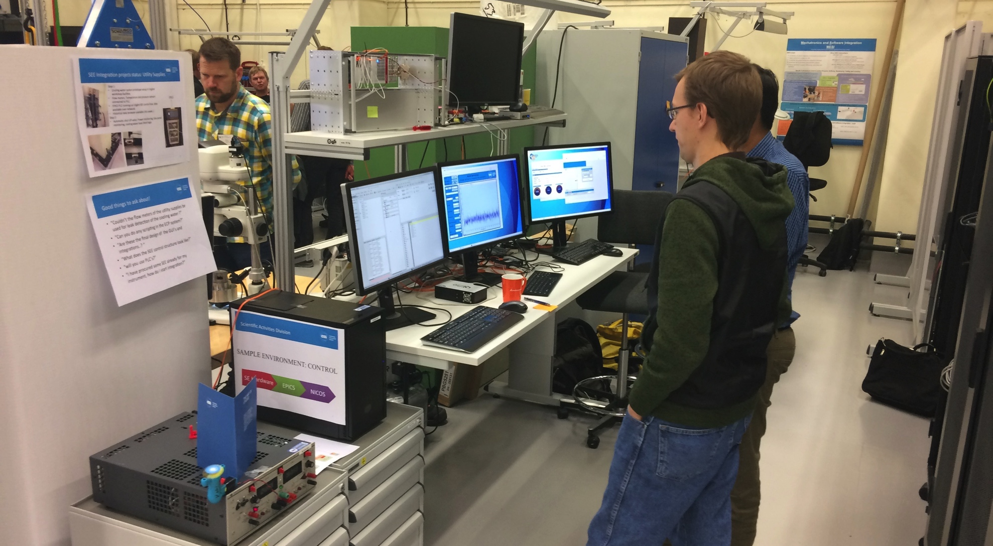
Start to make use of the system
EPICS: CCDB, IOC factory, Network booting , CSS GUI, Archiver
NICOS: History, Scripting, UI
First “user” (ESS SE colleague) now runs CSS GUI. NICOS “user” station soon to be available.

Slide 6
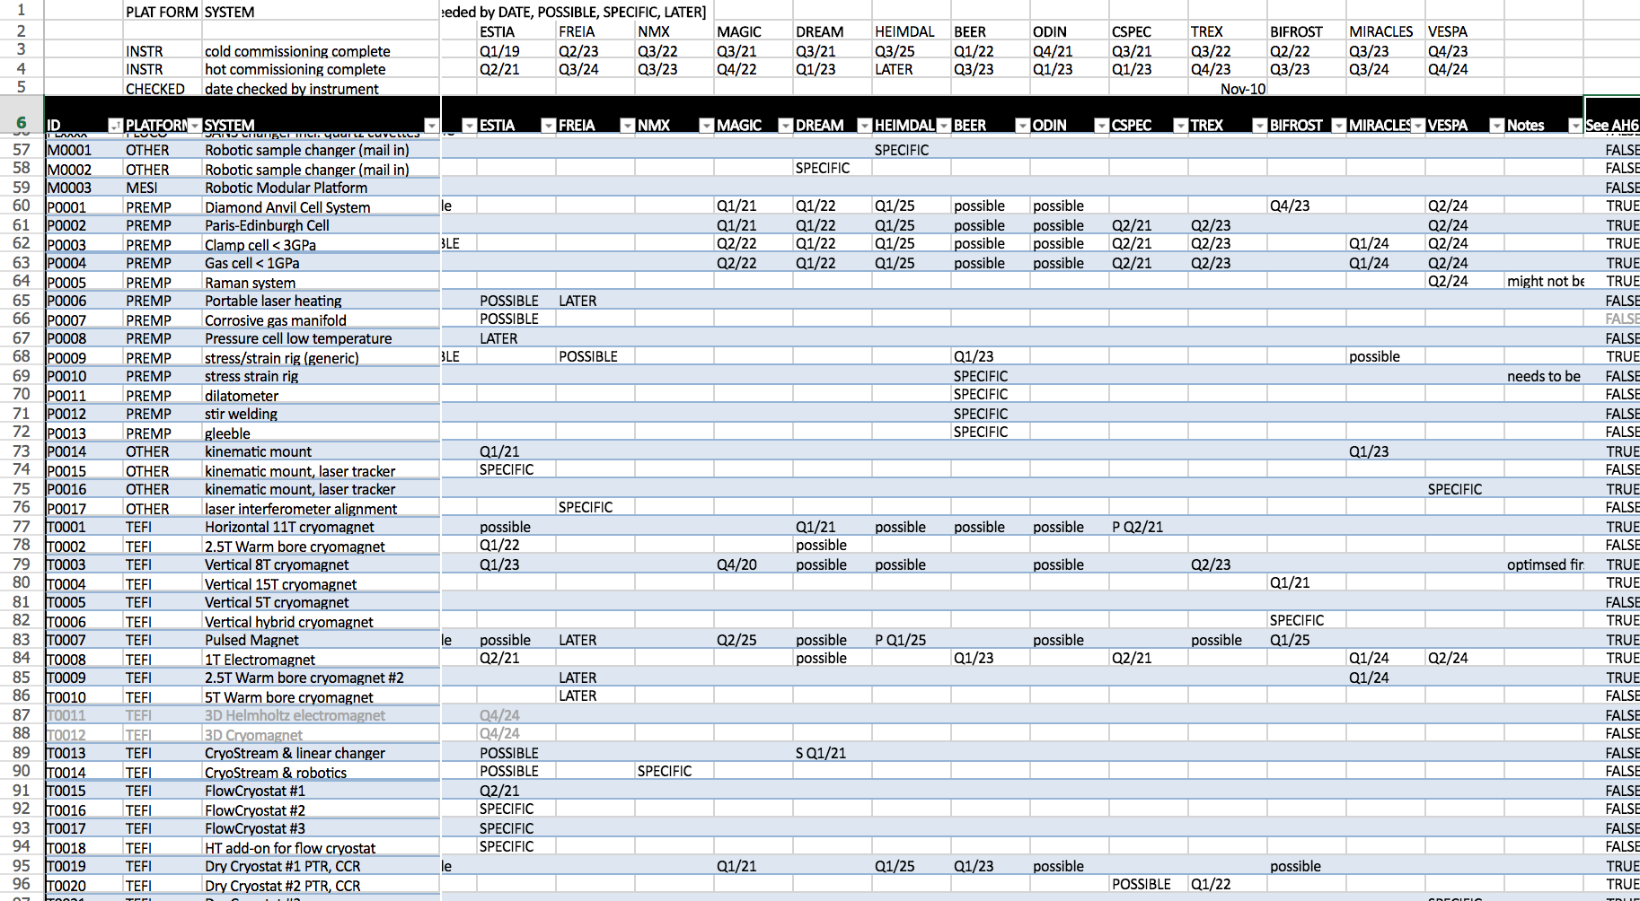
Quite some devices to be integrated

Slide 7
New colleagues
Niklas Ekström
Andreas Hagelberg
-> Integration work will accelerate
-> Work on SECoP will intensify
Topics:
Will there be a GUI for NICOS available?
How to handle a device scanning in the beam to find beam centre.?
Plotting Temperature vs Magnetic field?
Remote accsess/status check?
NICOS clients for “users” (colleagues)

Slide 8
Thank You for your attention!

