Slide 1
De risking the IBEX development workflow
An introduction to LeWIS and our IOC Test Framework

Slide 2
Contents

Slide 3
Setting the scene…

Slide 4
Old
New
SECI

Slide 5
UI
IOC
Device
Protocol

Slide 6
What’s the problem?

Slide 7
We haven’t built it yet
We’ve got the manual but it’s very old
It’s on order
It’s in pieces for maintenance
The person who built it has retired
It’s too big to move

Slide 8
UI
IOC
Device
Protocol

Slide 9
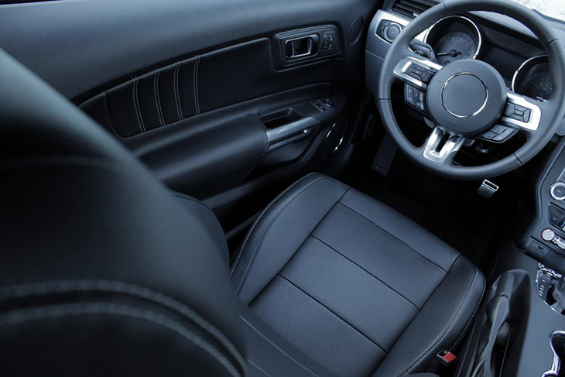
Speed (inches/μfortnight)
Opens boot
Brake
Acceleration
These buttons do nothing
Works even when car is off
Handbrake:
Up=Off, Down=On

Slide 11
Idea #1: Emulators

Slide 12
UI
IOC
Emulator
Protocol

Slide 13
Enter, LeWIS
Python-based
Communication over TCP
Supports state machine logic
Back door for simulating unexpected/error states
Shareable!

Slide 14
LeWIS architecture
TCP
Lewis engine
IBEX emulator
Adapters
Stream Interface
Simulation engine
Device
States

Slide 16
We haven’t built it yet
We’ve got the manual but it’s very old
We haven’t built it yet
We’ve got the manual but it’s very old
It’s on order
It’s on order
It’s in pieces for maintenance
It’s in pieces for maintenance
It’s too big to move
The person who built it has retired
It’s too big to move
The person who built it has retired

Slide 17
Idea #2: VI serial loop

Slide 18
UI
UI
IOC
IOC
Protocol
Emulator
Protocol
Device

Slide 19
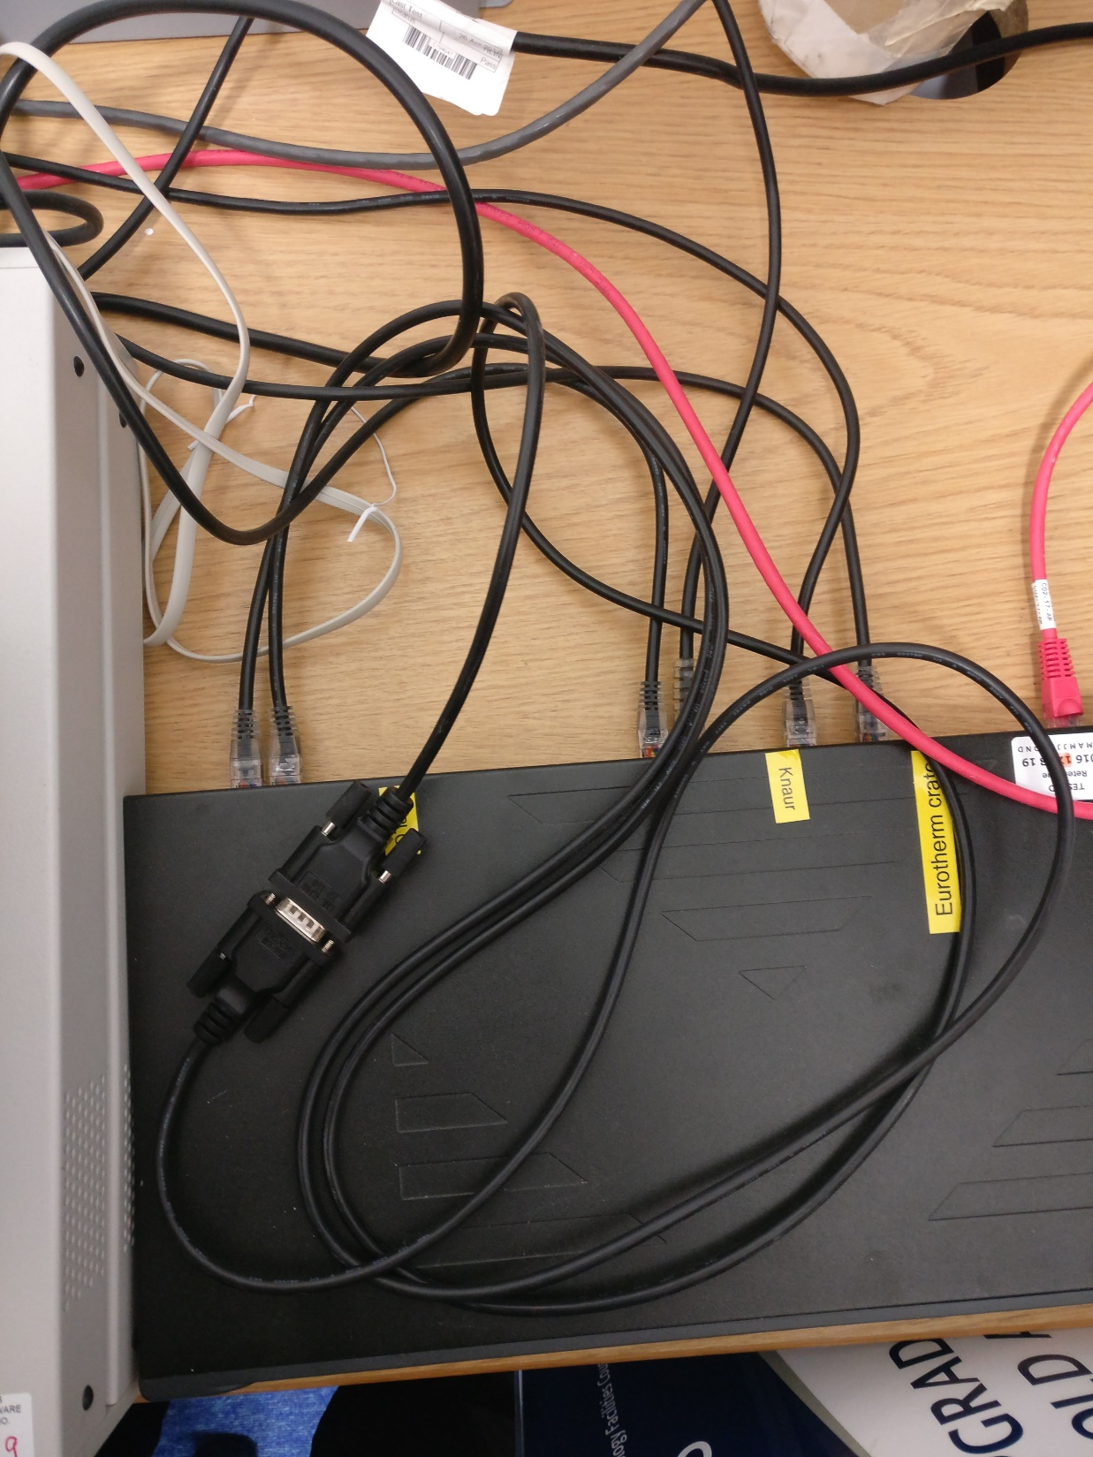
VI
Emulator
Device

Slide 20
We haven’t built it yet
We haven’t built it yet
We’ve got the manual but it’s very old
We’ve got the manual but it’s very old
We’ve got the manual but it’s very old
It’s on order
It’s on order
It’s in pieces for maintenance
It’s in pieces for maintenance
It’s in pieces for maintenance
It’s too big to move
It’s too big to move
The person who built it has retired
It’s too big to move
The person who built it has retired
The person who built it has retired

Slide 21
Idea #3: Automated testing

Slide 22
LeWIS Emulator
IOC Test Framework
IOC
“Unit” tests

Slide 23
Behaviour Driven Development (BDD)
Grew out of Test Driven Development
What it does, not how it’s built
Captures implicit knowledge
Ensures that existing behaviour is preserved on change
Code change more frequent than behavioural change

Slide 24
Recsim, Devsim or both?
BDD
Python Unittest: @skip, setUp, teardown etc.
Talk to LeWIS
Python modularity
Control system specific assertions…

Slide 25
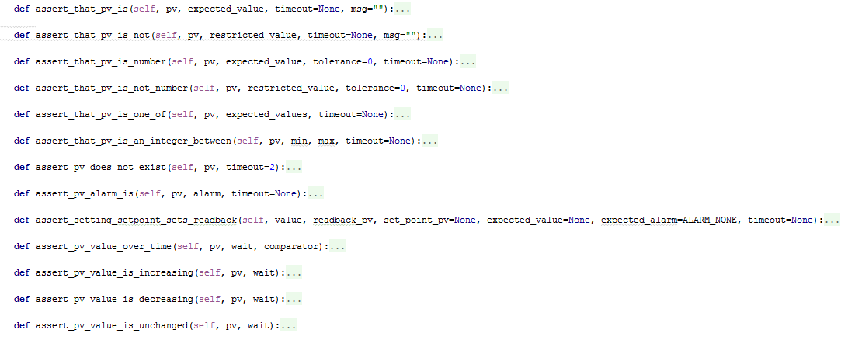

Slide 26
State of play
22 LeWIS emulators
20 devices covered by IOC test framework
>200 tests, run time ~1 hour
Emulators & test framework are independent

Slide 27
We haven’t built it yet
We haven’t built it yet
We haven’t built it yet
We’ve got the manual but it’s very old
It’s on order
It’s on order
It’s on order
It’s in pieces for maintenance
The person who built it has retired
It’s too big to move

Slide 28
Done?
Enhanced assertion
Pure BDD (Cucumber?)
More hardware
Closer LeWIS integration
Standard checks?
Better simulation of network behaviour

Slide 29
Questions?

