Slide 1


Detailed Design of High-Resolution Gadolinium-GEM neutron detectors for the NMX instrument at ESS
L. Bartels ^{c,b}, M. Christensenª, M. Guth ^{d,b}, M. Lupberger^{b}, D. Pfeiffer^{a,b},
L. Ropelewski ^{b}, M. Shettyª, P. Thuiner^{b}
ªEuropean Spallation Source (ESS AB)
^{b}CERN
^{c}Georg-August-Universität Göttingen, Göttingen, Germany
^{d}Albert-Ludwigs-Universität Freiburg, Freiburg, Germany
This work was funded by the EU Horizon 2020 framework, BrightnESS project 676548
IEEE 2017 Atlanta 26.10.2017

Slide 2
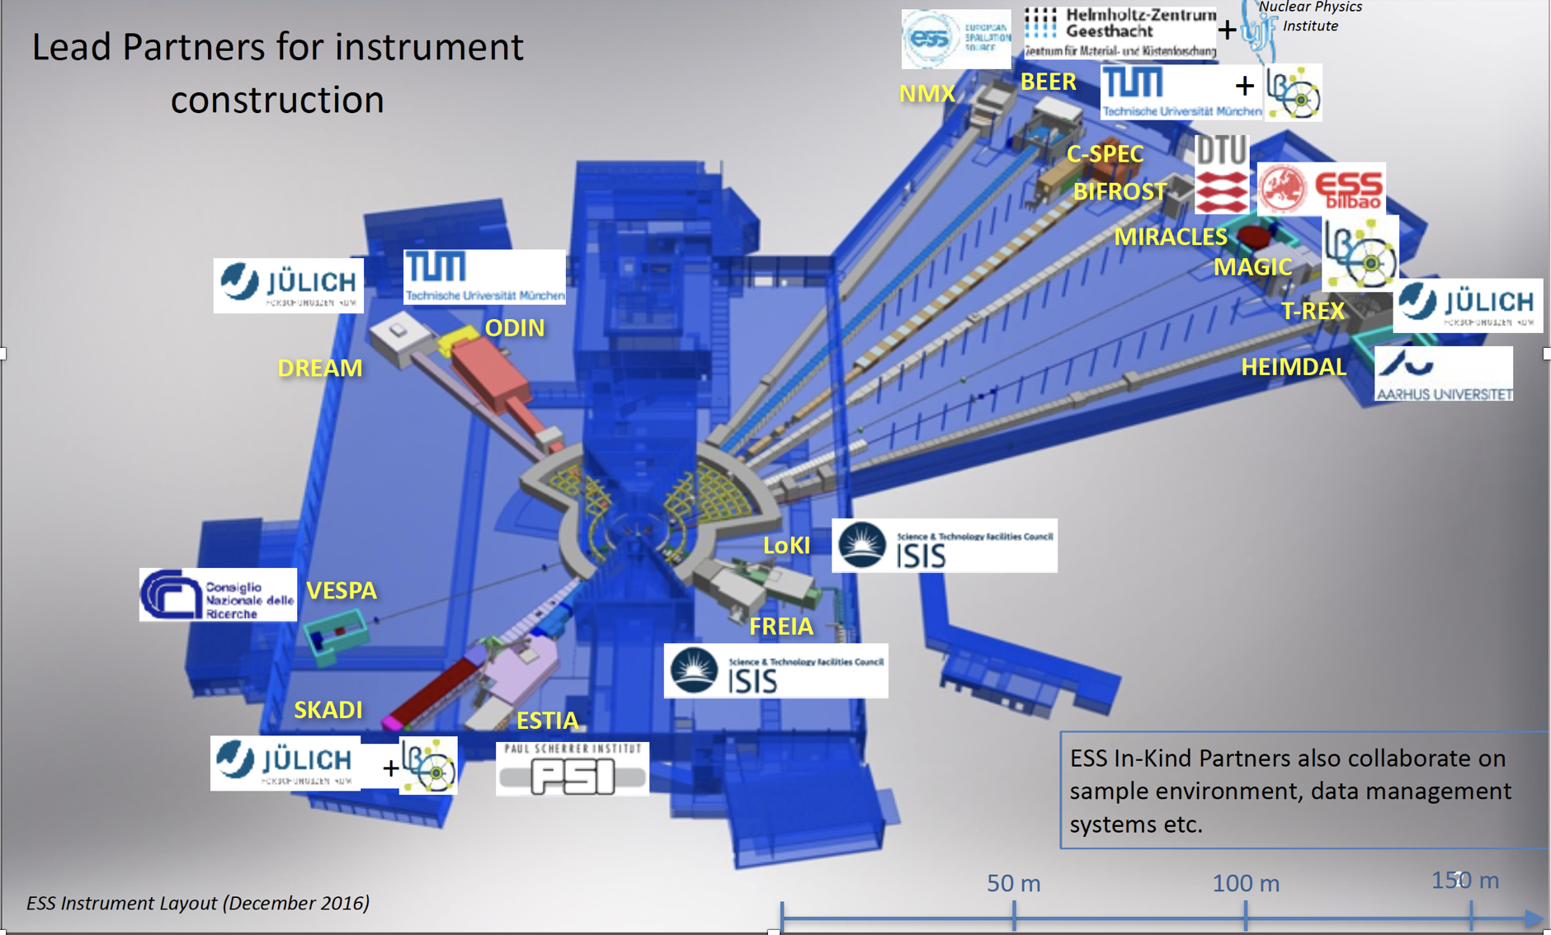
ESS Instrument Suite
sample
Detector Positioning System for ESS NMX, Final Design Report, J.-L. Ferrer

Slide 3
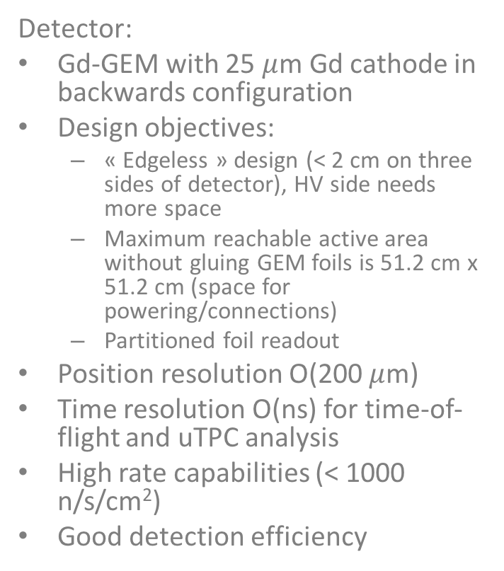
Detector Concept and Requirements
NMX:
Determine structure of proteins, location of hydrogen atoms
Optimised for small samples and large unit cells
Time-of-flight (TOF) quasi-Laue diffractometer
Wavelength band from 1.8 Å to 3.55 Å (6.49 to 25.25 meV)
Detector:
Gd-GEM with 25 $μ$m Gd cathode in backwards configuration
Design objectives:
  « Edgeless » design (< 2 cm on three sides of detector), HV side needs more space
  Maximum reachable active area without gluing GEM foils is 51.2 cm x 51.2 cm (space for powering/connections)
  Partitioned foil readout
Position resolution O(200 $μ$m)
Time resolution O(ns) for time-of-flight and uTPC analysis
High rate capabilities (< 1000 n/s/cm²)
Good detection efficiency
electrons
gadolinium
e⁻
γ
Triple-GEM
Read-out
n

Slide 4
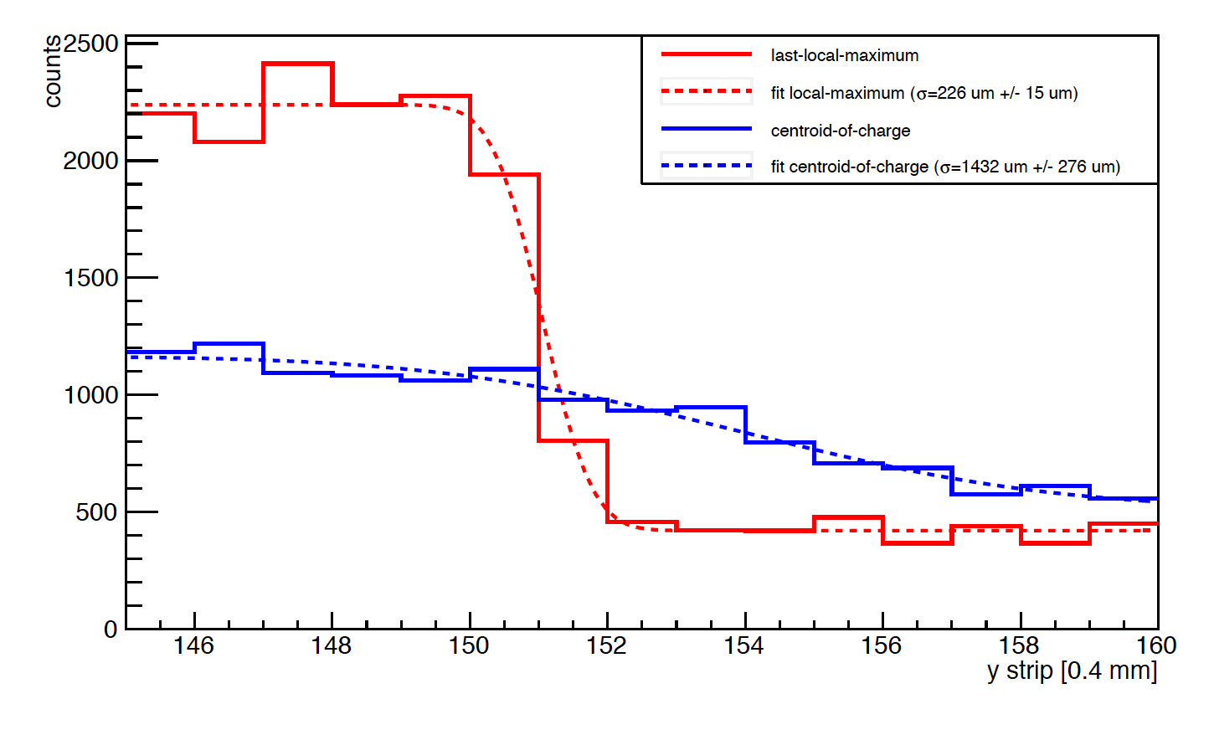
Gd-GEM μTPC Position Resolution
D. Pfeiffer et al, 2016 JINST 11 P05011
Position resolution σ = 300 μm with Triple GEM, FR4 readout and APV-25
Better position resolution expected with better time resolution of VMM3 and less scattering due to foil readout

Slide 5
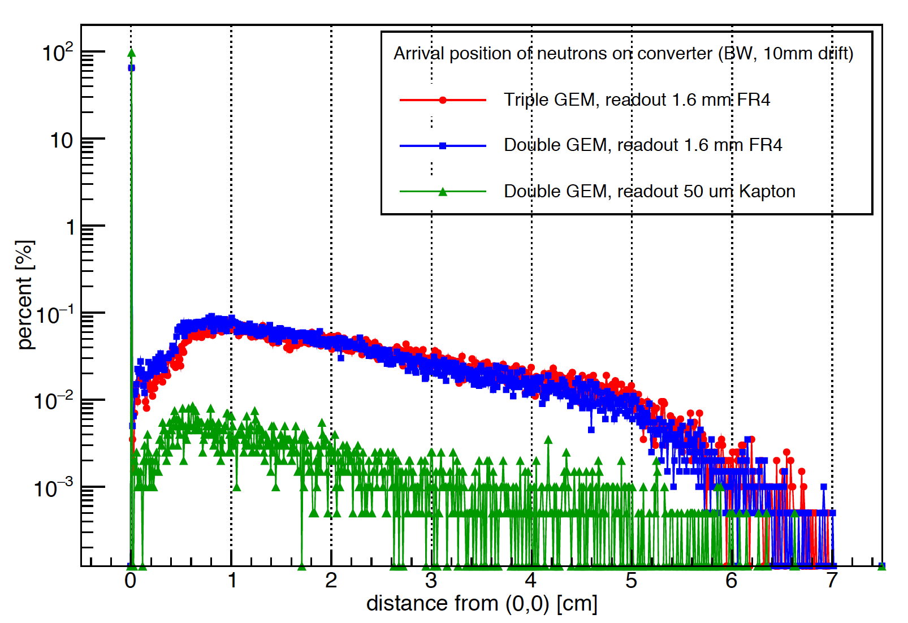
Geant4 10.2 Scattering Simulation
Improved position resolution, efficiency and S/N
expected with foil readout
Geometry used in measurements

Slide 6
Geant4 10.3 Simulation of Detection Efficiency
Measured efficiency with natural Gd and FR4 readout:
  11.5 % at 2.0 Å
  13% at 2.4 Å
With ¹⁵⁷Gd upgrade expected 30% at 1.8 Å
BEWARE: PhotonEvaporation Model gives different yield
of conversion electrons depending on Geant4 version
Simulation of 25 um natural Gd
[Å]

Slide 7
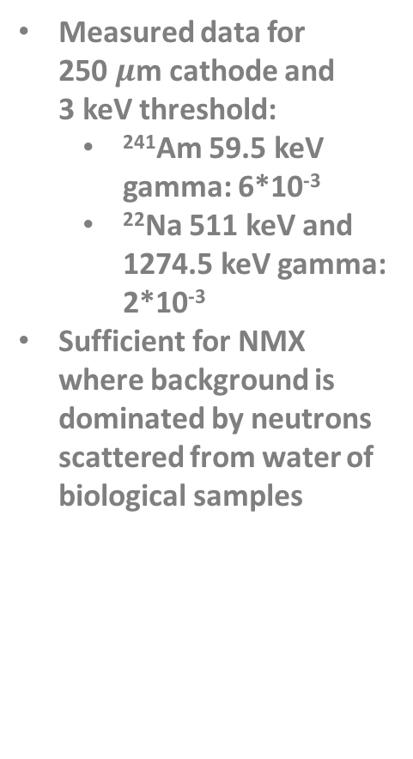
Gamma Sensitivity - Depending on Threshold
Measured data for
250 $μ$m cathode and
3 keV threshold:
  ²⁴¹Am 59.5 keV gamma: 6*10⁻³
  ²²Na 511 keV and 1274.5 keV gamma: 2*10⁻³
Sufficient for NMX where background is dominated by neutrons scattered from water of biological samples
10% of neutron events lost
25% of neutron events lost

Slide 8
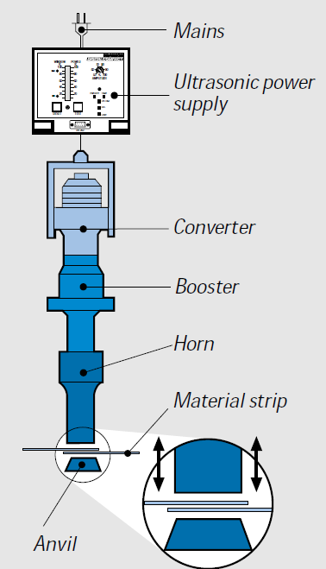
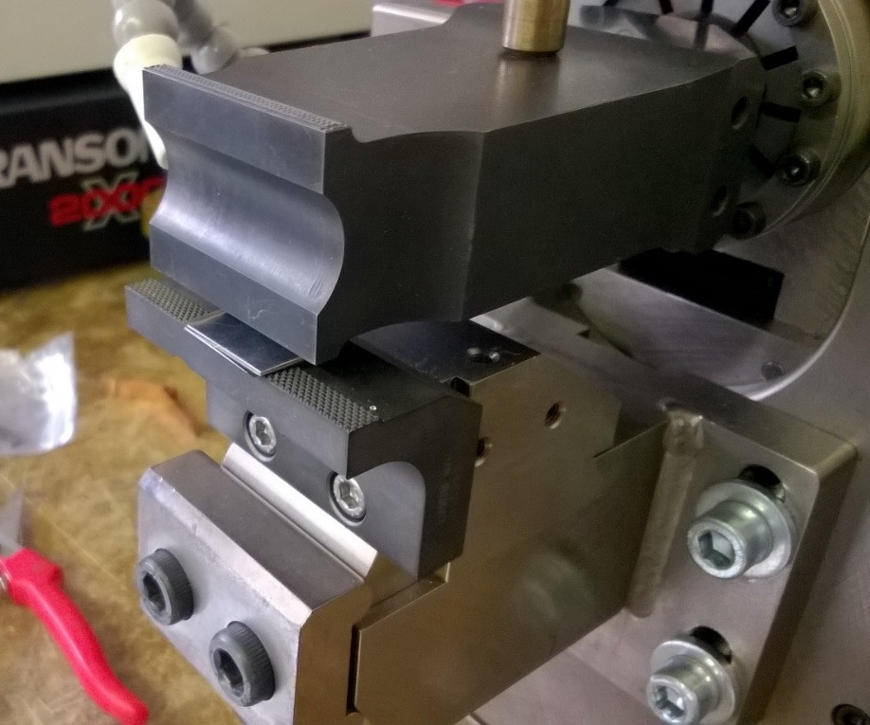
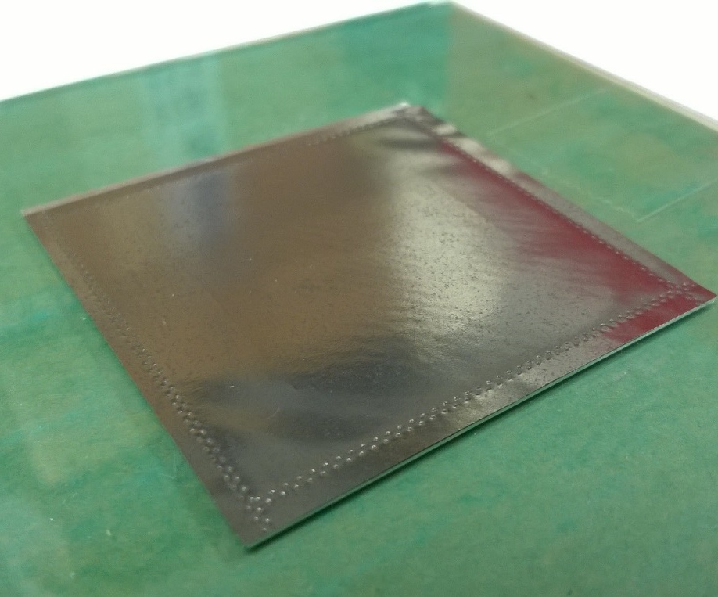
Ultrasonic Welding of Gd
Cathode assembly (25 pieces of 10cm x10cm) due to maximum foil size
Ultrasonic welding for
mechanical and electrical connection without dead area
Welds not visible in neutron beam
1 μm
Gadolinium
Ultrasonic welding
Aluminium
Sonotrode
sample
sonotrode
anvil
25 µm gadolinium on 1 mm aluminium, 5 x 5 cm²

Slide 9
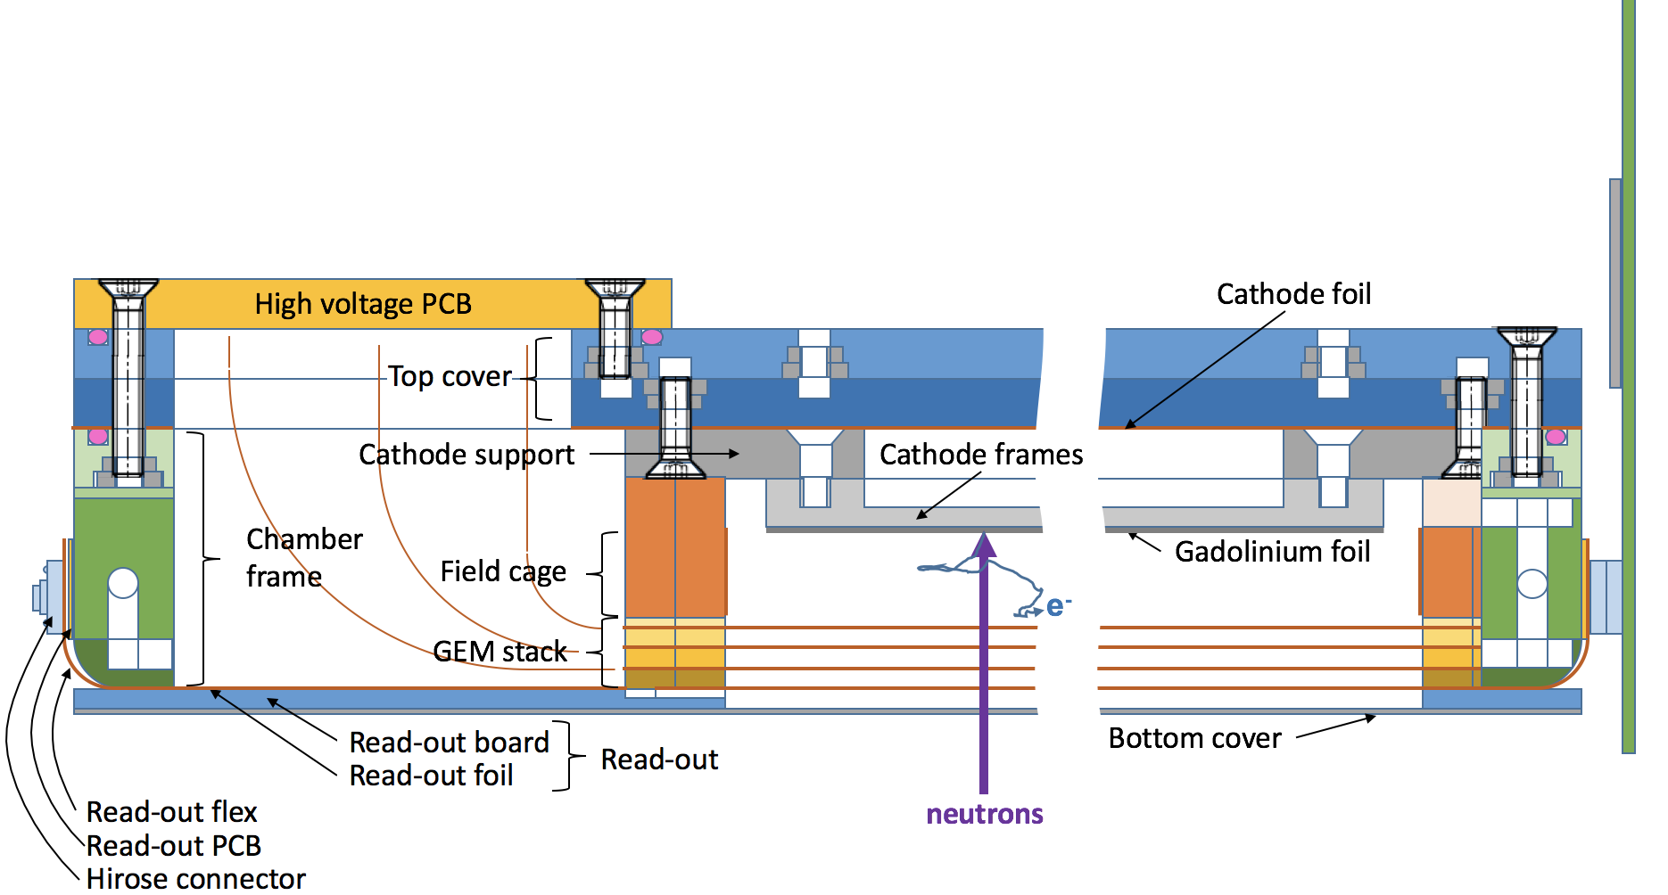
BrightnESS Detector Prototype

Slide 10
Requirements for electronics
Anode x/y strip readout with 400 μm pitch
NMX prototype: 5120 strips with 10 kHz hits per strip
→ fast dense electronics needed to process charge signal: integrated circuit
μTPC requires time resolution O(ns)
→ high time resolution required
Robotic arms restrict number of cables from detector to back-end
  → digitise data on detector
gadolinium
e⁻
Triple-GEM
Read-out
n
Anode strips
y-coordinate
x-coordinate

Slide 11
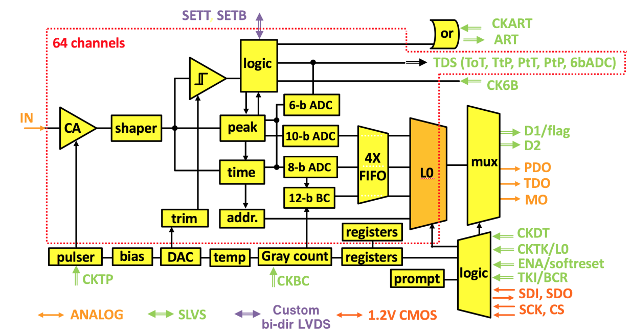
Readout ASIC VMM3
New VMM ASIC (130 nm CMOS) developed by Brookhaven National Labs for ATLAS new small wheel upgrade
64 input channels, self triggered
Pos. & neg. polarity sensitive
Adjustable gain 0.5 – 16 mV/fC
Adjustable shaping time from 25 ns – 200 ns
Input capacitance from few pF – 1 nF
38 bit per hit (if charge over threshold)
  Event flag (1 bit)
  Over threshold flag (1 bit)
  Channel number (6 bit)
  Signal amplitude (10 bit)
  Arrival time (20 bit)

Slide 12
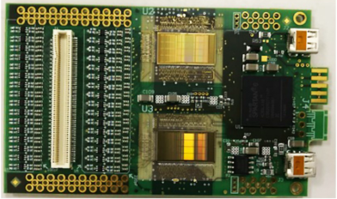
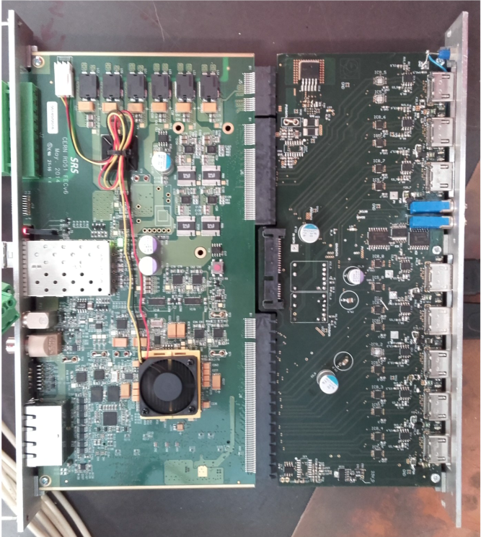
Detector Readout (VMM3+SRS)
New hybrid and adapter card, FPGA firmware, and PC software have been designed to implement VMM3 in RD51 Scalable Readout System (SRS)
Scalability: up to 8 VMM3 hybrids/FEC, many FECs/PC
For NMX: 3 detectors with 40 VMM3 hybrids
VMM hybrid
SRS FEC and adapter card for VMMs

Slide 13
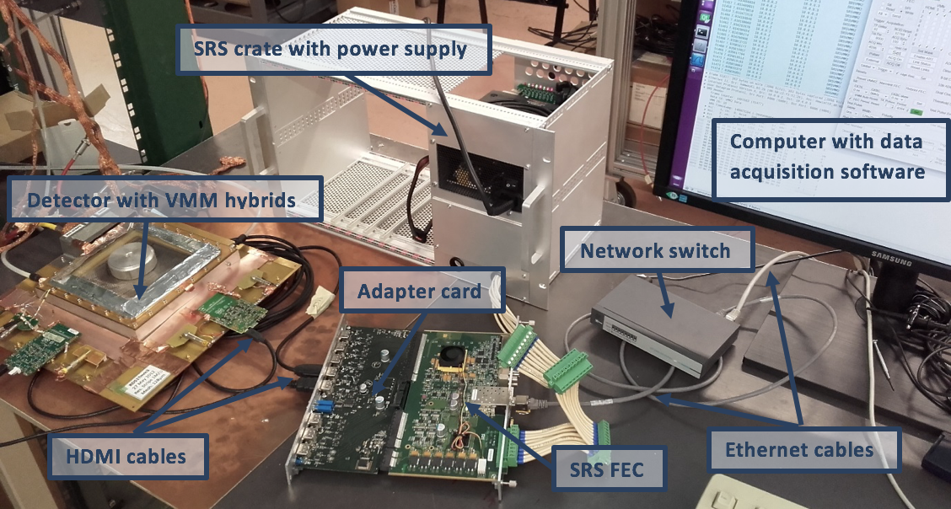
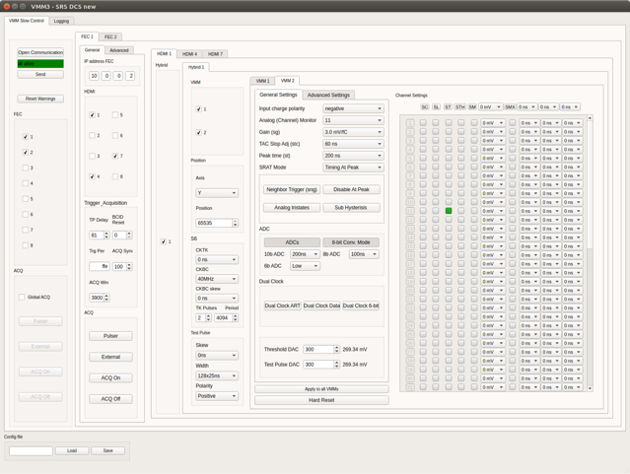
Detector Readout (VMM3+SRS)
VMM3 Slow control
CERN Summer student project of Manuel Guth
Readout chain

Slide 14
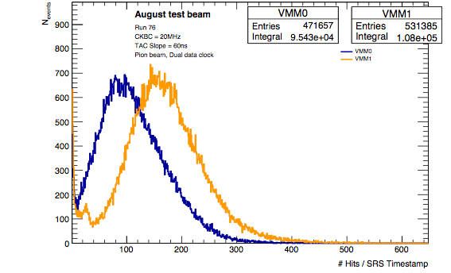
VMM3 Data Rates
VMM3 maximum data rate 4 Mhits/s per channel
For NMX, expected up to 10 kHits/s per channel
Data rate almost reached during pion test beam
Pion beam at H4 beamline at CERN
~ 500kHz/s
~ 20Mbit/s
~ 600 kHits/s
~ 30 Mbit/s

Slide 15
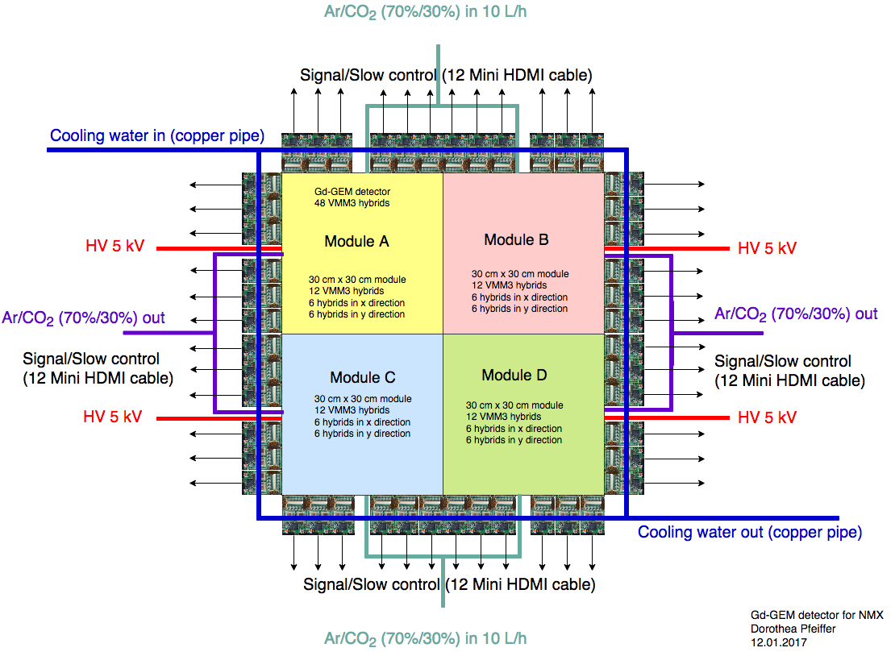
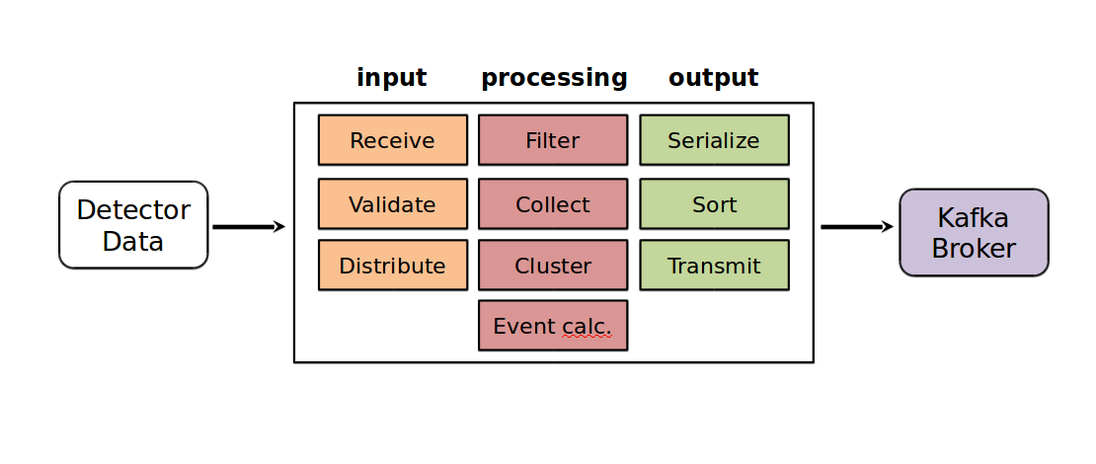
NMX Event Building
Per one detected neutron (efficiency 15%-30% at 1.8 A depending on Gd isotope) on the detector
On average 20 strips/channels hit (in x and y)
Per hit: VMM3 gives channel, pulse height and time
Must first cluster the events, then determine x and y entry positions with μTPC method
For clustering, data from each module (including overlap region with other modules) is sent to a separate PC core
Event formation unit

Slide 16
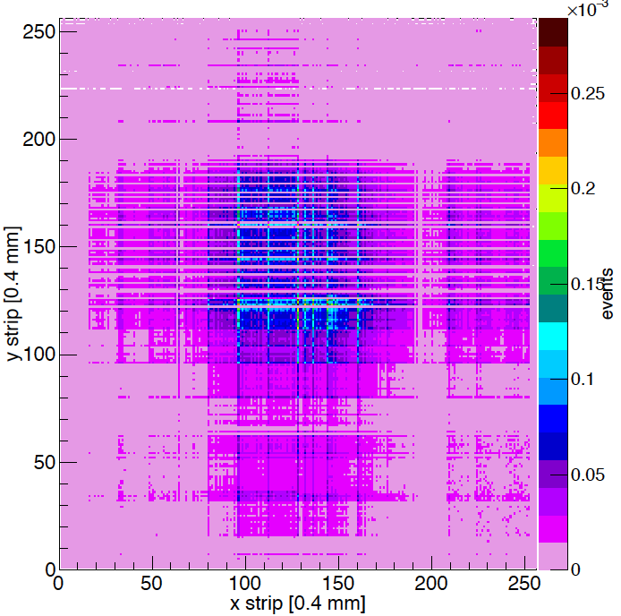
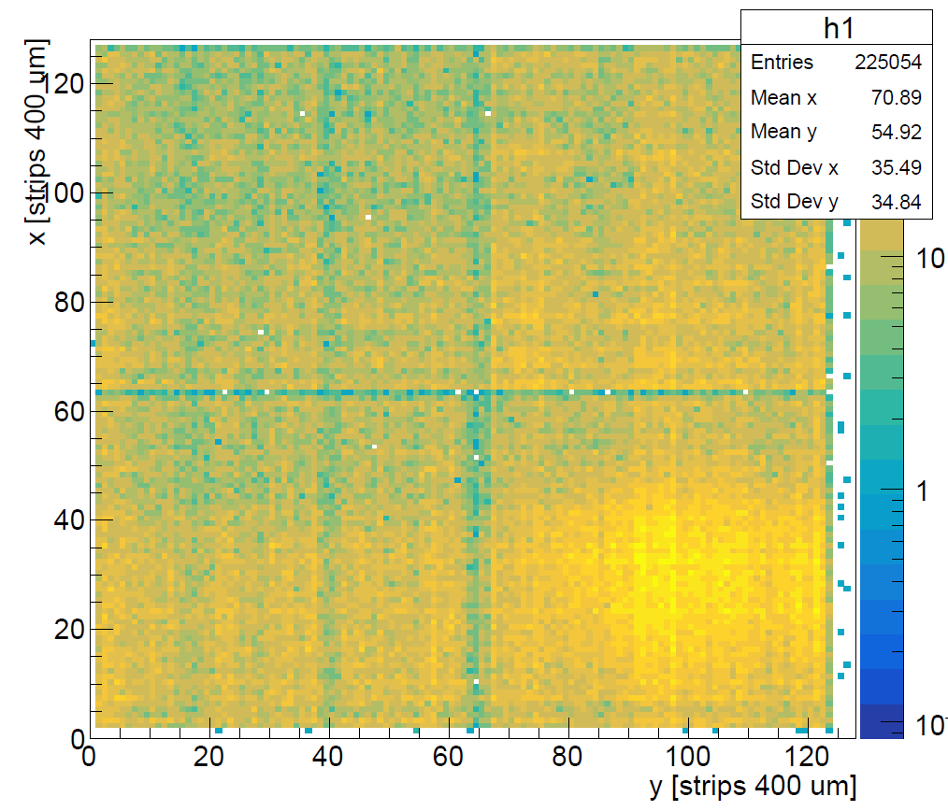
Examples of VMM Clustered Data
(10cm x 10 cm detector)
Thermal neutron beam
Gd-GEM with VMM2
Unfocused pion beam
GEM with VMM3
Focused pion beam
GEM with VMM3
Issues to be solved: Threshold equalization of channels to get rid of noisy channels, dead channels (need more VMM3 hybrids)

Slide 17
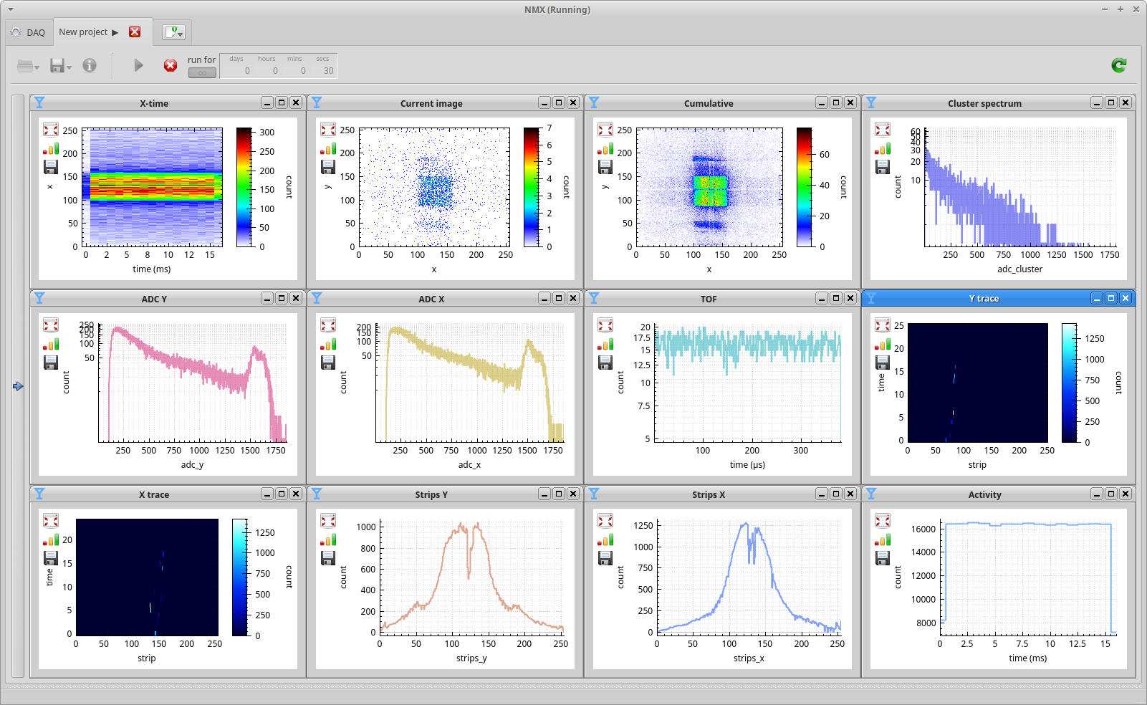
Detector Data Monitoring

Slide 18
Conclusions
Detector design for BrightnESS protoype has been finalized
Detector readout (VMM3 and SRS) available
Slow control software available
DAQ and event building software implemented
Monitoring software available
All basic compoments of the chain needed to take data at NMX exist
Next steps: Assemble detector and test with neutron beam

Slide 19
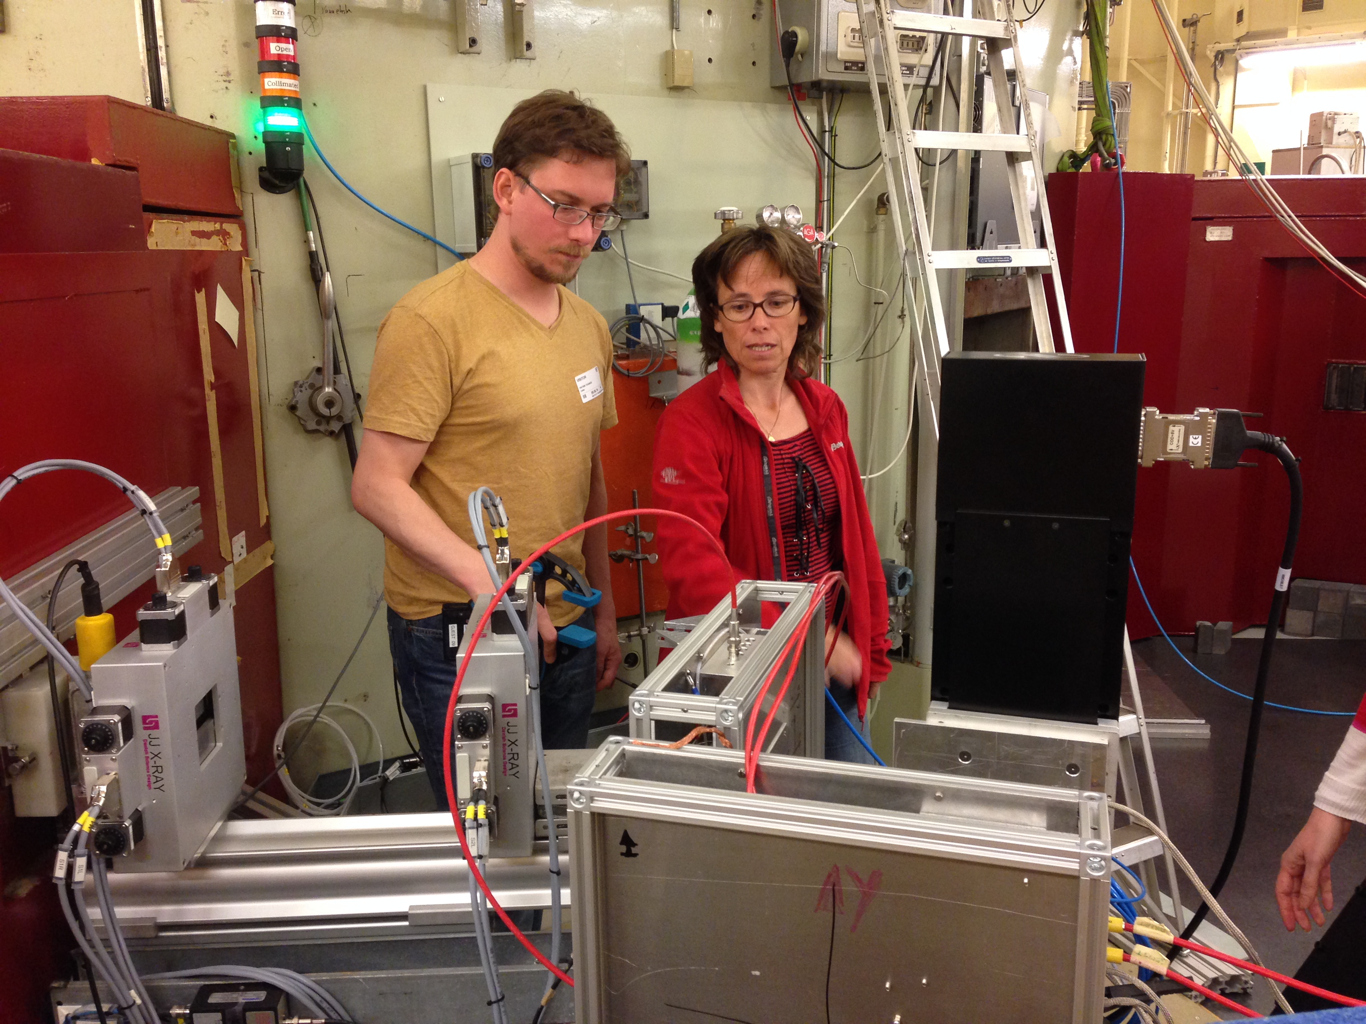
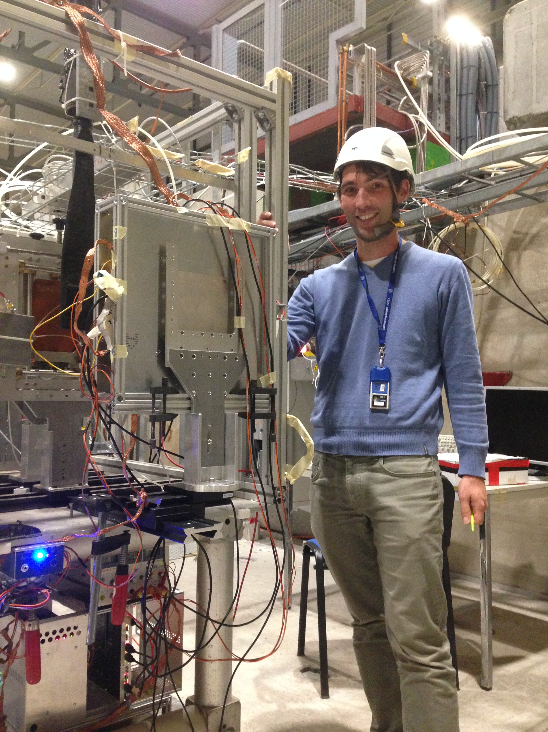
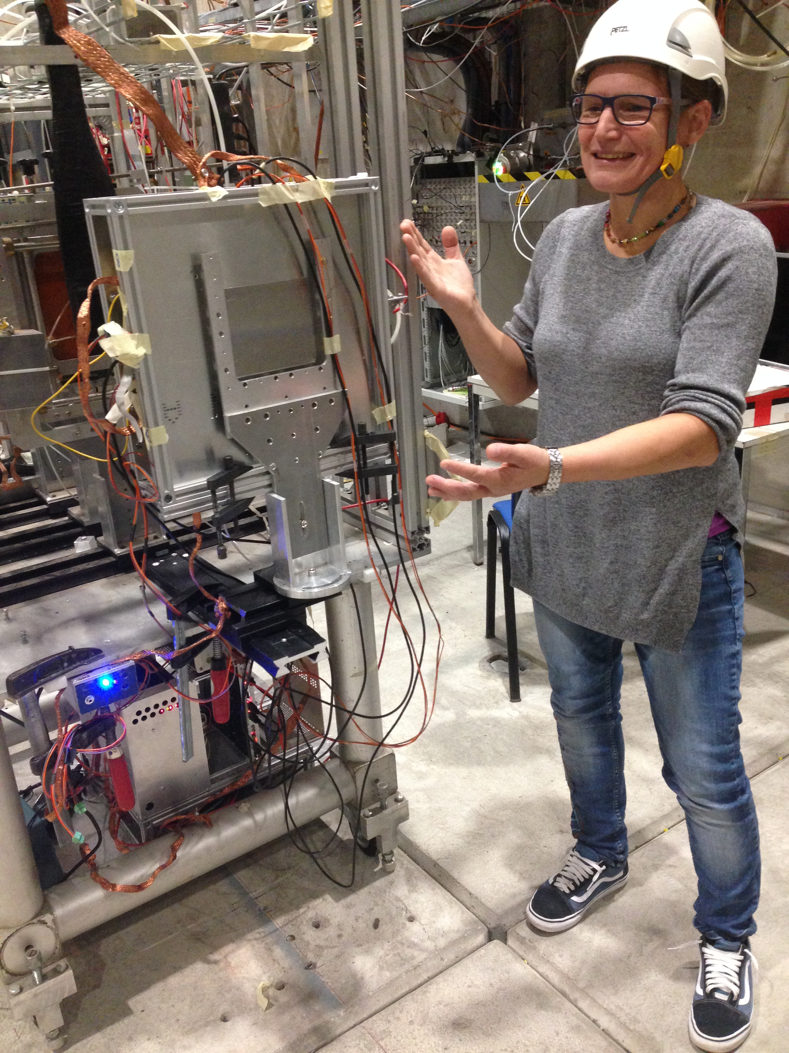
Extra Slides – Detector Assembly

Slide 20
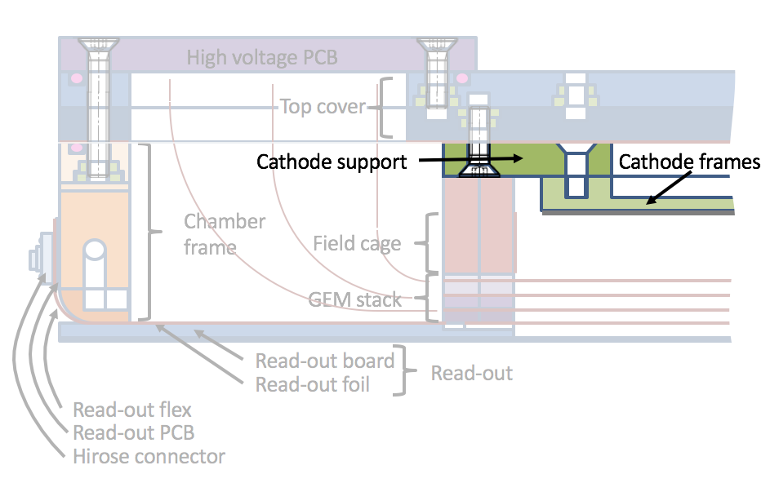
Assembly of Gd Cathode
Assembly of
gadolinium cathode

Slide 21
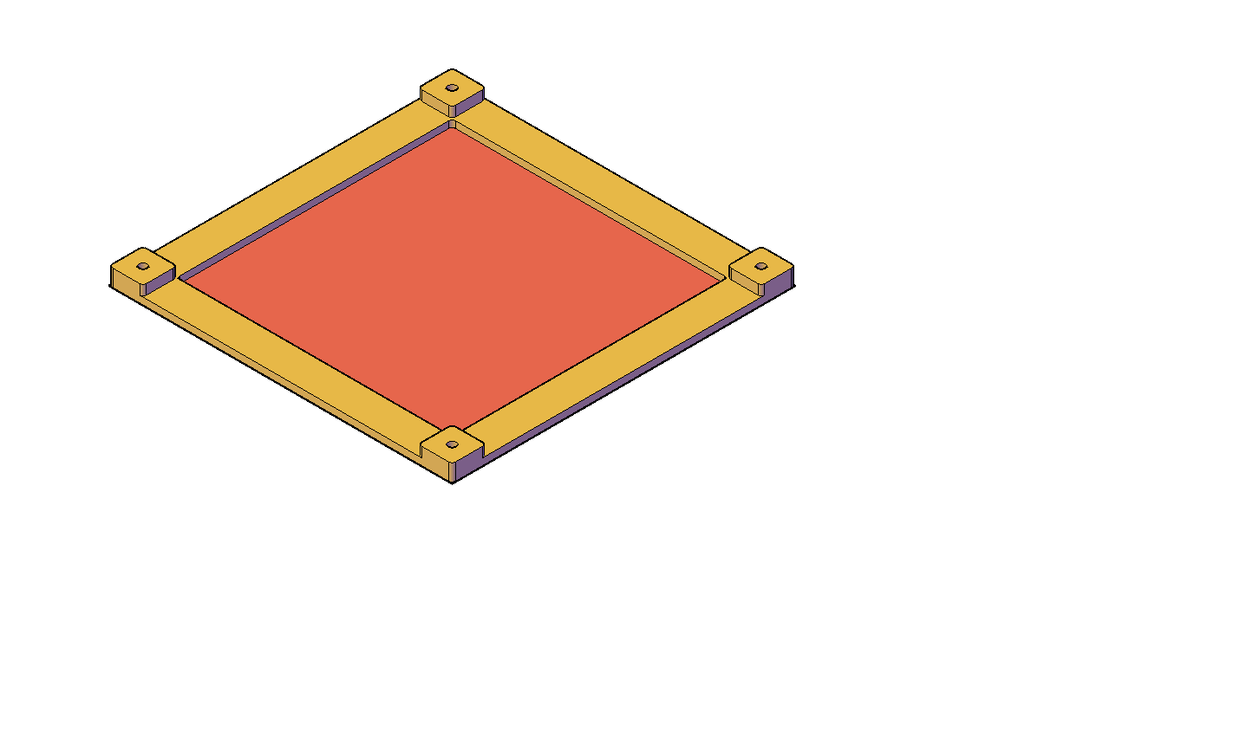
Gd Cathode
25 individual gadolinium foils ultrasonically welded onto aluminium frame
Gadolinium foil
Natural gadolinium
thickness 25 µm
area 10.24 x 10.24 cm²
(about maximum size produced by supplier)
Total active area
51.22 x 51.22 cm²
gadolinium foil
aluminium frame

Slide 22
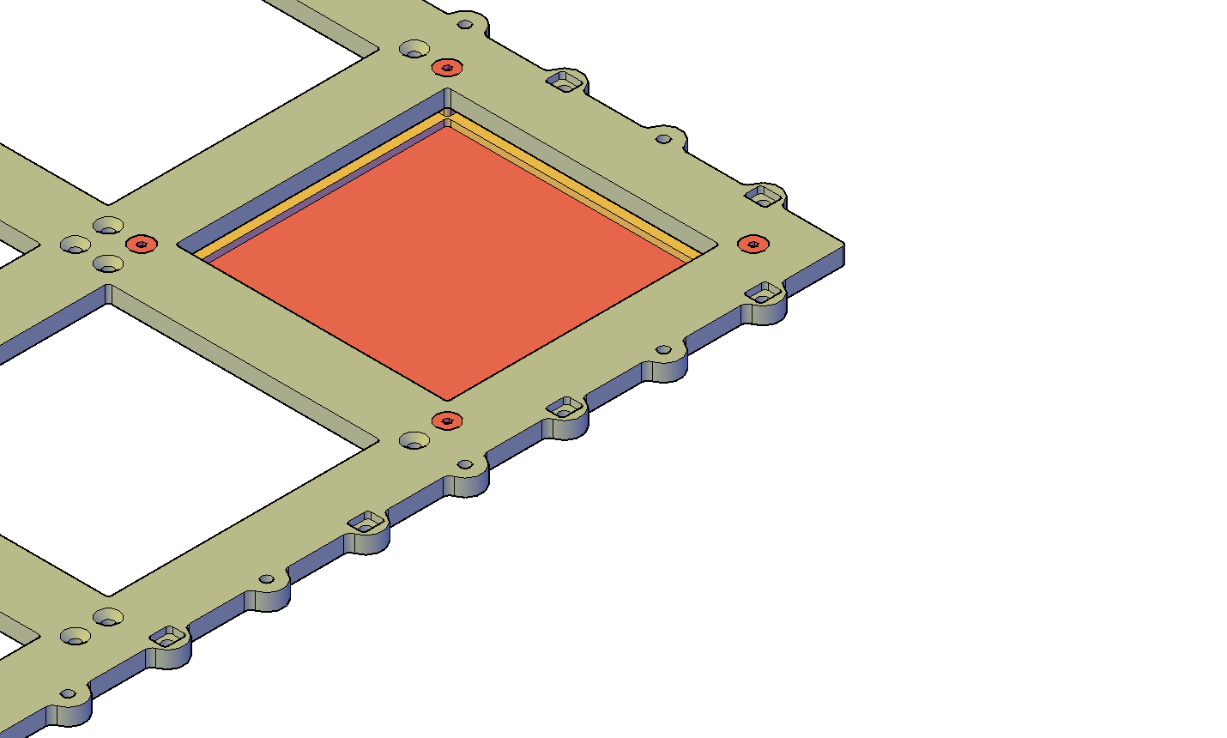
Cathode Frame
Gadolinium frame screwed onto aluminium support frame
Electrical contact between frame and support on four corners
gadolinium
foil & frame
stainless steel screw
support frame

Slide 23
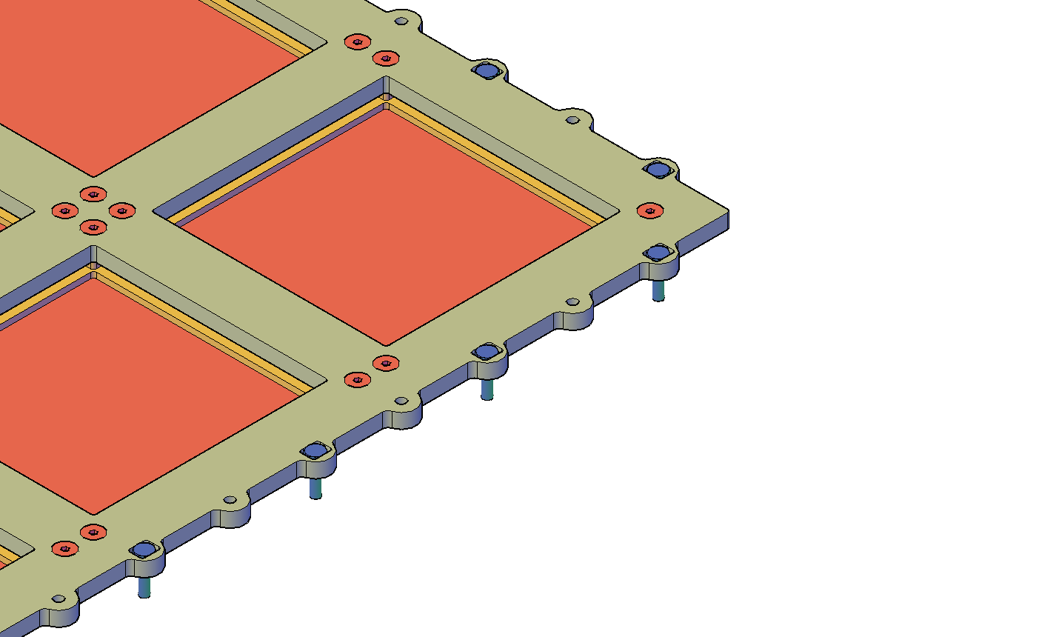
Cathode Frame with Gd Cathode
Gadolinium frames screwed onto aluminium support frame
w/ polyimide screws for field cage assembly already inserted
stainless steel screw
polyamide screw

Slide 24
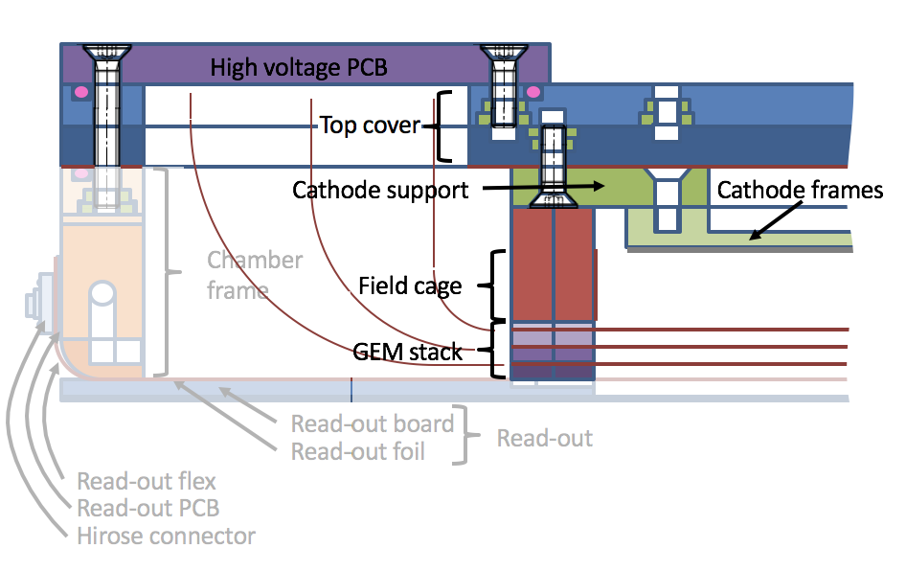
Assembly of Top Stack
Assembly of
top stack

Slide 25
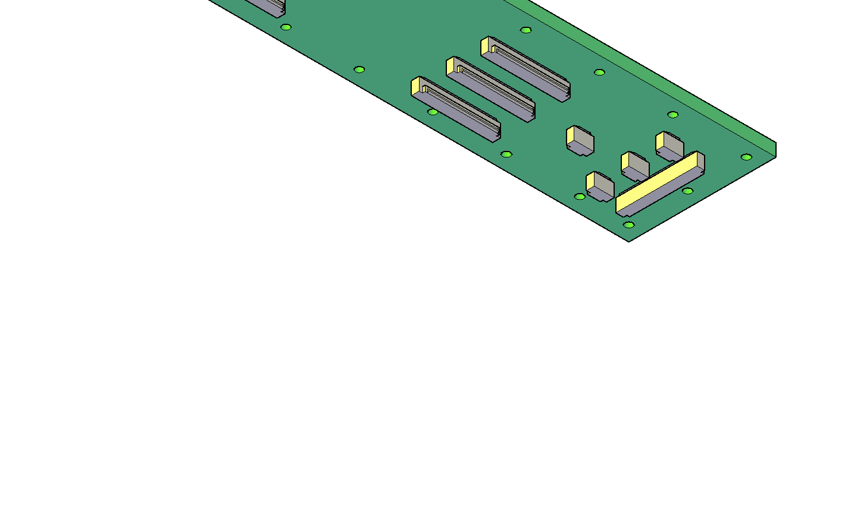
High Voltage PCB
High voltage PCB w/
HV connector
resistor divider and
protection resistors
on top side and
ZIF connectors
on bottom side
Cleaned after soldering of resistors and connectors
Bottom view
n

Slide 26
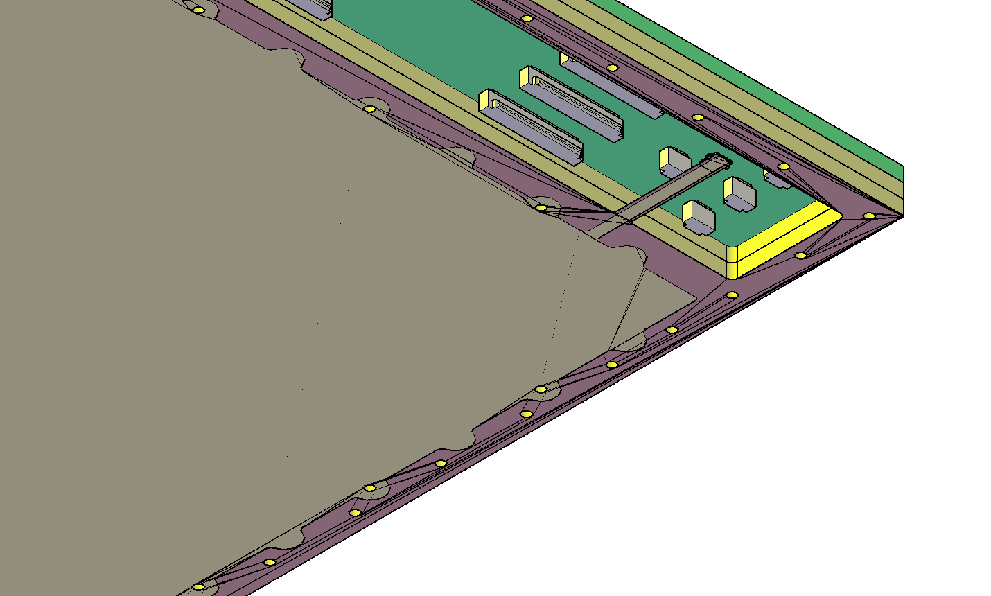
Top Cover
High voltage PCB screwed onto top cover
Top cover w/
Copper cathode
Inserts for screws
O-ring for gas-tightness
10 mm FR4
5 µm copper
threaded inserts
50 µm Kapton

Slide 27
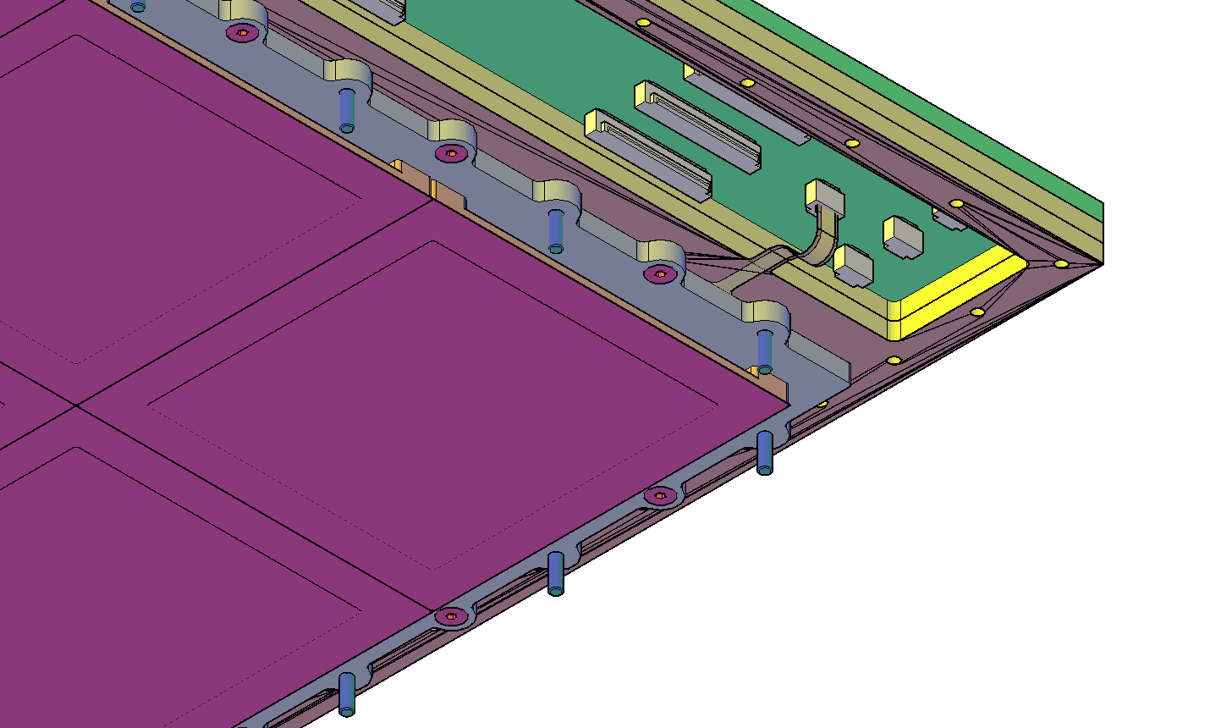
Top Cover with Gd Cathode
Cathode plugged in and tested
Gadolinium support screwed onto cathode
w/ 32 screws
Electrical contact to cathode along surface of frame
polyamide screw
stainless steel screw

Slide 28
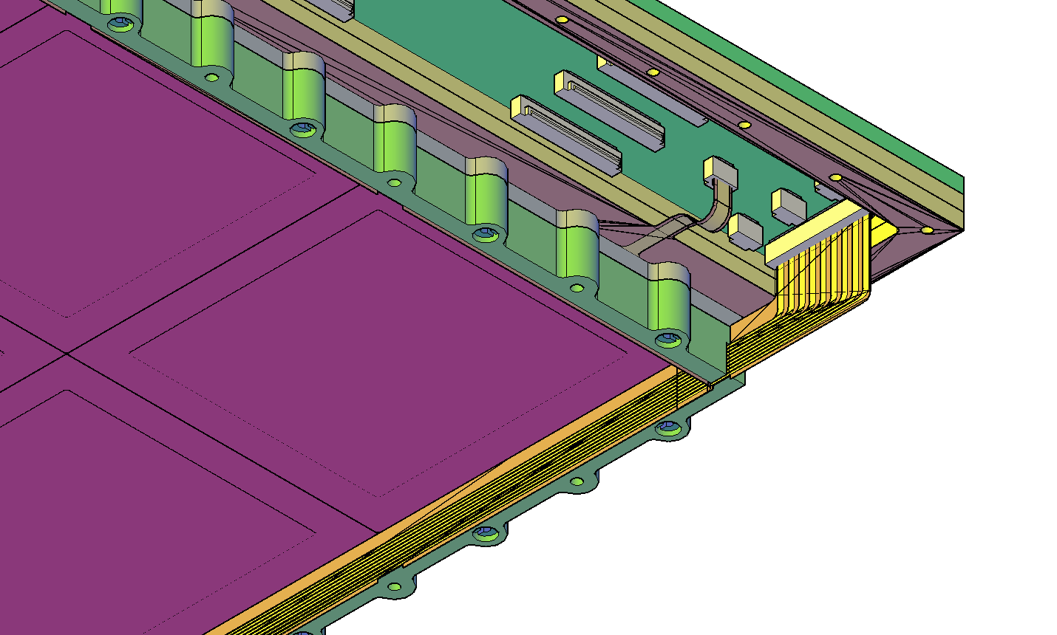
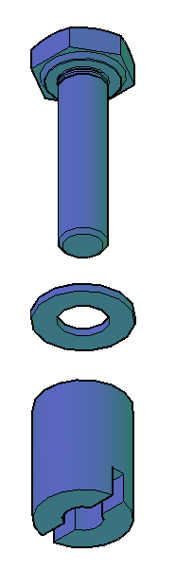
Field Cage
Field cage screwed onto support frame w/ 36 threaded rods
Field cage
9 individual copper strips
on Kapton foil
glued into support frame
connected to voltage divider with ZIF connector
5 µm field cage strips
on Kapton foil
support frame
polyamide washer
polyamide threaded rod

Slide 29
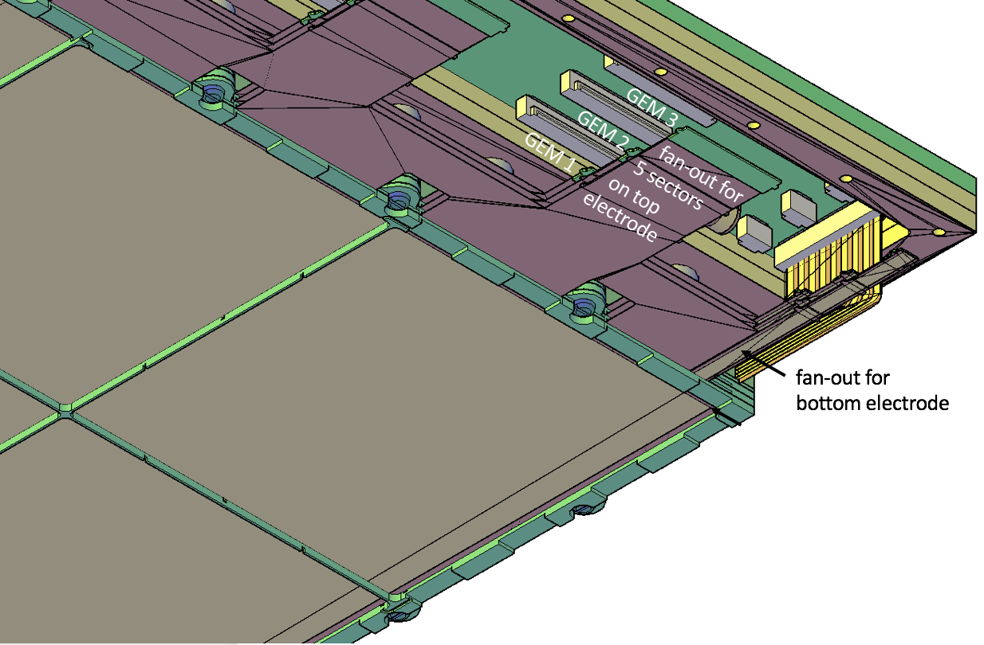
Triple-GEM Stack
Triple-GEM stack crewed onto field cage frame w/
32 screws
Each GEM with
5x5 sectors on top electrode (sector < 100 cm²)
one common bottom electrode
spacer grid to keep distance between stages

Slide 30
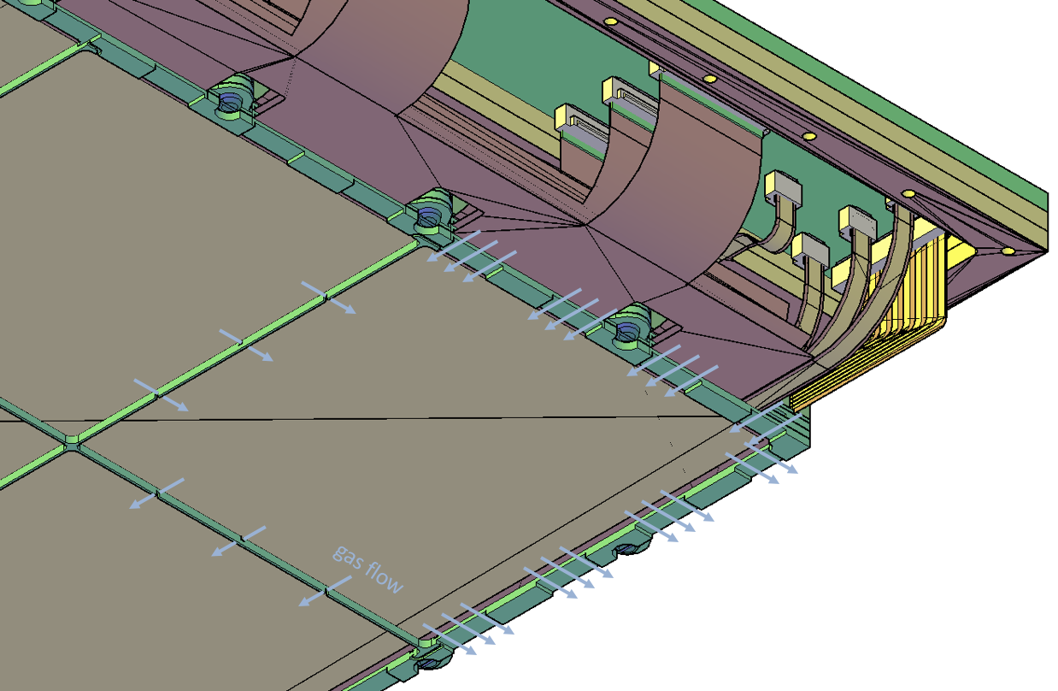
Fully Assembled Top Stack
Top stack fully assembled
All connectors plugged in
Ready to be screwed onto bottom assembly

Slide 31
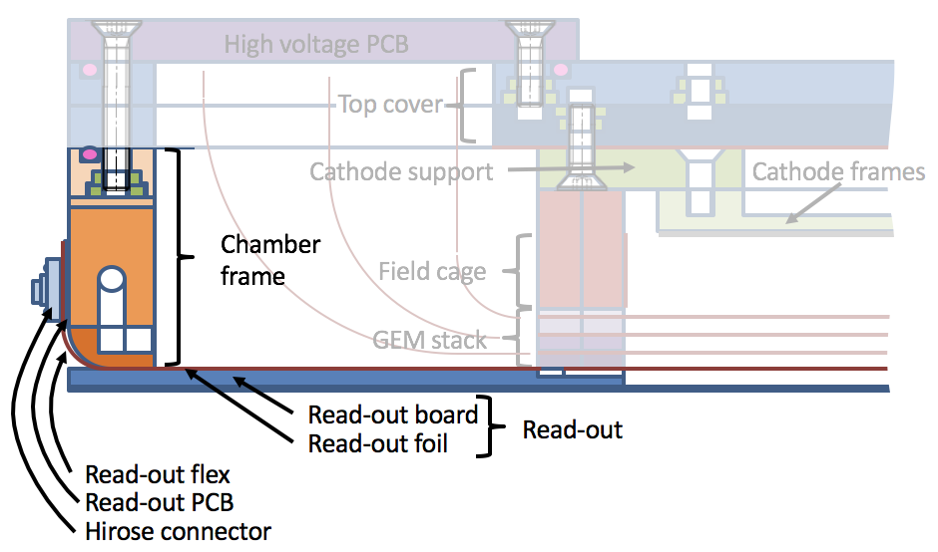
Assembly of Bottom Stack
Assembly of
bottom stack

Slide 32
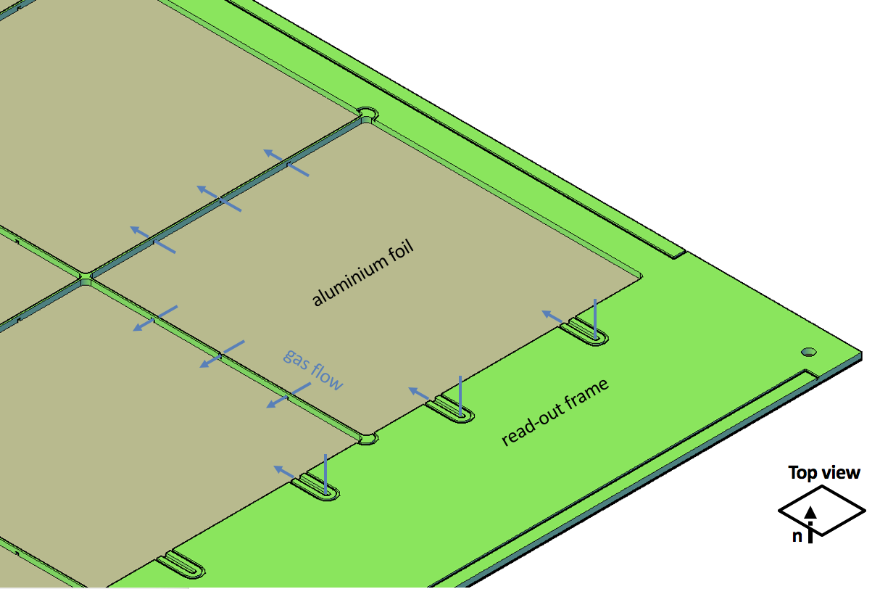
Readout Frame
Read-out frame with aluminium foil glued onto bottom side

Slide 33
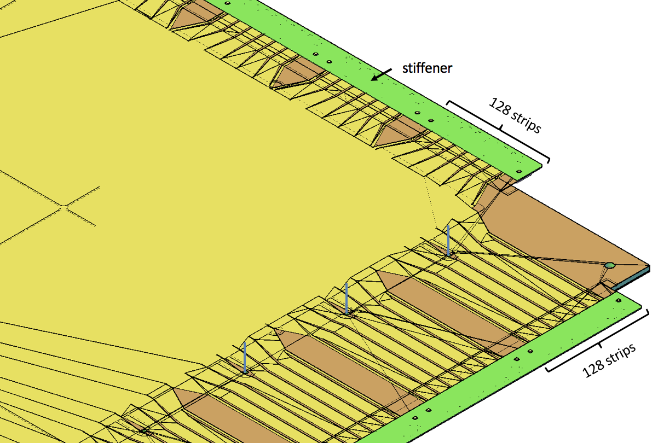
Strip Readout
Cartesian strip read-out with 400 µm strip pitch
Split into four quarters w/
640 strips per coordinate
Read-out foil glued onto cathode frame
Stiffener glued onto top side of read-out foil
140 pin-connectors soldered onto bottom side

Slide 34
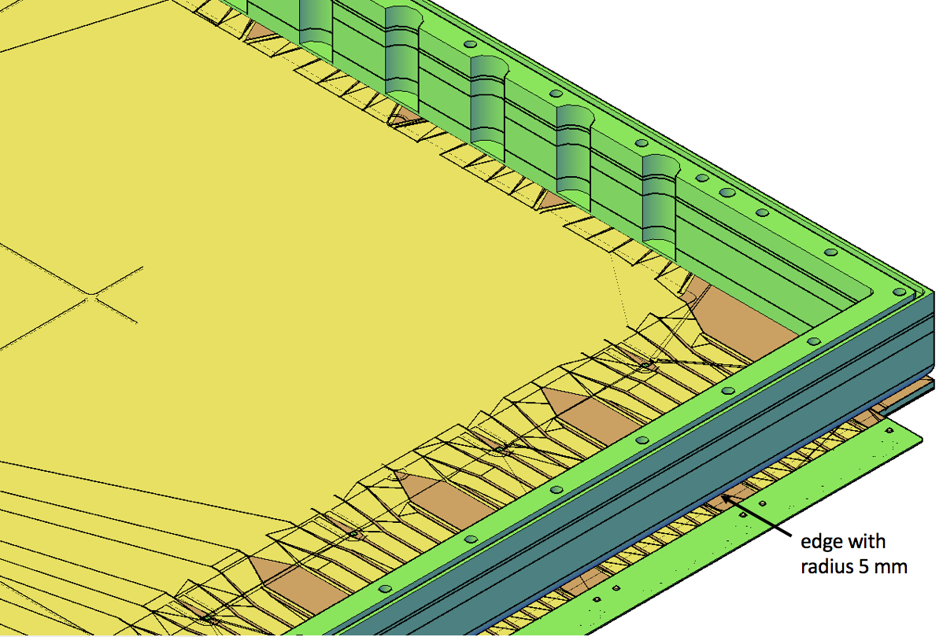
Chamber Frame
Chamber frame glued onto read-out

Slide 35
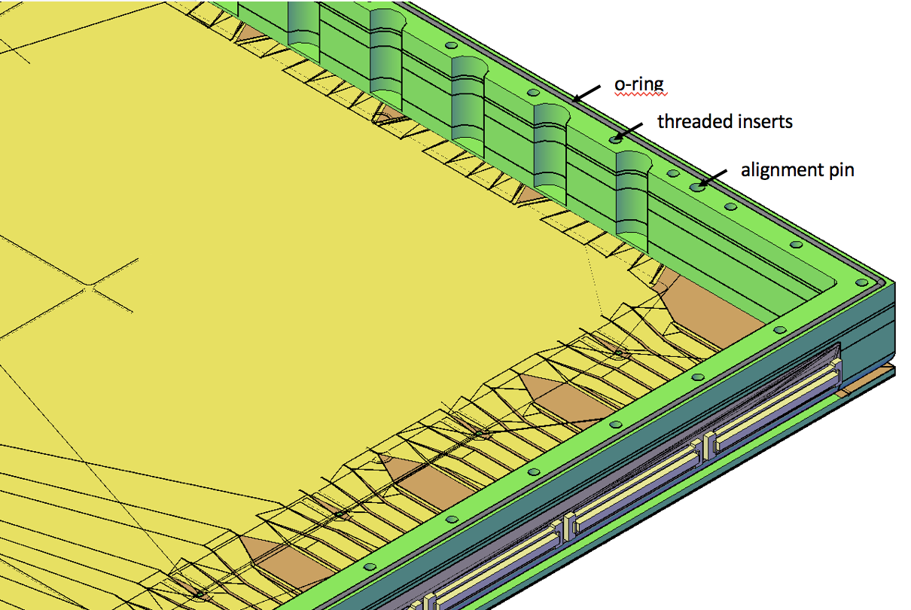
Hirose Connectors
140-pin connectors folded onto side of chamber frame
O-ring inserted into groove on top of chamber

Slide 36
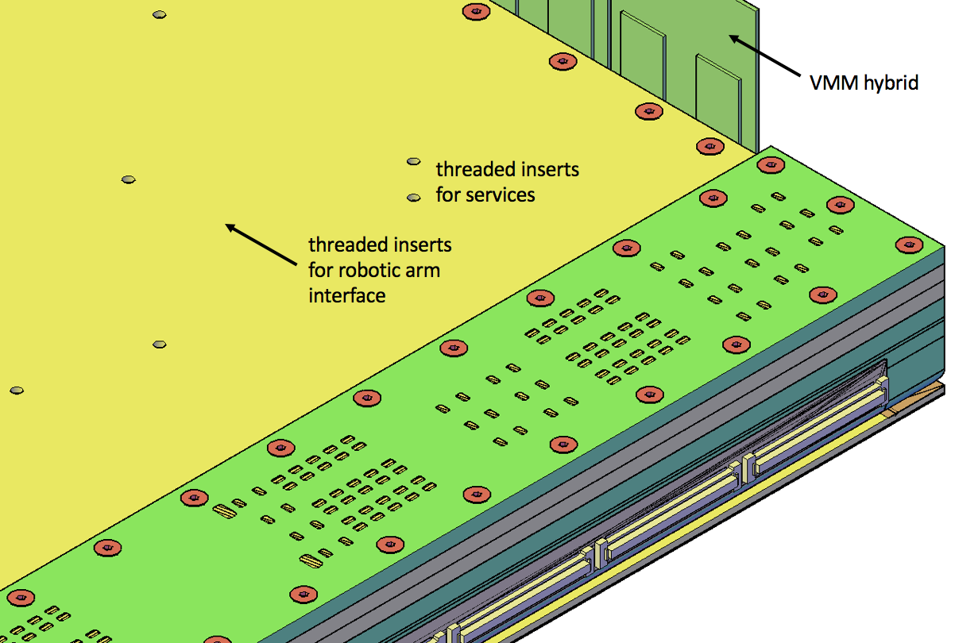
Fully Assembled Detector
Top stack screwed onto bottom stack w/
screws and polyamide washers for gas tightness
VMM hybrids connected
Detector fully assembled
Flushed with Ar/CO2 70/30 and ready for testing

Slide 37
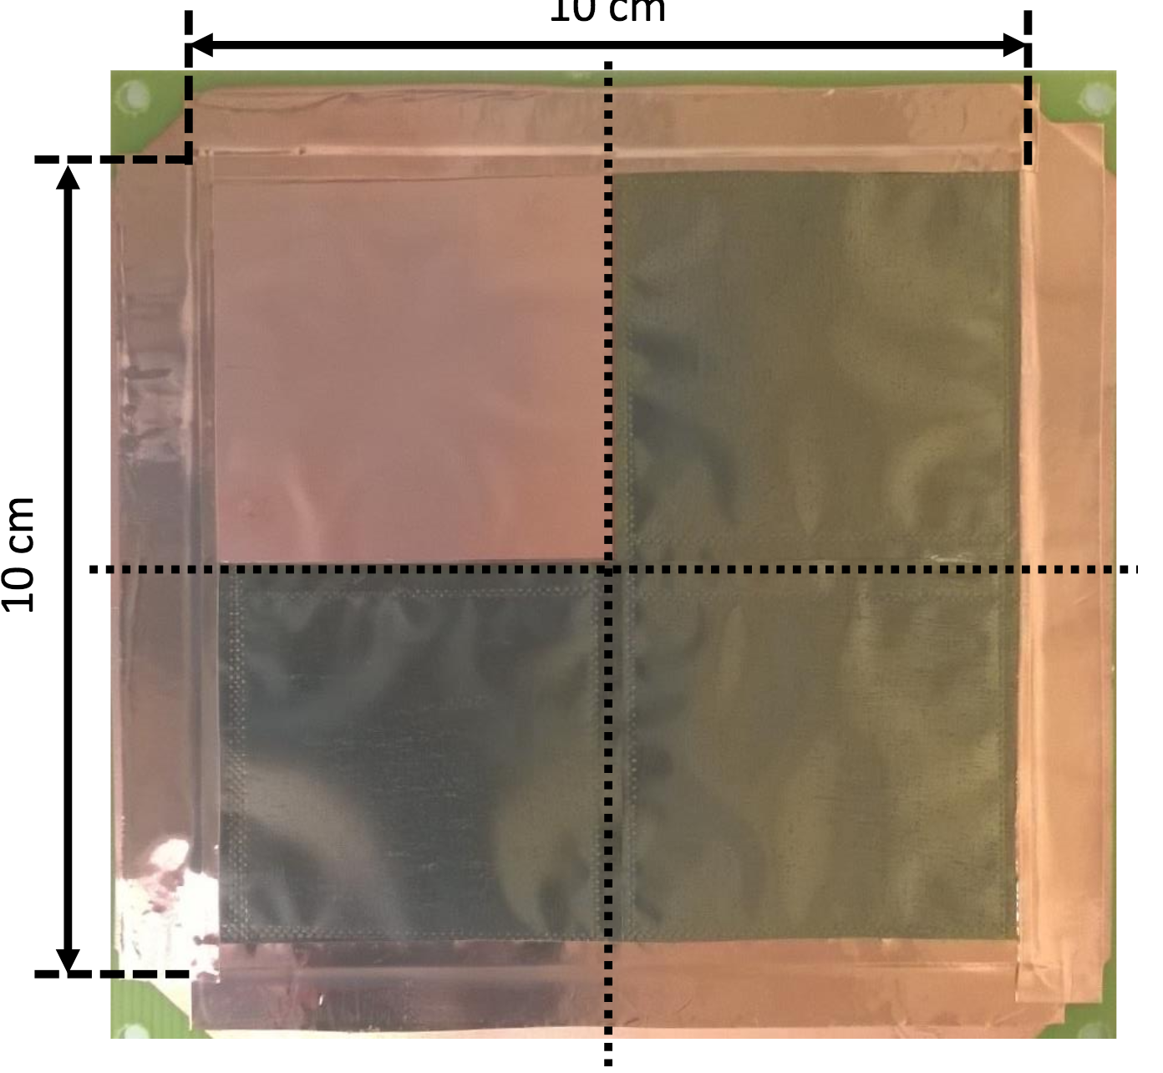
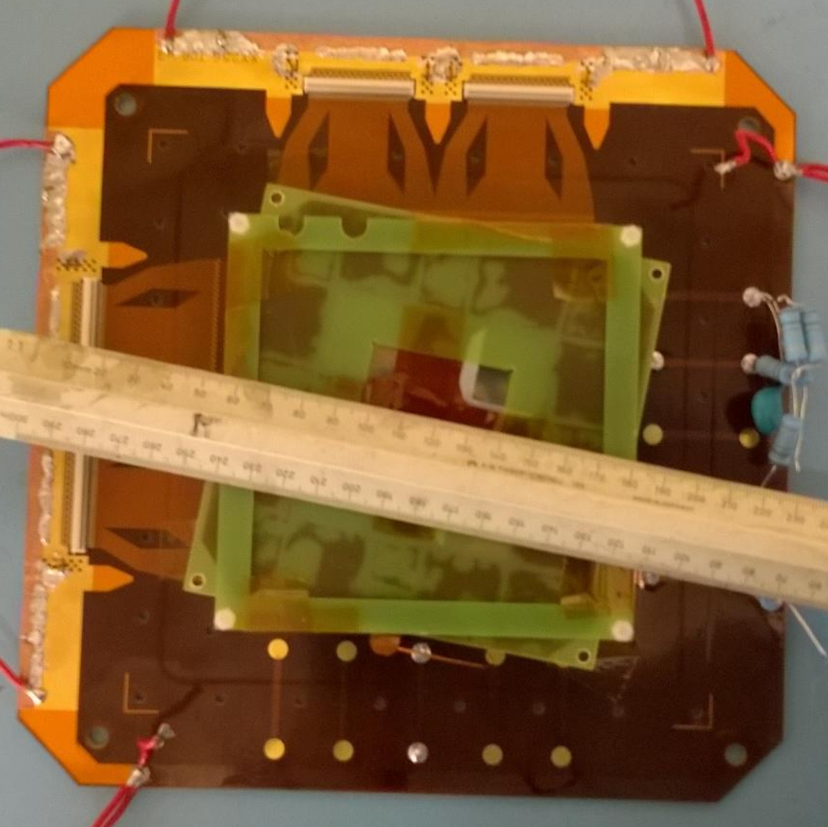
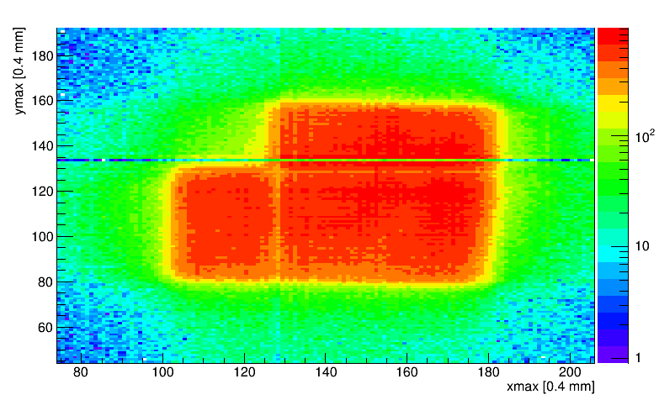
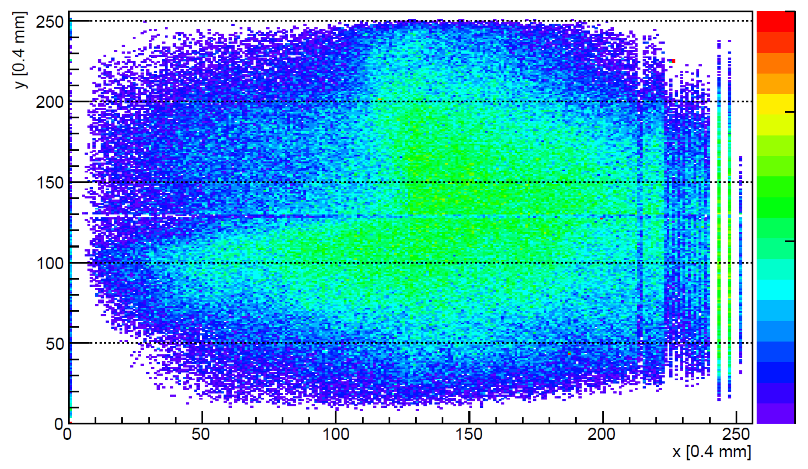
Analysis of Welded Gd Cathode
No effect of welds on neutron detection
Lines are boundary between different APV-25 readout chips and dead channels

Slide 38
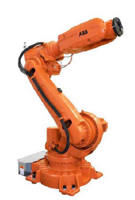
NMX Instrument – no fixed detector geometry
Detector 1
Detector 2
sample
Detector Positioning System for ESS NMX, Final Design Report, J.-L. Ferrer
beam line
Detector 3
beam line
ABB IRB 6620
6 axes, 2.2 m reach
robotic arms on rails

Slide 39
Gamma sensitivity – depending on Gd thickness

