Slide 1
Straw Tubes Development at ISIS
Operation in vacuum
Multiplexing the electronics
Davide Raspino
18/10/2017

Slide 2
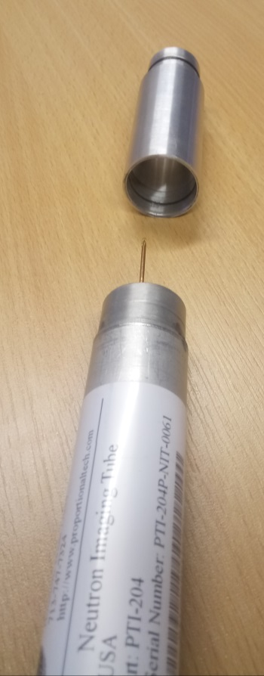
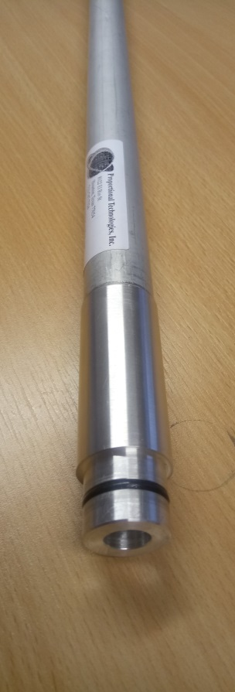
Operation in vacuum
We developed a solution to interface the straw tubes to a preamp air box
No need to operate at high vacuum
No need of expensive high voltage feedthrough

Slide 3
Faster Electronics
Width @ (ns) | WISH | Medium Fast | Fast | PTI
10% | 952 | 345 | 243 | 242
25% | 565 | 194 | 126 | 190
50% | 331 | 116 | 75 | 134
75% | 189 | 75.6 | 45.2 | 84
90% | 101 | 39 | 23.6 | 50
ratio | WISH | Medium Fast | Fast | PTI
10% | 1 | 0.36 | 0.26 | 0.25
25% | 1 | 0.34 | 0.22 | 0.34
50% | 1 | 0.35 | 0.23 | 0.40
75% | 1 | 0.40 | 0.24 | 0.44
90% | 1 | 0.39 | 0.23 | 0.50

Slide 4
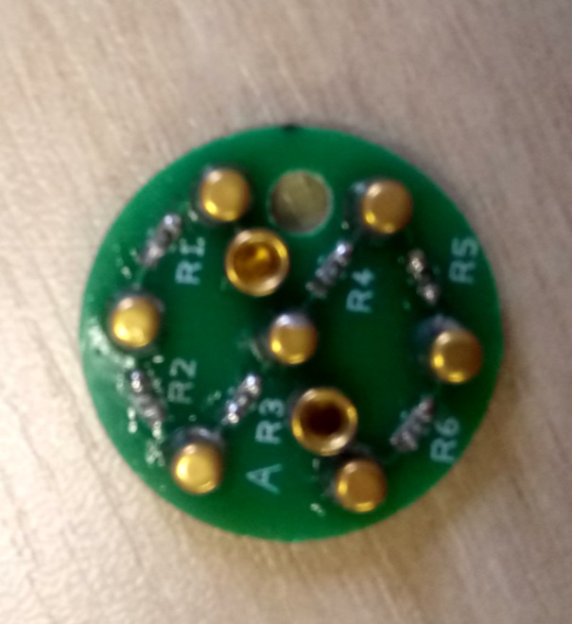
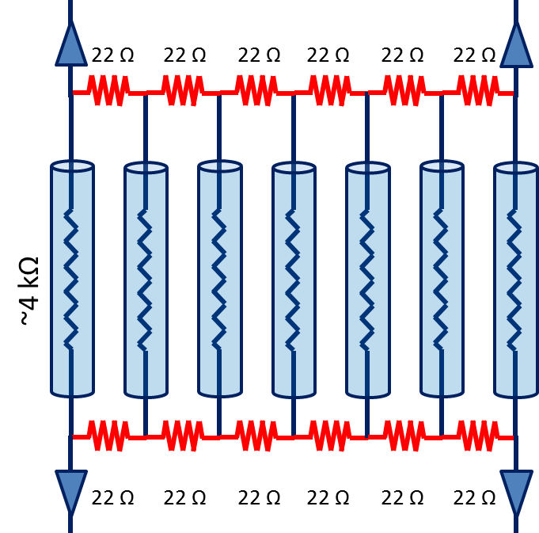
Electronics multiplex

Slide 5
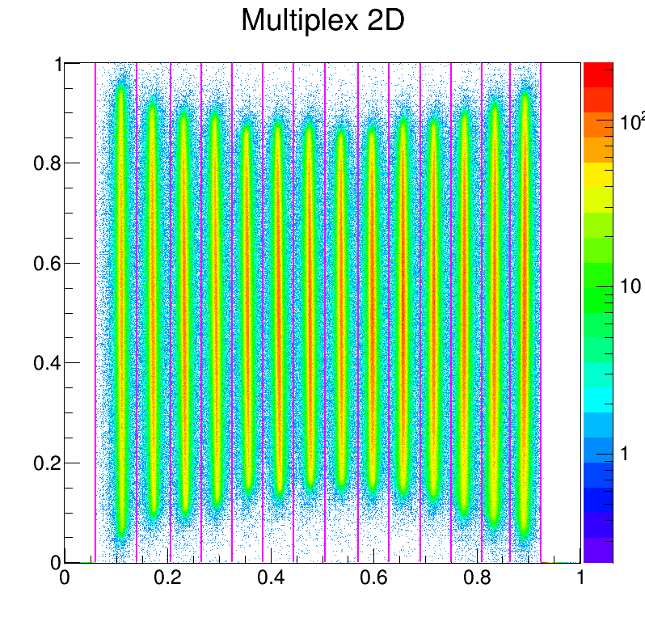
Electronics multiplex
On AmBe source
Position
Tube ID

Slide 6
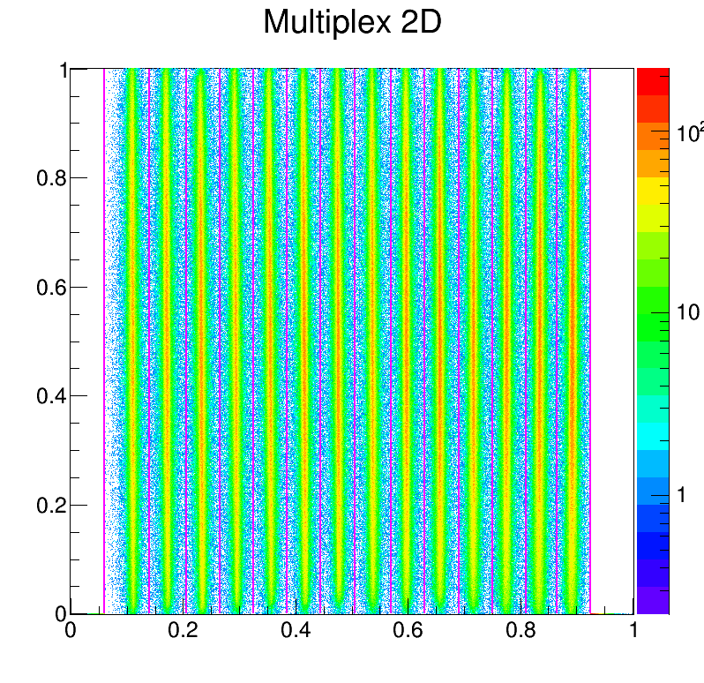
Electronics multiplex
On AmBe source
Position
Tube ID

Slide 7
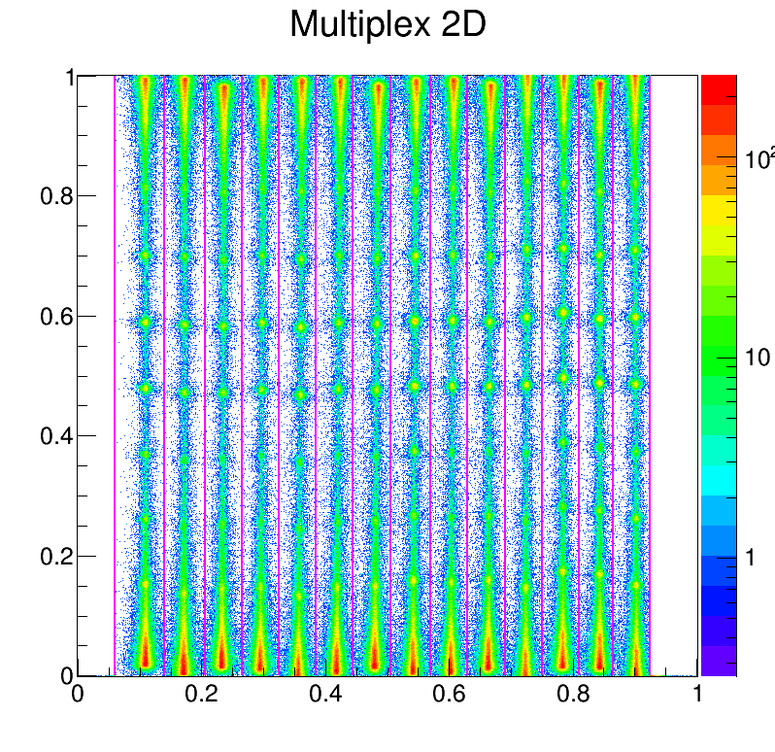
Electronics multiplex
On ISIS beam with Cd Slits
Position
Tube ID

Slide 8
As soon as the beam comes back…
Measure the ability to multiplex as a function of rate
Position resolution as a function of rate and multiplex

