Slide 1
Remote Handling Fasteners
Talal Osman
Mechanical Engineer
ESS Chopper Group
www.europeanspallationsource.se
20 November, 2017

Slide 2
Overview
Basic principles
Current concept
Missed Things
Future

Slide 3
Basic principles
Conical Head
Easier to find with the tool
Captive
To minimize the risk of loosing bolts
Easy to see
Oversized Bolt head
Colored Bolt head

Slide 4
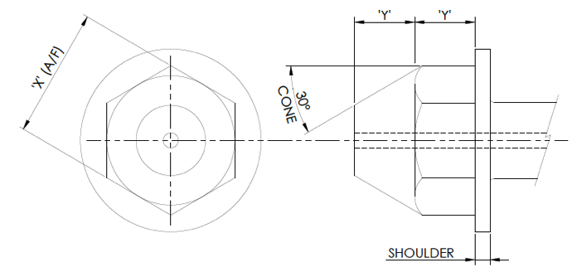
Bolt design
Dimension | M8 | M10 | M12 | M16 | M20
Head size | M16 | M16 | M16 | M16 | M20
Colour | Red | Blue | Yellow | White | Green
X (A/F) | 24.00 23.67 | 24.00 23.67 | 24.00 23.67 | 24.00 23.67 | 30.00 29.67
Y | 10.18 | 10.18 | 10.18 | 10.18 | 13.21

Slide 5
Bolt design
Nose style
Where possible a standard bolt nose style should be used:
Parallel nose diameter machined to root diameter of thread
Length of nose is 3 times the thread pitch. This length can be reduced, where the bolt axis is maintained by its housing to prevent cross-threading, to a limit of 1.5 times the thread pitch if required.
Note: the nose should be small enough to be within capture range of the female thread
In some circumstances the nose of the bolt can be designed to remain proud of the component and act as a dowel in aligning the component being installed.
The use of a protruding nose for this purpose is valid for all bolt designs – pop-up & non pop-up.

Slide 6
Current Concept
Captive Bolt
Conical head
The head is designed conical to make it easier to find with the tool.
“Washer”
The diameter of the washer is 6 mm bigger than the hole for the spring + the allowed movement of the bolt in x/y-direction.
Spring
Outer diameter smaller than the “washer”, inner diameter big enough to allow the bolt to move if misplaced. The length of the spring (loaded with the weight of the bolt) is the required length to move the bolt to the unthreaded hole.

Slide 7
Current Concept

Slide 8
Discussion
Materials?
Supply?
Each instrument manufacture their fasteners?
Centrally procured?
Cost split between instrument

