Slide 1
Remote Handling Lifting & Handling features
Talal Osman
Mechanical Engineer
ESS Chopper Group
www.europeanspallationsource.se
20 November, 2017

Slide 2
Overview
Basic principles
Current concept
Missed Things
Future

Slide 3
Basic principles
One point lifting – in combination with guide rods/rollers
Simple engagement and disengagement
Lack of height
Visibility
Ensure that the lift point is visible to the remote handling operator during hook engagement and disengagement.

Slide 4
Lifting Bails

Slide 5
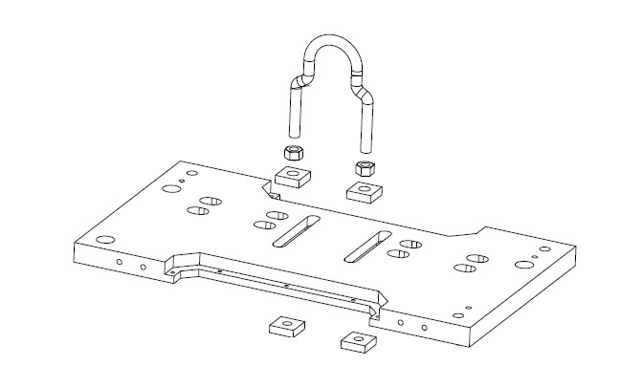
Adjustable lifting Bail
Adjustable lifting Bail in x-direction (along the beam) is preferred.
To take up the changes of COG caused by the cables and utilities (and other unforeseen things)
Stabilize lift to minimize the risk of damaging surrounding

Slide 6
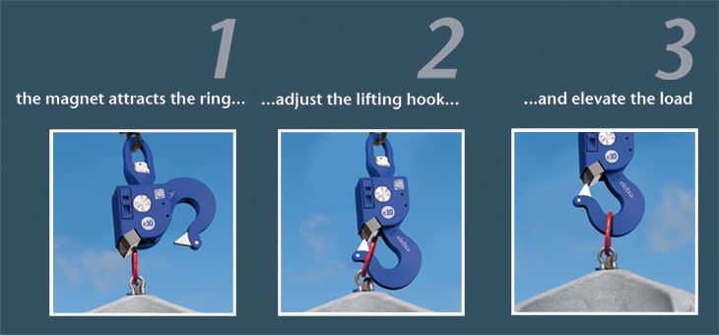
Current Hook assumption
Automatic lifting Hook
One 5 ton lifting Hook
One 20 ton lifting Hook

Slide 7
Discussion
When is one-point lifting not applicable?
Potential casket lid used for lifting (highly activated components)
Range of standard lifting interfaces required?
Typical weight-intervals?

