Slide 1
Remote Handling Electrical and fluid couplings
Erik Nilsson
Mechanical Engineer
ESS Chopper Group
www.europeanspallationsource.se
20 November, 2017

Slide 2
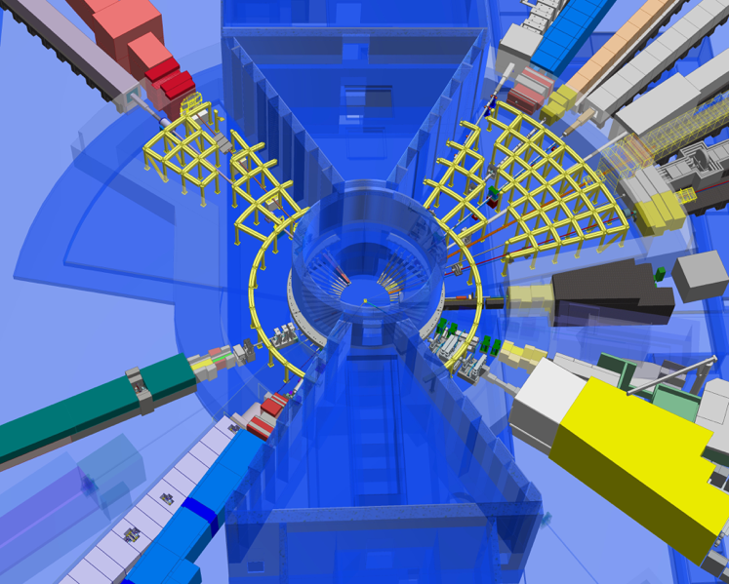
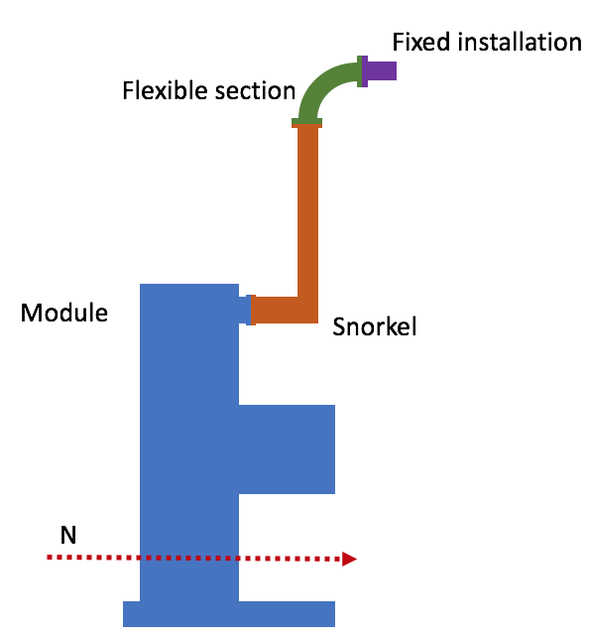
Quick on routing
Cables routed in two sections
Flexible section (change part)
Fixed section
Bulkhead connector between flexible and fixed section
Utilities routed in three sections
Self supporting snorkel
Flexible section
Fixed section
Connector requirements applicable on fixed end
More information and discussion tomorrow
Notes:
Routing
Avoid access limitations to remote handling interfaces.
Maintenance connectors within 200mm of the bottom of the bunker roof shielding.
Utilities routed in three sections
Self supporting snorkel
Flexible section
Fixed section
Bundling
The cables and utilities shall be collected in appropriate bundles.
Larger collected connectors preferred over multiple connectors.
Connectors
Minimise exposure to radiation during connection/disconnection.
Push-pull type of connectors with lanyard pulls are preferred.
“Breakaway“ plugs in bayonet type connector are a possible secondary choice.
A fully integrated, fully remote handling plate is required if manual actuation is not possible.

Slide 3
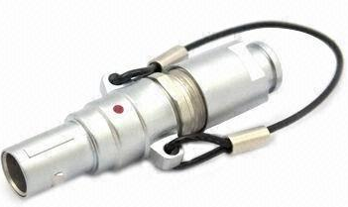
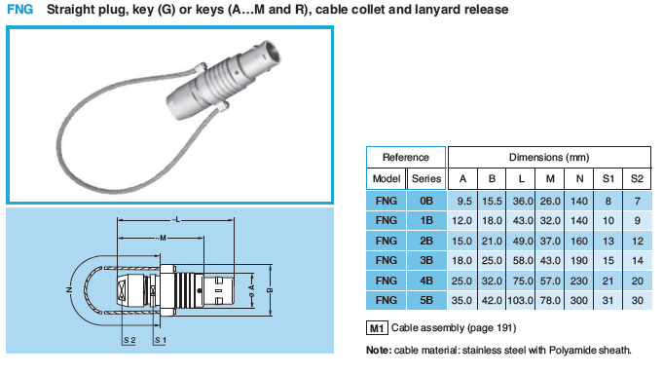
Electrical connectors
Appropriate bundles.
Module specific bundles.
Fast manual actuation connectors are sufficient.
Push-pull type connectors with lanyard pulls preferable
LEMO B Series [FNG] (stainless steel with PEEK contact isolators)
Bayonet type connectors is acceptable
Activation of connector might be an issue.
Local shielding?
LEMO B Series (Lanyard pull)

Slide 4
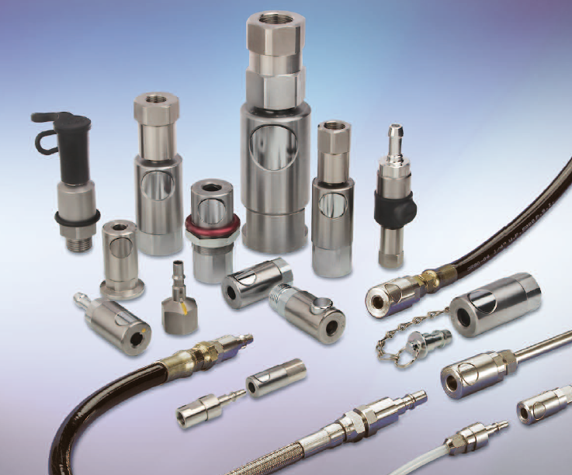
Fluid connectors
Water
Double shut-off connector
Button for disconnection
Stäubli RBE (Stainless steel 316L)
Pneumatic
Button for disconnection
8mm nominal diameter (11mm possible)
Stäubli RBE (Stainless steel 316L)
Vacuum
ISO-KF flange with clamp
Stainless steel flexible hose
Gas
Double shut-off connector
Button for disconnection
Stäubli RBE (Stainless steel 316L)
Stäubli RBE (quick release) series

Slide 5
Discussion
What level of standardisation is reasonable and achievable?
What sizes and types of connectors do you envision?
Notes:
Activities restricted to
Extraction (RH-I and RH-II)
Reinstallation (RH-I)
Inspection and/or realignment of component/module (if required)
Complex RH activities shall be avoided.
Reduced design complexity
Reduced construction cost
Reduced tooling cost
No in-situ RH maintenance is foreseen.
Modules/components stored on site during cool down.
Exchange of a module for a spare unit will be the quickest method to repair (hot-swap).

