Slide 1
Remote Handling Workshop Introduction
Erik Nilsson
Mechanical Engineer
ESS Chopper Group
www.europeanspallationsource.se
20 November, 2017

Slide 2
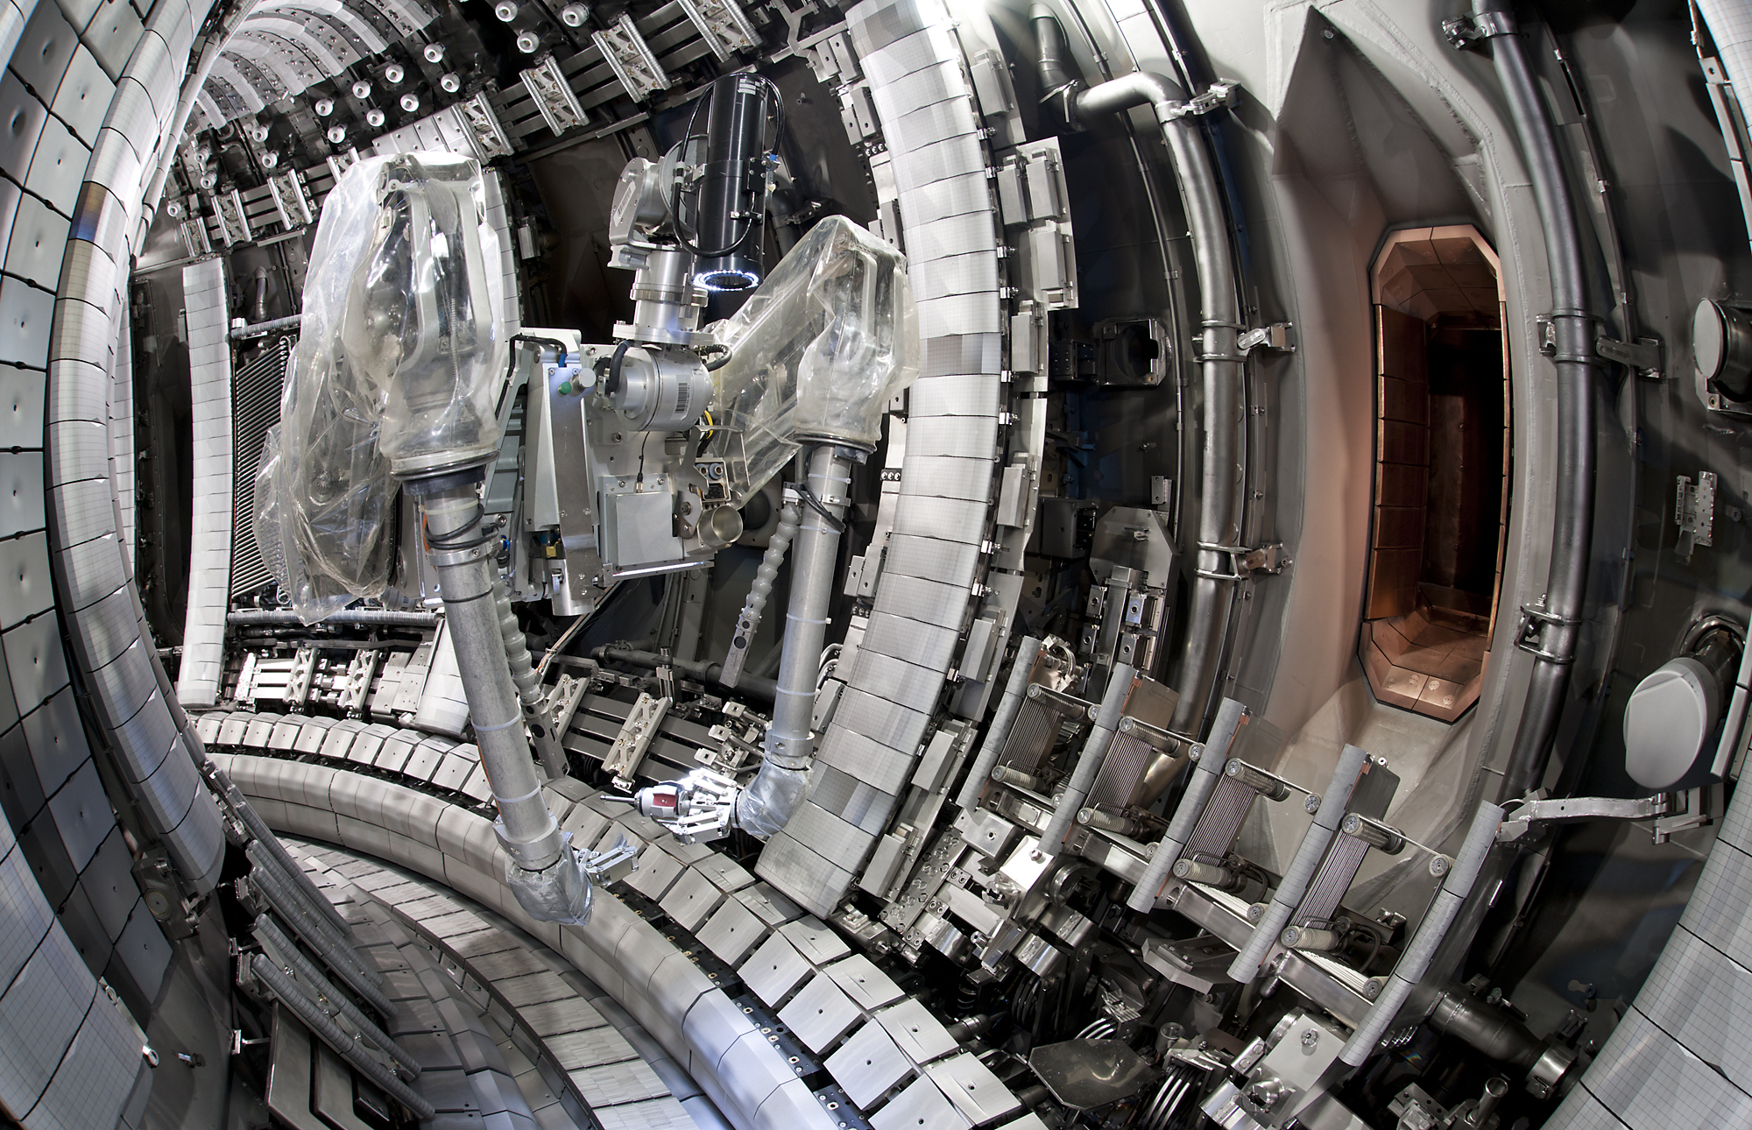
What is remote handling

Slide 3
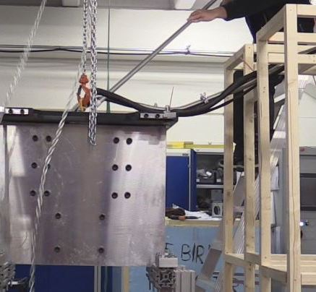
What is remote handling
ESS remote handling tool

Slide 4
Workshop charge
Goal:
Align views on RH-compatibility and what it means
Discuss and outline common solutions of common problems for all instruments to use if needed.
Assign resources to specific development tasks.
Day 1
Baseline justification and best practices
Sand box type components
Day 2
System solutions
Workshop spirit
Focus on finding solutions with a plausible way forward
Open and equal
Transparent discussion

Slide 5
RH Deployment
Development
Baseline strategy
Technical standards
Operations strategy
Internal validation
External validation
Developed with collaborators.
External validation.
Released as packages.
Aligned with SSM application
Developed internally
Deployment
Roll-out
Compliance checks
IKON
Newsletter
FtF meetings
During detailed design
During procurement phase
TG3
Implementation
Tools development
Prototypes and testing
Development of foreseen tools.
Prototyping of critical systems, tools and components.
Q1-17
Q3-17
Q1-18
Q3-18
Q1-19
Notes:
Reduce the amount of information. Refer to the document and point out the key. Aim for 30min content.
ESS-0042943

Slide 6
Thank you for your attention Questions?
Notes:
Add extra slides on what we are looking at.

