Slide 1
Remote Handling Justification – ESS-0111248
Erik Nilsson
Mechanical Engineer
ESS Chopper Group
www.europeanspallationsource.se
17 November, 2017

Slide 2
ESS unique source, with unique boundary conditions.
A challenging environment to operate equipment
Complex Installed systems
Limited access opportunities
Radiation environment
Internal and External rules and legislation
Notes:
Not a usual source
Special constraints on operations
Constraints on design of equipment and installations
Legislation on the dose limits allowed on personnel. Mitigated by the ALARA principle.
Legislation box
Clearer schedule
Radiation instead of hazardous

Slide 3
ESS current GSO
ESS-0000004 rev 4 (April 2016)
Operating conditions Initiative event likelihood | Workers limit (effective dose) | Public limit (effective dose)
Normal operation - H1 | 2 mSv/year (average) 10 mSv/year (max) | 0.05 mSv/year (0.1 mSv/year SSM)
Anticipated events - H2 F > 10⁻² | 20 mSv/event | 0.1 mSv/occurrence
Unanticipated events - H3 10⁻⁴ < F < 10⁻² | 50 mSv/event | 1 mSv/occurrence
Improbable events (DBA) – H4 10⁻⁶ < F < 10⁻⁴ | 50 mSv/event | 20 mSv/occurrence
Highly improbable events – H5 10⁻⁷ < F < 10⁻⁶ | 500 mSv/event | 100 mSv/occurrence

Slide 4
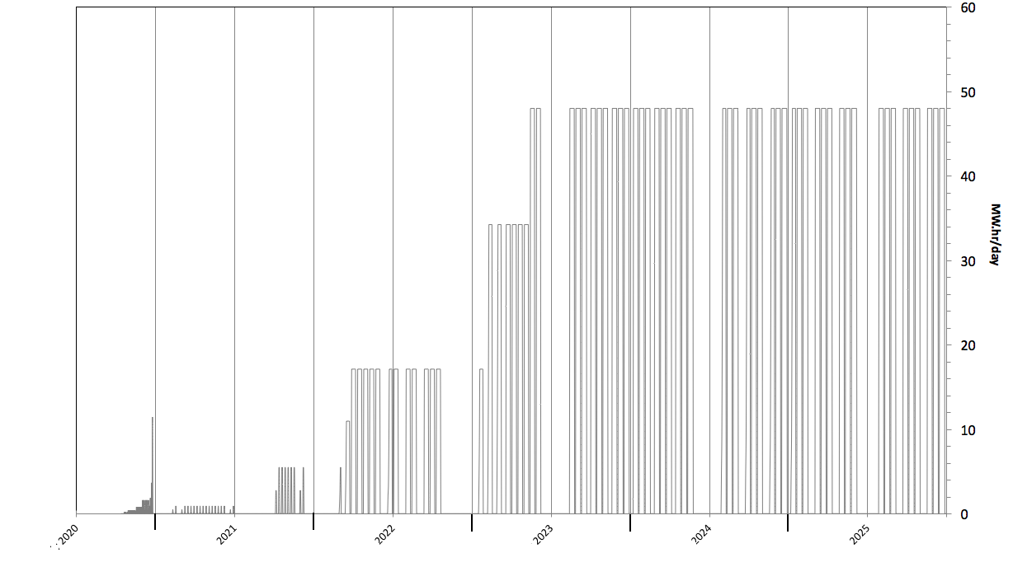
Component activation a long term issue …
Bunker access regime
Design for the future
Severely limited
access duration
Unlimited
access duration
Limited
access duration
Access
Prohibited ?
Based on activation estimations
Exact access regime will be dependent on operational experience
Notes:
Even though the activation will not be there instantly it will build up over the years.
We had to understand
To make the right choices – and develop strategy to reduce it and work with it
Activation will grow over time
Starting low in early operation
No problems to access
Building with beam power
Potentially to levels which prohibits access
Experience from other facilities shows that retrofitting RH compatibility is ineffective and very costly.
BASE SLIDE MORE ON REAL DATA FROM SHANE
Talk both long term to RH and short term to allow for all the installation.

Slide 5
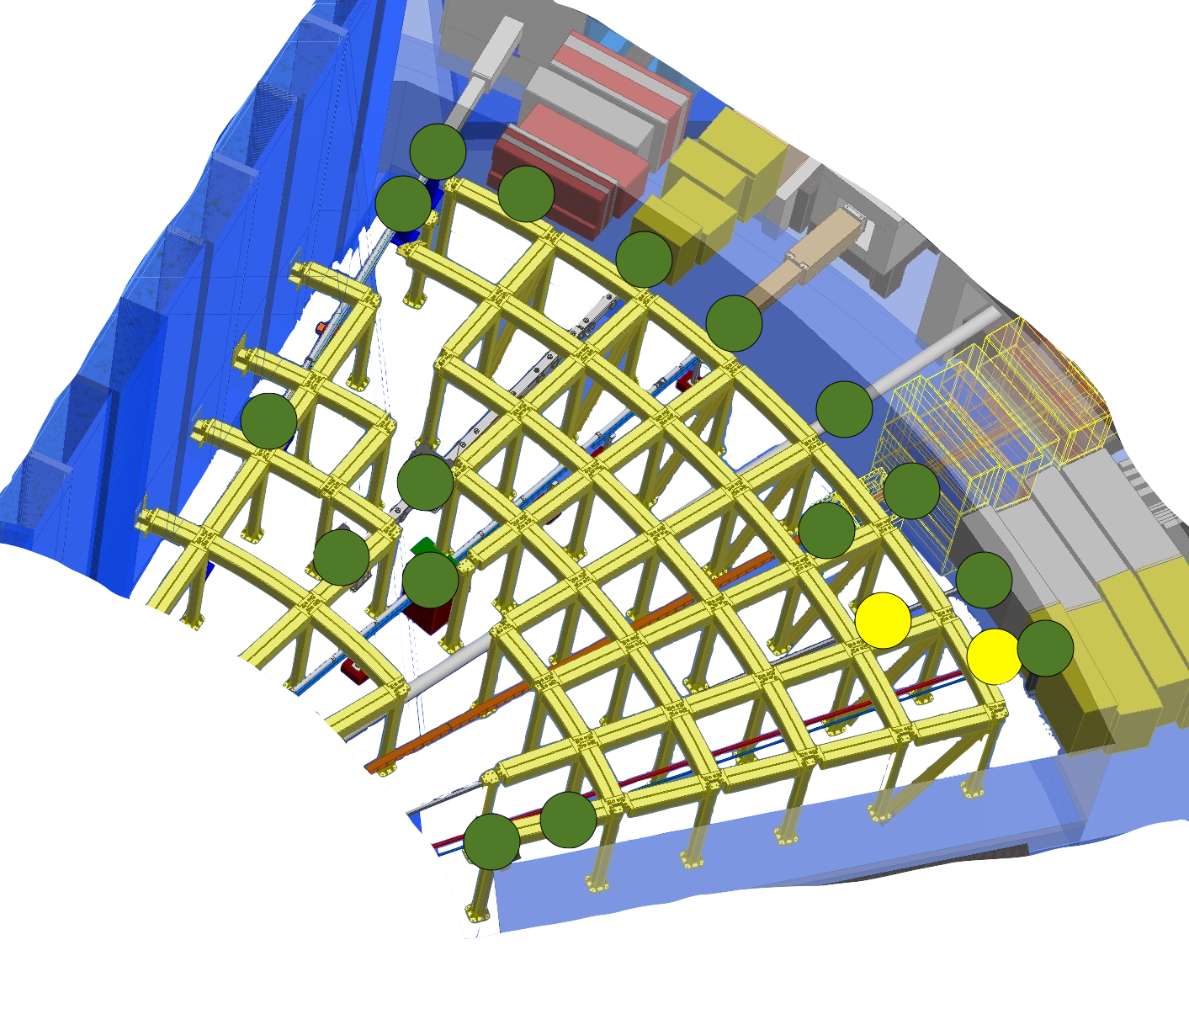
Activity during shutdown - rear of bunker
West sector
Note all calculations assume idealized configurations and ignore effects of trace material impurities
Exposition prior to shutdown is assumed to be 100 days at full rated power (5MW)
Dose >3 <25 microSv/h
UNRESTRICTED CONTROLLED
WORK AREA
(BLUE ZONE)
Number of sources (>0.5) 15-30
Source ‘density 0.5 per m2
Exposure dominated by ‘ambient’
Access prerequisites Gamma shutters
Remove or shield hotspots
Gamma source distribution 72hrs after shutdown (@30cm)
Notes:
Long sector. Hotspots are ‘the usual suspects’ – read list. Pretty well spread out.
Initial estimations of just after beam off are pretty unpleasant 24hrs
A few days later then the number of significant sources has dropped dramatically.
Limiting factor for access will be dose at 30cm distance.
Access will require local shielding or removed hot spots
but following this access is currently expected to be possible.
Routine maintenance operations should be remote handling to keep the dose down.
Designing for the worst case. But we can skip it early.

Slide 6
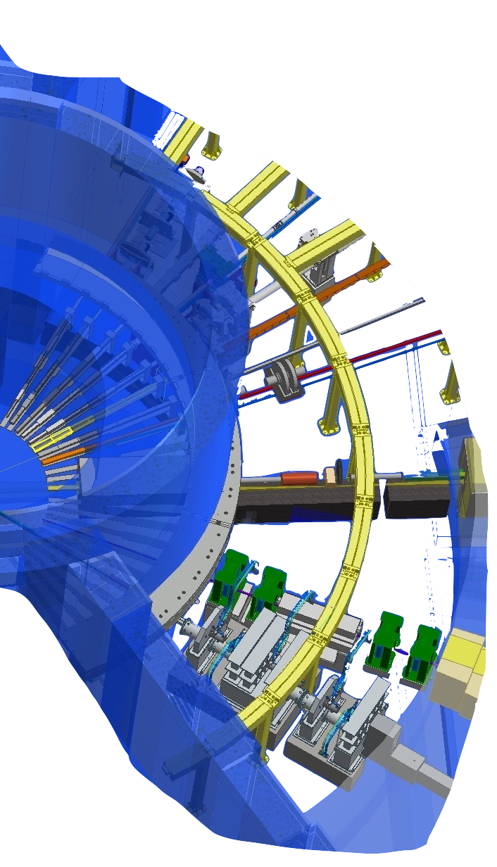
Activity during shutdown - front of bunker
West and north sector
Note all calculations assume idealized configurations and ignore effects of trace material impurities
Exposition prior to shutdown is assumed to be 100 days at full rated power (5MW)
Dose >25microSv/h
RESTRICTED CONTROLLED
WORK AREA
(YELLOW ZONE)
Number of sources (>0.5) ~50
Source ‘density’ >3 per m2
‘contact’ dose dominates
Access prerequisites Gamma shutters
Earliest access
Gamma source distribution three days after shutdown (@contact)
Notes:
Short sector
More densely packed in, sources are hotter.
Impossible to stay away from all sources
Limiting factor for access will be contact dose.
Dose rate is expected to be significantly higher
No normal personal access.
Installation activities expected to be hands on.
But maintenance and routine operations should all be remote handling.

Slide 7
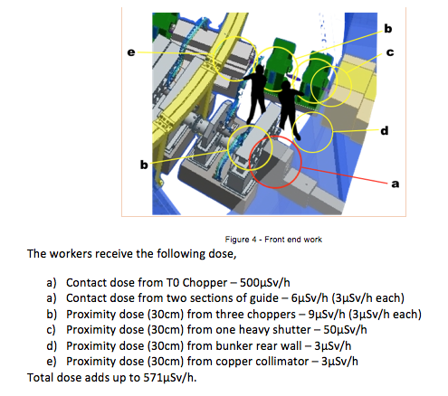
Calculated example
Integrated dose adds up to 95mSv per year for the maintenance of choppers

