Slide 1
Remote Handling Strategy and implementation
Erik Nilsson
Mechanical Engineer
ESS Chopper Group
www.europeanspallationsource.se
17 November, 2017

Slide 2
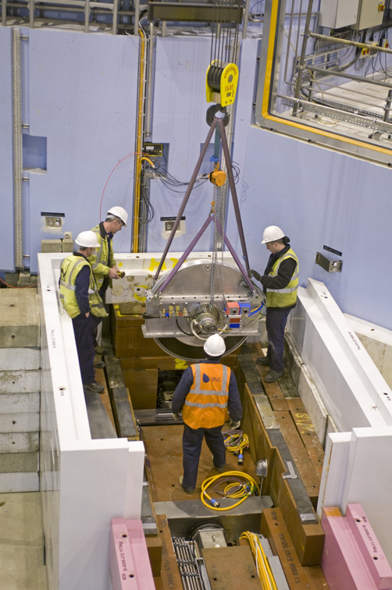
Handling strategy
Three classes of modules/components
Full remote handling compatibility
Limited remote handling compatibility
No remote handling compatibility
Activities restricted to
Extraction (Full-RH and Limited-RH)
Reinstallation (Full-RH)
Inspection and/or realignment of component/module (if required)
Complex RH activities shall be avoided.
Straight vertical lifts only (NEEDS CONFIRMATION)
No in-situ RH maintenance is foreseen.
Notes:
Activities restricted to
Extraction (RH-I and RH-II)
Reinstallation (RH-I)
Inspection and/or realignment of component/module (if required)
Complex RH activities shall be avoided.
Reduced design complexity
Reduced construction cost
Reduced tooling cost
No in-situ RH maintenance is foreseen.
Modules/components stored on site during cool down.
Exchange of a module for a spare unit will be the quickest method to repair (hot-swap).

Slide 3
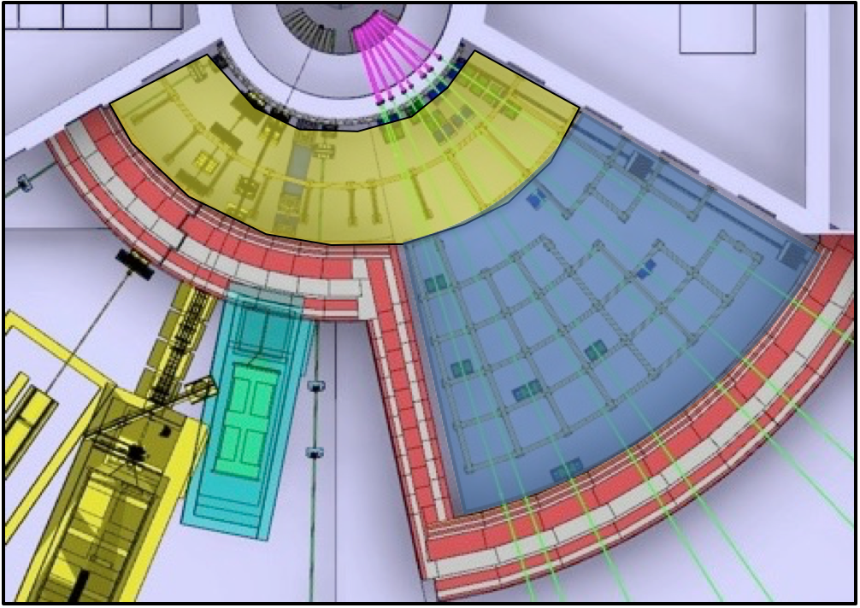
Classification
Classification dependent on
Location (Yellow or blue zone)
Levels of activation after 72 hours (expected time to access)
Expected service interval
Reliability
Full-RH or Limited-RH
Full-RH or no remote handling

Slide 4
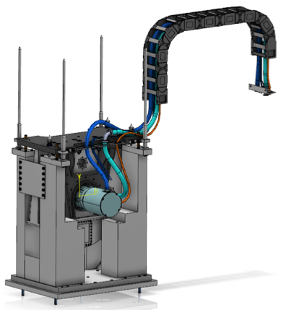
Remote handling classification
Module classified as Full-RH if any of the following three criteria apply
Module is installed within Yellow area and has maintenance or reliability constraints*
Module is installed in Blue area and has maintenance, reliability or activation constraints**.
Module has to be removed to access another Full-RH module.
Modules shall be classified as Limited-RH if it is installed within Yellow Zone and is not classified as Full-RH
Yellow area is required to be removable down to base plate for NBEX tool to operate
*Less then 5 years service interval or MTBF of less than 10 years
** Less than 5 years service interval, MRBF of less than 10 years or contact dose of >25μSv/h after 72h.
Notes:
Yellow zone + maintenance and/or reliability
Blue zone + maintenance and/or reliability and/or activation
Fall back answer if questioned: In line with operations staffing levels

Slide 5
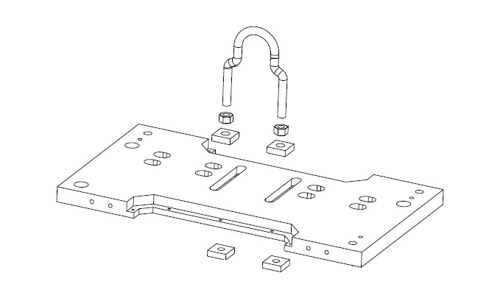
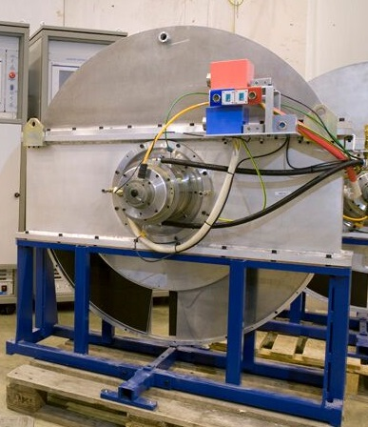
Best practices – Handling
Vertical lift of modules, using overhead crane and supported by self aligning features.
Use available lifting interfaces.
Simple and safe engagement and disengagement.
Special tools, jigs, and fixtures should be avoided
Single point lifting in combination with guide rails/pins/rollers.
Certain cases can justify specialised lifting rigs
Equipment lifted into caskets
Hard to reach components
Discussed on case by case bases
No loose items during handling.
Unbolted fasteners for extraction is required to be captive.
Avoid multiple simultaneous handling.
Avoid damage during handling.
Single point lifting
Maintenance support
Notes:
Vertical lift of modules, using the overhead crane and supported by self aligning features.
Any exceptions to this shall be discussed and approved with ESS.
5 000kg module weight on ”dexterous” operations
20 000kg module weight on “simple” operations.
Use available lifting interfaces where possible.
Simple and safe engagement and disengagement.
Unambiguous designs for lifting connections.
Avoid special tools, jigs, and fixtures.
Single point lifting is preferred, in combination with guide rails/pins
Modules shall be designed so that there are no loose items during handling.
Unbolted fasteners for extraction is required to be captive.
Cables and utilities shall be disconnected and fixed before RH operations.
Design to avoid multiple simultaneous handling.
Design to avoid damage during handling.
Natural resting points.
Maintenance supports or equivalent.

Slide 6
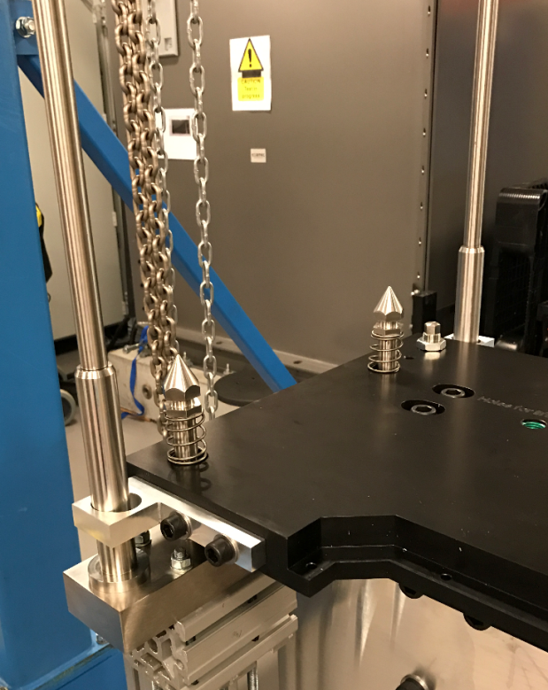
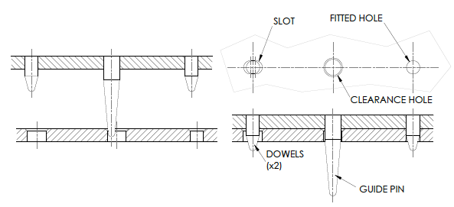
Best practices – Safe alignment of module
Self engaging and self aligning
Gradual alignment using guide pins or rollers
Generous tolerances and realistic capture ranges.
Guide pins should be of different lengths.
Dowels should generally be used in pairs.
Dowels shall be as short as possible.
Consider what RH equipment is available and required
Incorrect mating shall be impossible.
Notes:
Self engaging and self aligning
Gradual alignment and containment
No over-constraining
Generous tolerances and realistic capture range.
Prevent wedging and jamming
Provide visual cues where applicable
Guide pins and rollers are preferred over edge guide type alignment systems.
Length of guide pins depend on surrounding equipment and visibility.
Guide pins should be of different lengths to allow gradual engagement.
Dowels should generally be used in pairs to fully constrain two mating surfaces.
Dowels shall be as short as possible to reduce risk of jamming.
Dowels can be used to reduce side loads on fasteners
Consider what RH equipment is available and required
RH equipment is not ‘accurate’.
Incorrect mating shall be impossible.
Choice of correct datum and tolerancing is important.

Slide 7
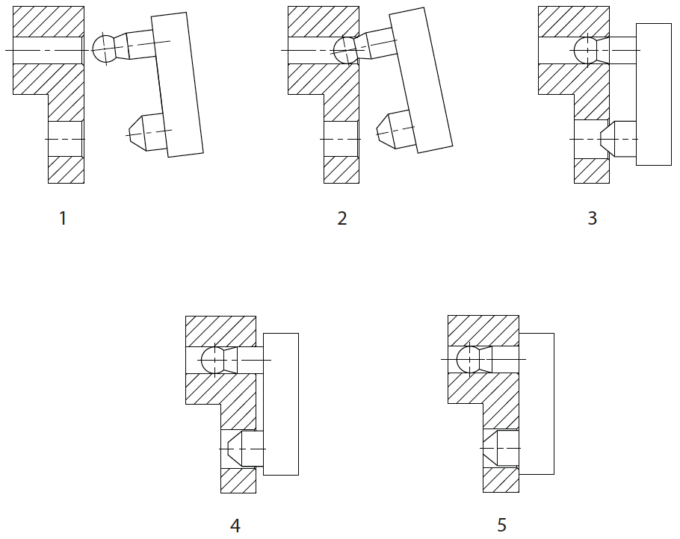
Best practices – Safe alignment of module
Step | DoF’s | Type
1. Module held in free space | 6 | 3 Translation 3 Rotation
2. Module located on dowel ball-end | 4 | 1 Translation 3 Rotation
3. Module located on single long ball-ended dowel pin | 2 | 1 Translation 1 Rotation
4. Module item located on second short dowel pin | 1 | 1 Translation 0 Rotation
5. Module fully in contact with mating face | 0 | 0 Translation 0 Rotation
Example of gradual kinematic constraint

Slide 8
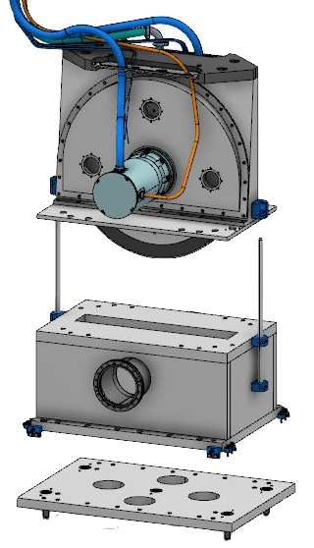
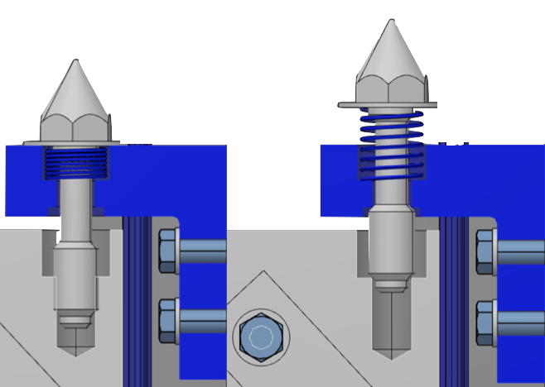
Best practices - Interfaces
Modules should be independent of other modules.
Bolted interfaces
Minimise number of bolts
Use few bolt sizes
Design according to standard or use standard components.
Captive pop-up design
No welding interfaces between modules.
Work on remote handling interface between vacuum sections is ongoing (together with the ESS vacuum group).
Example of captive bolts
Notes:
Modules should be independent of other modules.
Bolted interfaces
Minimise number of bolts
Use few bolt sizes
Design according to standard or use standard components.
Captive pop-up design
No welding interfaces between modules.
Work on remote handling interface between vacuum sections is ongoing (together with the ESS vacuum group).

Slide 9
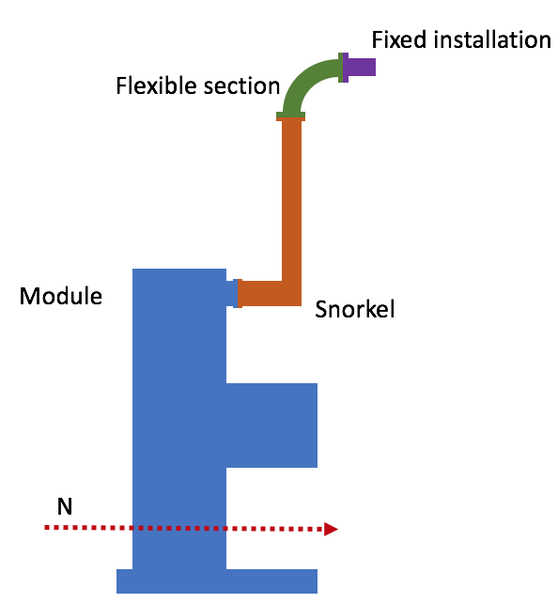
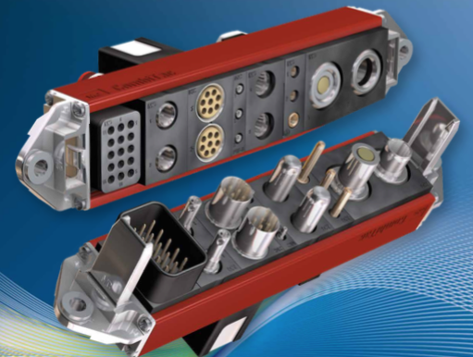
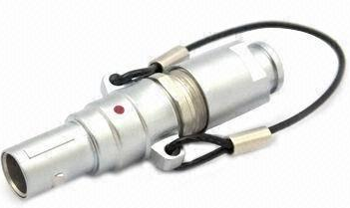
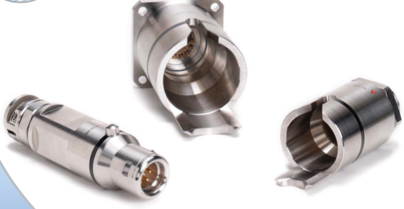
Best practices – Interfaces Electrical and fluid interfaces
Utilities routed in three sections
Self supporting snorkel
Flexible section
Fixed section
Bundling of connectors
Push-pull type connectors
Notes:
Routing
Avoid access limitations to remote handling interfaces.
Maintenance connectors within 200mm of the bottom of the bunker roof shielding.
Utilities routed in three sections
Self supporting snorkel
Flexible section
Fixed section
Bundling
The cables and utilities shall be collected in appropriate bundles.
Larger collected connectors preferred over multiple connectors.
Connectors
Minimise exposure to radiation during connection/disconnection.
Push-pull type of connectors with lanyard pulls are preferred.
“Breakaway“ plugs in bayonet type connector are a possible secondary choice.
A fully integrated, fully remote handling plate is required if manual actuation is not possible.

Slide 10
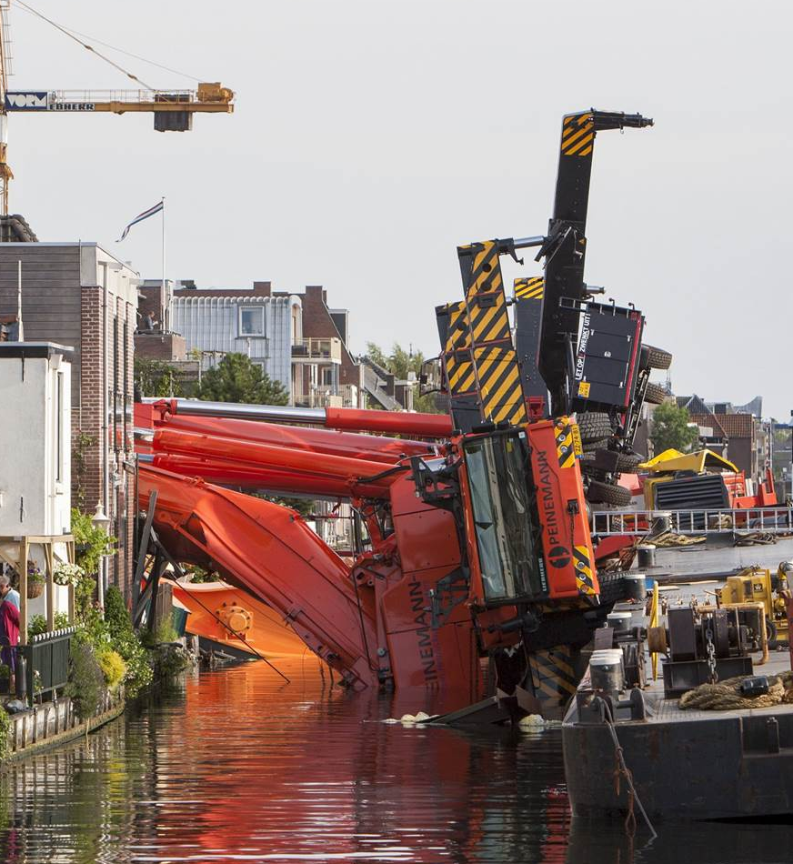
Other areas of best practice
Failure analysis
All modules shall be assessed for the probability and modes of failure.
Failure analysis
RH features shall not be damaged in any failure scenario.
Viewing and visibility
Identification
Activation
Decontamination

Slide 11
Best practices – Activation and contamination
Minimising the activation lowers the cooldown period
Beneficial for bunker access – Errors can cause access to bunker to be impossible.
Beneficial for hands on maintenance.
Lowers waste cost.
Must comply to the instruction and materials list to be released
Exceptions shall be approved by ESS.
Choose construction materials that minimise the need for decontamination.
Notes:
Minimising the activation lowers the cooldown period
Beneficial for bunker access
Beneficial for hands on maintenance
Lowers waste cost
Comply to the instruction and materials list to be released (from NOSG)
Exceptions shall be approved by ESS.
Choose construction materials that minimise the need for decontamination.
Choose construction materials for modules which resist degradation by the decontamination fluids and procedures.
No blind holes unless provided with drain ports.
Continuous welds to fill cracks and crevices.
Use smooth or polished metal surfaces.
Avoid porous materials, if possible.
Eliminate joints that may trap material, where possible.

Slide 12
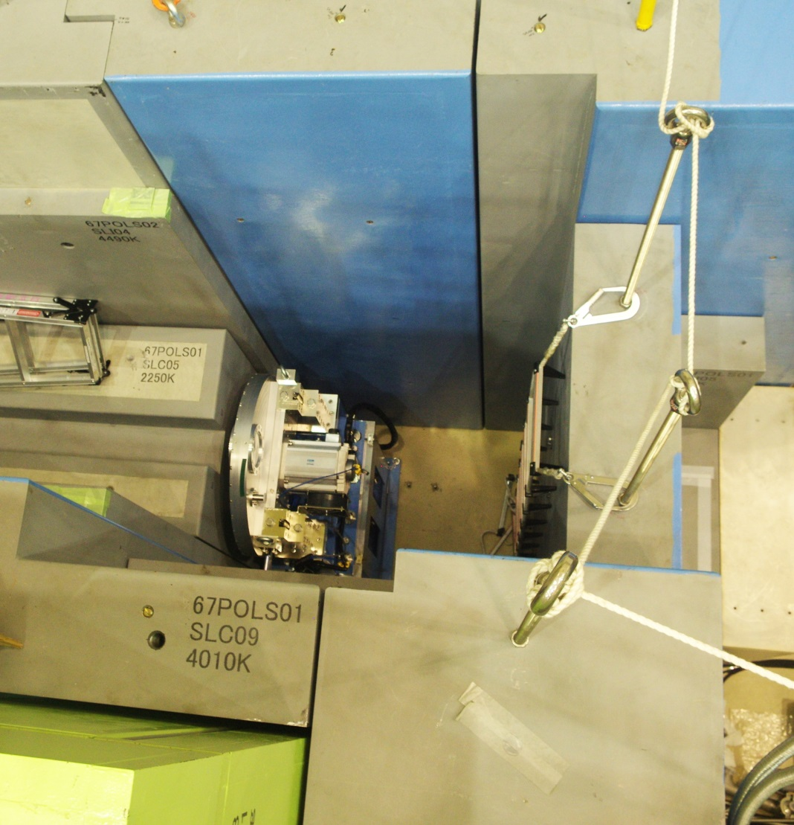
Best practices – Viewing, Visibility and Identification
High contrast or colour difference between mating modules and avoid highly reflective surfaces.
Physical features that clearly align when correctly assembled.
All module items, must be clearly marked and identified.
Have means to perform inspection in service, if required.
Incorporate suitable survey and alignment attachment points.
Notes:
The visibility of RH operations is crucial.
If the task area cannot be seen, the RH operation is not possible.
Cameras and associated lighting systems will be used when needed.
Strive for designs requiring no additional viewing aids.
High contrast or colour difference between mating modules and avoid highly reflective surfaces.
Physical features that clearly align when correctly assembled.
All module items, must be clearly marked and identified.
Have means to perform inspection in service, if required.
Incorporate suitable survey and alignment attachment points.

Slide 13
Best practices – Failure consideration
All modules shall be assessed for the probability and modes of failure.
Failure analysis
RH features shall not be damaged in any failure scenario.
Notes:
All modules shall be assessed for the probability and modes of failure.
Important for reliability and availability.
Important for maintenance planning and personnel dose exposure.
For all modules:
Failure analysis.
Method to detect and identify failures.
Methods to recover from or repair foreseen failures.
Assure the design and maintenance meet module availability requirements.
Recommend in-service preventive maintenance, and methods for accomplishing them.
Interface between module and RH equipment shall not be damaged in any failure scenario.

Slide 14
RH compatibility
Assessed as part of TG3 review for affected systems.
Module definition and classification.
RH consideration for handling, alignment and fastening.
Failure analysis of modules.
Case and reason when ESS best practices are not followed.
Case and reason when ESS standard RH equipment is not used.
Needs for specialised tooling outside of ESS standards.
Resources?

