Slide 1
Remote Handling Location and alignment devices
Erik Nilsson
Mechanical Engineer
ESS Chopper Group
www.europeanspallationsource.se
20 November, 2017

Slide 2
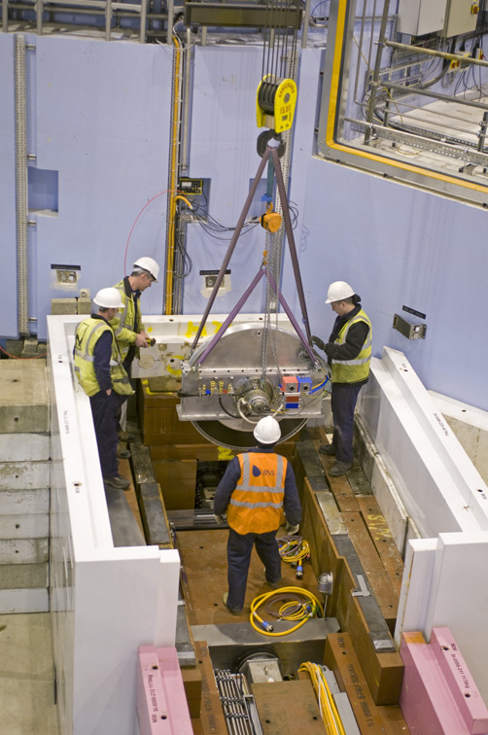
Handling strategy – Reminder
Activities restricted to
Extraction (Full-RH and Limited-RH)
Reinstallation (Full-RH)
Inspection and/or realignment of component/module (if required)
Notes:
Activities restricted to
Extraction (RH-I and RH-II)
Reinstallation (RH-I)
Inspection and/or realignment of component/module (if required)
Complex RH activities shall be avoided.
Reduced design complexity
Reduced construction cost
Reduced tooling cost
No in-situ RH maintenance is foreseen.
Modules/components stored on site during cool down.
Exchange of a module for a spare unit will be the quickest method to repair (hot-swap).

Slide 3
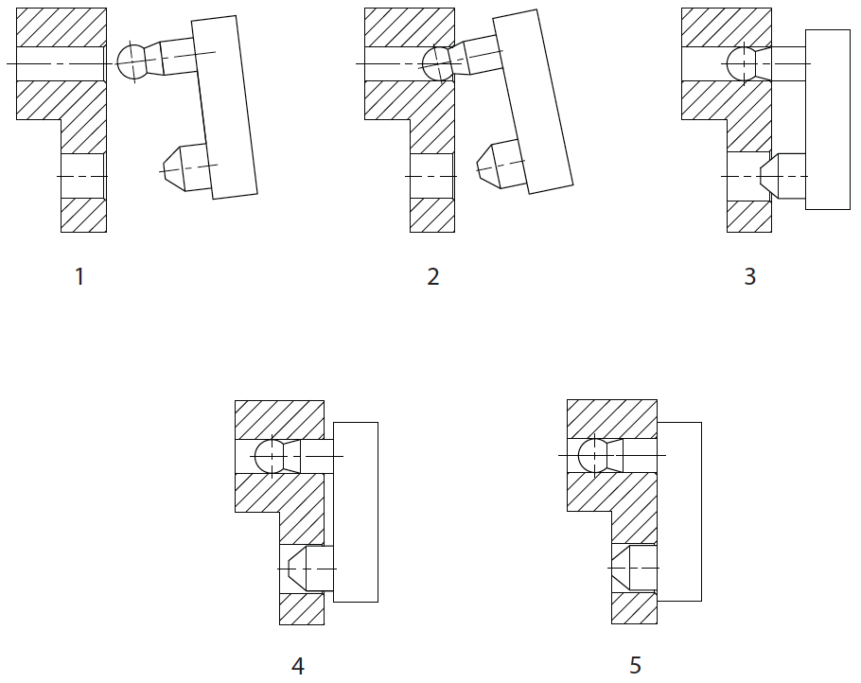
Best practices – Safe alignment of module
Step | DoF’s | Type
1. Module held in free space | 6 | 3 Translation 3 Rotation
2. Module located on dowel ball-end | 4 | 1 Translation 3 Rotation
3. Module located on single long ball-ended dowel pin | 2 | 1 Translation 1 Rotation
4. Module item located on second short dowel pin | 1 | 1 Translation 0 Rotation
5. Module fully in contact with mating face | 0 | 0 Translation 0 Rotation
Example of gradual kinematic constraint

Slide 4
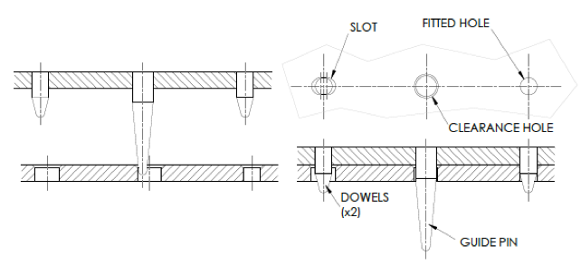
Dowel arrangement

Slide 5
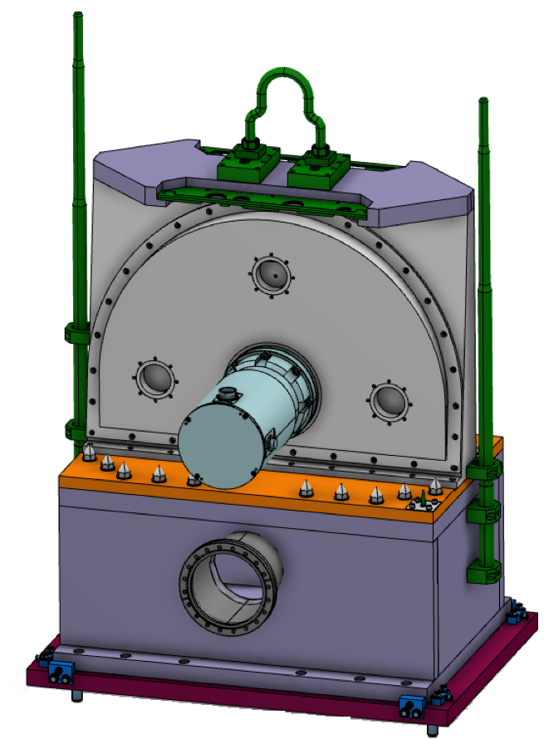
Guide rod – example
Length of guide rods to allow bunker installation (and protect surrounding)
Different length guide rods
Second guide block to prohibit tilt
Positioning dowels (fitted and slotted holes)
Capture ranges and accident scenarios considered

Slide 6
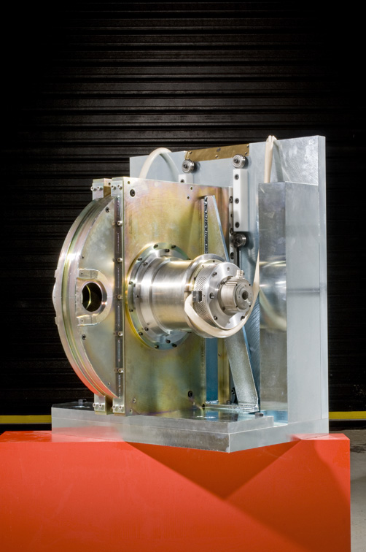
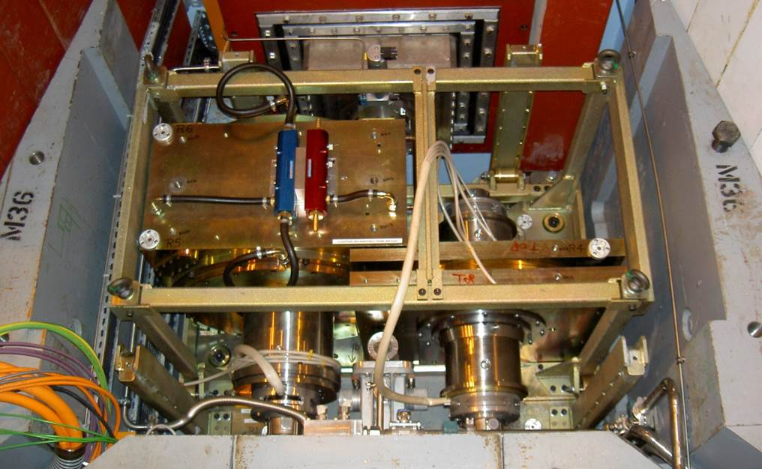
Rollers – example
LARMOR (ISIS)
ZOOM (ISIS)

Slide 7
Discussion topics
What types of components is interesting for standardisation
General sand-box solutions or overall system concepts?
Guide rods or rollers?
Benefits and disadvantages?
When to use what?
Best way of controlling tilt?
Notes:
Activities restricted to
Extraction (RH-I and RH-II)
Reinstallation (RH-I)
Inspection and/or realignment of component/module (if required)
Complex RH activities shall be avoided.
Reduced design complexity
Reduced construction cost
Reduced tooling cost
No in-situ RH maintenance is foreseen.
Modules/components stored on site during cool down.
Exchange of a module for a spare unit will be the quickest method to repair (hot-swap).

