Slide 1
Inflatable Seals for RH in Bunker
Laurence Page
Vacuum System Engineer Neutron Instruments
www.europeanspallationsource.se
22 November, 2017

Slide 2
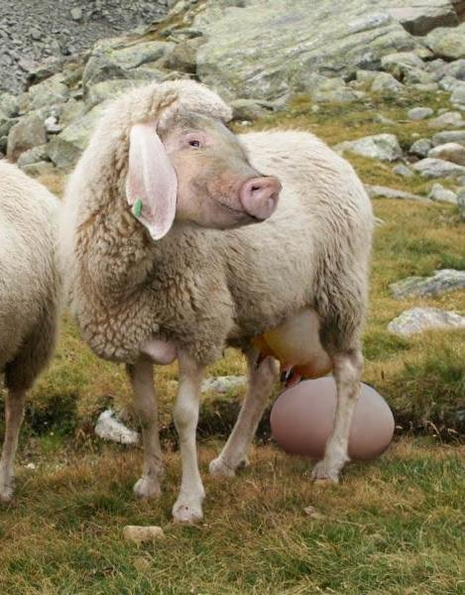
Developing Die Eierlegende Wollmilchsau For RH in the Bunker
Egg Laying
Wool Giving
Milk Bearing
Sow

Slide 3
Our Eierlegende Wollmilchsau Seal
Allows for very tight seal (Very low Leak-Rate)
Composed of Aluminium for activation
Reliable
Robust
Inexpensive
Our Reliablelowleakluminiuminflatable Seal

Slide 4
Our Eierlegende Wollmilchsau Seal
Administrative agreement with PSI
Two Possible Solutions to prototype
All-Metal
Al- EPDM seal
Must consider environment (dust)
Conductance issues require low leak-rates
Vacuum pumps for the Bunker are far away

Slide 5
Preliminary ODIN Model
Bunker Wall
23 M
Target
Need Tight Seals to keep low gas loads

Slide 6
All Metal Seal (PSI-SNS PBW)

Slide 7
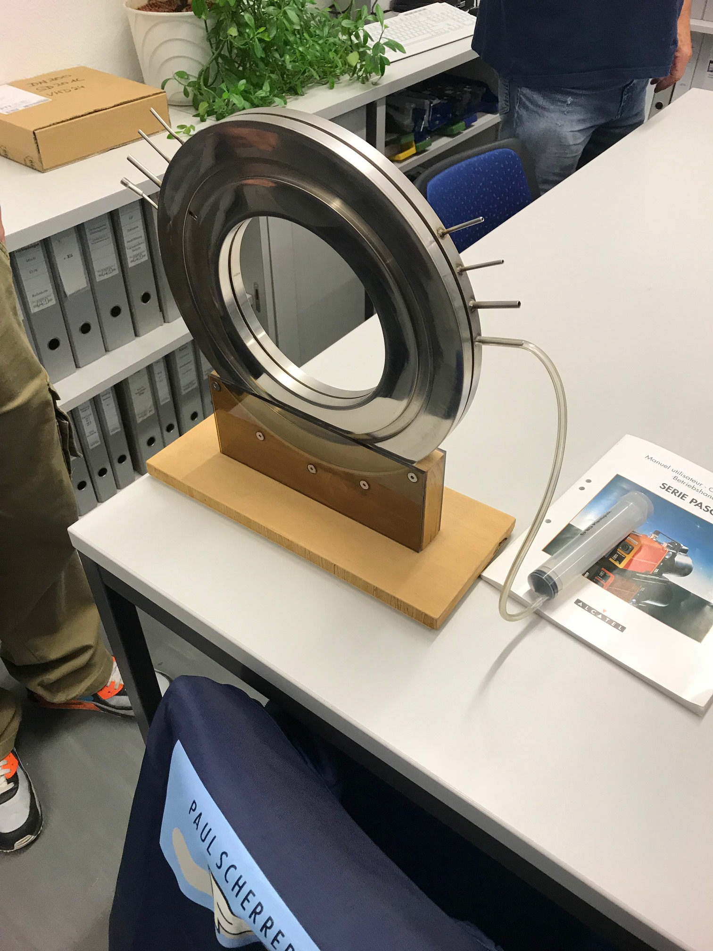
All Metal Solution

Slide 8
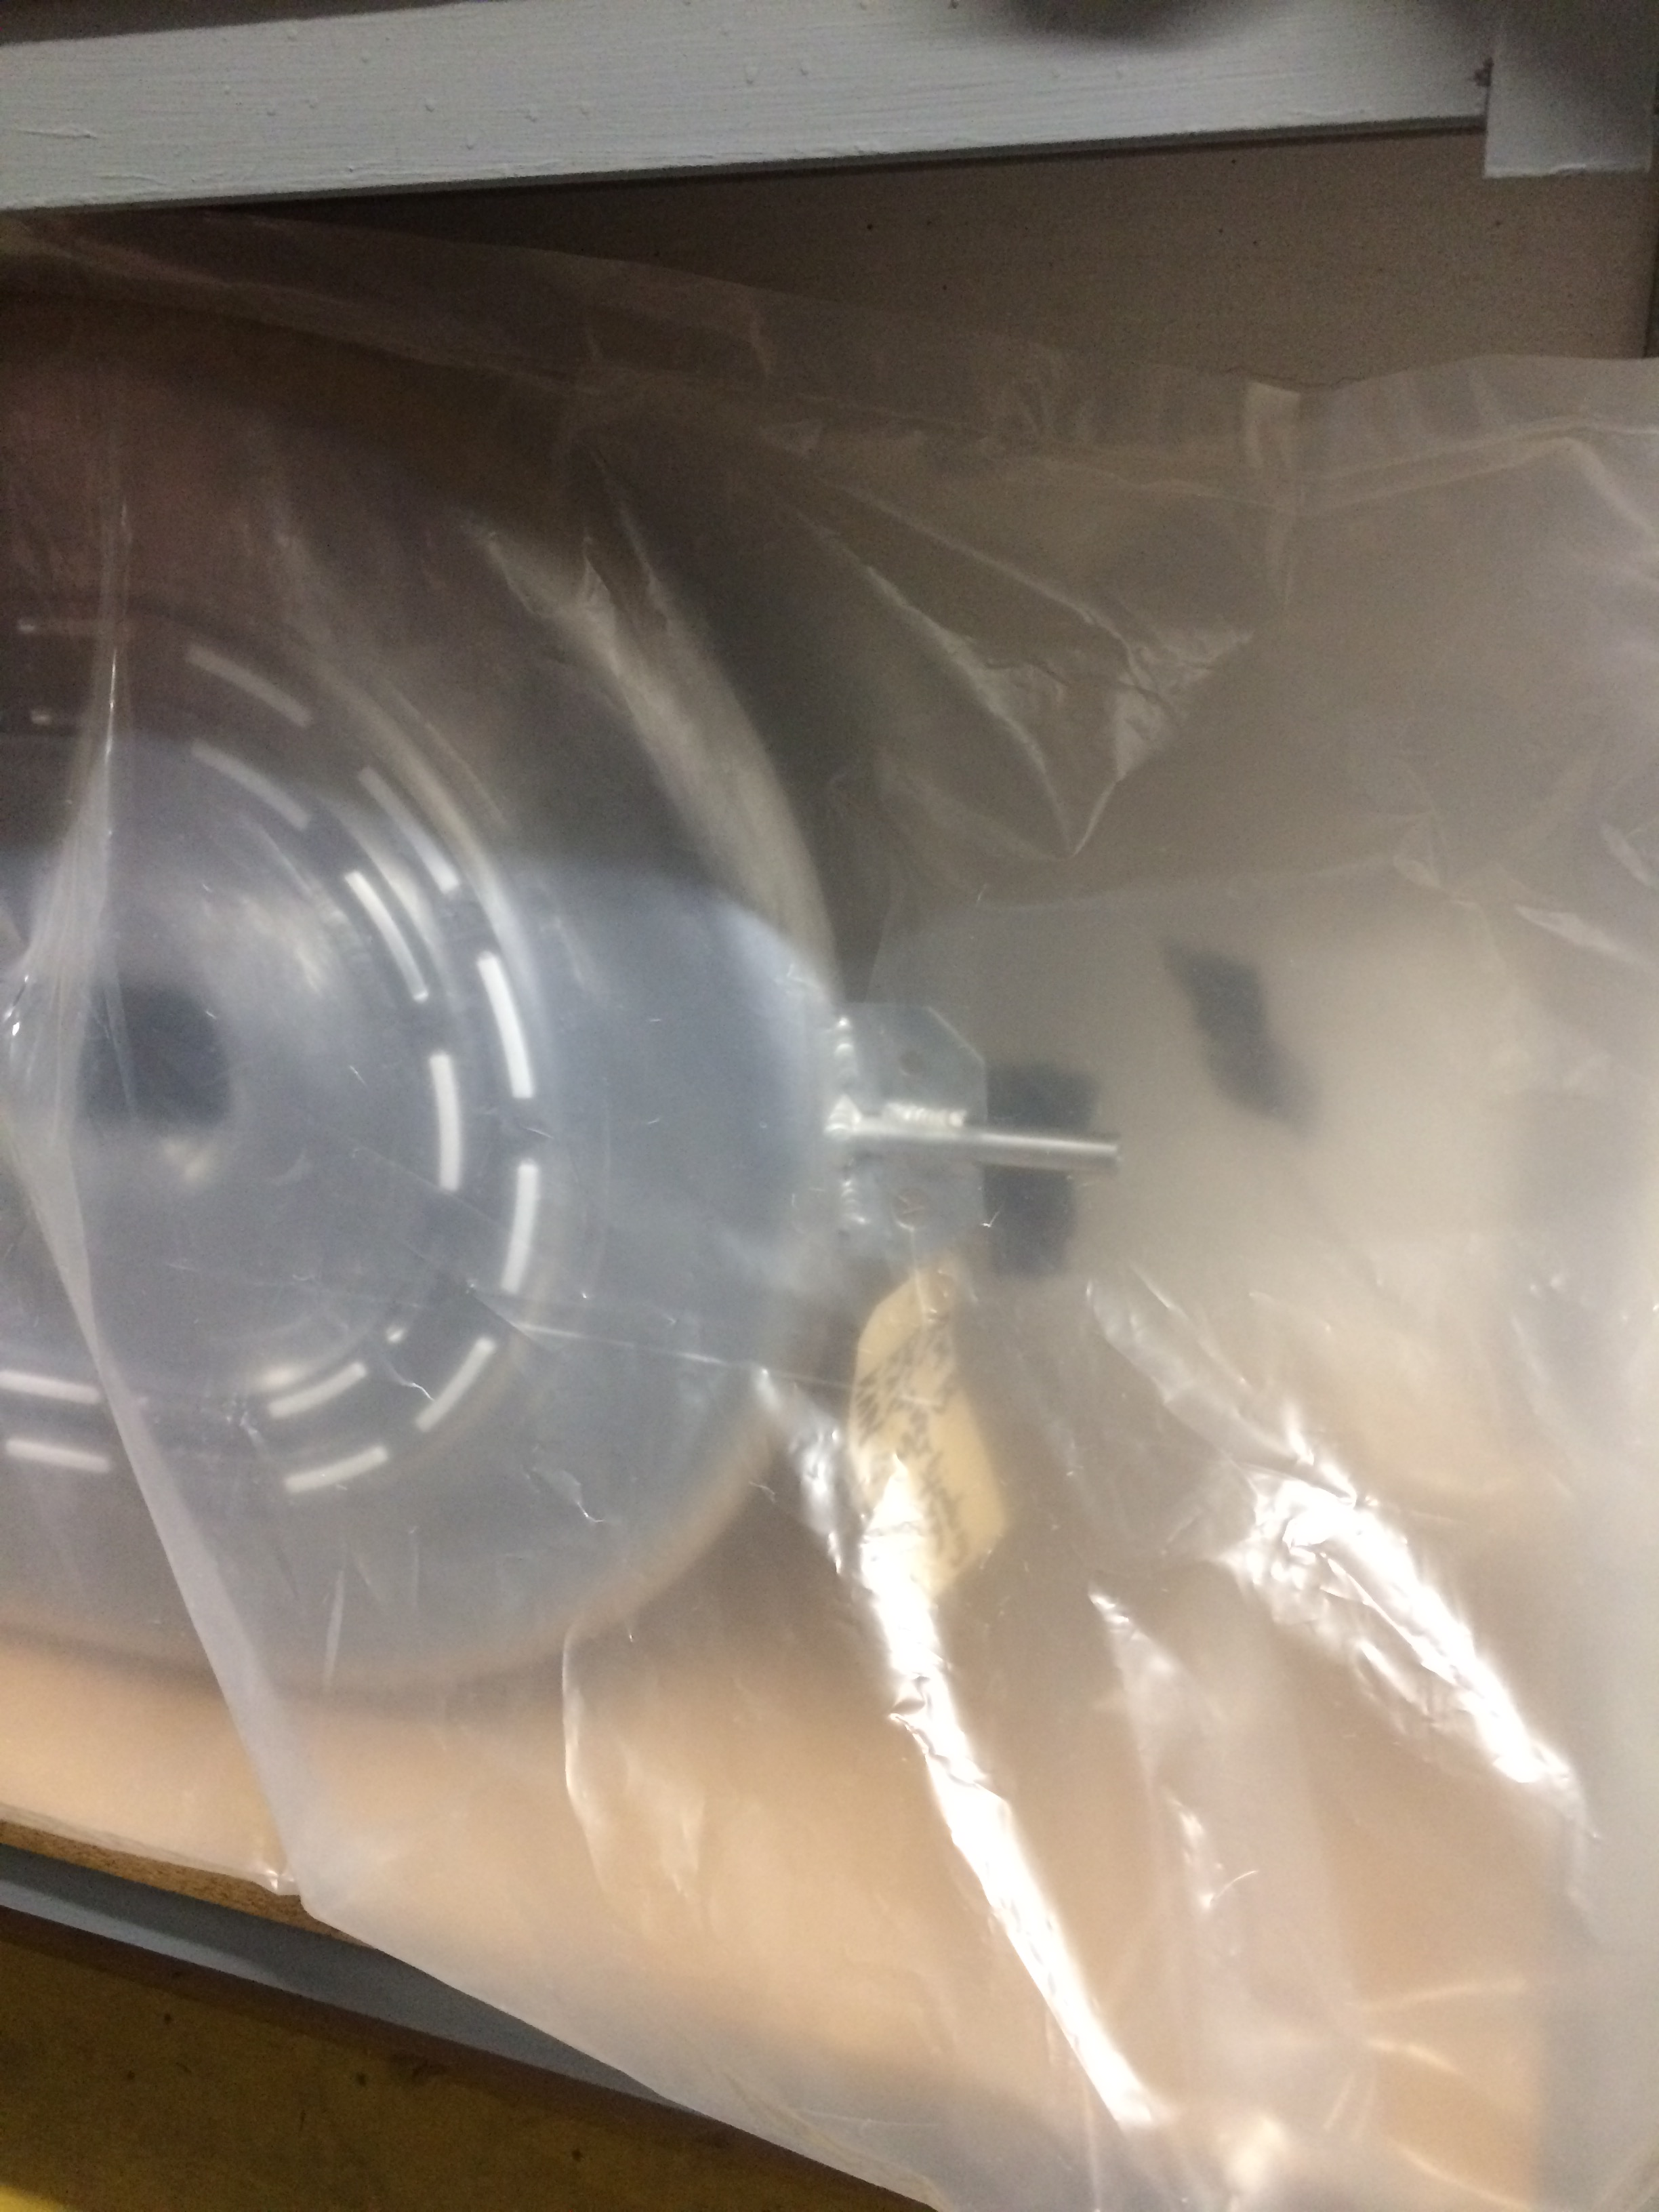
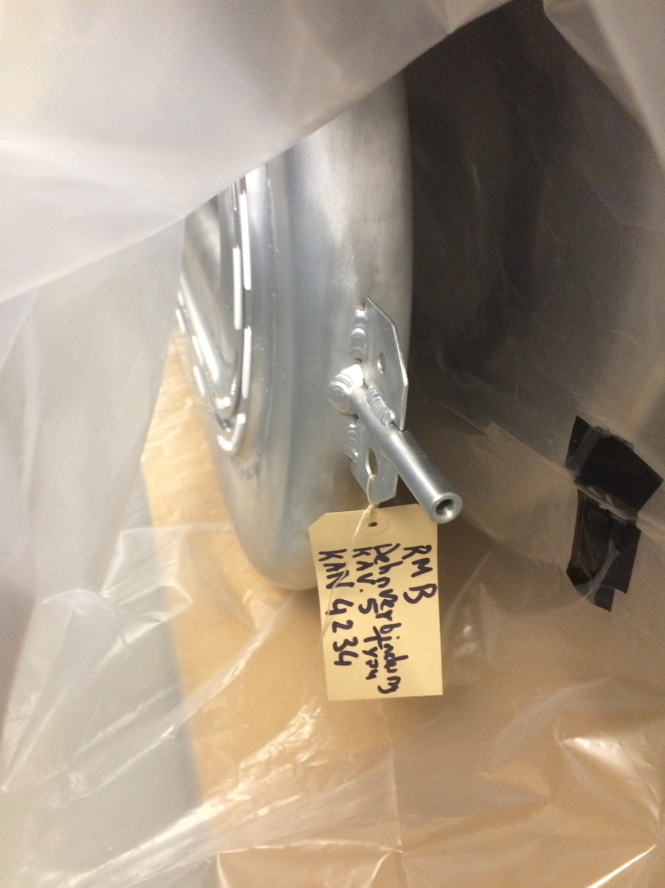

Slide 9
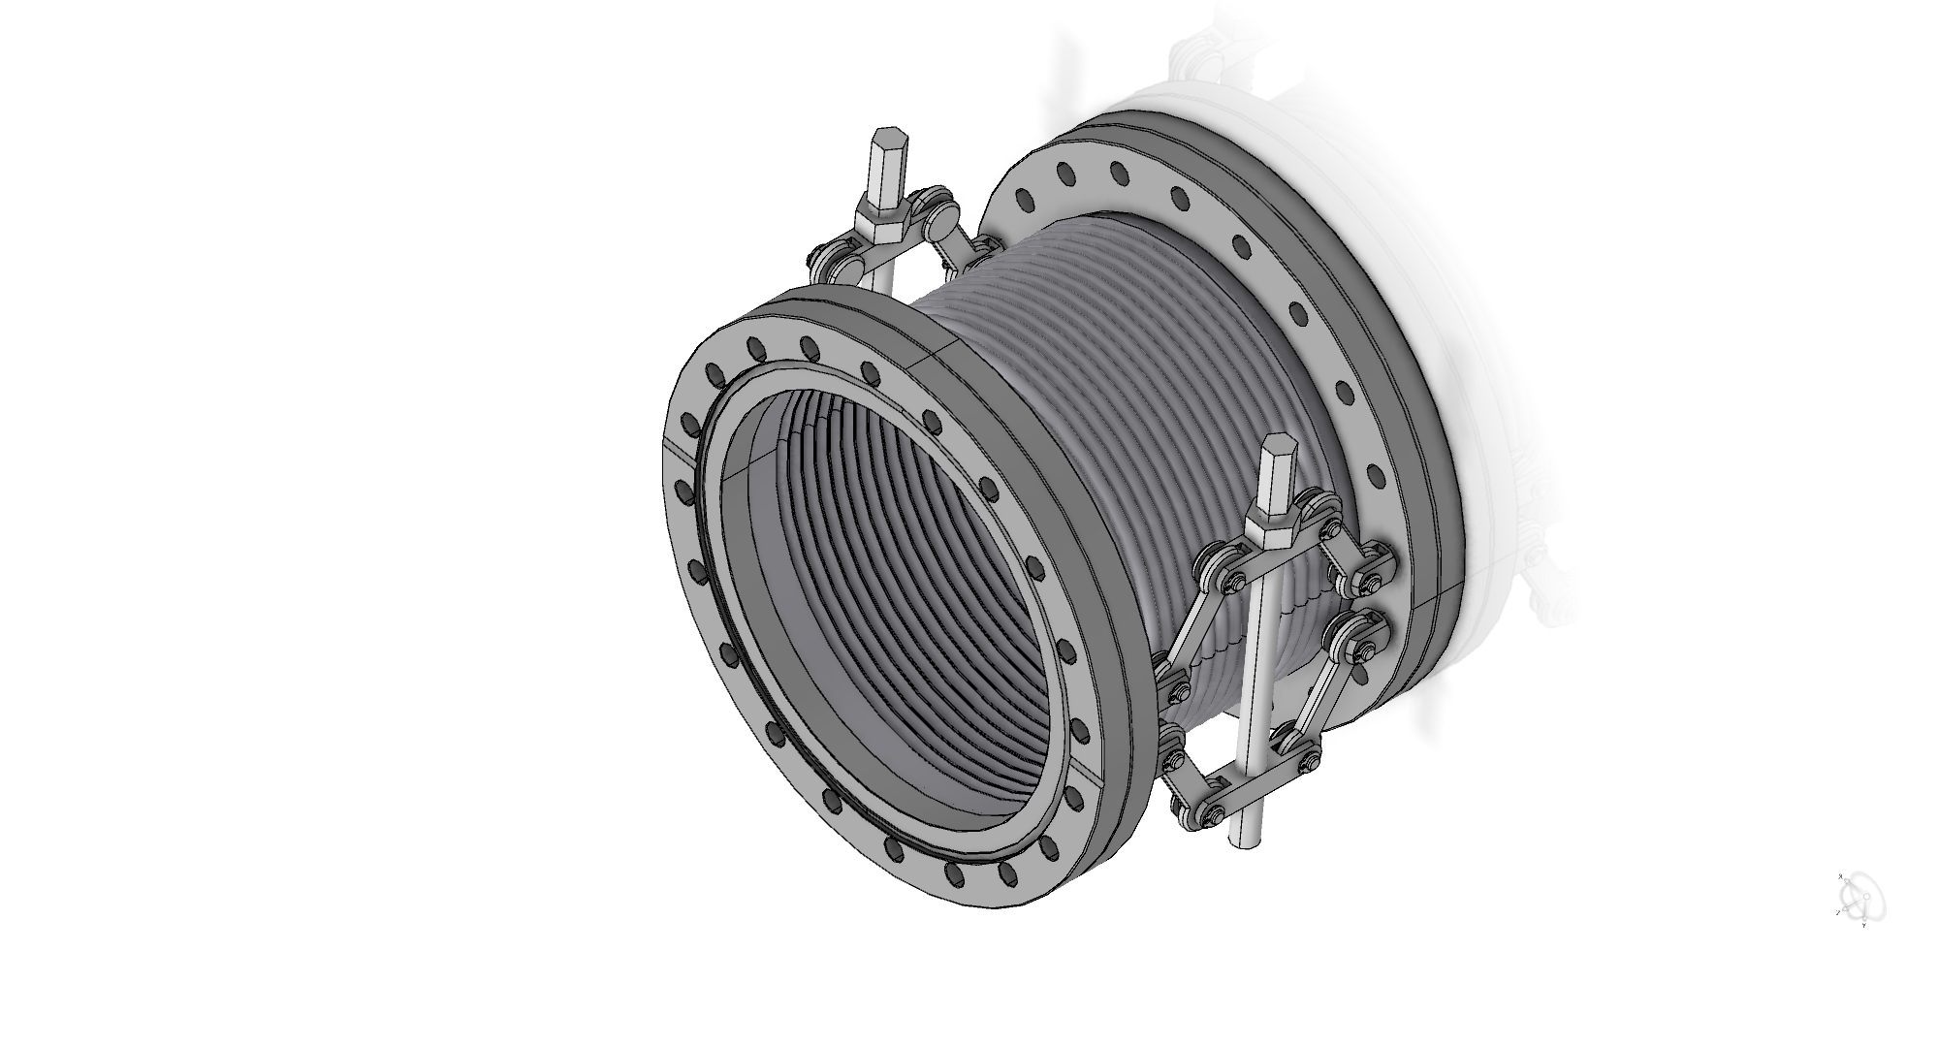

Slide 10
Our Eierlegende Wollmilchsau Seal
Can we maintain a good seal with low leak-rate
Cleaning Sealing Faces
Is this better than using thin AL-Windows?

