Slide 1
Remote Handling Guide positioning, extraction and realignment
Erik Nilsson
Mechanical Engineer
ESS Chopper Group
www.europeanspallationsource.se
20 November, 2017

Slide 2
Floor stability issue
Guide positioning not RH activity per say (no maintenance or reliability issues).
Only extraction (yellow zone)
Floor stability causes realignment of guides to become a RH activity.
Expected floor stability in bunker region:
+-3mm
Notes:
Activities restricted to
Extraction (RH-I and RH-II)
Reinstallation (RH-I)
Inspection and/or realignment of component/module (if required)
Complex RH activities shall be avoided.
Reduced design complexity
Reduced construction cost
Reduced tooling cost
No in-situ RH maintenance is foreseen.
Modules/components stored on site during cool down.
Exchange of a module for a spare unit will be the quickest method to repair (hot-swap).

Slide 3
Guide RH requirements in Yellow zone
Realignment of guide in Z-direction
Remote extraction of guide section
50 micro precision in installation (and realignment)
Adaptable to different types of guide solutions
Interfaces to choppers and other components

Slide 4
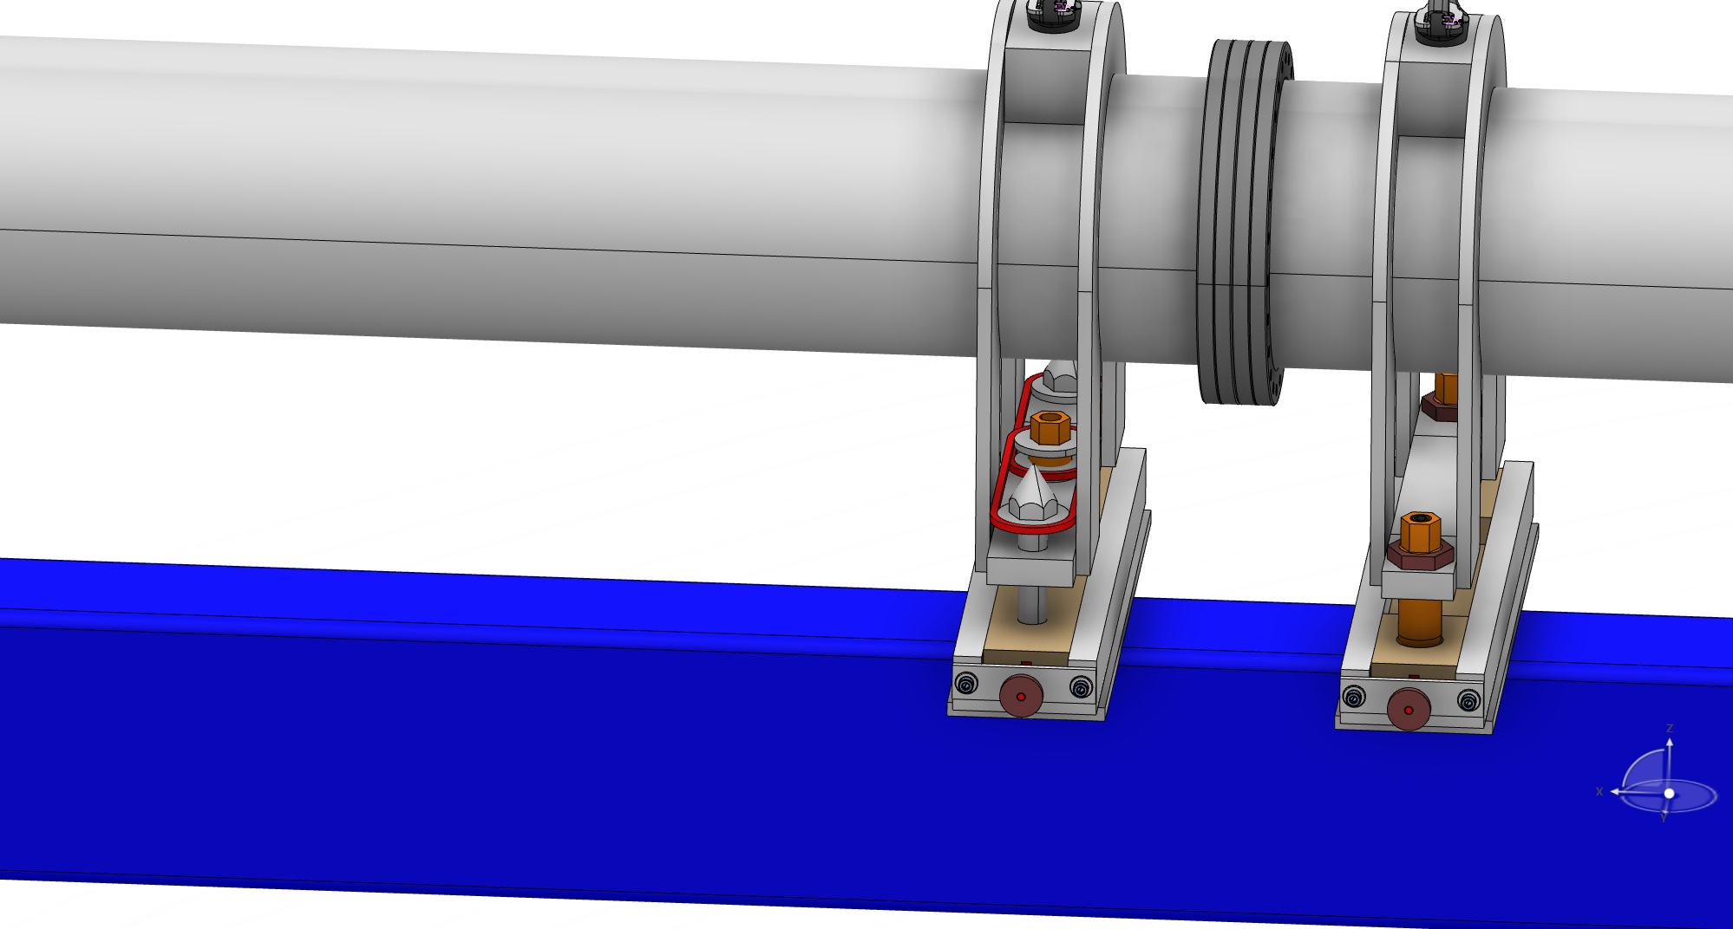
Concepts
Three point kinematic mount
Secured by two bolts (one in each end)
Extraction
Guide rods or rollers required
Re-alignment
Screw transferring force to “hidden” alignment point. Other two points are visiable.
Notes:
Activities restricted to
Extraction (RH-I and RH-II)
Reinstallation (RH-I)
Inspection and/or realignment of component/module (if required)
Complex RH activities shall be avoided.
Reduced design complexity
Reduced construction cost
Reduced tooling cost
No in-situ RH maintenance is foreseen.
Modules/components stored on site during cool down.
Exchange of a module for a spare unit will be the quickest method to repair (hot-swap).

Slide 5
Discussion
Other concepts?
Ways forward?
General common concept
Instrument specific
Transfer requirements to suppliers and let them handle it
Notes:
Activities restricted to
Extraction (RH-I and RH-II)
Reinstallation (RH-I)
Inspection and/or realignment of component/module (if required)
Complex RH activities shall be avoided.
Reduced design complexity
Reduced construction cost
Reduced tooling cost
No in-situ RH maintenance is foreseen.
Modules/components stored on site during cool down.
Exchange of a module for a spare unit will be the quickest method to repair (hot-swap).

