Slide 1
Remote handling at the
Reactor Orphée
CEA - Saclay
Sergey KLIMKO
Project lead engineer
Frederic Legendre
Instrument technician
RH-1, November, 2017

Slide 2
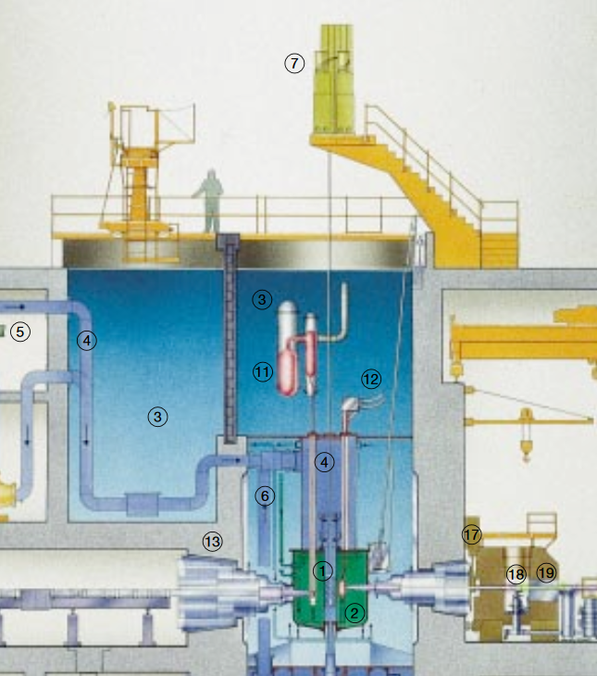
Orphee is a swimming pool type reactor
with a thermal power of 14 MW and a
neutron flux of 3.10¹⁴ neutrons cm⁻²s⁻¹.

Slide 3
Remote handling tools are made for manipulation (extraction, inserting, hold) in the swimming pool and with reactor pars.

Slide 4
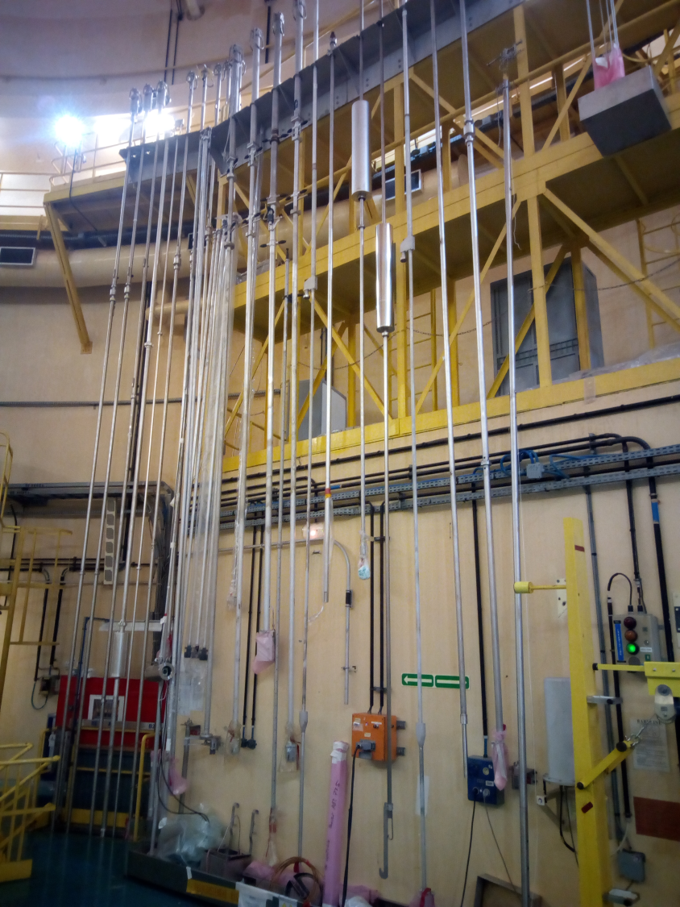
Each tool is unique, only one manipulation can be done.
New part or new manipulation requires new tool.
All tools are developed at Orphee.
The crane should be used to hold them during manipulation – tools are heavy and long.

Slide 5
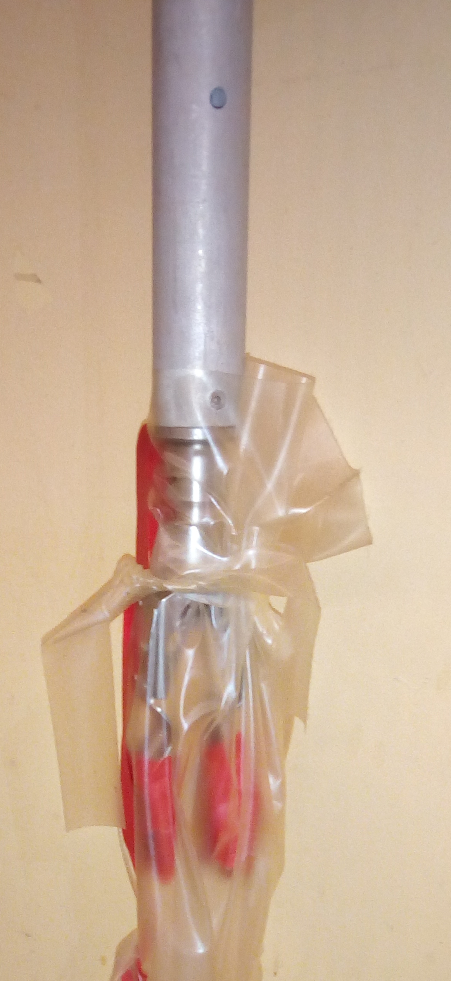
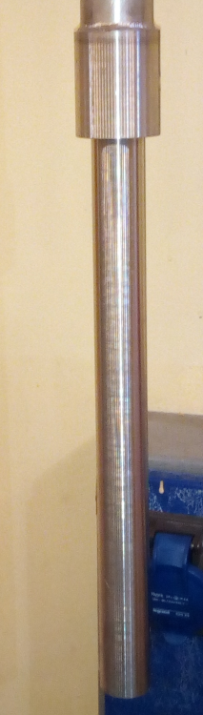
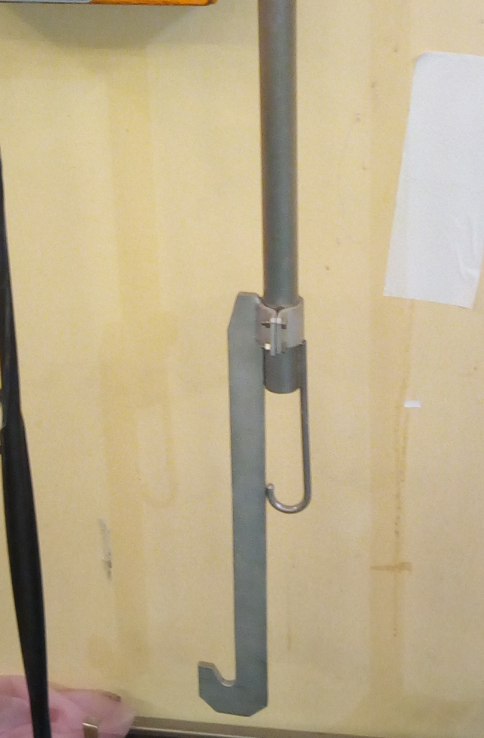
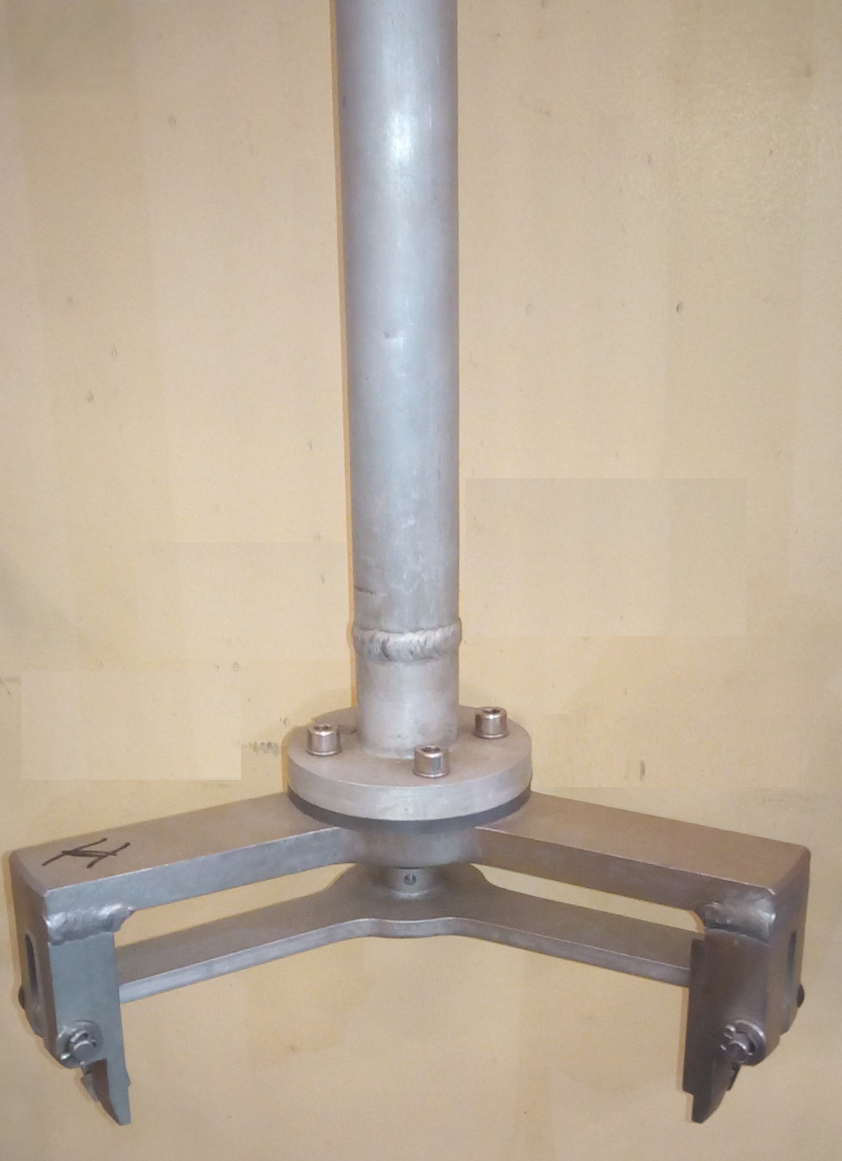
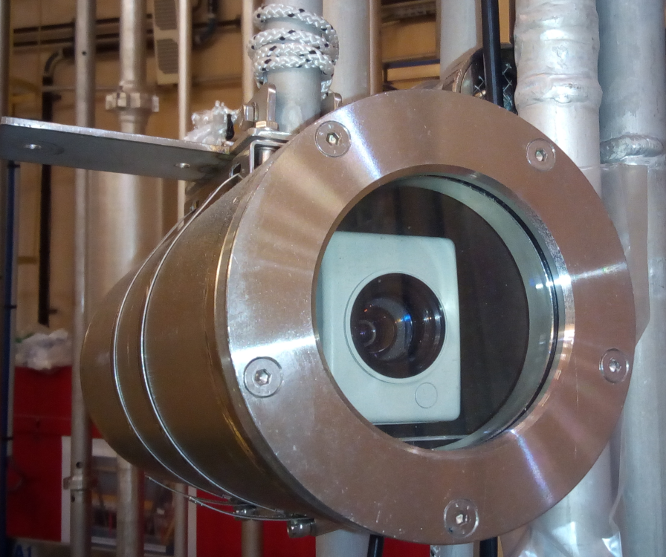
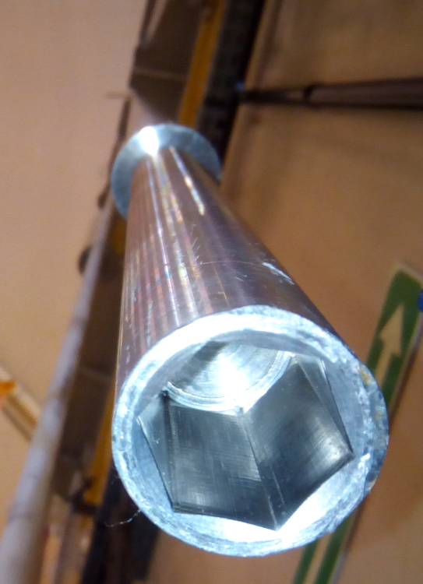
Pliers
Each tool is unique
Only one manipulation can be done.
Hooks
Special tool
Video camera
Socket wrench

Slide 6
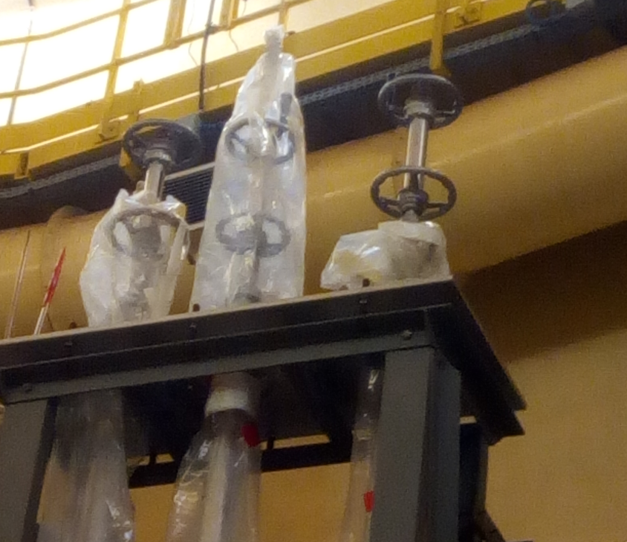
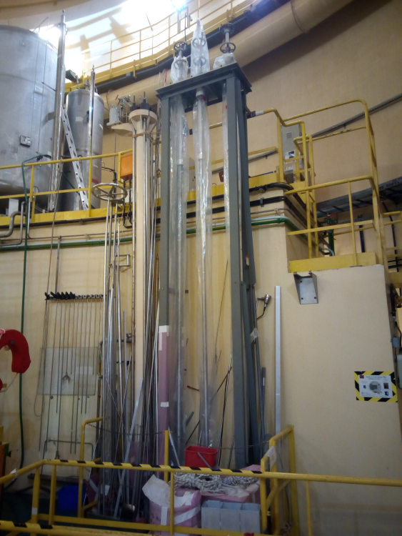
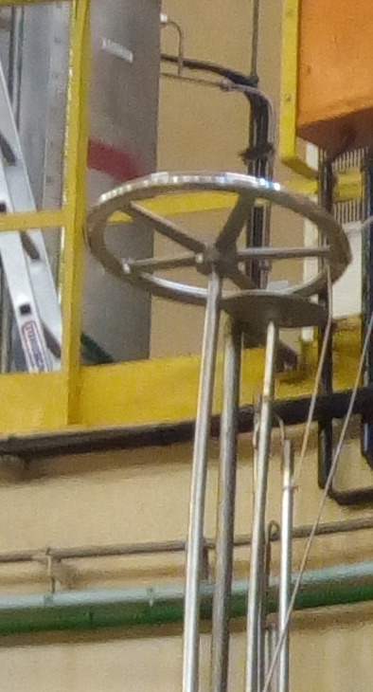
Some remote movements are previewed with handles

Slide 7

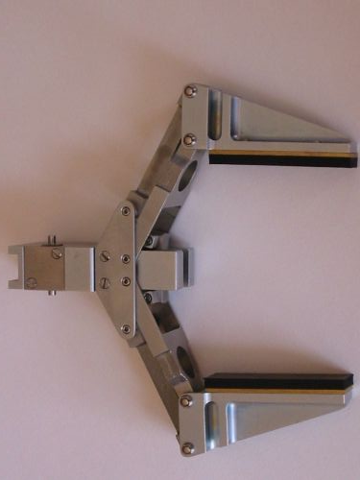
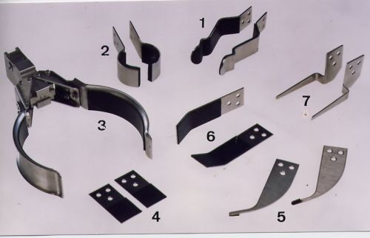
Industrial development
Remote handling pliers
Different clamps with interchangeable head
90 degree bevel gear
extendable
Notes:
Remote handling pliers

