Slide 1
Remote Handling Cabling and routing
Erik Nilsson
Mechanical Engineer
ESS Chopper Group
www.europeanspallationsource.se
20 November, 2017

Slide 2
Bunker overview
Notes:
Activities restricted to
Extraction (RH-I and RH-II)
Reinstallation (RH-I)
Inspection and/or realignment of component/module (if required)
Complex RH activities shall be avoided.
Reduced design complexity
Reduced construction cost
Reduced tooling cost
No in-situ RH maintenance is foreseen.
Modules/components stored on site during cool down.
Exchange of a module for a spare unit will be the quickest method to repair (hot-swap).

Slide 3
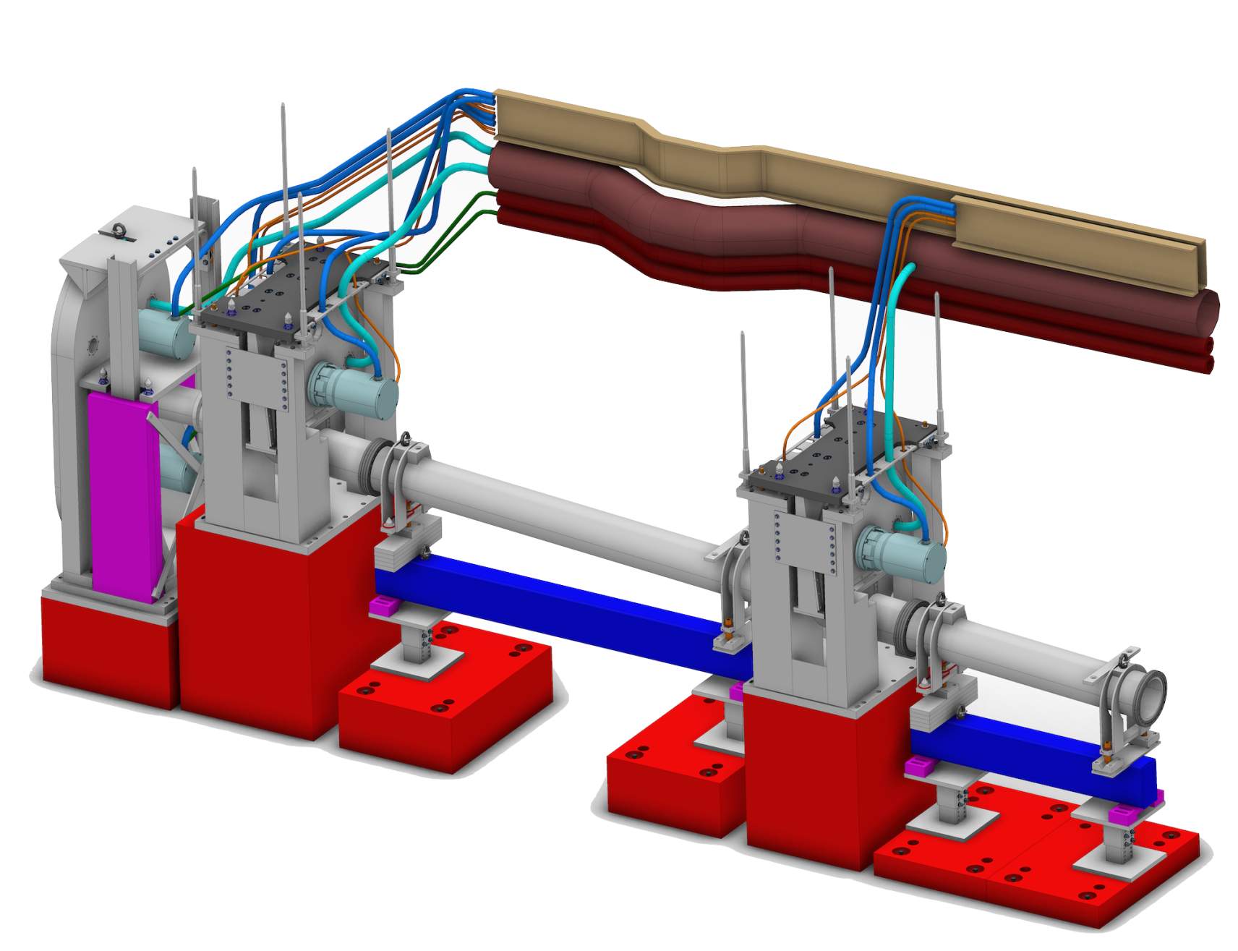
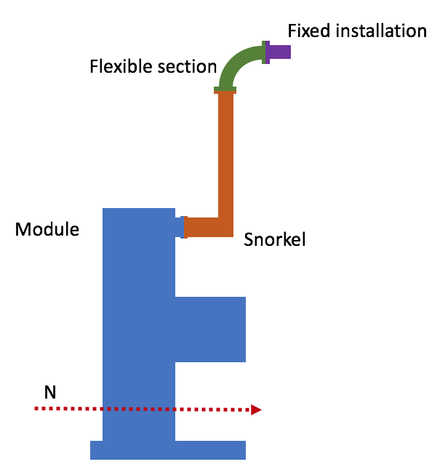
Routing principle
Fixed bulkhead connectors
Fixed installation
Flexible section
Snorkel (not shown)
Notes:
Activities restricted to
Extraction (RH-I and RH-II)
Reinstallation (RH-I)
Inspection and/or realignment of component/module (if required)
Complex RH activities shall be avoided.
Reduced design complexity
Reduced construction cost
Reduced tooling cost
No in-situ RH maintenance is foreseen.
Modules/components stored on site during cool down.
Exchange of a module for a spare unit will be the quickest method to repair (hot-swap).

Slide 4
Basic concepts
Electrical and fluid interfaces for a module shall be concentrated at one point with easy access (maximum 200mm below shielding).
Connections on the module should not be required to be disconnected for maintenance purposes before the module is extracted.
Routed to avoid access limitations to remote handling interfaces and extraction/re-installation of modules.
Flexible cables and utilities should be attached to snorkel or crane during extraction to avoid damage.
Grounding?
Notes:
Activities restricted to
Extraction (RH-I and RH-II)
Reinstallation (RH-I)
Inspection and/or realignment of component/module (if required)
Complex RH activities shall be avoided.
Reduced design complexity
Reduced construction cost
Reduced tooling cost
No in-situ RH maintenance is foreseen.
Modules/components stored on site during cool down.
Exchange of a module for a spare unit will be the quickest method to repair (hot-swap).

Slide 5
Snorkel concept
Possible to create uniform design/concept?
Same for all utilities?
Design?
Material?
Notes:
Activities restricted to
Extraction (RH-I and RH-II)
Reinstallation (RH-I)
Inspection and/or realignment of component/module (if required)
Complex RH activities shall be avoided.
Reduced design complexity
Reduced construction cost
Reduced tooling cost
No in-situ RH maintenance is foreseen.
Modules/components stored on site during cool down.
Exchange of a module for a spare unit will be the quickest method to repair (hot-swap).

