Slide 1
General Overview of WP 12
ESS Vacuum System
Ferreira, Marcelo J.
Vacuum System Section Leader
www.europeanspallationsource.se
17-11-28

Slide 2
Outline
Introduction to ESS Vacuum System,
LWU interfaces,
STFC/Daresbury collaboration timeline,
LWU baseline documents,
Status of the LWU requirements,
LWU Milestones,

Slide 3
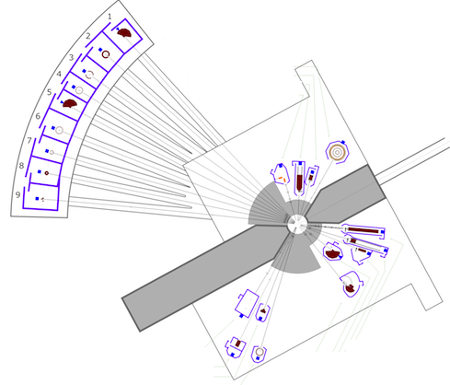
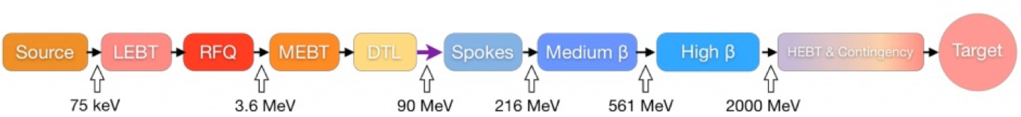
Introduction
Target tank diameter 6 m x 9m
Warm LINAC
Cold LINAC
Accelerator ≈ 600 m
Neutron Instruments
Neutron Instruments ≈ 90 m/each
Total = 22 x 90 ≈ 2000 m
The ESS organization charges the ESS Vacuum Group (VG) with the responsibility for all ESS vacuum systems including not only the Accelerator, but also Instruments and Neutron Beam Lines and the Target.
The main task of the ESS VG is to support the in kind contributions on the vacuum system and the integrated vacuum design of the ESS complex.
3

Slide 4
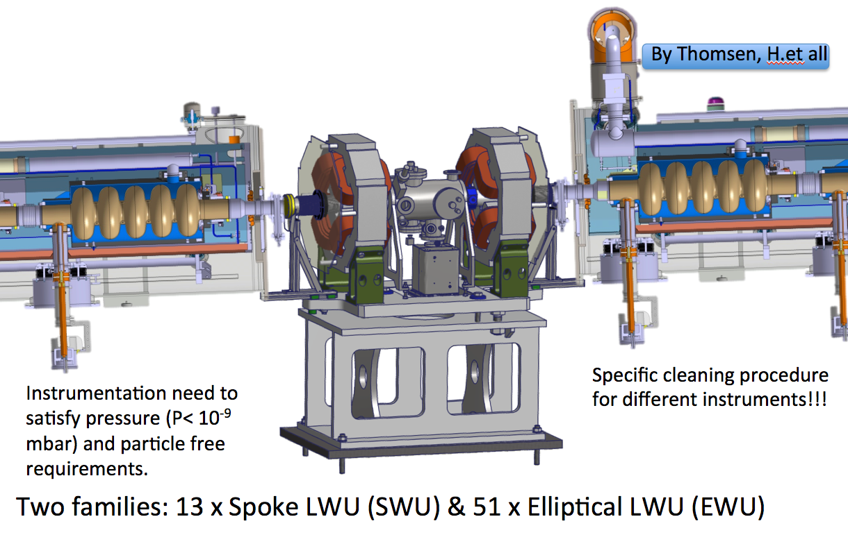
LINAC Warm Units for the cold LINAC
Cold LINAC
Elliptical LWU
x7 models (including HEDP and x3 HEBT LWU+Dummy CM)
Total 43 units
Ultra High Vacuum cleanliness
Particle free
Spoke LWU
x6 models (including LEDP)
Total 13 units
Ultra High Vacuum cleanliness
Particle free
LINAC Warm Units are in between cryomodules and contain quadruples, vacuum instrumentation (gauges, pumps and valves) and beam instrumentation.

Slide 5
Vacuum Requirements: “warm/cold” LINAC
Low & High Energy Differential Pumping (LEDP & HEDP)
LEDP is located between the last DTL tank and first spoke cavity: particle free required and a differential pumping of 1:100
The HEDP is located between the last cryomodule and start of the High Energy Beam Transport (HEBT) and has similar features to the LEDP.

Slide 6
ESS – STFC/Daresbury collaboration time line
April 2014 First meeting to ask STFC/Daresbury to participate as ESS Vacuum in kind for WP 12.
Jul 2014 STFC/Daresbury accepted to delivery full packed for all WP 12.
Aug 2014 First discussions on the test facilities specifications, ESS accepted ASTeC Vacuum documents,
Oct 2014 Visit of STFC/Daresbury to ESS/Lund to discuss in detail the scope of work: test facilities, LWUs, clean rooms, and training for particle free.
Sep 2014 Agreement to delivery the ESS Vacuum Facilities and clean room on summer 2015,
Dec 2014 Test Facility and clean room specifications agreed,
Mar 2015 Initial discussions on delivery schedule and technical specification for the LWUs cold LINAC. Clean room specifications finished,
May 2015 Acceptance meeting at STFC/Daresbury for the test facilities,
Jul 2015 Test facilities delivery at ESS/Lund, acceptance test approved,
Sep 2015 First discussions about DOORS requirements,

Slide 7
ESS – STFC/Daresbury collaboration time line
Oct 2015 PDR LWUs cold LINAC,
Nov 2015 Draft version of TA in revision,
Feb 2016 Agreed CDR for LWUs Jun/16,
Mar 2016 Delivery schedule and technical specifications for the detail design of LWUs cold LINAC,
May 2016 DOORS requirements agreed,
Jun 2016 CDR for LWUs at STFC/Daresbury,
Jul 2016 Delivery LWUs technical specifications for DogLeg, A2T and Dump,
Aug 2016 LWU elliptical delivery to ESS/Lund,
Aug 2016 Jun 2019 Initiated milestone feedback for LWUs,
Nov 2016 Agreed to do the CDR for LWUs DogLeg, A2T and Dump, after CDR for
the electromagnets.

Slide 8
LWU baseline documents
From ESS:
ESS main time schedule,
DOORS requirements (top-down and interfaces),
ESS Vacuum Handbook – ESS 0012894, 0012895, 0012896, 0012897,
Technical detail spreadsheet,
From STFC/Darebury and ESS
Technical Annex,
3D drawings,
From STFC/Daresbury:
Vacuum standards (ASTeC Vacuum documents equivalent to ESS Vacuum Handbook),
Clean room documentations,

Slide 9
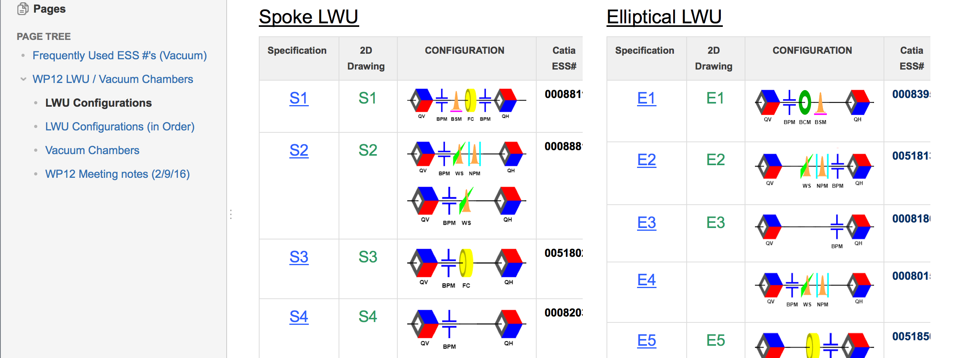
LWU baseline documents
- Non formal documents:
Wiki page
Skype meeting (almost once a week!),
Emails,

Slide 10

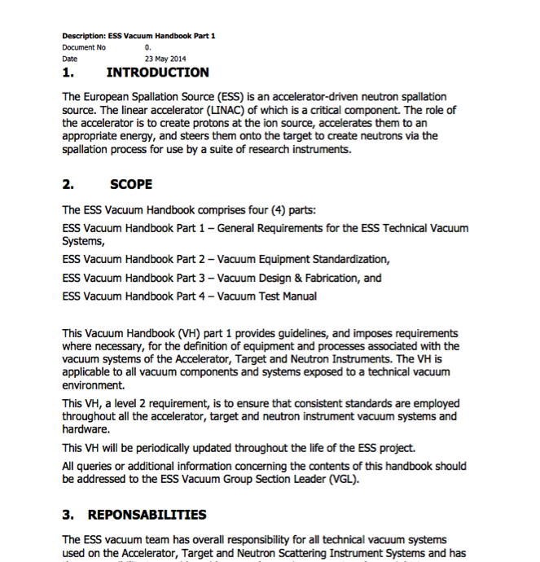
Vacuum Standardization, an Integrated Approach
Working closely with our partners across the project one of our primary goals was to promote the use of common vacuum equipment and standards. As a result a Vacuum Standardization meeting was held in February 2014 where equipment suitable for Standardization was agreed and reflected in the ESS Vacuum Handbook.
An important element of this Standardization is the Procurement Policy applied for the procurement of all “major” vacuum equipment. The primary objective of the program is to develop a list of standard vacuum equipment for use project wide to minimize project costs, reduce spares holdings, training and achieve other benefits of standardization.
STFC will join the ESS Vacuum Frame-Work Agreement (FA) procurement following the ESS Vacuum standardization policy
http://europeanspallationsource.se/accelerator-documents

Slide 11
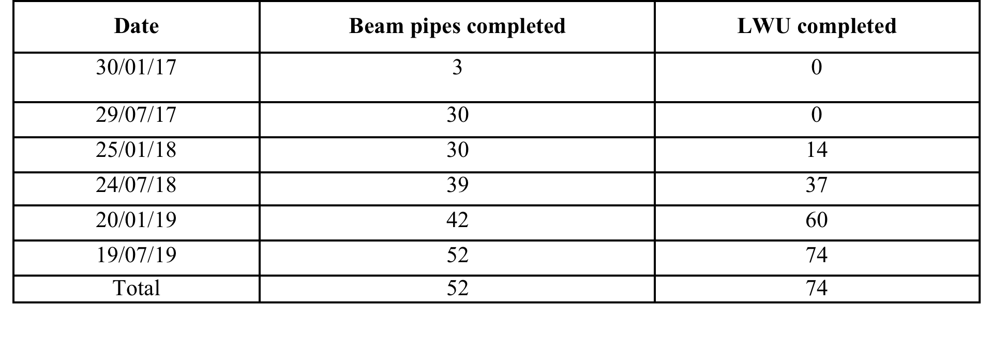
Document status for LWUs
ESS Vacuum Handbook => OK! (following ASTeC documents ) Aug 2014
DOORS => OK! May 2016
Technical Specifications (LWU cold LINAC) => OK! Mar 2016
ESS main time schedule => OK! May 2016
TA in kind from STFC/Daresbury => May 2016
LWU delivery follow Quadrupoles scheduling from TRIESTE
Key Milestones

Slide 12
Schedule
LWUs scheduling:
-updated in conjunction with DESY (BPMs) and TRIESTE (magnets).

Slide 13


Thank you!
Tack!

