Slide 1
Procedures for the Particle Free Installation and in-Tunnel Maintenance of LWU’s
Fabio Ravelli
Vacuum System Engineer
www.europeanspallationsource.se
29 November, 2017

Slide 2
Outline
Cold LINAC description
LWU, LEDP and HEPD description
Installation Schedule per Cold Linac Sections
Installation of LWU with Insert-able Beam Instrumentation
Preparation of the cryomodules to the LWU installation
LWU installation sequence
Mobile Clean Room Design
In-tunnel maintenance
Staffing, training

Slide 3
The ESS Cold LINAC
Cold & Particle free Linac
The cold Linac accelerates the proton beam from 90MeV to 2GeV and makes use of:
13 Spoke Cryomodules (spoke two-cell cavities hosted in couples, 352.21MHz, β=0.5)
9 Medium-β Elliptical Cryomodules (elliptical six-cell cavities grouped in 4, 704.42MHz, β=0.67)
21 High-β Elliptical Cryomodules (elliptical five-cell cavities grouped in 4, 704.42MHz, β=0.86)
2 differential pumping sections (LEDP and HEDP) that are the boundaries to the warm Linac and the Beam Delivery Systems, with a fast valve, capable of sustaining an inlet to outlet pressure ratio of 100:1
43 PF LWU’s (12 Spoke + 9 MBeta + 21 HBeta + 1 HEBT) to provide vacuum continuity between CM’s, they host various vacuum pump and gauges, beam diagnostics, quadrupoles and correctors
LWU’s comes in many ”styles”: 6 spoke, 7 elliptical

Slide 4
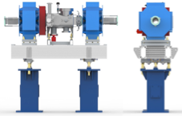
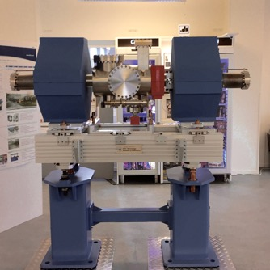
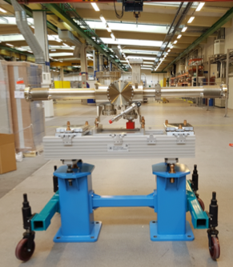
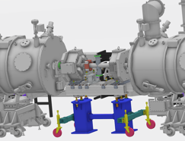
LWU lay out
Designed, manufactured and processed for UHV and PF operations
The unit is equipped with DN63 or DN100 edge welded bellows with 100mm stroke to make up room for the installation between two cryomodules
Vacuum requirement: A base vacuum of ~5x10⁻⁸ mbar at the 10 hour point shall be achieved with the bellows constrained and the end flanges blanked
Particle requirement: To be cleaned and particle counted to ISO class 5, assembled in at rest ISO 5 Cleanroom
The pump is the NEG+SIP combo Saes NEXTorr HV300 (ND) with ZAO getter alloy
With a deviation from the WP12 SRFC TA, these pumps will be conditioned to ISO 5 CR level prior installation per STFC procedure (Change Request)
Equipped with one cold cathode, pirani, burst disc @ 1.2bar, valve for pumping cart connection

Slide 5
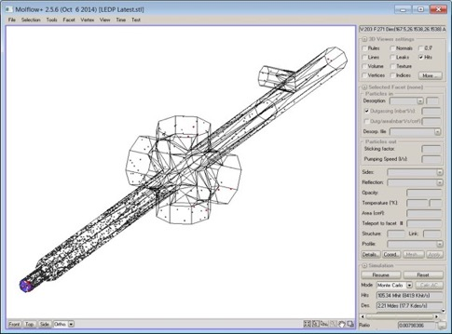
LEDP
LEDP, approximately 2m long
CM side
DN63 pump flange
1 DN160 for a Beam Stopper
Low Pressure
Region, DN63
3 DN160 for
NEG+SIP pumps
High Pressure Region, DN40
Requirement of the differential pumping sections: HPR pressure / LPR pressure = 100
LEDP is a particle free unit
Molflow+ simulations have shown that approximately 2000 l/s (N2) are required
This unit is equipped with:
  Three Saes Getter NEXTorr D 1000-10 (ND) with St172 getter alloy, probably in ZAO at instal time
  One Saes NEXTorr HV300 (ND) / NEXTorr HV200 (ND) with ZAO getter alloy
  Pirani, CC gauge, DN40 angle valve, burst disc @ 1.2 bar
  VAT DN63 fast valve (13ms closing + 20msec electronics) sensor in DTL tank 5, s-p @ 5*10⁻⁷ mbar
  VAT Gate valve on DTL 5 DN40 closes in 1.5s, gate valve in Spoke 010 CM DN63 in 2 s
  VAT Gate valves series 48 relase from 100 – 1000 particle > 0.3 μm per cycle, no information about particle performance of VAT fast valve series 75
On-board insertable beam diagnostic: Bunch Shape Monitor, Beam Stopper

Slide 6
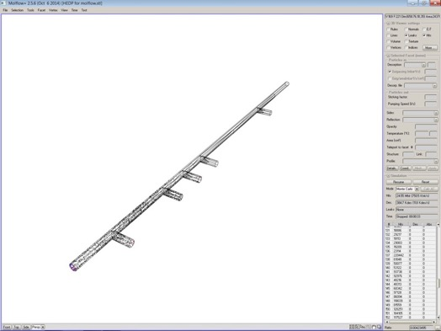
HEDP
HEDP, approximately 6m long
High Pressure Region, DN100
CM side
5 DN100 pump flanges
Low Pressure Region, DN100
The HEDP is not particle counted
Molflow+ simulations has shown that for this ratio approximately 600 l/s (N2) are required
This unit is equipped with:
  Three NEXTorr HV300 (ND) with ZAO getter alloy
  Pirani, CC gauge, DN40 angle valve, burst disc @ 1.2 bar
  VAT DN100 fast flap valve (15ms closing + 20msec electronics), sensor in HEBT section 20m apart, set point @ 1*10⁻⁶ mbar
  2 VAT Gate valves DN100, 4s closing time
  VAT Gate valve series 48 relases from 100 – 1000 particle > 0.3 μm per cycle, no information about particle performance of VAT fast valve series 75
No Quads nor Beam Diagnostics on board

Slide 7
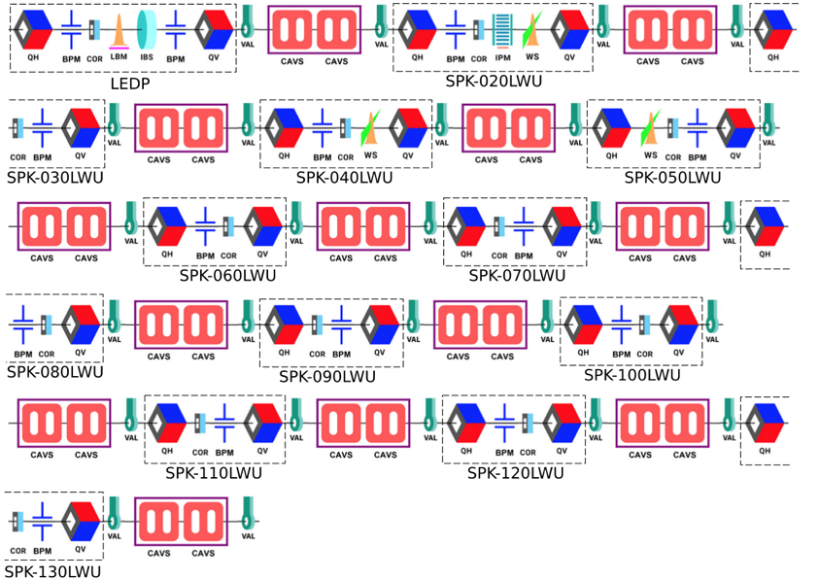
Spoke LWU Installation Schedule
Synoptic layout pictures
courtesy of Thomas “Tommaso” Grandsaert II
General rule is to install LWU’s after CM’s
All installation dates from Ciprian Plostinar, Machine Directorate all-hands meeting presentation
12 SPK LWU’s from 24 Feb – 1 May 2020, each 5.5 days, insufficient for sequential, need to plan for parallel install
LEDP (aka SPK-010LWU) 13 Jul – 7 Aug 2020, 25 days, some buffer here

Slide 8
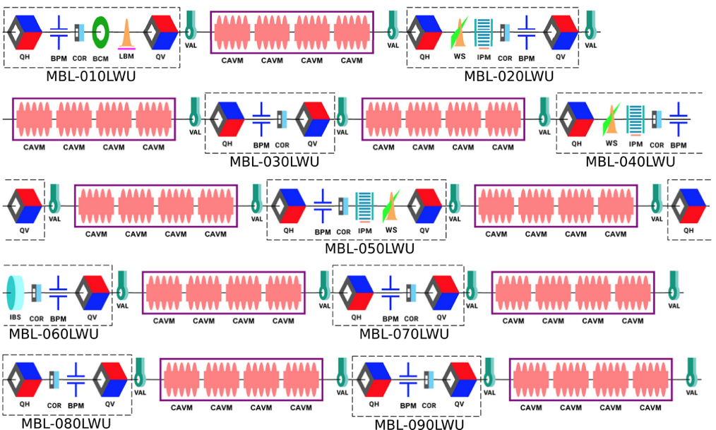
MBeta LWU Installation Schedule
9 MBL LWU’s from 20 Apr – 12 Jun 2020, each 5.9 days, insufficient for sequential, need to plan for parallel install

Slide 9
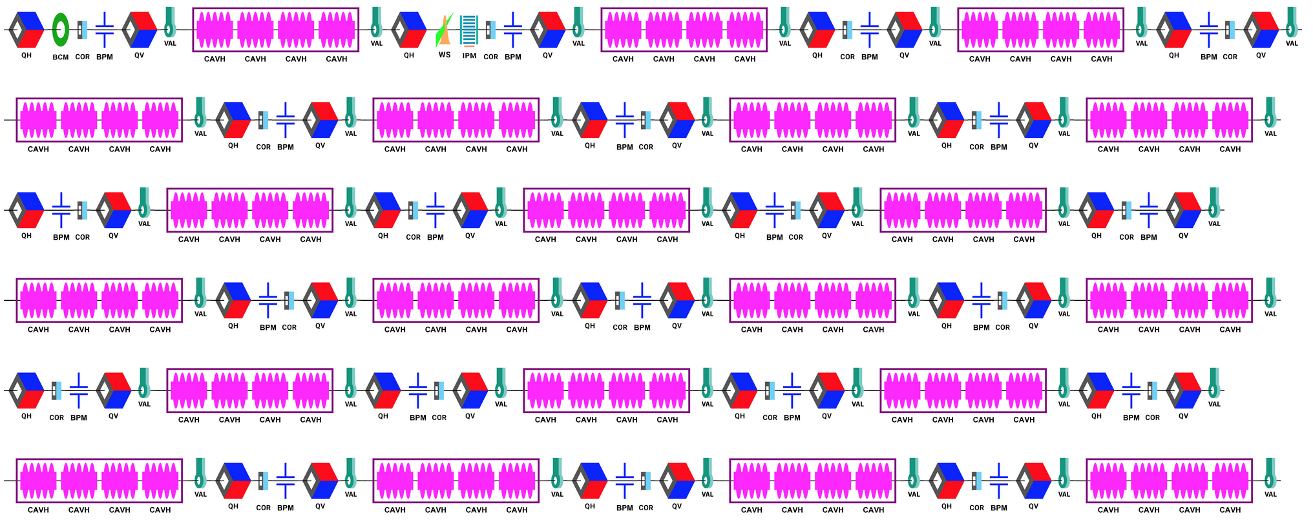
HBeta Section Design
The design of the accelerator calls for 21 HBETA CM’s, however for budget management reason it has been decided to install only the first two by 2021

Slide 10
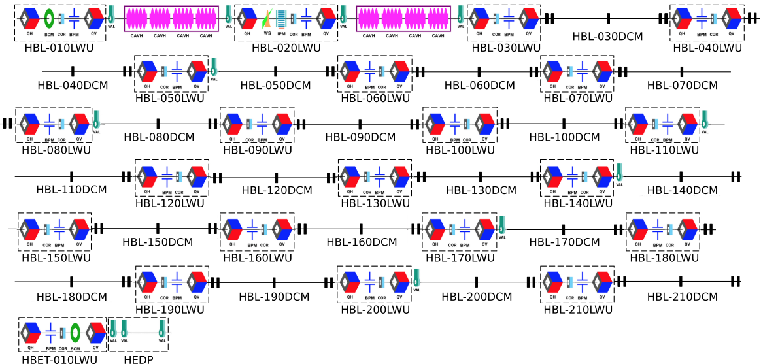
HBeta CM Lay out till 2021
The HBeta section will have 2 CM’s, 19 Dummy CM’s (particle free spool pieces) and 21 LWU’s
One additional LWU (PF) in HEBT needs to be considered as well as the HEDP (non PF)
The rest of HEBT, A2T and DMPL are not PF
Vacuum sectioning with gate valve every 3 LWU’s

Slide 11
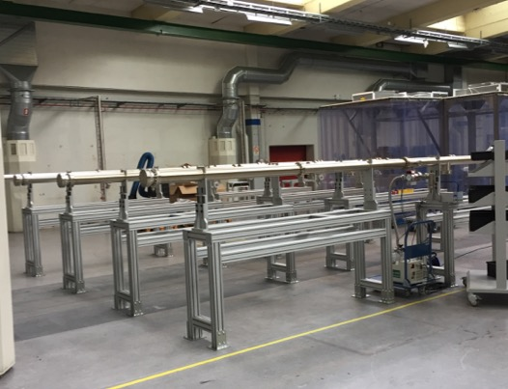
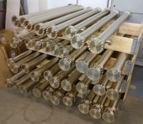
HBeta Section Installation Schedule
All DCM’s are received mid Feb 2018 & mid Aug 2018
Install all DCM’s in Q2-Q4 2018, TBC with Ciprian
LWU HEBT-010LWU & HEDP install in Oct 2018 - Jan 2019, TBC with Ciprian
Same LWU install rule for DCM’s as CM’s, so CM’s first and LWU’s later
HBL-011LWU to HBL-021LWU install in time slot 5 Aug – 18 Oct 2019, 7 days per LWU
HBL-001LWU to HBL-010LWU install in time slot 25 May – 7 Aug 2020, 7 days per LWU

Slide 12
Installation of LWU with Inserted BI
In case the LWU is equipped with inserted BI (e.g. WS, BSM, etc.) the diagnostic will be assembled on the LWU’s in RATS or in a suitable Lab area to minimize installation time in the tunnel
The mobile CR will be used, tall enough for the vertical WS
10 LWU’s are involved
SPOKE (Feb – May 2020 & LEDP Aug 2020)
Bunch Shape M, Beam Stopper
Wire Scanner, IPM
Wire Scanner
Wire Scanner
MBETA (Apr – Jun 2020)
Bunch Shape M
Wire Scanner, IPM
Wire Scanner, IPM
Wire Scanner, IPM
Beam Stopper
HBETA (Maj 2020)
Wire Scanner, IPM

Slide 13
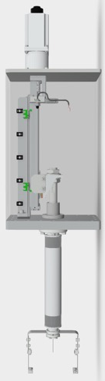
BI to be Delivered by 2019 - early 2020
Bunch Shape Monitor
Ionization Profile Monitor
Wire Scanner
The following BI are required by 2019 - early 2020:
7 Wire Scanner, delivered UHV&PF ready, all WS will be delivered in 2019, the first prototype will be tested for CR ISO 5 condition
2 BSM, delivered not Particle Free in 2019
2 Beam Stopper, under development
5 Ionization Profile Monitor, PDR 2017.01.31, CDR in Q1 2018, delivered by Q3 2019, delivered PF

Slide 14
Cryomodules Prep for LWU’s installation
Spoke
Elliptical
The LWU’s will be installed after the CM installation, they will slide in between 2 CM’s
Due to the CM to LWU clearance during installation, limited by the 100mm stroke of the bellows, the CM’s needs to enter in the tunnel with blank flanges (DN100-63) on the gate valves
Any pumping system or spool piece attached to the gate valves of the CM’s must be disconnected before entering the tunnel
Blank off of the CM’s gate valves needs to be carried out in CR ISO 5 conditions; it can be made in the tunnel but it will imply two install and qualify two times the mobile CR

Slide 15
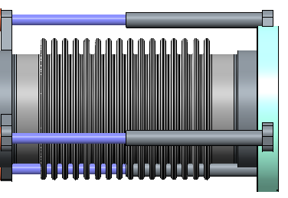
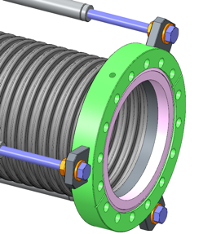
LWU Installation Sequence (1)
All cryomodules are installed and ready to receive the connecting LWU
In Vacuum Lab inside the mobile CR and on a dedicated pedestal set, the LWU is prep for installation:
  Insert-able BI’s are installed
  The LWU is pumped down with the Particle Free Pumping Cart
  Vacuum is checked (Leak detection and RGA check, pump down)
  By acting to the Bellows Retainer, the bellows are slowly fully compressed, to provide 100mm clearance to CM gate valve both sides
Clamping hole to prevent bellows moving through rotatable flange when the retracting the bellows
Courtesy Paul Aden

Slide 16
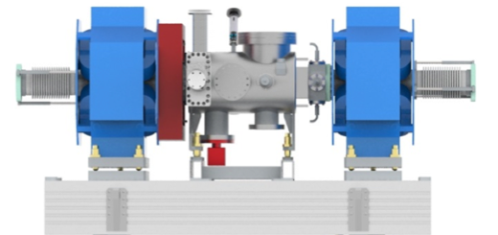
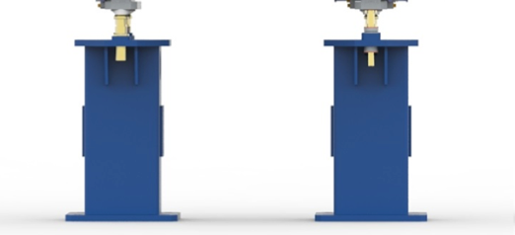
LWU Installation Sequence (2)
The LWU is vented with the PF Pumping Cart
The LWU pedestals are transported to the tunnel, aligned and bolted to the floor in their final positions
The LWU are transported in the tunnel vented, with chamber and quads aligned to the girder
The Girder+LWU+Quad is positioned onto its pedestal
We are currently investigating on a suitable transportation equipment

Slide 17
LWU Installation Sequence (3)
The LWU is pre-aligned by Survey and Alignment
The mobile Clean Room is placed and qualified to ISO 5
The CM’s and LWU are wiped clean
Tools, gaskets, fasteners are cleaned and available in CR
The flanges to be opened (2xDN100 gate valve, 2xDN100 LWU, 1xDN40 HV pumping LWU) are blown clean with ionized N2 and particle checked
The Particle Free pumping cart + Leak Detector is connected
The gate valve flanges are opened and blown clean
The LWU bellows flanges are opened
The bellows retainers are slowly released close to 0 compression/extension

Slide 18
LWU Installation Sequence (4)
The copper gasket is inserted and the LWU-CM vacuum connection is made (2x)
HV pumping through the PF pumping cart is started
Leak detection
Wait to reach “good” pressure (5e-8 mbar)
Open gate valve of the upstream CM and start cooling down procedure (we cool down CM’s one at a time)
At cool down completion, close gate valve
Wait for 1e-8 mbar and activate the NEG
At activation completion, start ion pump
Close HV pumping LWU valve
Vent Leak detector, vent pumping cart and disconnect it
Open gate valve to CM
Remove CR

Slide 19
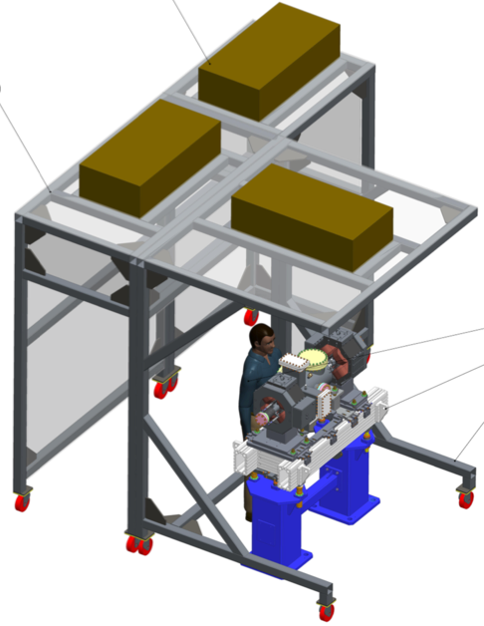
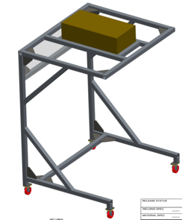
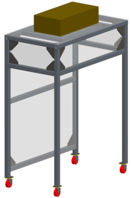
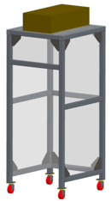
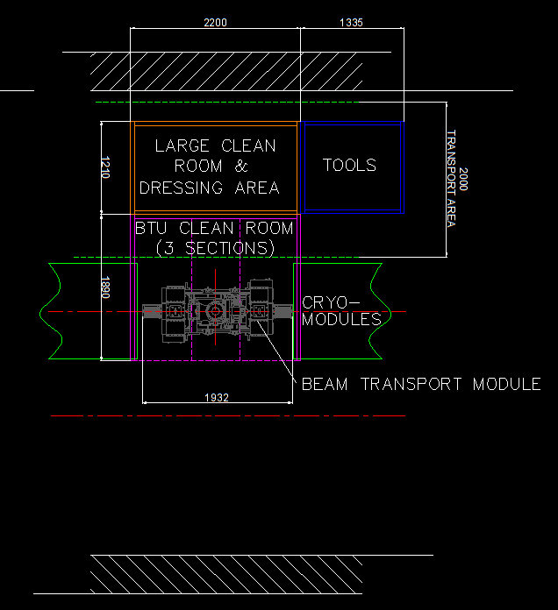
Mobile Clean Room
HEPA Filters
The Mobile Clean Room has a modular design and it consists in three section, each dedicated to a function:
A Working Section that fits over the LWU encompassing the 2 cyromodule connections – ISO 5 or better
An attached Gawing/Dressing module – ISO 6-7 or better
An attached Storage module – ISO 5 or better
STFC will supply 3 CR and one prototype already received
Will be equipped with particle counter and cleaning station
Soft-walls not showed
Storage Section
Working Section
Gawing Section

Slide 20
Mobile Clean Room Prototype
The prototype was delivered in May 2017, it can be extended in height.
We realized it was to big and we wanted to have also small clean room environment to operate on a single flange as well.

Slide 21
New Mobile Clean Room Lay Out
Lateral View, mm
Top View, mm
250
1700
2300
1000
1700
2500
The height has been reduced to avoid possible collision with items installed on top of the LWU (e.g. RF reference line)
The width of the Gawing and Stock Modules has been reduced to allow for the passage of personnel around the CR
The Working Area is provided with 2 filters, placed closer to the CM’s flanges
The Stock Area has also a cantilever design, it can be attached to the Gawing area to replace the large Working Section CR and it can be used for single flange operation (it can host only one technician)

Slide 22
Maintenance in Tunnel
Tall CR for maintenance of wire scanners, BSM
General maintenance will require some capability of repairing and cleaning bigger components for particle free operation
It is likely we will need to develop bespoke CR mobile environment for interventions on particular components
4 PF pumping carts will be built and available in 2018

Slide 23
Staffing
3 Vacuum technicians will be recruited in 2018
Total of 6 technicians in 2018, possible to work 2 per CR in tunnel
Technicians and Engineers will be trained in CR etiquette and LWU particle free handling and processing at Daresbury Lab
The In Kind Contribution Agreement foresees 8 wildcards, up to 4 weeks for teams of 2-4
The Technicians will have the necessary work permit per ESS Safety Program (e.g. fork use)

Slide 24

How About Particles Entering in the Cold Linac????

Slide 25
Thank You!
Q&A

Slide 26
Back up slide, ISO CR class

Slide 27
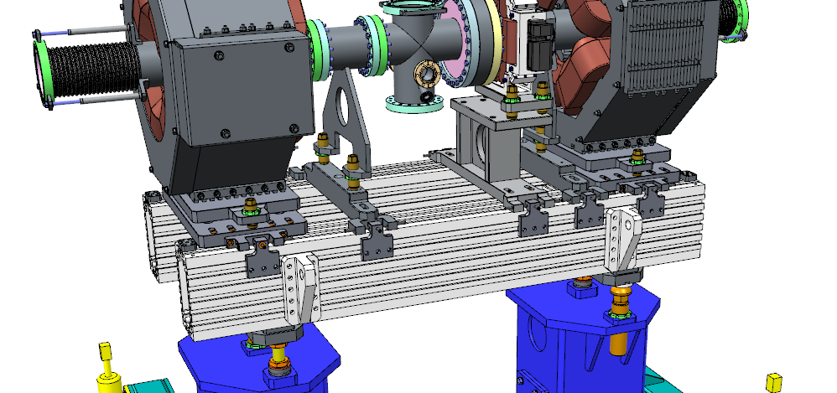
Lifting Point Positions, Paul Aden courtesy
Adjustable to CoG

Slide 28
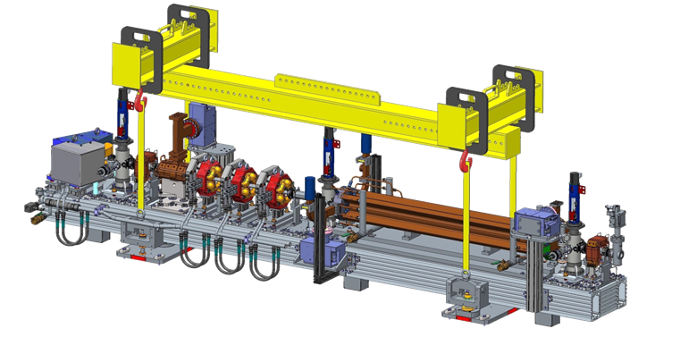
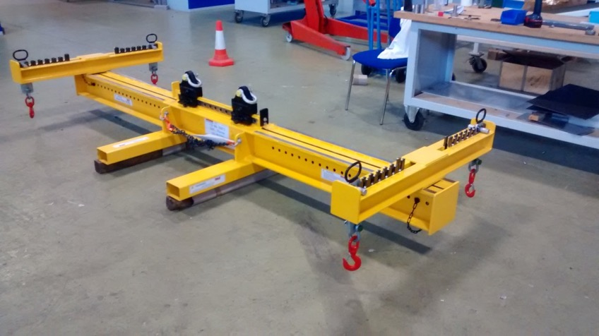
Adjustable Lifting Frame , Paul Aden courtesy

Slide 29
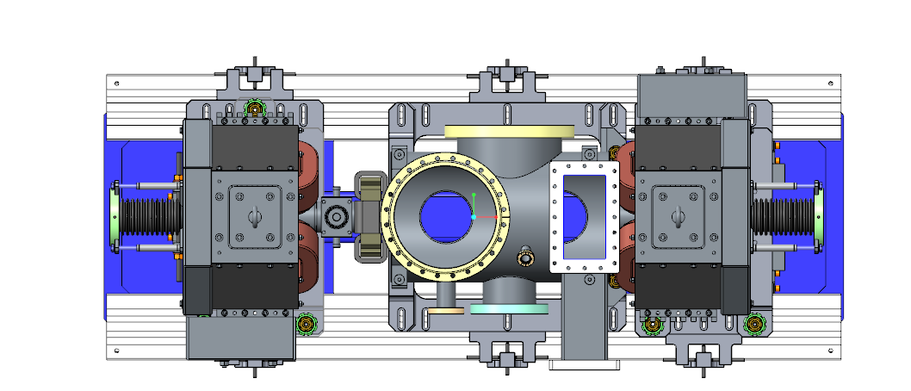
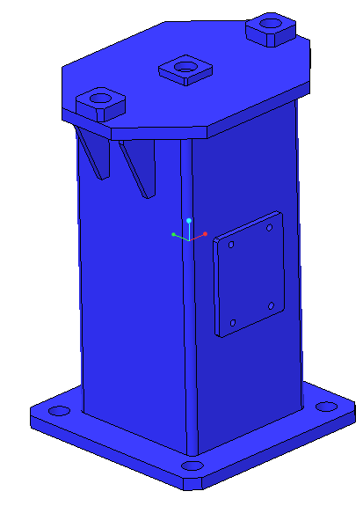
Survey & Alignment, Paul Aden courtesy
4 x 6H7 Fiducial Mounting points at each corner of the girder.
4 x 6H7 Fiducial mounting points at each corner of the pedestal.

Slide 30
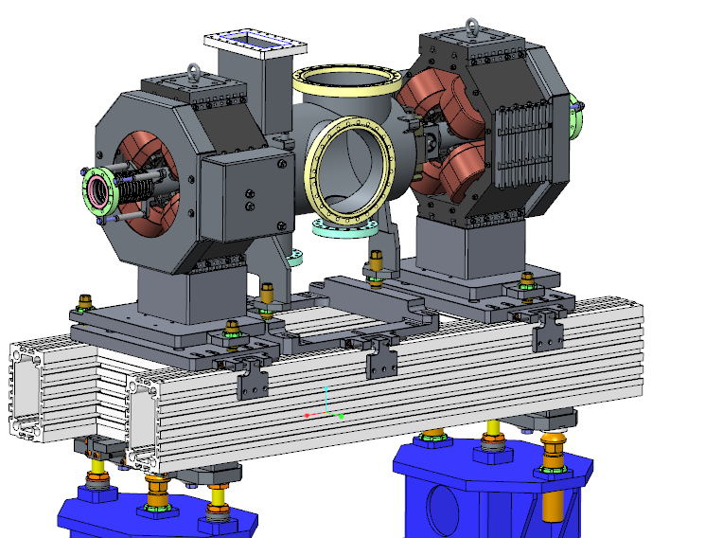
Adjustment, Paul Aden courtesy
Individual item adjustment on three point kinematic mounts

Slide 31
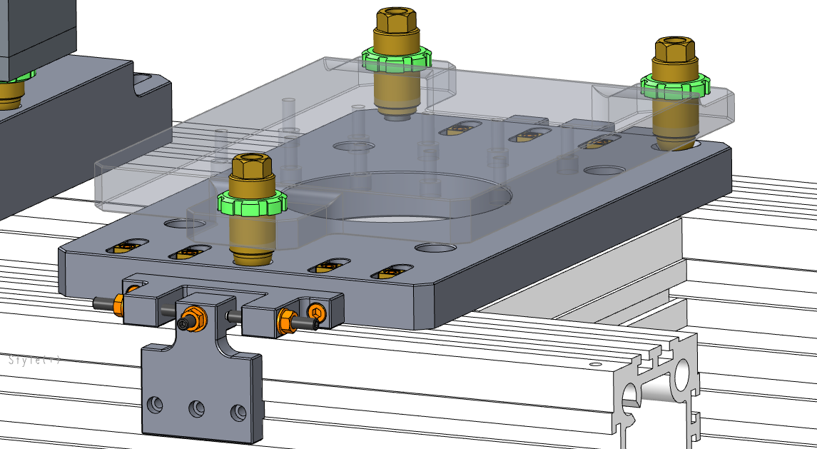
Adjuster & Supports, Paul Aden courtesy

Slide 32
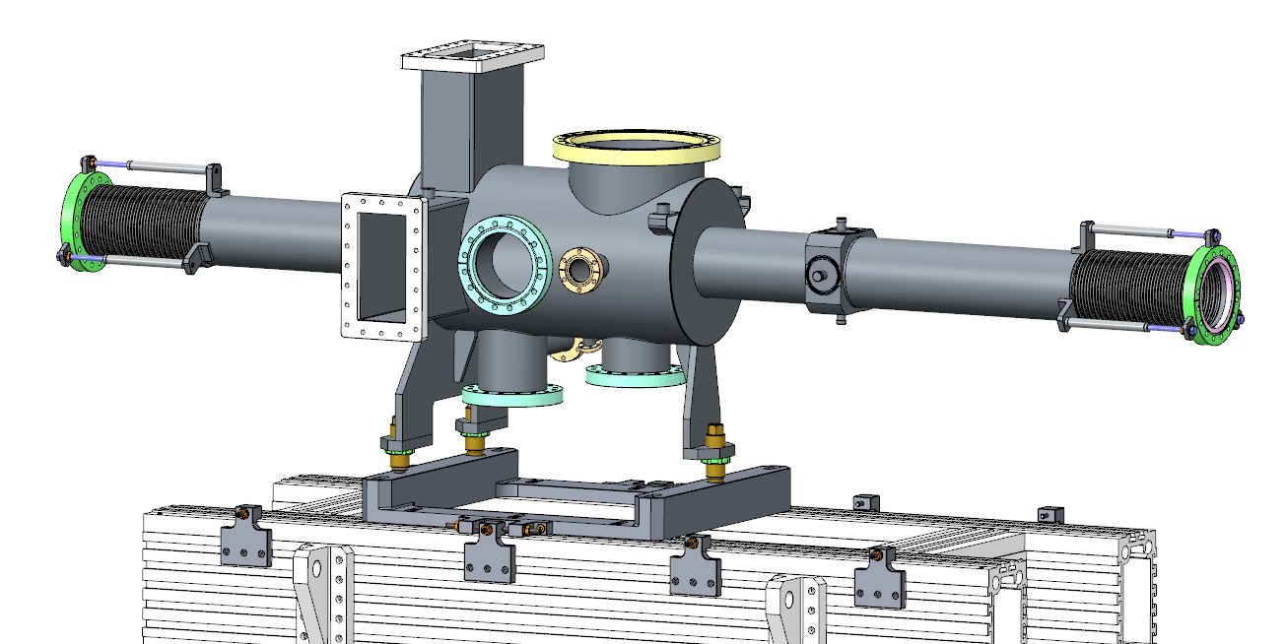
Chamber Adjusters, Paul Aden courtesy

Slide 33
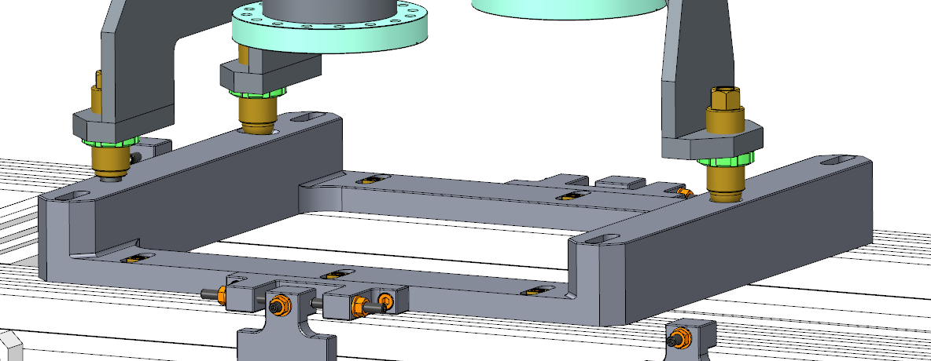
Chamber Adjusters, Paul Aden courtesy

