Slide 1
The Life of a Beam Transport Module for the ESS Project
Keith Middleman
STFC Daresbury Laboratory
ESS Particle Control CDR, Lund, 29th November 2017

Slide 2
Overview
Daresbury Vacuum Overview:
  Large scale facility designs and experience
  ISO9001
  Cleaning
  Baking
  Vacuum acceptance
  Cleanroom
  Particle control
  Controlled venting and evacuation
Notes:
Well defined UHV specs

Slide 3
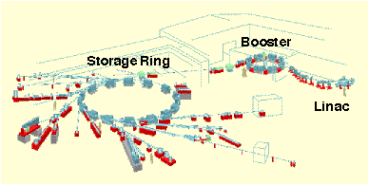
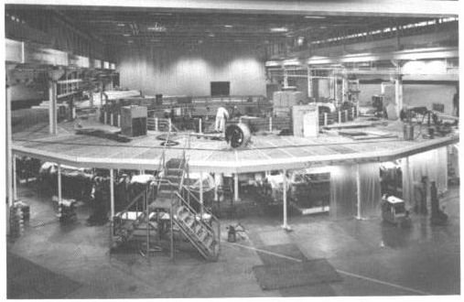
Synchrotron Radiation Source (SRS)
Ultra High
Vacuum Guide
CLRC Daresbury Laboratory
Synchrotron Radiation Department
Vacuum Support Group.
A compendium of Proceedures and Specifications
<Issue 3>
©CLRC Daresbury Laboratory,1996

Slide 4
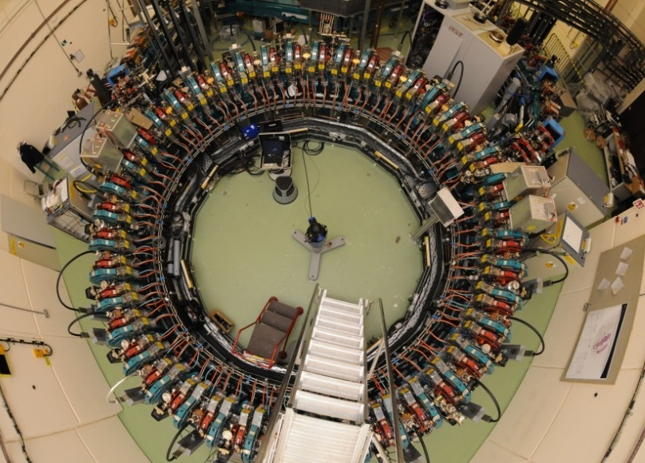
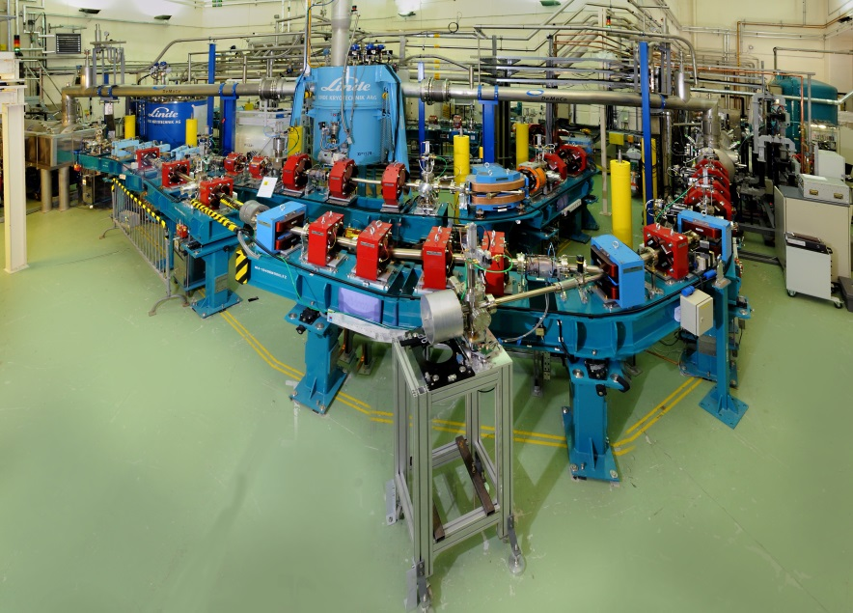
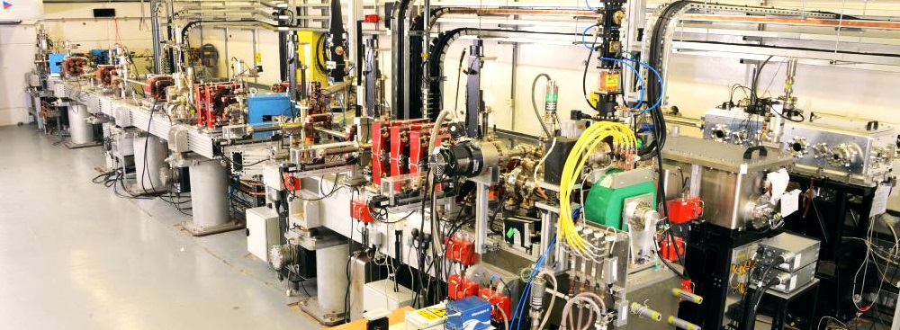
3 Onsite Accelerators
EMMA
ALICE
VELA

Slide 5
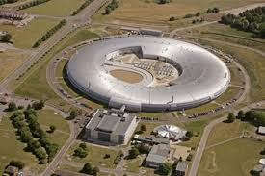
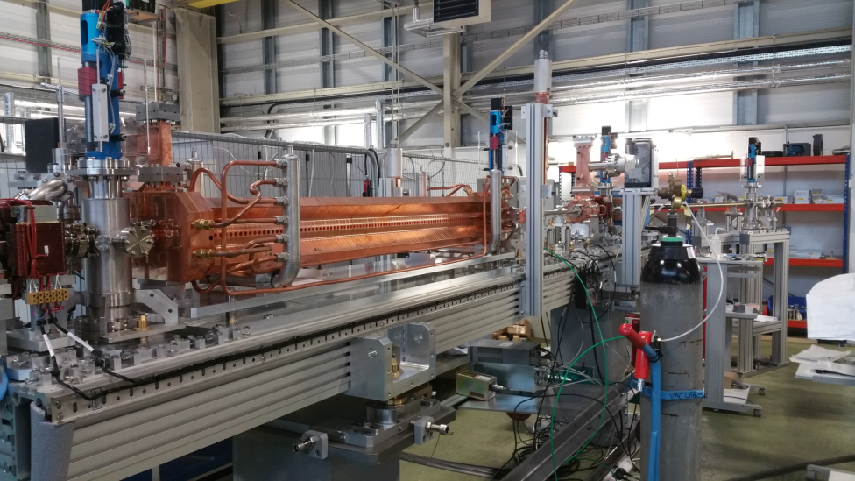
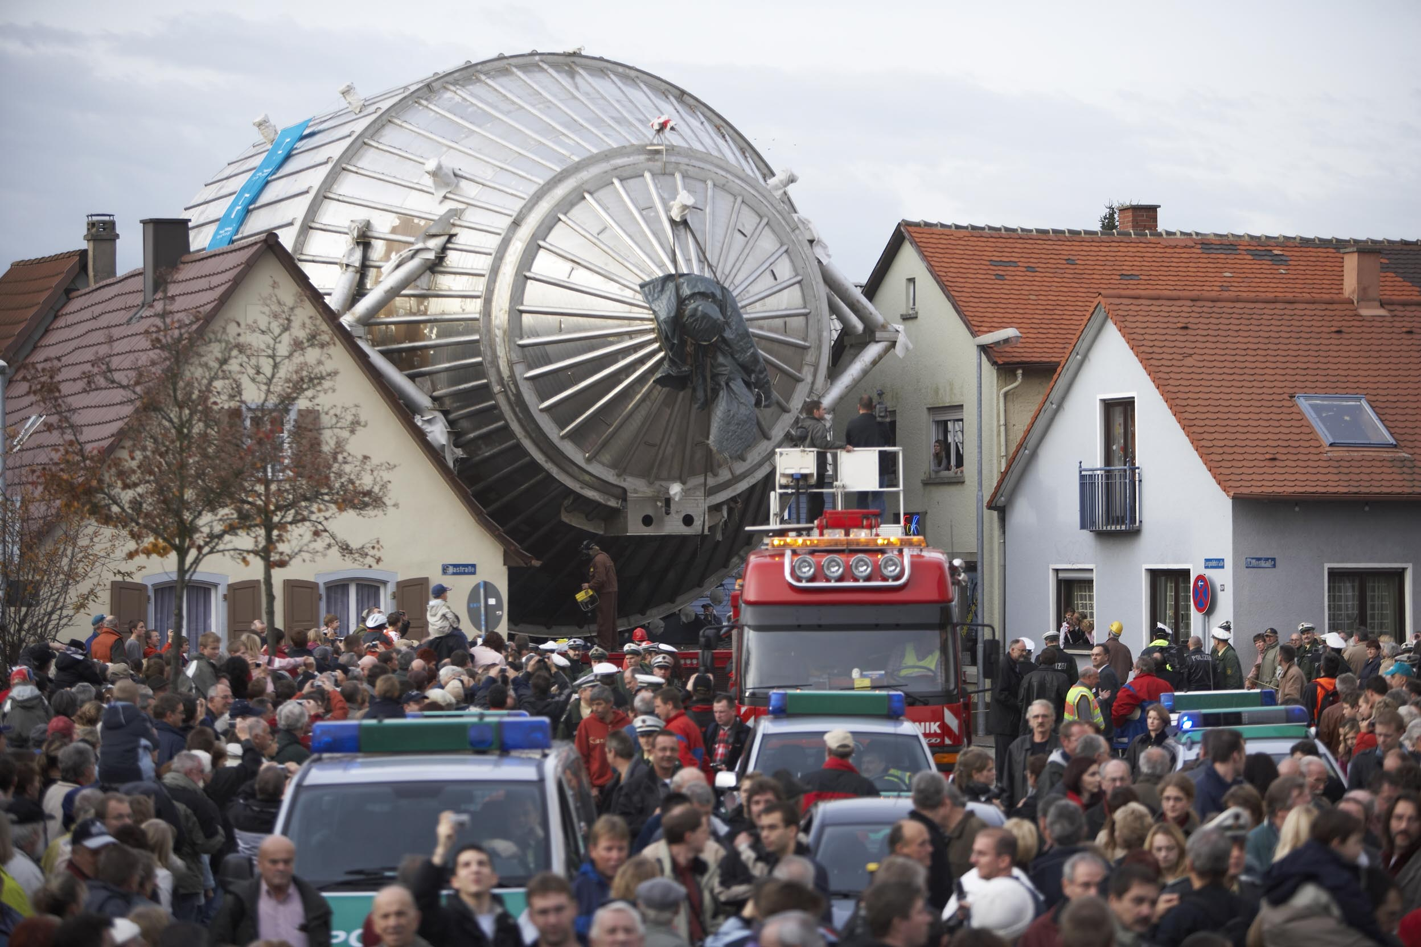
International Vacuum Design of Accelerators
DIAMOND
ELI-NP
KATRIN

Slide 6
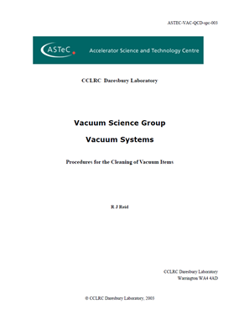
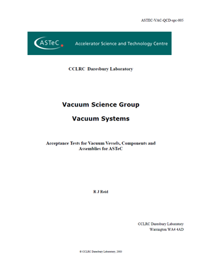
Vacuum/Mechanical specifications
Ultra High
Vacuum Guide
CLRC Daresbury Laboratory
Synchrotron Radiation Department
Vacuum Support Group.
A compendium of Proceedures and Specifications
<Issue 3>
©CLRC Daresbury Laboratory,1996
Notes:
Well defined UHV specs

Slide 7
Quality Control Documentation
Vacuum documents include 3 process documents:
  Proc-001 – Calibration of Total Pressure Gauges
  Proc-002 – Calibration of Residual Gas Analysers
  Proc-003 – Measurement of Thermal Outgassing
And 8 specification documents:
  Spc-001 – General Definitions
  Spc-002 – General specification for UHV
  Spc-003 – Cleaning of vacuum items
  Spc-004 – Leak Testing of Vacuum vessels
  Spc-005 – Acceptance tests for vacuum vessels
  Spc-006 – Acceptance tests for clean mechanical pumps
  Spc-007 – Material for Vacuum Flanges
  Spc-008 – Standard Vacuum Notes
Notes:
Well defined UHV specs

Slide 8
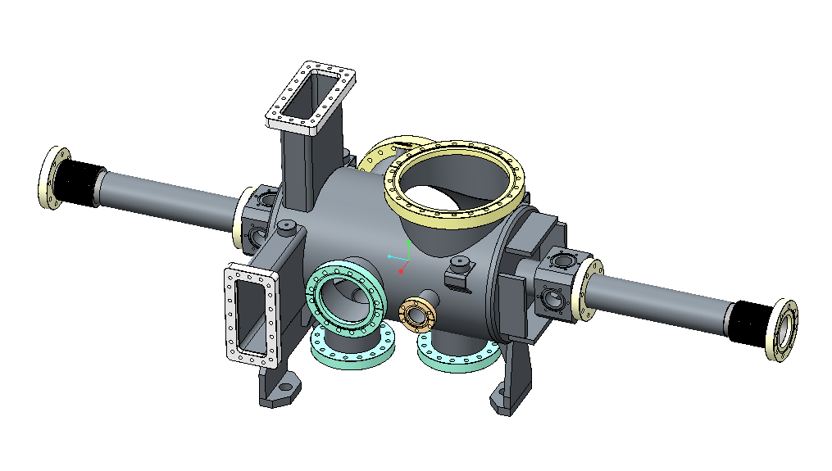
Beam Transport Module requirements
To design, procurement and assemble;
  2 Differential pumping systems
  74 LWUs, 52 Beampipes
STFC design
ESS Vacuum Requirements:
  1 x 10⁻⁹ mbar
  UHV Cleanliness
  Particle free to ISO 5 or better
Vacuum requirements within STFC Vacuum Specs & will include:
  Cleaning
  Baking
  RGA Scanning
  Particle counting
Notes:
ESS design on LHS is still to be done, RHS is STFC design`

Slide 9
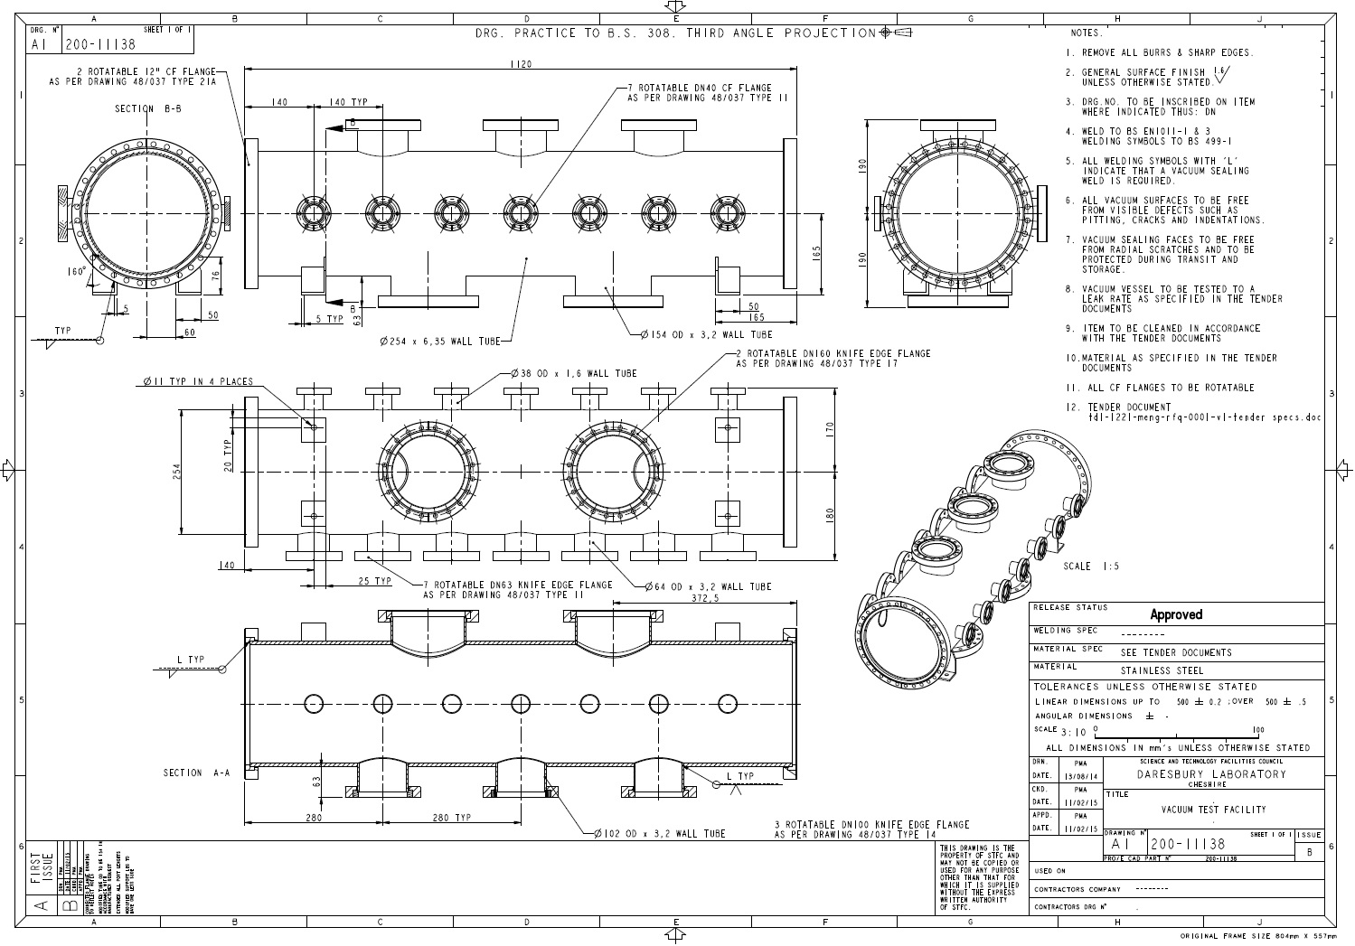
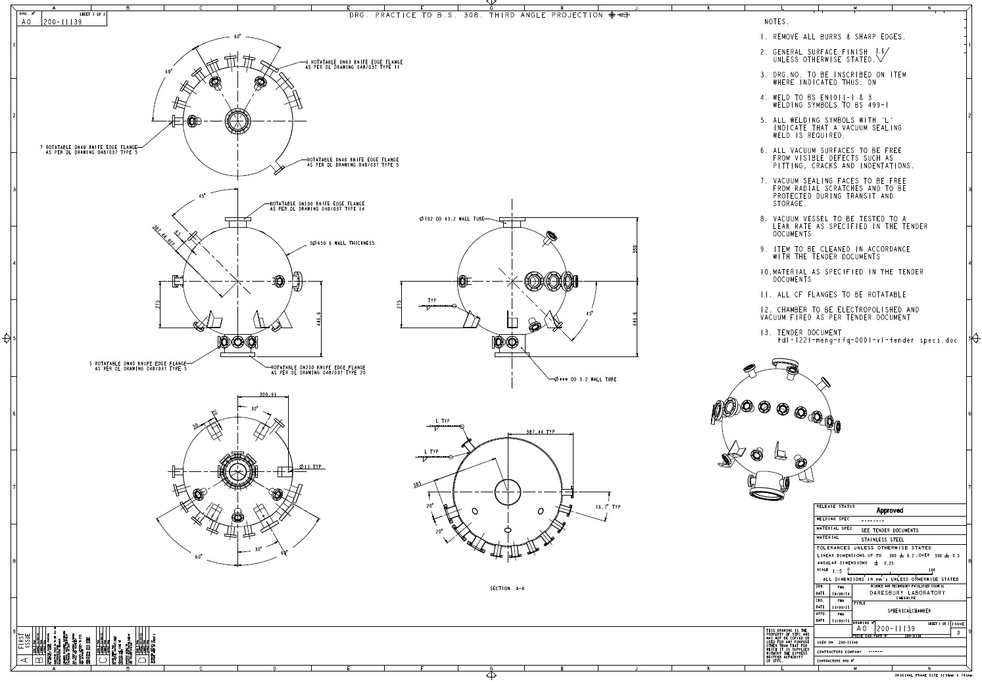
Mechanical drawings referencing STFC specifications
Notes:
Well defined UHV specs

Slide 10
Vacuum Vessel Acceptance
There are 2 main methods that STFC have used over the years to ensure that STFC mechanical and vacuum specifications are met:
  1) Allow manufacturer’s to strictly adhere to our specifications and conduct factory visit and acceptance tests
  2) Allow manufacturer’s to manufacture vessels (STFC still conducts factory visits) and ensure the completed vessel has a suitable leak rate and then ship back to STFC for all further processing to be done
STFC has successfully used options 1 and 2 over the years, however, no manufacturer’s have the infrastructure or facilities STFC has in house.
Option 2 allows STFC to maintain greater control over the processes and provides better quality control over the vacuum specifications.
Option 2 has been implemented for the ESS BTM work package
Notes:
Word the last 2 bullet points more carefully

Slide 11
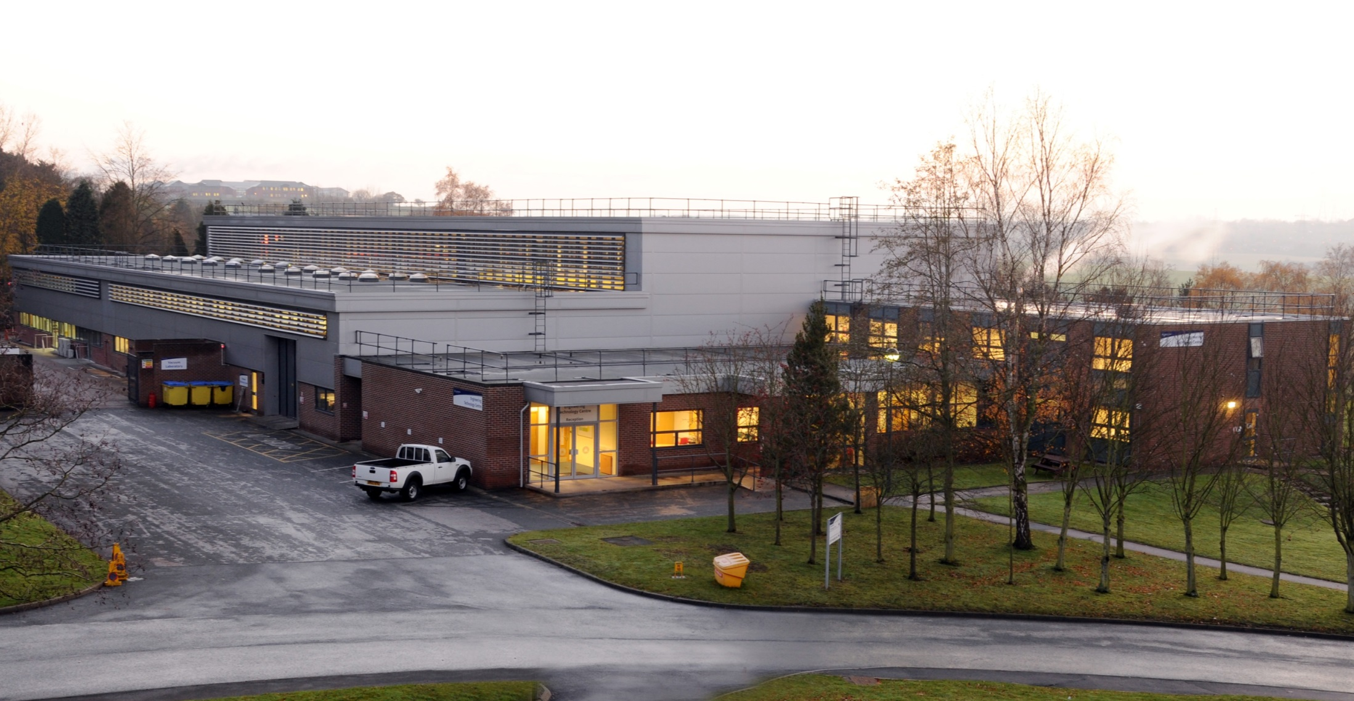
Assembly locations & Facilities
Engineering technology centre
Notes:
Engineering technology centre

Slide 12


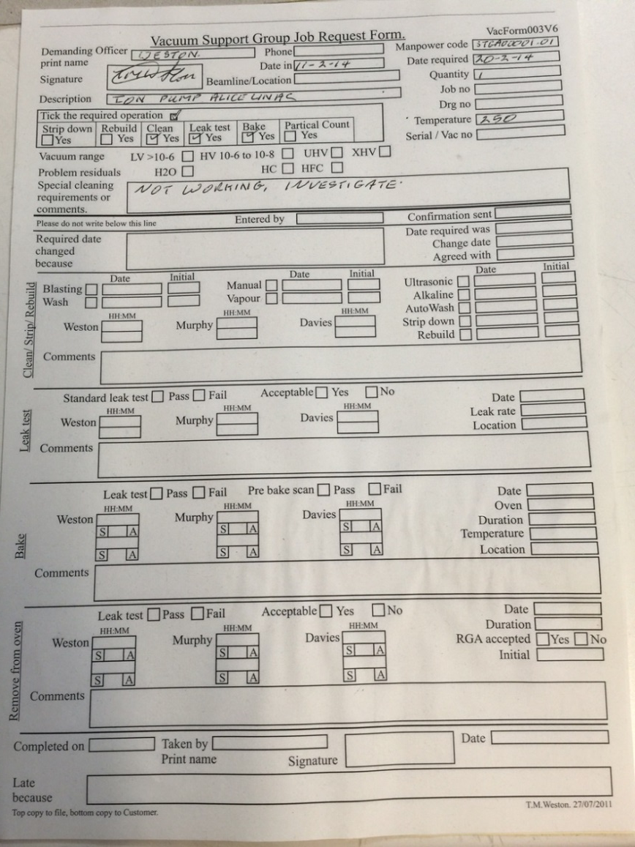
ISO 9001
Job cards completed upon entry to vacuum laboratory
Job card remains with vacuum component through all stages of the process as a record
Notes:
Engineering technology centre

Slide 13
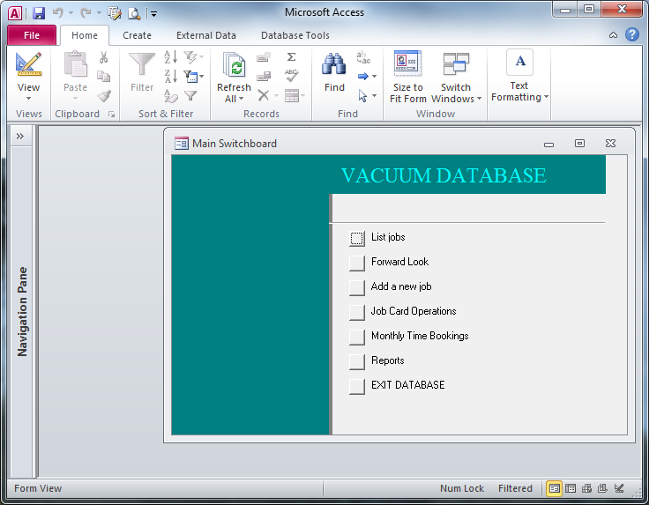
Database starting point

Slide 14
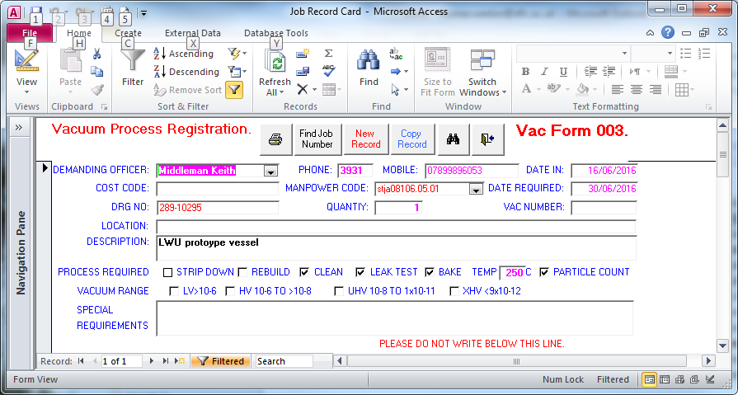
Information extracted from the paper Form

Slide 15
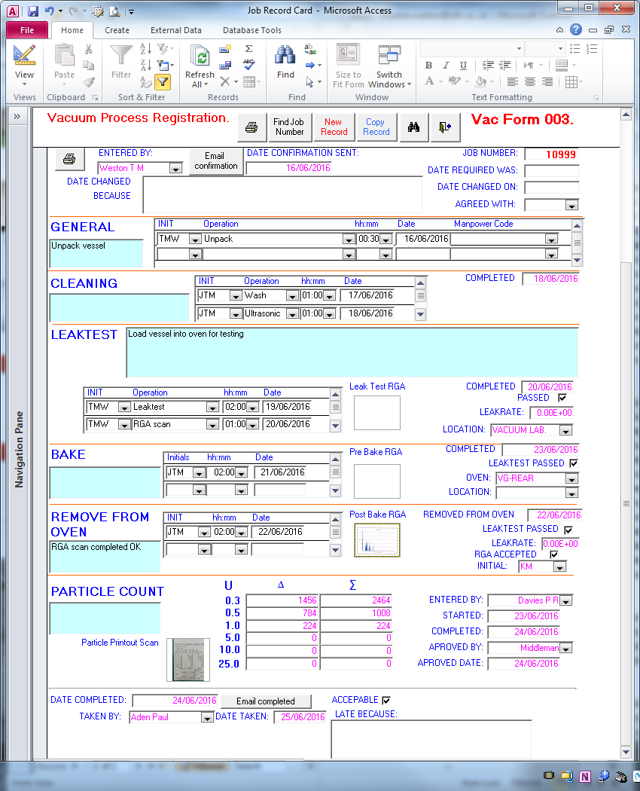
The electronic form completed as tasks undertaken

Slide 16
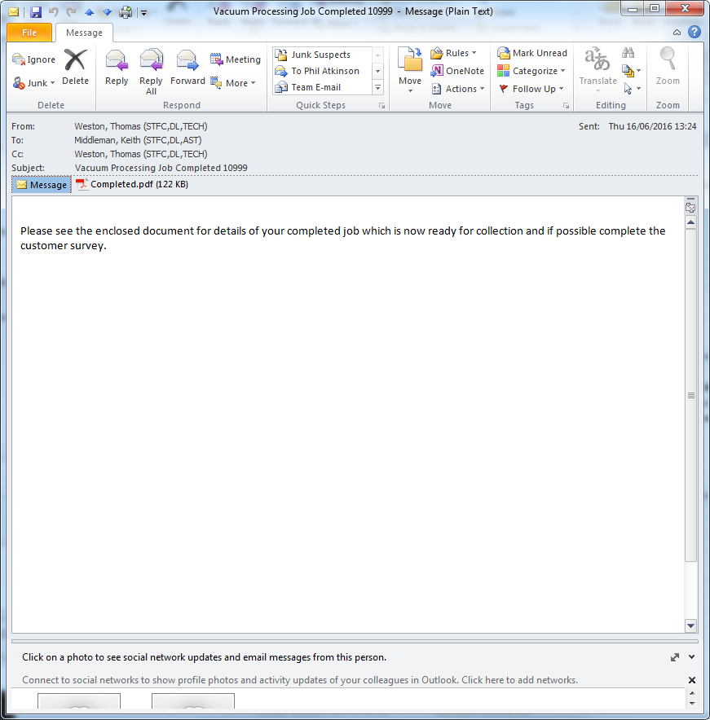
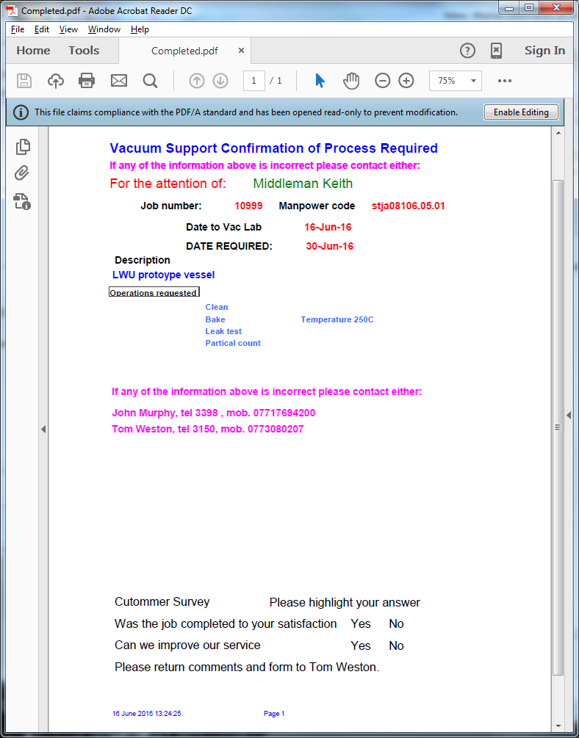
email sent to customer and archive to confirm job completion

Slide 17
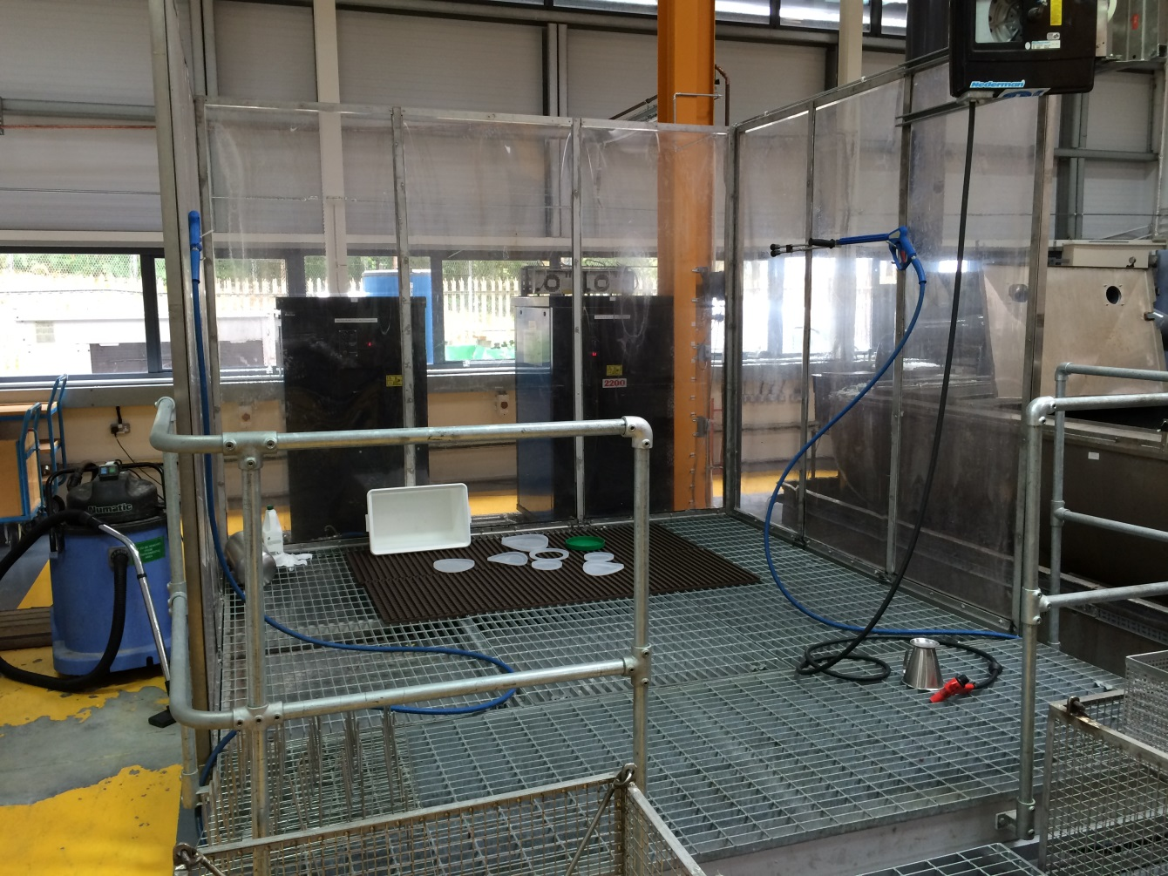
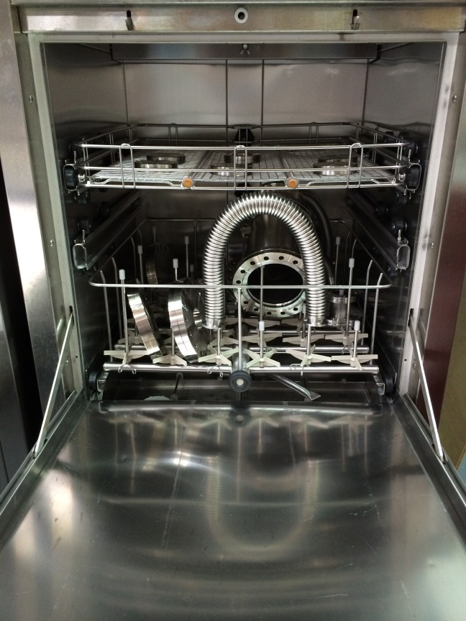
Cleaning Process
Full detailed procedure in ASTeC spc-003 - Cleaning of vacuum items
Auto washers for small items
Power wash booth for large items

Slide 18
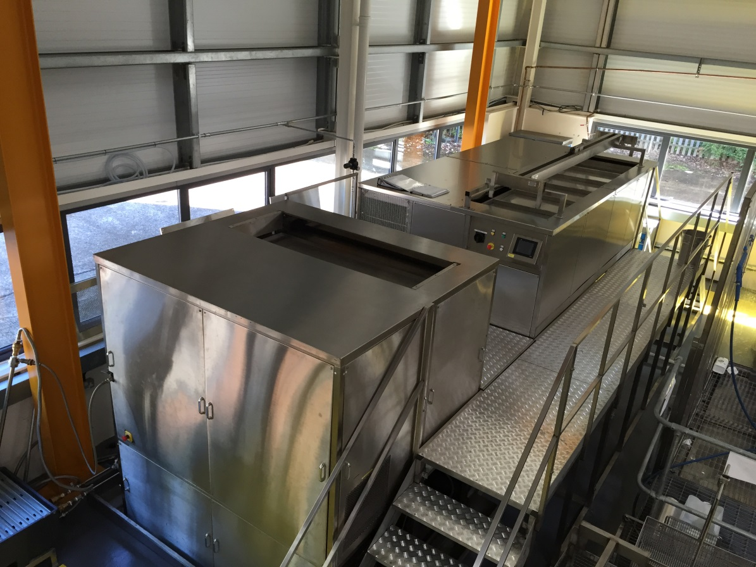
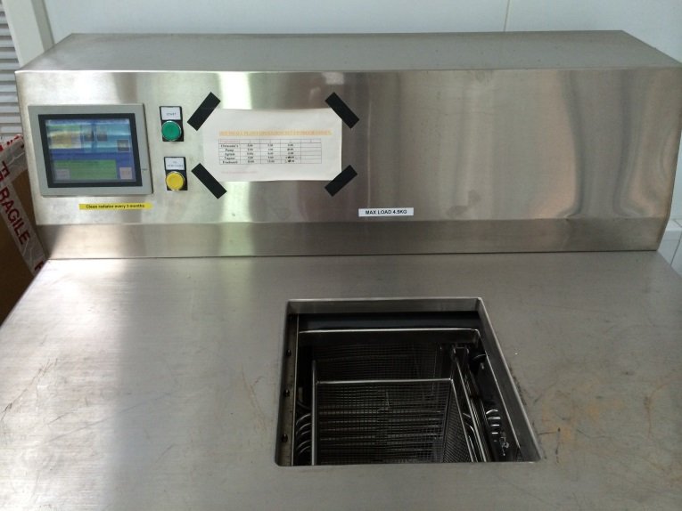
Solvent wash, HFE72DE
1 x Automatic solvent
cleaning plant, model F100.
70% Trans-dichloroethylene,
10% Ethyl nonafluorobutyl ether,
10% Ethyl nonafluoroisobutyl ether,
5% Methyl nonafluorobutyl ether,
5% Methyl nonafluoroisobutyl ether.
2 x Solvent cleaning plants:
Model E1500 – 1500mm x 500mm x 500mm
Model S3000 – 3000mm x 600mm x 500mm

Slide 19
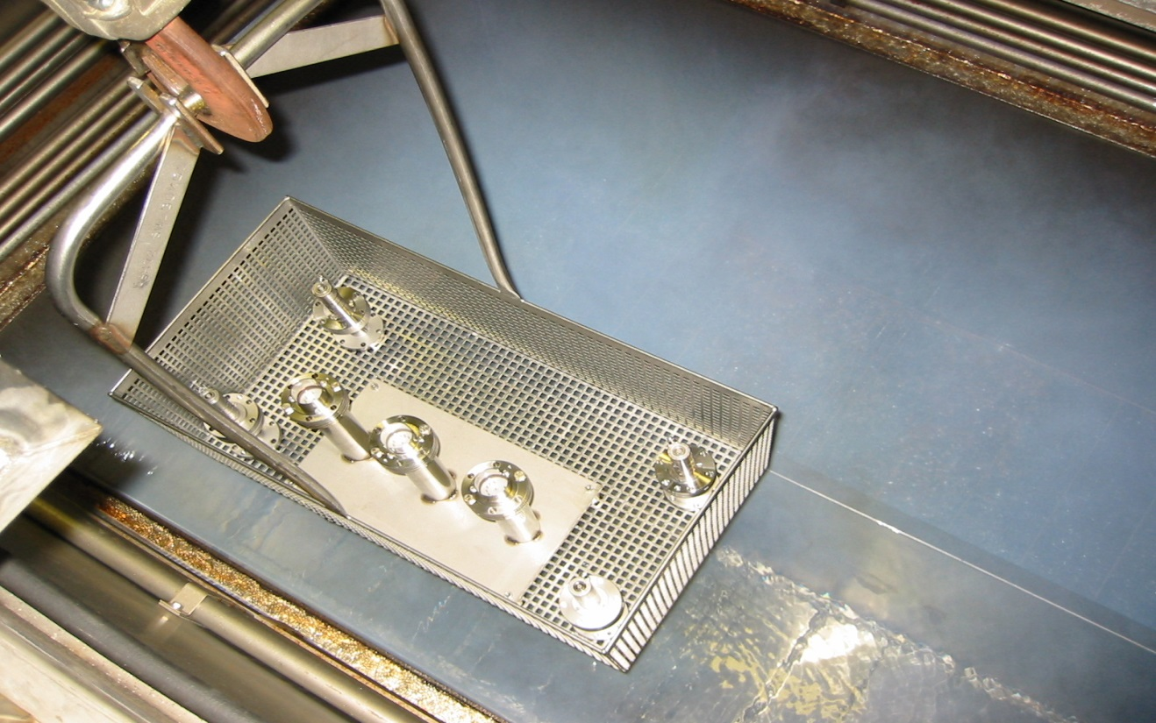
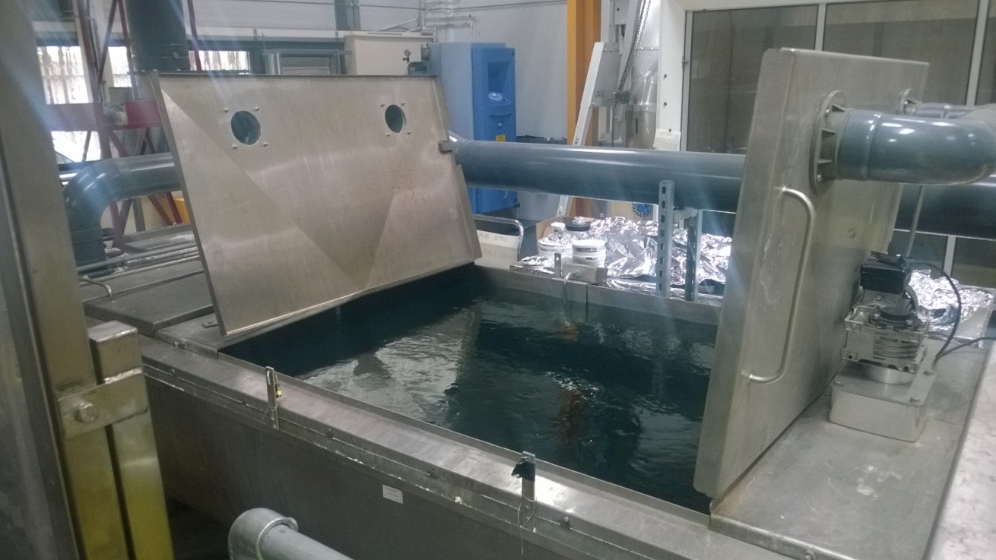
Solvent Cleaning
Vapour Stage
Alkaline degreaser

Slide 20
Cleaning Process Scientifically Developed
Publications:
K.J. Middleman, J.D. Herbert, R.J. Reid, Vacuum 81 (2007) p793-798
J.D. Herbert and R.J. Reid, Vacuum, Vol. 47, 6-8, p693 (1996)
J.D. Herbert, R.J. Reid, A.E. Groome, J. Vac. Sci. Technol. A12(4), p1767, (1994)
Considered aqueous and solvent based cleaning solutions
Considered main gas loads in an accelerator – Thermal outgassing and stimulated desorption
Conclusions
  Aqueous cleaners suitable only for thermal outgassing and not stimulated desorption
  Solvent based cleaners produced better results
  HFE (Hydrofluoroether) based solvent performed best, even better than our previous solvents

Slide 21
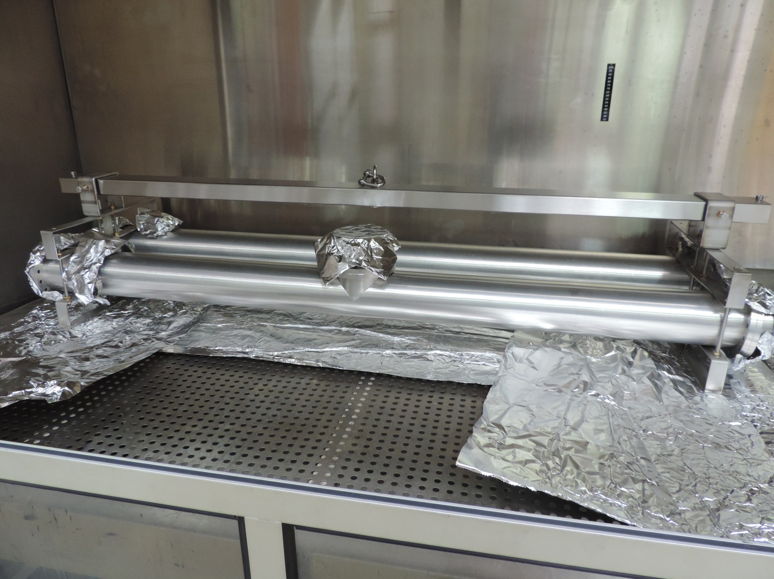
Drying
Hot drying cabinet.

Slide 22
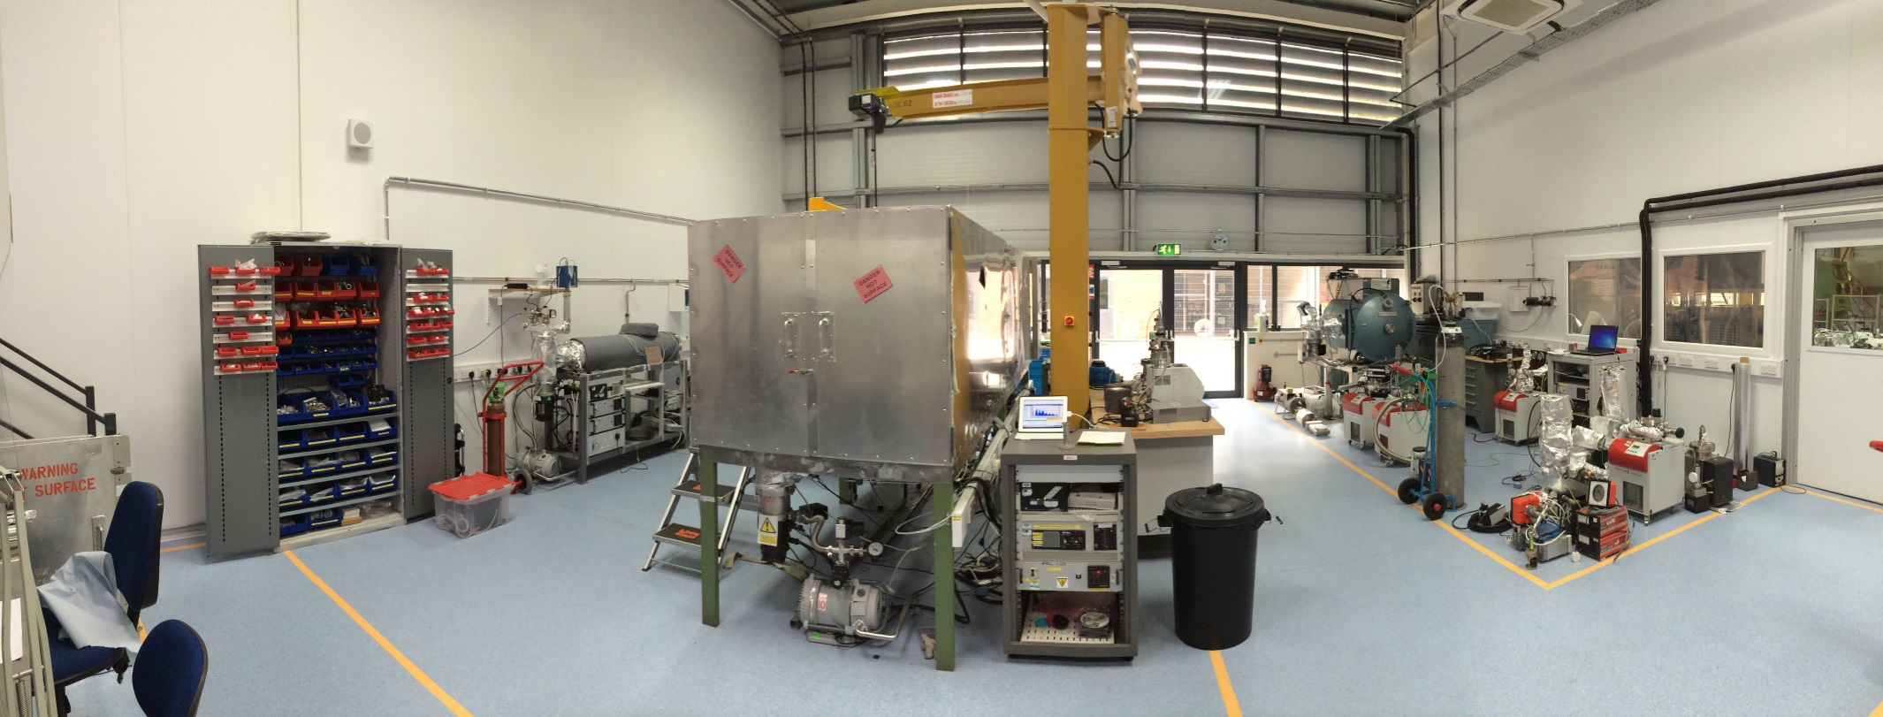
Vacuum Laboratory
4 x ovens to 250ºC
vacuum furnace to 1100ºC
Air oven to 150ºC
Leak detection & test facilities.

Slide 23
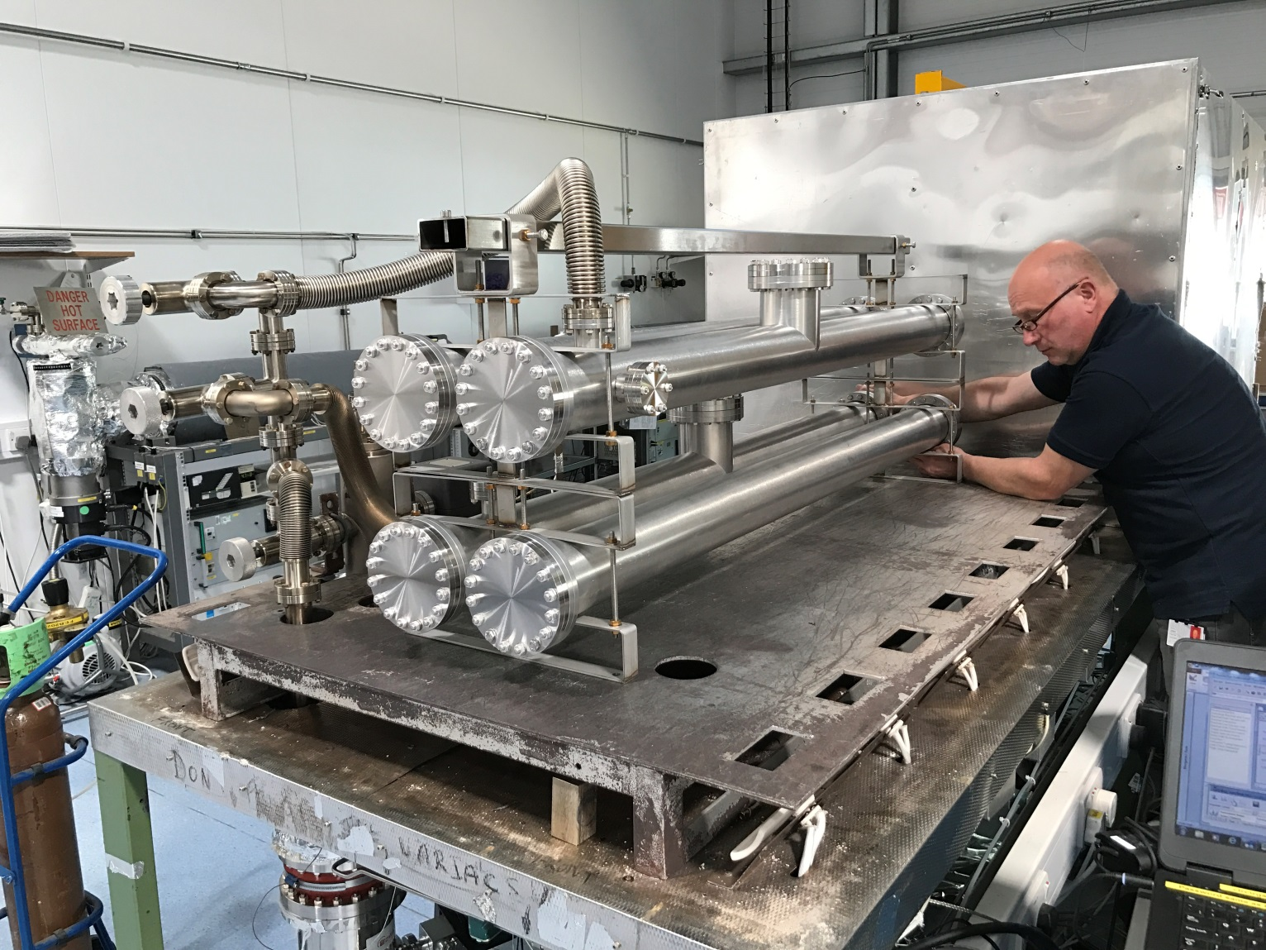
Bakeout
Beampipes baked to 250ºC for 24 hours
LWU’s with BPM’s welded in only bakeable to 50ºC. Discuss?

Slide 24
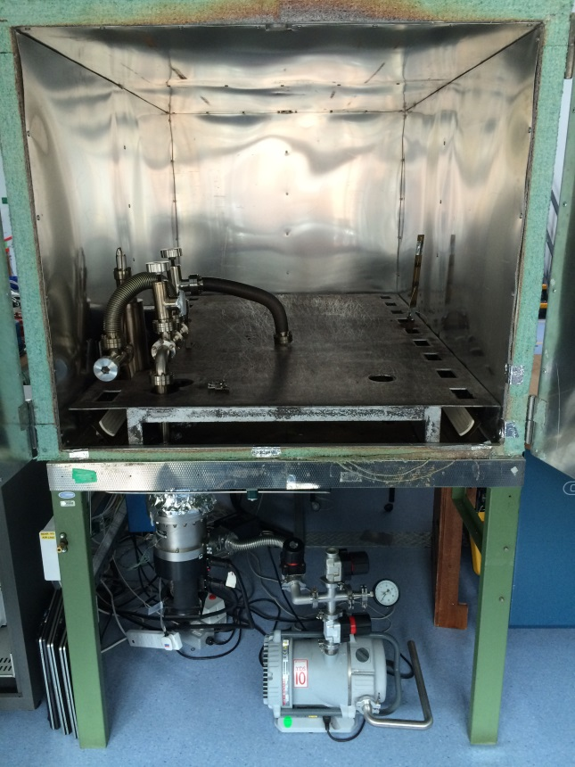
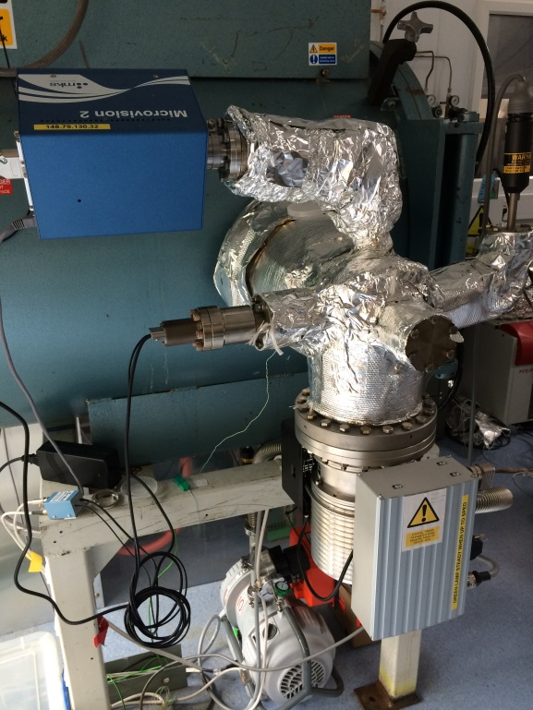
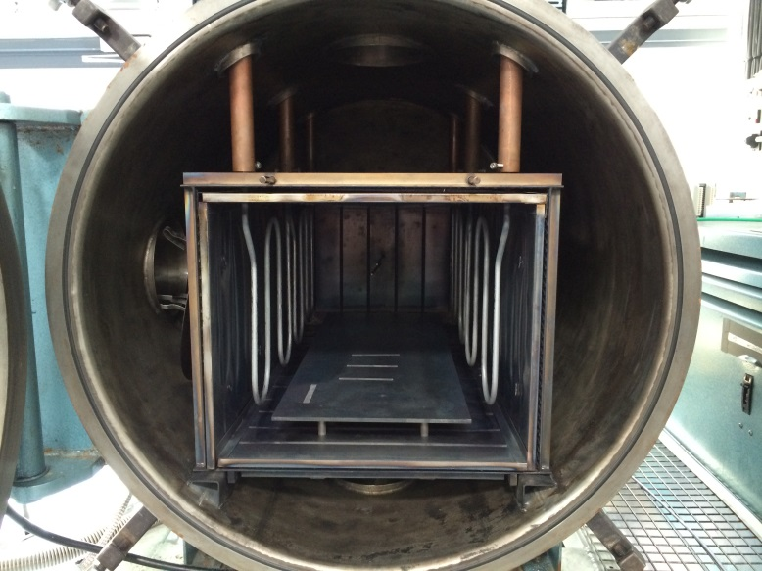
Vacuum Ovens
Vacuum furnace, immersion bake,
1100ºC, 1 x 10⁻⁸mbar.
General Vacuum oven,
250ºC, 1 x 10⁻¹⁰ mbar.

Slide 25
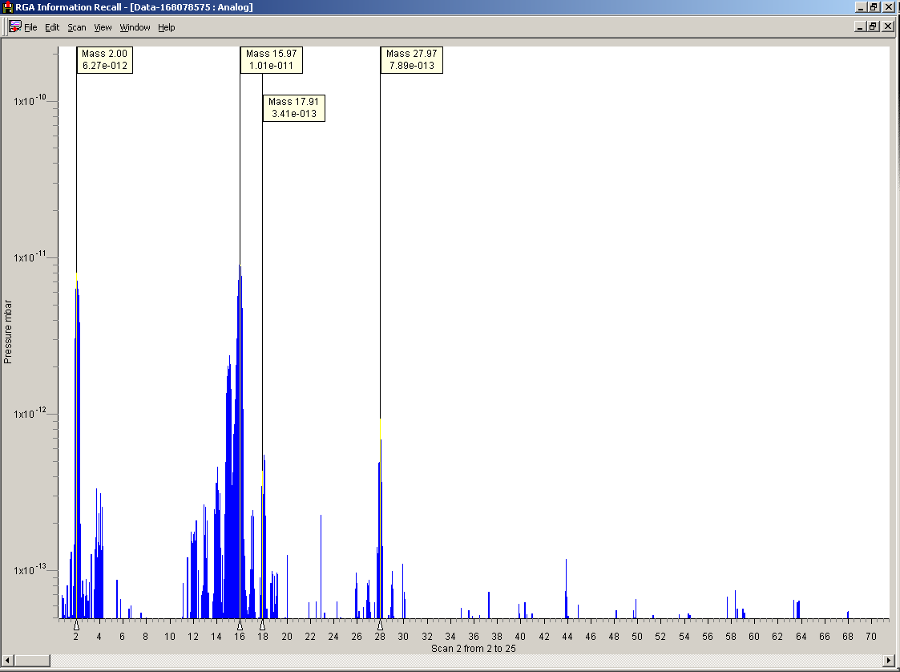
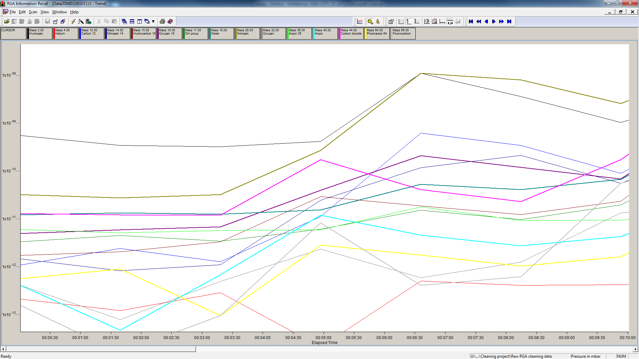
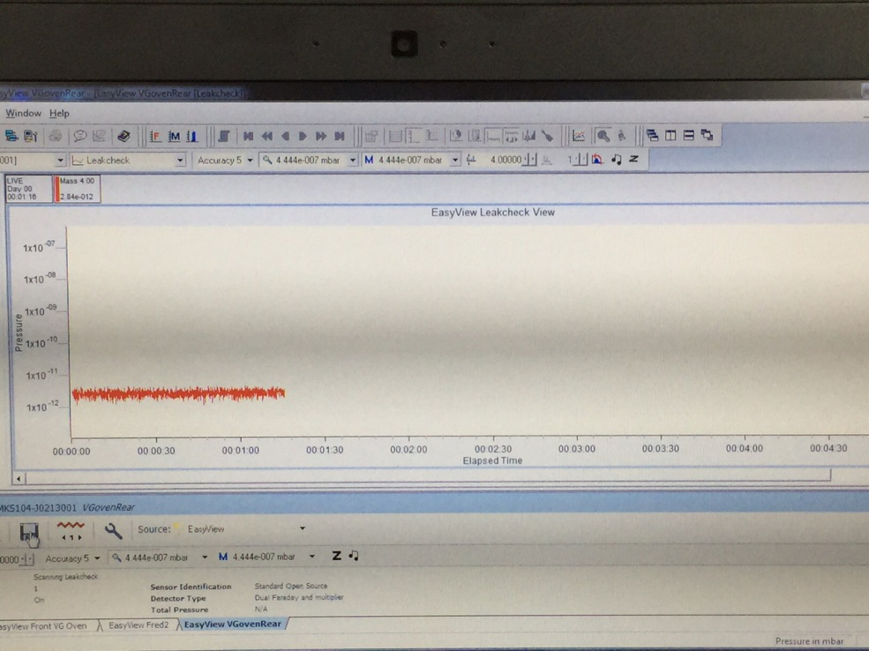
How do we accept vacuum vessels?
RGA scanning at temperature
Pre and Post bake RGA scan
Pressure Region* | Typical Leak Rate (mbar l sec⁻¹) | Typical Outgassing Rate (mbar l sec⁻¹ cm⁻²) | Comment
Low Vacuum | 10⁻² | 10⁻⁴ | Outgassing rates not usually relevant in this region
Medium vacuum | 10⁻⁵ | 10⁻⁷
High Vacuum | 10⁻⁷ | 10⁻⁹
Very High Vacuum | 10⁻⁹ | 10⁻¹¹
UHV | 10⁻¹⁰ | 10⁻¹³
XHV | <10⁻¹² | <10⁻¹⁵ | Special techniques required to measure leak and outgassing rates
Leak testing

Slide 26
How do we accept vacuum vessels?
Vessel acceptance is based upon the RGA analysis, a vessel is clean if:
The residual gas spectrum shall have been recorded over 1 –200 amu
The spectrum shall have been corrected for sampling error, mass discrimination and species relative sensitivities (see Appendix 3)
These limits are expressed in terms of percentages of the total pressure in the system, corrected as indicated
The definition of “general contaminants” is the sum of the partial pressures of all peaks present in the residual gas spectrum of mass to charge ratio (amu) equal to 39, 41-43 and 45 and above (excluding any above 45 specifically listed in the table below). Also to be excluded from this summation are any peaks related to the rare gases xenon (i.e. 132, 129, 131) and krypton (i.e. 84, 86, 83)
Pressure Region | General Contaminants (%) | Perfluoropolyphenylethers Sum of (peak at 69 and 77 amu) (%) | Chorinated species (Sum of peaks at 35 and 37 amu) (%) | Comment
UHV | 0.1 | 0.01 | 0.01 | Assuming system baked. Calculation to be done at 10⁻⁹ mbar or below
HV - UHV | 0.75 | 0.075 | 0.075 | Assuming system unbaked. Calculation to be done at 10⁻⁷ mbar or below

Slide 27
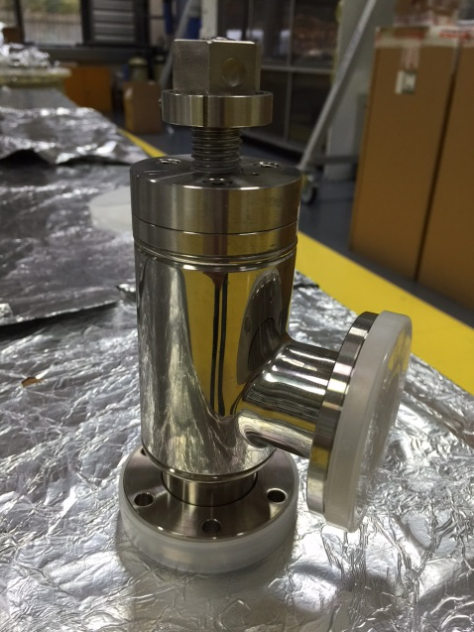
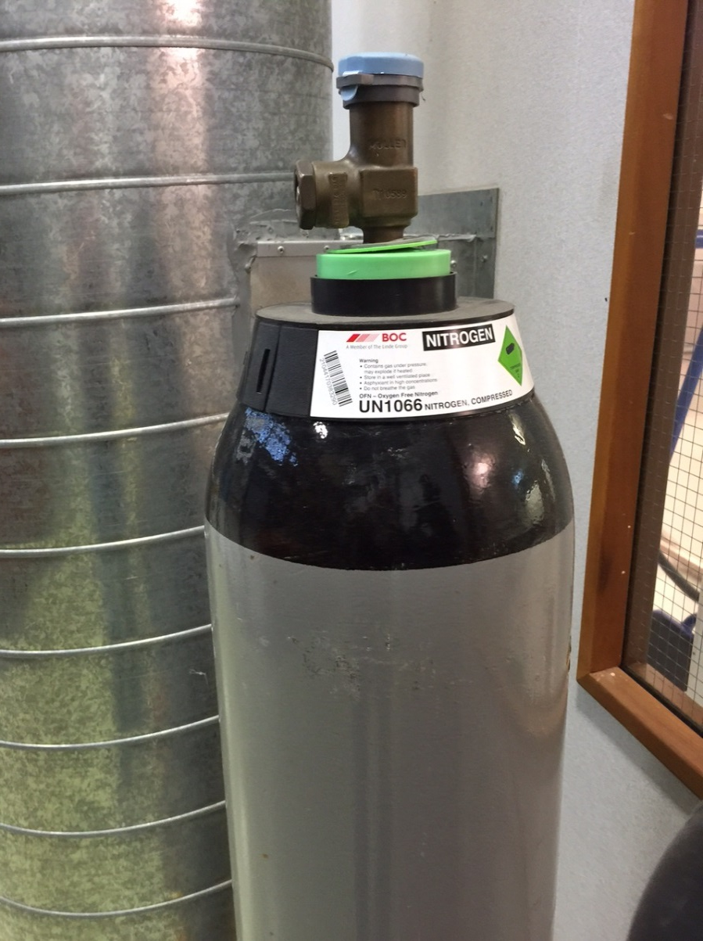
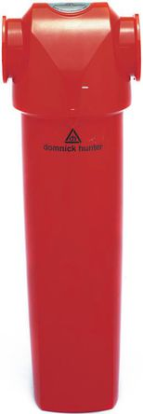
Vacuum vessel acceptance
After acceptance of the vacuum component it will be vented with pure ‘dry’ filtered N₂
Filtered down to 0.1µm
‘Dry’ - N₂ purged until a dew point of -70⁰C is measured, keeping moisture down to acceptable low levels
Vessel is capped and remains under a N₂ atmosphere

Slide 28
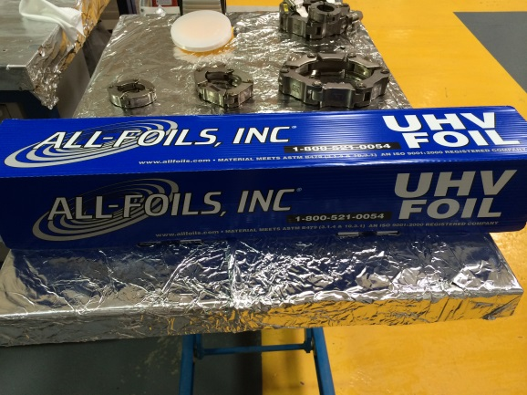
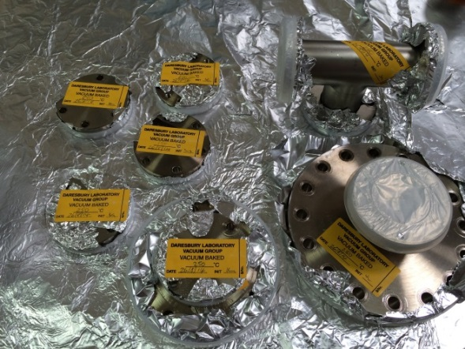

Use foil?
In general we wrap all ‘clean’ vacuum components and they are labelled
Protects clean items.
  Indicates cleaned items.
For particle control foil is bad
  Shed particles of all sizes.
For particle controlled ‘clean’ vacuum components we only use ‘clean’ plastic caps and NO foil

Slide 29
Cleanroom

Slide 30
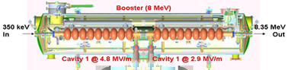
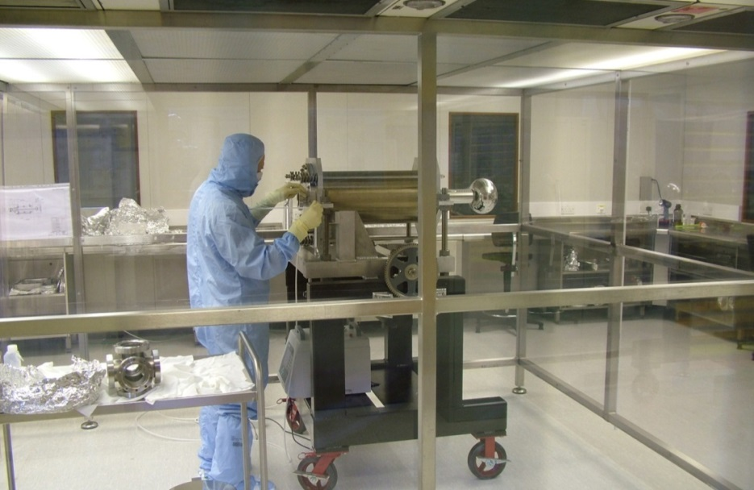
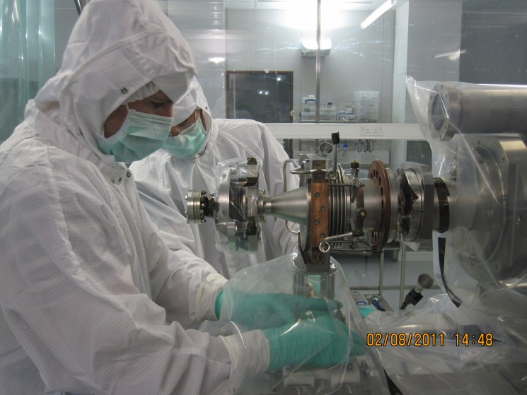
Low particulate experience on ALICE
ALICE Photoinjector vessel
In ISO 4 Cleanroom

Slide 31
Particle counting procedures
A one minute sample of particle level should then be taken and checked to ensure it meets the ISO 5 standard. If it does not then the chamber should be left for a further 30mins and the area retested. If it is still not below the required level then the chamber should be moved back out to the changing area and re-cleaned with a lint free wipe and blown down with N₂.
The chamber then should be un-flanged, to do this remove all but two bolts from the flanges (note: this will produce an increase in the particle count) then let the chamber settle again and take another one minute particle count. Then remove the flanges and take a one minute area sample to check ISO class.
If ISO 5 is not achieved wait a further 30mins and take a further sample. Repeat this upto 5 times. If the area still does not reach the required level the chamber should be removed and the process re-started.
Once the area is acceptable blow the internal chamber surfaces with filtered N₂ at 7 bar. The chamber should then be tapped delicately a number of time across the surface with a rubber mallet. This, N₂ blow then tapping procedure, should be repeated twice more.
Then take a one minute sample at the location specified for the unit whilst purging at 0.5 bar with filtered nitrogen. This should be done remotely if possible.
Repeat stages 4&5 four more time, recording the counts each time.
If each of the particle counts in stage 5 meets the ISO5 specification seal/cap the vessel – passed
If any of the particle counts in stage 5 do not meet ISO5 repeat another 5 times, if vessel repeatedly fails then speak to area supervisor.

Slide 32
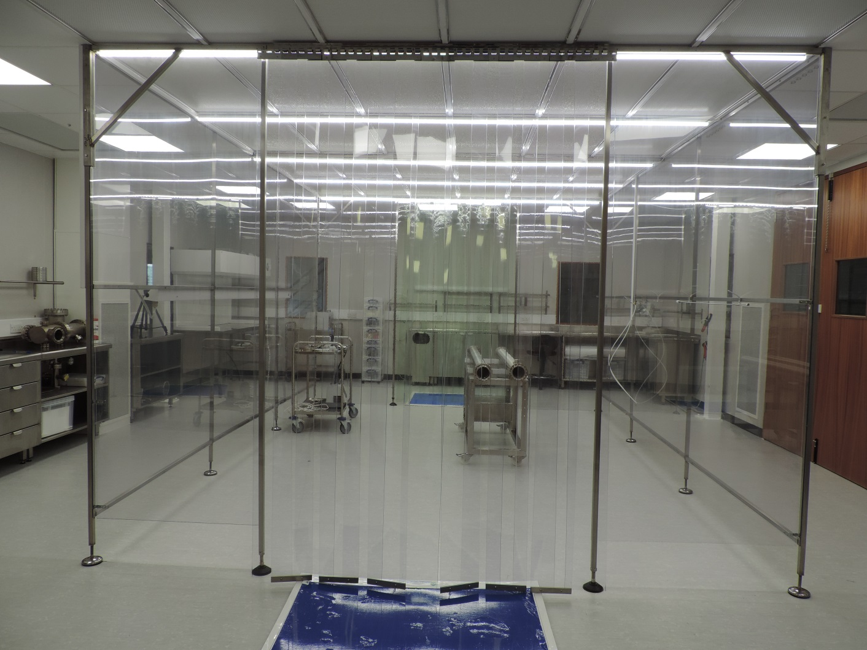
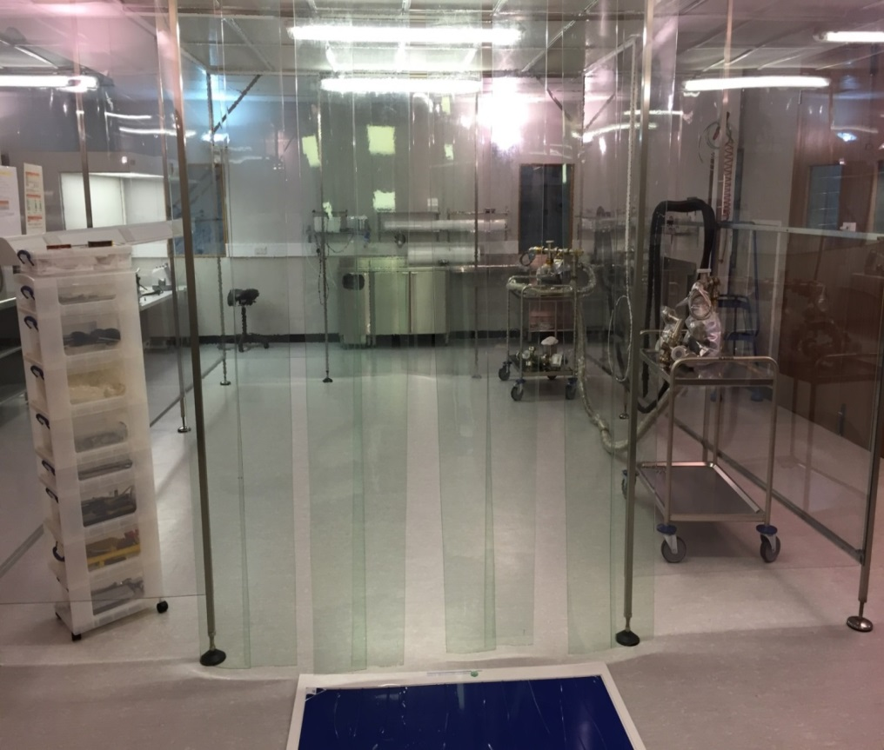
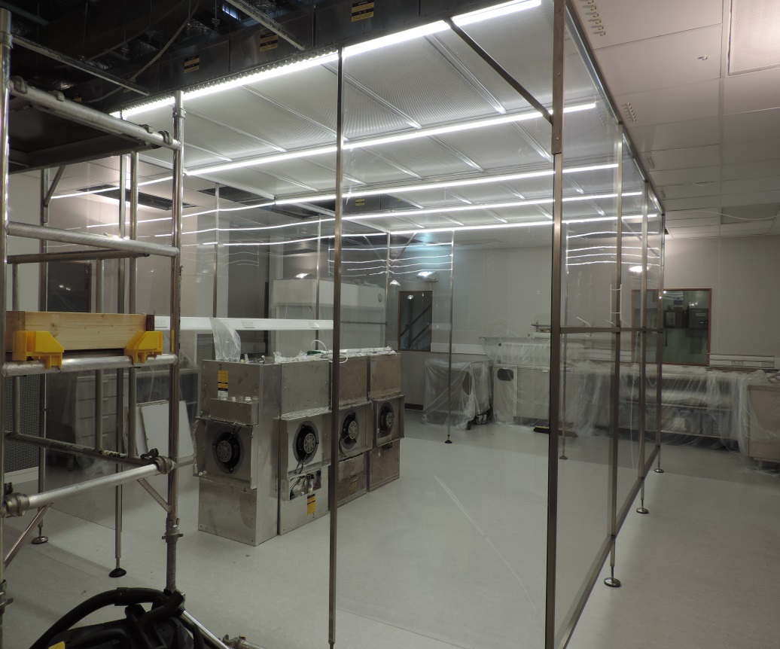
Cleanroom Upgrade
Change area 6m² - ISO 7
Outer area 80m² - ISO 6
Inner area 12m² ISO 4 at rest
ISO 5 with 2 people
Change area 6m² - ISO 7
Outer area 80m² - ISO 5
Inner area 12m² ISO 3 at rest
ISO 4 with 2 people

Slide 33
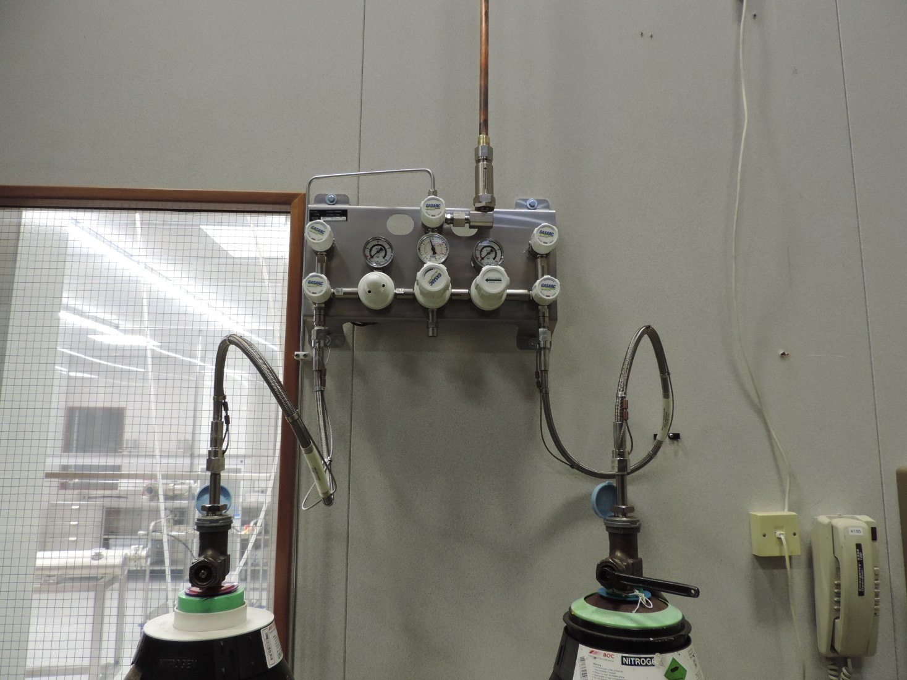
Cleanroom Upgrade
High and Low pressure feeds for the particle counting process.
Automatic switch over when N₂ runs low
One set at 5-7 bar, one at 0.5-1.5 bar

Slide 34
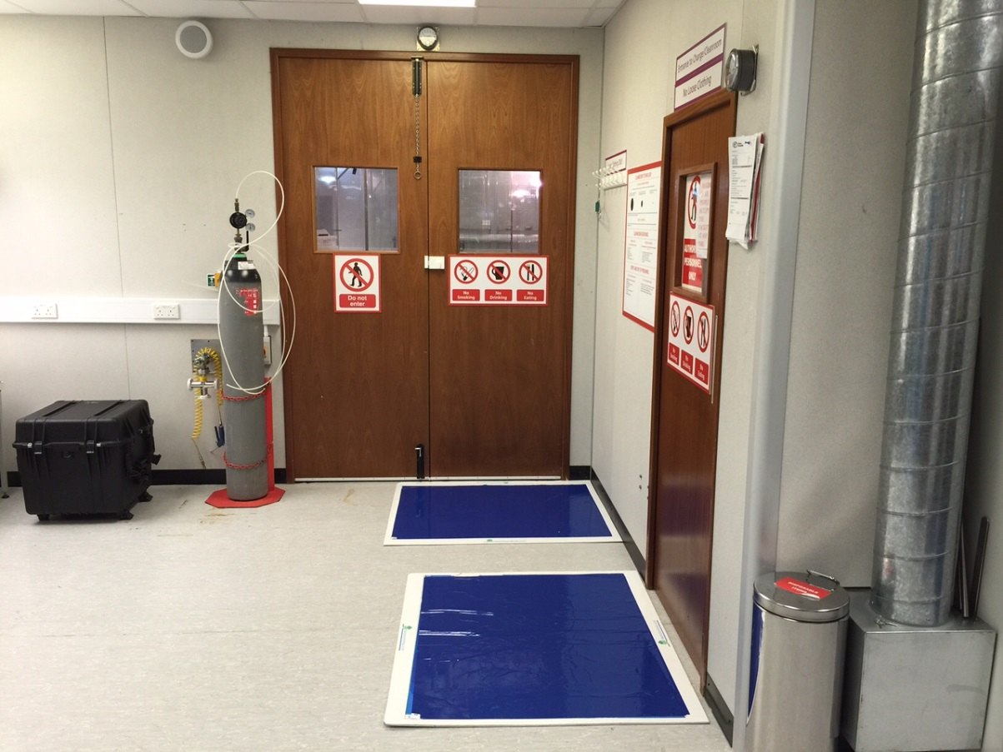
Cleanrooms
Once all vacuum work in the vacuum laboratory is completed the vessel or component is then transferred to the area outside the clean room and prepared for the cleanroom
Vessels are wiped down with tack cloths
All surfaces cleaned and wiped down with IPA wipes
Vessels blown off with high pressure filtered N2
Allow time for any particles to settle and then open doors for transfer into the clean room
Vessels are transferred into the outer area of the cleanroom – ISO5 and are left for a number of hours before they enter the main ISO3/4 assembly area

Slide 35
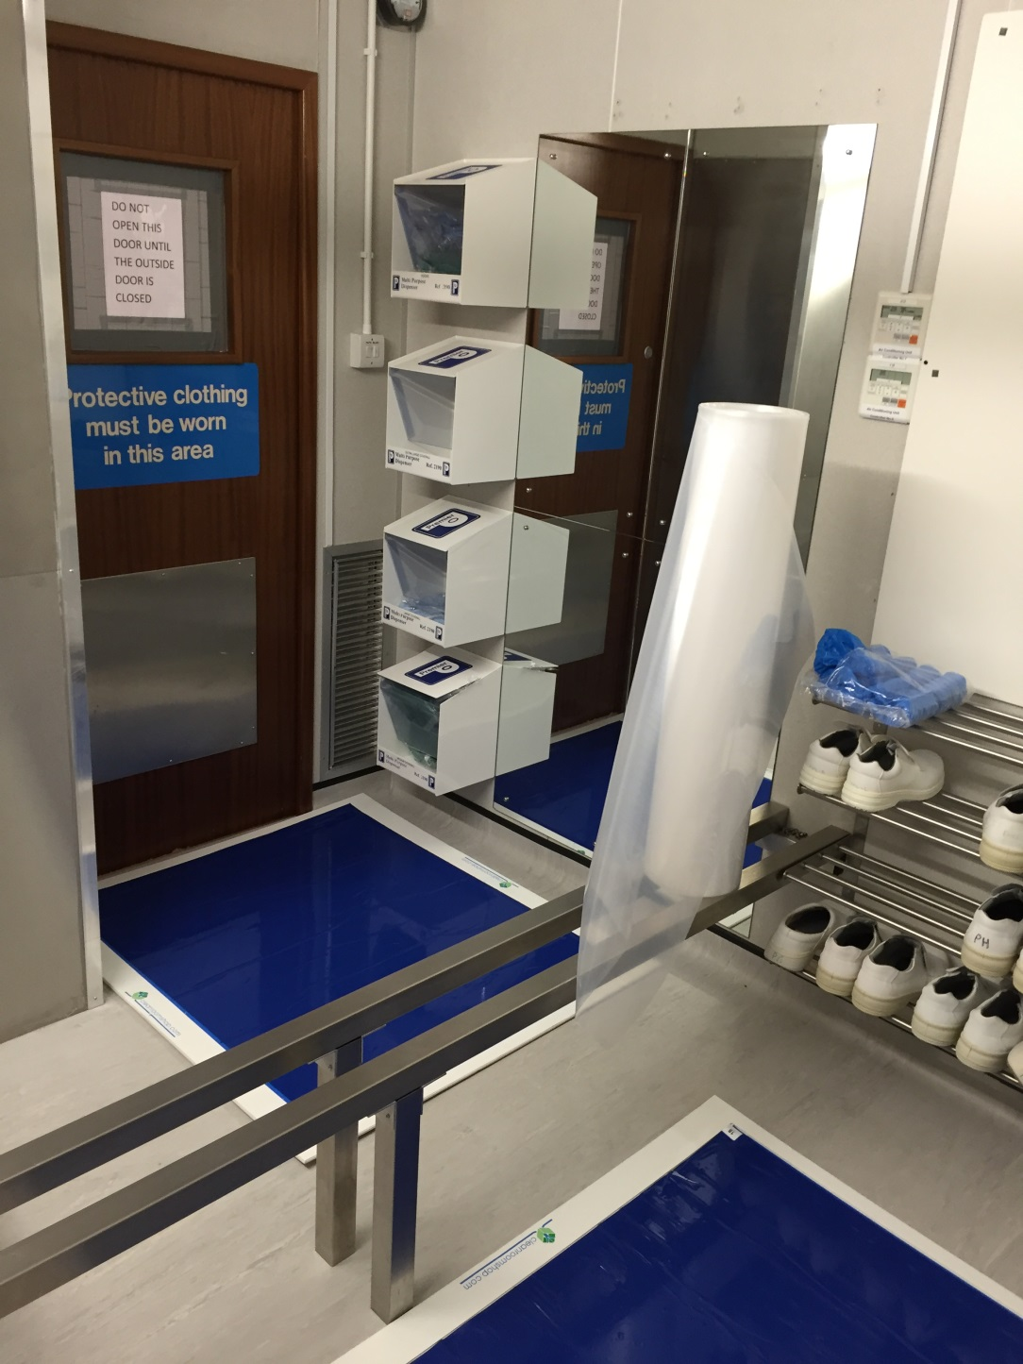
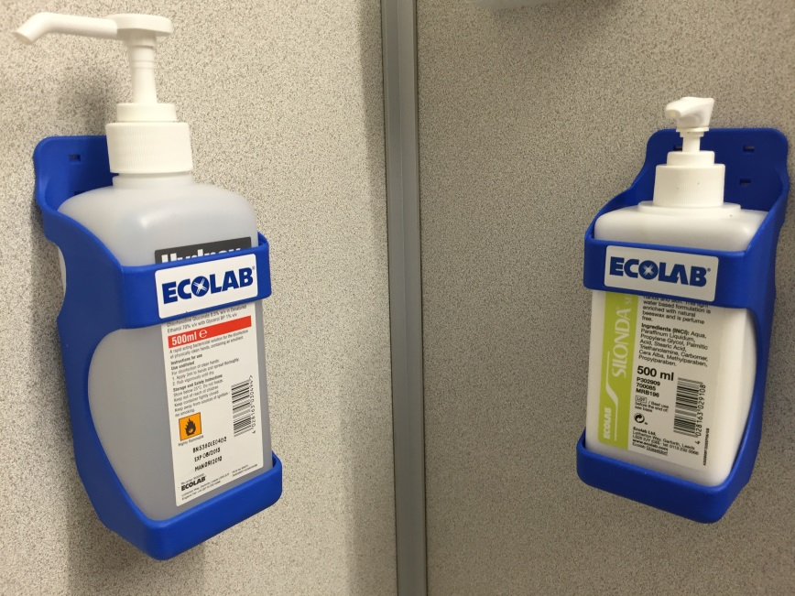
Changing room.
Sanitise & moisturise

Slide 36



How do we do it?
Wands designed and made specifically for the LWU’s.
PTFE end on with holes drilled to force the N₂ backwards
Wand with specific angle designed to push the N₂ from the central chamber back towards the ends

Slide 37




LWU Particle Counting Preparation
Blow down with high pressure N₂, then repeat with gentle mallet tapping. Repeat process 3 times.
Switch to low pressure N₂ then perform particle counts WITH mallet tapping (worst case scenario) until ISO5 achieved.
Repeat particle counts WITHOUT mallet tapping until ISO 5 achieved

Slide 38


How do we do it?
Purge vessel with 4 m/s bar N₂
Purge vessel with 4 m/s bar N₂
Measure particle count
Measure particle count
Measure particle count
Measure particle count
Particle counts to meet ISO 5 on 5 consecutive occasions before moving to the next position
Particle counts to be taken in 4 positions

Slide 39


Procedures

Slide 40



Beampipe Particle Counting
Measure particle count
Blow down with high pressure N₂, then repeat with gentle mallet tapping. Repeat process 3 times.
Switch to low pressure N₂ then perform particle counts WITH mallet tapping (worst case scenario) until ISO5 achieved.
Repeat particle counts WITHOUT mallet tapping until ISO 5 achieved

Slide 41


Particulate counting
Unfiltered
12 mins
of filtering
later.
Resultant data file to be saved to database

Slide 42

SAES NEXTorr Particle Counting

Slide 43


Pumping Carts
Controlled pumpdown and venting using the carts shown.
One is permanently located in the cleanroom, the other in the assembly area.

Slide 44


Summary Report
Printed particle count results to included with the report along with the job card
1-2 page summary after all vacuum processes complete

Slide 45



STFC Delivered

