Slide 1
Controls for TS2
Cryomodule Testing System Review
Wojtek Fabianowski
Integrated Control Systems
ESS/ICS
2017-11-30

Slide 2
Test Stand 2 – ICS planning and activities
Outline
  ICS scope
  Resource situation/organization
  Collaboration
  Schedule/planning
  Areas of attention – modulator, RF, LLRF

Slide 3
ICS contribution to TS2
ICS involvement at test stand 2
    Controls infrastructure (Technical network, Timing, Control room)
    RF local protection system
    Personnel safety system
    LLRF system
    Cryo distribution system, Valve box
    Vacuum Controls
Other activities
    Machine protection system (to be tested later in future, not planned for TS2)

Slide 5
Control Architecture and Process
High-level controls (EPICS)
Low-level controls (PLC, MTCA)

Slide 6
Process Control Architecture picture taken from ESS-0099046..ICD between ICS-processand Test Stand 2

Slide 7
Resources and Staff – ESS and Partners
ESS ICS
IPNO
CEA

Slide 8
ICS Resources
Henrik Carling
Head of Division
Controls infrastructure
Remy Mudingay
Controls Software
Susanne Regnell
Hardware & Integration
Henrik Carling
Safety and protection
Annika Nordt
Anna Gillberg
Team assistant
Alessio Curri
ICS administrator
Emanuele Laface
Accelerator physicist
Angel Monera
FPGA Engineer
François Bellorini
Integrator
Riccard Andersson
Technical Project Coordinator
Anni Frönell
PMO
Benjamin Bertrand
Software engineer
Juan Esteban Müller
Software scientist
Jeong Han Lee
Integrator
David Brodrick
Integrator
Enric Bargalló
Lead Analyst
Stuart Birch
Senior safety engineer
Hector Novella
Deputy project manager
Johan Christensson
Network Engineer
Ben Folsom
PhD student
Simone Farina
Embedded systems engineer
Tomasz Brys
Integrator
Mattias Eriksson
MPS Technician
Thilo Friedrich
Systems Engineer
Susann Skarin
Sys Admin
Claudio Rosati
Software engineer
Thomas Fay
Integrator
Faye Chicken
Controls Technician
Viktor Fred
Electrical engineer
Saeed Haghtalab
Controls Engineer
Benedetto Gallese
Integrator
Stephane Gabourin
MPS engineer
Anders Harrisson
Software Engineer
Ricardo Fernandes
Senior software engineer
Begin 2018-01-08
Timo Korhonen
Chief engineer
Fredrik Luthander
Software engineer
Jan-Åke Persson
Senior software engineer
Julen Etxeberria
Junior controls engineer
Joao Paulo Martins
Integrator
Szandra Kövecses
Lead integrator
Wojtek Fabianowski
in-kind manager
John Sparger
Integrator
Morteza Mansouri
Safety Engineer
Peter Holgersson
Electrical Engineer
Karin Rathsman
Senior scientist
Javier Cereijo
PhD Student
Denis Paulic
Deputy Group Leader
Fredrik Söderberg
Software engineer
Michael Davidsaver
Expert EPICS
Peter van Velze
Controls Technician
David Sánchez Valde-
peñas Automation Engineer
Mehdi
Mohammednezhad
Krisztián Löki
Integrator
Yong Kian Sin
IEC61508 engineer
Banafsheh Hajinasabi
Software engineer
Begin 2017-12
Oliver Talevski
Embedded engineer
Miklós Boros
Target Integrator
Alberto Toral Diez
Technician
Georg Weiss
Software engineer
Maria Romedahl
Technical coordinator
William Ledda
Integrator
Manuel Zaera-Sanz
PLC Engineer
Consultants
Manorma Kumar
PSS analysis
Nour Akel
Installation cordinator

Slide 9
Deliverables by partners
Deliverables by ICS/IPNO
Establish the elliptical cryogenic control system specifications based on instruments/sensors and control devices integrated in the elliptical cryomodules and valve boxes, but also regarding the interface requirement to the ESS main control system.
Perform the detailed design of the control system, in particular the rack integration and the cable routing of the whole system.
Program the PLCs to integrate the cryogenic sequences as they are defined by the cryomodule and valve box designers.
Support to ESS for the study of the system physical implementation in the klystron gallery and in the linac tunnel.
Deliverables by ACCSYS-WP10/ACCSYS-WP05/CEA
Instrument list of the elliptical cryomodule
Operation modes and cryogenic sequences of the elliptical cryomodule
Deliverables by ACCSYS-WP11/WUT
Instrument list of the elliptical valve box
Operation modes and cryogenic sequences of the elliptical valve box

Slide 10
Time plan from ICS perspective
PSS for TS2 analysis and preliminary documentation
2018-02-02
CDS CS Factory Acceptance Test (s7driver)
2018-03-16
PSS for TS2 RFI (bunker ready for PSS)
2018-03-30
PSS for TS2 Installation complete
CDS CS Site Acceptance Review (hardware test including vacuum) done
2018-04-20
CDS CS RFI
2018-04-27
RF LPS Lab Prototype
PSS for TS2 Validation
2017-12-22
2018-05-25
RF Cell Interlock Logic
RF CS Hardware test start
2018-02-02
2018-06-01
2018-08-31
2017
Nov
Dec
2018
Feb
Mar
Apr
May
Jun
Jul
Aug
2018
Today
RF Local Protection System
2017-11-06 -- 2017-12-22
RF Cell Interlock Design
2018-01-08 -- 2018-02-02
RF Control System
2018-02-05 -- 2018-06-01
CDS Control System (IPNO, FR)
2017-11-23 -- 2018-03-16
Control System Infrastructure installations
2018-03-12 -- 2018-07-12
PSS for TS2 Hardware and Software design
2018-02-05 -- 2018-03-30

Slide 11
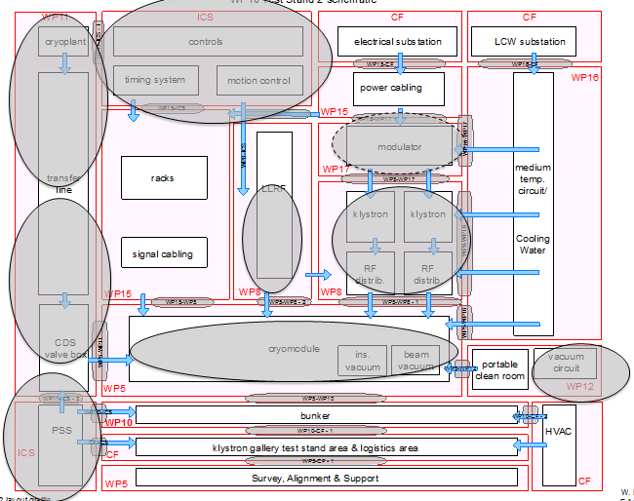
Areas of further attention ?
LLRF
Modulators
Water cooling systems
Auxiliary systems

Slide 12
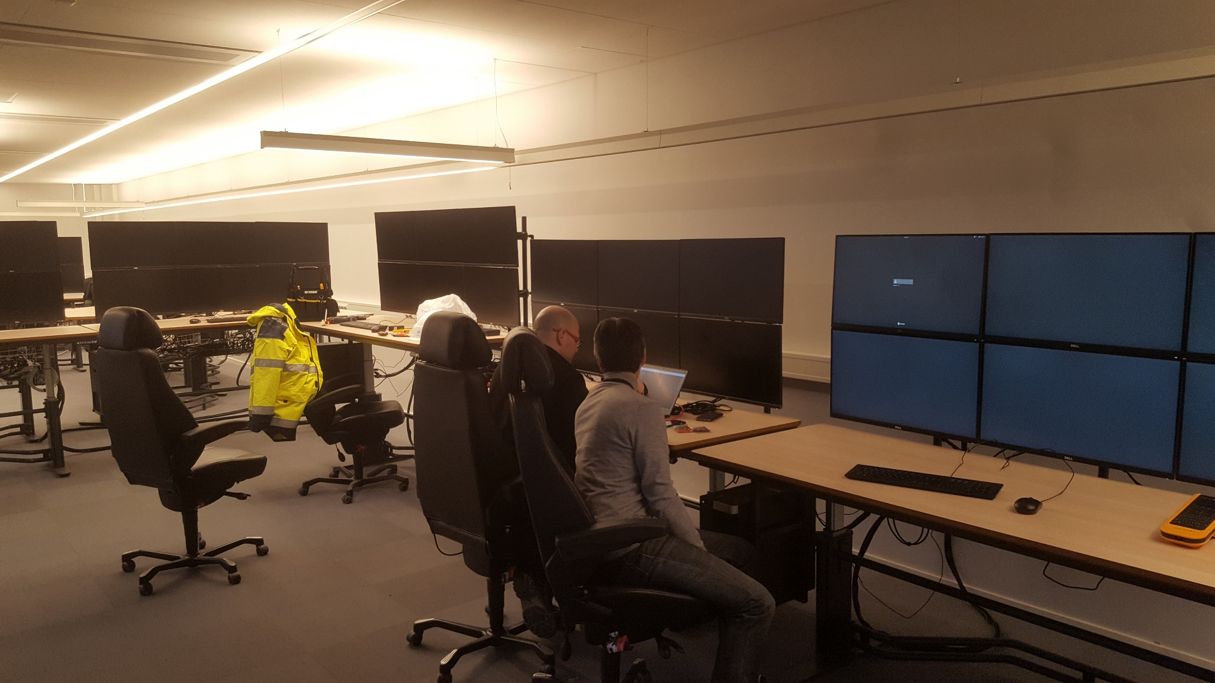
Some pictures from site…

Slide 13
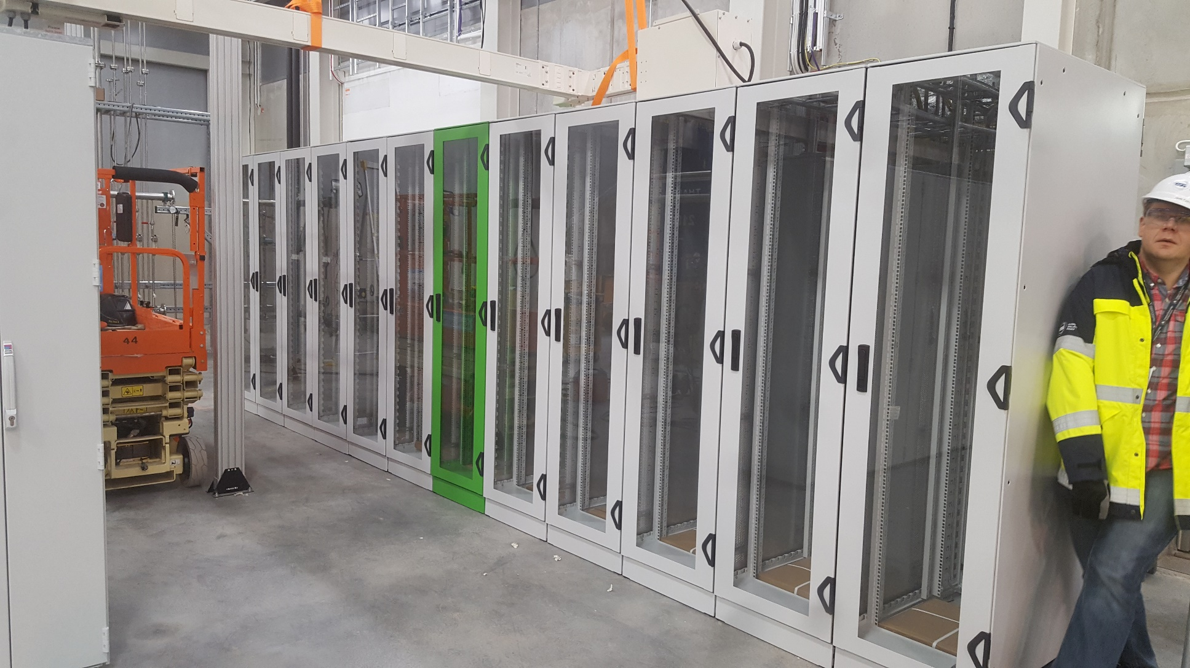
Racks

Slide 14
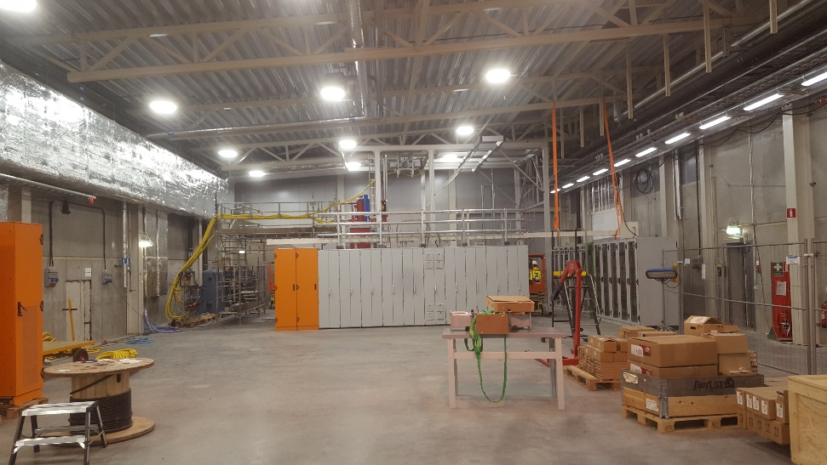
Questions?
Thank You!

