Slide 1
Modulator and RF system Status for TS2
Morten Jensen
RF Section Leader
WP8
www.europeanspallationsource.se
29 November, 2017

Slide 2
Overall System Design

Slide 3
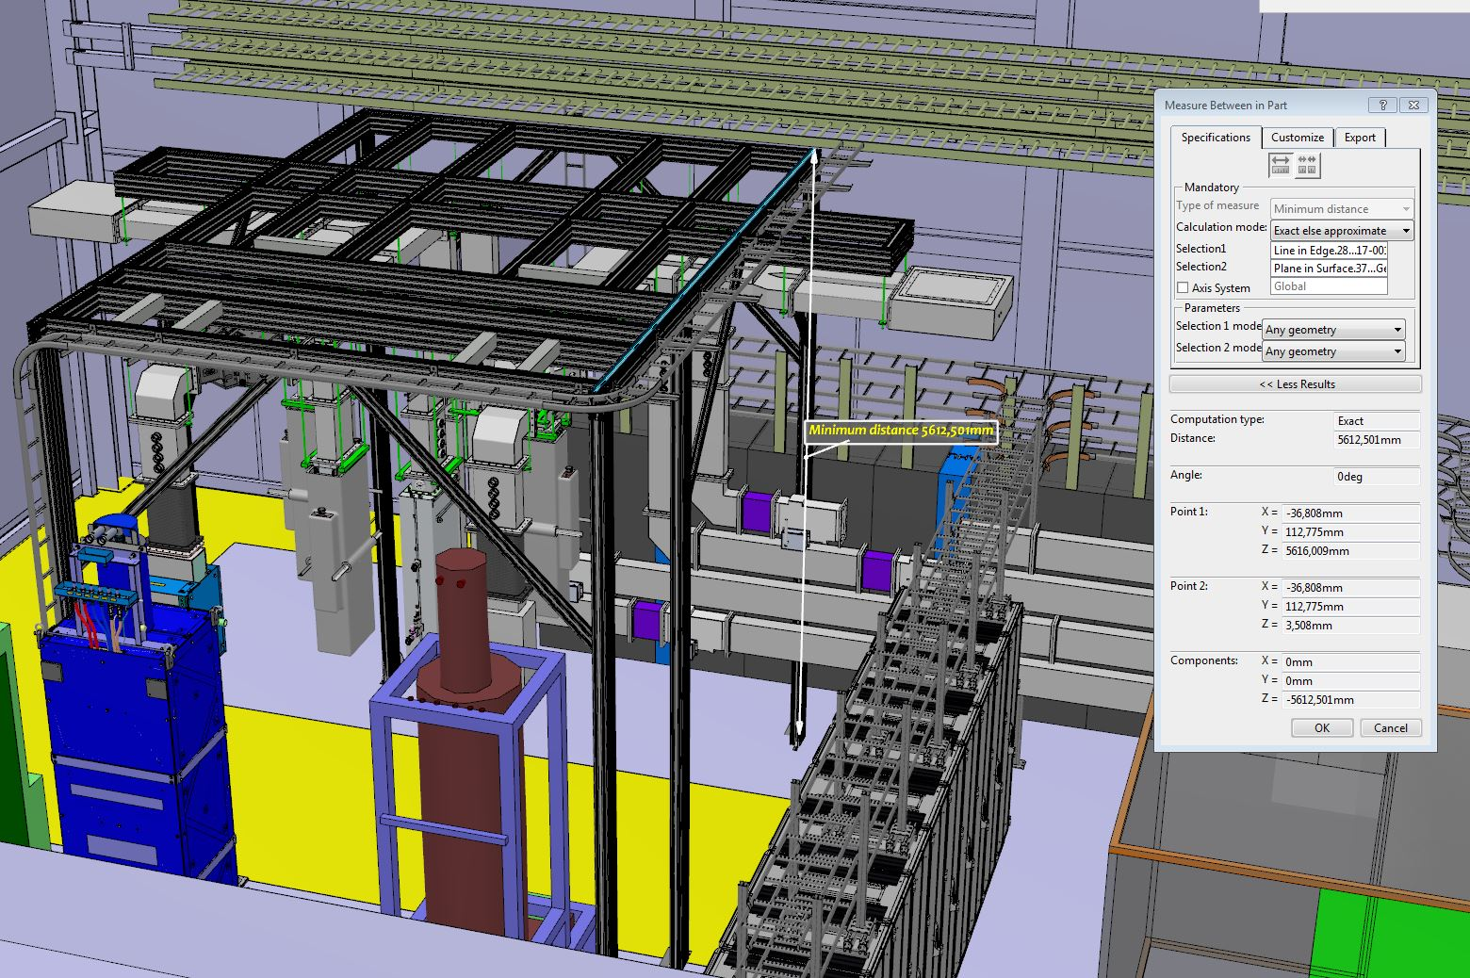
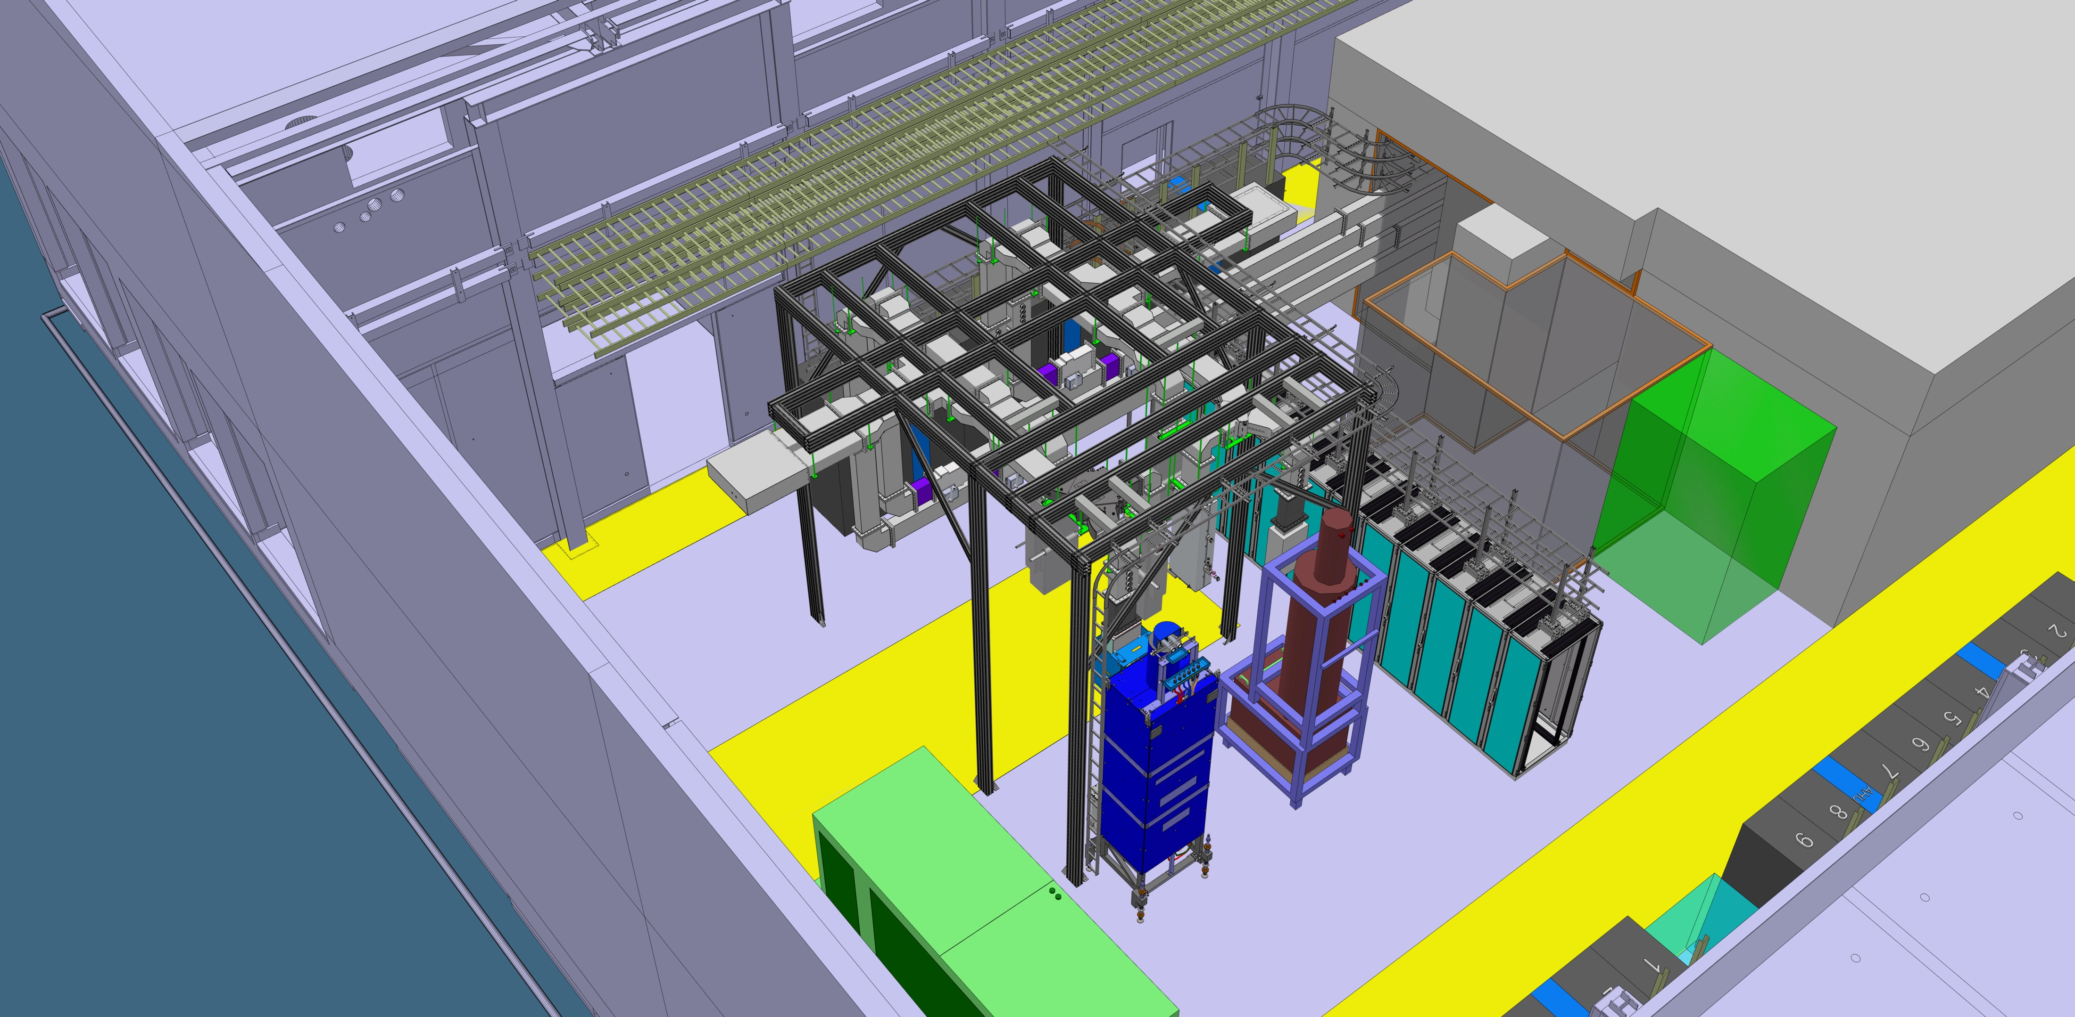
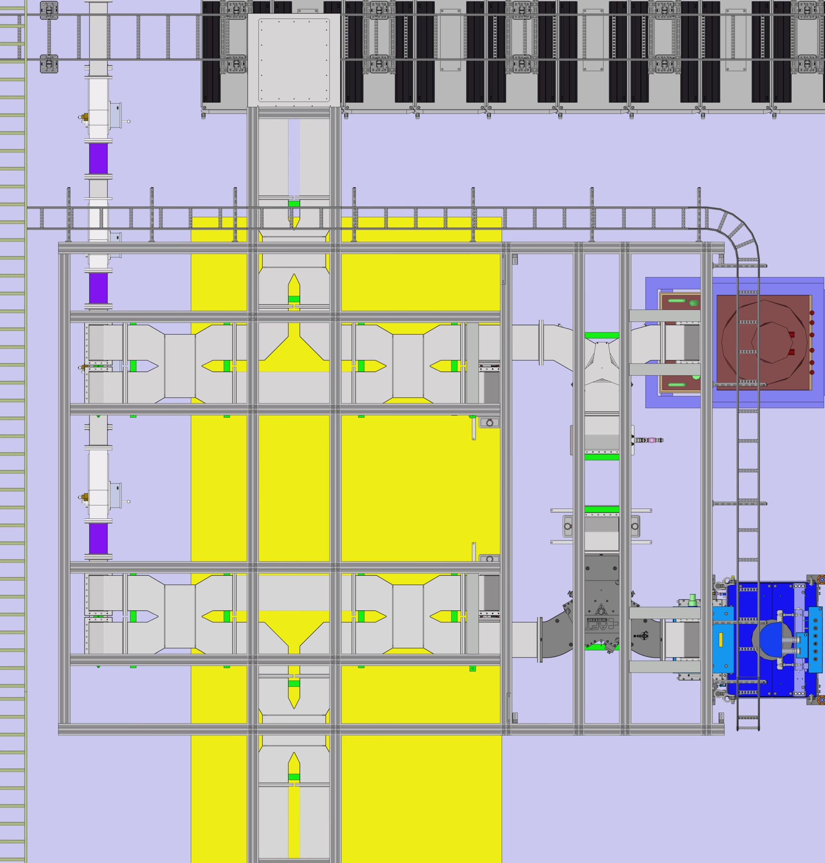
Layout: Model in Catia

Slide 4
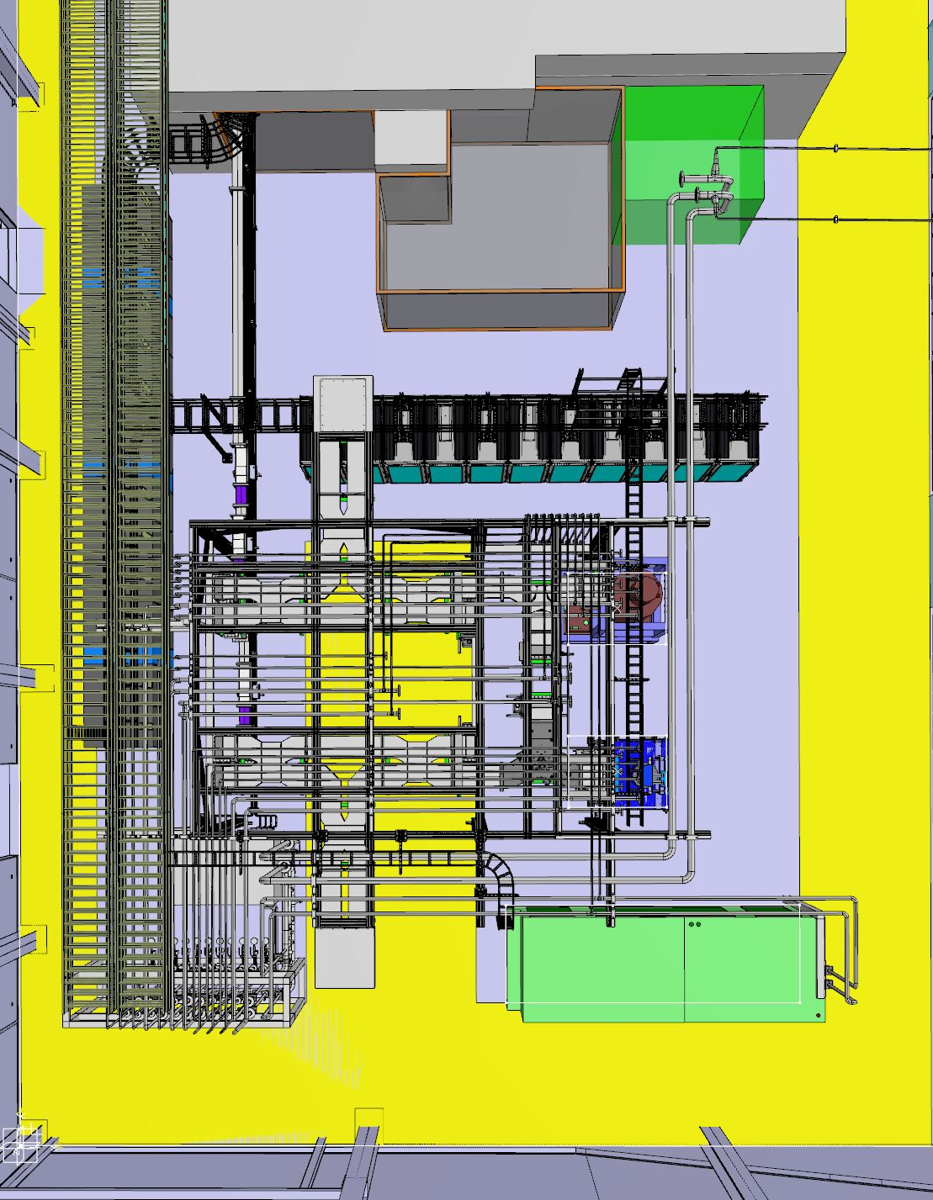

Slide 5
Current Management
RF Section Leader / WP8 – Morten Jensen
  TS2 RF Systems general overview – Stevo Calic
  RF Support - Staffan Ekström and Walther Borg (and others)
TS2 Bunker and Cavities – Wolfgang Hees
Electrical Safety Leader – Morten Jensen
Water Systems – Anton Lundmark and others
Electrical – Frithiof Jensen and others

Slide 6
Summary Equipment List
Two Klystrons (Toshiba and Thales) Ampegon modulator (can supply two klystrons)
Two circulators (AFT and MEGA)
Two RF loads (AFT and Thales)
Two reject loads (AFT to be procured)
Two high power splitters (0-100%) to be procured
Waveguide including PSS and waveguide switches for 4 cavities
LLRF x 2, (controls pairs of cavities)
2 complete klystron aux systems, interlock systems etc

Slide 7
Schedule/Status – Installation System 1
Support Structure in place
RF systems being installed now
Klystrons in place
Temporary water cooling in place
Permanent water cooling expected by end of the year
Racks installed and rack layout drafted
Rack power installed
Klystron auxiliary supplies installed

Slide 8
Schedule/Status – Installation System 1
Drive amplifier installed
Fast switches installed
Interlocks (Slow Interlock) tested in the lab. Installation on Friday 1st Dec.
Fast interlock system (VME) tested in the lab
Fast interlock system mTCA in progress in the lab. Installation by end of the year (not needed before)
Modulator to be installed by the end of January 2018
Circulator installed
RF Load - prepared, currently at LTH. Return date TBC

Slide 9
Schedule Commissioning
Mains power commissioning for rack distribution complete
Rack component commissioning starting on Friday 1st December 2017
Temporary water system commissioned and connected to loads
Permanent water commissioning TBD
LLRF mTCA crate available with a ‘prototype’ running the the lab

Slide 10
Safety
Radiation license applied for and granted
Local rules drafted and under review
Area fenced off
Local background monitoring started in the summer
Commissioning procedure drafted to be reviewed
LOTO station in place
RF General Work Procedures and RA produced
Local ‘Special Hazard’ procedures being drafted (RF waveguides, water, electrical

Slide 11
Concerns
System 2 has many items missing (currently at LTH and planned for HB cavity testing in Uppsala)
Staff availability is at critical level as the installation in the gallery is starting
Strong dependence on availability of:
  electricity (recently connected to temporary supplies)
  permanent water (currently no chilling capacity installed)
  Modulator (Ampegon modulator in Uppsale, PPT modulator under repair, SML under test at LTH)

Slide 12
Full LLRF requirements may not be fully appreciated
Cryomodule test requirements and RF support not be fully appreciated
Operations support not fully appreciated
Increased risk for MB and component testing due to delays in getting started:
  Late access
  Power
  Modulator
  Water

Slide 13
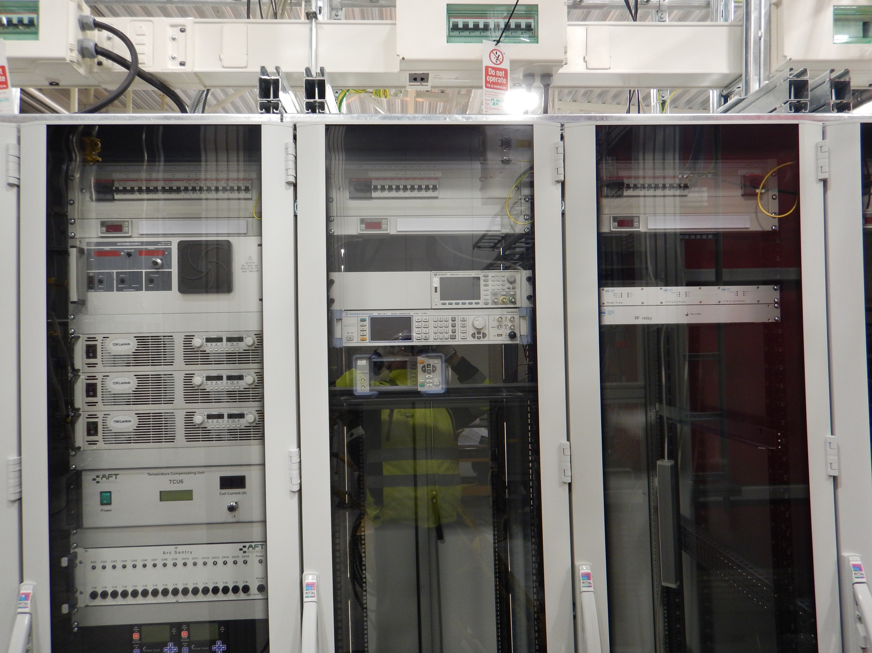
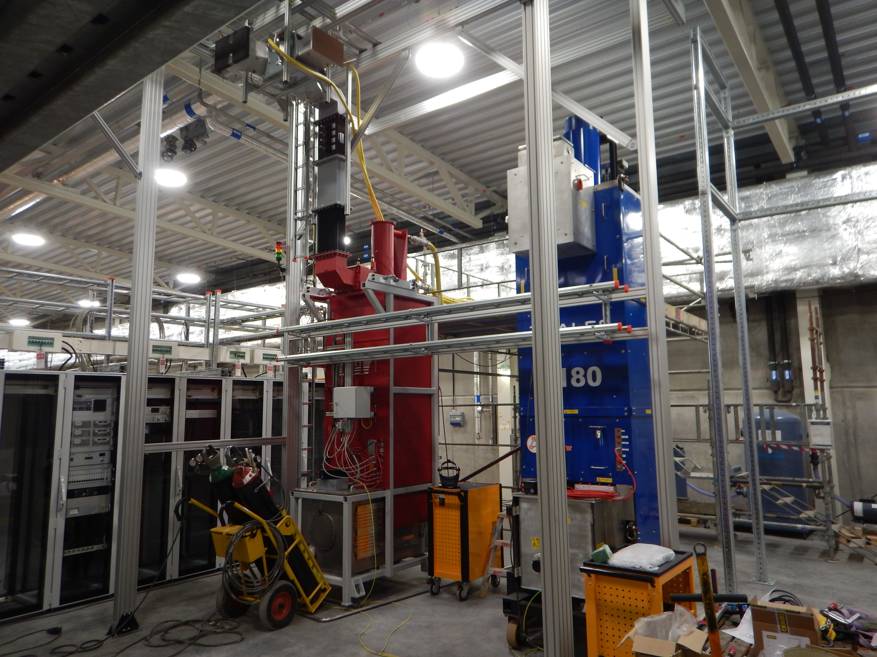
Photos from Today

Slide 14
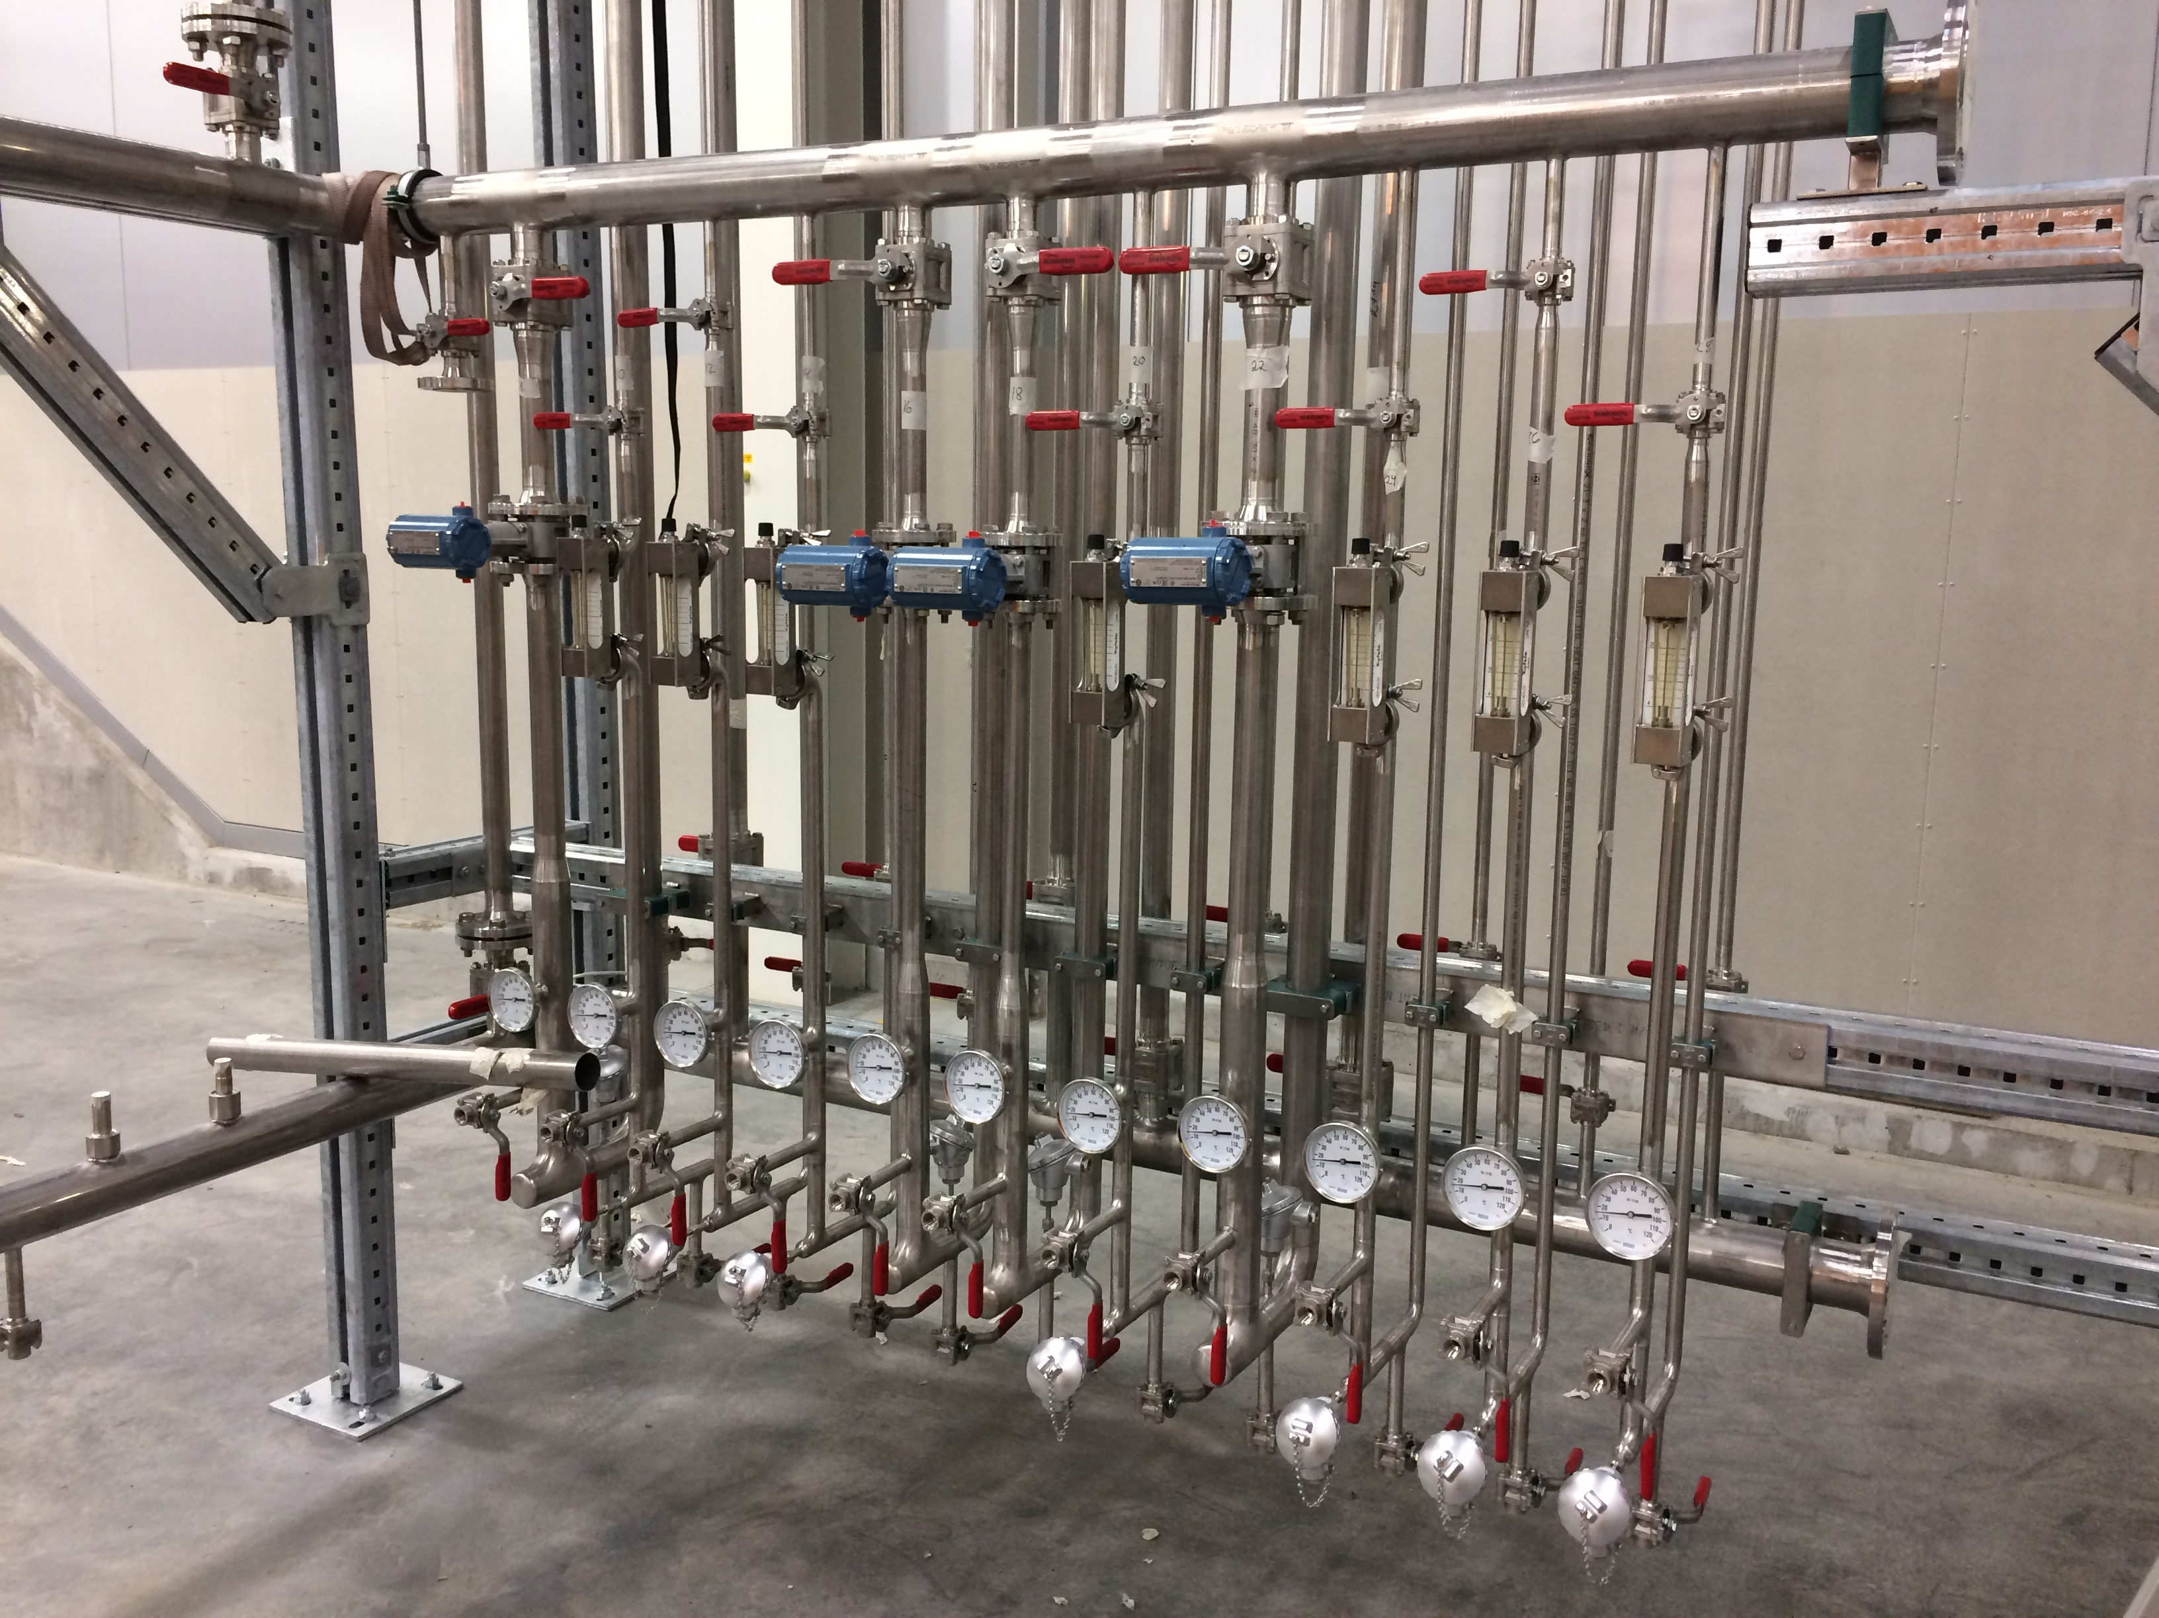
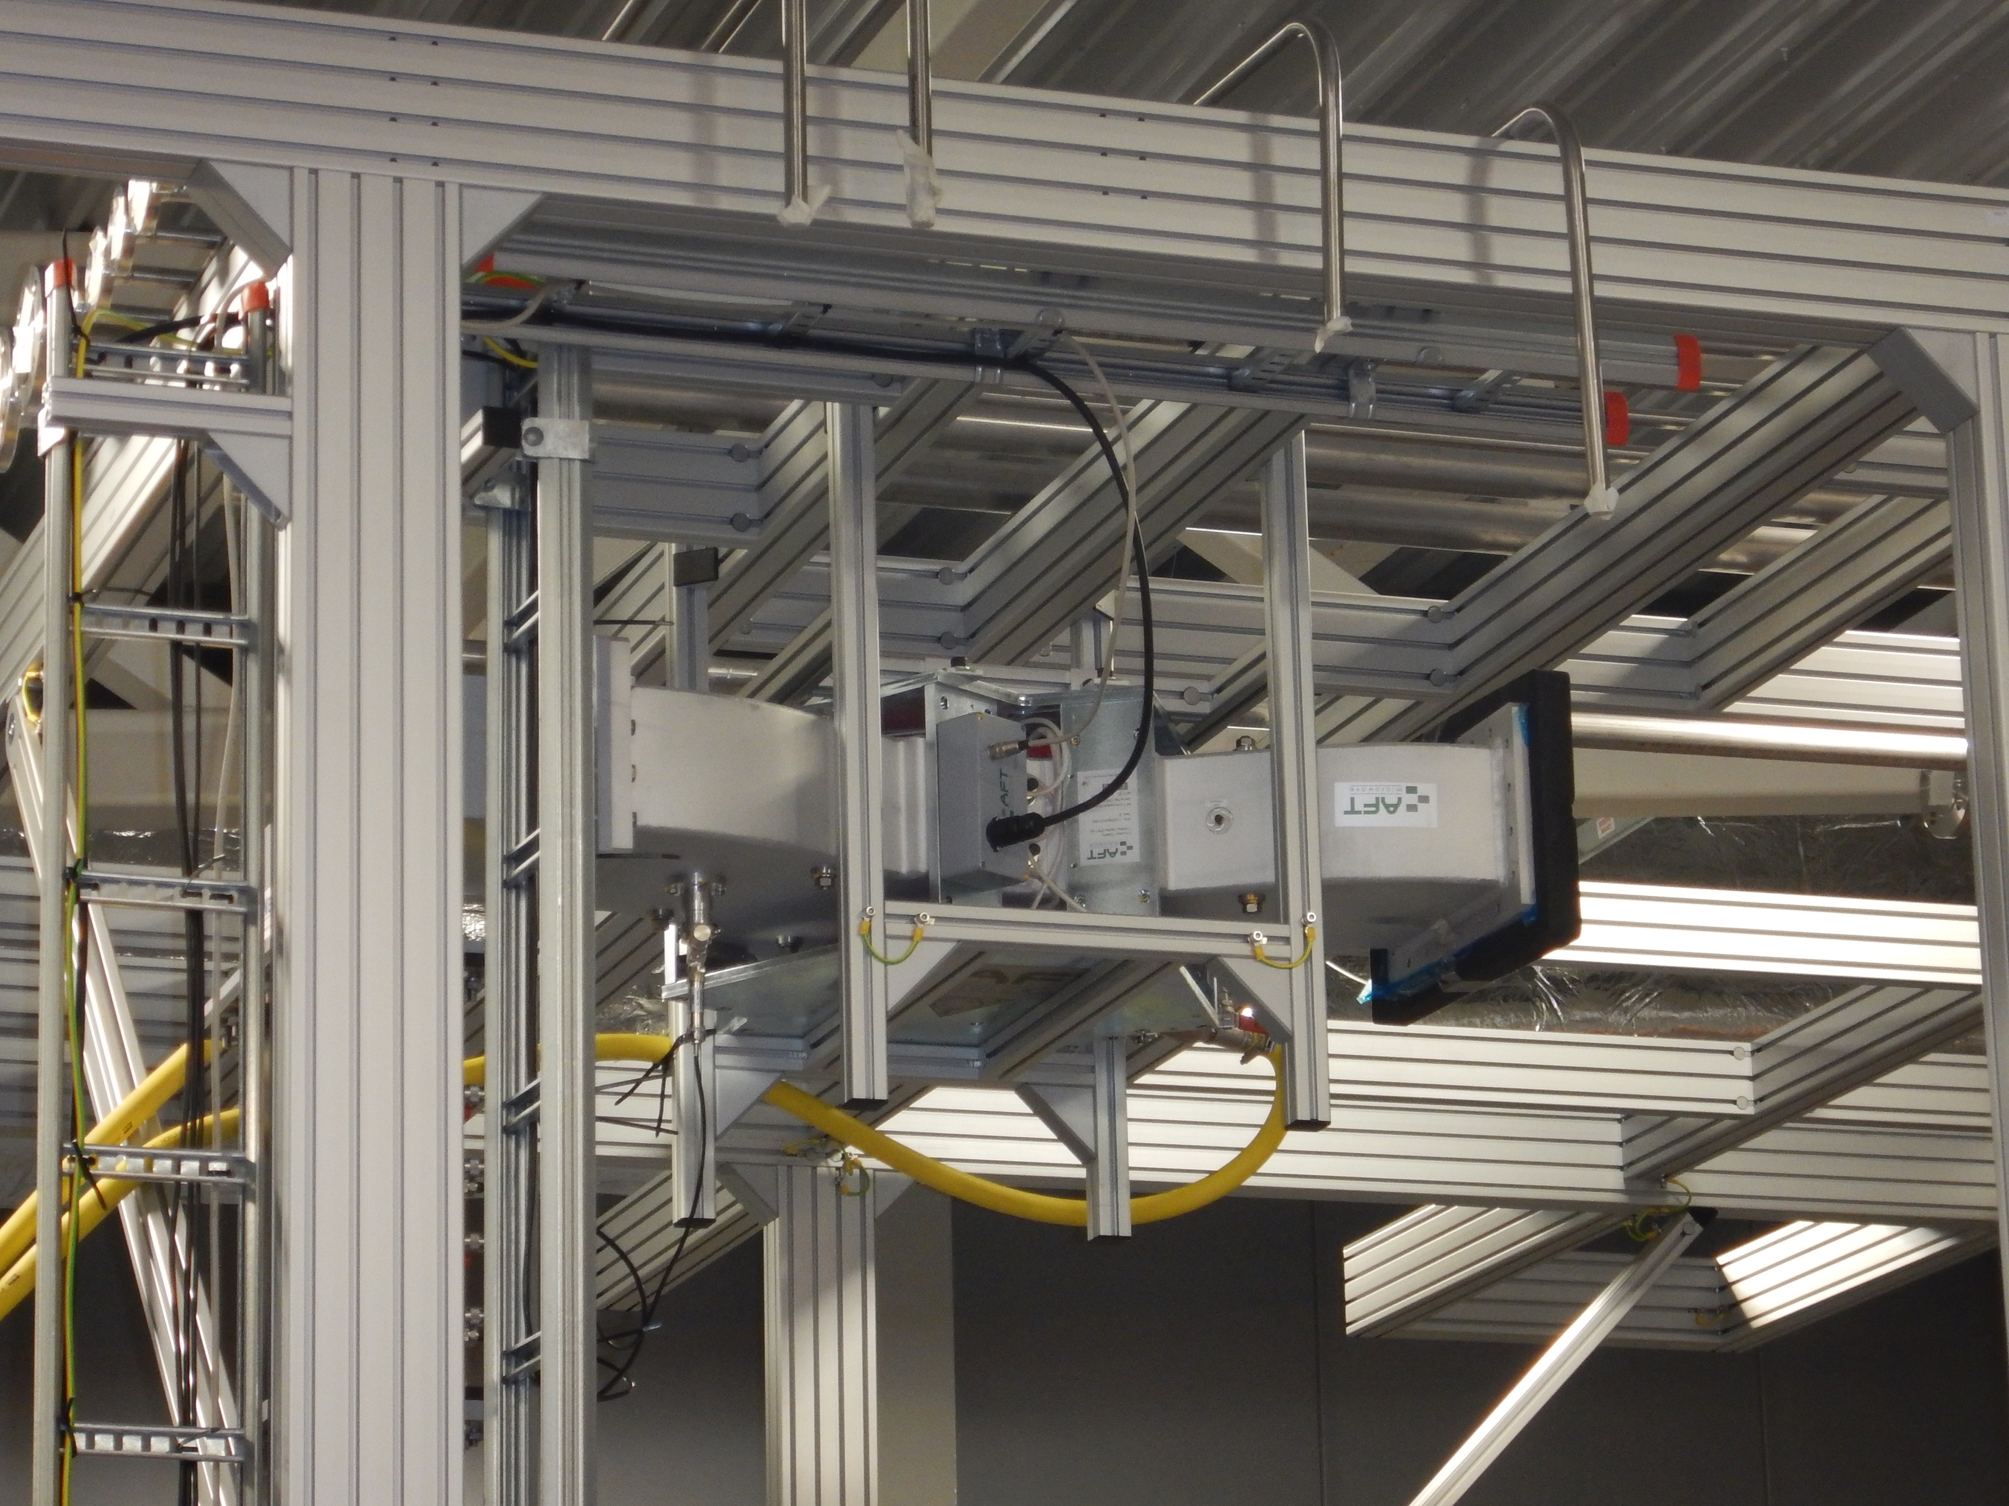
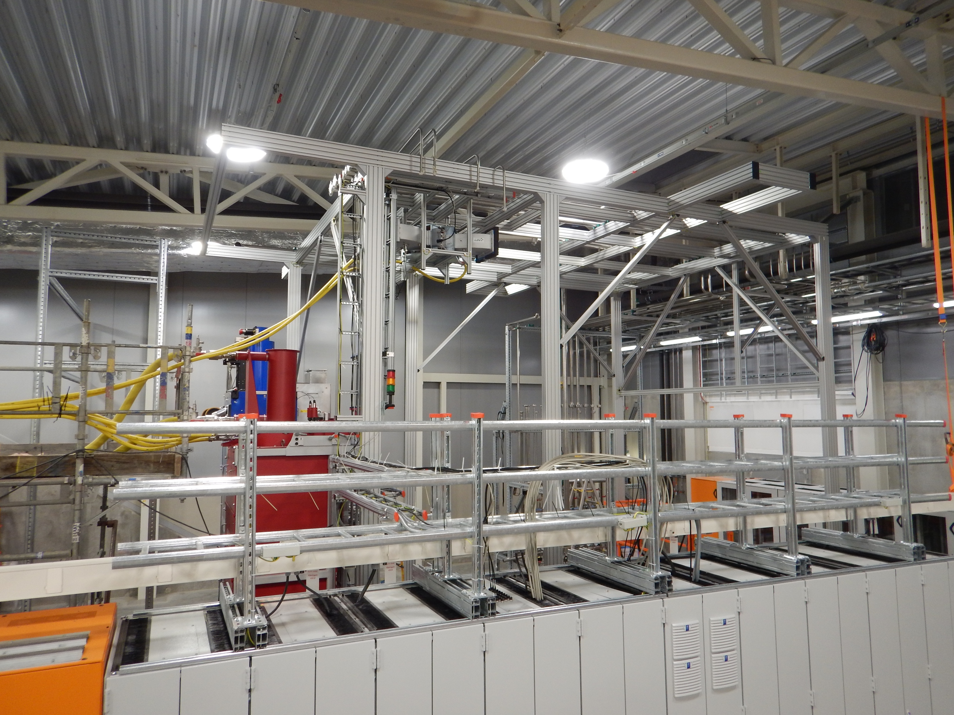
Photos from Today

