Slide 1
FREIA Laboratory
Facility for Research Instrumentation and Accelerator Development
System Review
of the
ESS Cryomodule Tests
⎯⎯⎯⎯⎯⎯⎯⎯⎯⎯⎯⎯⎯⎯⎯⎯⎯⎯⎯⎯⎯⎯⎯
Spoke Cryomodule Testing
at the FREIA Laboratory
30 November 2017
Magnus Jobs & Roger Ruber
for the FREIA Team

Slide 2
Contents
Plans and schedule for the FREIA Laboratory, Uppsala University,
for acceptance testing of 13 spoke cryomodules
Description of the FREIA Laboratory
Control and safety systems
Quality assurance and documentation
Test plan
Testing schedule
Spoiler:
Present ESS overall schedule allows 4 weeks per cryomodule test, reduced from original 18 months combined (= 6 weeks/cryomodule).
No time allotted for re-test, failure or vacation (= resource squeeze).
We consider this not feasible and request a minimum 6 weeks (average).

Slide 3
Reminder – Some History
2009: ESS-S and Uppsala start discussion on collaboration
  development of 704 MHz RF and high power test of cavity
2010: Uppsala University decides to construct the FREIA Laboratory
  funding from KAWS, Swedish Government and Uppsala University
  funding from ESS for ESS development work
2011: Collaboration agreement ESS – Uppsala
  development of 704 MHz RF
2013: Amendment and change of direction
  development of 352 MHz RF, tetrode and solid-state
  test of spoke cavity package and prototype cryomodule
2015: Extended collaboration for ESS construction
  development and test of series spoke cryomodules and controls
  test of prototype and pre-series 704 MHz RF stations
2017: Modification
  test of 704 MHz high beta elliptical cavity instead of pre-series 704 MHz RF

Slide 4
Spoke Cryomodule Testing at FREIA
Basic infrastructure available
  and tested during development prototype spoke RF system and high power test of spoke cavity package
Original time schedule for test (and thereby training possibilities)
  1 year spoke cavity package
  → finally 3.5 months: 6 wks (conditioning to warmup) + 8 wks (install/remove)
  1 year prototype spoke cryomodule
  → now < 6 months (installation, test, removal)
  18 months for acceptance test of 13 series spoke cryomodules
  → now 12 months
Reasons for decreased testing time
  delays in ESS schedule but keeping with the end date (acceleration completion)
  → cut testing time to keep scheduled end date
  now the end date has been delayed
  → but end date for testing kept on paper as the present contract with Uppsala University foresees end of financial support by ESS in February 2019

Slide 5
Relevant Tests Performed
Single spoke cavity
  antenna, low power
  self-excited loop (SEL)
  RF calibration procedures
Double spoke cavity with tuner
  antenna and cold tuner, low power
  cryogenics: cooling, heat load
  LLRF, SEL
  Q₀ and gradient, microphonics
Double spoke cavity package
  power coupler and tuner, nominal gradient
  Q₀ and gradient, microphonics, fill time, Lorentz force detuning
  tuner operation
RF Station 352 MHz (2x)
  acceptance and functional test
    including RF distribution components
  soak test
  pulsed and CW operation on cavity
RF Station 704 MHz
  acceptance & operation of modulator

Slide 6
Description of the
FREIA Laboratory

Slide 7
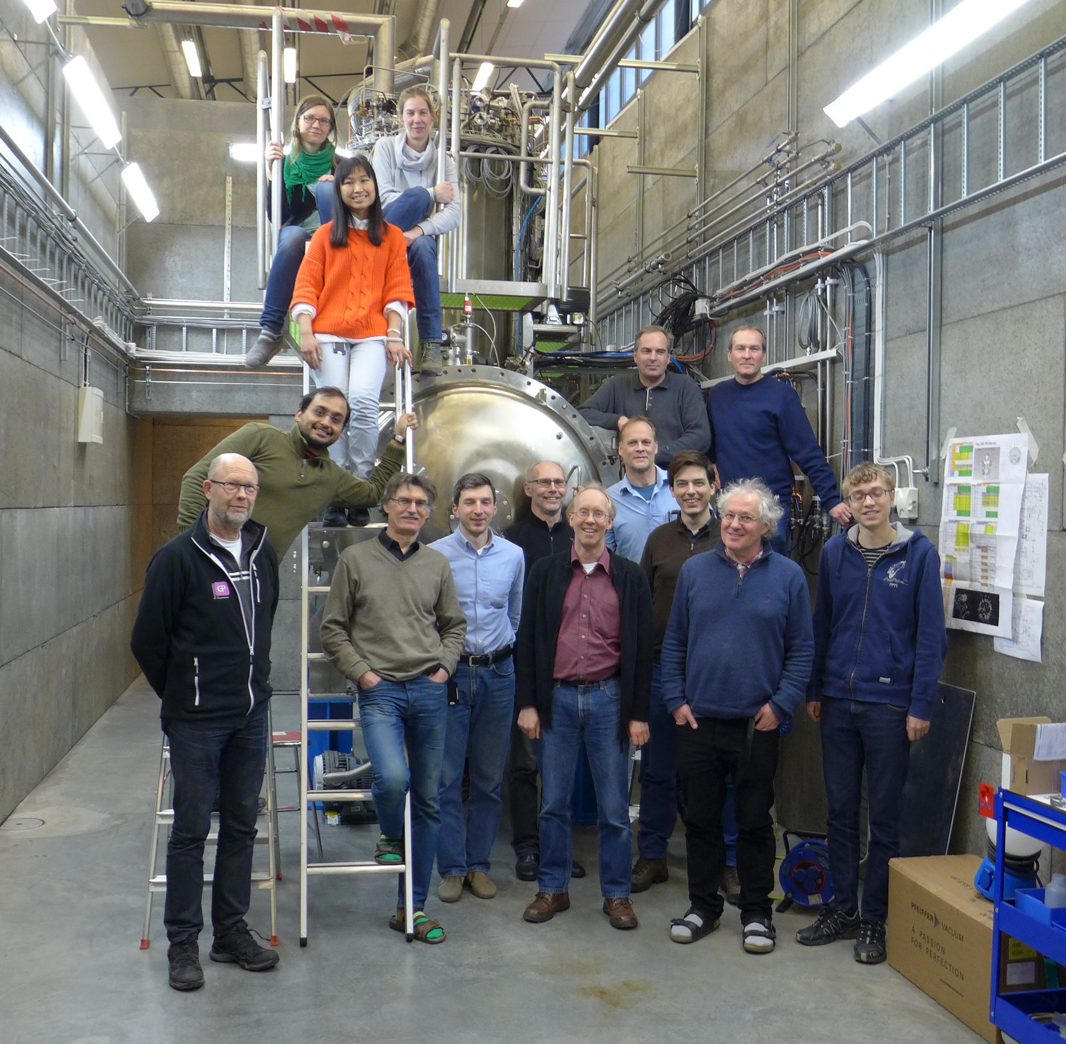
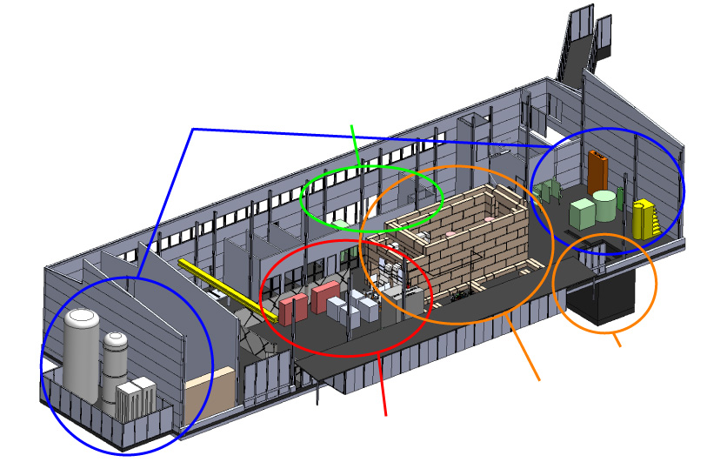
What and Whom?
Facility for Research Instrumentation and Accelerator Development
State-of-the-art Equipment
cryogenics
- liquid helium
- liquid nitrogen
control room
- equipment controls
- data acquisition
Competent and motivated staff
collaboration of physics (IFA)
and engineering (Teknikum).
Funded by
KAWS, Government, Uppsala Univ.
vertical cryostat
3 bunkers
with test stands
horizontal cryostat
radio-frequency (RF) power sources

Slide 8
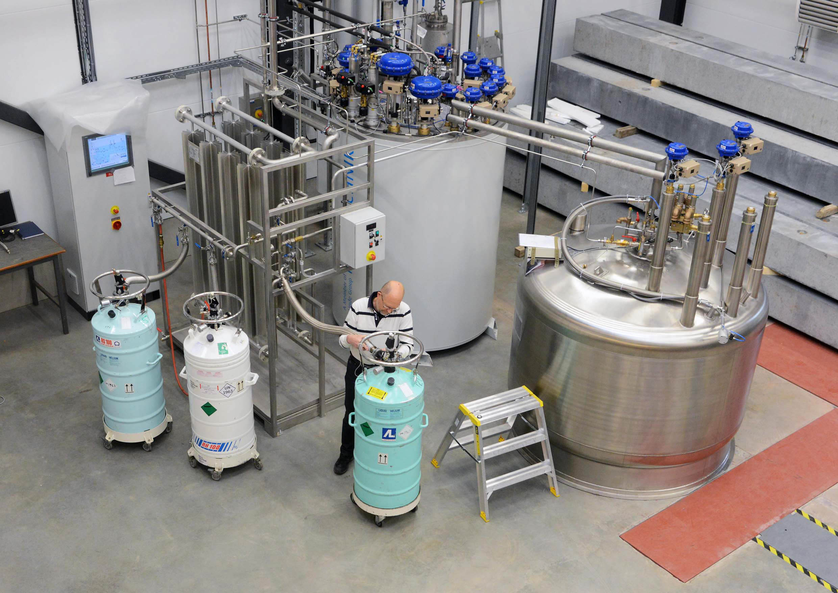
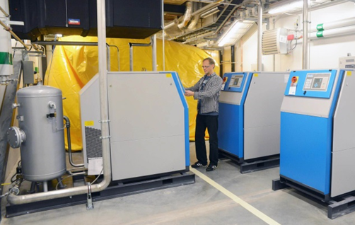
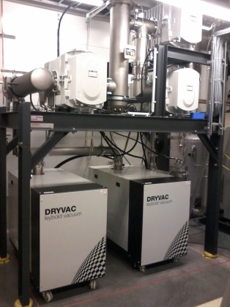
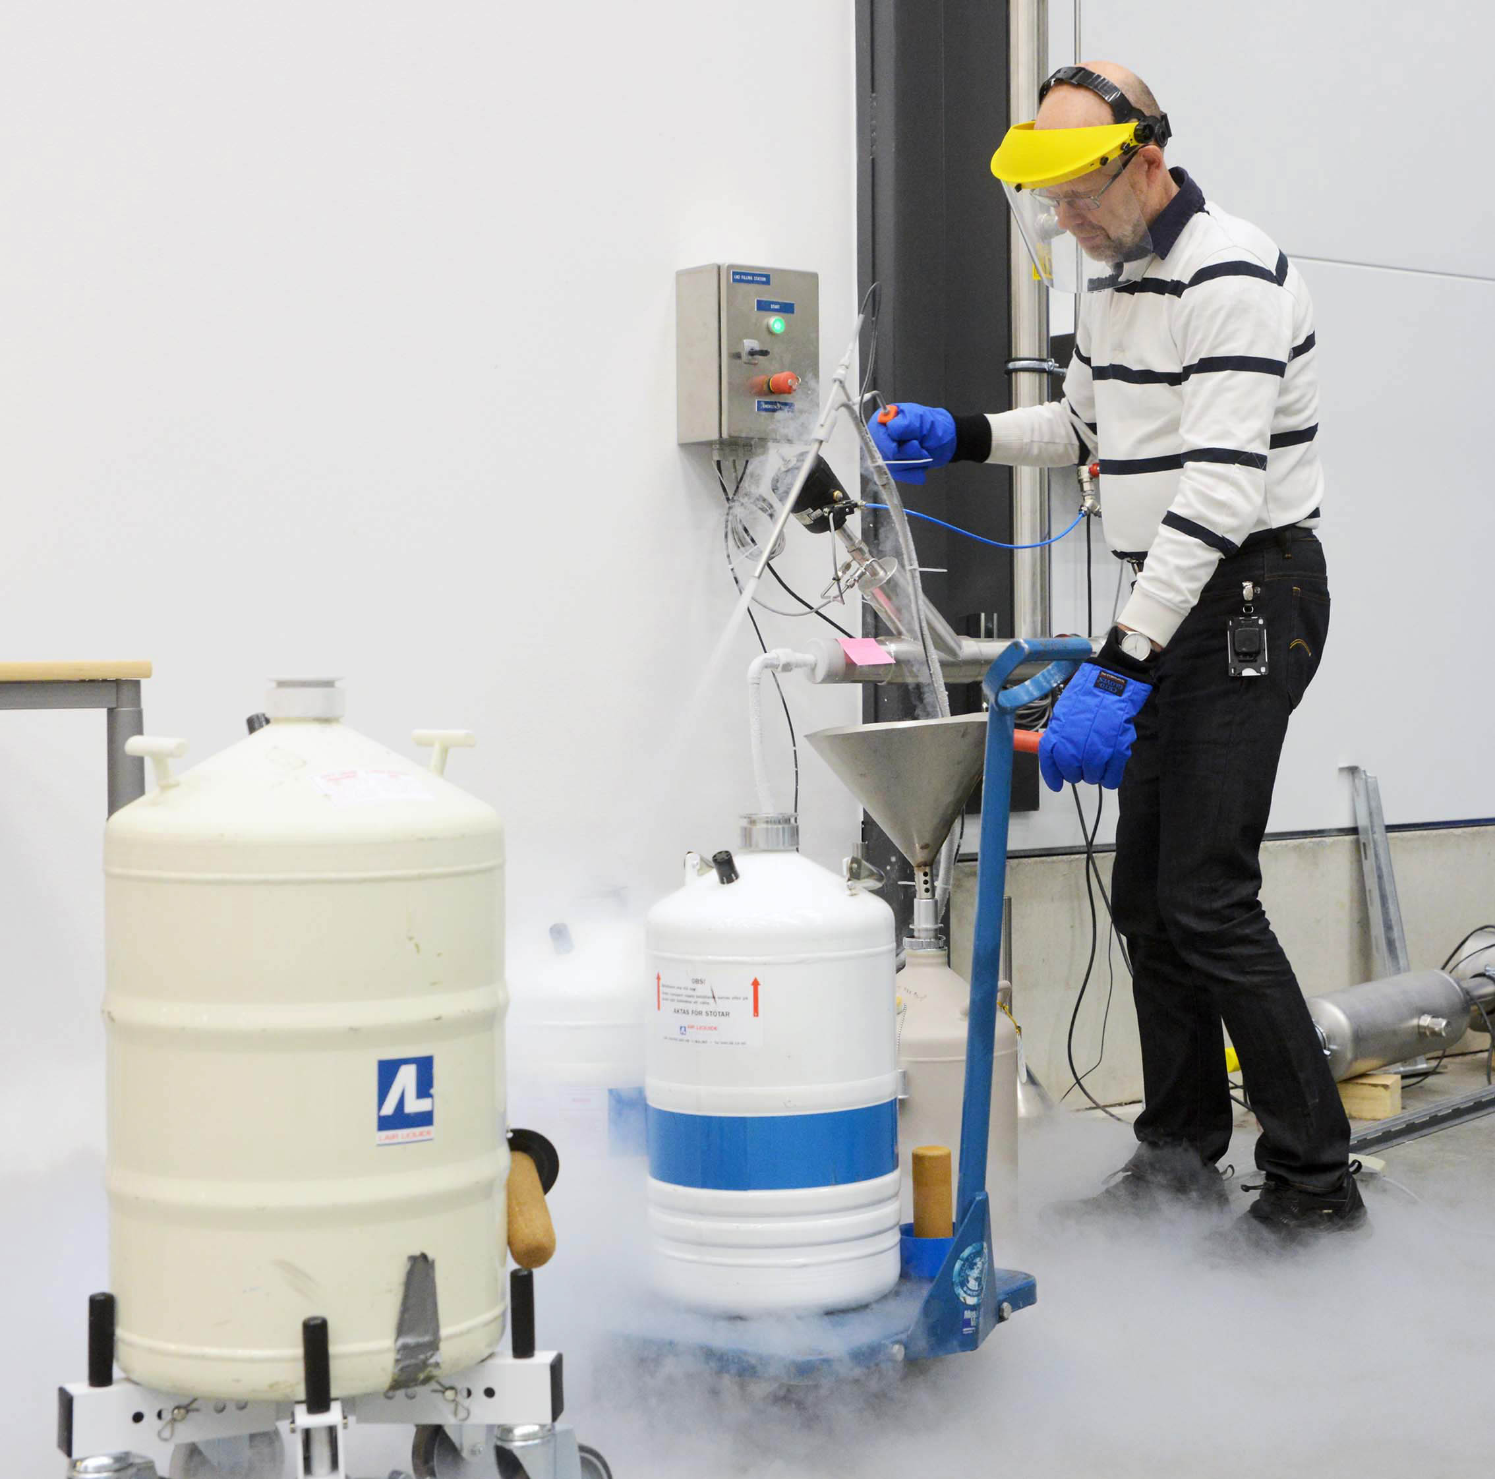
Cryogenics
Helium liquefaction
  150 l/h at 4.5K (LN2 pre-cooling)
  2000 l LHe dewar/buffer, 3+1 outlets
  cryostats connected in closed loop
Gas recovery
  100 m³ gasbag
  3x 25 m³/h compressor
  10 m³ 200 bar storage
2K Pumping
  ~3.2 g/s at 10 mbar
  ~4.3 g/s at 15 mbar
  110(90)W at 2.0(1.8)K
Liquid nitrogen
  20 m³ LN2 tank
Helium gas recovery system
Sub-atmospheric pumping station

Slide 9
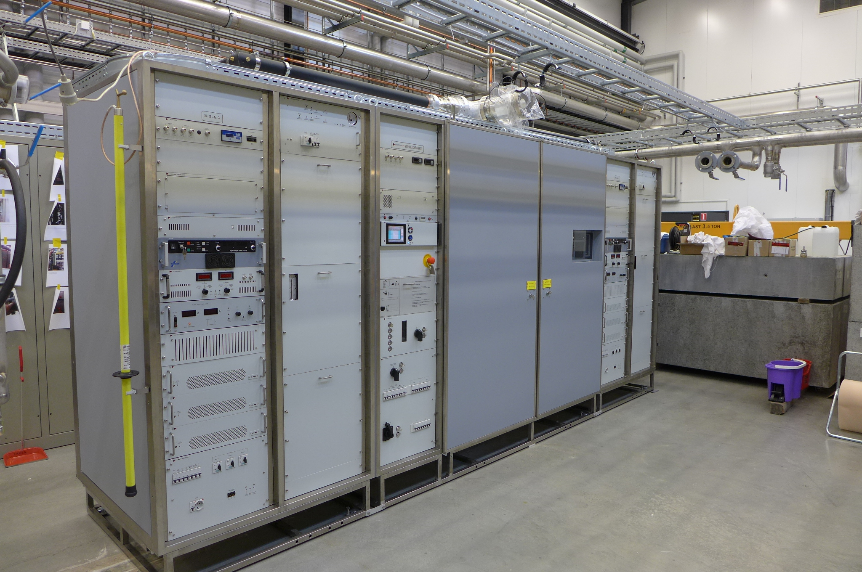
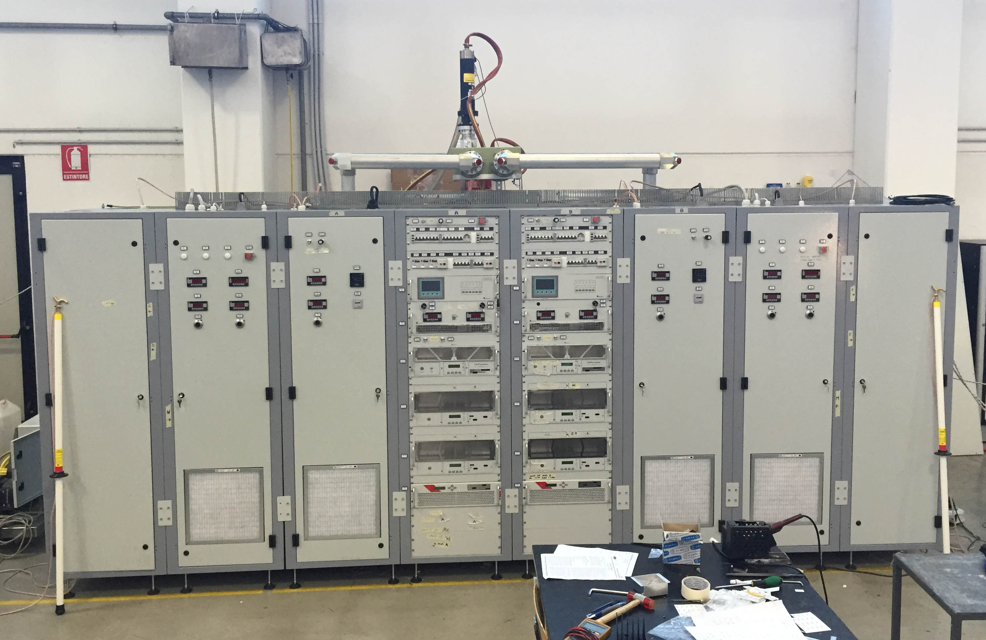
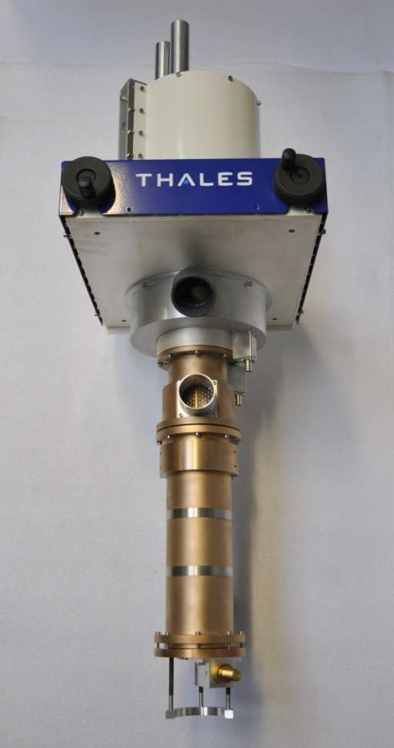
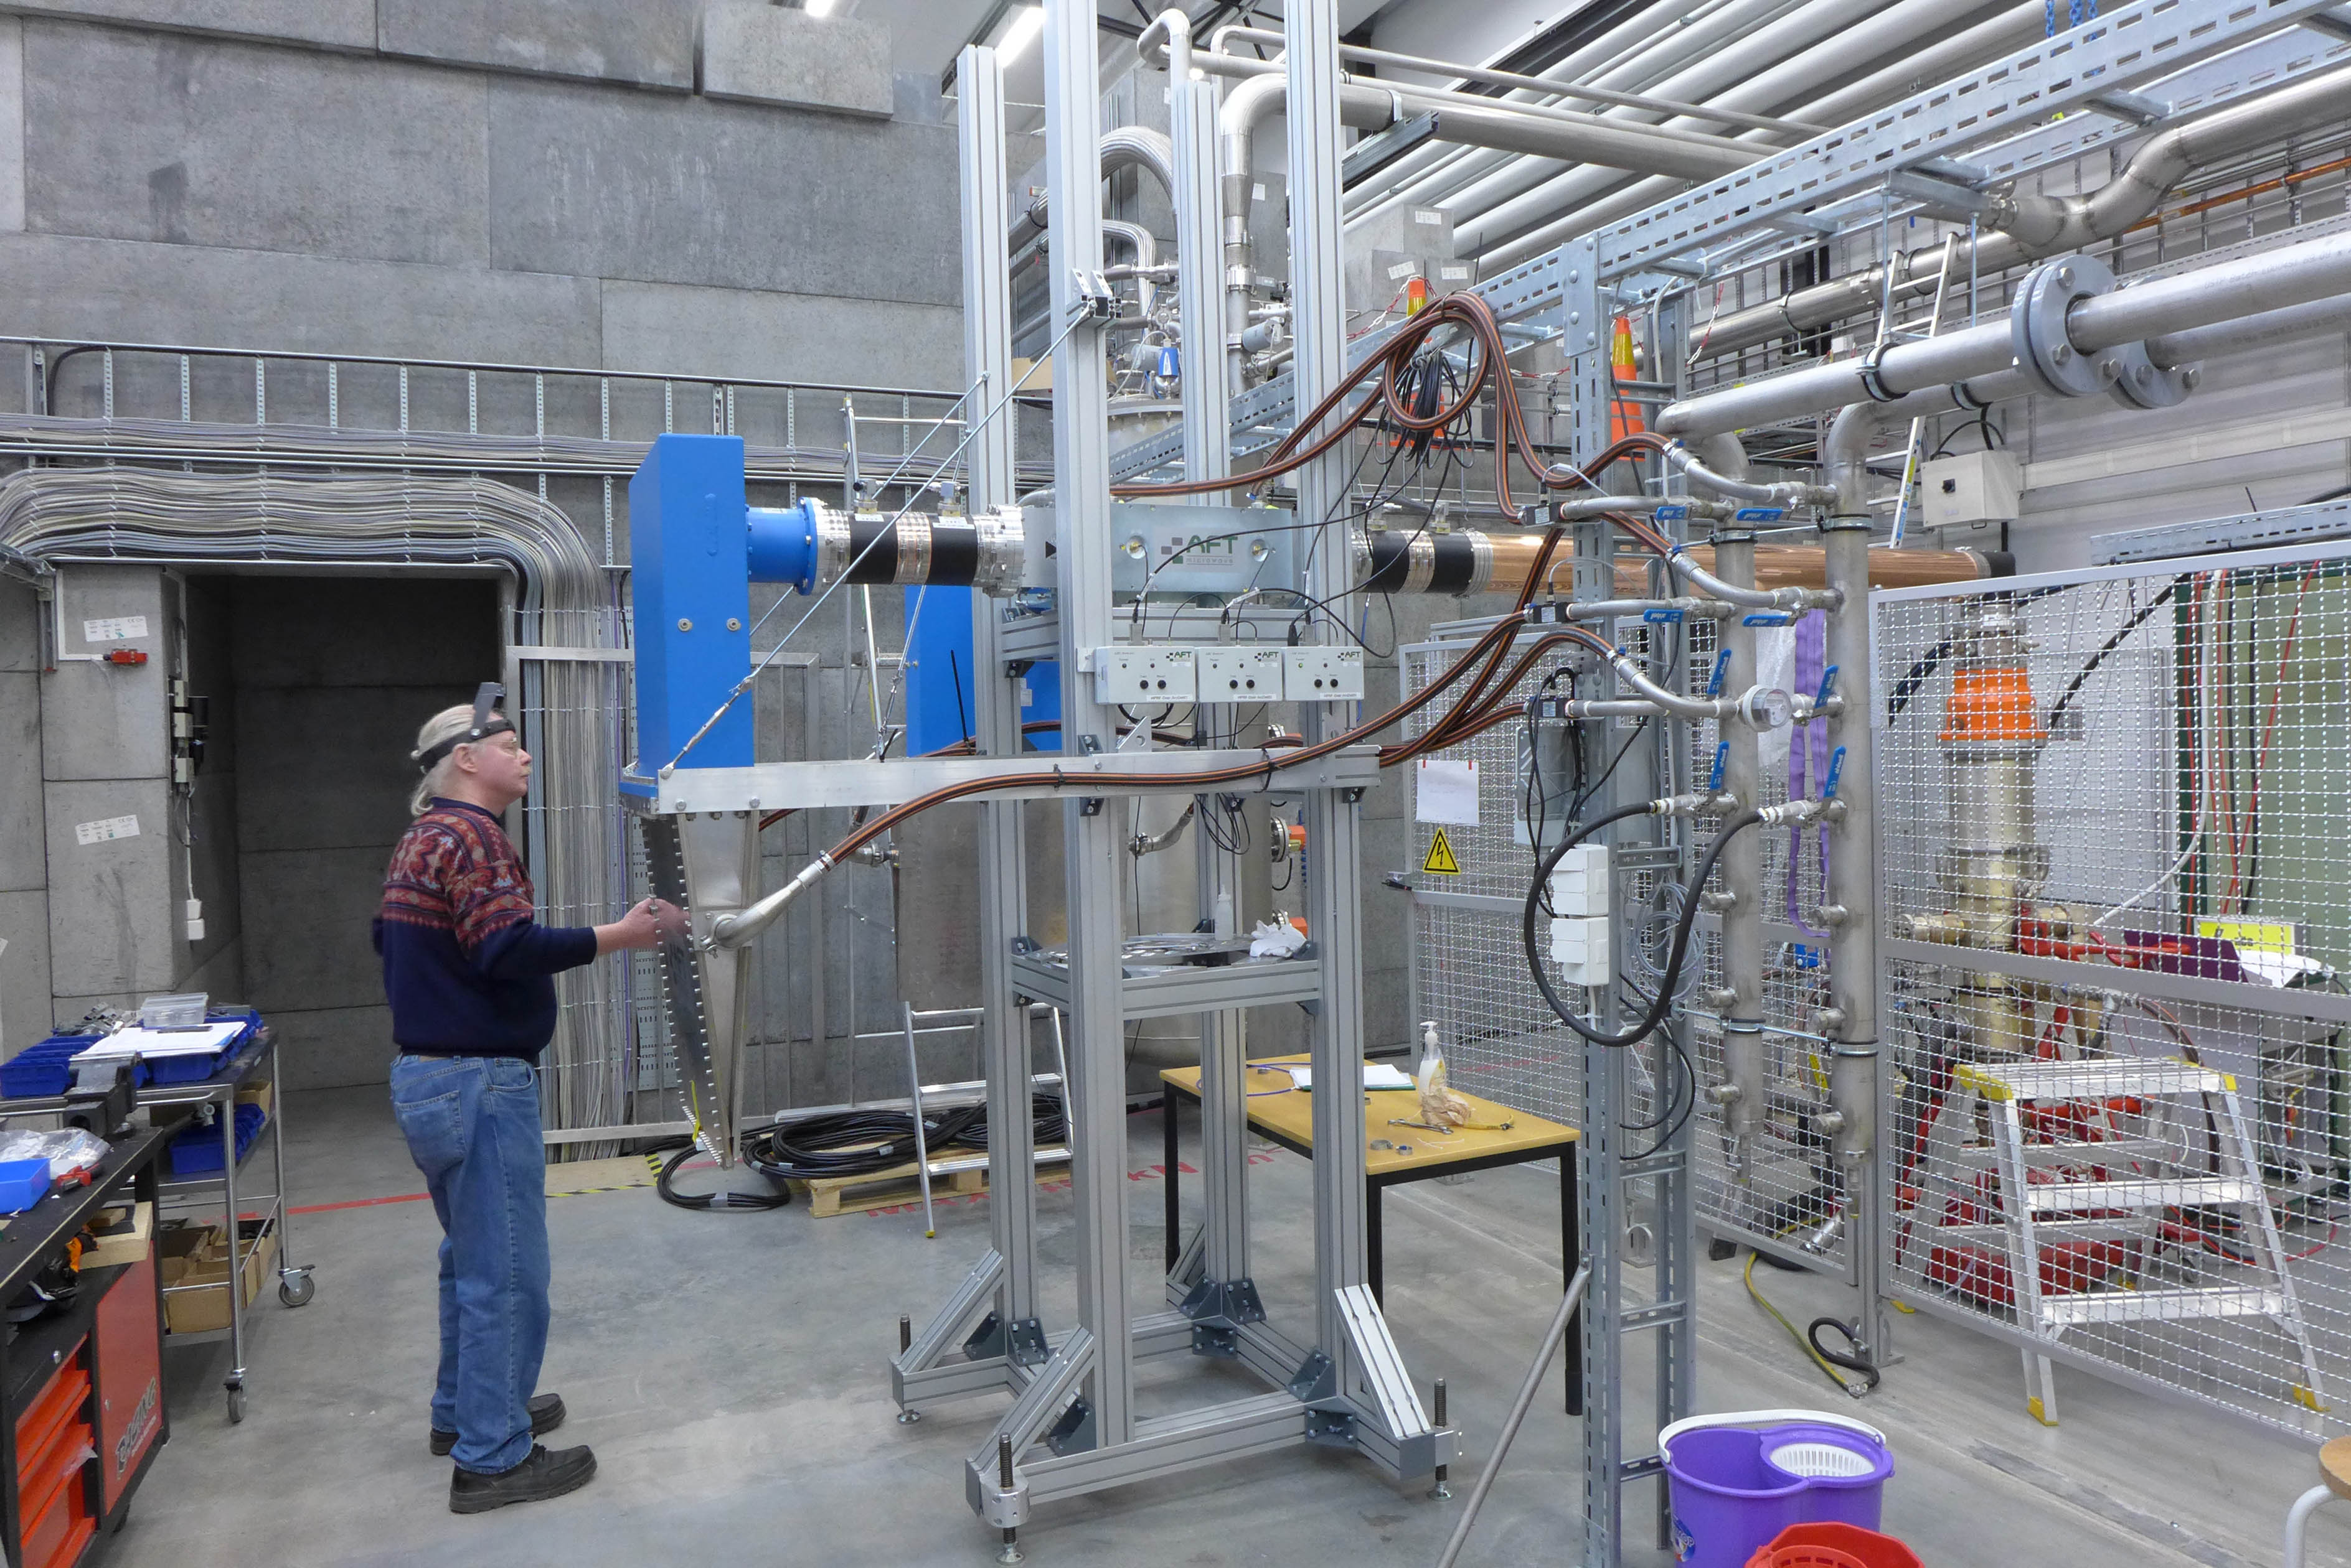
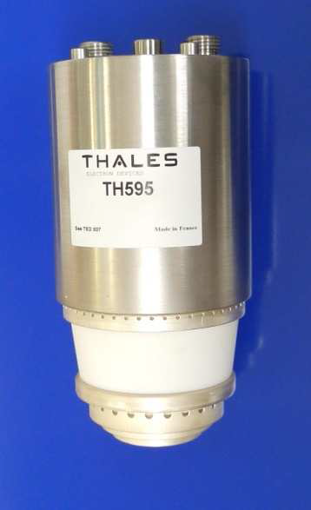
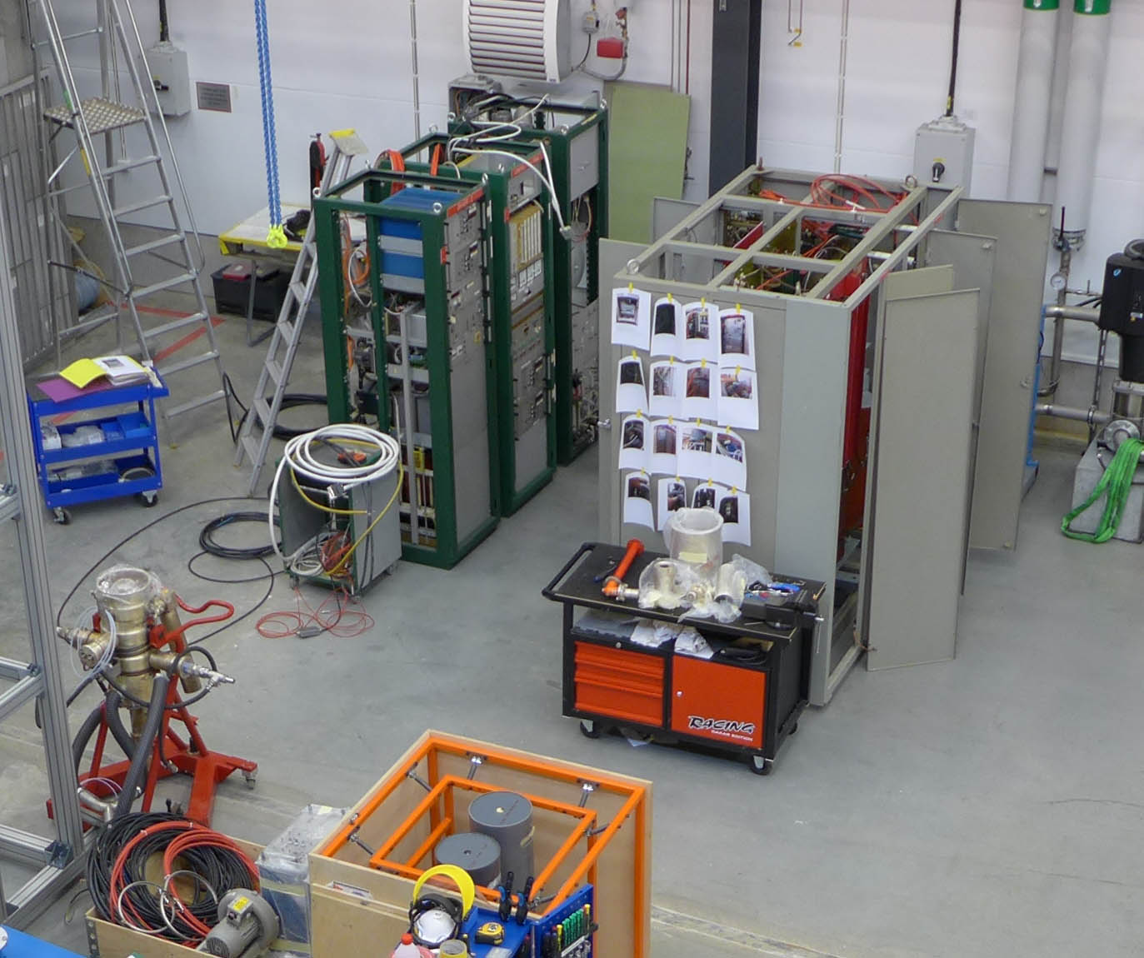
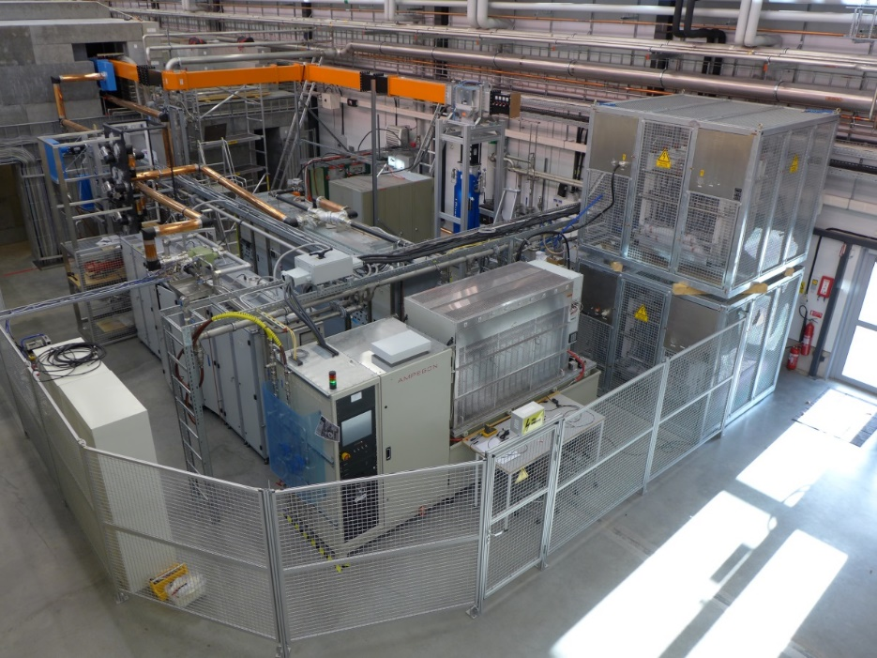
352 MHz RF Amplifiers
50 kW, CW
  on loan from CERN
    in operation since October 2015
    TH571b
    352 or 400 MHz output cavities
400 kW, 3.5 ms, 14-28 Hz
  Uppsala development
  combined output 2 tetrodes
    TH595
  Itelco-Electrosys (IT)
    in operation since August 2015
  DB Elettronica/DB Science (IT)
    in operation since December 2016
CERN 50 kW CW

Slide 10
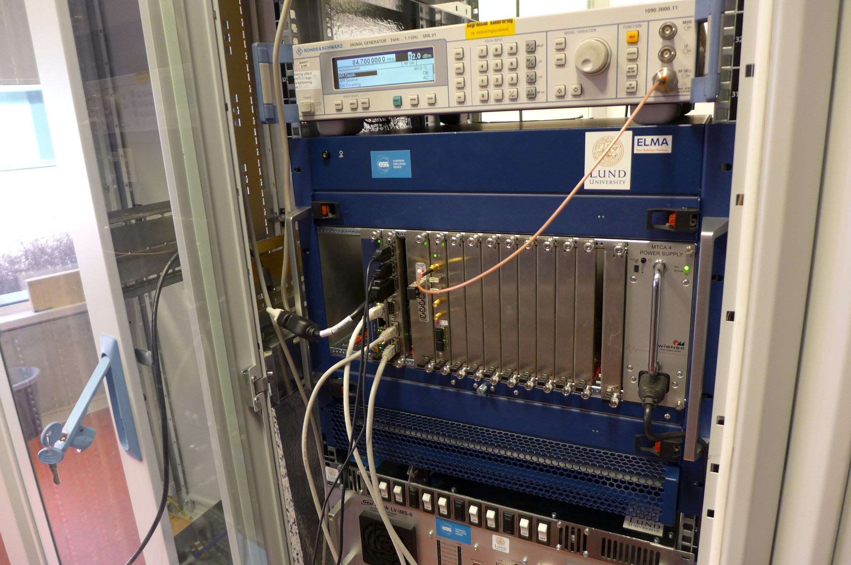
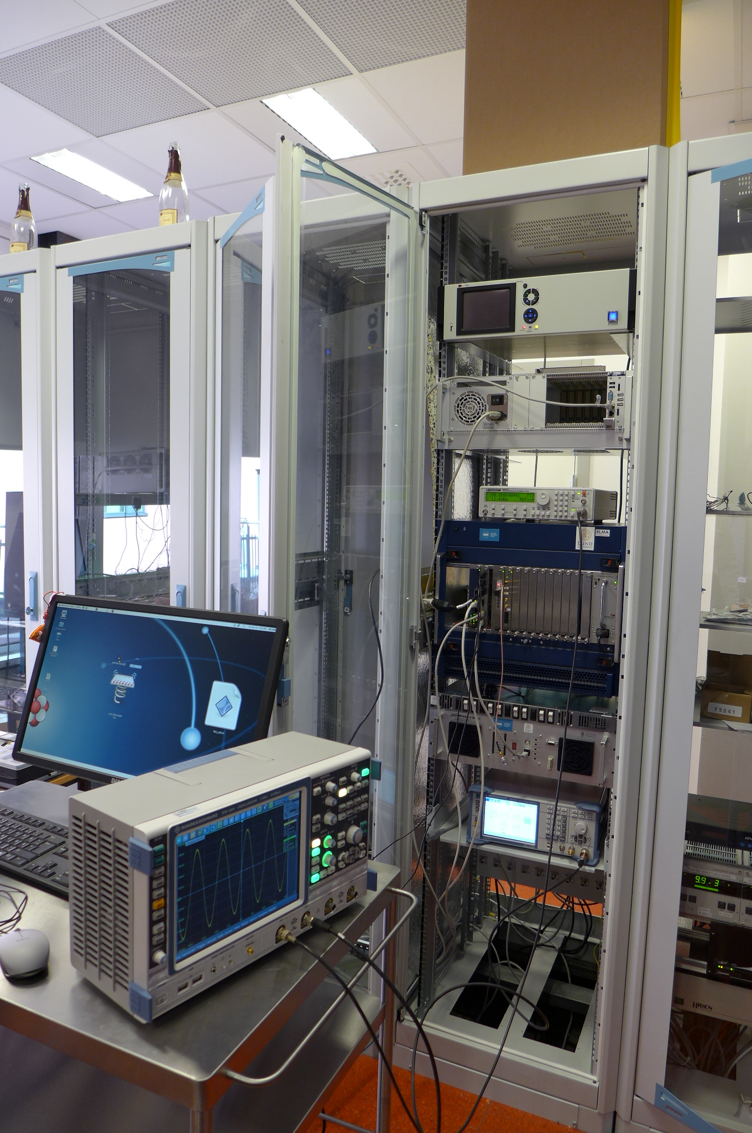
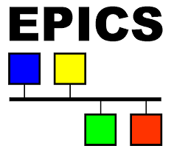
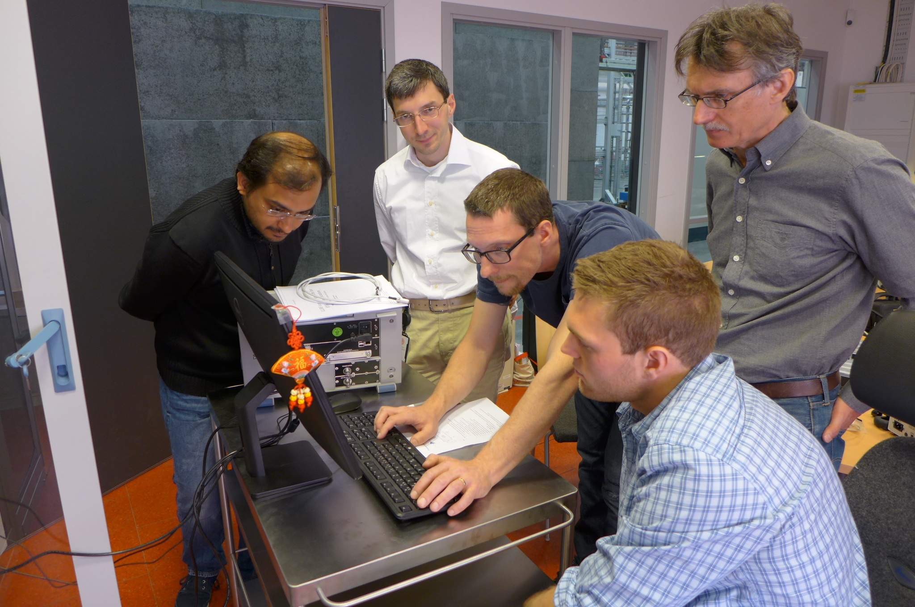
Low Level RF and Controls
Lund Univ./ESS LLRF
  µTCA includes timing system
  external signal generators
Uppsala LLRF
  Nat. Instr. PXI and LabVIEW
  digital phase control for SEL
  extended RF measurements
Controls and interlock
  Siemens PLC, NI cRIO
  EPICS interface with data archiver
  connecting different sub-systems:
  Linde, Cryo Diffusion, Leybold ...

Slide 11
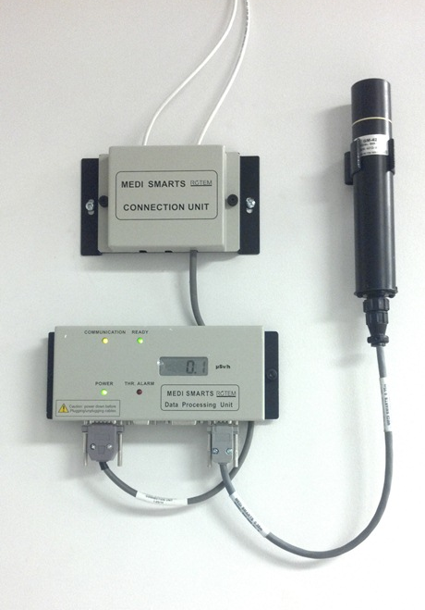
Safety
SSM authorization
  as part of university license
  for supervised operation
  visit by SSM foreseen 18/01/2018
Personal dosimeter
  14 pcs + spare for personnel
    Instadose (USB interface)
    readout once per month
  1 pcs hand held
    immediate indication
Radiation monitoring
  Rotem MediSmarts
  1 pts inside bunker
  1 pts bunker entrance
  2 pts outside bunker
Oxygen deficiency monitoring
  1 pts inside the bunker
  2 pts at cryo installation
    dewar filling area, compressor room
RF leakage monitoring
  home build system
  1 pts in the RF/HV area
Fire and smoke alarm
  provided by Akademiska Hus
  information panels installed at strategic locations
  recent inspection by Uppsala fire brigade (10/2017)

Slide 12
Spares and Maintenance
Main spare parts and maintenance contracts
  balance between risks and costs
  spares
    turbines for helium liquefier too expensive, low risk
    tetrode tubes, 2 spares, 1 already used (replacement order delayed)
  maintenance contracts
    compressors for helium liquefier, gas recovery
    data backup (to university data centre)
  framework support and procurement contracts
    delivery liquid nitrogen and gas helium
    installation work electricity, water, welding
    procurement most consumables: electric, electronics, mechanics, vacuum
Ångström mechanical workshop
    milling, machining, welding, mechanical design

Slide 13
Control Systems

Slide 14
Control System Overview
EPICS based,
  the same environment as at ESS (EEE v2.0.0).
  The goal is to keep it in sync with ESS at least to the end of the tests.
All systems at FREIA are connected to EPICS
  cryoplant, cooling water, LLRF, interlocks, radiation monitors, etc.
  valve box and cryomodule needs to be integrated
    upon arrival prototype (preparation discussions ongoing)
    hardware will be delivered by IPNO
Interlocks
  slow interlocks are implemented in the PLC,
  fast (operating the rf switch) are implemented on FPGA in CompactRIO.

Slide 15
Data Archiving
Most of the process variables connected to EPICS are stored in a data archive using archive appliance.
  The "slow" data are sampled with 60 s interval.
  There is a possibility to save the data at every rf pulse (up to 14 Hz) using the DOD (Data On Demand) module.
  The data is stored on local FREIA server but will be backed-up regularly using the University file backup system.
  This backup system is used now for backing up another archiver program (from Control System Studio) that is up till now used parallel to the archive appliance.

Slide 16
Conditioning etc
LabVIEW programs have been used for the tests and power coupler conditioning.
  We use so called NI Client I/O Server to gain access to all EPICS process variables.
  The results of the measurements are saved in plain files.
  For the acceptance tests we plan to use both LabVIEW and python/Matlab programs for automatic tests procedures.
We plan to use as much as possible CryoModule Calibration & Measurements Configuration Management Tools proposed by Nuno Elias https://confluence.esss.lu.se/display/CRYOM/CM3T

Slide 17
Lund Low Level RF and Timing System
Lund Univ. / ESS system (the "Lund" system)
  So far mostly used in so called "special operation" mode.
  In this mode one can generate a fixed frequency rf pulse up to 14 Hz with an arbitrary shape.
  The "normal" mode (with the feedback) has been tested
    it's not yet clear if it will be used during the tests (depends on test program).
  The Lund system has also been used for generation of the synchronization pulse to the RF stations.
  The signal monitoring has been used for setting-up the interlock signals based on the forward and reflected power levels measured by the system's ADCs.
  Saving of the DOD data (data from ADC) has been tested
    but not routinely used during the tests of the spoke cavity.

Slide 18
FREIA Low Level RF System
based on FPGA unit connected to two ADC input channels and two DAC output channels
  ADC is sampled at 250 MSps, input bandwidth of 750 MHz.
  DAC is sampled at 500 MSps or 1 Gsps.
  With undersampling can operate from 10 to 750 MHz.
  RF signal is downconverted to baseband, ie 0 Hz, with digital downconversion. No analog mixers are used. The bandwidth of the downconverted signal is either +/- 5 MHz or +/- 1 MHz, selected by user.
  All control of the signal is done at baseband, that is amplitude feedback, phase feedback, delay, amplitude modulation etc.
used to control the cavity with self-exited loop (SEL) measurements
will also be used to control the cavity when running the system with a driving signal.

Slide 19
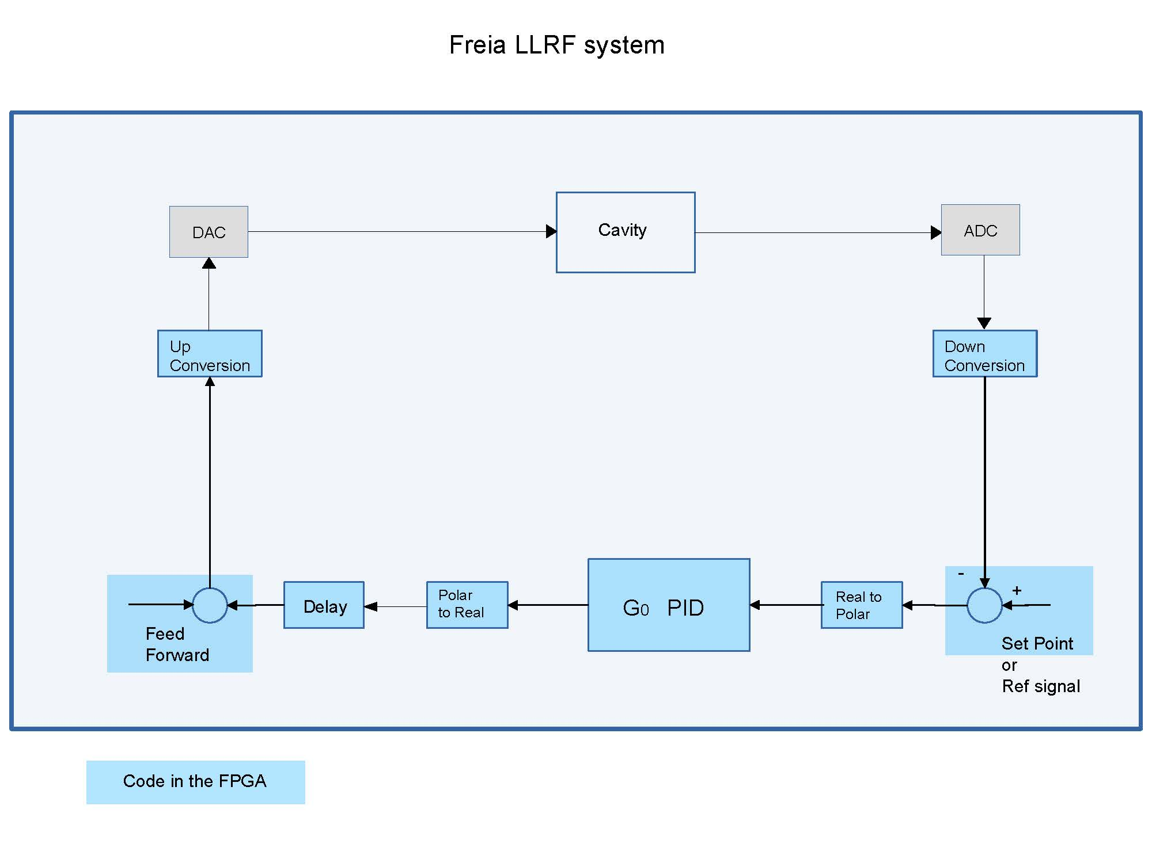
FREIA LLRF

Slide 20
FREIA LLRF as Data Acquisition
three FPGA's are used.
Connected to the FPGA's are 10 ADC input channels.
  Each ADC is sampled at 250 Msps.
  All 10 channels are downconverted to baseband, with digital downconversion.
At baseband, mathematical calculations can be performed in the FPGA's directly, with all the 10 channels at the same time.
  This way data storage for post analysis will be less needed, but is still possible.
The FPGA unit is connected to and controlled by a host computer.
  The host computer is running LabVIEW.
  Both the LLRF system and the data acquisition system are controlled from dedicated LabVIEW programs on the host computer.
  These dedicated LabVIEW programs are often used as sub programs in larger LabVIEW programs, when measurements are made at FREIA.

Slide 21
Quality Assurance
and
Documentation

Slide 22
Quality Assurance
Quality Assurance
  develop installation and test procedures, and training of personnel
  during tests of the spoke cavity package and prototype cryomodule (upcoming)
    note the importance of the prototype cryomodule
      procedures for "jumper" (cryomodule to valve box) connection
      tooling for installation RF doorknob (waveguide to power coupler connector)
      cavity internal vacuum connections most probable not required
        will be transported with NEG and ion pump connected
        if required, procedures, tools and experience from cavity installations in HNOSS
    will follow same procedures with same personnel during series tests
  travellers
    expect cryomodule to be transported with traveller documentation
    to register all handling and other important remarks

Slide 23
Non Conformities
If a deviation is found
Document (photo, text, measures)
Inform collaboration (ESS, IPNO)
Wait for decision
  decision options
    perform additional measurements,
    return (repair at IPNO),
    repair (at Uppsala or Lund),
    make concession and accept
  this might impact schedule / scope / cost

Slide 24
Documentation
Functional (tbd by ESS)
  upon arrival, installation: traveller documents
    status of instrumentation, vacuum level (ion pump current)
    other important observations
Acceptance criteria (tbd by ESS)
  checks upon arrival
  tests to be performed
Log book
  electronic log book used during tests
  EPICS data archive
Report
  summarizing the testing and results

Slide 25
Relevant Publications
Overview FREIA
  Progress at the FREIA Laboratory,
  M. Olvegård et al., IPAC 2015, WEPMN065
  352 MHz Tetrode RF Stations for Superconducting Spoke
  M. Jobs et al., IPAC 2017, THPIK090
Controls
  The EPICS Based Control System at the FREIA Laboratory
  K. Fransson et al., IPAC 2017, TUPIK084
Testing
  High Power Testing of the First ESS SPOKE Cavity Package
  H. Li et al., SRF 2017, THPB035
  ESS Spoke Cavity Conditioning at FREIA
  H. Li et al., IPAC 2017, MOPVA092

Slide 26
Test Plan

Slide 27
Test Plan Basics
Arrival and inspection
  initial checks and measurements
Installation and connection to valve box
Warm testing
  conditioning of power couplers
Cool down
Cold testing
  tuner functionality and range
  conditioning of power couplers and cavity package
  measurements
Warm-up
Disconnect, (wait for acceptance decision), shipment
Write report...
Develop
Criteria
Approve
Test and Approve
Test
Analyze
Results
Retest

Slide 28
Acceptance Decision
Acceptance criteria
  input required from ESS to define the final set of criteria
Acceptance decision
  FREIA informs collaboration of the test results
  and possible non-conformities
  decision
    accept,
    repair
      at IPNO, Lund or Uppsala.
Develop
Criteria
Approve
Test and Approve
Test
Analyze
Results
Retest

Slide 29
Spoke L4 Requirements (Selection)
ID | Name | Units | Min. | Nominal | Max.
1369 | Number of cavities per cryomodule | # |  | 2
1373 | Optimal beta | v/c |  | 0.5
1375 | Operating temperature | K |  | 2
1376 | Accelerating voltage | MV | 5.75
1378 | RF coupler power handling | kW | 335
1379 | External quality factory |  | 175’000 |  | 285’000
1381 | Voltage pulse length | ms |  | 2.86
1382 | Voltage pulse rate | Hz |  | 14
1383 | Cavity shunt impedance | W |  |  | 2.35
1384 | Accelerating mode tuning range | kHz | 100
1386 | Mode spacing | MHz | 0.45
1387 | Higher order modes | MHz | 5
1388 | Length of cryomodule vessel | m |  |  | 2.9
1393 | Cool down time | h |  |  | 48
From: https://confluence.esss.lu.se/display/CRYOM/Interface+between+Cryomodule+and+Cavities-+Within+EMR

Slide 30
Measurement Overview
Preliminary, minimum set of tests
To be adapted based on agreed acceptance criteria
Warm test | Cool down | Cold test | Warm up
Cavity vacuum Mechanical checks? Cavity frequency Qext | Frequency vs. Temperature | Tuner range and sensitivity Coupler and cavity conditioning | Frequency vs. Temperature
 |  | Cavity frequency Loaded Q and Qext
 |  | ---
Coupler conditioning |  | Q0 Dynamic heat load Nominal gradient Filling time
 |  | Dynamic Lorentz force detuning Tuning range Long term stability test (4h)
CRYO
VNA
SEL
SGD
signal
generator driven

Slide 31
Warm Tests
Initial inspection
  check of cavity vacuum → connect external pump required or not
  mechanical checks required? → dimensions?
  instrumentation checks required?
Measurements
  cavity frequency and Qext (with VNA)
RF conditioning
  warm re-conditioning of the power couplers
    have to agree on optimization of the conditioning algorithm to save time
    will take at least 1 day if no major multipacting barriers
    can do both couplers simultaneously

Slide 32
Cold Tests
Tuner functionality and range
  first test, also to tune cavity frequency
Cavity frequency and Qext
  in combination with tuner functionality test
RF conditioning
  cold re-conditioning of the couple and cavity
  both simultaneously to gain time
Self excited loop measurements
  Q0, dynamic thermal load, accelerating gradient, filling time
  all measured simultaneously
Signal generator driven measurements
  Lorentz force detuning and tuning range
Long term stability test
  run for ≥4 hours

Slide 33
Testing Schedule

Slide 34
Present Schedule Overview
Prototype cryomodule & valve box
  arrival in January/February 2018
  removal by August 2018
Series cryomodule deliveries
  CM01 in August/September 2018
  CM02 in November 2018 (2 month after CM01), then 1 month intervals to CM13
Series cryomodule testing
  CM01 start September 2018
  CM13 to be finished by
    February 2019 (ESS end of support to FREIA)
    November 2019 (present planning) = 4 weeks per cryomodule
    February 2020 (in-time for installation) = 5.5 weeks per cryomodule
Installation planning
  CM01 starts November 2019 (boundary condition: CDS completion)
  CM13 starts February 2020

Slide 35
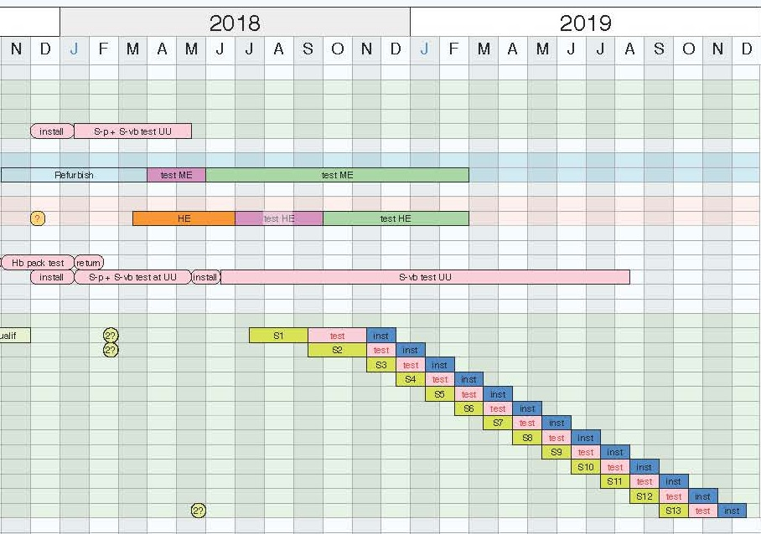
ESS Spoke Testing Schedule
From: Nuno Elias
170929 cavities and cryomodules activities program
CM01 = 2 months
CM02→13 = 1 month
CM04 done by Feb.2019
CM13 done by Nov.2019

Slide 36
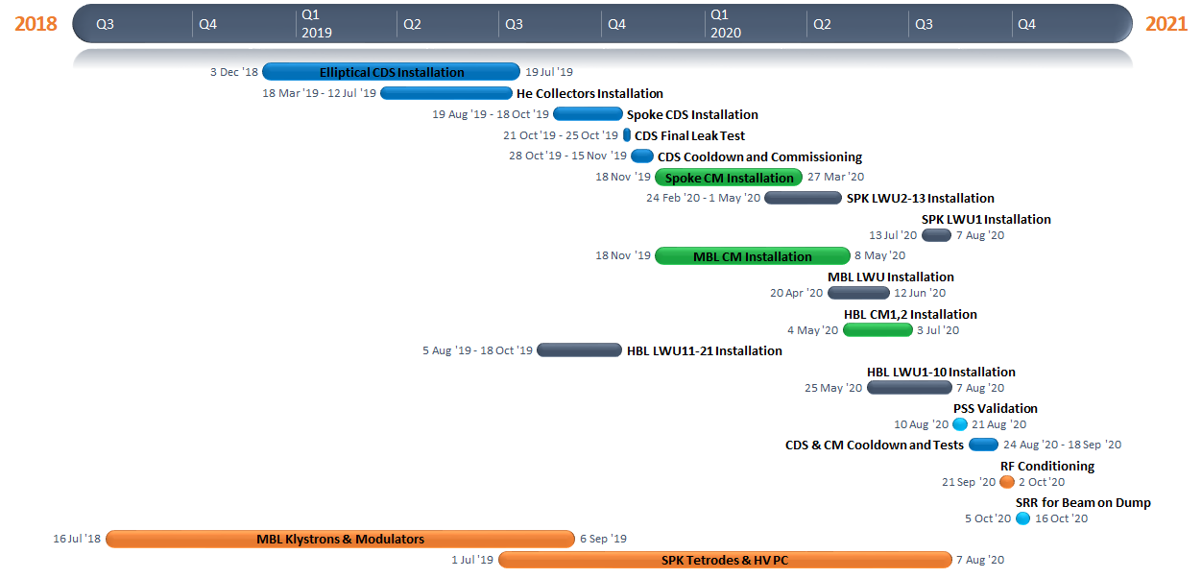
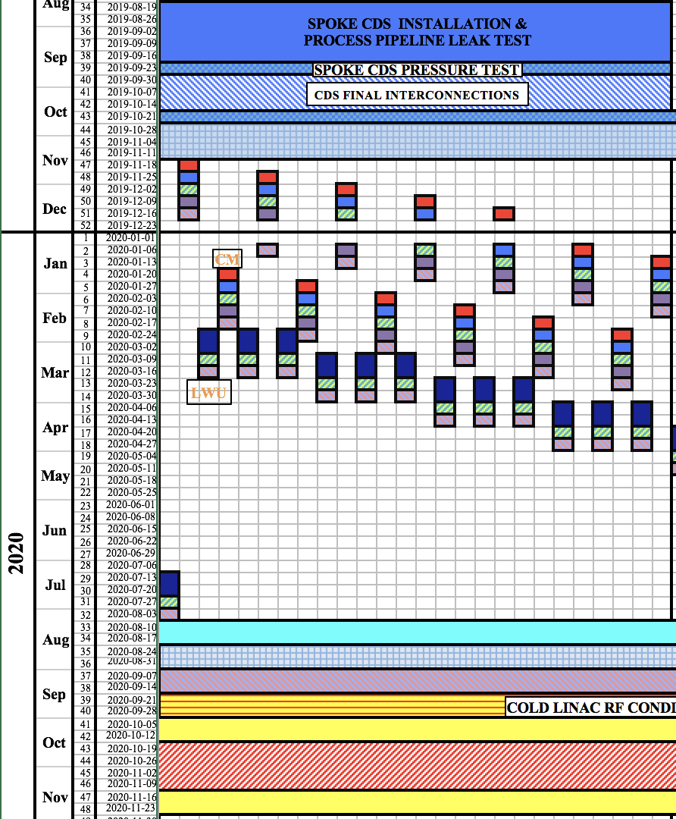
ESS Installation Planning
From: Ciprian Plostinar
ESS Accelerator System Project (ACCSYS) - 24th Technical Board Meeting
15 November, 2017

Slide 37
Notes on the schedule
Resource limitations
  double shift work requires employing additional staff → cost increase
  university closes for 5 weeks during summer, 2 weeks during Christmas
    to bridge this will require additional staff → cost increase
Prototype cryomodule test has been delayed
  less time to perform the installation and test
  less time to train staff and check procedures
  will require more learning time for the first cryomodules
Schedule optimization
  cool down and warm-up continues automatically 24h/day
  present SSM authorization does not allow un-attended operation when producing radiation
  testing plan to be optimized after decision on final acceptance criteria

Slide 38
Testing Schedule for a Cryomodule
 | time [days] | time [weeks] | in bunker [days]
Arrival, unpacking, initial inspection | 2.5
Installation, connection to valve box | 5.0 |  | 5.0
Warm testing | 2.0 |  | 2.0
Cool down | 2.0 |  | 2.0
Cold testing | 5.0 |  | 5.0
Warm-up* | 4.0 |  | 4.0
Disconnect, packing, shipment | 4.5 |  | 3.0
TOTAL | 25.0 | 5.0 | 21.0
Spare and wasted time, 20% (DESY statistics) | 5.0 |  | 4.2
GRAND TOTAL | 30.0 | 6.0 | 25.2
Time given in 8h work days, 1 shift, holidays and vacation not included. Details in separate document send to the committee. *) Warm-up is shorter if during weekend

Slide 39
Summary and Conclusions

Slide 40
Conclusions
FREIA is prepared and ready to test the spoke cryomodules
  infrastructure, people and experience available
  controls, data storage and reporting are prepared
Prototype cryomodule installation and test will be used to verify and fine tune our procedures and schedule
Discussions ongoing to determine acceptance criteria and thereby optimize the required test plan
Present scheduling
  FREIA requires 6 weeks per cryomodule,
  of which 5 weeks inside the bunker,
  decreased cold testing to absolute minimum required,
  ESS present schedule allows only 4 weeks per cryomodule,
  however more time is available due to late start of the installation.

