Slide 1
Test Plan for Cryomodule testing at ESS Test Stand 2
Emilio Asensi
Test Stand Engineer
With slides and diagrams from Nuno Elias and Cecilia Maiano
www.europeanspallationsource.se
30 November, 2017

Slide 2
Outline
Prelude: Cavities Flow
Reception
Preparation for test stand
Initial RF measurements
Installation in test stand
Warm Tests
Cool down
LP Cold Tests
HP Cold Tests
Warm up
Disconnection
Preparation for dispatch
Dispatch

Slide 3
Medium Beta Cavities Flow
High Q Configuration
FPC Configuration
INFN
Ref f at warm
Out
CEA
ESS TS2
Out
In
In
Out
CM
Measurements
In
DESY
Out
Assess
ESS Linac
Reference f @ 2K
VT Measurements
Operation
f

Slide 4
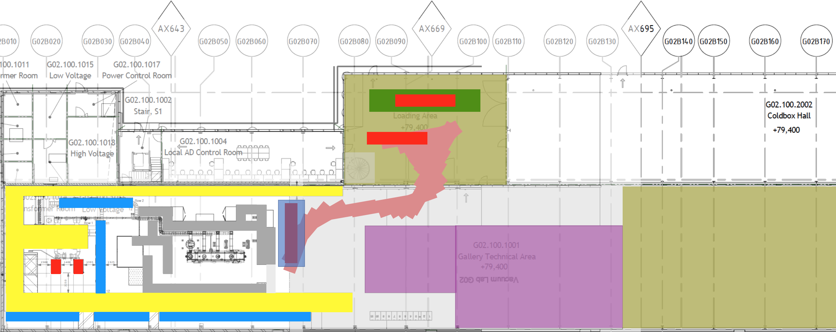
Reception (1 day)
Prepare reception checklist
Check transportation documents
Check if CM is properly fixed in the container
Check utility box and its content
Read-out of shock loggers
Unload CM and place it in a support
Read-out beam vacuum
Visual inspection for damage

Slide 5
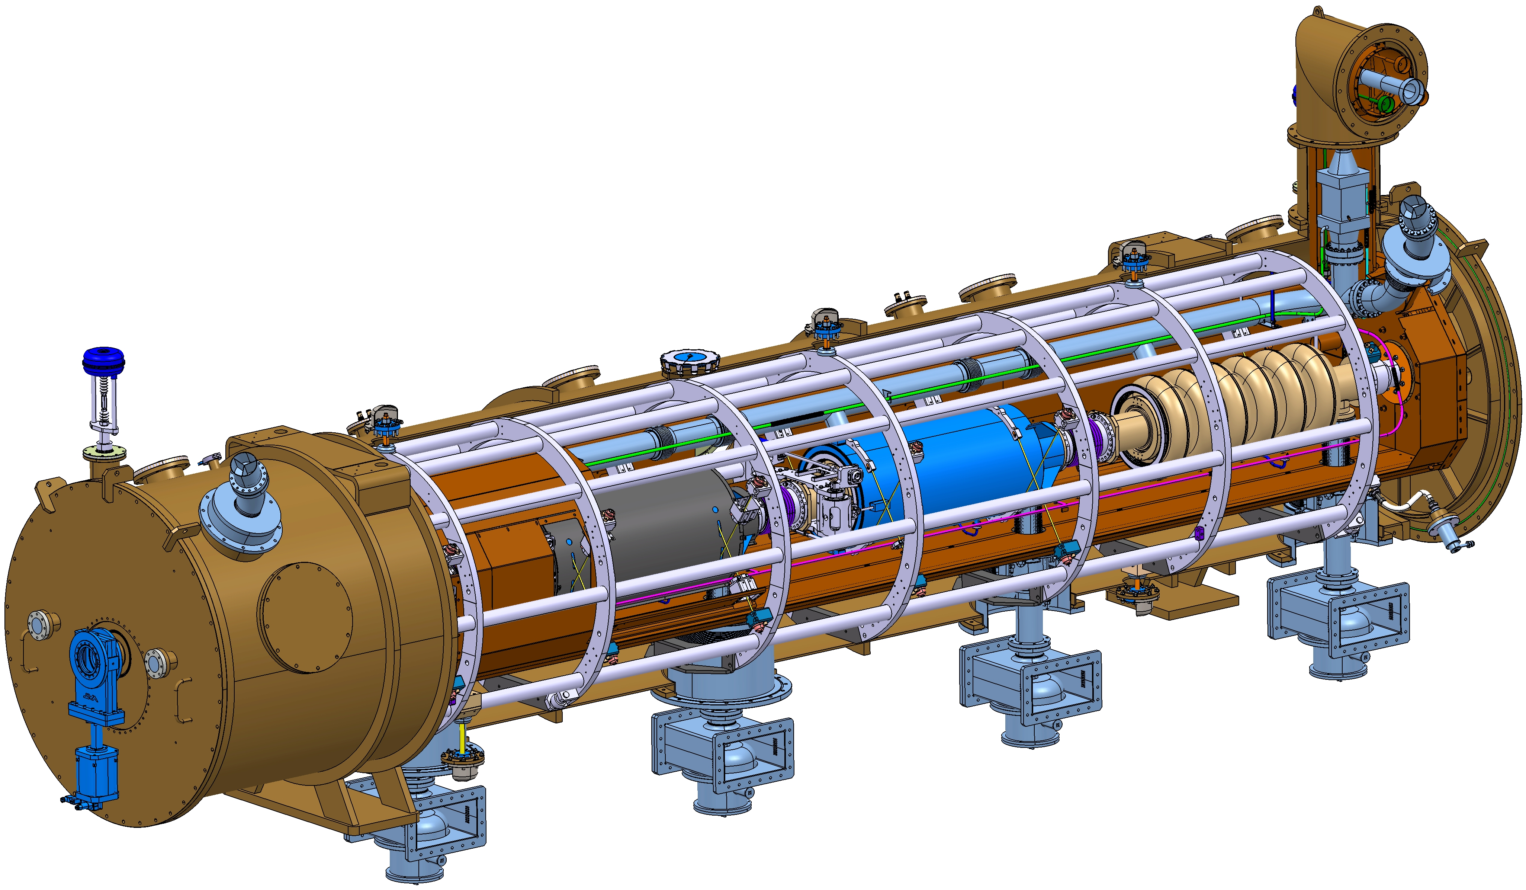
Preparation for test stand (3 days+)
Mounting of door knobs with cavities at atmospheric pressure? (+3 days)
Mounting and dismounting of parts
  Cavities supporting bar
  Door knobs (1 day+)
Vacuum leak checks
Connect insulation vacuum pumping group
Connect beam vacuum pumping group (clean room)
Check electrical continuity
Check nominal resistance values in temperature sensors
Check step motors
Before Doorknob assembly it is NOT possible to perform any RF measurement, unless CEA provides the temporary antenna (used at Saclay).
This “temporary” tool would be useful for the incoming check!
Notes:
Cavities alignment prototype.
Vacuum leak checks short, already performed at CEA.

Slide 6
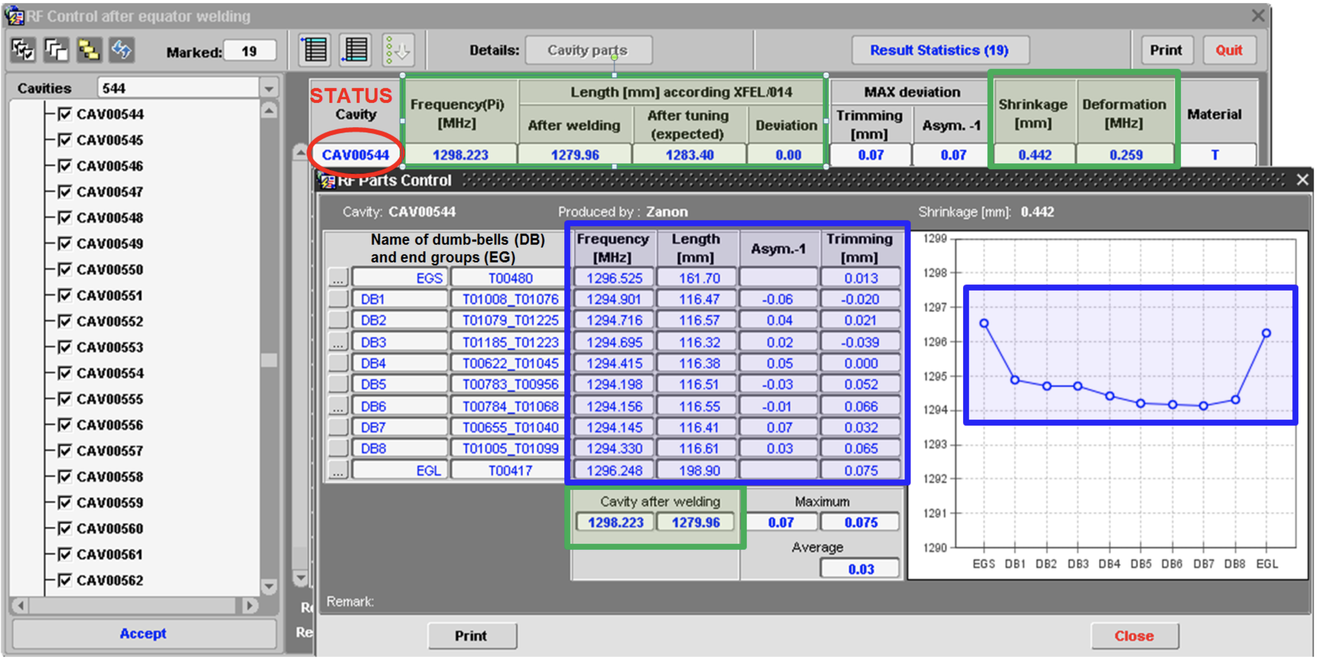
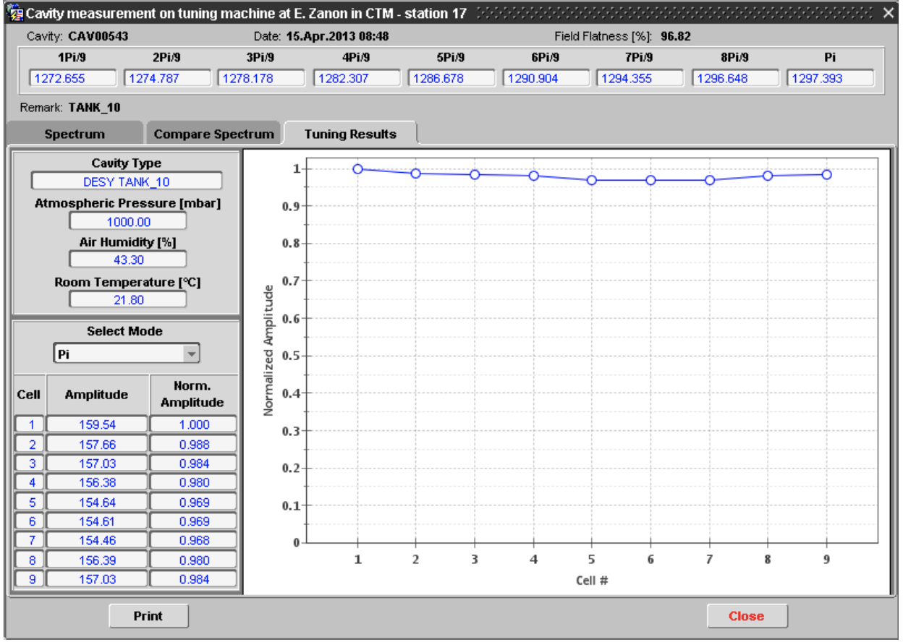
Initial RF measurements (1 day)
Measure piezo capacitance/Tuner functionality (on short range)
Measure inner RF cabling (TDR), length and shorts
Measure Warm spectrum, transmissions and dangerous HOM (WR1150-N transitions-PU flange)
Compare results with CEA and cavity IKC
Fill incoming inspection report
Online cavity data analysis (ex. from XFEL CAV DB)
At ESS being implemented by SRF in the CM3T from ICS
Notes:
MSE analysis: Mean spectrum deviation
Piezo test device from INFN?

Slide 7
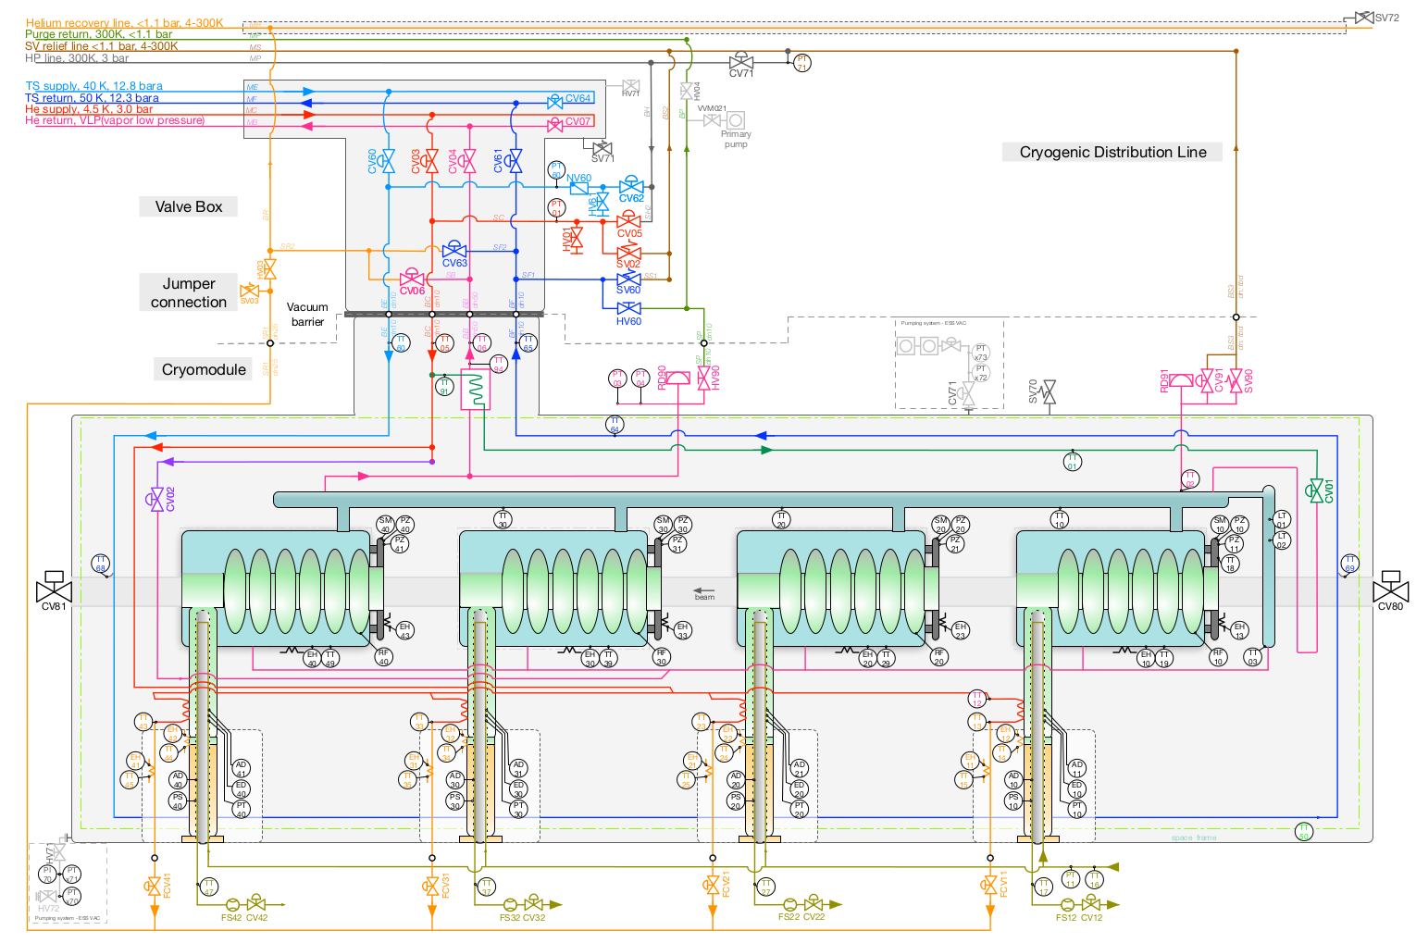
Installation in test stand (3 days+)
Move Cryomodule inside bunker
Perform and check interconnections
  Waveguides
  Cryolines
  Cooling water pipes
  Instrumentation
  Compressed air
Check proper functioning of
  Interlocks
  Control System

Slide 8
Installation in test stand (3 days+)
Move Cryomodule inside bunker
Perform and check interconnections
  Waveguides
  Cryolines
  Cooling water pipes
  Instrumentation
  Compressed air
Check proper functioning of
  Interlocks
  Control System

Slide 9
Warm Tests (1 day+)
Spectra Measurements
VNA S21 Coupler/PU – two options:
Instruments Inside bunker
  WR1150-N at doorknob, PU on module flange
  This means that waveguide cannot be connected in the previous point
Instruments Outside bunker (preferable solution)
  WR1150-N installed outside, PU signal available at some patch panel on RF rack
  This means waveguide installation inside the bunker, but section outside needs to be opened (disconnecting klystron)
Static calibration
  Dir. Couplers/Circulators: get calibration data
  Calibrate RF power measurement cables with attenuators
  Document: RF calibration summary table
Klystron/LLRF check on the load
WGs visual check
System check / RF leak check at low power (not if waveguide is not yet reconnected)

Slide 10
Power Coupler Conditioning (1 day+)
Taking into account of 30% power overhead need for LLRF regulation, and full reflection at the beginning of cavity filling, significant high peak power handling is expected in elliptical cavity/coupler conditioning.
CEA conditioning experience offers valuable and particular high-power input to abstract high level logical schema
  EPICS Procedures will be implemented, using guidance from conditioning experience at CEA and FREIA
1 day allocated but no experience so far in module test stands!
Parameters to be checked/under control
• vacuum levels
• arc detection events on vacuum and air side (the most of these events are expected to happen on the air side)
• Multipacting events
• RF (f/r power to couplers)
• Temperature (box, window, water)
• Water flowmeter
• Security signals (vacuum, water)
…
Back-to-back power coupler conditioning system at
CEA-Saclay
Required peak beam power in ESS elliptical cavities
10

Slide 11
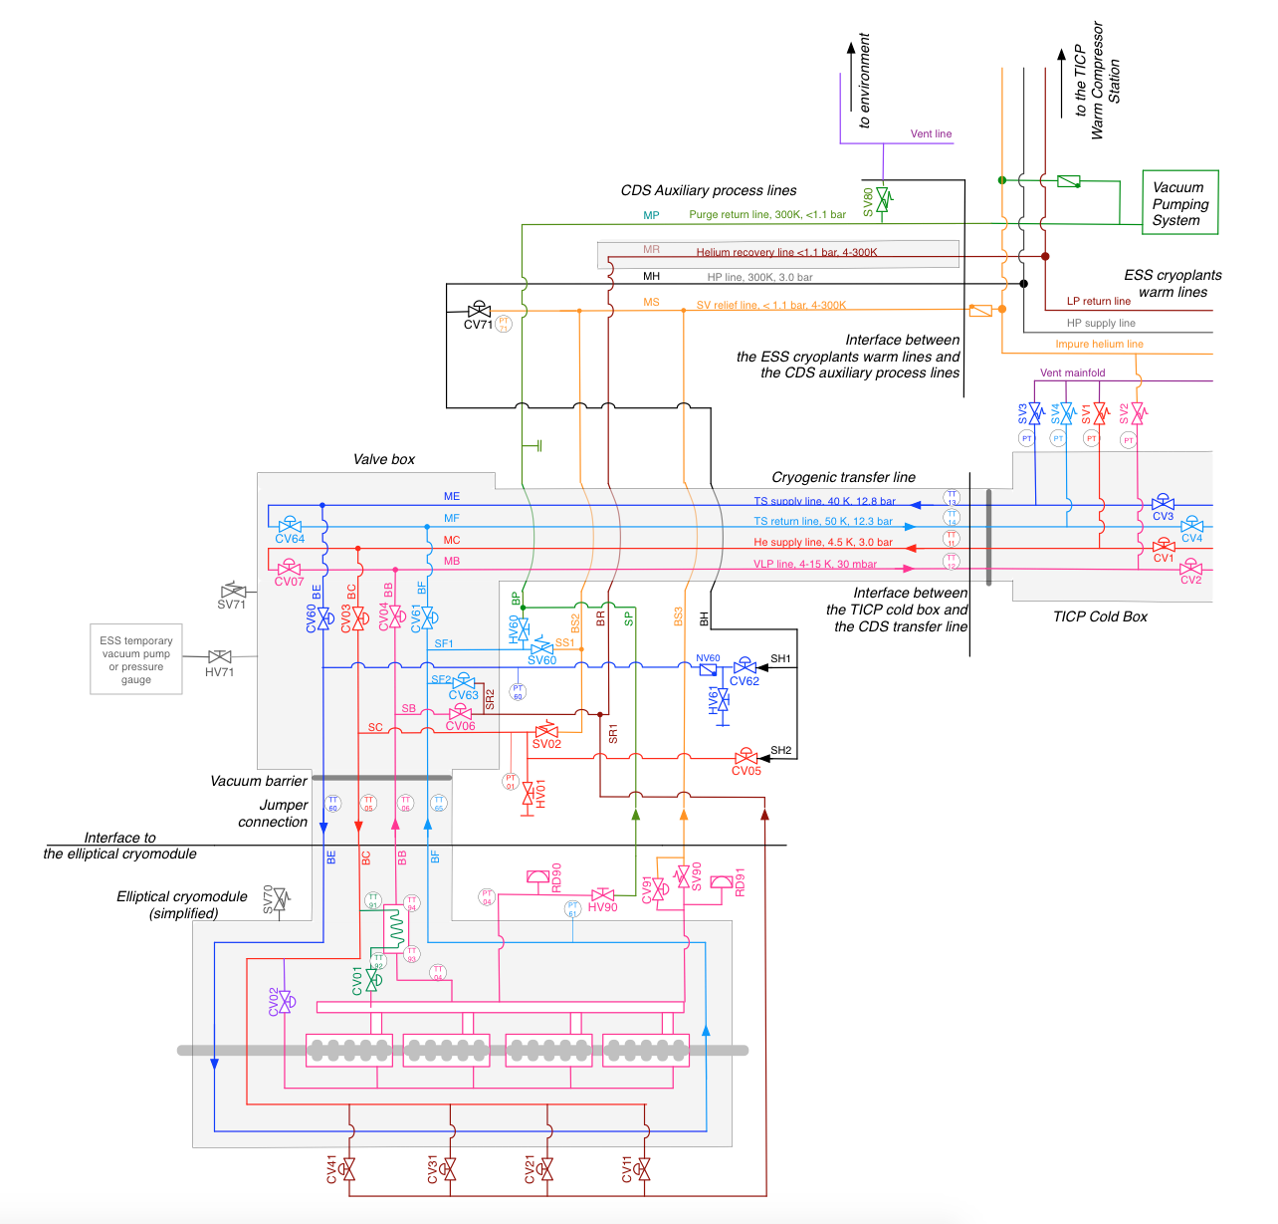
Cooldown (2 days)
Purge and clean cryolines (-1 day)
Leak checks (-1 day)
Cool down to 4.5 K
Cool down to 2 K
Fill cool down report
Complete thermal stabilization
Notes:
Thermal shield at 50 K
Cold masses at 4.5-2K: Supercritical helium

Slide 12
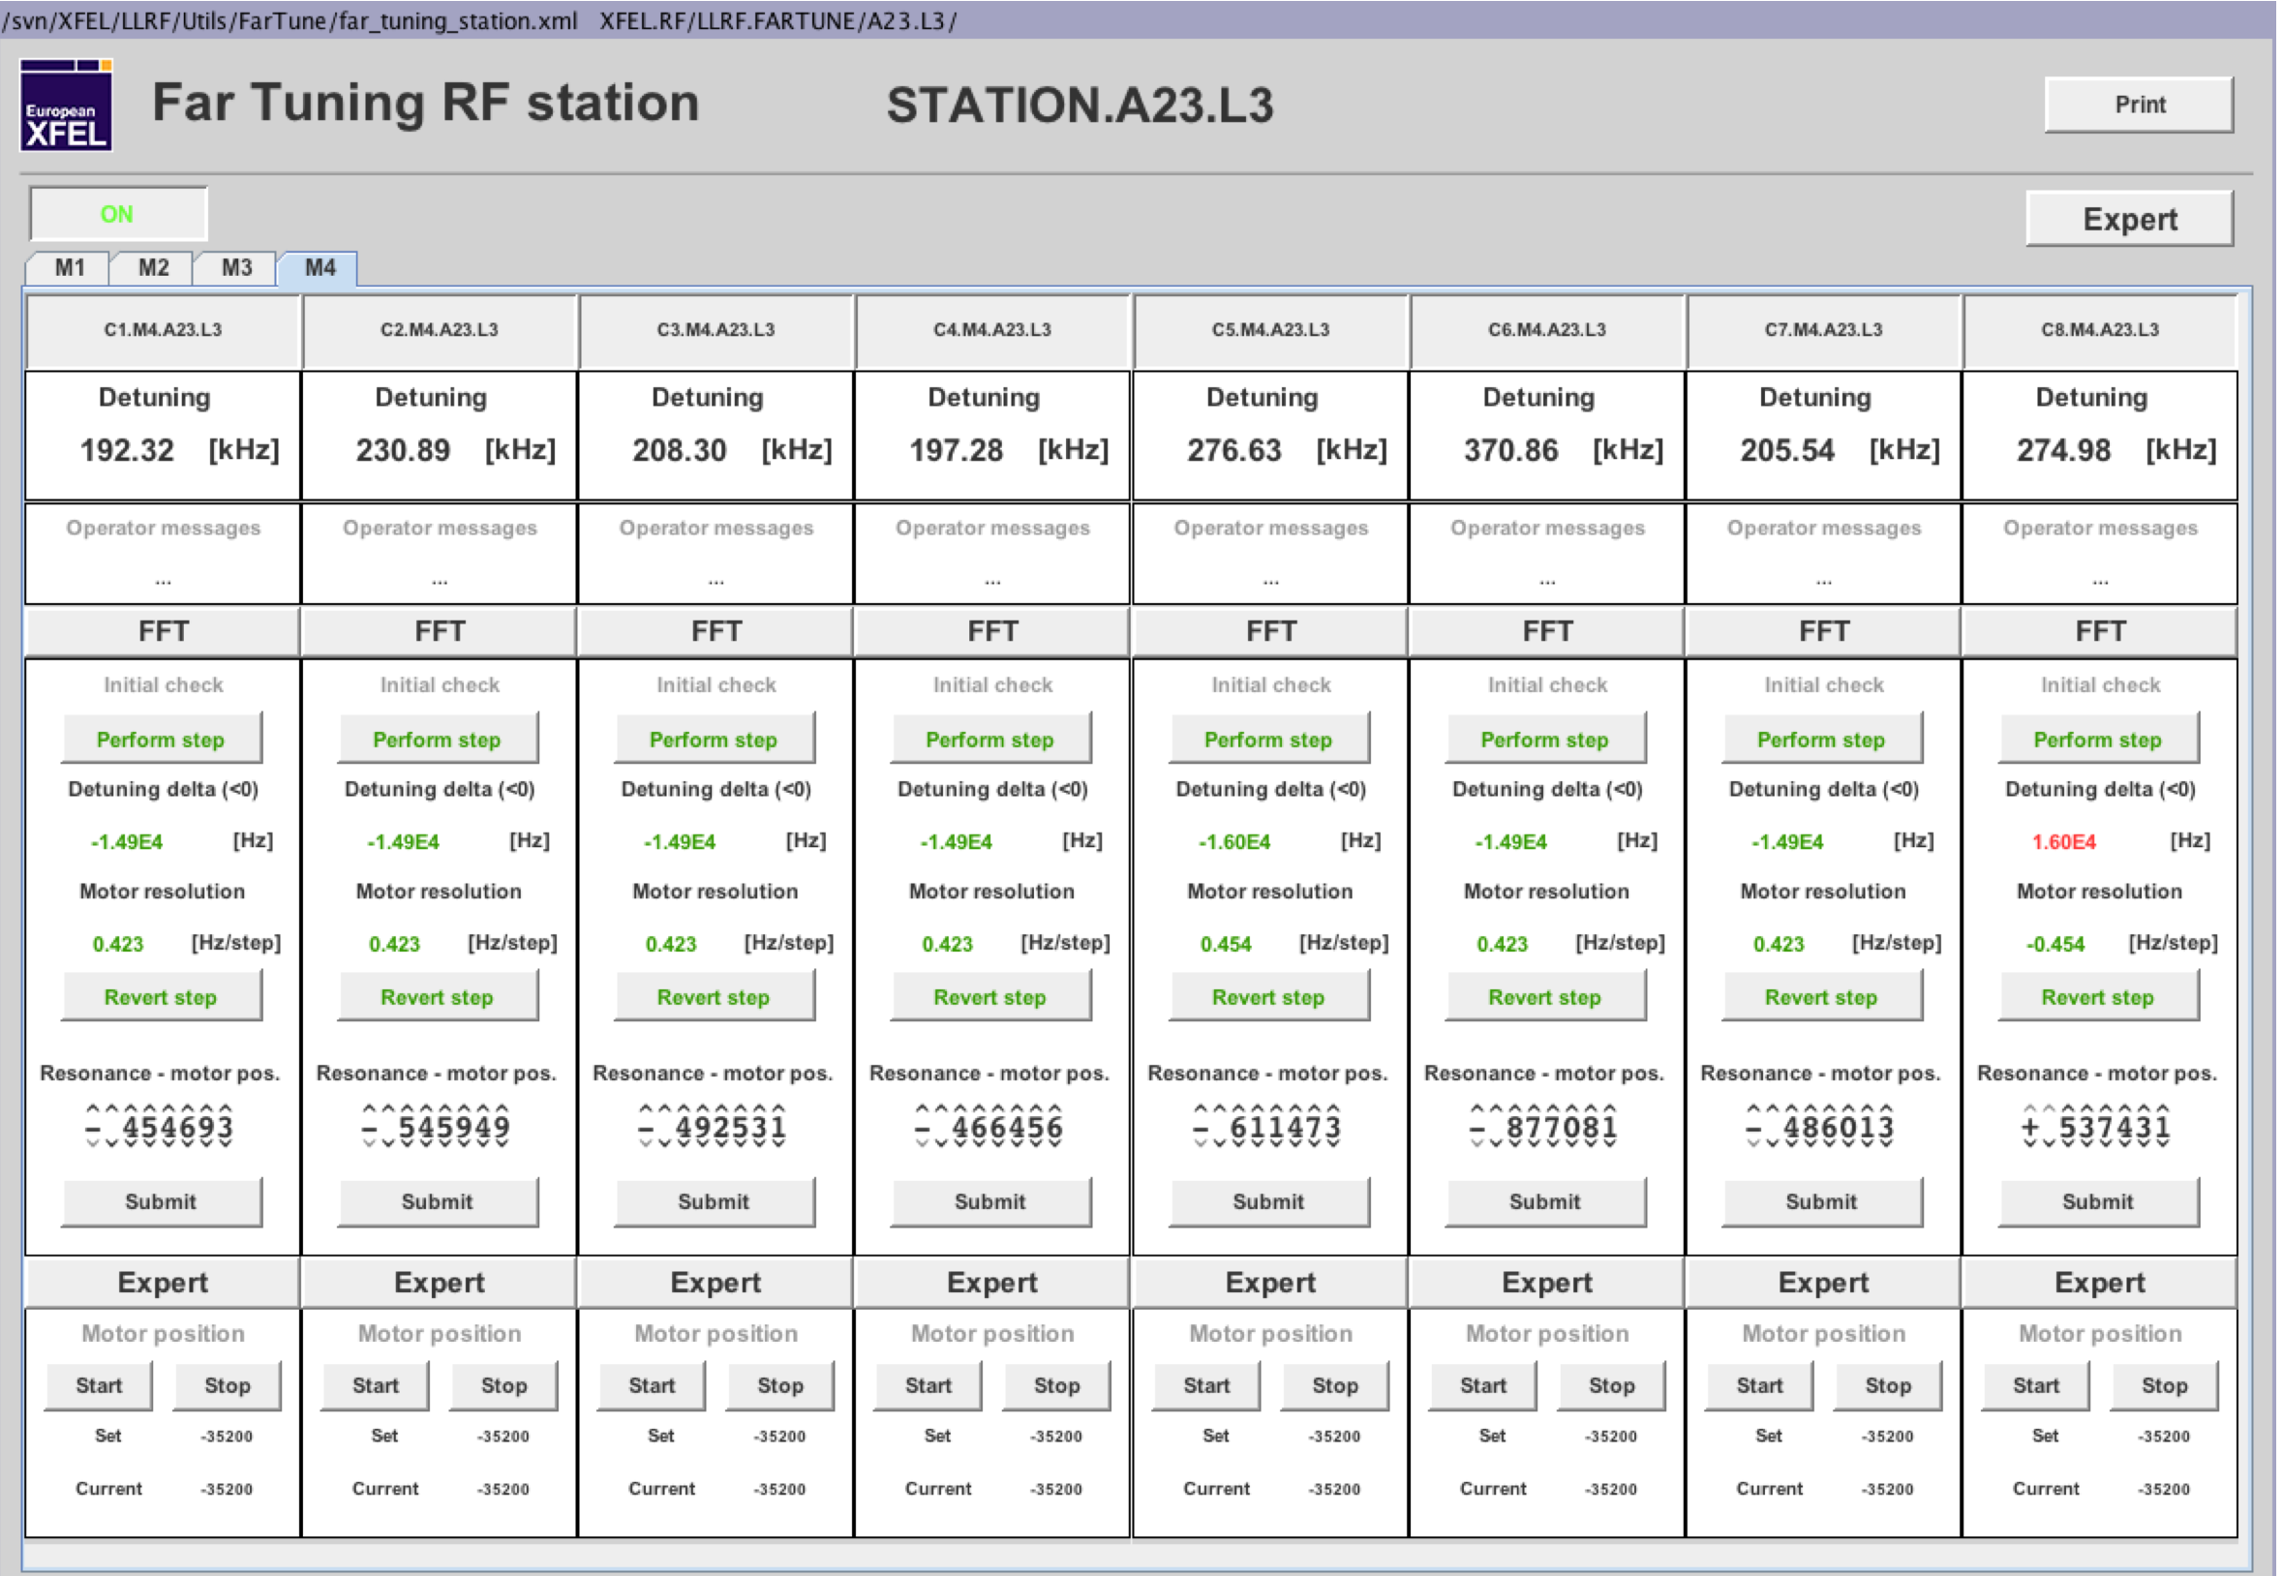

LP Cold Tests: initial actions (1 day)
Initial measurements:
Fundamental Bandwidth Measurement (inside/outside bunker-transmission or doorknob)- check of proper frequency shift/MSE analysis
Cold cable calibration
VNA, S11 measurements at each cold cable (PU)
Document: RF Power calibration final table
Cavity pretuning to operating frequency
Cavity connected to VNA (move motor tuner until frequency is reached on the VNA
  and record the needed number of tuning steps for the tunnel pre-tuning instructions (comparison with the expected steps).
(No VNA) e.g. “EXFEL Far tuning tool”
  (LLRF team, W. Cichalewski)
  FFT of the probe signal
  from the cavity excited
  at the nominal frequency
  to determine the large detuning
  Or other LLRF-based mode to detect cavity
  frequency when it’s approx 200 BW away
  from machine (ongoing discussion with LLRF).
Piezo capacitance measurement
Dedicated Piezo Operation and Tuner Test
Apparatus
Notes:
WR1150-N transitions-PU flange
LLRF agrees, but no time

Slide 13
LP Cold Tests (2 days+)
Microphonics measurement
Piezo scans: cavity detuning transfer function
Lowest bandwidth mode identification
Fine tuning with LLRF
  Drive LLRF in open loop FF pulsed mode (rectangular pulses ok) at low klystron power
  Maximize level of transmitted power → approaching resonance
  Use detuning information from LLRF server to perform last tuning steps
  Record the tuning steps for the final tuning for future operation in Linac
Calibrate RF pickup signals
  Extract decay time from Pt at end of pulse, compute QL
  Evaluate E_{acc} from P_{forward} measurement
  Measure Pt and determine Gradient calibration constant kt
  Store and document calibration data in report
  Correlate with CEA and VT data
Establish closed-loop, feedback operation
Detune the cavities (for cold processing)
Notes:
4π/5 and 3π/5 mode identification (we should not use VNA here but do a system identification in the LLRF system, otherwise we need disconnections again)
Disassemble WR1150-N coaxial transition and connect module to klystrons before fine tuning
Detune the cavity by a sufficient number of bandwidths to prepare for the cold coupler processing

Slide 14
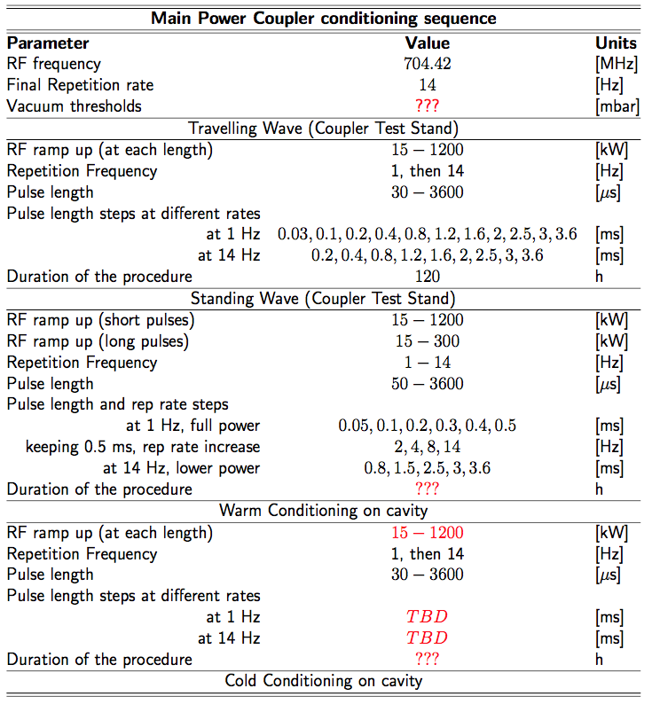
HP Cold Tests (5 days+)
Cold Coupler and Cavities Conditioning (1 day +)
Power rise to nominal gradients (in-kind VT data)
Open loop and closed loop operation
Active piezo Lorentz force detuning compensation
Cryomodule gradient performance assessment
P_{for} power used to drive a cavity to the quench limit
Identification of limiting mechanisms (power, X-ray, quench, ...) [MV/m]
X-rays measurements
  X_{rays} start – Value of gradient when radiation starts [MV/m]
  X_{rays} quench – Value of radiation just before cavity quench [mGy/min]
Data storage, correlation with VT data Power Rise to nominal gradients
Optimization of the LLRF parameters
Heat Loads measurements (1 day+)
Cavities to parking position
Fill test report
no experience so far in module test stands!
Acceptance
CEA coupler test stand conditioning sequence
Notes:
Optimization of the LLRF parameters for feedback and active piezo compensation at nominal gradient.
We can see in the table that we don’t know the duration of the conditioning in the test stand, thus the assumption of one day is worrying…

Slide 15
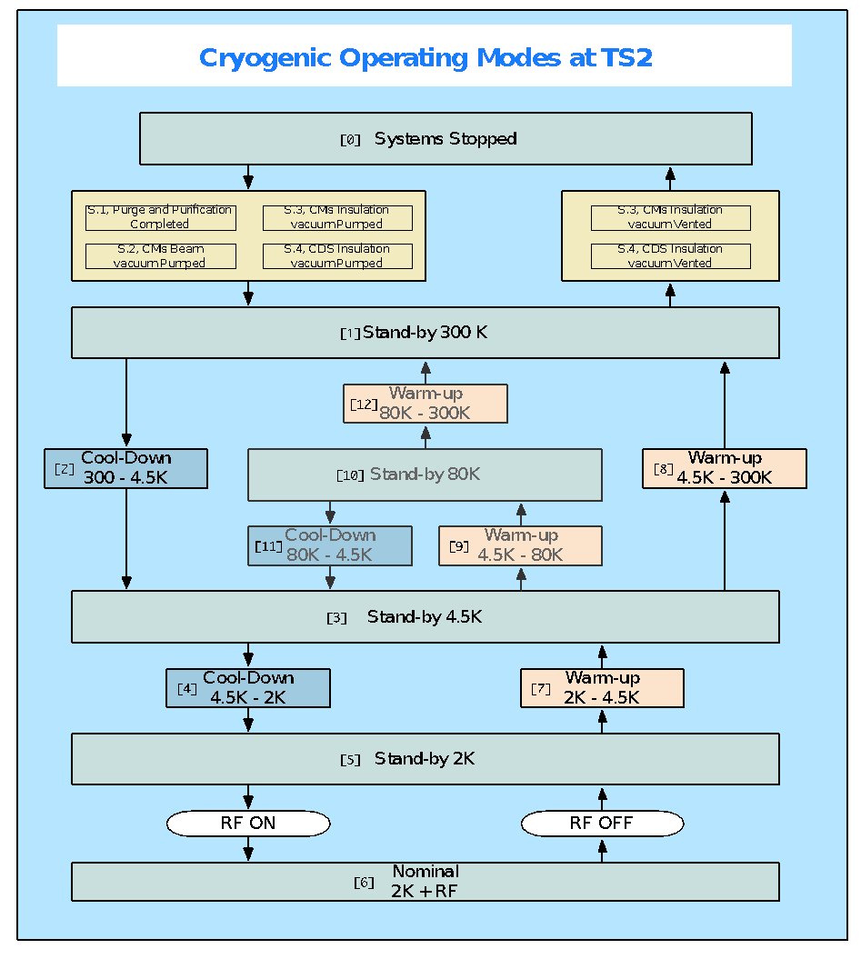
Warm up (1 day)
Warm up
Notes:
TICP does not provide 80 K

Slide 16
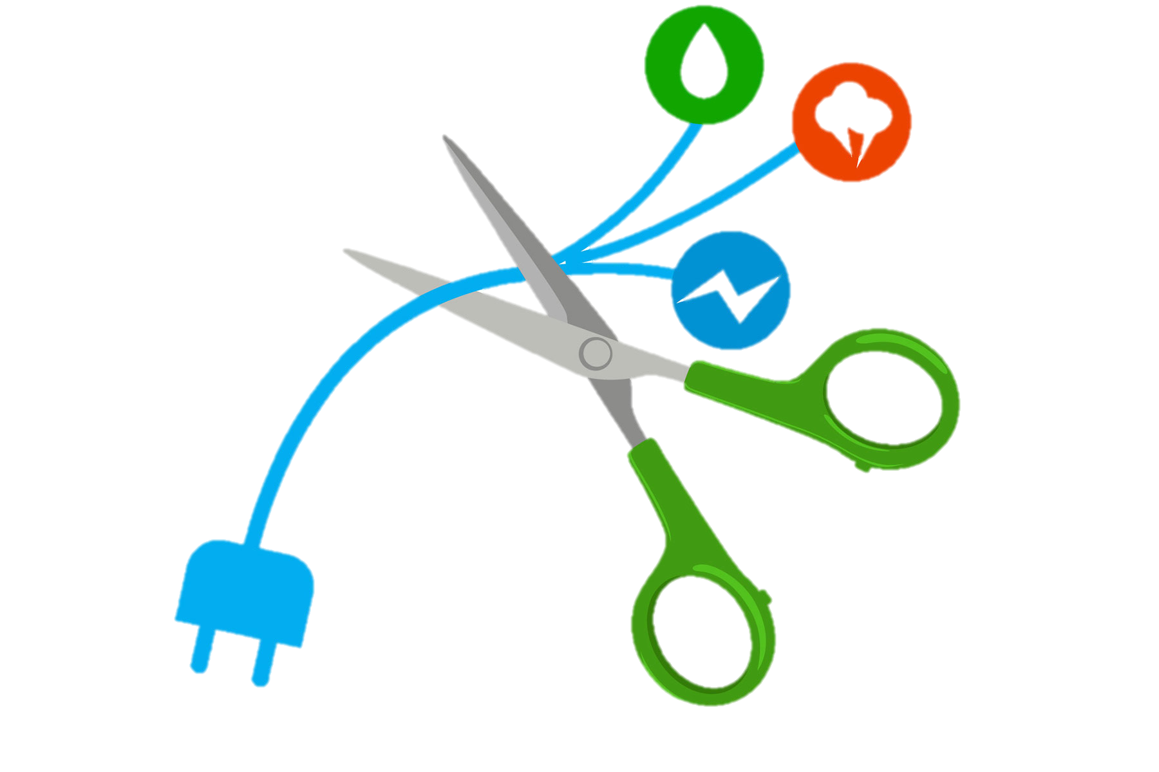
Disconnection (1 day)
Perform disconnections
  Waveguides
  Cryolines
  Cooling water pipes
  Instrumentation
  Compressed air

Slide 17
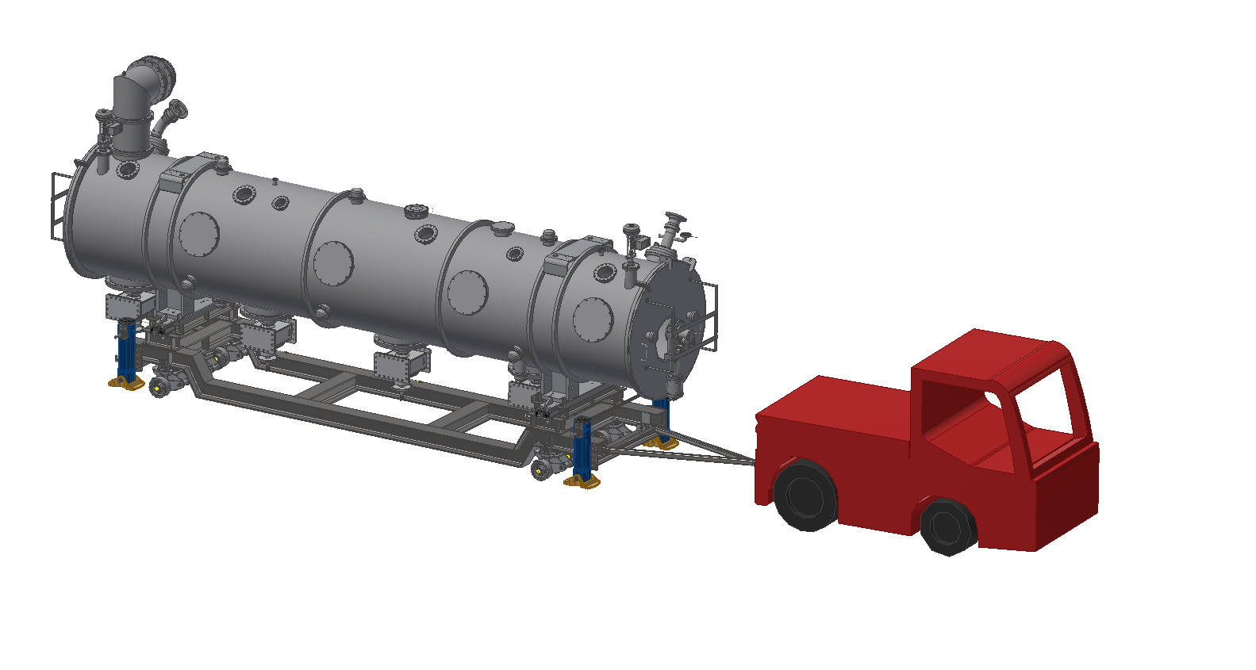
Preparation for dispatch (2 days)
Move Cryomodule outside bunker
Check frequencies
Remove vacuum pumping groups
Cut cryogenic connections
Install blank flanges
Fill outgoing report
Dispatch

Slide 18
Summary
Detailed testing procedures are being written in collaboration between In-Kind partners, WP10 and SRF specialists.
Cryomodule Acceptance Criteria comes from WP05.
Current schedule of 4 weeks/Cryomodule without shifts does not allow margin for retesting, equipment failures or personnel issues (estimated SAT time 24++ days).
  Coupler RF conditioning time has been estimated in 24 h, but there is no statistics in support of that.
  We need to gain experience with the ECCTD, also with the firsts series Cryomodules.

