Slide 1
How Do We Define Acceptance of a Cryomodule? - A Discussion
Christine Darve
WP04 and WP05 deputy leader
Reference to Emilio (Elliptical) and Roger (Spoke) presentations
www.europeanspallationsource.se
30 November, 2017

Slide 2
Acceptance Criteria (AC)
Elements for discussion
Identify AC – ESS Requirements to Validate
  L3, L4, Interface Requirements
  → Matrix to be completed using Technology Demonstrators testing Phase
Assess AC – Process for validation
  Strategy for acceptance along the product life cycle
  Test plans for TS2 and FREIA
  Measurements
Control/Mitigate AC – From data management to Operation readiness
  Calibration & Measurement Configuration – CM3T
  Product Break-down Structure – History and configuration
  Non-conformity reports

Slide 3
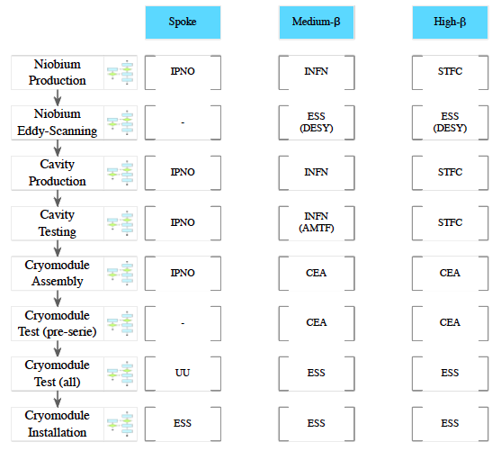
Recall: Cryomodules life-cycle
Nuno Elias

Slide 4
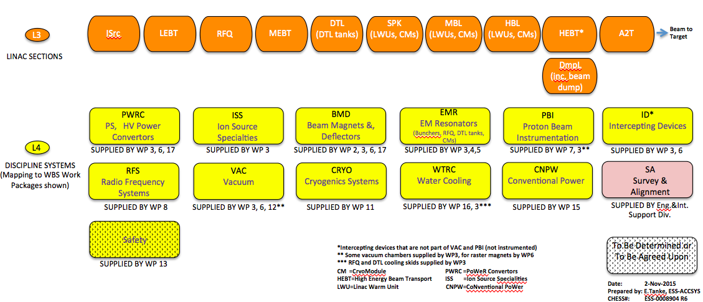
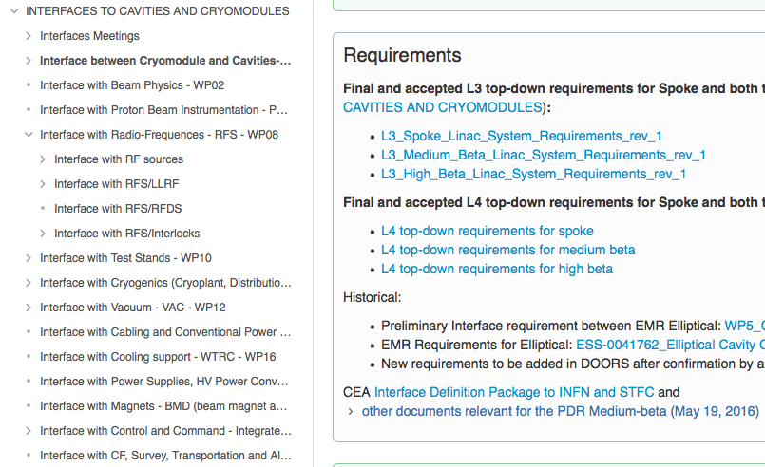
Identify AC - Requirements
Requirements and Interface requirements
https://confluence.esss.lu.se/display/CRYOM
id | User ID | DWA ID | Name | Primary Text | Clarification | Traced to | Verify Method | SysTags | Units | Min. | Nominal | Max. | Phase
1220 | L4-MBL-EMR-010 | MBL.EMR-49 | Resonant Frequency | The nominal resonant frequency of each medium beta elliptical cavity shall be 704.42 MHz. | The resonant frequency is defined as that for the cavity installed in the cryomodule, at the nominal operation temperature, with no RF or beam fields present, and within the operating range of the tuner. | MBL.SyR-10 | Measurement | ACC.MBL.EMR | MHz |  | 704,42 |  | Design
1221 | L4-MBL-EMR-201 | MBL.EMR-79 | Accelerating mode tuning: Lower extreme | The lower limit of the tuning range of the frequency of the accelerating mode shall be less than or equal to 704.37 MHz | That is, the tuning system shall be capable of setting the resonant frequency of the cavity to a value >=50 kHz below the nominal accelerating frequency |  | Measurement | ACC.MBL.EMR | MHz |  |  | 704,37 | Operation
1222 | L4-MBL-EMR-202 | MBL.EMR-80 | Accelerating mode tuning: Upper extreme | The upper limit of the tuning range of the frequency of the accelerating mode shall be greater than or equal to 704.47 MHz | That is, the tuning system shall be capable of setting the resonant frequency of the cavity to a value >=50 kHz above the nominal accelerating frequency |  | Measurement | ACC.MBL.EMR | MHz | 704,47 |  |  | Operation
1223 | L4-MBL-EMR-020 | MBL.EMR-50 | Number of Cavities per Cryomodule | The number of cavities per cryomodule shall be 4. | This value shall be referred to in other documentation by the symbol, n_cav. | ESS.SyR-470, ACC.SyR-27 | Inspection | ACC.MBL.EMR | Quantity |  | 4 |  | Design
1224 | L4-MBL-EMR-030 | MBL.EMR-51 | Cavity type - geometrical | Each cavity shall be a series of elliptical cells coupled via their beam pipes | I.e., so-called multi-cell elliptical cavities | ACC.SyR-27 | Inspection | ACC.MBL.EMR |  |  |  |  | Design
1225 | L4-MBL-EMR-040 | MBL.EMR-52 | Cell count | The number of cells in each cavity shall be 6. |  | ACC.SyR-27, MBL.SyR-11, MBL.SyR-14 | Inspection | ACC.MBL.EMR | Quantity |  | 6 |  | Design
1226 | L4-MBL-EMR-050 | MBL.EMR-53 | Accelerating mode type | The accelerating mode shall be the pi-mode of the first monopole passband |  | ACC.SyR-27, MBL.SyR-11, MBL.SyR-14 | Inspection | ACC.MBL.EMR |  |  |  |  | Design
1227 | L4-MBL-EMR-060 | MBL.EMR-54 | Geometric beta | The geometric beta* of each cavity shall be 0.67 | *This is not the optimal beta | ACC.SyR-27, MBL.SyR-11, MBL.SyR-14 | Inspection | ACC.MBL.EMR |  |  | 0,67 |  | Design

Slide 5
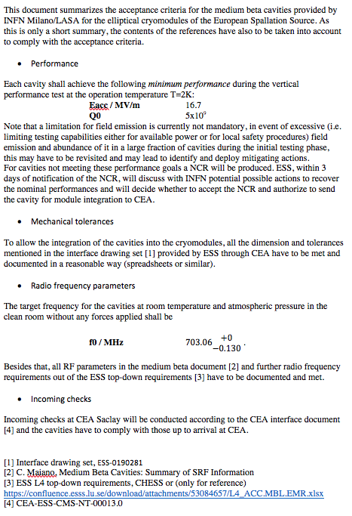
Identify AC
Draft “Acceptance criteria for the ESS medium beta cavities” by Felix Schlander

Slide 6
e.g. - Main Acceptance Criteria: Frequency
High Q Configuration
FPC Configuration
INFN
STFC
IPNO
Ref f at warm
Out
CEA
IPNO
ESS TS2
FREIA
Out
In
In
Out
CM
Measurements
In
DESY
STFC
IPNO
Out
Assess
ESS Linac
Reference f @ 2K
VT Measurements
Operation
f

Slide 7
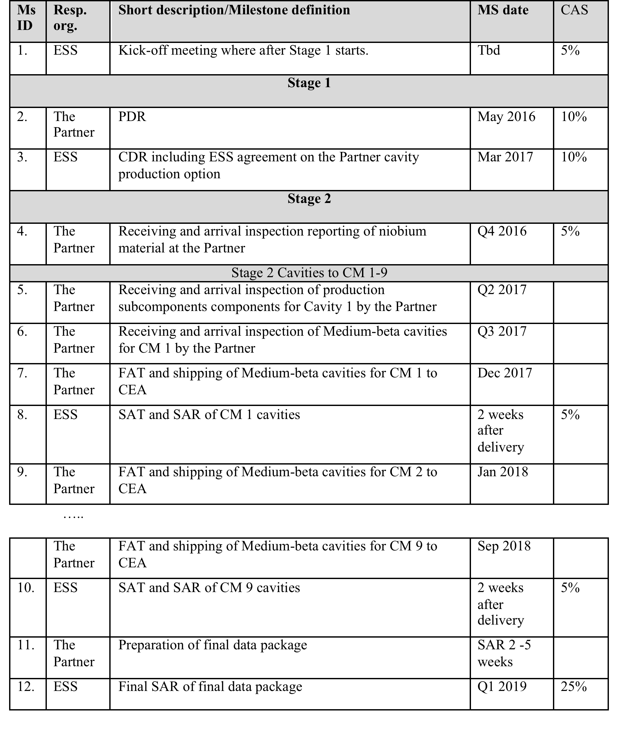
Assess – e.g. LASA/CEA/ESS

Slide 8
CEA Saclay/Irfu projet ESS | 04/04/2017
Detect and record the deviation
L2 : NCR or CR that will affect interfaces, safety, lifetime, performances, functional requirements with an impact at ESS level.
After corrective actions, the item is compliant to all specified requirements.
Actions implemented after the CEA approval.
L3 : NCR or CR that will affect interfaces, safety, lifetime, performances, functional requirements with an impact at ESS level.
Actions implemented after the ESS approval.
L1 : NCR or CR that will affect internal interfaces, performances and functional requirements without impact at the ESS level.
(CEA responsibility)
Deviation classification
L1
Not L1
but L2 or L3
List of level 2 NCR/CR sent to ESS every two months
CEA PMO & WP
Define a process to manage deviations between CEA and ESS
Analyse the root causes
and the consequences
Propose corrective and preventive actions
CEA WP
Impact at higher level
Analyse the root causes and the consequences / Validate the corrective and preventive actions
L2
L3
ESS - CEA
Analyse the root causes and the consequences / Validate the corrective and preventive actions
Implement the actions
Check the actions
Close the report
Notes:
The procedure of non-conformity and change request classifies the deviation in 3 levels. The first and second level are defined as minor deviations. The third level corresponds to the major deviation.
According to these levels, the way in the procedure is not the same.
The first level corresponds to a deviation that will affect interfaces, performances and functional requirements WITHOUT impact at the ESS Level. For this L1, for example a screw with dimensions which is not allowed the assembly. The way is like this. The corrective action could be changing the screw type.
The second level corresponds to a deviation that will affect interfaces, safety, etc. WITH an impact at the ESS level but after implementation of corrective action, the deviation is compliant. For example, a motor of tuning system isn’t operating and after the switch of a new motor, the system is ok and compliant with the functional requirements. So, the way for this level is like this.
The third and final level corresponds to the deviation that will affect the same thing that the second level but there is a necessity to have the ESS approval to implement actions. It could be a coupler according to the ESS specifications. So, the way to process these deviations is like this.

Slide 9
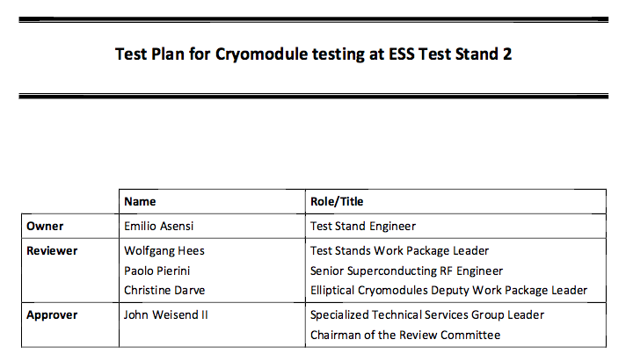
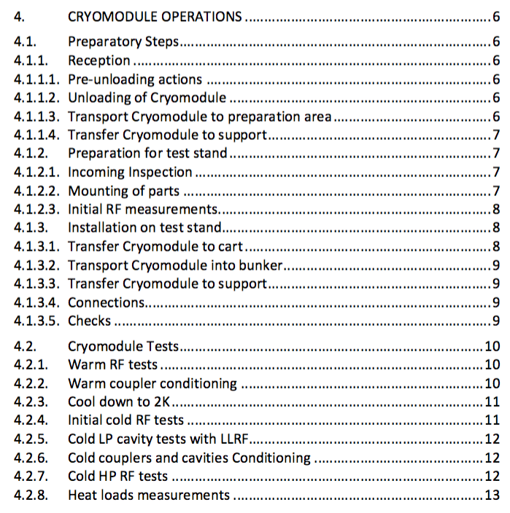
Assess – Test plan, e.g. Elliptical

Slide 10
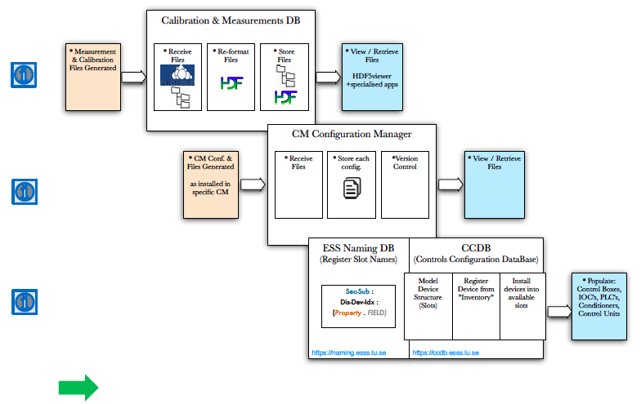
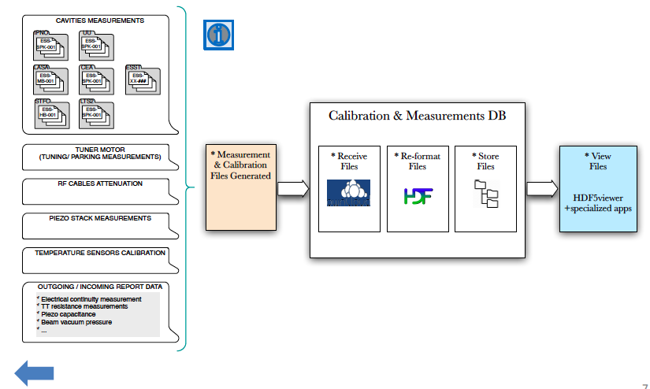
Control / Mitigate AC
Nuno Elias, Paolo Pierini, Emilio Asensi, Inigo Alonso, Cecilia Maiano
“CryoModule Calibration & Measurements
Configuration Management Tools” = CM3T

Slide 11
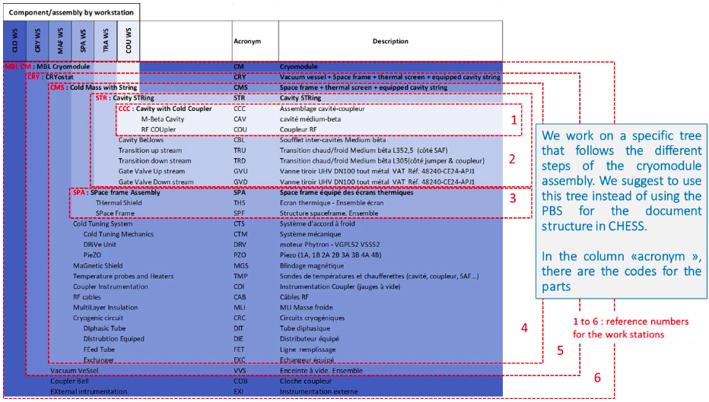
Control / Mitigate AC

Slide 12
Extra

Slide 13
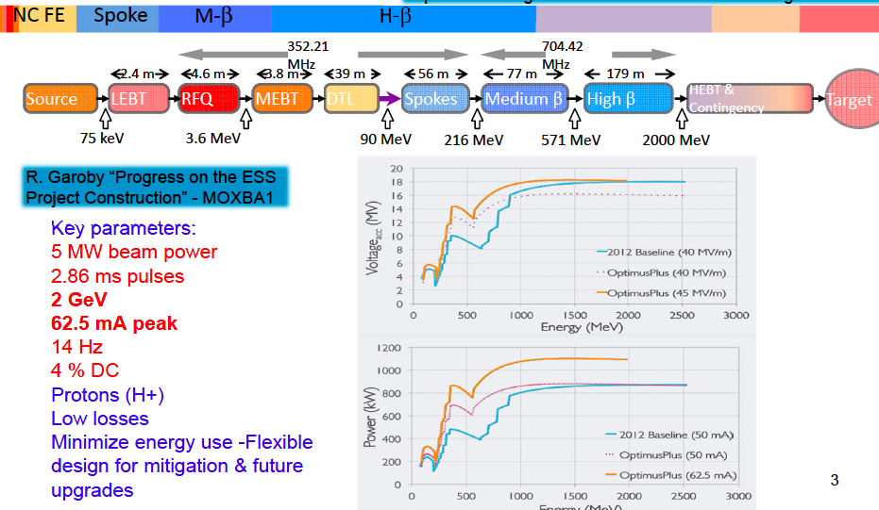
Goal ….

