Slide 1





Multi-Blade ¹⁰B-based detector for
neutron reflectometry at ESS:
tests at the
CRISP reflectometer at ISIS - RAL (UK)
Francesco Piscitelli
on behalf of
ESS / Wigner / Lund University / Linköping University collaboration
IEEE NSS Atlanta
2017/10/26
Wigner Research Institute
Linköping University
Building research infrastructure and synergies for highest scientific impact on ESS

Slide 2



Slide 3
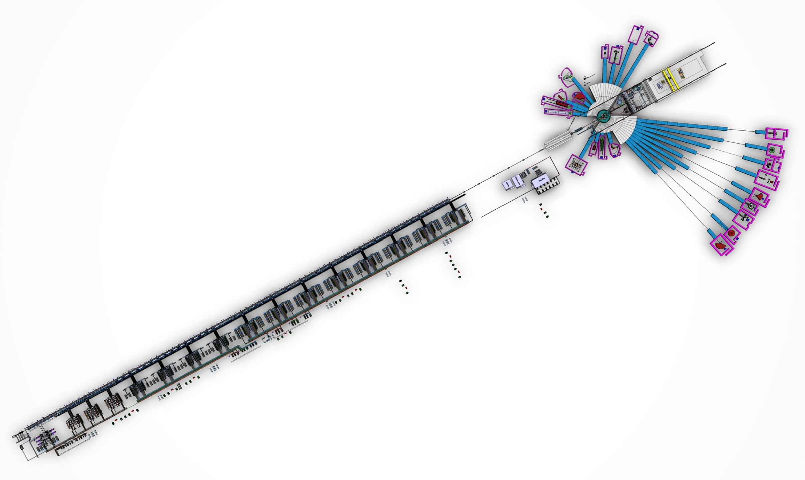
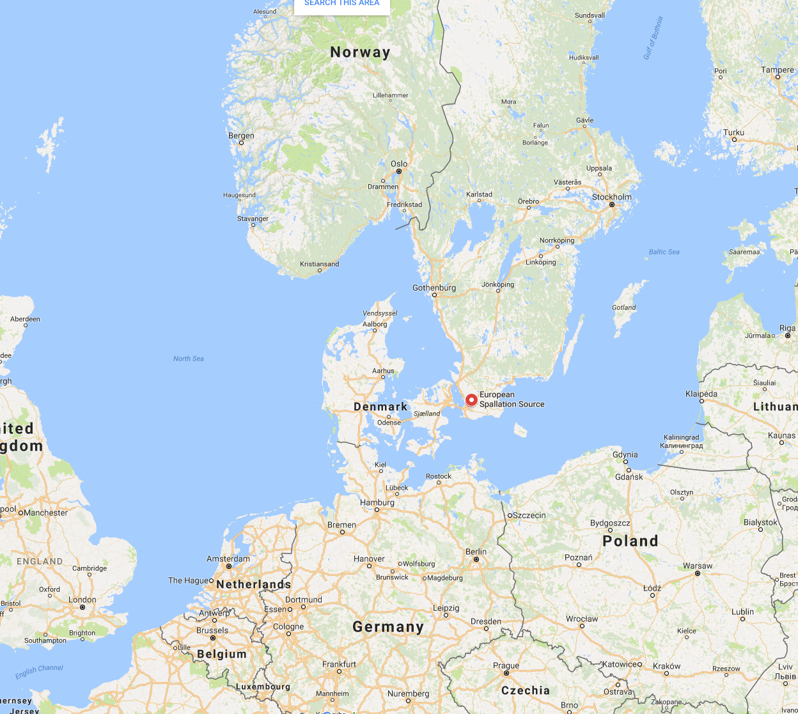
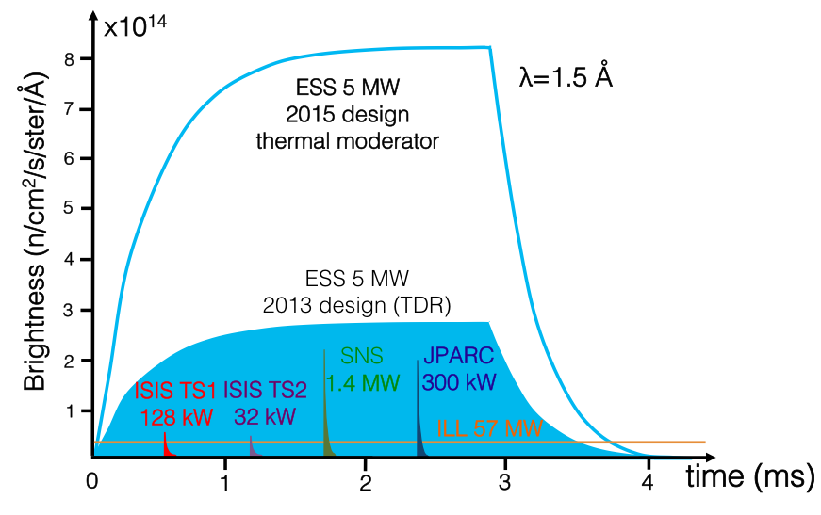


ESS will be several times brighter than existing facilities
Powerful neutron instruments
Sweden
instruments
target
Linear proton accelerator
August 2015

Slide 4


ESS will be several times brighter than existing facilities
Powerful neutron instruments
2 Reflectometers:
FREIA: horizontal refl.
ESTIA: vertical refl.
instruments
target
Linear proton accelerator
August 2015

Slide 5
ESS will be several times brighter than existing facilities
Powerful neutron instruments
2 Reflectometers:
FREIA: horizontal refl.
ESTIA: vertical refl.
instruments
target
Linear proton accelerator
High detector requirements
100 kHz/mm²
Instantaneous
Rate Capability
Reflectometry
August 2015
1 10 100
1 = state-of-the-art
0.5 mm
Spatial Resolution
Reflectometry
1 2 3 4

Slide 6
The Multi-Blade project
¹⁰B-detector for reflectometers

Slide 7
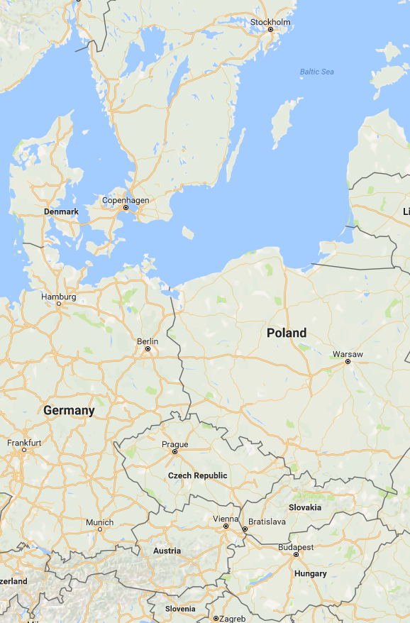





The Multi-Blade project
Linköping
¹⁰B-detector for reflectometers
Lund
Wigner Research Institute
3 years
Linköping University
The key objective of WP4 is the technological
evolution of neutron detectors in terms of
resolution, intensity and dimensions.
Budapest
Task 4.2 Neutron Detectors – The Intensity Frontier

Slide 8
The Multi-Blade project
High counting rate capability
High spatial resolution
MWPC
¹⁰B-detector for reflectometers
neutrons
Multi-Blade
sample
wires X
substrate
¹⁰B₄C
neutrons
strips Y
θ
A cassette (unit)
θ = 5 degrees

Slide 9
The Multi-Blade project
High counting rate capability
High spatial resolution
MWPC
A single Boron layer inclined at 5 degrees
¹⁰B-detector for reflectometers
Efficiency <5% at 2.5Å
Efficiency 45% at 2.5Å
neutrons
Multi-Blade
neutrons
¹⁰B₄C
neutrons
sample
¹⁰B₄C
θ
θ
wires X
substrate
θ = 90 degrees
θ = 5 degrees
¹⁰B₄C
neutrons
strips Y
θ
A cassette (unit)
θ = 5 degrees

Slide 10
The Multi-Blade project
High counting rate capability
High spatial resolution
MWPC
Why the counting rate capability is improved?
The intensity is spread over a wider surface (5 degrees ~ factor x10)
Thin gap MWPC (4mm)
Low gas gain operation G~20
(max 0.2pC avalanches)
¹⁰B-detector for reflectometers
neutrons
Multi-Blade
sample
wires X
substrate
¹⁰B₄C
neutrons
strips Y
θ
A cassette (unit)
θ = 5 degrees

Slide 11
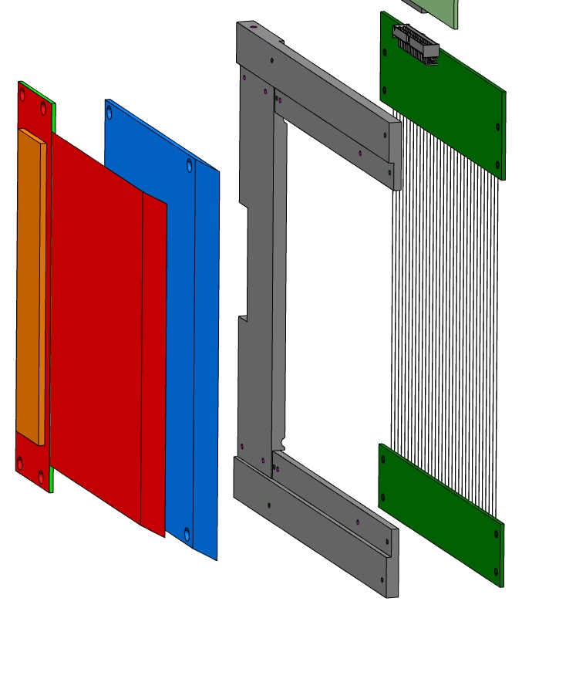
The Multi-Blade project
MWPC
¹⁰B₄C substrate
¹⁰B-detector for reflectometers
holding frame
cathode strips
anode wires
neutrons
Multi-Blade
sample
wires X
substrate
¹⁰B₄C
neutrons
strips Y
θ
A cassette (unit)
θ = 5 degrees

Slide 12
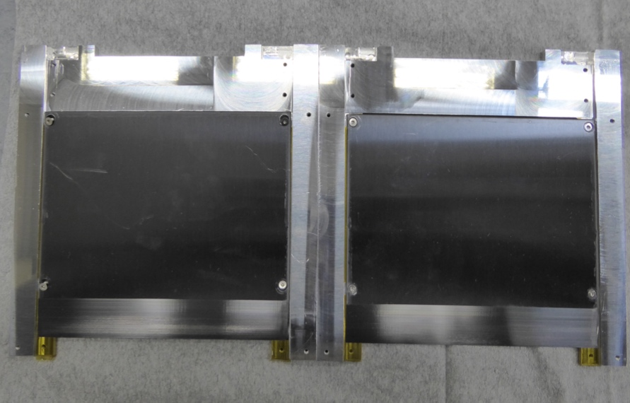
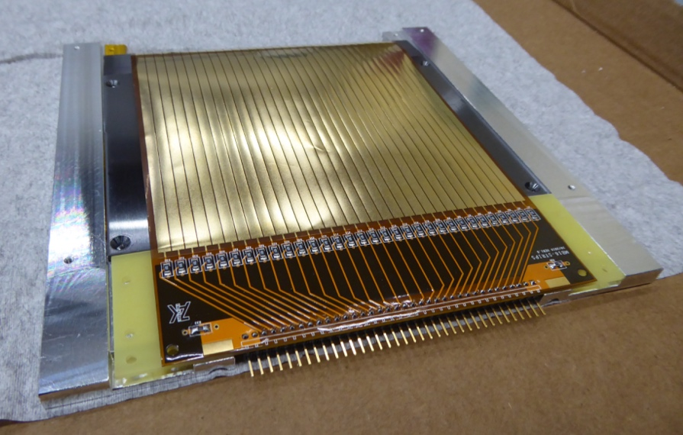
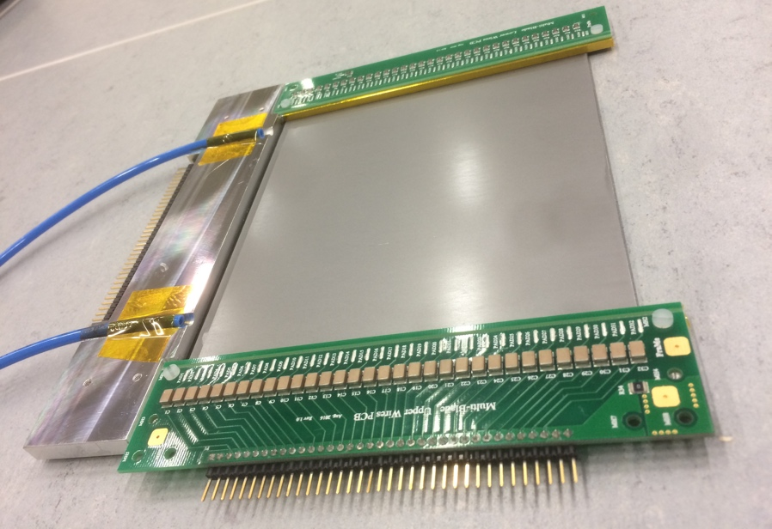
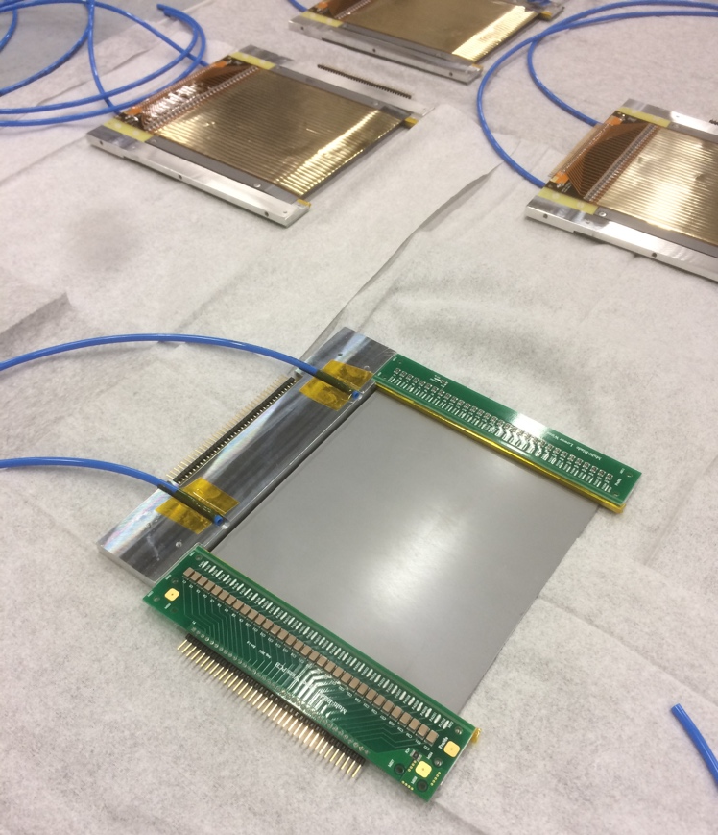
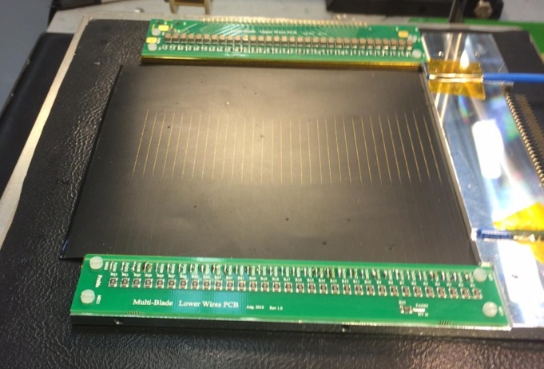
The Multi-Blade project
Ti blades
MWPC
¹⁰B₄C substrate
32 Strips
¹⁰B-detector for reflectometers
holding frame
cathode strips
anode wires
neutrons
Multi-Blade
sample
A cassette (unit)
wires X
substrate
¹⁰B₄C
neutrons
strips Y
θ
A cassette (unit)
32 Wires
A cassette (unit)
θ = 5 degrees

Slide 13
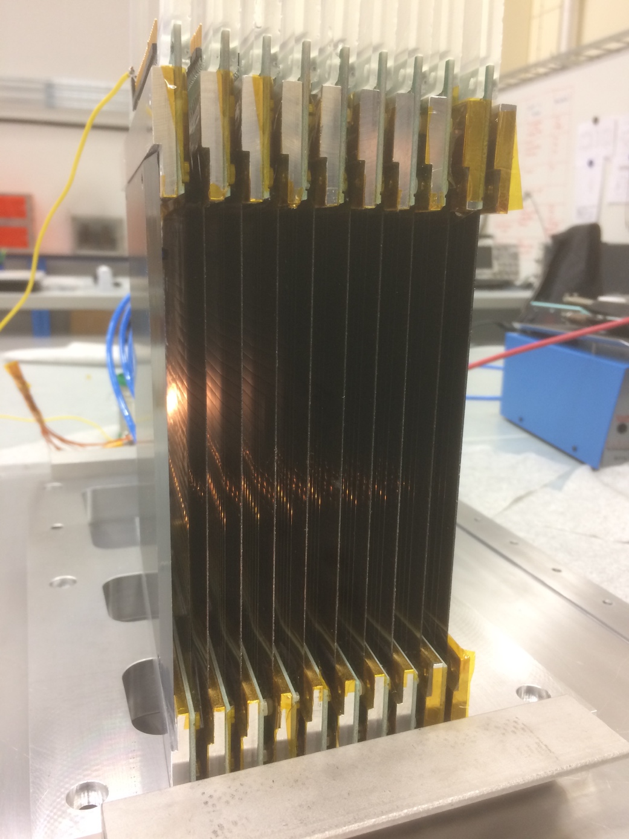
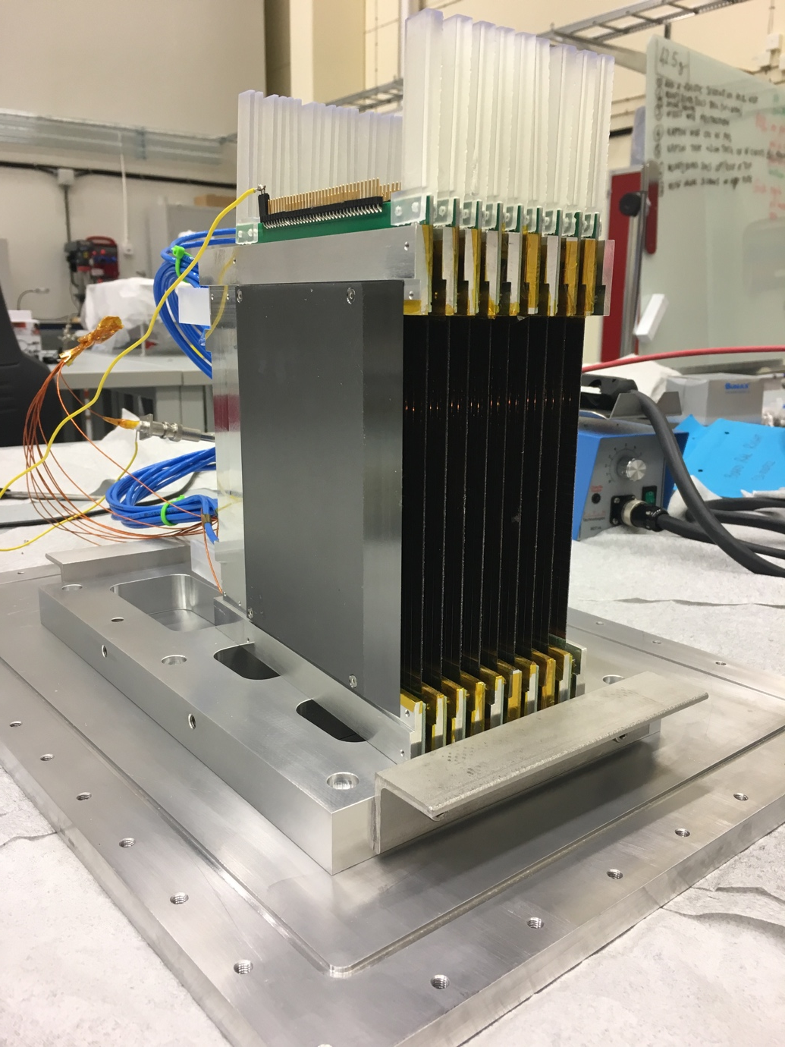
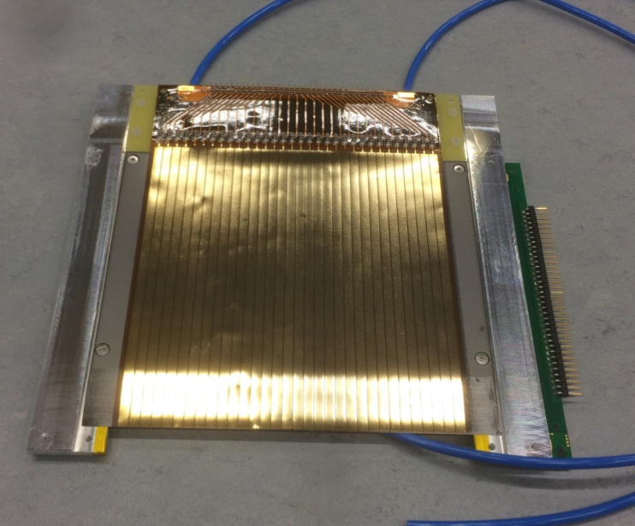
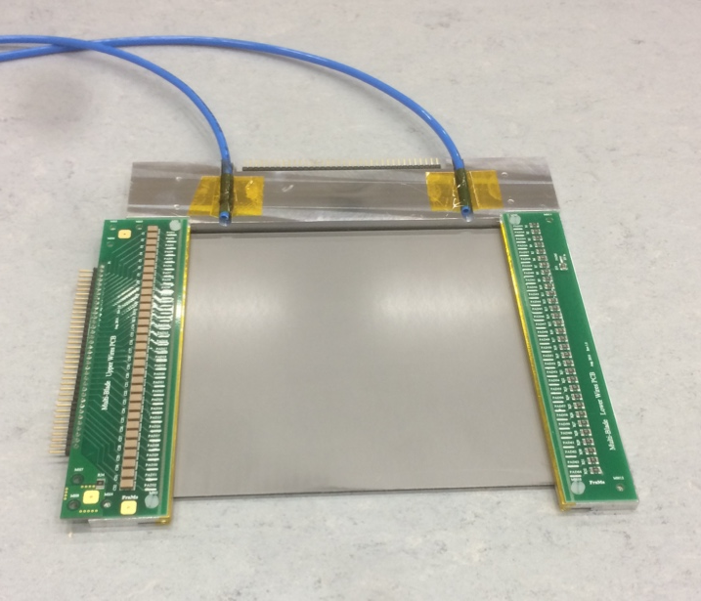
The Multi-Blade project
MWPC
9 units
130mm
neutrons
neutrons
neutrons
Multi-Blade
sample
100mm
wires X
substrate
¹⁰B₄C
neutrons
strips Y
32 Strips
(back)
32 wires
(front)
θ
A cassette (unit)
θ = 5 degrees

Slide 14
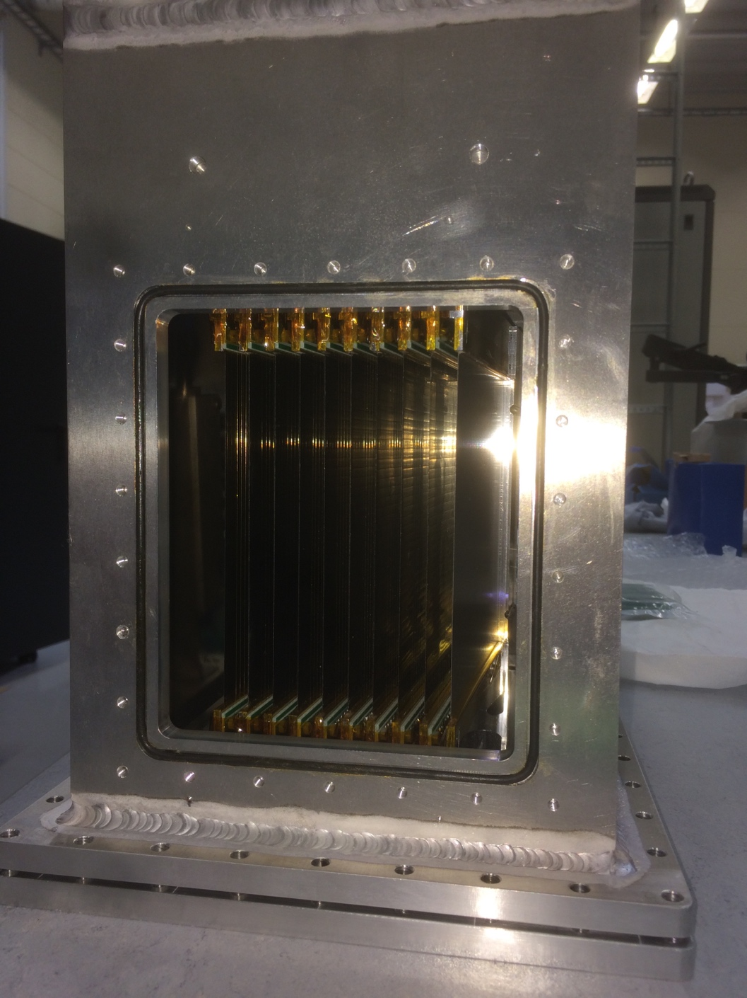
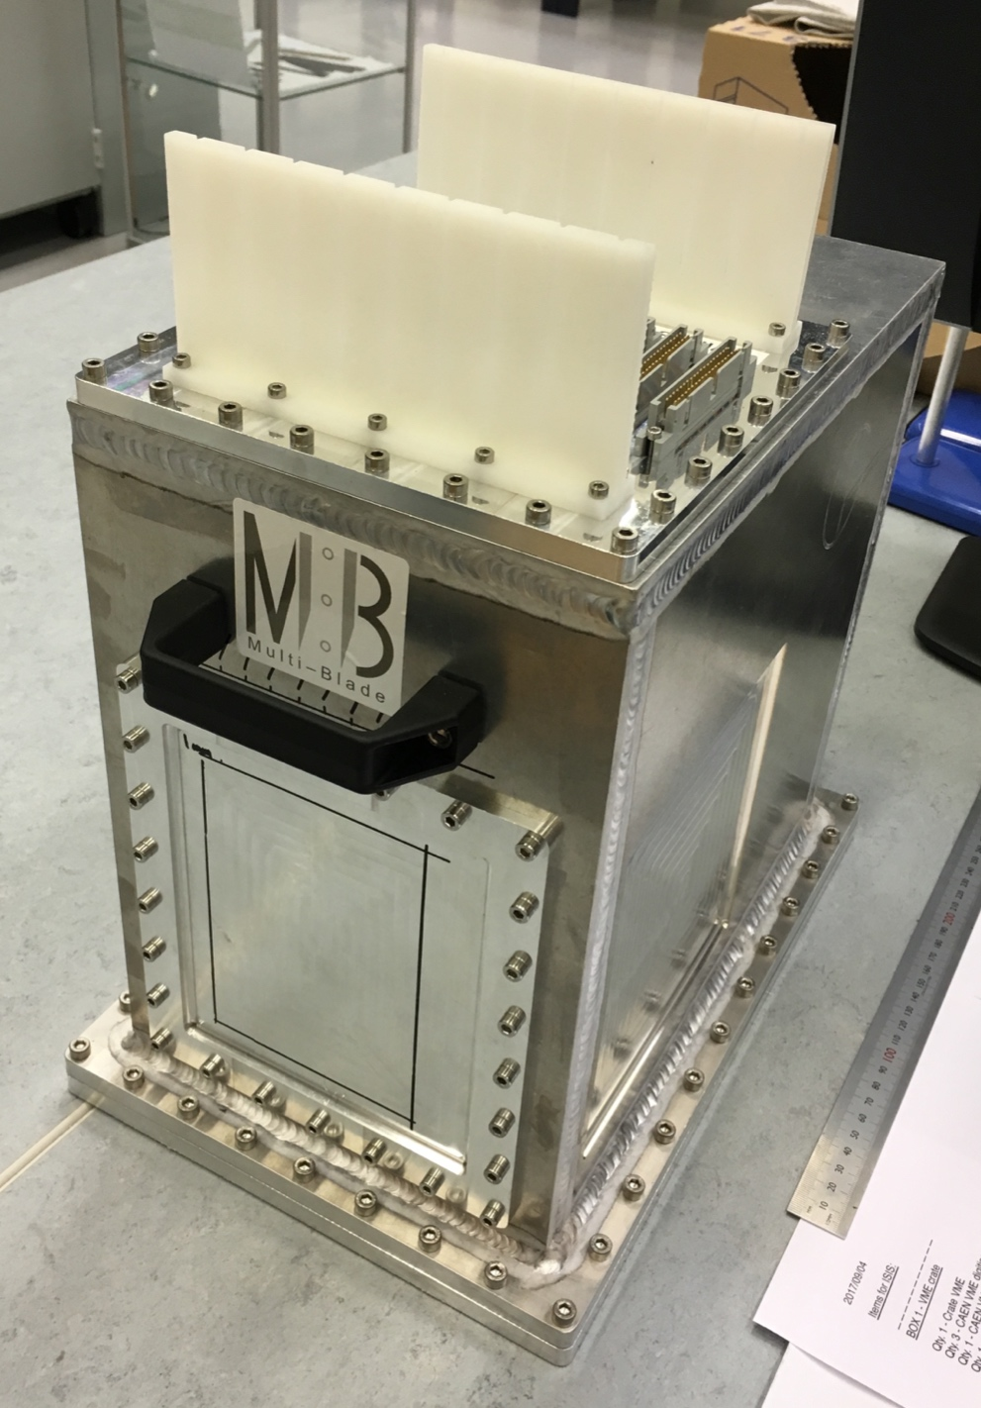
The Multi-Blade project
9 units
130mm
neutrons
neutrons
100mm
vessel
32 Strips
(back)
32 wires
(front)

Slide 15
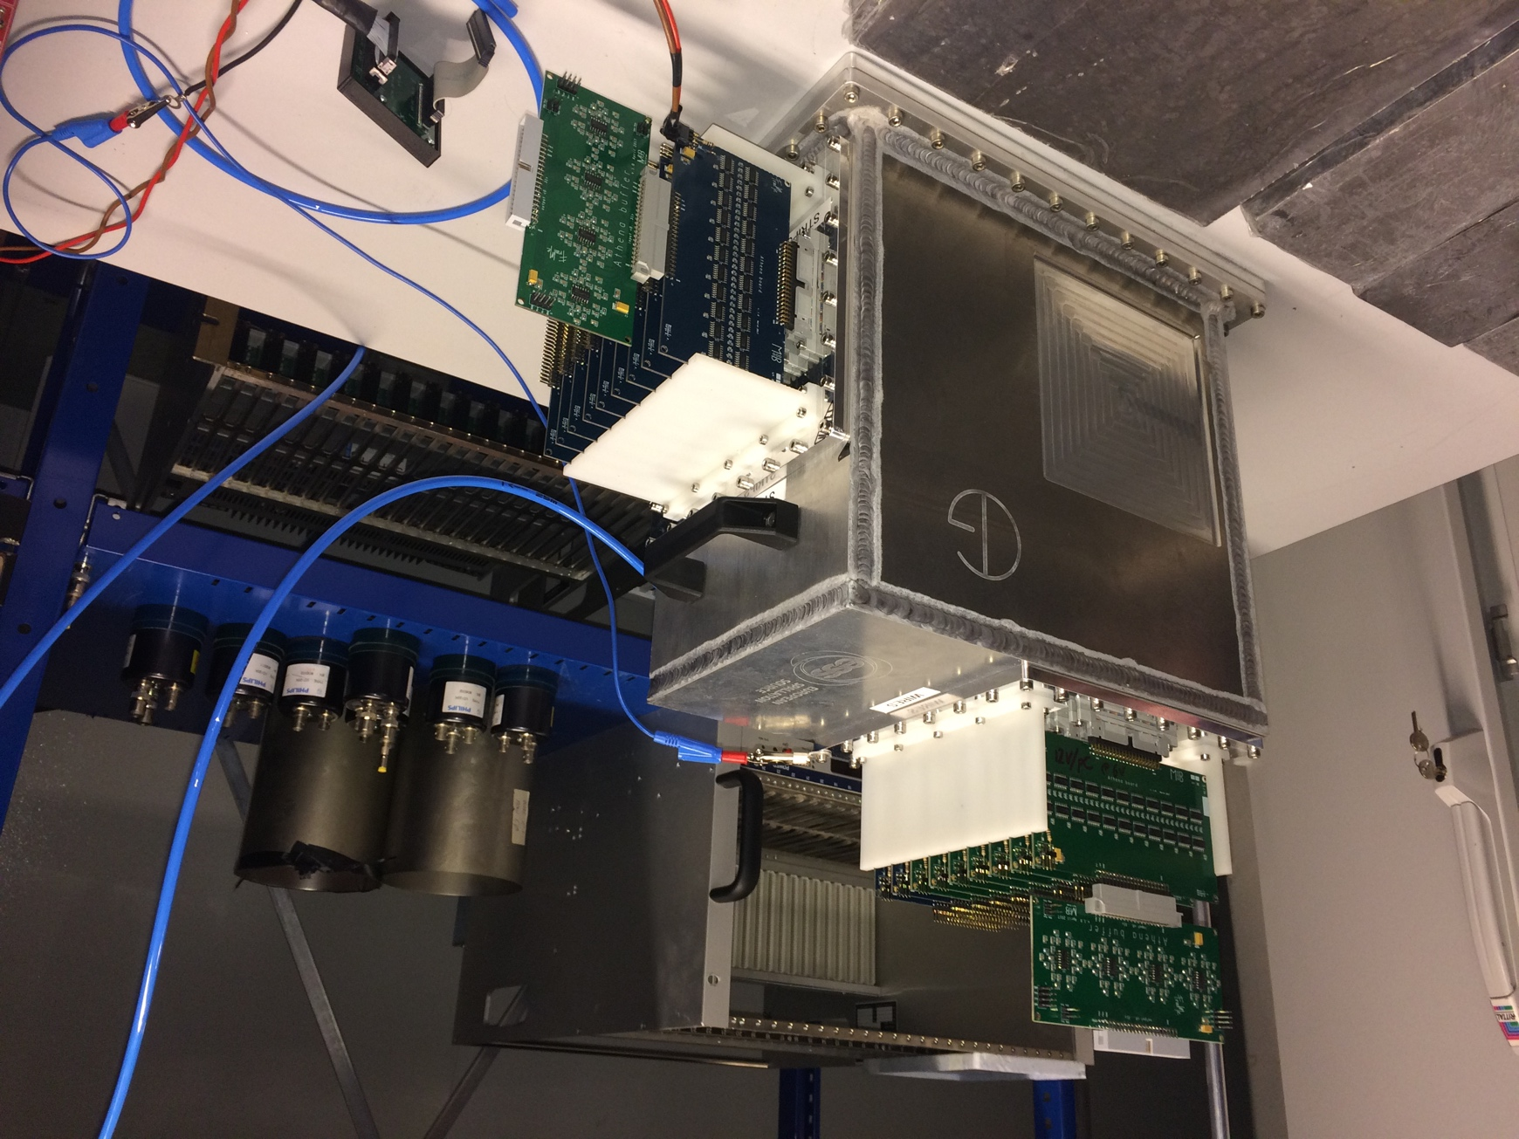
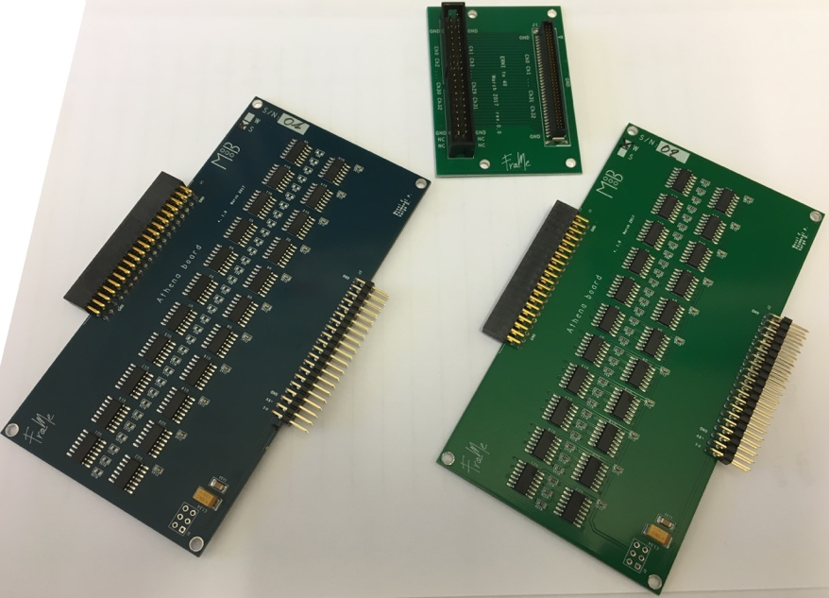
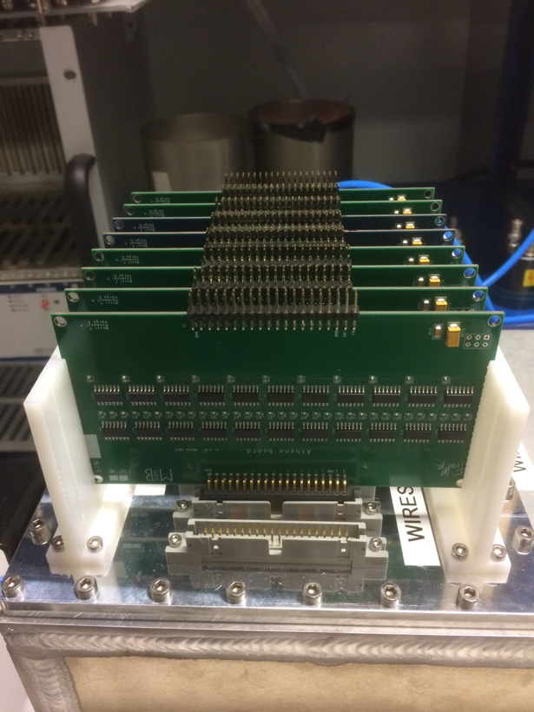
The Multi-Blade project
Front-end on wires
9 boards (32x9ch)
Front-end on strips
9 boards (32x9ch)
vessel
32ch front-end boards

Slide 16
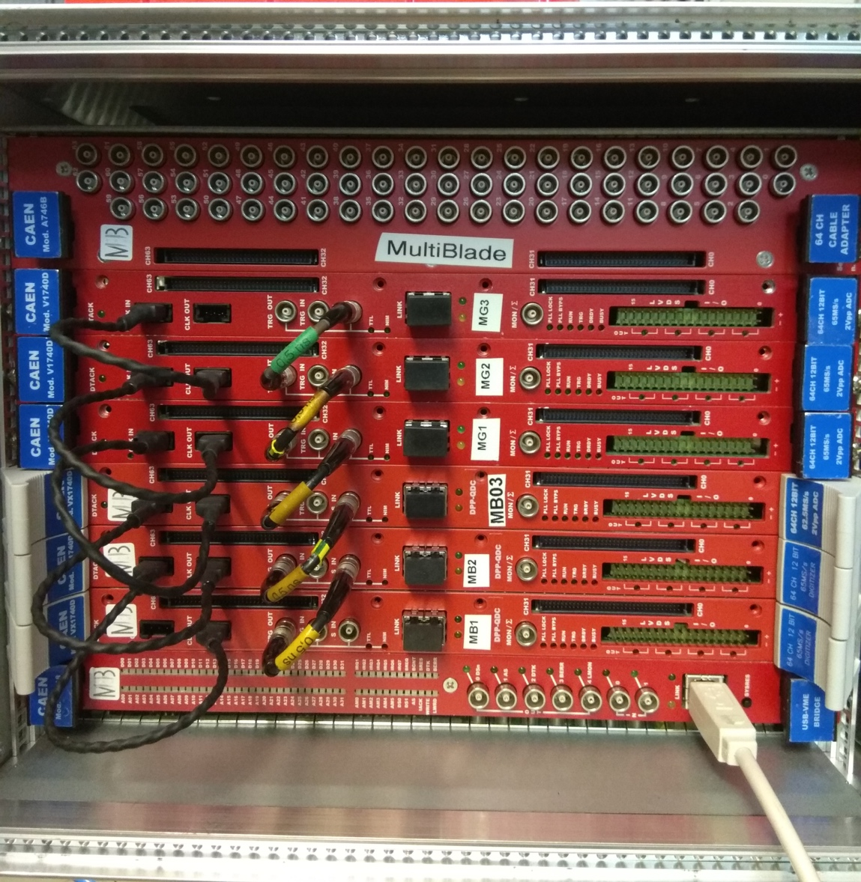
The Multi-Blade project
Front-end on wires
9 boards (32x9ch)
TTL for time stamp reset
x9
FEE
vessel
CAEN
V1740D
One Digitser (64ch is 1 cassette)
32 wires
x9
32x9 outputs
from FEE strips
Front-end on strips
9 boards (32x9ch)
32 strips
FEE
cassette
x9
Each blade has 32 wires and 32 strips
readout individually,
in total 9 units (64x9 channels)

Slide 17
Summary
 | Multi-Blade
efficiency | 45% @ 2.5Å 56% @ 4.2Å 65% @ 5.1Å
spatial resolution | 0.5 x 2.5 mm²
uniformity | 10%
stability | <1% in 12h
counting rate capability | >1.6 kHz/mm2 (lower limit) >17kHz / channel (lower limit)
gamma-ray sensitivity | < 10⁻⁷ (with 100keV threshold)
gas gain | 20
overlap | 50% eff. drop in 0.75mm gap
F. Piscitelli et al., The Multi-Blade Boron-10-based Neutron Detector for high intensity Neutron Reflectometry at ESS, JINST 12 (3) P03013 (2017).

Slide 18
Summary
 | Multi-Blade
efficiency | 45% @ 2.5Å 56% @ 4.2Å 65% @ 5.1Å
spatial resolution | 0.5 x 2.5 mm²
uniformity | 10%
stability | <1% in 12h
counting rate capability | >1.6 kHz/mm2 (lower limit) >17kHz / channel (lower limit)
gamma-ray sensitivity | < 10⁻⁷ (with 100keV threshold)
gas gain | 20
overlap | 50% eff. drop in 0.75mm gap
Matching ESS requirements
F. Piscitelli et al., The Multi-Blade Boron-10-based Neutron Detector for high intensity Neutron Reflectometry at ESS, JINST 12 (3) P03013 (2017).

Slide 19
Summary
 | Multi-Blade
efficiency | 45% @ 2.5Å 56% @ 4.2Å 65% @ 5.1Å
spatial resolution | 0.5 x 2.5 mm²
uniformity | 10%
stability | <1% in 12h
counting rate capability | >1.6 kHz/mm2 (lower limit) >17kHz / channel (lower limit)
gamma-ray sensitivity | < 10⁻⁷ (with 100keV threshold)
gas gain | 20
overlap | 50% eff. drop in 0.75mm gap
Matching ESS requirements
F. Piscitelli et al., The Multi-Blade Boron-10-based Neutron Detector for high intensity Neutron Reflectometry at ESS, JINST 12 (3) P03013 (2017).

Slide 20
Summary
 | Multi-Blade
efficiency | 45% @ 2.5Å 56% @ 4.2Å 65% @ 5.1Å
spatial resolution | 0.5 x 2.5 mm²
uniformity | 10%
stability | <1% in 12h
counting rate capability | >1.6 kHz/mm2 (lower limit) >17kHz / channel (lower limit)
gamma-ray sensitivity | < 10⁻⁷ (with 100keV threshold)
gas gain | 20
overlap | 50% eff. drop in 0.75mm gap
x3 better than
state-of-the-art
Matching ESS requirements
x10 better than
state-of-the-art
F. Piscitelli et al., The Multi-Blade Boron-10-based Neutron Detector for high intensity Neutron Reflectometry at ESS, JINST 12 (3) P03013 (2017).

Slide 21
ToF Reflectometry
2 Reflectometers @ ESS:
FREIA: horizontal refl.
ESTIA: vertical refl.
¹⁰B-detector for reflectometers

Slide 22
ToF Reflectometry
detector
2 Reflectometers @ ESS:
FREIA: horizontal refl.
ESTIA: vertical refl.
sample
¹⁰B-detector for reflectometers

Slide 23
ToF Reflectometry
detector
sample
Reflectometry is a technique to study
SURFACES & INTERFACES

Slide 24
ToF Reflectometry
detector area
λ₁
detector
λ₂
sample
λ₃
reflected intensity
θ
θ
ToF (Time-Of-Flight) reflectometer
Reflectometry is a technique to study
SURFACES & INTERFACES

Slide 25
ToF Reflectometry
detector area
detector ToF
λ₁
detector
λ₂
ToF of the
reflected intensity
sample
λ₃
reflected intensity
θ
θ
ToF (Time-Of-Flight) reflectometer
ToF (or λ)
Reflectometry is a technique to study
SURFACES & INTERFACES

Slide 26
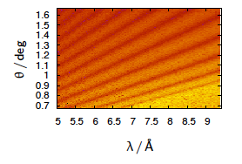

ToF Reflectometry
detector area
λ₁
detector
λ₂
sample
λ₃
reflected intensity
θ
θ
ToF (Time-Of-Flight) reflectometer
0.5 6
Reflectometry is a technique to study
SURFACES & INTERFACES

Slide 27
ToF Reflectometry
detector area
λ₁
λ₂
λ₃
λ₁
detector
λ₂
sample
λ₃
reflected intensity
θ
θ
ToF (Time-Of-Flight) reflectometer
0.5 6
Reflectometry is a technique to study
SURFACES & INTERFACES

Slide 28
ToF Reflectometry
detector area
detector ToF
λ₁
detector
λ₂
ToF of the
reflected intensity
sample
λ₃
reflected intensity
θ
θ
ToF (Time-Of-Flight) reflectometer
0.5 2 6Å
ToF (or λ)
λ₁
λ₂
λ₃
λ∝1/v = ToF / Distance
Smaller ToF
Larger ToF
T₁
T₂
T₃
0.5 6
Smaller λ
Larger λ
λ₁
λ₂
λ₃
(6Å)
(0.5Å)
Reflectometry is a technique to study
SURFACES & INTERFACES
v₁
v₁
v₁
Faster neutrons
Slower neutrons

Slide 29

ToF Reflectometry
detector area
detector ToF
λ₁
detector
λ₂
ToF of the
reflected intensity
sample
λ₃
reflected intensity
θ
θ
ToF (Time-Of-Flight) reflectometer
0.5 2 6Å
Line at constant q
ToF (or λ)
λ₁
λ₂
λ₃
q ∝sin(θ) / λ
λ∝1/v = ToF / Distance
Momentum transfer
q =(4π/λ) sin(θ)
Neutron wavelength
Log R =
= reflected
/ incoming
λ₃
Incidence angle
λ₂
0.5 6
λ₁
Reflectometry is a technique to study
SURFACES & INTERFACES
q

Slide 30
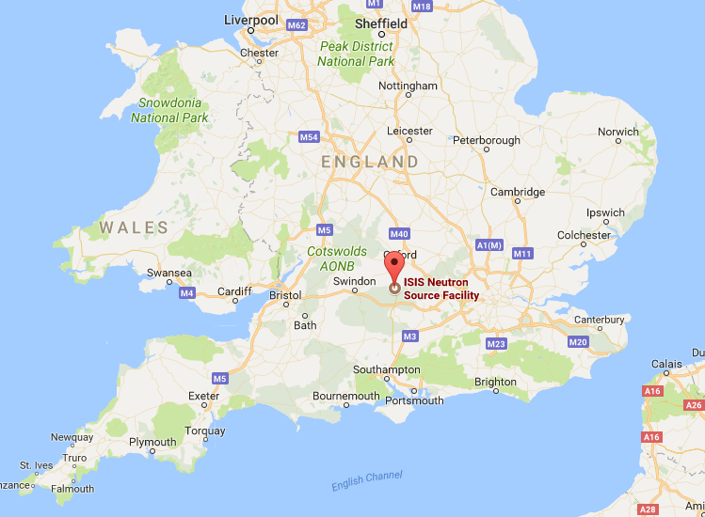
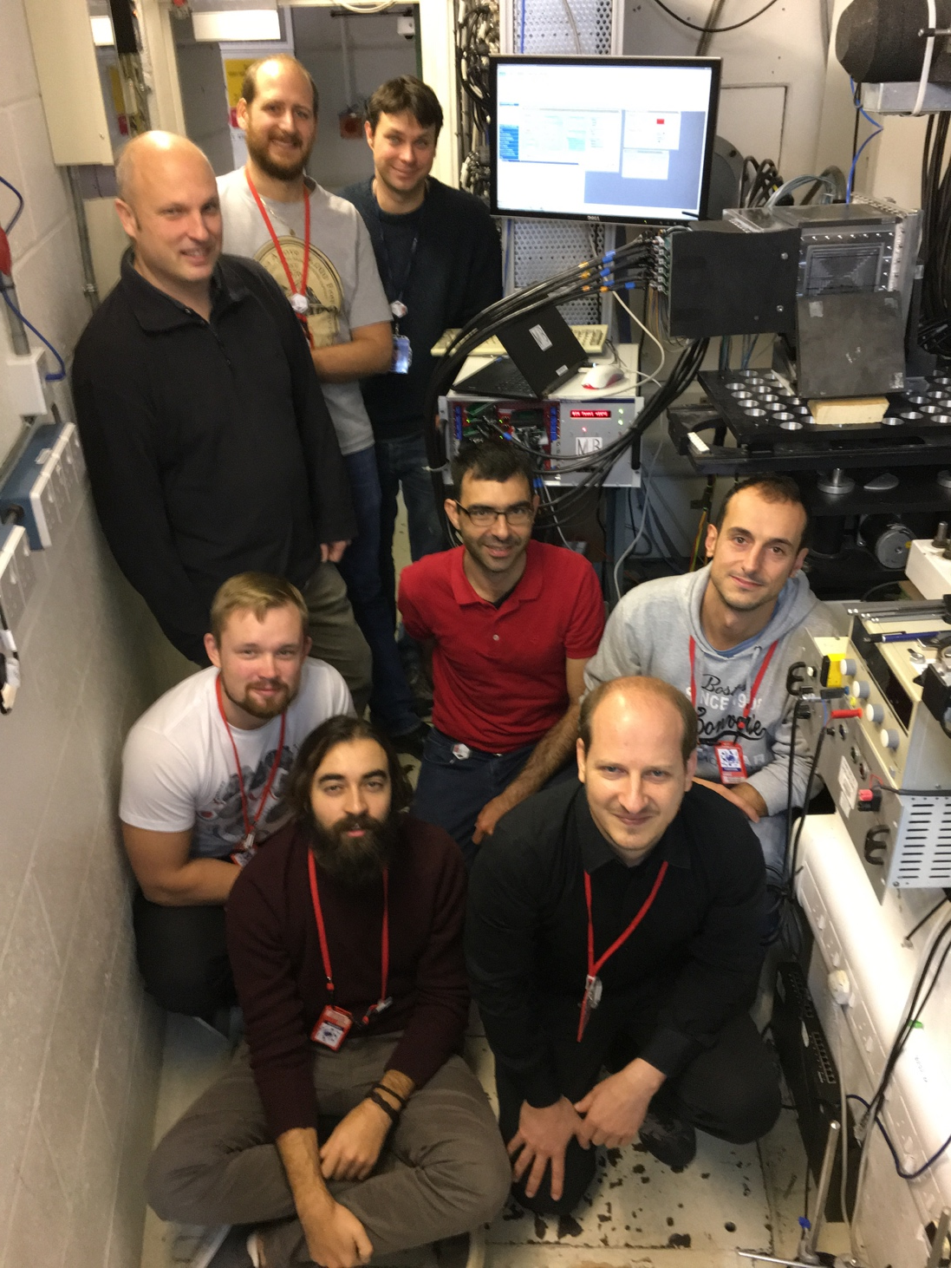
CRISP reflectometer at ISIS
Tests performed 2 weeks ago on the CRISP reflectometer at ISIS

Slide 31
CRISP reflectometer at ISIS
detector
sample
Thermal Neutron Reflectometer
Neutron wavelength | 0.5 – 6.5 Å @ 50Hz (0.5 – 13 Å @ 25Hz)
q range | 0.005 – 1.1 Å⁻¹
Moderator - sample distance | 10.25m
Sample - Detector distance | 1.87m
Sample - MB Detector distance | 2.33m

Slide 32
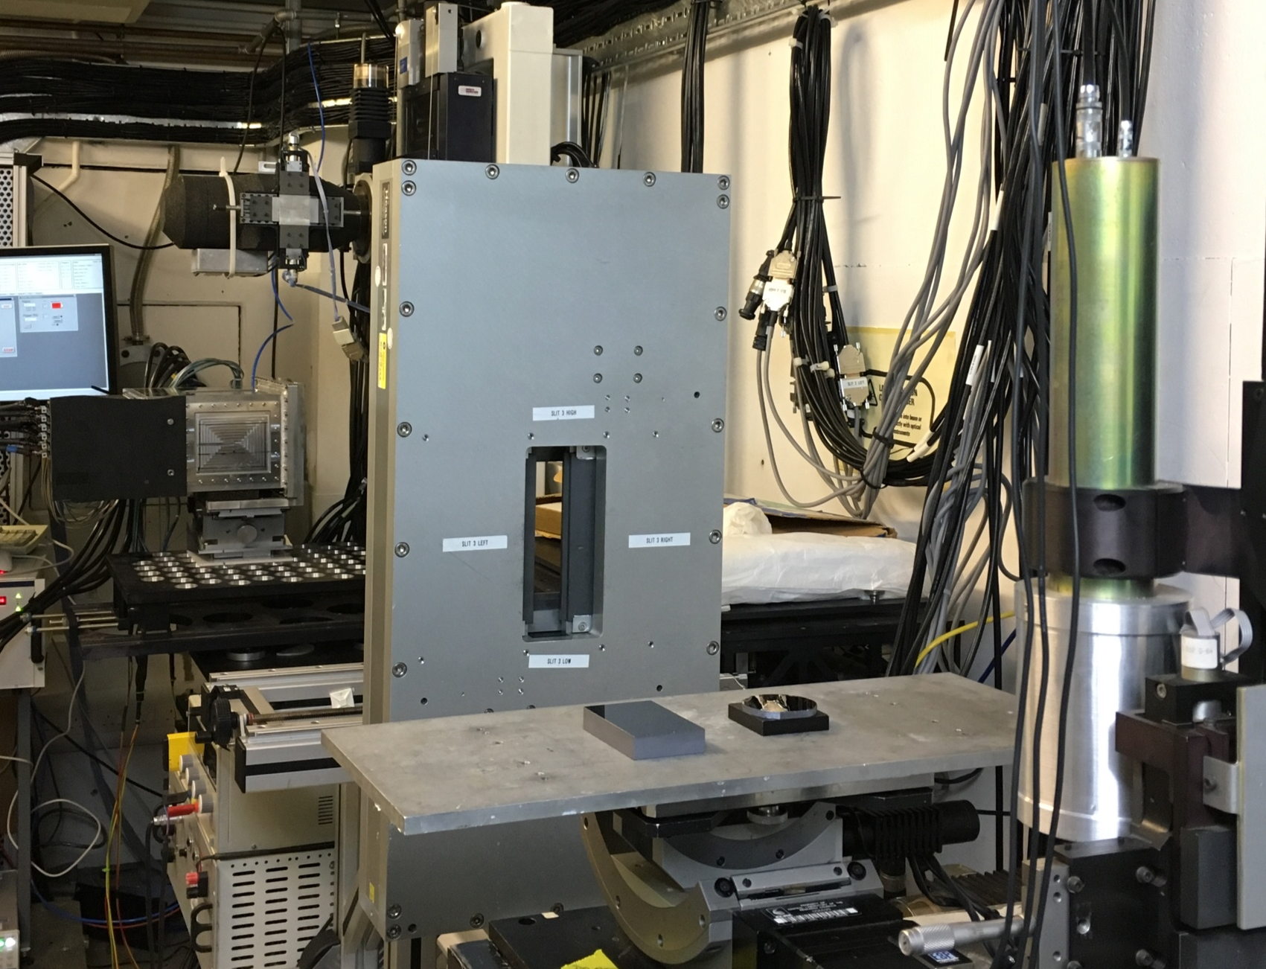
CRISP reflectometer at ISIS
detector
sample
detector
Thermal Neutron Reflectometer
Neutron wavelength | 0.5 – 6.5 Å @ 50Hz (0.5 – 13 Å @ 25Hz)
q range | 0.005 – 1.1 Å⁻¹
Moderator - sample distance | 10.25m
Sample - Detector distance | 1.87m
Sample - MB Detector distance | 2.33m
sample

Slide 33
CRISP reflectometer at ISIS
Multi-Blade
detector
sample
MB detector
sample

Slide 34
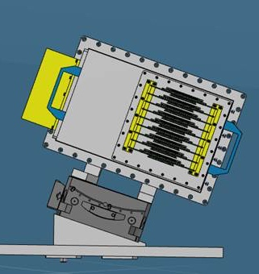
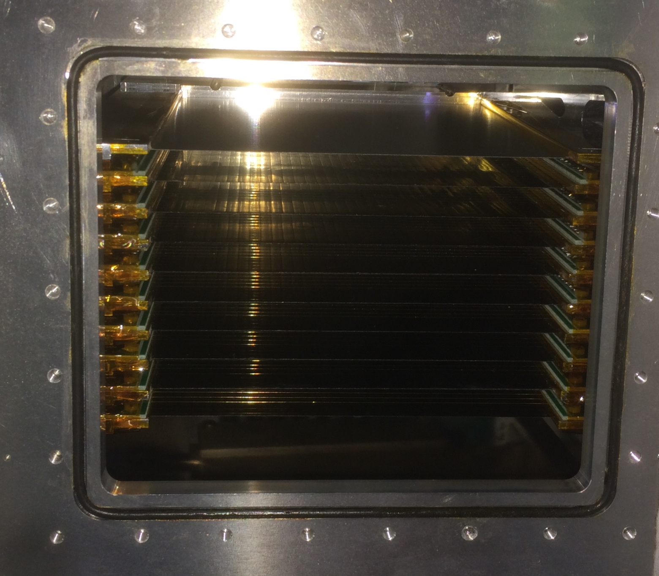
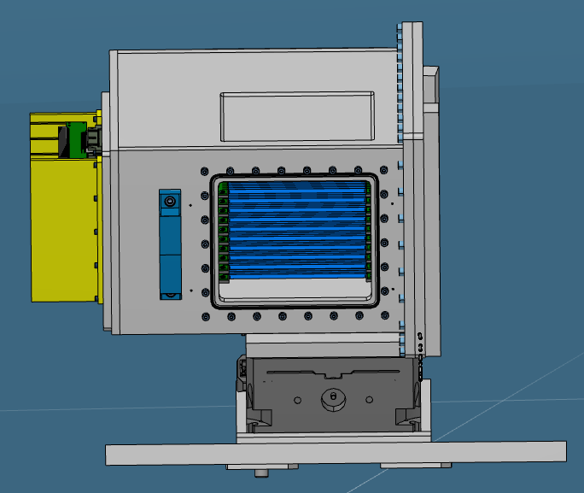
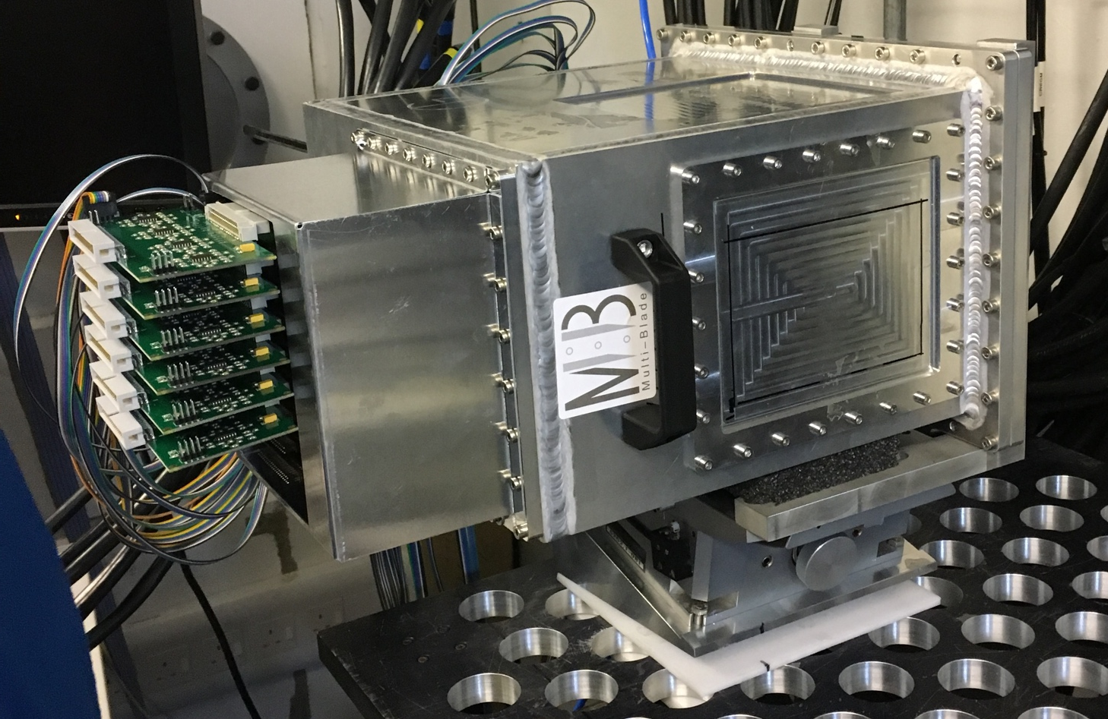
CRISP reflectometer at ISIS
Multi-Blade
detector
sample
MB detector
Resolution 4mm
sample
130mm
100mm
The cassette (units)
are placed horizontally
Resolution 0.5mm

Slide 35
Results

Slide 36
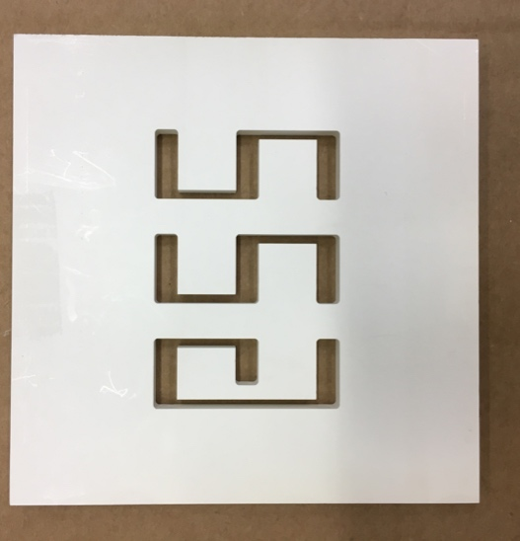
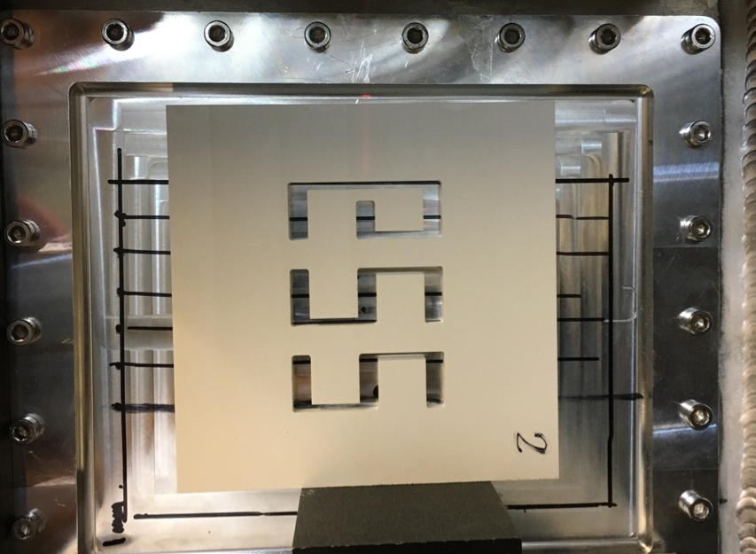
Results
Multi-Blade
detector
sample
BN mask
40mm
60mm

Slide 37
Results
Multi-Blade
detector
sample
BN mask
40mm
(Log scale)
60mm

Slide 38
Results
Multi-Blade
detector
sample
BN mask
40mm
(Log scale)
60mm
shadow

Slide 39
Results
Multi-Blade
detector
substrate
wires
strips
¹⁰B₄C
sample
BN mask
40mm
(Log scale)
60mm
shadow
shadow

Slide 40
Results
Multi-Blade
detector
substrate
wires
strips
¹⁰B₄C
sample
BN mask
40mm
(Log scale)
60mm
shadow
shadow
Not a dead area but the overlap avoids dead zones
shadow
No shadow

Slide 41
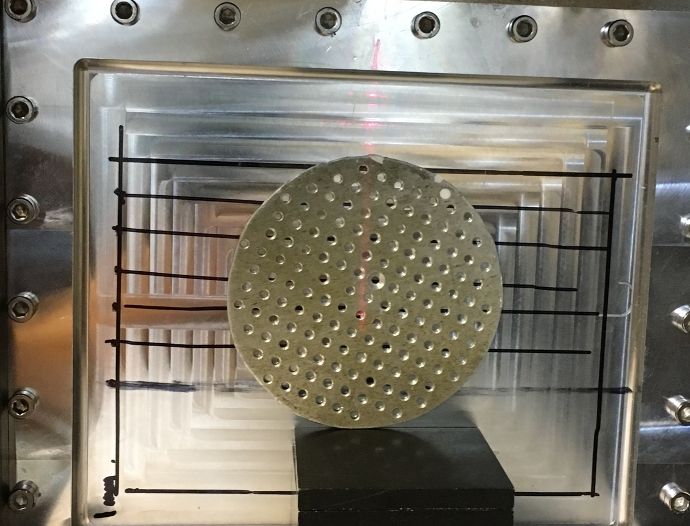

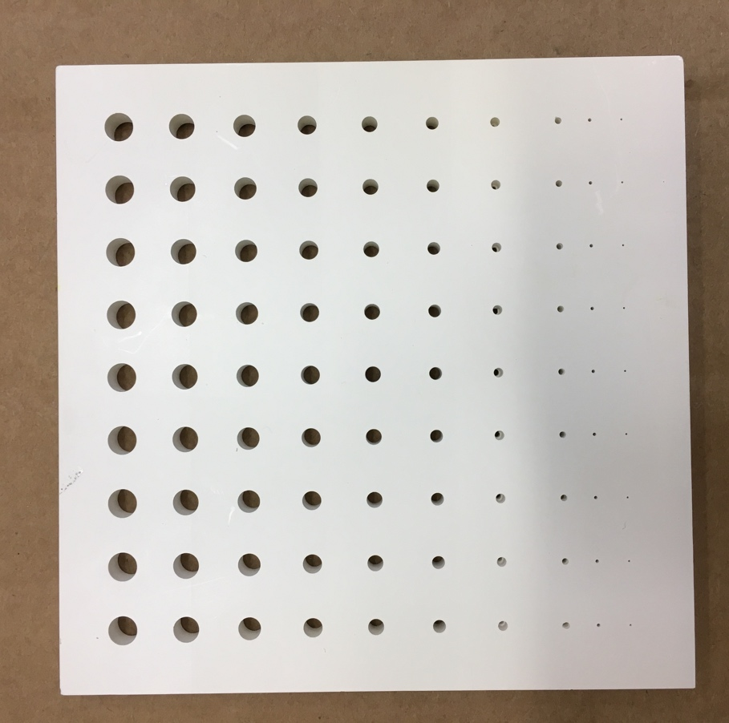

Results
BN mask
1.5mm
(Log scale)
60mm
130mm

Slide 42
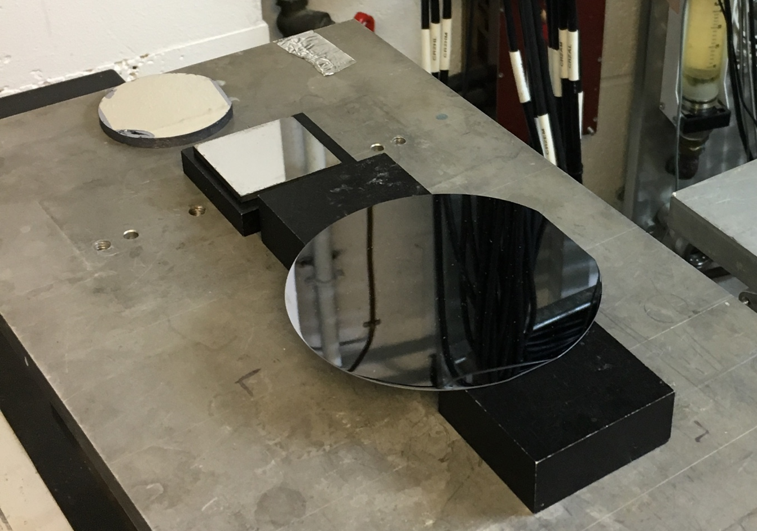
Results
Multi-Blade
detector
sample
θ
θ
Ir sample
Si sample
Fe/Si sample
Fe/Si
Ir
Si

Slide 43
ToF Reflectometry
detector area
detector ToF
λ₁
detector
λ₂
ToF of the
reflected intensity
sample
λ₃
reflected intensity
θ
θ
ToF (Time-Of-Flight) reflectometer
0.5 2 6Å
Line at constant q
ToF (or λ)
λ₁
λ₂
λ₃
q ∝sin(θ) / λ
λ∝1/v = ToF / Distance
Momentum transfer
q =(4π/λ) sin(θ)
Neutron wavelength
Log R =
= reflected
/ incoming
λ₃
Incidence angle
λ₂
0.5 6
λ₁
Reflectometry is a technique to study
SURFACES & INTERFACES
q

Slide 44
Results
detector area
detector ToF
Multi-Blade
detector
sample
ToF of the
reflected intensity
reflected intensity
θ
θ
Ir sample
Si sample
Fe/Si sample
0.5 2 6Å
ToF (or λ)
6ms (2Å)
20ms (6Å)
Ir sample
0.5 6
(Theoretical R)

Slide 45
Results
detector area
detector ToF
Multi-Blade
detector
sample
θ₂
ToF of the
reflected intensity
reflected intensity
θ
θ
θ₁
Ir sample
Si sample
Fe/Si sample
0.5 2 6Å
ToF (or λ)
θ₂
6ms (2Å)
20ms (6Å)
θ₁
0.5 6

Slide 46
Results
detector area
detector ToF
Multi-Blade
detector
sample
θ₂
ToF of the
reflected intensity
reflected intensity
θ
θ
θ₁
Ir sample
Si sample
Fe/Si sample
0.5 2 6Å
ToF (or λ)
θ₂
6ms (2Å)
20ms (6Å)
θ₁
Log R =
= reflected
/ incoming
λ₃
θ₁
λ₂
0.5 6
λ₁
θ₂
λ₃
λ₂
λ₁
q
q =(4π/λ) sin(θ)

Slide 47
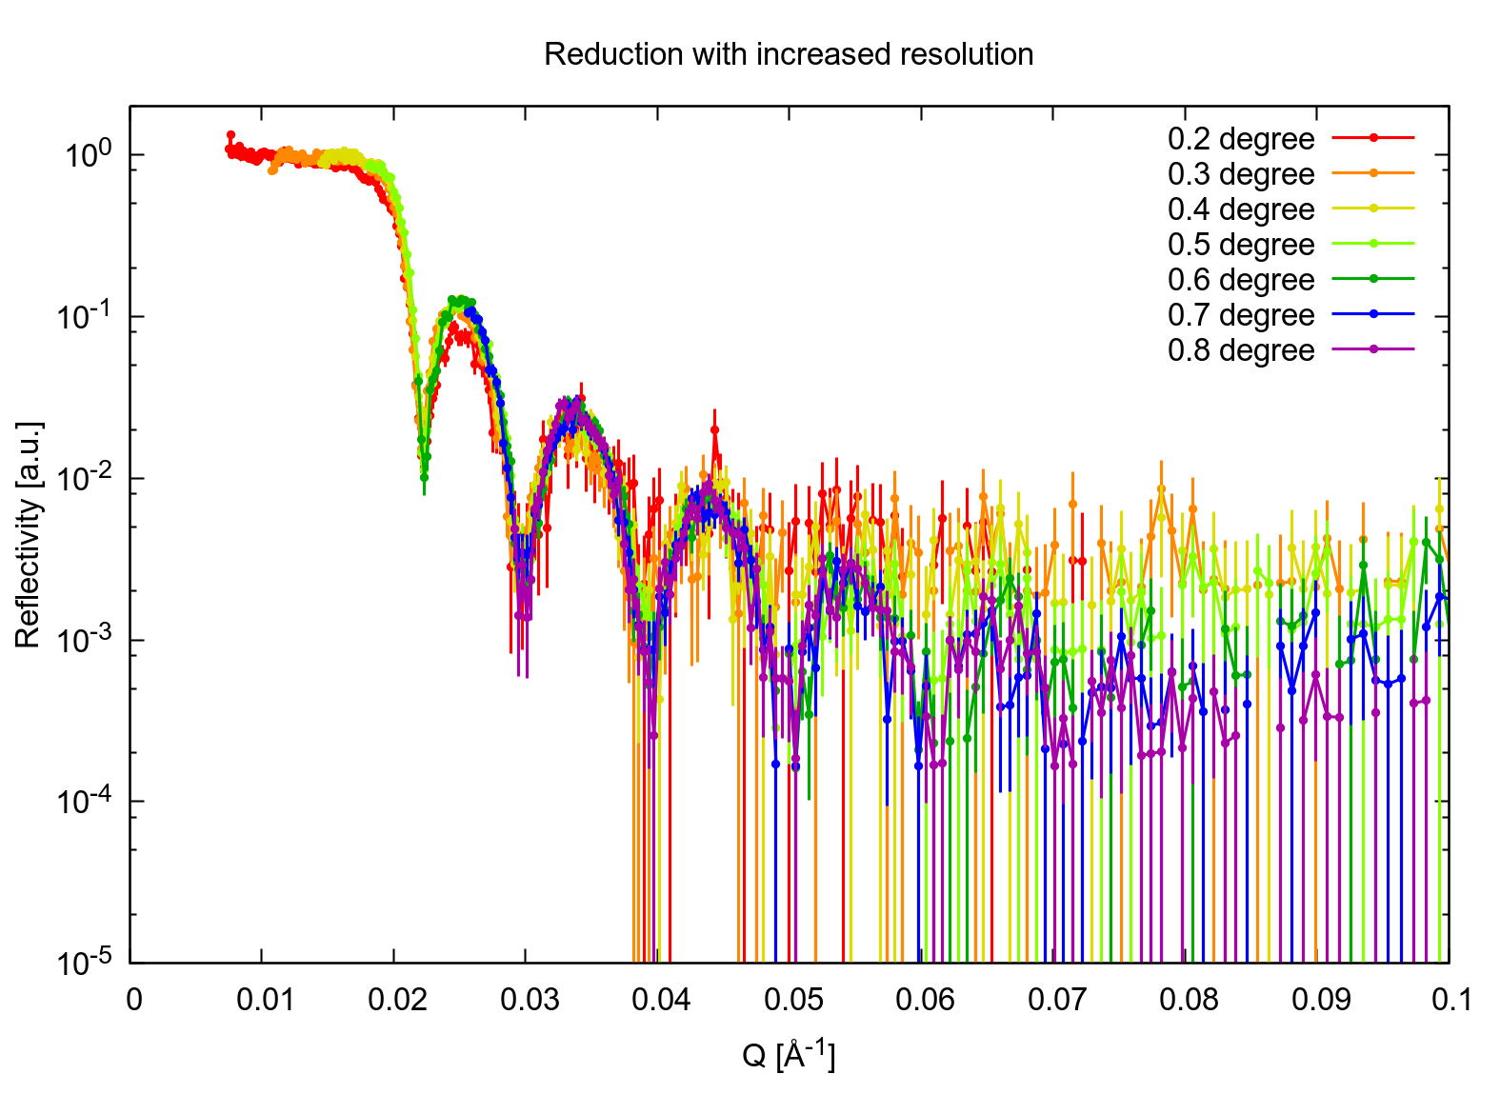
Results
detector area
detector ToF
Multi-Blade
detector
sample
θ₂
ToF of the
reflected intensity
reflected intensity
θ
θ
θ₁
Ir sample
Si sample
Fe/Si sample
0.5 2 6Å
ToF (or λ)
6ms (2Å)
20ms (6Å)
θ₇ = 0.8deg
…
θ₁ = 0.2deg
0.5 6

Slide 48
Results
detector area
detector ToF
Multi-Blade
detector
sample
θ₂
ToF of the
reflected intensity
reflected intensity
θ
θ
θ₁
Ir sample
Si sample
Fe/Si sample
0.5 2 6Å
ToF (or λ)
6ms (2Å)
20ms (6Å)
θ₇ = 0.8deg
…
θ₁ = 0.2deg
0.5 6
Background

Slide 49
Results
detector area
detector ToF
Multi-Blade
detector
sample
θ₂
Background
Background
ToF of the
reflected intensity
θ
θ
θ₁
reflected intensity
Ir sample
Si sample
Fe/Si sample
0.5 2 6Å
ToF (or λ)
(Log scale)
20ms (6Å)
6ms (2Å)

Slide 50
Results
detector area
detector ToF
Multi-Blade
detector
sample
θ₂
Background
Background
ToF of the
reflected intensity
θ
θ
θ₁
reflected intensity
Ir sample
Si sample
Fe/Si sample
0.5 2 6Å
ToF (or λ)
(Log scale)
20ms (6Å)
Gating between 6ms and 20ms
6ms (2Å)
(Log scale)

Slide 51
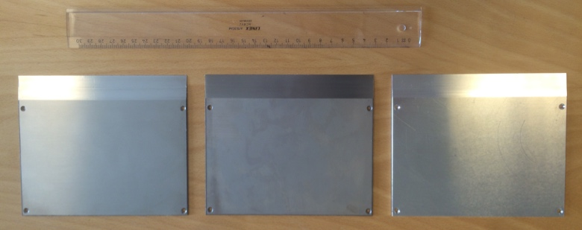
Results
detector area
detector ToF
55 neutrons get scattered @ 0.5Å
Background
Background
ToF of the
reflected intensity
100 neutrons
reflected intensity
substrate
wires X
¹⁰B₄C
strips Y
0.5 2 6Å
ToF (or λ)
(Log scale)
20ms (6Å)
98%
Nominal ¹⁰B₄C coating 7um
Gating between 6ms and 20ms
6ms (2Å)
Actual ¹⁰B₄C coating 4um
90%
MB is optimized for cold wavelengths
and
CRISP is a thermal reflectometer
Al Ti SS
61%
2Å
Blades
45%
0.5Å
(Log scale)

Slide 52
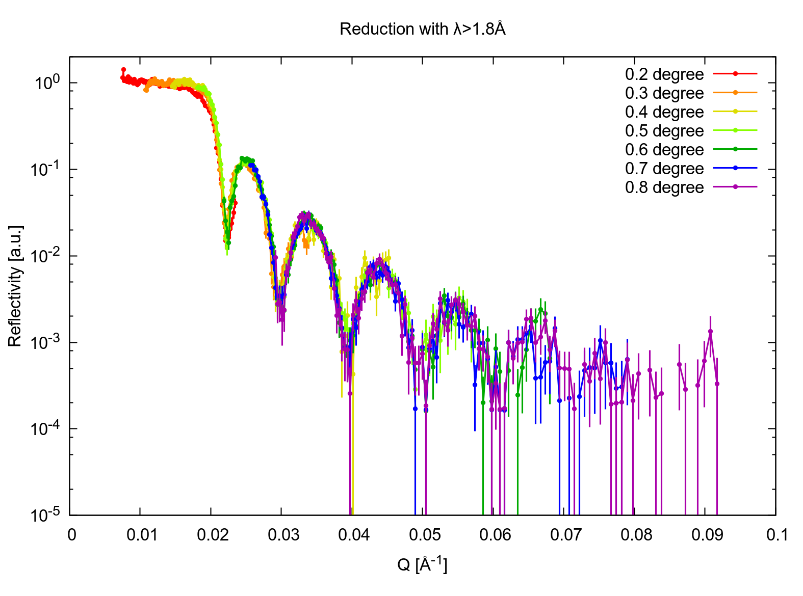
Results
any ToF
ToF > 6ms (2Å)
Background identified and understood
6ms (2Å)
20ms (6Å)

Slide 53
Results
ToF > 6ms (2Å)
λ₄
Line at constant q
Line at constant q
θ₇ = 0.8deg
…
θ₁ = 0.2deg
0.5 6
λ₁
All curves match for all angles and neutron wavelengths
The MB uniformity is good enough
6ms (2Å)
20ms (6Å)

Slide 54
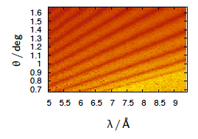
Results
Multi-Blade
detector
sample
θ
θ
Ir sample
Si sample
Fe/Si sample
0.5 6
0.5 2 6Å

Slide 55
Results
Multi-Blade
detector
sample
θ
θ
Ir sample
Si sample
Fe/Si sample
Conventional
Conventional
θ
0.5 6
0.5 2 6Å

Slide 56

Results
Multi-Blade
detector
sample
θ
θ
Ir sample
Si sample
Fe/Si sample
Integration at constant q,
correcting θ with the position
on the detector
Incl. Res.
Incl. Res.
Conventional
Conventional
θ
0.5 6
0.5 2 6Å

Slide 57
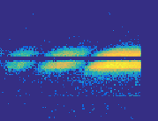
Results
Multi-Blade
detector
sample
θ
θ
Ir sample
Si sample
Fe/Si sample
Integration at constant q,
correcting θ with the position
on the detector
Incl. Res.
Incl. Res.
Conventional
Constant q
Conventional
θ
0.5 6
θ + Δθ
q₁ =(4π/λ) sin(θ+Δθ)
θ
0.5 2 6Å
θ − Δθ
q₂ =(4π/λ) sin(θ−Δθ)
The 0.5mm spatial resolution is needed to calculate the right q
Same λ

Slide 58
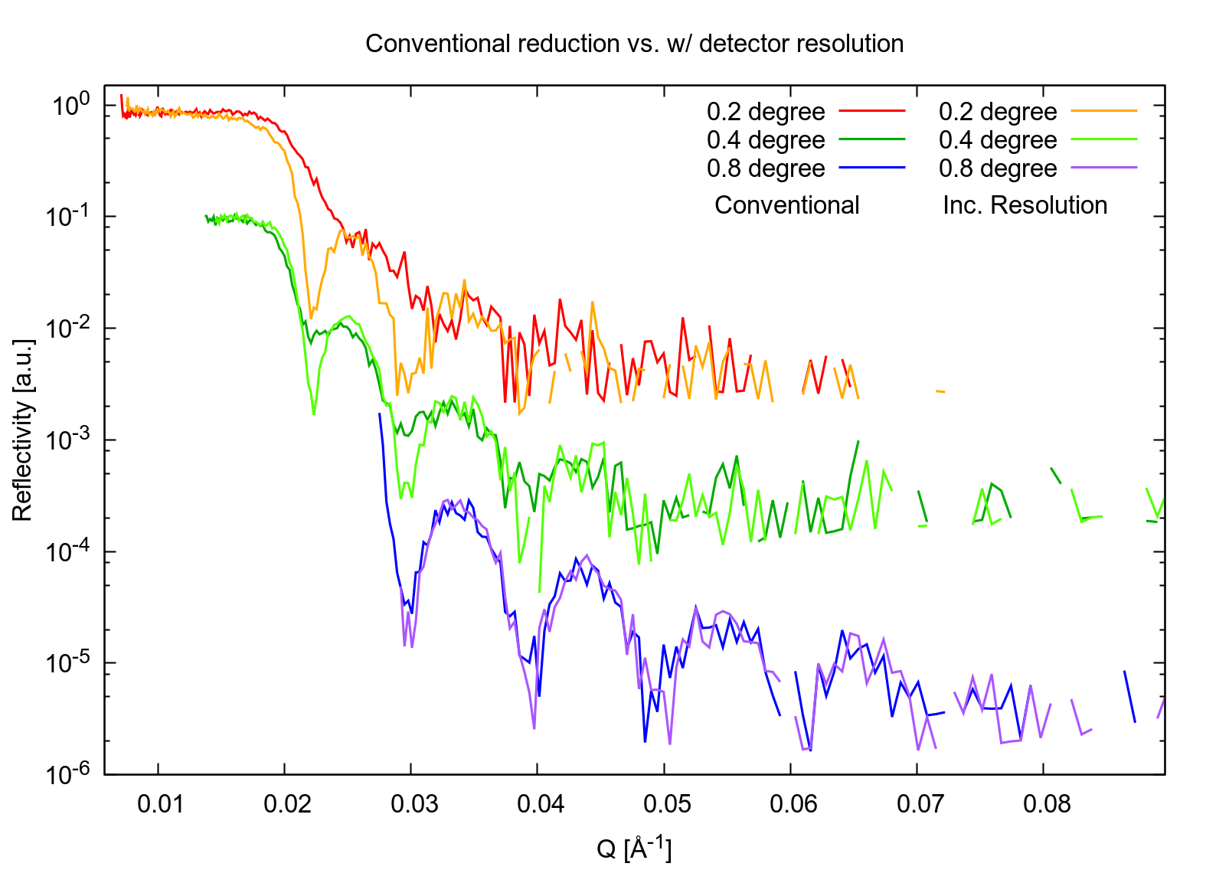
Results
Multi-Blade
detector
Conventional
sample
Incl. Resolution
θ
θ
Ir sample
Si sample
Fe/Si sample
Integration at constant q,
correcting θ with the position
on the detector
Incl. Res.
Incl. Res.
Conventional
Constant q
Conventional
θ
0.5 6
θ + Δθ
q₁ =(4π/λ) sin(θ+Δθ)
θ
0.5 2 6Å
θ − Δθ
q₂ =(4π/λ) sin(θ−Δθ)
The 0.5mm spatial resolution is needed to calculate the right q
Same λ

Slide 59
Results
Multi-Blade
detector
DIVERGENT
sample
θ
θ
0.5 6
HIGHER
RATE
Ir sample
Si sample
Fe/Si sample
Multi-Blade
detector
LOWER
RATE
COLLIMATED
sample
θ
θ
0.5 6

Slide 60
Results
Integration at constant q,
correcting θ with the position
on the detector is mandatory
Multi-Blade
detector
DIVERGENT
sample
θ
θ
0.5 6
HIGHER
RATE
Ir sample
Si sample
Fe/Si sample
Multi-Blade
detector
LOWER
RATE
COLLIMATED
sample
θ
θ
0.5 6

Slide 61
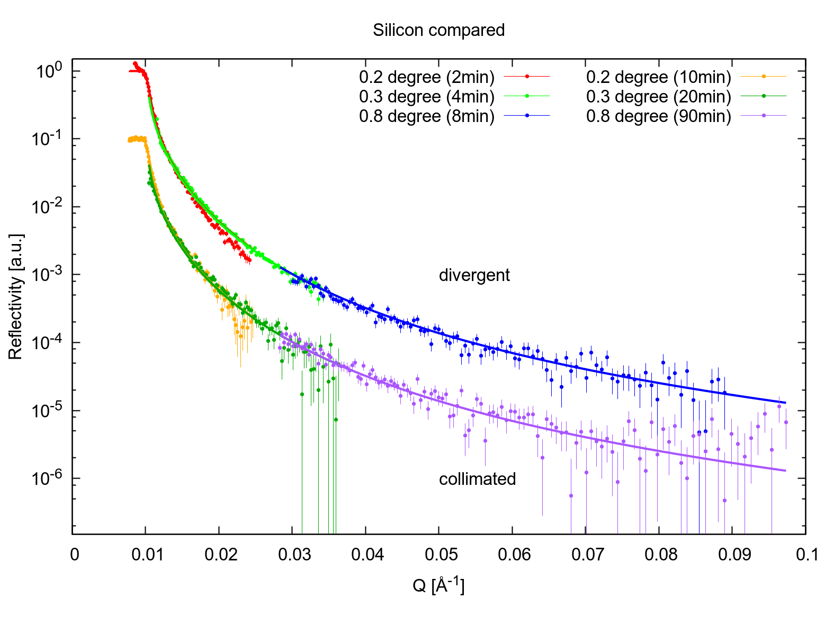
Results
Integration at constant q,
correcting θ with the position
on the detector is mandatory
Multi-Blade
detector
DIVERGENT
sample
θ
θ
0.5 6
HIGHER
RATE
Ir sample
Si sample
Fe/Si sample
DIVERGENT (14 min)
Multi-Blade
detector
LOWER
RATE
COLLIMATED
sample
COLLIMATED (120 min)
θ
θ
0.5 6
The MB 0.5mm resolution and rate capability is needed to measure in divergent mode

Slide 62
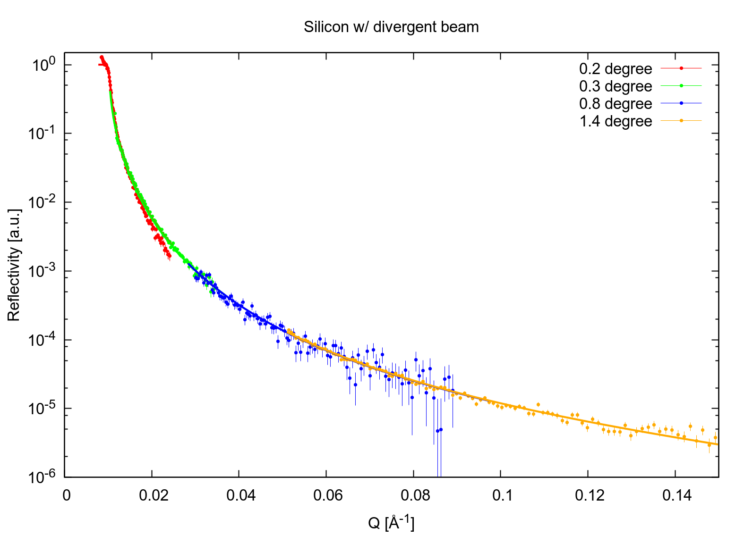
Results
Multi-Blade
detector
DIVERGENT
q - Dynamic range
sample
10⁰
θ
θ
0.5 6
Ir sample
Si sample
Fe/Si sample
10⁻⁵
>5 orders of magnitude with a poor shielding for background
(Usually 10⁻⁶ is obtained in experiments)

Slide 63
Results
Multi-Blade
detector
sample
θ
θ
Ir sample
Si sample
Fe/Si sample

Slide 64
Results
detector area
detector ToF
Multi-Blade
detector
sample
ToF of the
reflected intensity
reflected intensity
θ
θ
Ir sample
Si sample
Fe/Si sample
0.5 2 6Å
ToF (or λ)

Slide 65
Results
detector area
detector ToF
Multi-Blade
detector
sample
θ
θ
Ir sample
Si sample
Fe/Si sample
0.5 2 6Å
ToF (or λ)

Slide 66
Results
Off-Specular
Off-Specular
Multi-Blade
detector
sample
θ
θ
Specular
Specular
Ir sample
Si sample
Fe/Si sample
0.5 2 6Å
ToF (or λ)

Slide 67
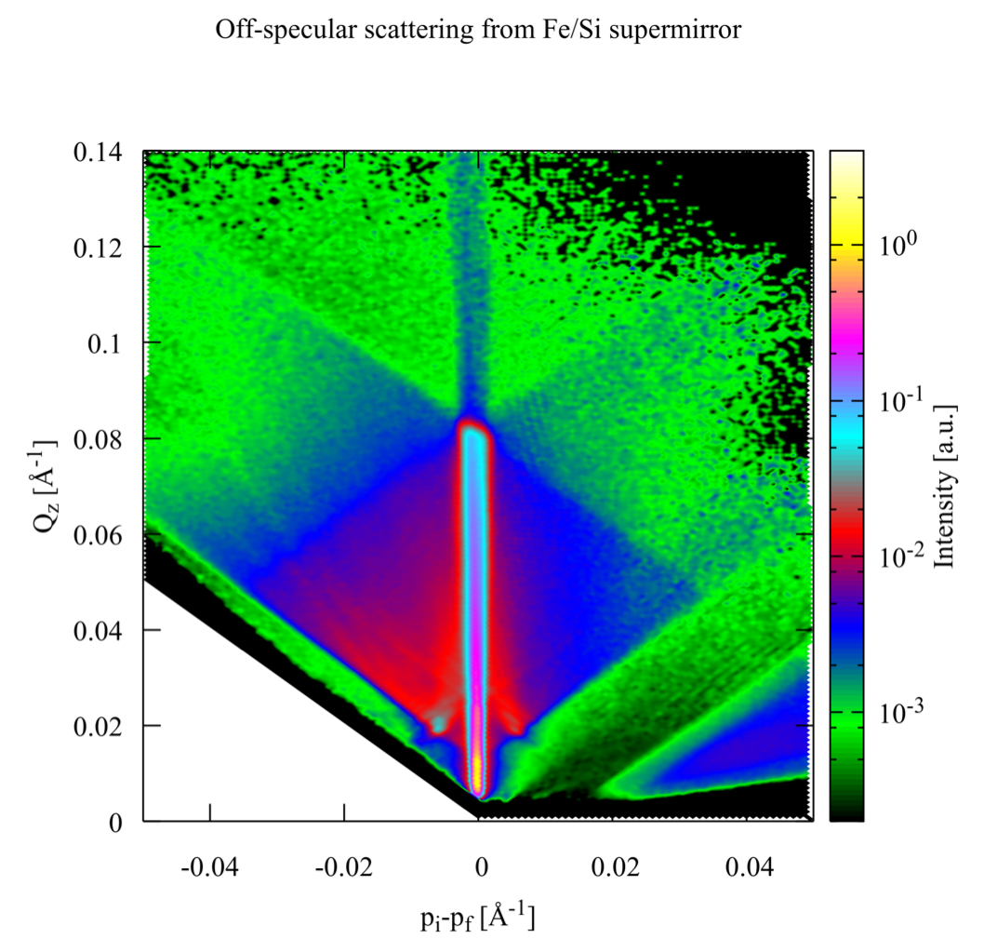
Results
Off-Specular
Off-Specular
Multi-Blade
detector
sample
θ
θ
Specular
Specular
Ir sample
Si sample
Fe/Si sample
0.5 2 6Å
ToF (or λ)

Slide 68

Results
Off-specular scattering from Fe/Si neutron supermirror
Specular Reflectivity
Correlated roughness
domains from the layers
Supermirror edge
(m=3.8)
No Transmitted beam,
total reflection
Sample Horizon
Spin-flip scattering
signal from the layers
Si edge
Transmitted beam
through the sample

Slide 69
Conclusions
All the features of the samples have been clearly identified
Off-specular scattering from Fe/Si neutron supermirror
Specular Reflectivity
Correlated roughness
domains from the layers
Supermirror edge
(m=3.8)
No Transmitted beam,
total reflection
Sample Horizon
Spin-flip scattering
signal from the layers
Si edge
Transmitted beam
through the sample

Slide 70
Conclusions
All the features of the samples have been clearly identified
Off-specular scattering from Fe/Si neutron supermirror
Science can profit from the features of this detector
Specular Reflectivity
Correlated roughness
domains from the layers
Supermirror edge
(m=3.8)
No Transmitted beam,
total reflection
Sample Horizon
Spin-flip scattering
signal from the layers
Si edge
Transmitted beam
through the sample

Slide 71
Conclusions
All the features of the samples have been clearly identified
Off-specular scattering from Fe/Si neutron supermirror
Science can profit from the features of this detector
Specular Reflectivity
The Multi-Blade detector can be considered
a mature technology for neutron reflectometry
Correlated roughness
domains from the layers
Supermirror edge
(m=3.8)
No Transmitted beam,
total reflection
Sample Horizon
Spin-flip scattering
signal from the layers
Si edge
Transmitted beam
through the sample
… now it is time for the fine tuning ...

Slide 72
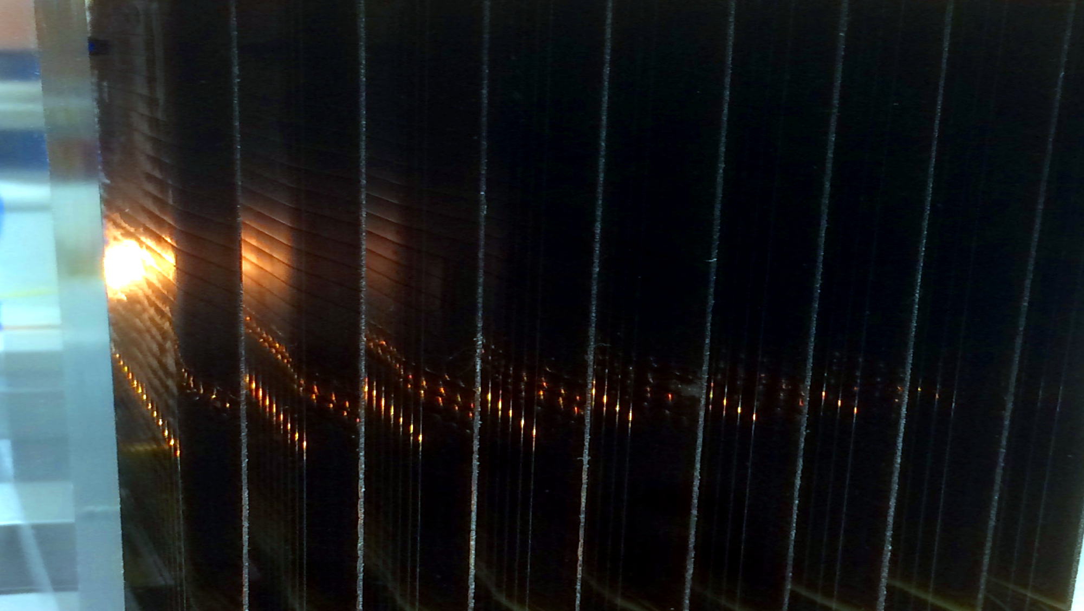
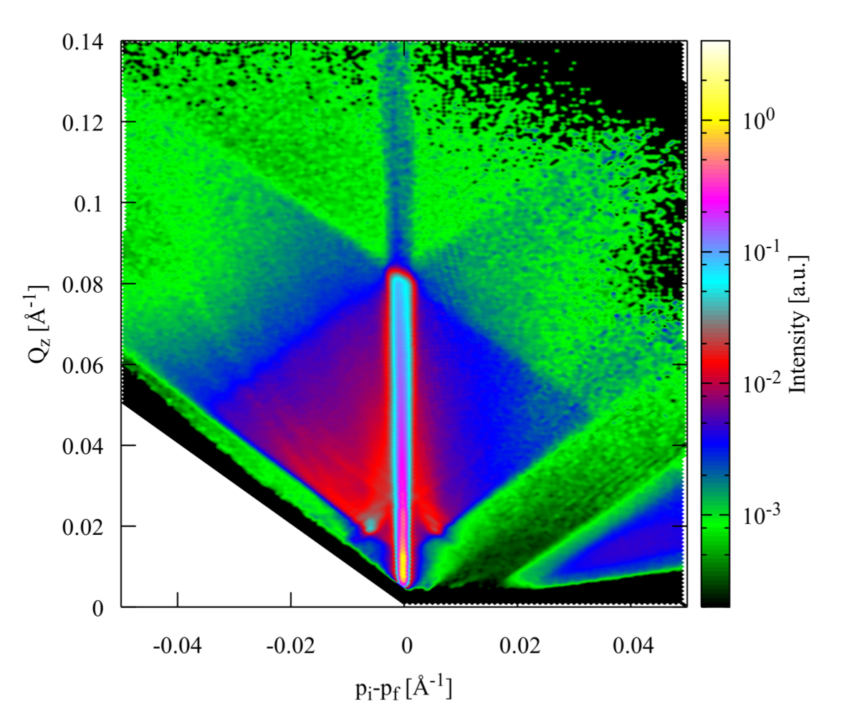
Thank you

Slide 73
Backup slides

Slide 74

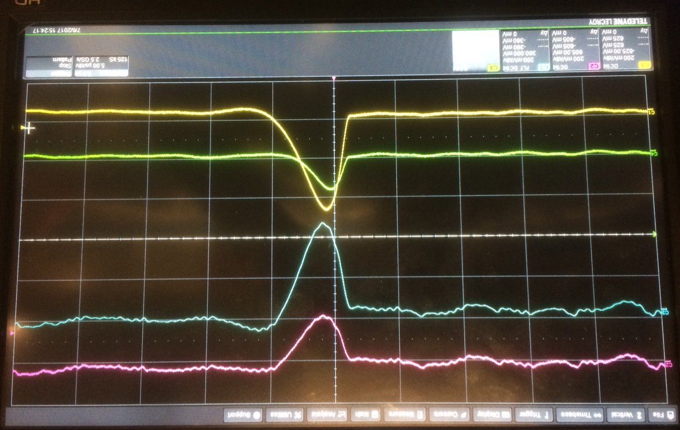
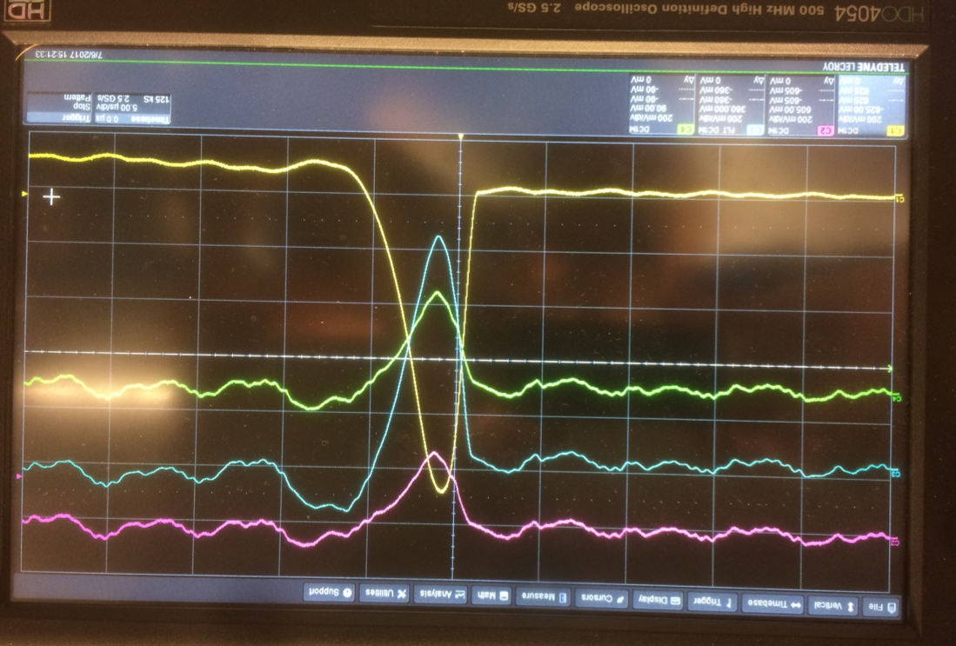
The Multi-Blade project
Front-end on wires
9 boards (32x9ch)
TTL for time stamp reset
x9
FEE
vessel
CAEN
V1740D
One Digitser (64ch is 1 cassette)
32 wires
x9
32x9 outputs
from FEE strips
Front-end on strips
9 boards (32x9ch)
32 strips
FEE
cassette
x9
Each blade has 32 wires and 32 strips
readout individually,
in total 9 units (64x9 channels)
Example of clusters per neutron event
Strip n
Strip n-1
Strip n+1
Strip n
Strip n+1
Wire m
Wire m+1
Wire m

Slide 75
Results
detector area
detector ToF
Multi-Blade
detector
sample
θ₂
Background
Background
ToF of the
reflected intensity
θ
θ
θ₁
reflected intensity
Ir sample
Si sample
Fe/Si sample
ToF (or λ)
Gating between 6ms and 20ms
6ms (2Å)
20ms (6Å)
10⁻³
10⁻⁴

Slide 76
Uniformity and overlap
wires
Edge
Edge
gain corrected
gain not corrected
Measured
Garfield Simulation

Slide 77
Efficiency
calculated
measured
64% @ 5.1Å
58% @ 4.2Å
45% @ 2.5Å

Slide 78
PHS and Gain
*F. Piscitelli and P. van Esch,
Analytical modeling of thin film neutron converters and its application to thermal neutron gas detectors
J. Instrum. 8, P04020 (2013)
arXiv:1302.3153
calculated*
measured
Measured @ 4.1Å 5 degrees
Energy Resolution ~50 KeV
Energy Threshold ~100 KeV
Gas Gain ~ 20 (max 0.2pC avalanche charge)
(contributes to improve the counting rate capability)

Slide 79
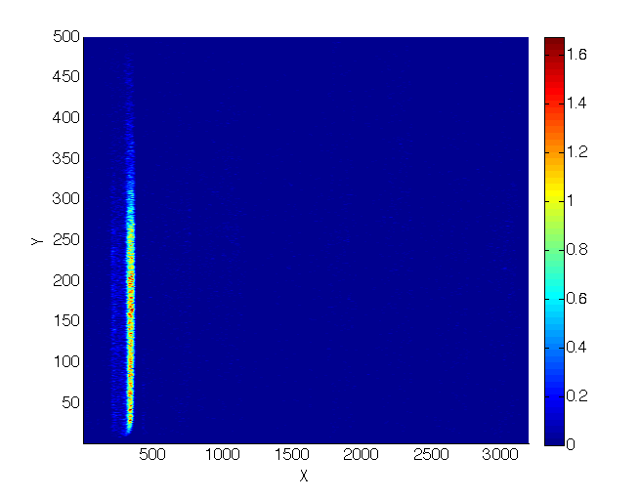
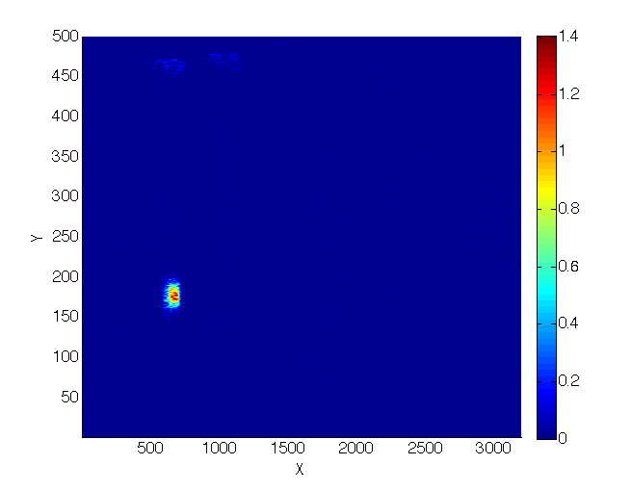
Counting rate capability
17kHz
Rate per channel
1.6kHz/mm²
Rate per mm²
Slit
Beam flux (a.u.)
Spot
No saturation observed up to ~ 1.6kHz/mm²

Slide 80
Spatial resolution X – wires
0.35mm
wires
Spatial Resolution
equivalent FWHM* ~ 0.6mm
Neutron beam
(Step 0.25mm)
*P. Van Esch et al.,
An information-theoretical approach to image resolution applied to neutron imaging detectors based upon discriminator signals
in Proceedings of ANNIMA conference, Marseille 2013
arXiv:1307.7507

Slide 81
Results
Multi-Blade
detector
substrate
wires
strips
¹⁰B₄C
sample
BN mask
Shadow = Overlap
shadow
No shadow = No overlap
shadow
Not a dead area but the overlap avoids dead zones
dead area
No shadow

