Slide 1

ESS Lund – Installation Readiness Review
Ulf Broome, Carsten Müller & Jan Zimmermann
2017-11-15

Slide 2
Agenda
09:00 – 09:10 | Executive Session (Closed Discussion).
09:10 – 09:20 | Welcome and opening of the meeting. Anders Sunesson, ESS.
09:20 – 09:40 | Introduction to Rack Design and Installation. Frithiof Jensen (ESS) – presentation of “input to the process”.
09:40 – 10:00 | Presentation of Rack Aisle Design, important Interfaces. Pentair Representative (?) – the response to the requirements, cooling, electrical design, mechanical design, racks naming and layouts.
10:00 – 10:30 | Rack Aisle Assembly and Installation Process. Pentair Representative (?) - how are the installers going to install the racks (including logistics and local transportation), testing, commissioning, safety issues, and installation issues.
10:30 – 10:45 | Coffee Break
10:45 – 11:45 | Deliberations by the review board (Closed Session).
11:45 – 12:00 | Close Out Session

Slide 3
IRR Charge Questions
Will the racks meet their technical specifications? Do we know how to verify this?
Have all interfaces between this system and other systems been completely defined and agreed. Are all the connections on the ESS site in place? This applies to physical connections and physical parameters (flows, pressure, temperatures, current, voltage, UPS requirements)
Have all safety issues been defined and dealt with? Are additional separate safety reviews or inspections required?
Have all QA/QC plans been defined and implemented?
Will the system fit within its allocated space and can be transported there within the give transport path (height of doors, pass by other equipment) with the available transport means?
Are the alignment requirements agreed upon and can the system components be aligned within these requirements?
Is the installation plan for the system adequate? Have all tools, including cranes, movement devices, stands, alignment fixtures etc. been defined. Has the staff for this work been identified? Is the installation sequence consistent with the overall installation plan?
Has the reliability and maintainability of the system been optimized? Have all the spare parts required from the first day of operation been identified and procured?
Have all inspections and permits required prior to installation been carried out? Have the inspections and permits required between installation and the Accelerator Readiness Review been identified?
Have all recommendations from component design reviews been addressed?

Slide 4
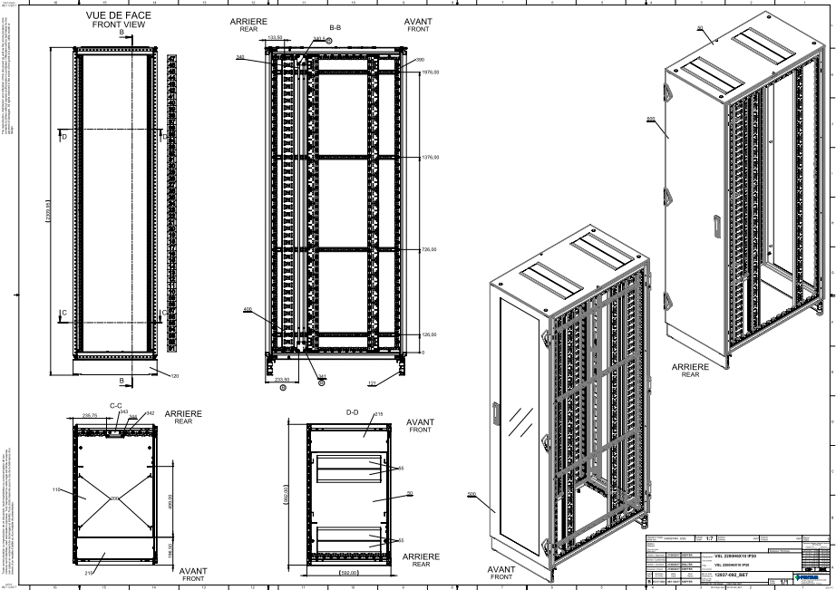
IRR Answers
1. Q: Will the racks meet their technical specifications? Do we know how to verify this?
A: The racks will meet the technical specifications, because they have been adjusted together
with the project engineers at ESS
All rack drawings (stp- and pdf-files) provided by Pentair have been approved

Slide 5
IRR Answers
2. Q: Have all interfaces between this system and other systems been completely defined and
agreed. Are all the connections on the ESS site in place? This applies to physical connections
and physical parameters (flows, pressure, temperatures, current, voltage, UPS requirements)
A: Liquid interfaces had been identified after the last visit in August 2017. The connection
between the cooling system of the rack rows and the ESS infrastructure will be realized
flexible tubes. The PDUs are prepared for electrical connection realized by ESS the design of
the racks and the PDUs is according to the ESS specification
3. Q: Have all safety issues been defined and dealt with? Are additional separate safety
reviews or inspections required?
A: The electrical safety aspect are considered in the design of the racks (Earthing point and
contact protection)
4. Q: Have all QA/QC plans been defined and implemented?
A: Product are designed and fabricated according to the Pentair quality and safety
requirements
  .

Slide 6
IRR Answers
5. Q: Will the system fit within its allocated space and can be transported there within the give
transport path (height of doors, pass by other equipment) with the available transport
means?
A: Product are according to the ESS dimension requirements. Racks will be delivered as a
single unit. Final installation will be realized on site.
6. Q: Are the alignment requirements agreed upon and can the system components be aligned
within these requirements?
A: It is agreed that marks for each installation are visible on the ground
7. Q: Is the installation plan for the system adequate? Have all tools, including cranes,
movement devices, stands, alignment fixtures etc. been defined. Has the staff for this work
been identified? Is the installation sequence consistent with the overall installation plan?
A: Delivery Installation plan provided to ESS. Pentair installation team prepared with all
needed equipment
  .

Slide 7
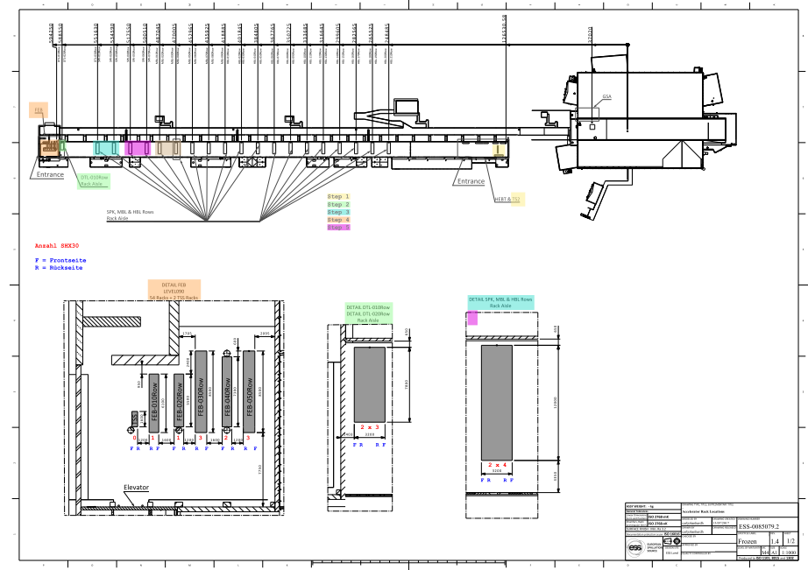
IRR Answers

Slide 8
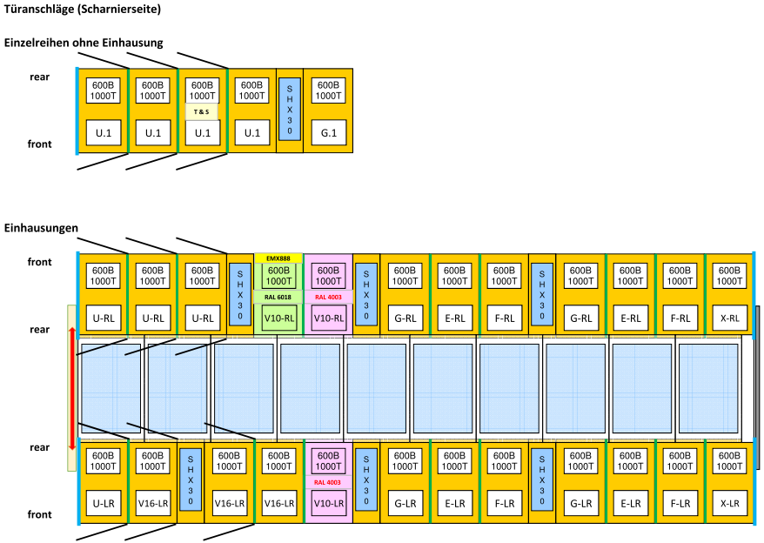
IRR Answers

Slide 9
IRR Answers
  8. Q: Has the reliability and maintainability of the system been optimized? Have all the spare
  parts required from the first day of operation been identified and procured?
  A: Pentair identified all potential spare parts. Pentair offered Service and Maintenance
  Contract.
  9. Q: Have all inspections and permits required prior to installation been carried out? Have the
  inspections and permits required between installation and the Accelerator Readiness Review
  been identified?
  A: IOD6 cards available. Safety instruction trainings scheduled
  10. Q: Have all recommendations from component design reviews been addressed
  A: Pentair provided documentation of each product with the expception of the PDU that is
  still in development due to the recent changes

Slide 10
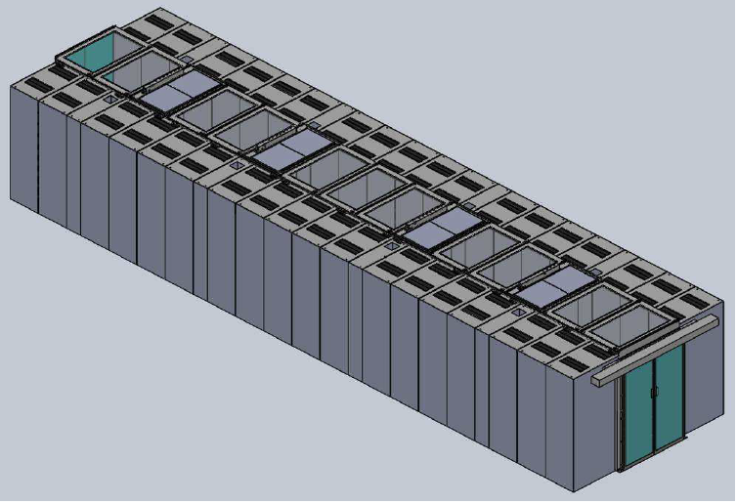
ESS Aisle 3d-View

Slide 11
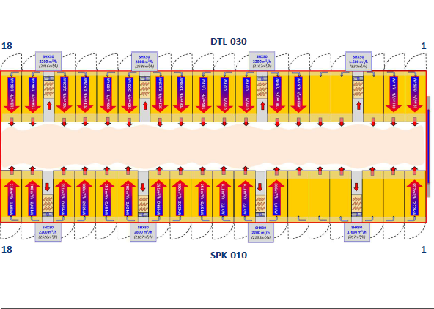
Thermal Simulation

Slide 12
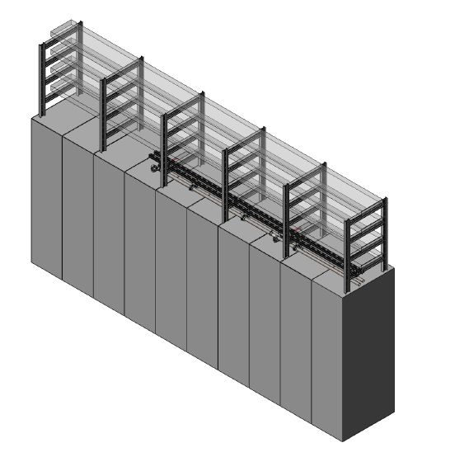
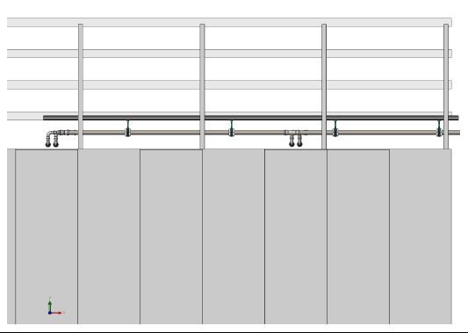
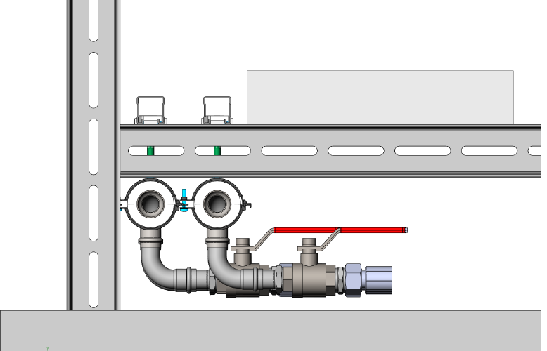
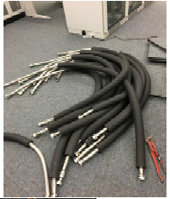
Piping & Tubes

Slide 13
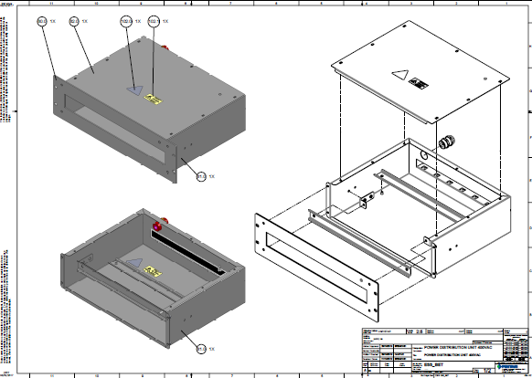
Basic PDU view

Slide 14
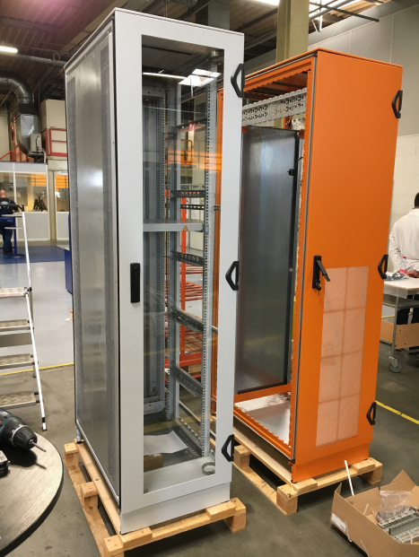
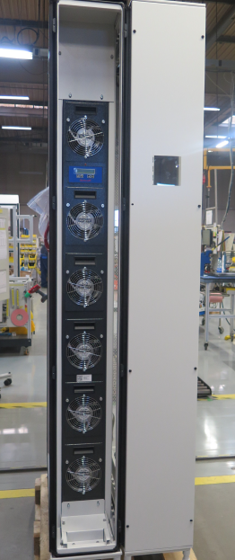
Racks & Side Coolers (2)

Slide 15


