Slide 1
Introduction to Rack Design and Installation
Frithiof Jensen
Power System Engineer,
WP Manager, WP 15
www.europeanspallationsource.se
13 November 2017

Slide 2
Rack System Design (PDR)
  We need many “blocks” of work that can be parallelized,
    Cooled rack Aisle or Row assemblies made from standard parts. “Standard Parts” including rack types. Racks Types determine PDU, Colour and Factory Mounted Accessories.
  A high level of standardisation for efficient production,
    Rack Types repeat across the different rows and aisles, Aisles are fairly uniform, the number of unique PDU’s has been reduced.
  Logistics “flow” that can move the racks from operations performed on them to the final assembly and integration,
    Installation of mostly pre-assembled rack frames, alignment, the linking of frames installation of doors and covers is on-site,
    Handling of packaging and waste materials generated,
  Interfaces that can absorb variations so that changes can be localised to few components.
    The variable interfaces, exposed to user requirements, are the PDU’s, the cable exits and the internal volume (which the users manage themselves).
    Cable trays and cooling water pipes are installed using fixing rails on the “roof” of the rack assemblies
  Installation “slots” at ESS are 14 days per block.

Slide 3
Rack Documentation
Rack information available in Confluence:
https://confluence.esss.lu.se/display/AWES/Rack+Documentation
Detailed Rack Layout
ESS-0085695 - Statement of Work-Supply, Design and Installation of Rack Cabinets
"Appendix 5.2, Rack space power and heat dissipation requirements RevN.xlsx". Where 'N' is the latest revision.
Complete Pentair Data-dump
This is the response to the Rack Specification from the selected vendor, Pentair. It includes 1’st versions of CAD files, installation manuals and other information, some of it historical, most of it not.
ESS-0120672 - Pentair Documentation (Complete).
Miscellaneous:
Contract and procurement information (maybe not visible everyone due to CHESS access rules).
ESS-0087982 - Supply and Service Agreement Concerning the Supply, Design and Installation of 19” Racks Systems.
Naming of Accelerator Buildings, Rooms and Sections: ESS-0052867
Basic Rack Layout: ESS-0085079
Notes:
When the PBS-structure in CHESS is operational, the Confluence Page will be changed to more descriptive texts with links to the “live” information found in the PBS structure. For now, we use Confluence to make it easier for people to find things.

Slide 4
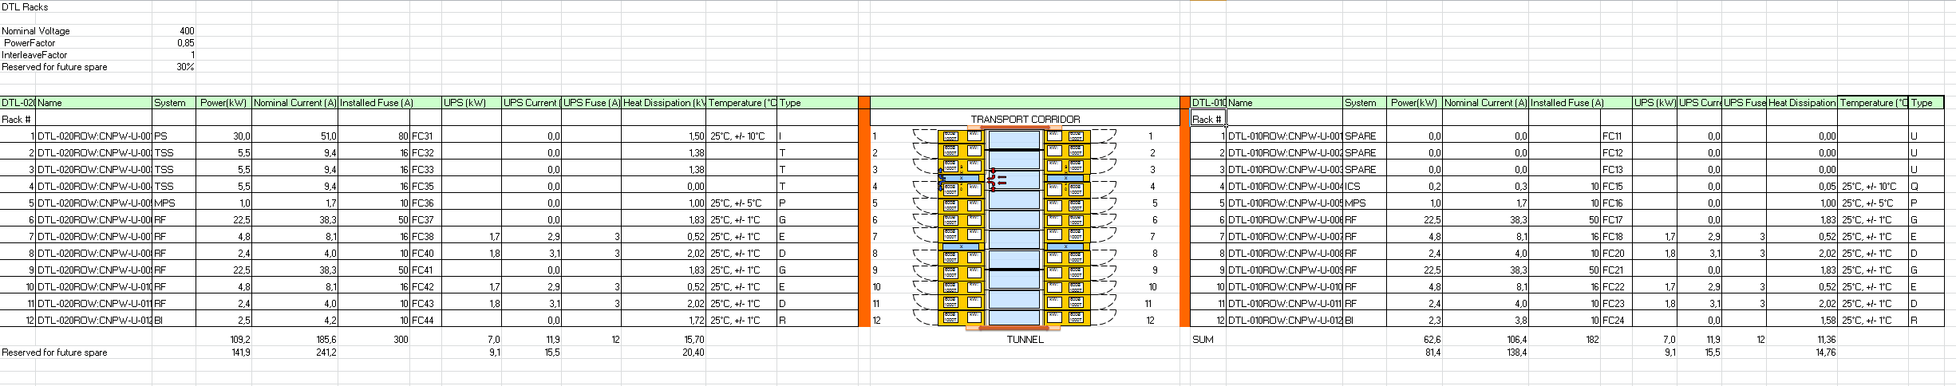
“Appendix 10: Rack space, power and heat dissipation requirements”
The cooling system in Each Rack Row or Rack Aisle can be remotely monitored
Pentair
assembles the rack aisles / rows,
Commission the cooling systems

Slide 5
CAD Model / Integration
Because the available installation space is *very* tight, ESS accelerator group and EIS decided to use a 3D integration process based on the tools:
  “Aveva 3D” for cable routing, pipework design, cable trays,
  Catia V6 for 3D integration work, with Catia as the Master,
  CHESS for version control and release management.
The process works like this:
  Systems delivered to ESS are represented by STEP models (Good) or Space Envelopes (Less Good), these are installed in the Catia V6 3D model,
  Aveva E3D can “import” the Catia Model, this allows for rapid design and placement of cable trays, pipework and cabling; conflict resolution in case of clashes is done “online”, usually by the CAD designers.
  System Owners approve the resulting 3D models and designs.
  When a part or section of the Gallery is approved by system owners and released, part of the release process is to annotate 3D Components with alignment points. These show up on the installation drawings for the different systems.
  We do this because many different systems will be installed independently of each other – but – the final assembly has fit together and “work”.

Slide 6
RF Cell – Racks Installed
Borrowed from: Ciprian Plostinar

Slide 7
RF Cell – Hardware Installed
Borrowed from: Ciprian Plostinar

Slide 8
Installation Drawing (ESS-0185916)
Rack Aisles are placed relative to the Centre of the stubs, the
Alignment of stubs have been found to be quite good, +-10 mm

Slide 9
Installation Drawings (ESS-0185916)
The X, Y, Z coordinates are relative to the target, which tracks what CF/Skanska are using.
Notice that no other systems are shown, this means that it is very important to follow the design.

Slide 10
Installation Schedule 2017

Slide 11
Installation Schedule, 2018
No services are available before “Cable Trays” January 2018 (Procurement is preparing Installation Framework Contract).
The schedule has been communicated to Cyprien Plostinar, responsible for the Accelerator Installation Schedule.
Risks:
The Gallery Installation Framework may be delayed,
Changes in Gallery Layout due to ES&H requirements,
Changes in Rack Row Design due to ES&H requirements.

Slide 12
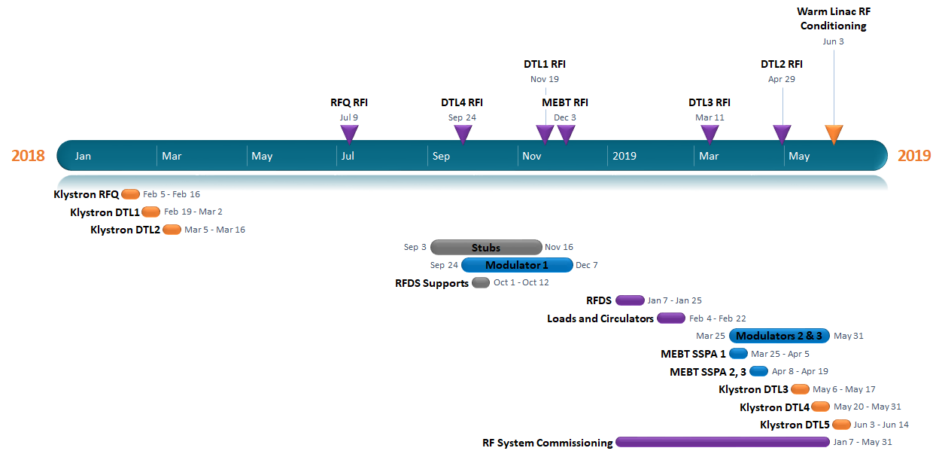
DTL Timeline – Gallery
Rack Stuffing, Cabling
All Services Needed100%!

Slide 13
Thank You!

