Slide 1

Technical Updates
Gábor László
NSS Lead Instrument Engineer
14.02.2018

Slide 2
Enquiries From NSS
Please create a draft schedule for the TG3 stages based on the expected ESS delay for our planning. We need the date of the call for tender (if applicable), the end of the detailed design and the scope of the specific stage.

Slide 3
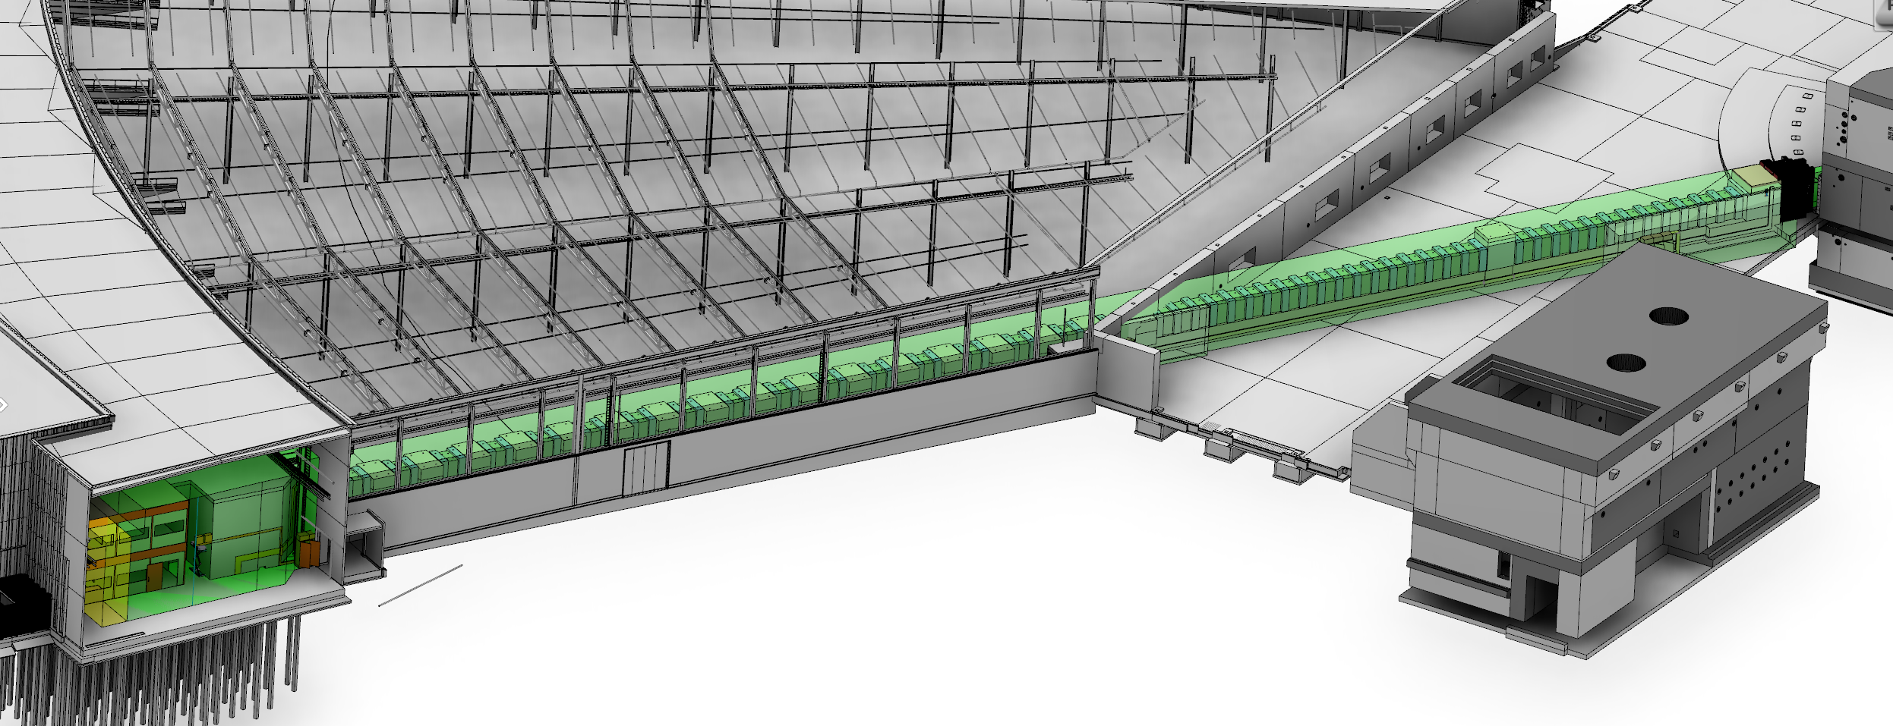
3D Model Related Enquiries From NSS
For integration purposes we need the 3D envelope of the instruments. You can check the NMX solution as an example: https://confluence.esss.lu.se/display/NMX/NMX+Instrument+spacial+envelope Giuseppe used green envelope for permanent allocation of floor-space and yellow for the temporarily occupied area that can be available for transport if needed.

Slide 4
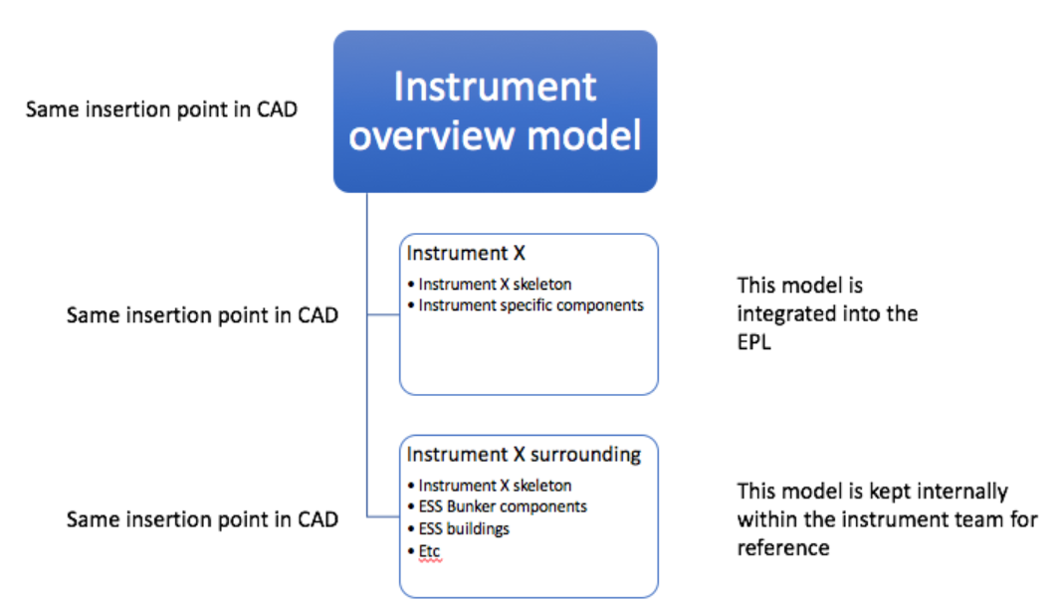
3D Model Related Enquiries From NSS
With the exception of the moderator and the NSS NBOA, please do not include ESS components in your instrument models!
  (No Monolith Components, Bunker Instrument Base plates, Bunker Wall Blocks and other bunker components, floors etc.)
Please do not send sub-assemblies, only complete Instrument models in order to make the integration easier
Suggested model structure: In-bunker, Out of Bunker, Cave – Hatch, Infrastructure, Envelopes

Slide 5
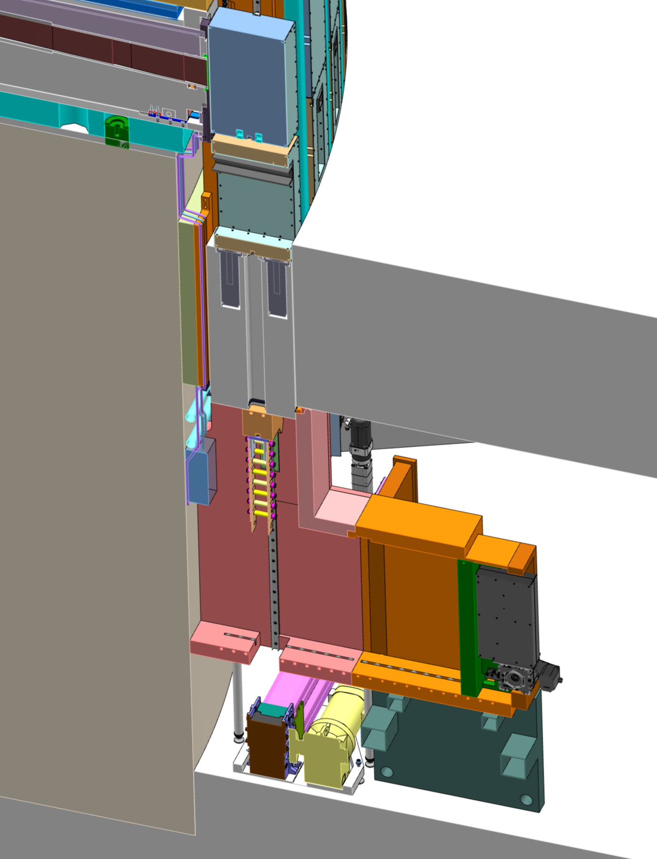
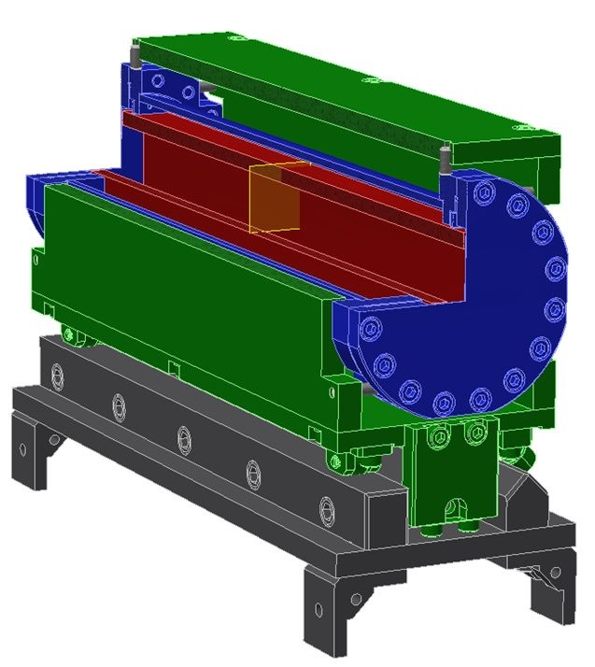
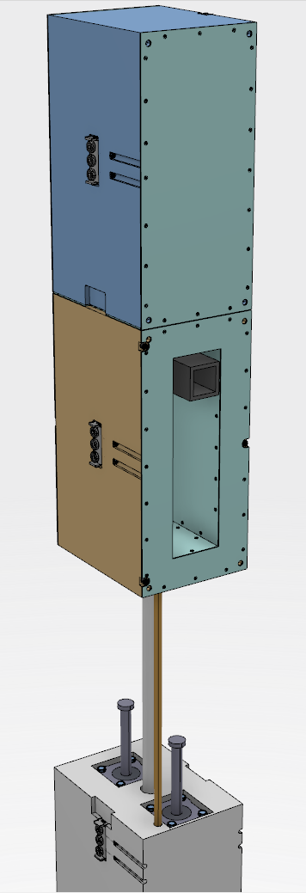
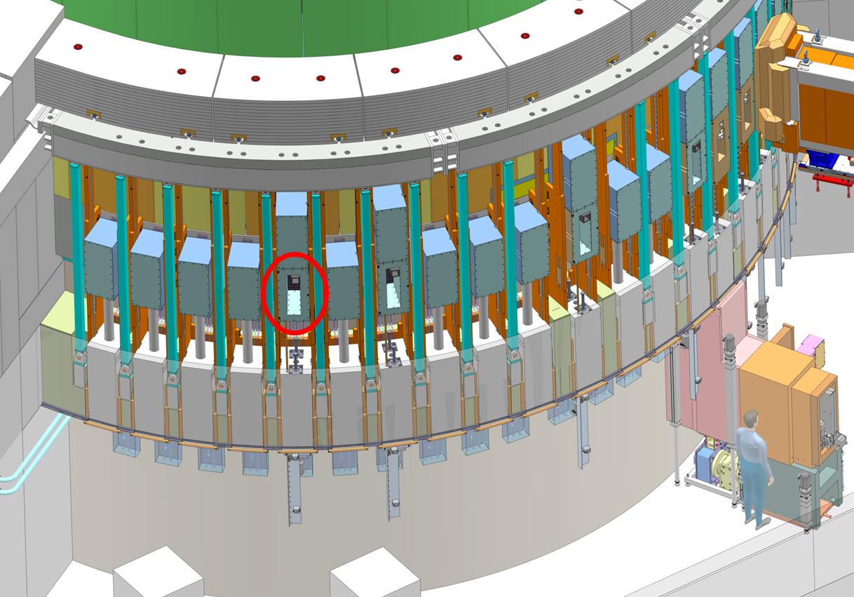
Bridge Beam Guide Design (BBG)
Optics
Pressure Vessel
Alignment Frame
Rail Assy
Critical Requirement
Minimize air activation (ES&H)
Potential Requirements
Alignment system
Installation/ replacement shall be possible in irradiated environment
https://confluence.esss.lu.se/pages/viewpage.action?pageId=247646116

Slide 6
Bridge Beam Guide Resposibilities
Design
Instrument:
Optics (full geometry of any optical component in the light shutter) /15.June.18/ + Verification of ESS integration.
Optional: If the optics does not fit into the standard vessel, then the vessel should be also designed by the instrument.
ESS: Pressure vessel (see above), Alignment frame, Rail system
Manufacturing
Instrument: Optics.
If the pressure vessel or the holder frame is not standard then those too.
ESS: Pressure vessel (see above), Alignment frame(see above), Rail system

Slide 7
Bridge Beam Guide Resposibilities
Budget for manufacturing
Instrument: Optics + Pressure Vessel. If it is not possible to use the standard frame concept, and the customized design is more expensive, then the instrument shall pay the difference
ESS: Alignment frames and rails. /Very preliminary cost estimation: 3500-4000 EUR./
Installation
The installation and alignment will be done by ESS.
The cost of the installation shall be paid by the instrument. (Assembly, survey/ alignment, gas filling) /Very preliminary cost estimation: 3000 EUR./

Slide 8
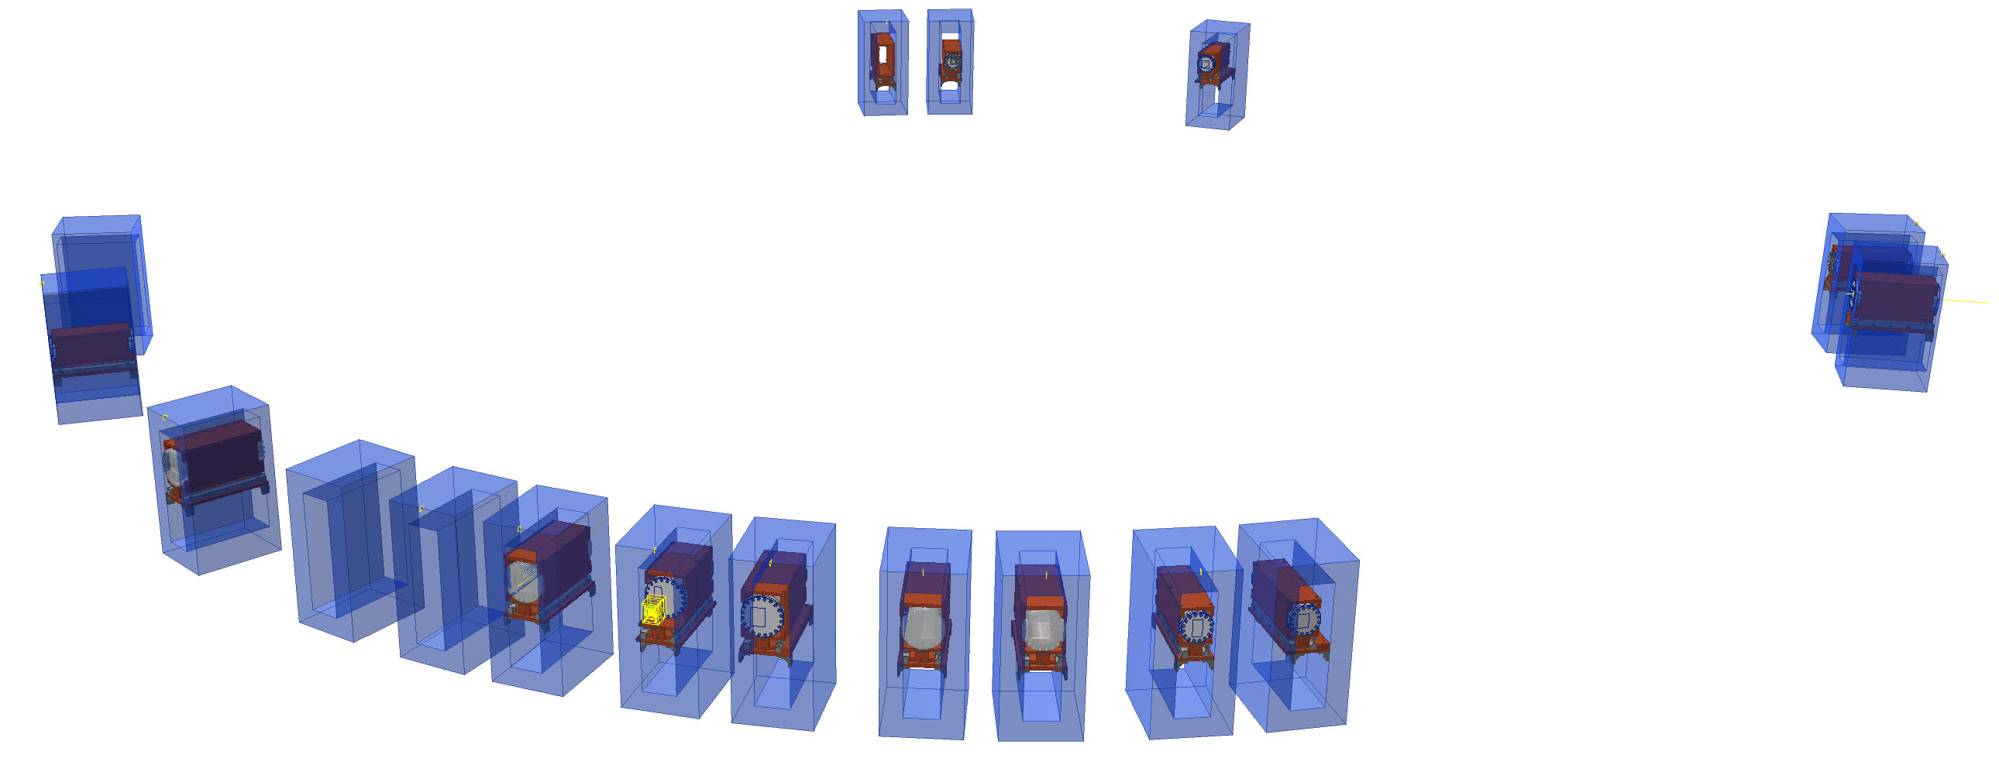
Bridge Beam Guide Models
Instrument name | Type/ NSS model
NMX /W1/ | CF100: ESS-0217876
BEER /W2/ | CF100: ESS-0217880
CSPEC /W3/ | CF160: ESS-0217886
BIFROST /W4/ | CF160: ESS-0219107
MIRACLES /W5/ | CF160: ESS-0222155
MAGIC /W6/ | CF160: ESS-0225975
T-REX /W7/ | CF160: ESS-0222060
HEIMDAL /W8/ | Custom (Coming soon)
LOKI /N7/ | CF100: ESS-0218218
FREIA /N5/ | Custom (Coming soon)
ESTIA /E2/ | Custom: ESS-0218043
SKADI /E3/ | CF100: ESS-0222444
Instrument name | Type/ NSS model
VESPA /E7/ | CF100: ESS-0224174
DREAM /S3/ | CF100: ESS-0217885
ODIN /S2/ | CF160: ESS-0222128
TBL /W11/ | CF160: ESS-0219115

Slide 9
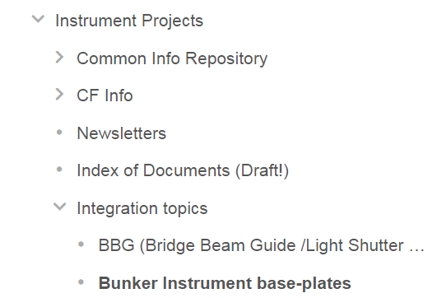
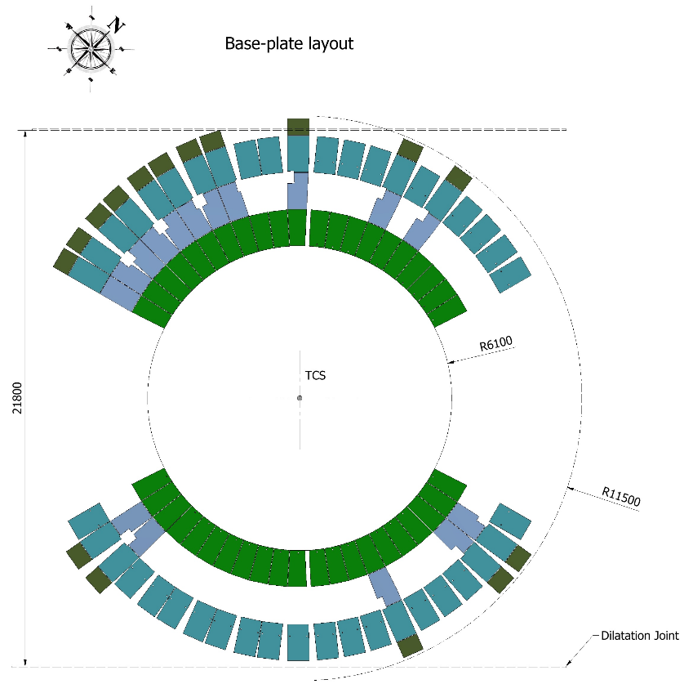
Base-plates
CATIA model (integrated with the bunker assembly): ESS-0191187
The instruments can drill the holes on site until the end of 2022 (or until the area is accessible and there is no risk of contamination).
The instruments can provide drawings of the holes until the end of March. The template can be found on the confluence page
Maximum Instrument cost | 5 000 €
https://confluence.esss.lu.se/display/SPD/Bunker+Instrument+base-plates

Slide 10
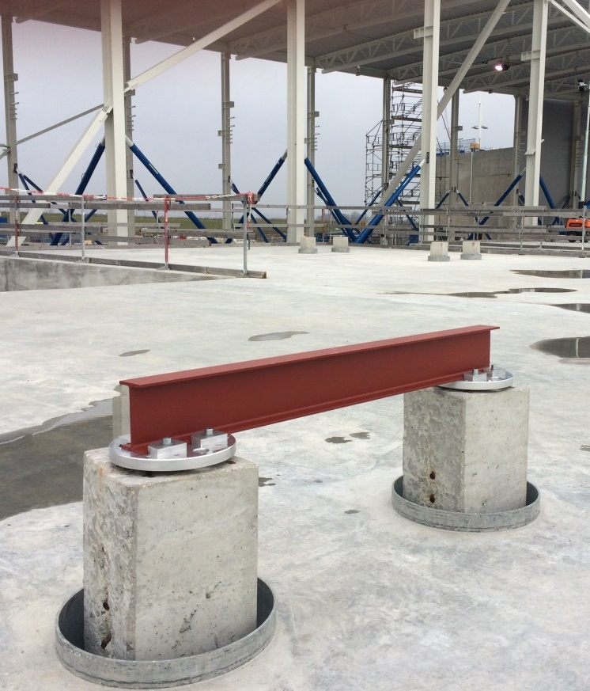
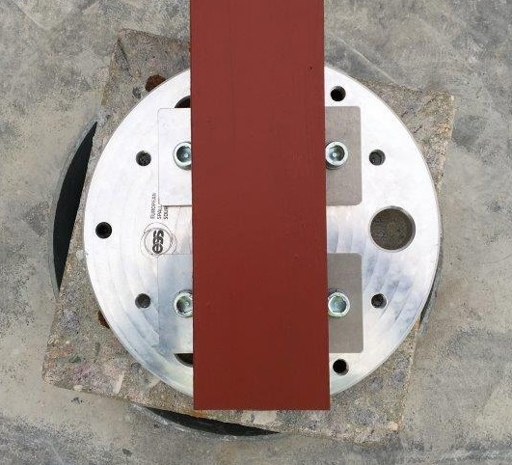
Pile interfaces in E01
https://confluence.esss.lu.se/display/SPD/Guide+Support+Concepts

Slide 11
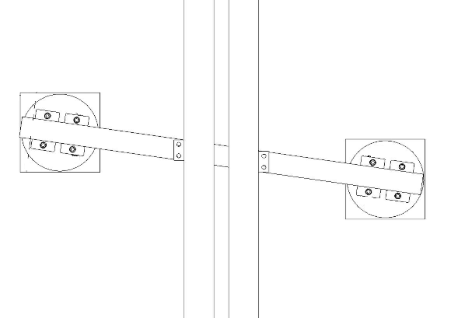
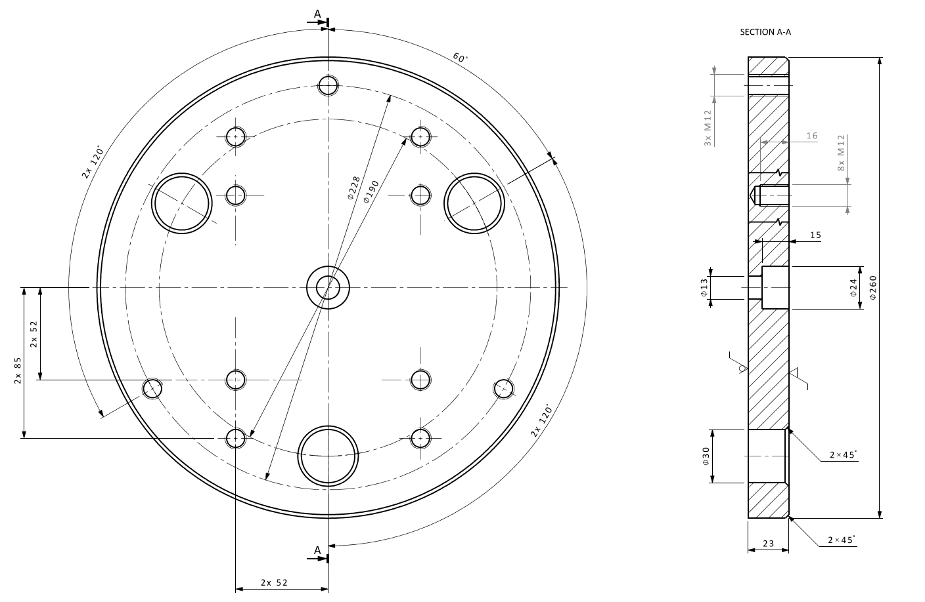
Pile interfaces in E01
IPE 140
(140mmx73mm) or
HEB 140
(140x140)
Top of the interface plate: TCS -550mm
(450mm from Floor) Tolerance: ±2mm
CHESS nr: ESS-0122167

Slide 12
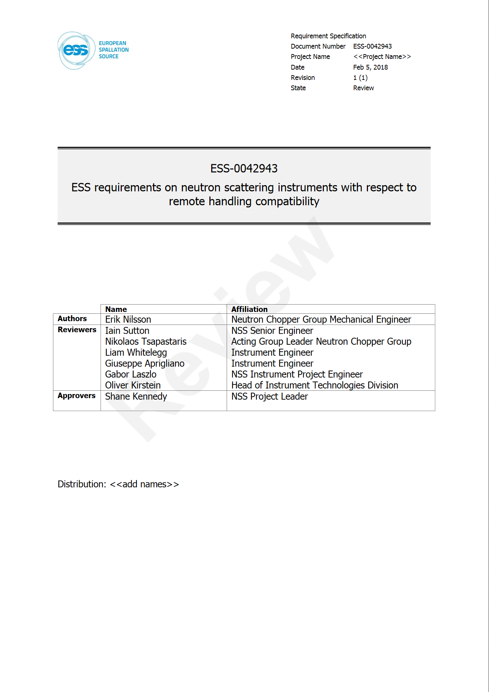
Remote Handling
New document is about to be released!
Requirements and best practices for the remote handling compatibility of neutron scattering instruments.
ESS-0042943

Slide 13
Calculation example for borated in-bunker instrument shielding
https://confluence.esss.lu.se/display/NOSG/Boron-based+shielding+materials

Slide 14

Questions?

Slide 15
Thank You!

