Slide 1
Neutron Chopper Systems Update
Nikolaos Tsapatsaris, Acting Group Leader
On behalf of the Neutron Chopper Group
www.europeanspallationsource.se
15 February, 2018

Slide 2


Slide 3
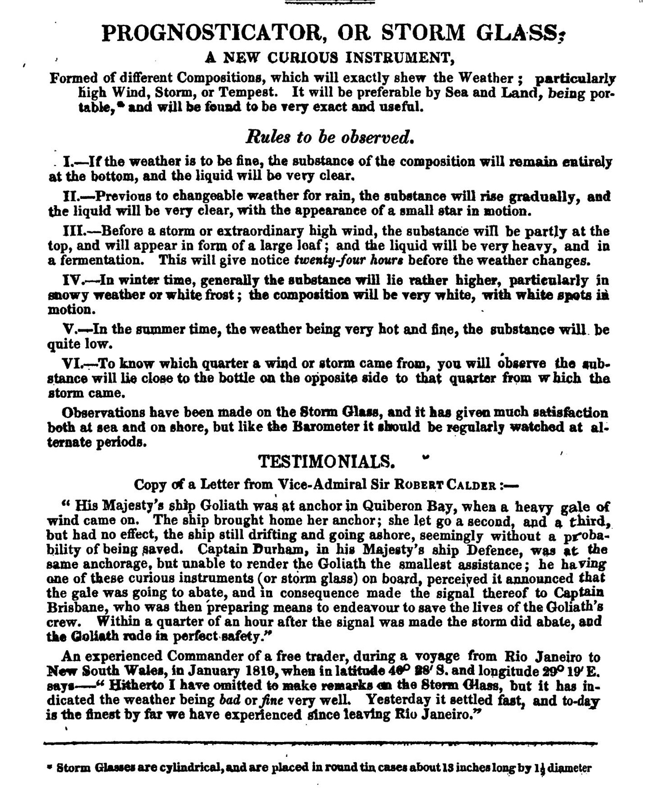
"Pattern formation of crystals in storm glass".Journal of Crystal Growth.310(10): 2668–2672. doi:10.1016/j.jcrysgro.2008.01.037.

Slide 4
Reminder
The Neutron Chopper Group (NCG) is part of the Instrument Technologies Division within the ESS Science Directorate.
Once completed the ESS instrument suite will contain 120 chopper systems 60% of which are placed within difficult to access areas.
The mission of the Neutron Chopper Group (NCG) is to ensure the successful installation and integration of chopper systems and during operations, to provide a high level of instrument availability, maintainability and obsolescence management in order to fulfill the immediate and long term scientific objectives of the facility.
Deliver quality and quantity

Slide 5
Outline
Chopper needs: supply and demand
Standards Update: Tender Spec and TG3
Technology enabling development packages: in kind/contracts
Integration/Installation/Maintenance work training procedure for installation and maintenance RH
Commissioning and Vertical Integration tests

Slide 6
Current NSS Chopper Needs

Slide 7
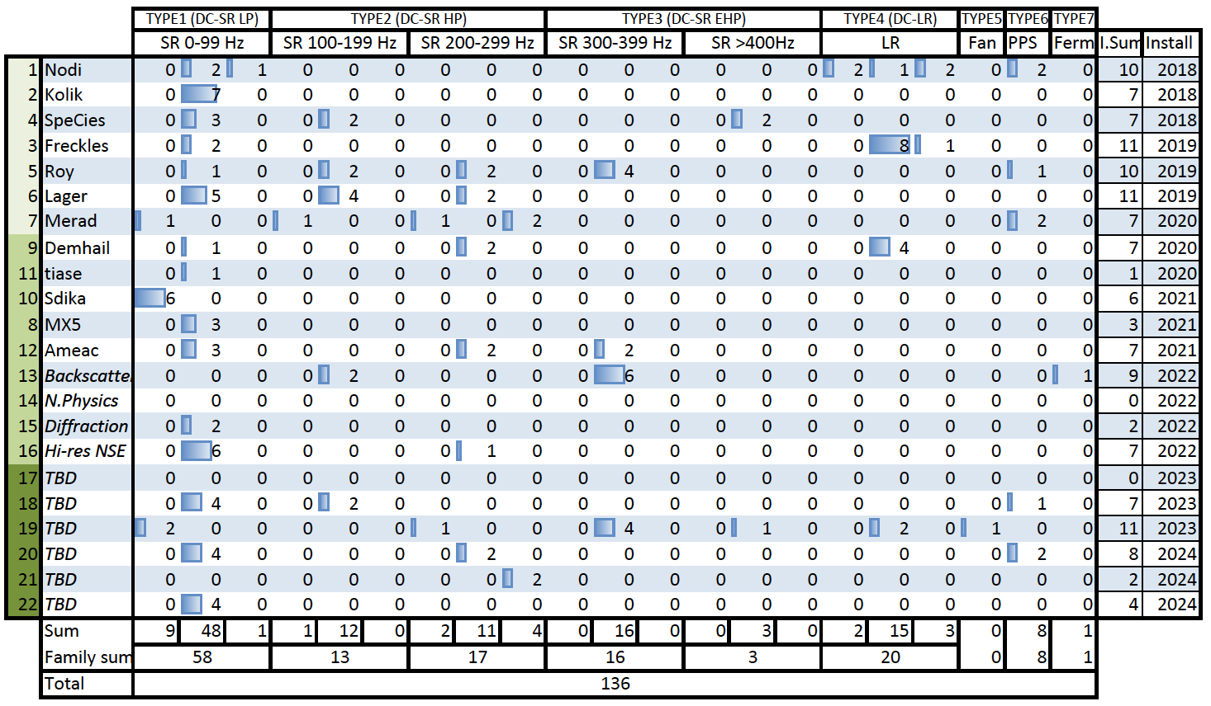
Optimisation
DISC CHOPPER LOW SPEED
PLATFORM 1 50-70 units 35
DISC CHOPPER HIGH SPEED
PLATFORM 2 20-40 units 22
DISC CHOPPER L. ROTOR
PLATFORM 4 10-25 units 14
DISC CHOPPER V.HIGH SPEED
PLATFORM 3 15-25 units
6
T0
PLATFORM 6 4-8 units
3
)

Slide 8




3rd Chopper supplier forum
ISIS STFC
Inform suppliers on evolving needs
Latest supplier developments
Keep momentum of supplier ecosystem and identify challenges early on
Promote a global view and constructive collaboration – In view of early procurement
Dissemination of up to date supplier info to instruments (supplied in monthly update) http://project.esss.dk/owncloud/index.php/s/xa0Spdx0cWhFHku

Slide 9
Info:
Procurement of neutron choppers for ESS
The NCG does not procure chopper systems for instruments
NCG will maintain CS at ESS
The NCG provides tender documentation suggestions and guidelines- > standards, Tech . Spec. , validation program (FAT/SAT examples), warranty indicators
The NCG reviews the completeness of the tender

Slide 10
Chopper Demand
Expected installation dates 2019-2025
Notes:
Informed suppliers about instrument installation needs

Slide 11
Grouping of instruments by possible suppliers

Slide 12
From capacity/complexity to delivery date

Slide 13
The ideal case

Slide 14
Supplier 20% capacity reduction

Slide 15
Supplier 35% capacity reduction

Slide 16
Delivery estimates and suggested delivery order
OBSOLETE: WILL BE UPDATED ASAP WITH NEW INSTALLATION DATES

Slide 17
TG3 process: Neutron Chopper Systems
ESS-0239466 - NCG TG3 Review Process: completed by next newsletter
  Description of NCG process, required documentation, criteria for success (traffic light), compliance matrix
ESS-0034257 - Template for chopper system technical specification for Instruments: in review V2
  Definition of system, system break-down PBS, delivery scope, sub-system specification, validation program (FAT/SAT examples), warranty requirements etc
  The NCG reviews the completeness of the tender
Notes:
Such as include FAT/SAT information included in System verification and validation plan

Slide 18
TG3 process: Neutron Chopper Systems

Slide 19
TG3 process: Neutron Chopper Systems

Slide 20
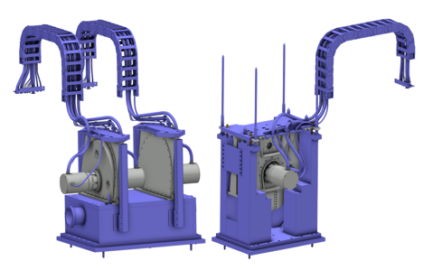
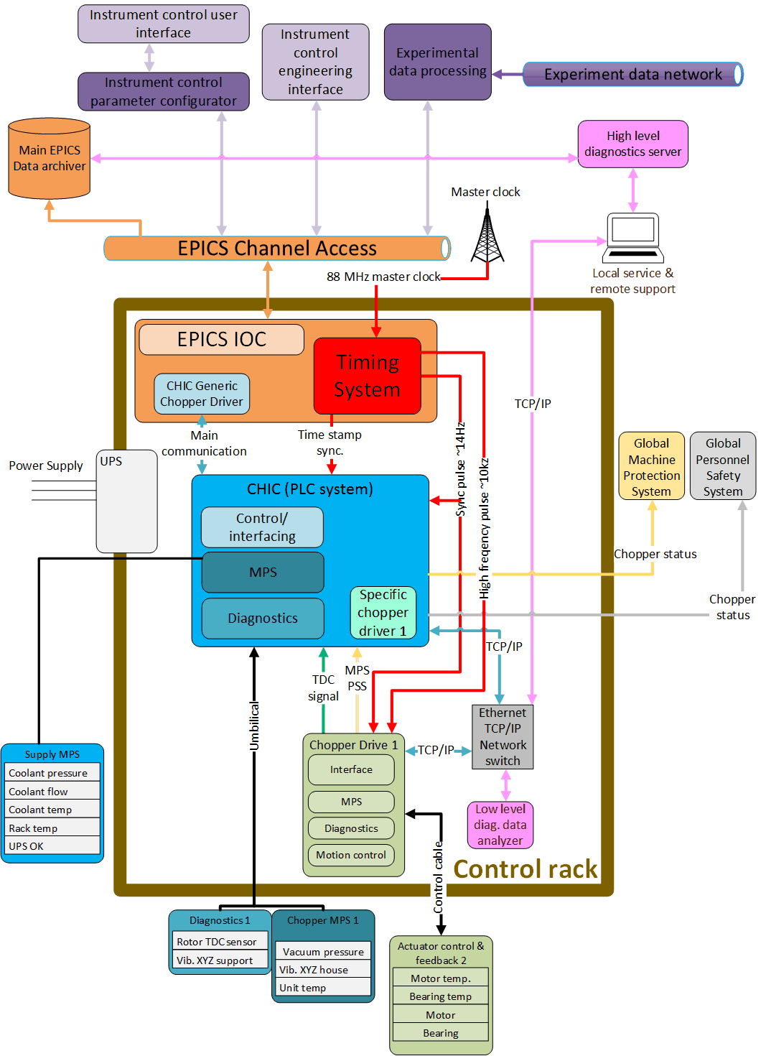
Overview of NCG activities
Company standards and requirements for all ESS neutron chopper systems
Undertake critical enabling technology development in Chopper Control Systems, Chopper Mechanical integration, High speed choppers, T0 chopper
Support and advise instrument teams: Procurement of neutron chopper systems, QA and Validation functions.
Maintenance and support facilities operate and maintain neutron chopper systems at the ESS.

Slide 21

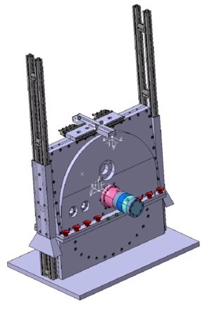
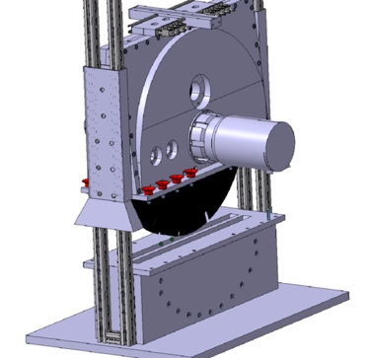
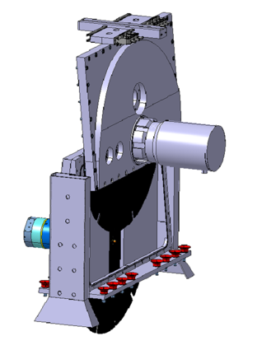

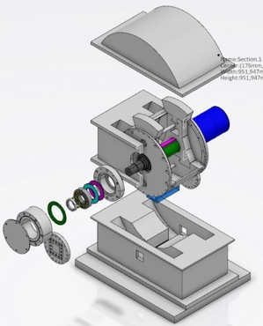
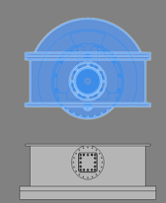
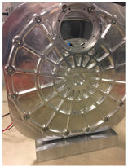
NCG key enabling developments
In-kind collaboration in the field of high speed chopper systems
Key development points
>300Hz, 750mm ø, CFRP based
1xSKF + 1xJülich magnetic bearings
Interchangeable disk-motor coupling
CFRP radiation hardness
Mechanical assembly stiffness
Remote handling
Ease of repair
In-kind collaboration for Chopper system control
CHIC – Vx
Seamless integration of all ESS chopper system to EPICS
Condition monitoring of all choppers systems
Machine protection functionality
Chopper speed and phase control with ESS timing for T0 and others
T0 chopper development
Key development points
28 Hz, in vacuum, Long pulse source
500 kg rotor weight (W, Ni ,Cu ,B)
Rad hard sensors, motor, lubricants
Mechanical assembly stiffness
Remote handling
Ease of repair
Exchangeable rotor
Mini chopper test development for vertical integration
Key development challenges
200mm ø , 14-150Hz
Complete vertical integration using ESS controls

Slide 22

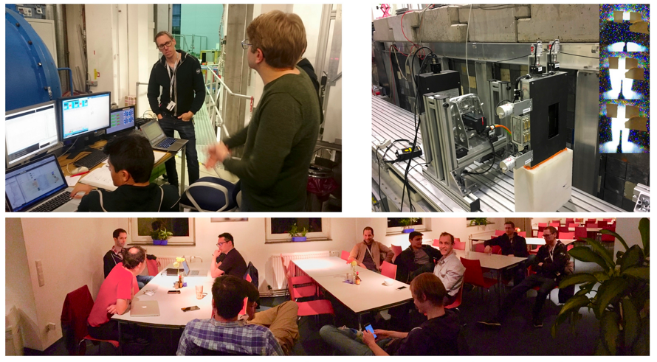
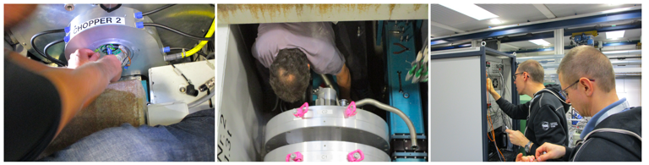
NCG key integration, installation and maintenance activities
Chopper mechanical Integration
Remote Handling of Active Components
ESS collaboration:
Neutron Chopper Group+
Integrated Control Systems+
Detector Group+
DMSC++
Chopper Control Systems Integration - EPICS
Timing, Vertical Integration tests and commissioning at HZB, DE
Procedures for Chopper Installation Commissioning and Maintenance: SSM

Slide 23
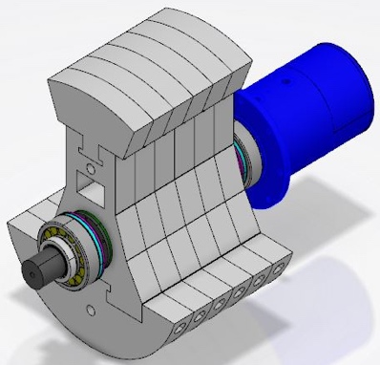
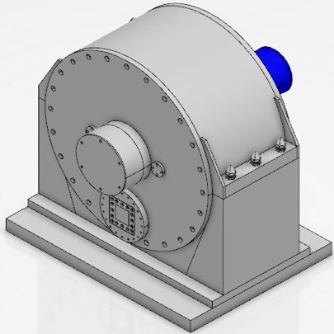
T0 Overview
Block fast neutrons and gamma radiation from the prompt pulse to the required level
Place an absorber mass of high-cross-section material in the neutron beam during the brief time the fast neutrons are present
Rotate sufficiently rapidly to leave the beam completely unblocked when neutrons of the desired wavelengths travel through the chopper position.
Typically rotates at some multiple or submultiple of the source frequency and is kept in phase with the source.
Distance [m]
0
Time [ms]
PPS chopper
Filtered
beam
Incoming
beam

Slide 24
T0 chopper development with commercial partner - Mirrotron
Current status
Kick off – end of Nov 2017
Preliminary Design – ongoing
PDR – expected end of Feb 2018
Short description | Planned date | Comment
P1 Kick-off meeting | T0 (project start) | Kick-off meeting report
T0 PDR (Preliminary design review) | T0 + 9 weeks | System basic portfolio released – Milestone 1
T0 Detailed design – intermediate review | T0 + 20 weeks | Intermediate review
T0 Detailed design final review +TC preliminary review | T0 + 34 weeks | System detailed portfolio released
T0+TC CDR (Critical design review) | T0 + 62 weeks | Detailed drawings issued – Milestone 2

Slide 25
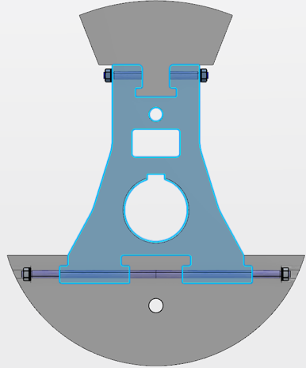
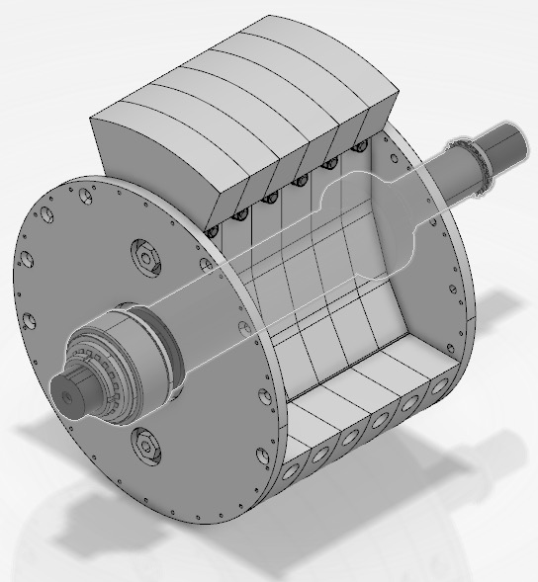
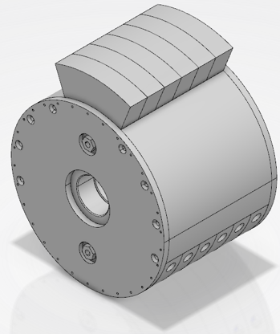
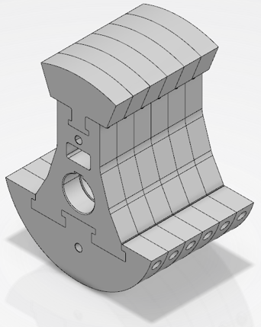
A conceptual representation of the ESS T0 rotor arrangement.
Beam profile
Single T-shape locking
Absorber
B/W/Cu/Ni/W
Tie rods
Body
Triple T-shape locking
Counterweight

Slide 26
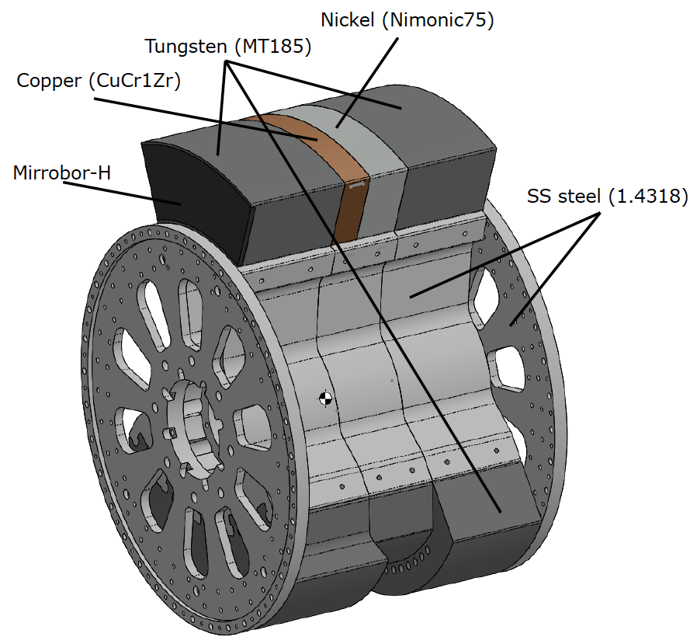
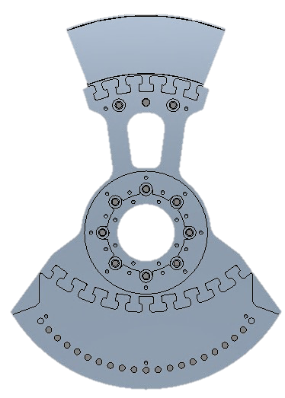
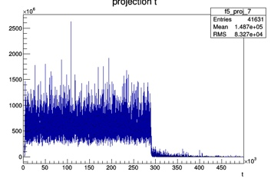
Current status of preliminary design model
Rotor assembly
□70
⍉600
300
L.Zanini

Slide 27
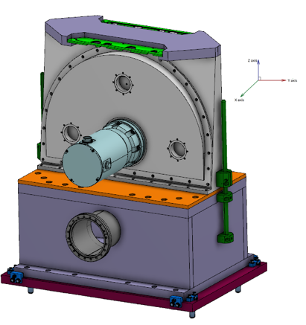
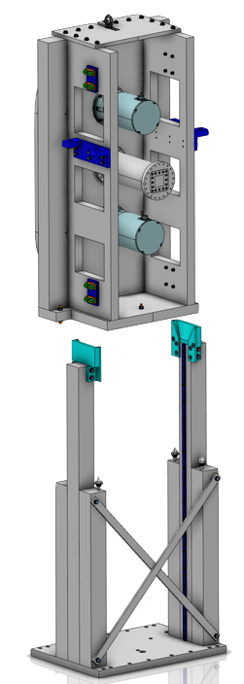
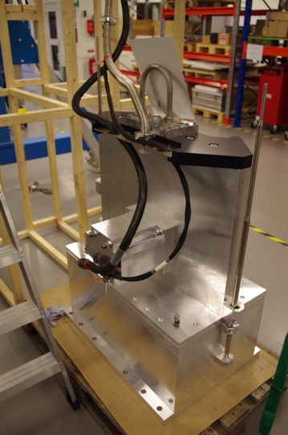
Chopper Mechanical integration
CHIM status
  Tightly linked to and integral part of RH work
  CHIM document to be updated once all three variants are released (ESS-0041170)
  Three main variants, specifications completed and validated by the end of the summer.
    Pillar (ESS-0041171) – Done
    H-split (ESS-0041176) – almost done
    Over/under – not completed
  Hazard analysis together with maintenance and installation focus is currently improving the CHIM designs.

Slide 28
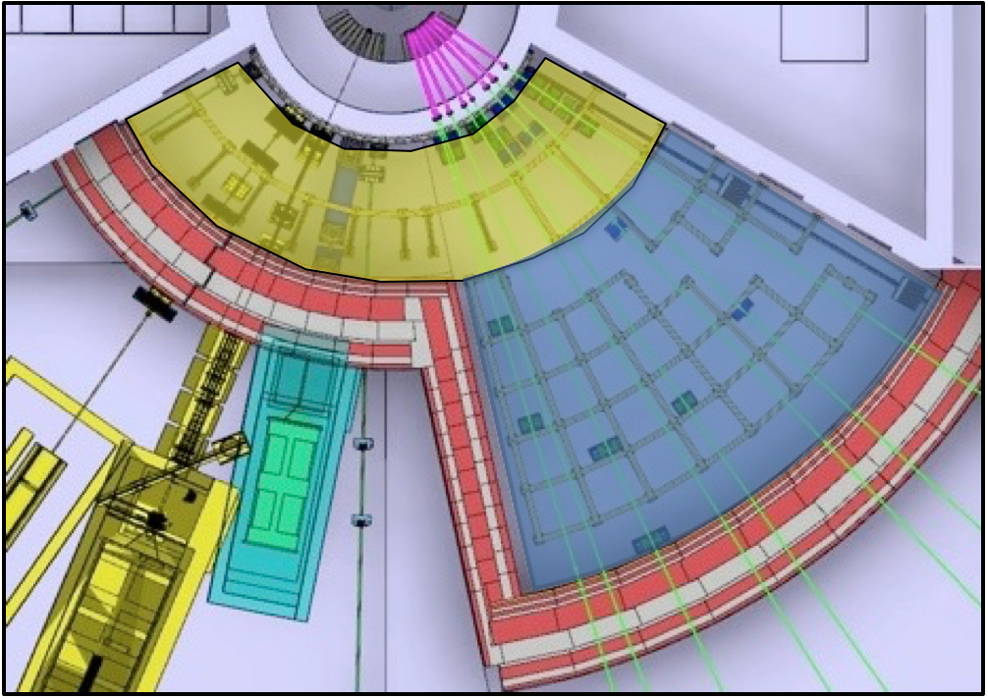
Remote handling – Quick overview
Three classes of modules/component dependent on
  Location (Yellow or blue zone)
  Levels of activation
  Expected service interval
  Reliability
Activities restricted to
  Extraction (Full-RH and Limited-RH)
  Reinstallation (Full-RH)
  Inspection and/or realignment of component/module (if required)
No in-situ RH maintenance is foreseen.
Installation is not considered a RH-activity.
More and detailed information in: ESS-0042943
Living database on: https://confluence.esss.lu.se/display/SD/NSS+Remote+handling+Homepage
Full-RH or Limited-RH
Full-RH or no remote handling
Notes:
Component density

Slide 29
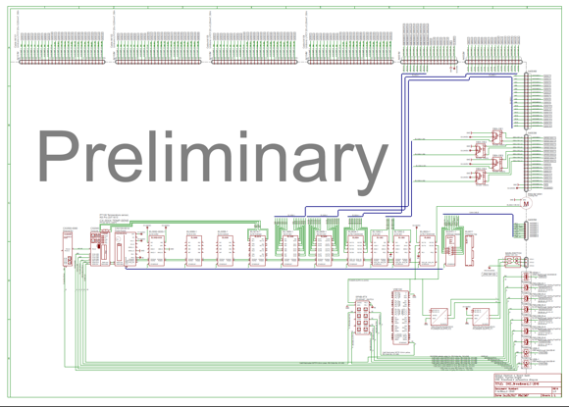
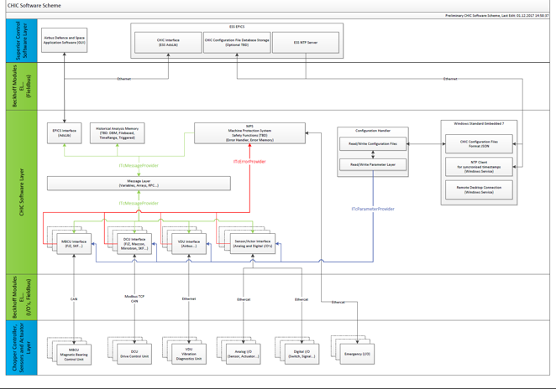
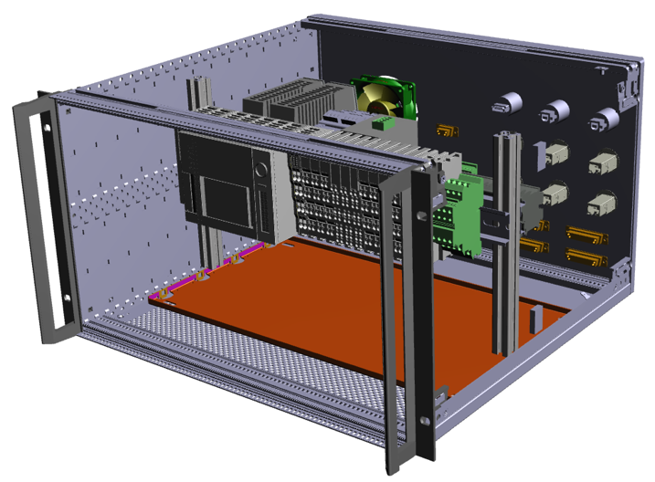
Chopper Control Integration
Chopper Control System Status
  Working closely with Jülich and Airbus, current state phase is detailed design.
  Chopper group is working closely with ICS, a result of that is successful tests at HZB with working the ESS version of the CHIC integrated with NICOS and EPICS.
  NCG is currently working with ICS on the timing system. We are verifying that the timing frequencies are fulfilling the chopper requirements. This was also tested during HZB project.

Slide 30
Vertical Integration and Commissioning programme at ESS test beamline V20
Demonstrate functioning vertical integration – CHIC-EPICS control on fully functional chopper prototype + timing +++ ICS, Detectors, DMSC
Chopper In-kind critically depends on outcome – A proven EPICS control with reference pulse and time stamping
Training – FAT, SAT, Cold and Hot Commissioning training of chopper group and others
Working together – Tech groups working as a team in-vivo
First Session – November:
Demonstration of Timing
Chopper low level control and operations
Readout of TDC values and beamline metadata
Second Session – January:
EPICS and NICOS control of
chopper and beamline
Readout of monitors through DG system
Processing and storing of event data
Future:

Slide 31
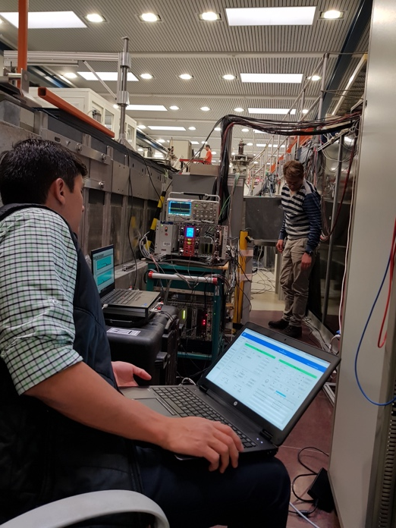
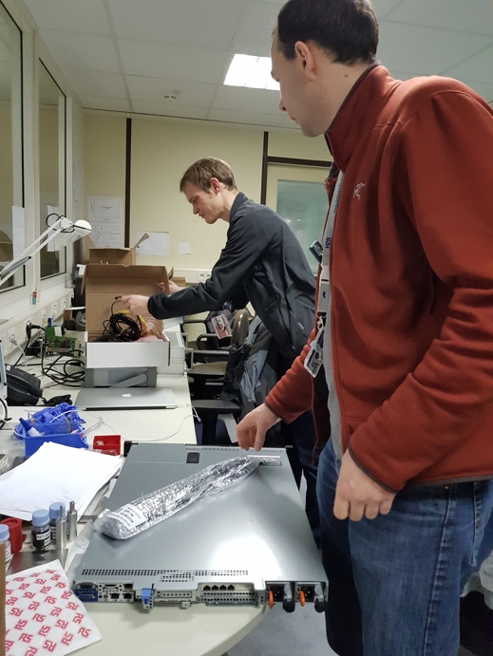
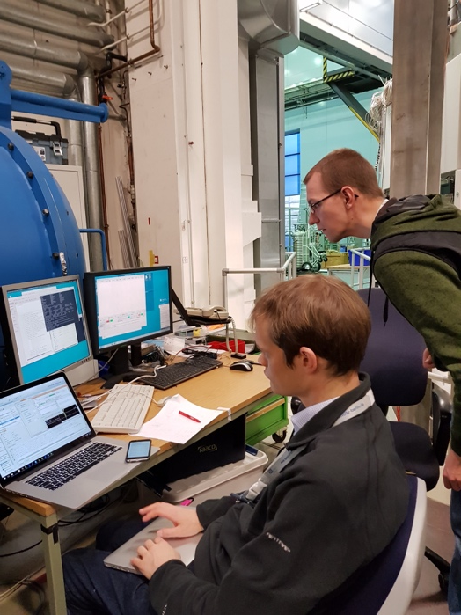
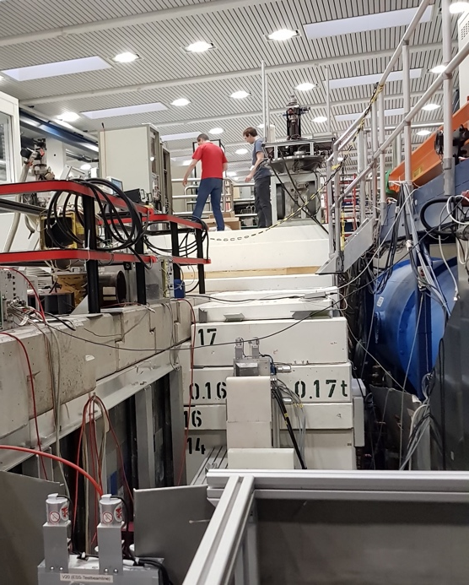
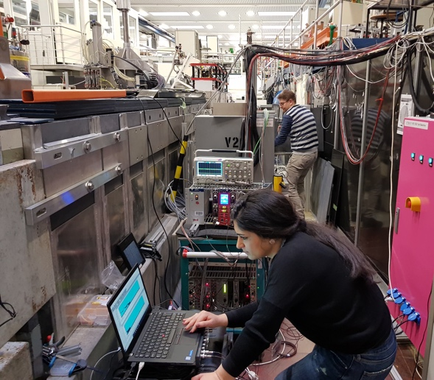
V20 test at HZB
V20 test at HZB-Berlin:
Detector Group
Chopper Group
DMSC
ICS

Slide 32
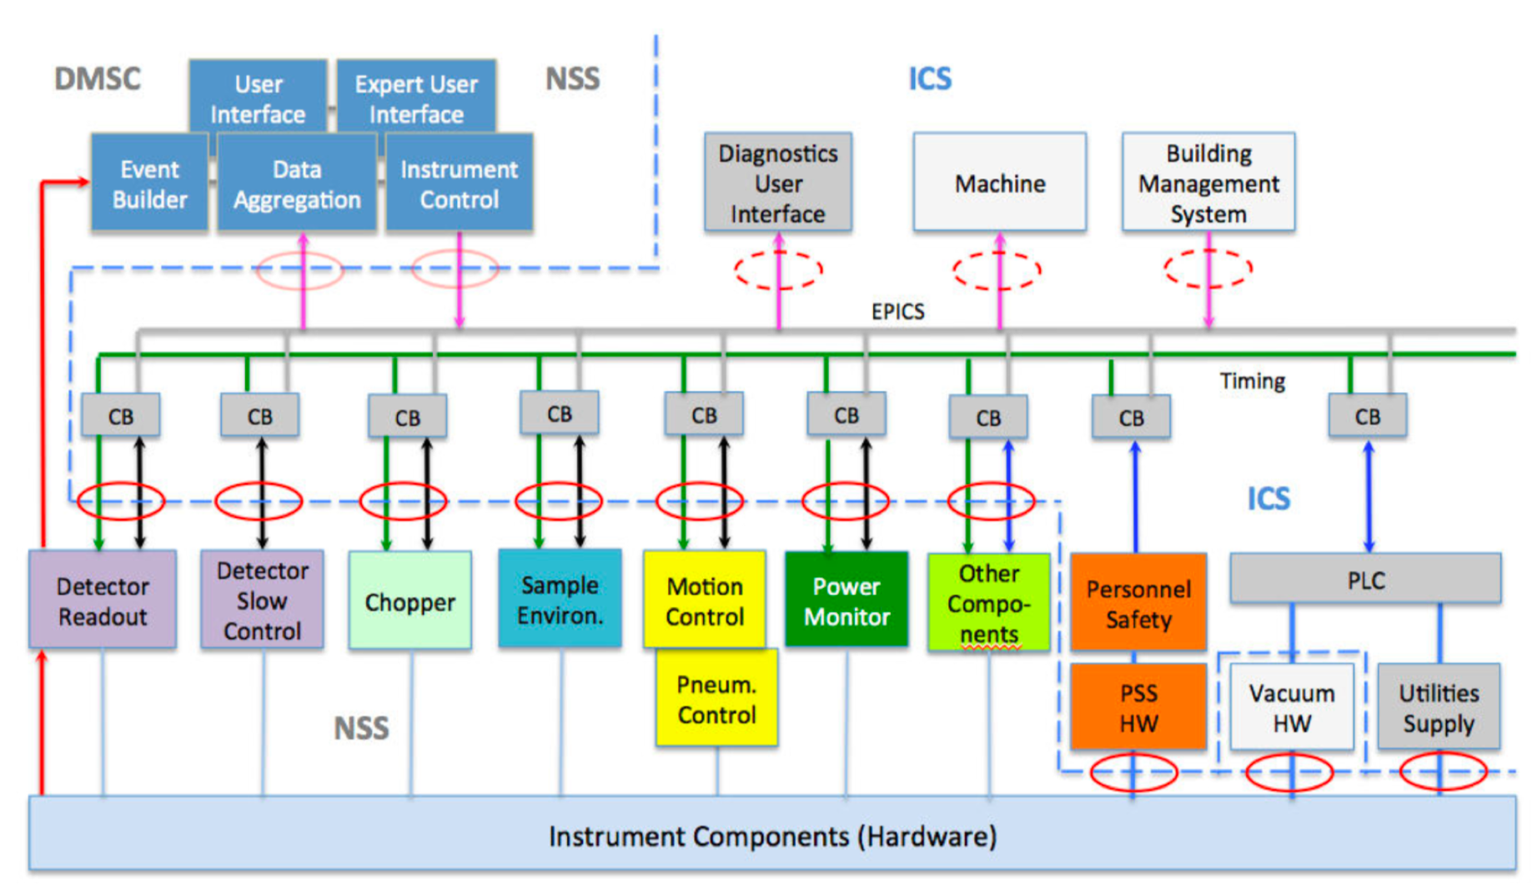
Vertical Integration Tests at HZB:
ESS Controls and Readout Architecture
Tested: Vertical integration and commissioning

Slide 33



Vertical Integration Tests at HZB:
ESS Controls and Readout Architecture
Source Chopper
Front Monitor
Mini chopper
Back Monitor
Reactor
EPICS Forwarder
Timing system
DETECTOR GROUP CONTROL & TIMING DEMONSTRATOR
ADC
TEST
STATUS
Kafka
EFU
DATA
TIMING
CONTROL
JTAG
POWER
File writer

Slide 34

Mini chopper: Chopper System Integration
DMSC
NICOS User interface
EPICS
Timing System
Time stamping
(TDC pulse)
Synchronization signal (14Hz)
CHIC
Control Interface
Chopper
Servo Motor
Speed & Phase control

Slide 35
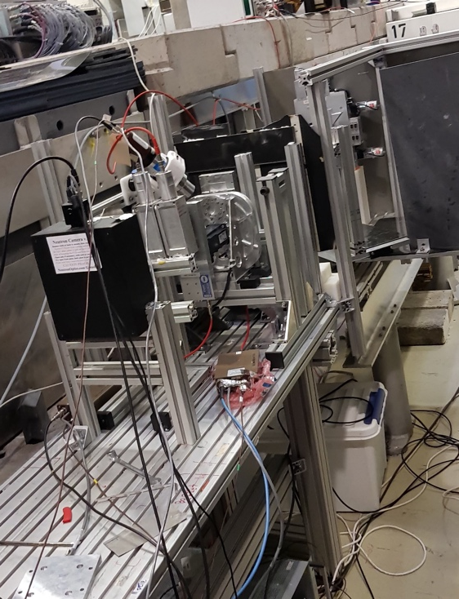
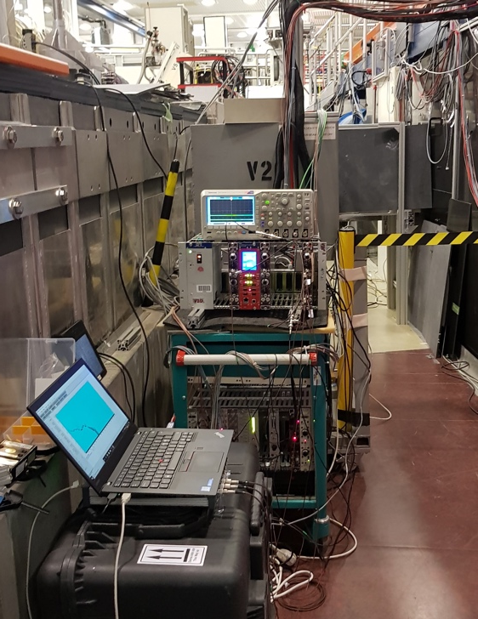
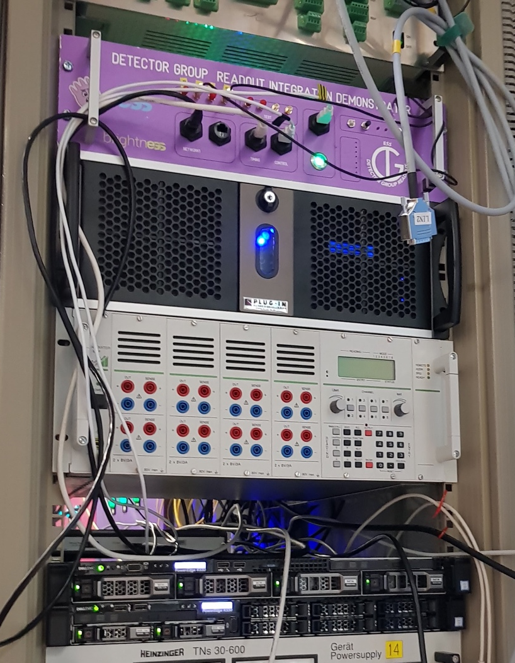
Monitors integration
Timing EPICS
DMSC
Beam monitor
Front end
AMP
DAQ
Event formation
BM electronics several options (for more details see Scott talk at IKON13):
Integration Demonstrator (Done)
Talin
Talin ++
Standard detector readout
DMSC and ICS

Slide 36
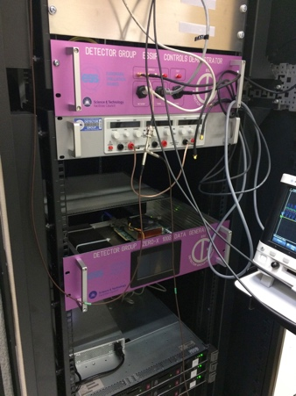
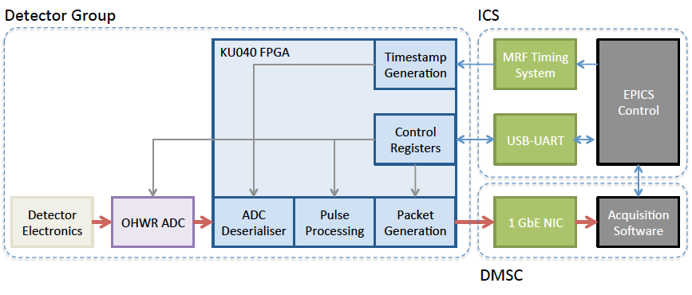
Beam monitor electronics
Timing EPICS
DMSC
Beam monitor
Front end
AMP
DAQ
Event formation
example
Work done by: Steven, Scott (DG) Tobias and Janos (DMSC)
Notes:
So now what is a beam monitor as a system is the detector itself with electronics ..

Slide 37
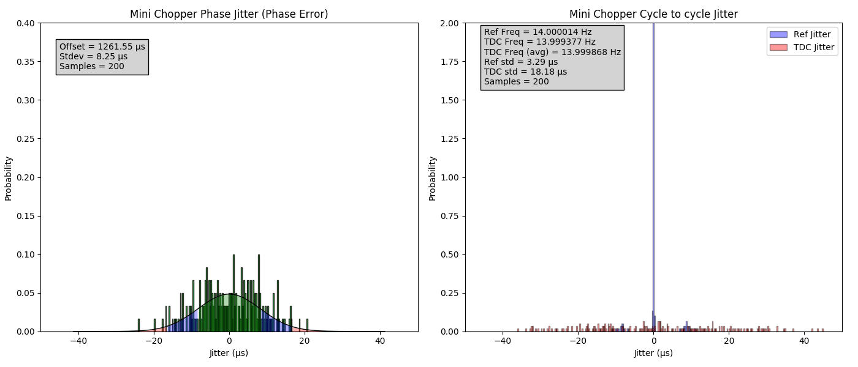
Chopper: Phase jitter and Cycle to cycle jitter

Slide 38
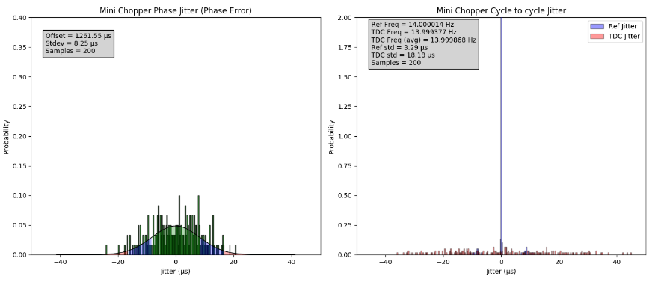
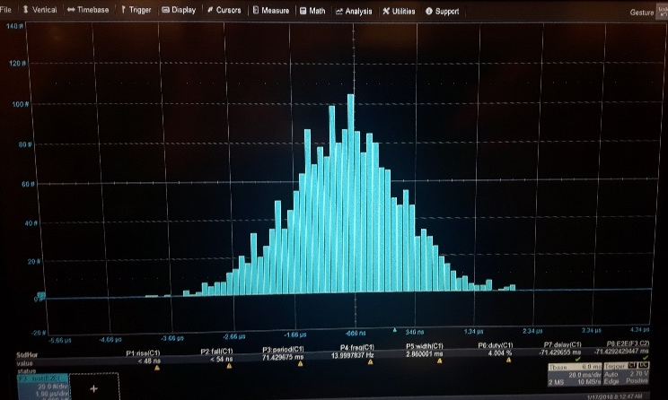
Chopper Phase jitter and Cycle to cycle jitter: Verification
Chopper verification
  Every rotation recorded and compared to a reference pulse via EPICS
  Statistical analysis of the behaviour of the chopper and the reference pulse.
  Verified with external system
  (10Gs/s oscilloscope)

Slide 39
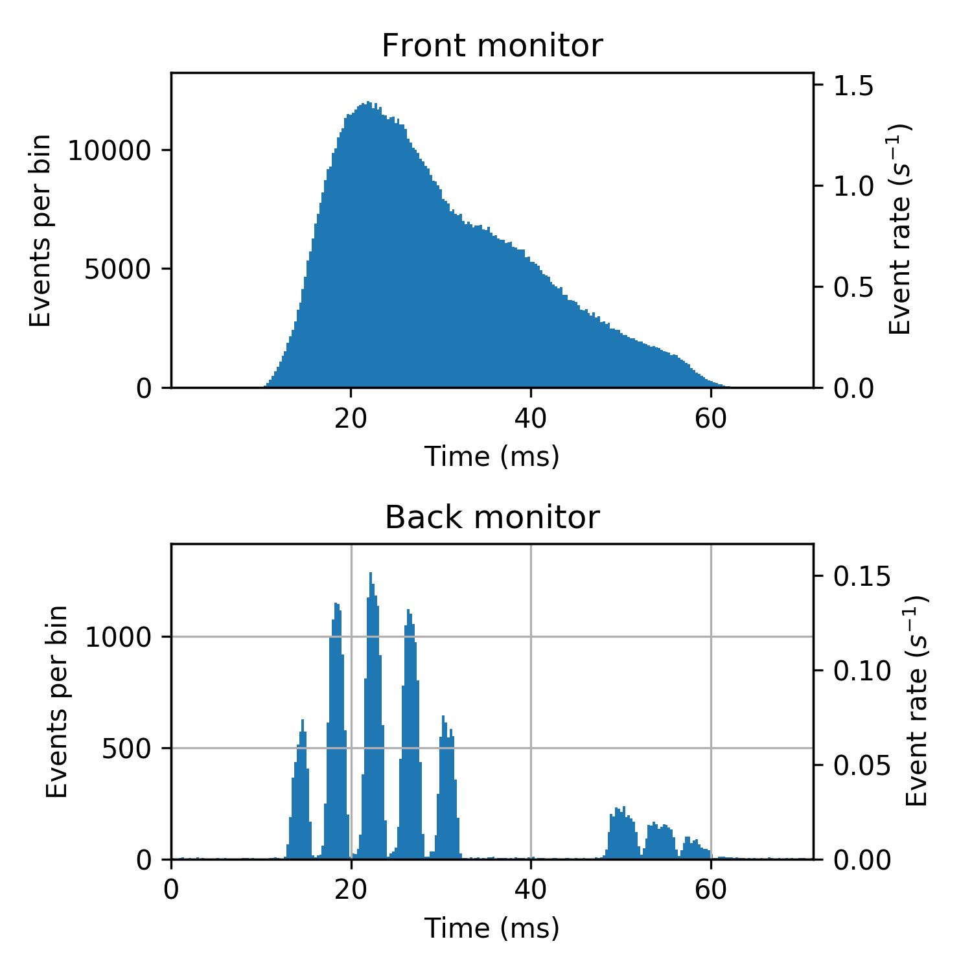
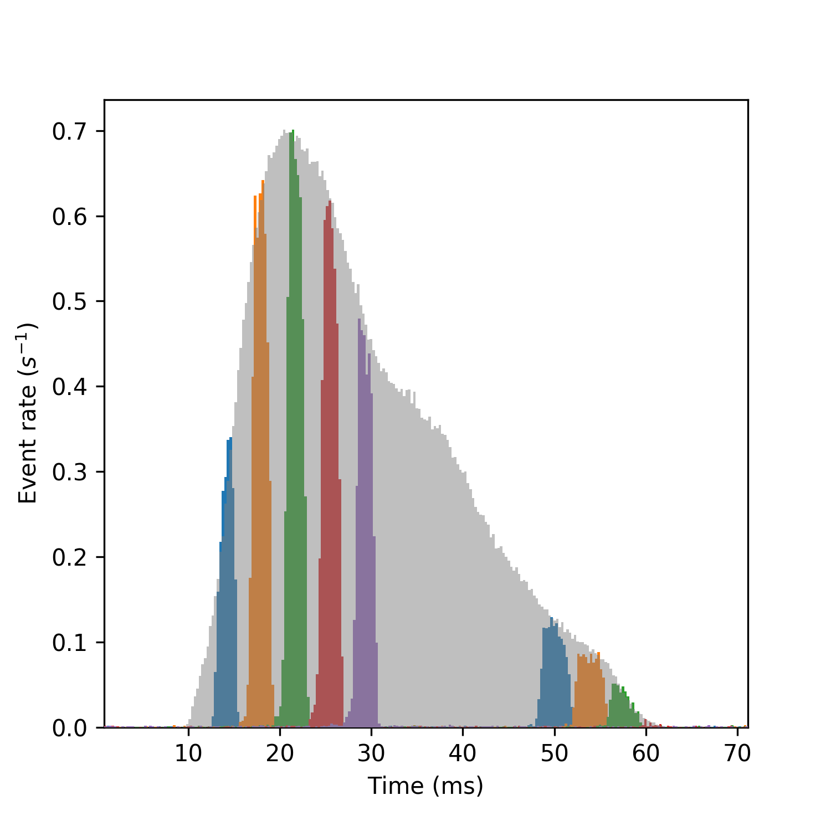
Test Results: Neutron monitor data
Overnight experiment using NICOS user interface

Slide 40
Test result summary
Chopper and its control system (CHIC) are performing as expected
NICOS has high level control of the chopper and most V20 equipment
Monitors acquire useful data
DG readout electronics capture the signals correctly
EFU can process the data sensibly
Data Streaming with Kafka and
HDF5/NeXus file writing works
We have gained better understanding of the devices from the data captured
Timing system works in principle
Better idea of priorities for future tasks

Slide 41
Conclusions
Standards been finalised: TG3 in focus
Integration work and training: on track
Enabling technology development: on track
Vertical integration an commissioning: Positive outcome
  Higher speeds
  Expand epics integration
  Further tests with Wavelength Frame Multiplication,
  Sample Environment, Motion Control

Slide 42


Thank you for your attention. Questions ?
Jonas Nilsson
Michael Hart
Nikhil Biyani
Tobias Richter
Steven Alcock
Fatima Issa
Andres Quintanilla
Darek Zielinski
Markus Olsson
Erik Nilsson
John Sparger
Krisztian Löki
Robin Woracek
In spirit and budget:
Richard Wall Hilton, Jonathan Taylor, Oliver Kirstein, Shane Kennedy

