Slide 1
IKON 14 Summary & feedback Instrument Technologies (+ a tiny little bit of DMSC & ICS)
15. February 2018
European Spallation Source ERIC

Slide 2
Progress since last IKON
Who was/in involved
All of us
Topics to be addressed/focus for next IKON

Slide 3
Progress - I
Signed in-kind agreements for high-speed CHIM and CHIC system
Signed contract for T₀ chopper system
both contracts are covering a 48 months period
Approved “Remote Handling Strategy”; ESS-0042943
Implications beyond chopper systems such as licensing but also staff levels for steady-state operations
Workshop November 2017 (ESS-0191767) ; included feedback from partner institutes
On-going process; looking forward to receiving further input from partner institutions

Slide 4
Progress - II
In-monolith Optics Supplier Forum ; ESS-0185465
Estimate capacity considering vendors capacity incl. schedule
Materials and radiation
Complement using ESS-Dubna collaboration
Vertical integration incl. DMSC, Detector Systems, Chopper Systems, Integrated Control Systems
V20 test beamline at HZB; November 2017 /January 2018
Resembles “basic” ESS instrument;
ESS pulse characteristics; functional building blocks

Slide 5
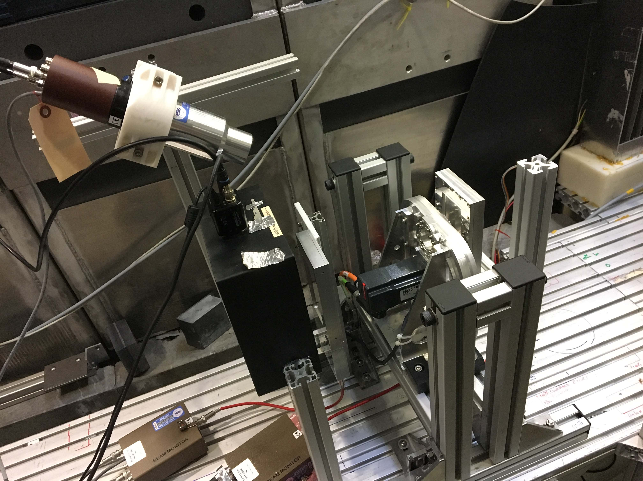
Progress - III
Excerpt from email; 25 January 2017
mini chopper is performing as expected
we have control over the chopper from NICOS
V20 Caress problems are resolved for good
good signal comes out of one of the monitors
DG readout electronics capture the data correctly and reliably
the EFU can process the data sensibly
Kafka does its job (no surprise)
we write a HDF5 file with the pertinent data (not quite proper NeXus)
analysing the file allows us to find out things about the devices involved

Slide 6
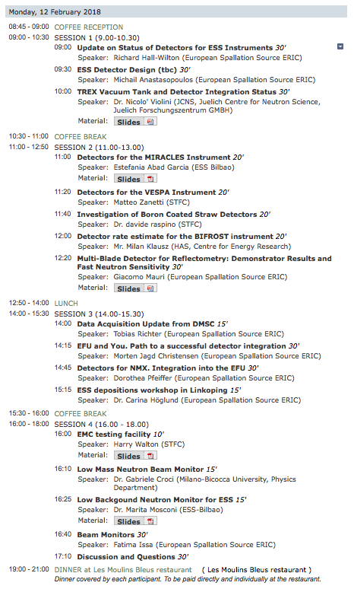
Progress - Detectors
https://indico.esss.lu.se/event/971/
Follows on from last IKONs 2 parallel sessions on detectors and on beam monitors
Organising committee asked for satellite event
Slides will be available on Indico (like previous IKONs): an important resource for all
Last+this: 10 instruments covered
“Detectors and Data Acquisition”: we need to consider the whole data chain
DMSC and DG well aligned, advanced status, good definition of interface
Next IKON: continue satellite.
Cover remaining 5 instruments
Discuss details at IKON meetings

Slide 7
Beam monitors per zone: prioritise bunker and guides first
Presentations from Fatima Issa (ESS), Gabriele Croci (CNR), Marita Mosconi (ESS-B)
Ionisation, GEM or Fission Chamber
Parasitic Monitor preferred: 4 types under consideration
Use-cases and requirements to be developed
mechanical integration
attenuation
attenuation
scattering
scattering
radiation hardness
Saturation
Challenges
Looking at
Looking at
Instruments need to provide much more detailed input
Similarly: Background
Bunker area
Guideline
Sample area
n-camera
Beam stop
Flux (x,y,t)
“Position sensitive” Transmission BM
“Flux” BM
“Flux” BM
“Position sensitive” BM
F(x,y)
F(t) F(t) F(x,y,t) F(t)
10¹⁰ - 10¹² n/cm².s
10⁷- 10¹⁰ n/cm².s
Neutron Flux at various locations
Very different challenges and requirements
What monitoring do you need to commission instrument?
What monitoring do you need to operate instruments?
BIG ISSUE

Slide 8
IKON 15
Effort requirements; crucial to know as early as possible
if instrument scope is transferred/subcontracted to tech groups
Look at each major technical area
lead time to find staff min. 3 months
need to make sure that we can train them…and seat them!
Continue discussing in detail
Materials selection / radiation hardness; activation
Detector; monitors, background, build effort
Electrical integration; finalise component standards
Centralisation; cave/guide shielding et al

