Slide 1

TG3 Process /Part 2
Gábor László
NSS Lead Instrument Engineer
13.02.2018

Slide 2
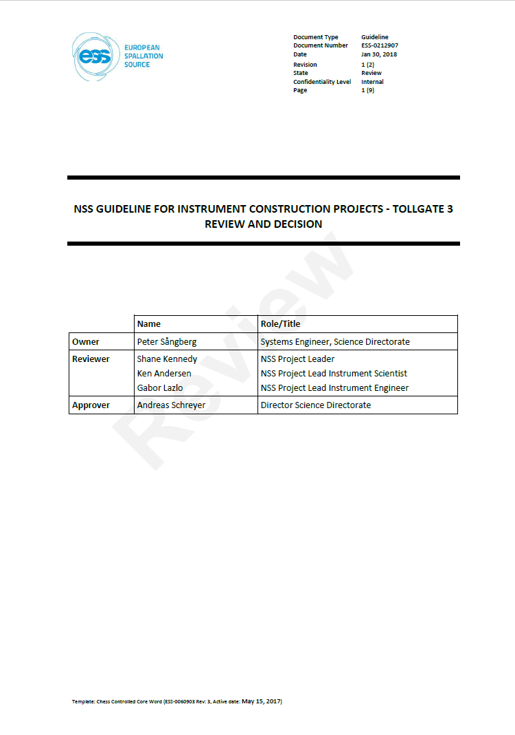
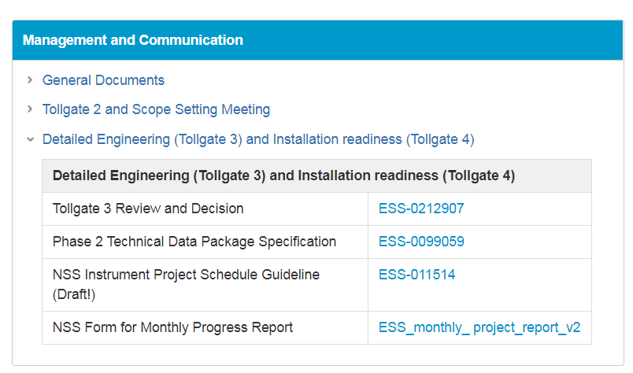
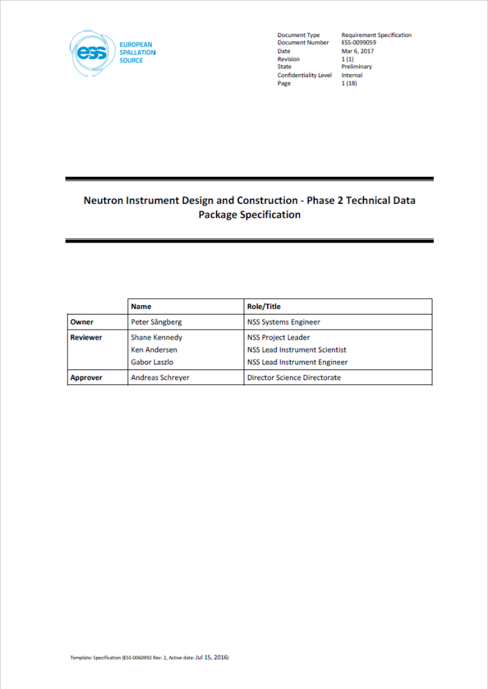
TG3 Description documents
(By Peter Sångberg & Gábor Lászlo)

Slide 3
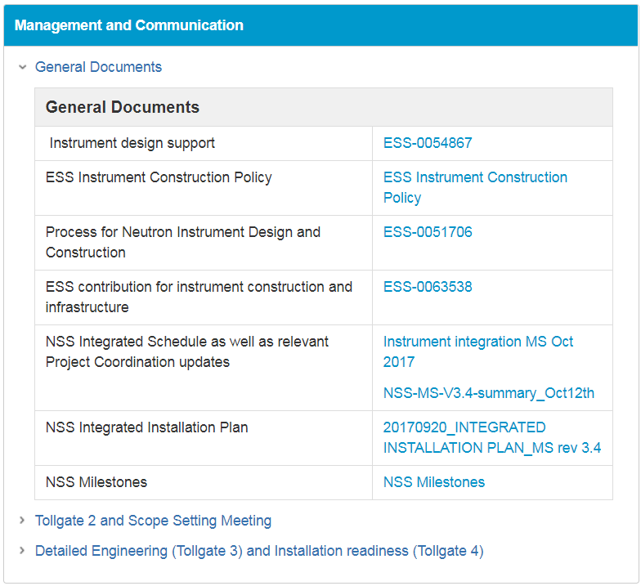
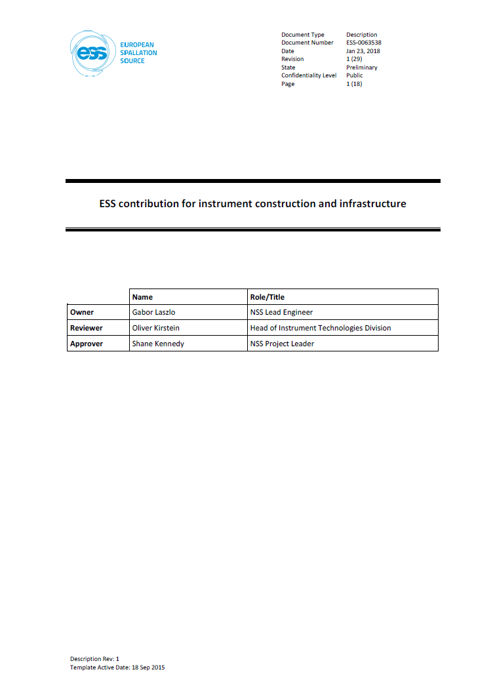
ESS Contribution

Slide 4
Scope of NSS TG3 Review
Basic scope
Verification of the structure of the design proces and completeness of the documentation (not content verification!)
Verification of compliance with ESS standards
Verification of instrument integration /Spatial, infrastructural, logistics, schedule/
In case of a Stage also the verification of the completeness of the internal interface definition.
Additional scope of the Technology Groups are defined individually by them, considering the available time, resources and legal(SSM) requirements.

Slide 5
Technology group specific TG3 scope definition (NSS)
Motion control
The details of the necessary planning and technical requirements can be found here: ESS-0240219
Chopper Team
The details of the necessary planning and technical requirements can be found here: ESS-0239466
Template for tendering: ESS-0178215
Sample Evironment (SAD Team)
The details of the necessary planning and technical requirements can be found here: ESS-0189147
NOSG:
The shielding requirements can be found here: ESS-0052625
There are QA requirements are in the handbook: ESS-0039408

Slide 6
Technology group specific TG3 scope
Detector Team: No specified requirements yet
DMSC: No specified requirements yet
Cooling
3D Envelope of the out of bunker cooling system according to the P&ID from cooling Group
Vacuum
3D Envelope of the out of bunker cooling system according to the P&ID from Vacuum Group
ICS
No specific requirement
PSS
PSS hazard identification document: ESS-0135291

Slide 7
Phase 2 Communication with
Technology groups
COMSOL Simulation
INSTRUMENT
TEAM
NOSG
Vacuum
PSS
DETAILED DESIGN
Control details
PSS DE
Input for FBS
ICS PE incl. FBS structure
Detector
Control details
ICS
Control details
Table of motion
Table of motion
Control details
MCA
DMSC
Control details
Cooling P&ID
Cooling
SAD
Chopper
ESS Rad. Safety
ES&H

Slide 8

Phase 2 Communication with
Technology groups
NOSG
ESS-0052625, ESS-0039408
INSTRUMENT
TEAM
MCA
ESS-0240219
Potential Risk Mitigation
Table of Motion
Chopper
ESS-0178215, ESS-0239466
Potential Risk Mitigation
Chopper Registry
TG3 requirements
ES&H
ESS-0047810, ESS-0100583
Neutron Optics Design,
Shielding Analysis,
Detector Design,
Sample Environment
Potential Risk Mitigation
Prel. PSS and MPS Design
ESS-0189147
SAD
S.E. Suite List
Risk analysis
Standards/ Guidelines
https://confluence.esss.lu.se/display/SPD/Instrument+Projects
Motion C. Design
DMSC
Chopper Design
Prel.Cooling Design
Cooling P&ID
Prel. ICS Design
3D Cooling Envelope (OOB)
Size and placement of comp.
Potential Risk Mitigation
Cooling
More Items With Cooling
Prel.Vacuum Design
3D Vacuum Envelope (OOB)
Potential Risk Mitigation
Vacuum P&ID
Size and placement of comp.
Vacuum
Vacuum Chamber Data
COMSOL Simulation
Survey
Potential Risk Mitigation
Detector
Detector List
ICS/MPS
Preliminary ICS Integration
TG3
Documents
Clarifying Functional Breakdown
Preliminary MPS Design
Potential Risk Mitigation
Preliminary FBS
Answers to PSS questionaire
PSS
Preliminary PSS Design
Preliminary Vacuum Design

Slide 9
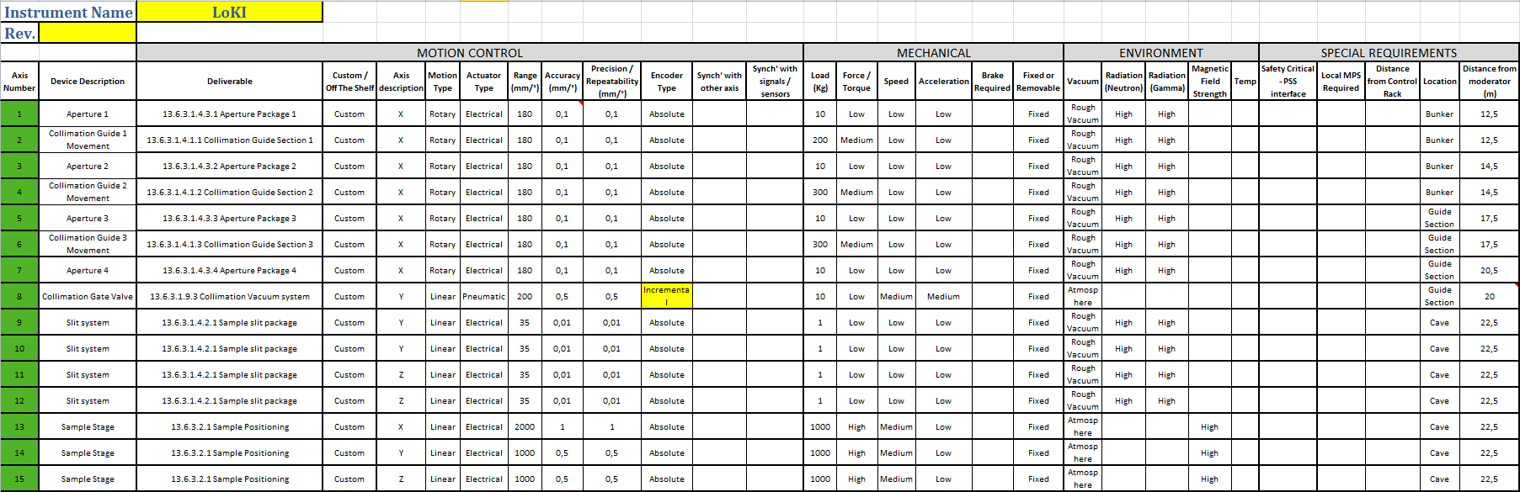
Summary Tables
Motion control:
Repository: https://confluence.esss.lu.se/display/MCAG/Instruments

Slide 10
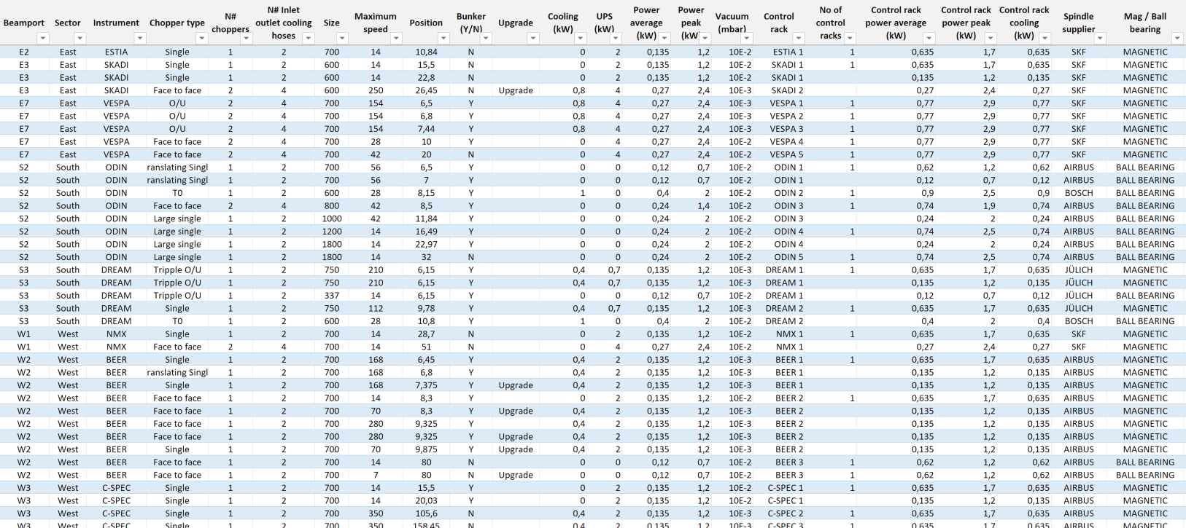
Summary Tables
Chopper registry
Repository: https://confluence.esss.lu.se/display/CG/Neutron+chopper+registry+@+ESS

Slide 11
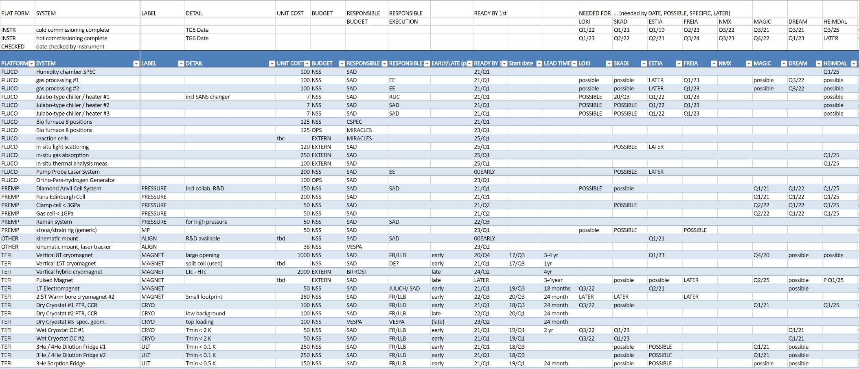
Summary Tables
Sample Environment Suite List
Repository: https://1drv.ms/x/s%21AuCQb_HPf3b9g8g2HHqvybpQKix-Lg

Slide 12
Staged Phase 2 Process Example
Phase 2
Phase 2/1
(In monolith optics)
Phase 2/2 (TG3-2)
In bunker components
(TG3-n-1)
Phase 2/n-1
(Final TG3)
Phase 2/n
TG3-1
TG3-2
TG3-n-1
Final TG3

Slide 13
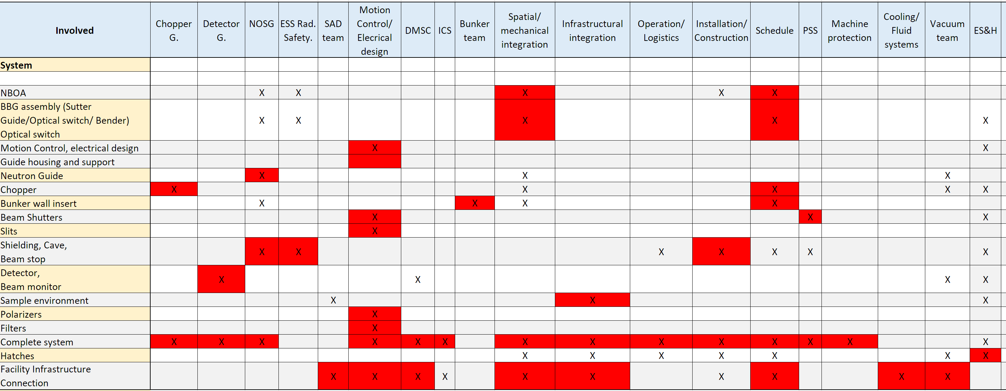
Review Process

Slide 14
Typical Example
(For the first 8 instruments)
Stage 0
    Procurement of NBOA
Stage 1
  Early procurement of Choppers
Stage 2
  Early procurement of remaining Bunker components
Stage 3
  Early procurement of the detector vessel
Stage 4
  Design of the entire remaining system

Slide 15
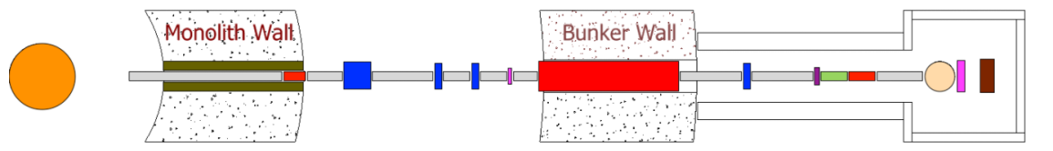
Stage 1.
Early procurement of Choppers
Tendering (First phase of Stage 1)
Deliverables before call for tender (Assuming no changes since TG2):
Optical analysis data (Unless it was delivered during Phase 1)
Call for tender /Technical parts shall be in english/ (Template: ESS-0178215)
Schedule
Declaration of conformity with Appendix 1
ESS action:
Approval for Schedule and Resources
Chopper team shall Review the call for thender based on ESS-0178215
Review meeting is necessary since no Sub TG3 is required after the detailed engineering. Major part of approval of the sub TG3 is the approval of the CFT.
NSS Response time: less than 2 weeks

Slide 16
APPENDIX 1
/Procurement verification/
The Contract/Tender shall contain the following points
There has to be a CDR between the Instrument team and the supplier.
(For the approval of the CDR, ESS shall approve the design.)
Sub TG3
Scope of the work / Expected execution of the specified product or service /
Performance requirements /Acceptable products or acceptable substitutions/
List of required submittals including documents list, language requirement
Request of a Quality-assurance plan from the supplier in the tender documentation
If the NSS requirements are not compatible with the rules of the partner institute, or instruments schedule or the resource plan is conflicting with NSS planning then the issue has to be discussed and addressed by a common agreement.
List of applicable codes and standards
The product has to be designed and manufactured according to ESS and European standards.
Details about the verification process (SAT, FAT), the delivery and the handover of the product/service

Slide 17
Stage 1.
Early procurement of Choppers
Before CDR with subcontractor (Second phase of Stage 1)
UpdateTG2 WPS, Schedule, PBS, Budget
Project Quality Plan (General example provided)
Instrument Hazard Analysis complementing the Chopper Hazard Analysis /Provided by the Chopper Team/ if necessary
Radiation Safety Analysis complementing the Chopper Radiation Analysis /Provided by the Chopper Team/ if necessary
Sub-System Design Description (SSDD) Based on chopper team´s guidelines
  Units decription an validation against requirements
  Description of mechanical and infrastructural interfaces of the choppers
  Potential Chopper section of the PSS documentation
Assembly drawings with BOM identifying the quality, mass and distance range from the beam.
Reviewers: Chopper team, NSS Lead eng., Vacuum team, Cooling team, Survey, Remote handling, Spatial integration, NOSG, PSS (TBD), ES&H (Helena)
(Review meeting with the instrument team is necessary if there is a request for it)

Slide 18
Stage 2.
In-bunker components
Tendering (First phase of Stage 2)
Deliverables (Assuming no changes since TG2):
Before tender
Call for tender /Technical parts shall be in english/ (No template for the first)
Schedule
Declaration of conformity with Appendix 1
Reviewers (Only critical from schedulig perpective):
Planners, NSS Lead eng., NOSG, MCG (potential)
(Review meeting is not necessary unless there is a serious issue!)
NSS Response time: less than 1 week

Slide 19
Stage 2.
In-bunker components
Before CDR with subcontractor (Second phase of Stage 2)
UpdateTG2 WPS, Schedule, PBS, Budget
Project Quality Plan (General example provided)
In-Bunker part of the Instrument Hazard Analysis (Templates: ESS-0135291, ESS-0047810) (Customization)
In-Bunker part of the Radiation Safety Analysis (Template: ESS-0052625, ESS-0100307) (Customization)
Sub-System Design Description (SSDD)
    Units decription an validation against requirements
  Description of mechanical and infrastructural interfaces
  Potential PSS documentation
Assembly drawings with BOM identifying the quality, mass and distance range from the beam.
3D model + Assembly drawings
Reviewers: NSS Lead eng., Vacuum team, Survey, Remote handling, Spatial integration, NOSG, Bunker team (bunker operations), Survey, PSS (TBD), ESS Radiation Safety (TBD), ES&H (Helena)
Review meeting shall be scheduled. Furter scope of the meeting: PSS and ICS integration

Slide 20
Stage 3.
Detector Vessel
Tendering (First phase of Stage 3)
Deliverables (Assuming no changes since TG2):
Before tender
Call for tender /Technical parts shall be in english/ (No template for the first)
Schedule
Declaration of conformity with Appendix 1
Reviewers (Only critical from schedulig perpective):
Planners, NSS Lead eng., Detector team, Sample environment
(Review meeting is not necessary unless there is a serious issue!)

Slide 21
Stage 3.
Detector Vessel
Before CDR with subcontractor (Second phase of Stage 3)
UpdateTG2 WPS, Schedule, PBS, Budget
Project Quality Plan (General example provided)
Detector part of the Instrument Hazard Analysis (Templates: ESS-0135291, ESS-0047810) (Customization)
Detector part of the Radiation Safety Analysis (Template: ESS-0052625, ESS-0100307) (Customization)
Sub-System Design Description (SSDD)
  Units decription an validation against requirements
  Description of mechanical and infrastructural interfaces
  Potential PSS documentation
Assembly drawings with BOM identifying the quality, mass and distance range from the beam.
3D model + Assembly drawings
Reviewers: NSS Lead eng., Vacuum team, Detector team, SAD, ES&H(Helena)
Review meeting shall be scheduled. Furter scope of the meeting: PSS and ICS integration

Slide 22
Stage 4.
Entire remaining system
Tendering (First phase of Stage 4)
Deliverables (Assuming no changes since TG2):
Before tender
Call for tender /Technical parts shall be in english/ (No template for the first)
Schedule
Declaration of conformity with Appendix 1
Reviewers (Only critical from schedulig perpective):
Planners, NSS Lead eng., Detector team, Sample environment, NOSG, MCAG
(Review meeting is not necessary unless there is a serious issue!)

Slide 23
Stage 4.
Entire remaining system
Before CDR with subcontractor (Second phase of Stage 4)
UpdateTG2 WPS, Schedule, PBS, Budget
Project Quality Plan (General example provided)
Instrument Hazard Analysis (Templates: ESS-0135291, ESS-0047810) (Customization)
Radiation Safety Analysis (Template: ESS-0052625, ESS-0100307) (Customization)
Sub-System Design Description (SSDD)
  Units decription an validation against requirements
  Description of mechanical and infrastructural interfaces
System Design Description (SDD)
    Preliminary design for the internal utilities
    Complete PSS evaluation and design
    Description of mechanical and infrastructural interfaces for the whole system
    Integration: Interfaces: spatial/infrastructural/logistics, Data Aquisition, S.E. Operation
  System Integration and Verification Plan
  Preliminary plan for cold and hot commissioning
  Draft of System Operations & Maintenance Manual
Assembly drawings with BOM identifying the quality, mass and distance range from the beam.
Native 3D model + Assembly drawings

Slide 24
Stage 4.
Entire remaining system
Reviewers: NSS Lead eng., Vacuum team, Detector team, Sample Enviroment, MCAG, NOSG, ICS, PSS, ESS ES&H, NOSG, ESS Radiation Safety, SAD, Cooling, DMSC, Survey, R. handling, Waste management

Slide 25

Questions?

Slide 26
Thank You!

Slide 27
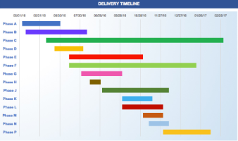
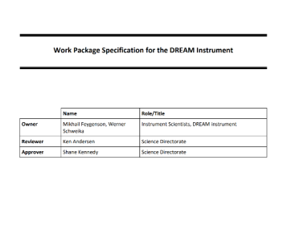
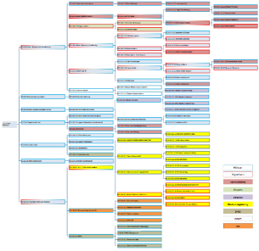
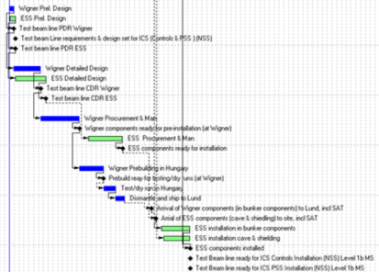
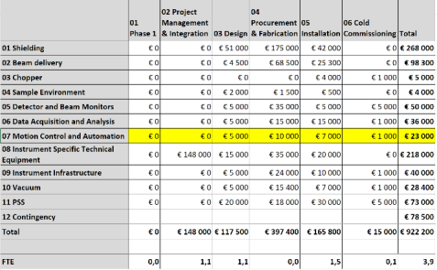
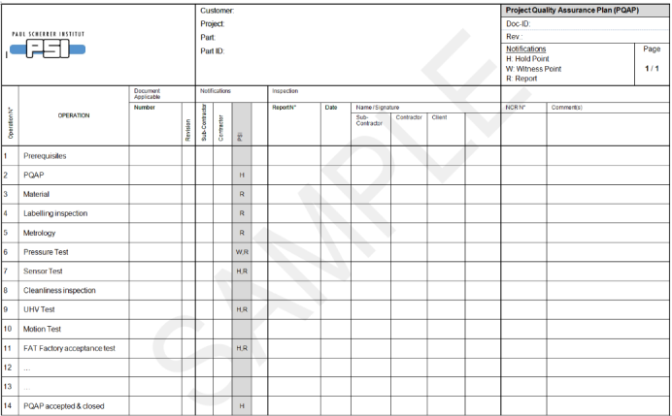
Project Documentation
      Update of the Work Package Specification (WPS) Schedule, PBS, Budget etc. if applicable.
      Project Quality Plan (PQP)
It shall include identification of standards and procedures applied in design, procurement, manufacture and assembly, and planning for compliance testing and inspection.

Slide 28


Safety Documentation
Instrument Hazard Analysis
  References:
  ESS-0047810 /ESS Guideline for Instrument Hazard Analysis/
  ESS-0100583 /Template for Instrument Hazard Analysis/
  ESS-0016468 / ESS rule for identification and classification of safety important components/
Radiation Safety Analysis
  References (Not exclusive):
  ESS-0052625 /NOSG phase 2 guidelines for designing instrument shielding for radiation safety/
  ESS-0100307 /NMX Cave shielding: H1 and H2 scenarios/

Slide 29
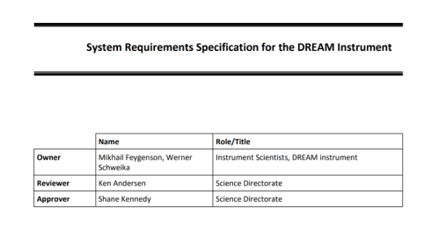
System Documentation
System Requirements Specification update
  Update of the Phase 1 document, if necessary.
Sub-System Design Description (SSDD)
  List of characteristic sub-system properties and solutions derived from requirements, with references to the requirements in the System Requirement Specification (SRS).
  Low level Component(s) or unit(s) description with critical technical parameters and requirements /E.g.: RH compatibility, temperature stability, accuracy, range, load capacity( of Structural components, Bearings, Pressure systems, Lifting features), The compliance to requirements shall be indicated, with references, if applicable.
  The components that are detailed in the technology documents should be not detailed again, but has to be included. (Appendix 2./ next slide)

Slide 30
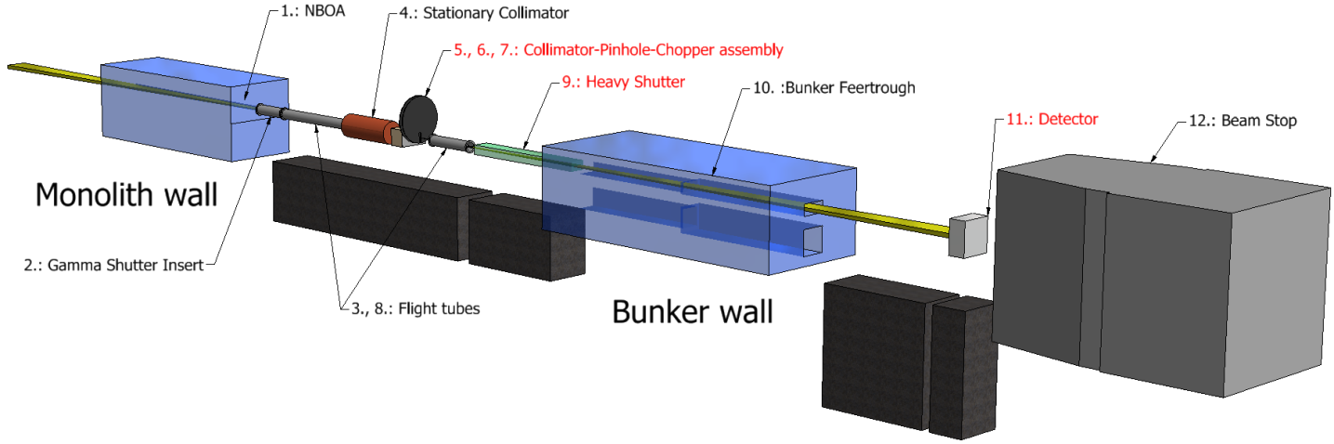
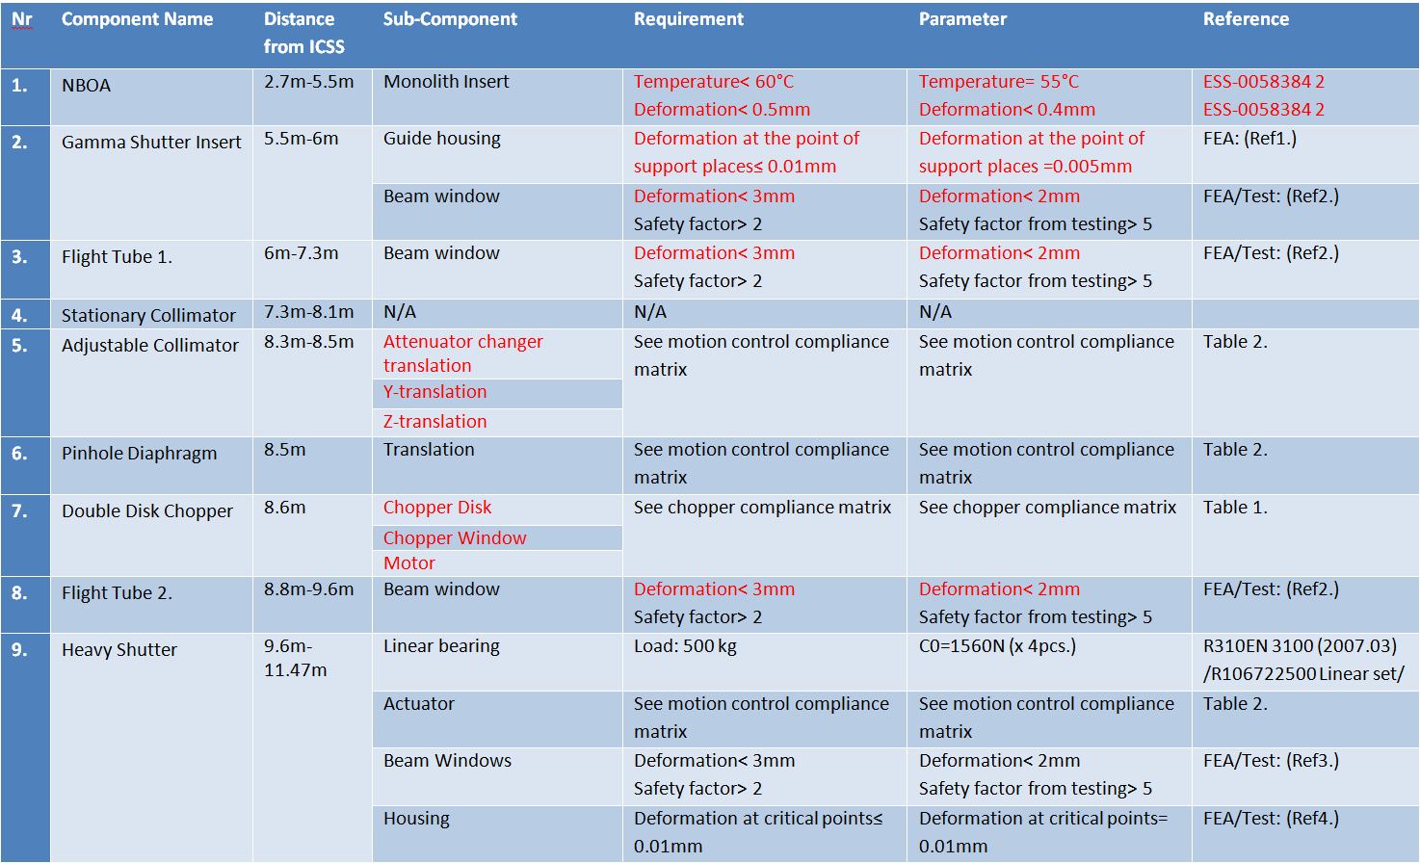
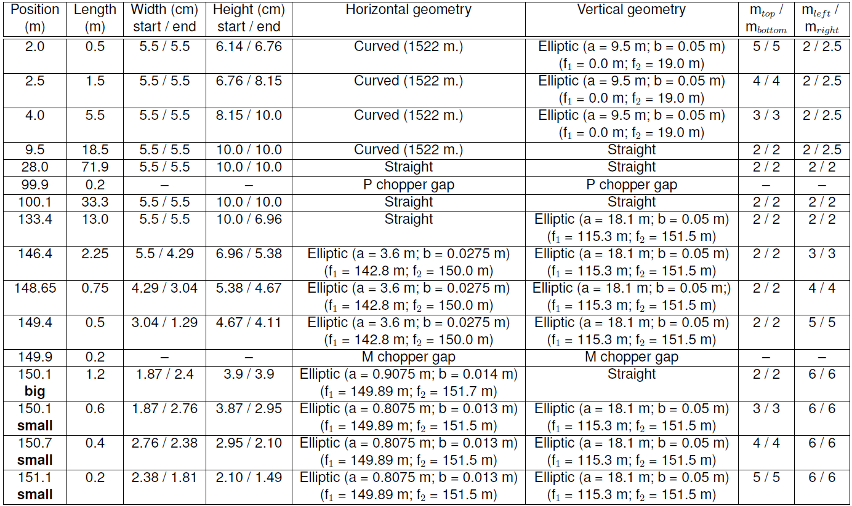
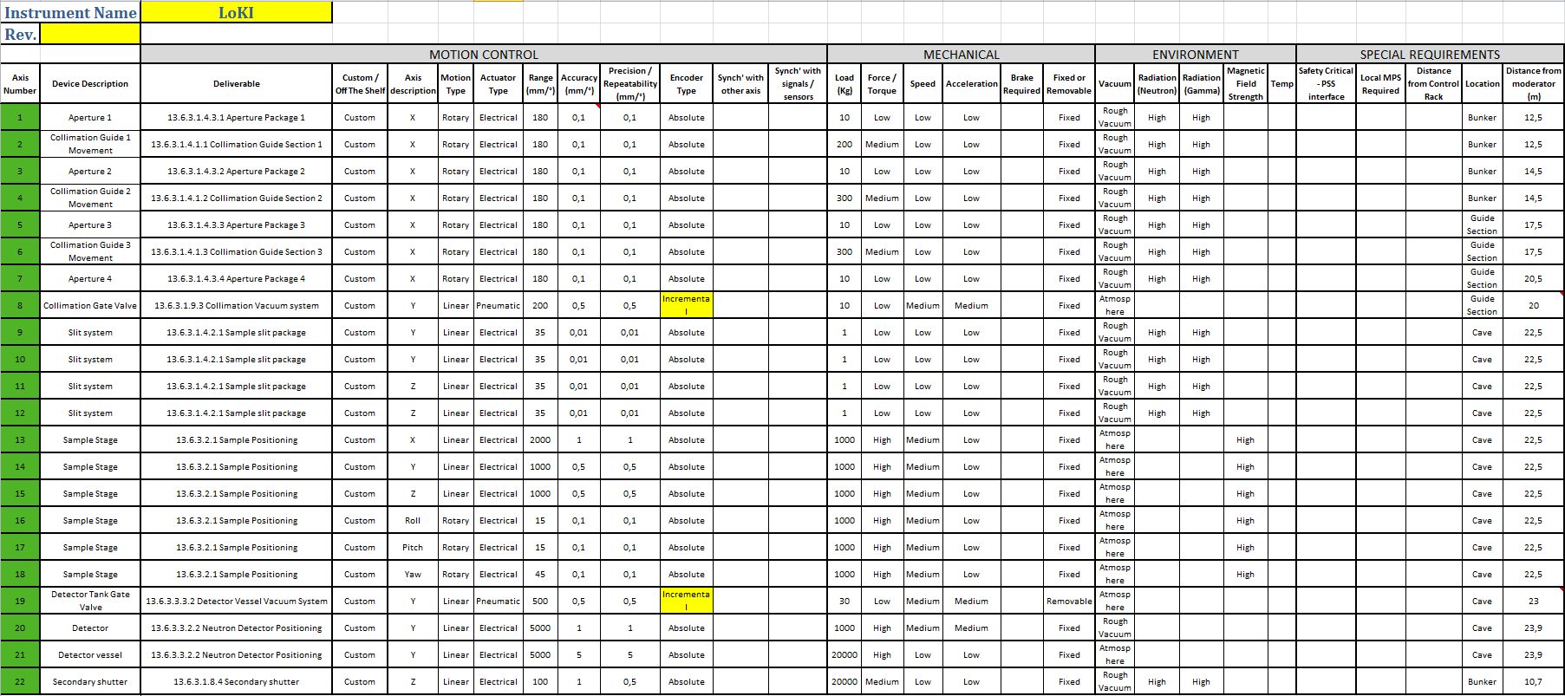
Sub-System Design Description (SSDD) 2.

Slide 31
Sub-System Design Description (SSDD) 2.
PSS Check-list
Design considerations, as applicable, to record the justification of the selection of a particular design solution in case there are several obvious alternatives. Selection criteria could be any combination of, but may not be limited to, the following aspects; maintenance, operations, remote handling, decommissioning, installation, cost-efficiency .
Integration Data:
  External interfaces of the instrument sub-system
  System- Sub-System internal interfaces
Sub-system 1.
This information can be written or visual (2D drawings, 3D model views etc. with dimensions) and/or reference to such.
Sub-system 2.

Slide 32

Final TG3/
System Documentation
This information can be written or visual (2D drawings, 3D model views etc. with dimensions) and/or reference to such.
System Design Description (SDD)
References to the SSDDs.
Integration data:
  External interfaces to the Instrument. Shall include infrastructural interfaces and visual information on allocated footprint for the Instrument and the utilised area within this footprint - thus verifying the geometry. This information shall display that the instrument is not interfering with the local environment, the requested free path is available and there are no logistic issues around it.
  System design for integration to Data acquisition and analysis systems
  Operational analysis of integration to Sample Environment Equipment and Laboratory Infrastructure and logistics

Slide 33
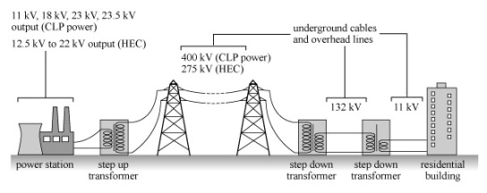

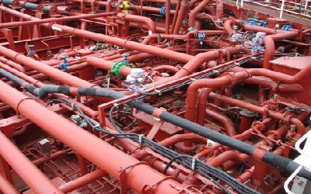
System Design Description (SDD)
Preliminary design for the following cross system sub-systems (utilities), with references to the requirements in the System Requirements Specification:
  /Only include in the SDD if not entirely covered in the sub-systems/
  Power distribution
  Control system
  Personnel Safety System, PSS
  Cooling and other fluid systems
  Vacuum and gas support systems
Certificate of Conformity for Hazardous Materials and Sustainability [ISS]; - Specify exceptions to the list stipulating what materials not to use. Could be a separate attachment.

Slide 34
System Documentation
      System Integration and Verification Plan
Describes the activities and resources (heavy equipment, special tools, staff etc.) required for installation, integration and verification of the technical requirements and the schedule for these. These activities shall be described in accordance to ESS-0115143, NSS project schedule guideline.
      System Validation Plan,
Preliminary plan for cold and hot commissioning
Defining content and depth of detail of all activities to validate the realized product against the high level scientific requirements (CONOPS).
      Draft of System Operations & Maintenance Manual
The document is to be started early in the design work and is intended to evolve throughout the phase and into the coming phases as the design gradually matures.

Slide 35
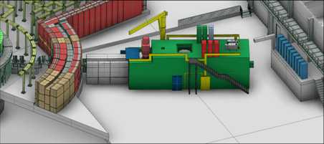
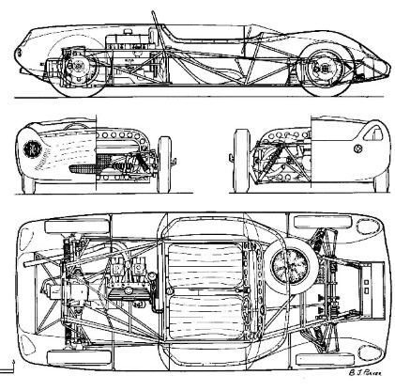
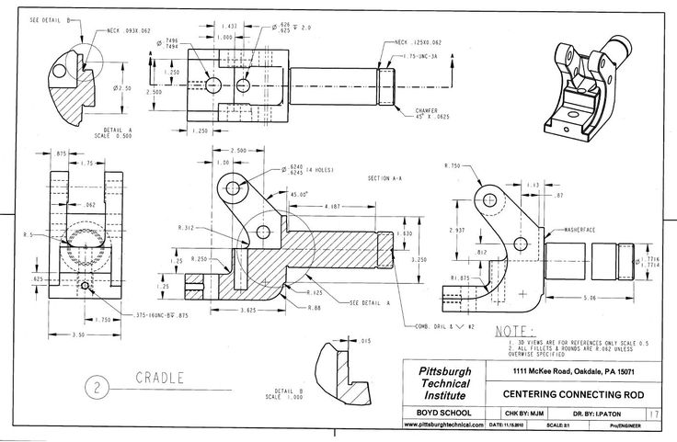
Detailed Technical Design
3D model
Detailed Drawing documentation

Slide 36
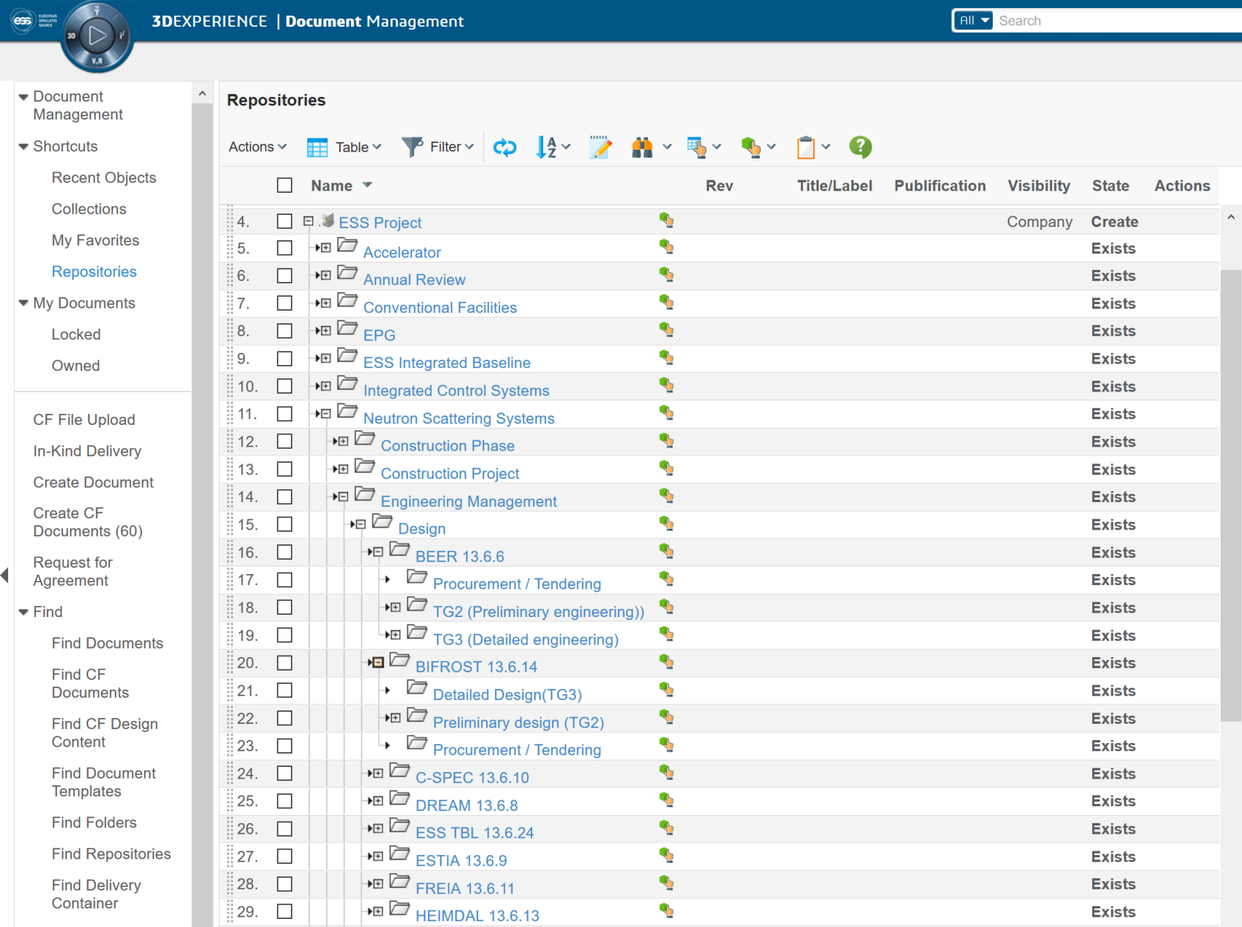
CHESS

Slide 37
Thank You!

Slide 38
Brief Explanation of ESS Activities
Phase 1
Definition of base parameters and requirements
Tendering
Phase 2: Outsourced Design
Manufacturing
Preliminary engineering, or design change
Detailed engineering
TG2
Design review by ESS technology group
Sub TG3
Procurement verification
Procurement verification (reply: 1 week)
Deliverables:
The technical part of tender
Schedule
Declaration of conformity with Appendix 1
ESS action:
Approval for Schedule and Resources
Comment the content (optional)
No personal meeting is necessary unless the NSS integration group recommends it.
Interim Review (if necessary)
Deliverables:
New technical information
ESS action:
Verification of Integration
Verification of change
Informal meeting. Either personal or via Vidyo/Skype
Sub TG3 (2 weeks)*
See below
Formal meeting with the involved ESS group(s)
/*: See ESS-0099059 for the detailed description of the deliverables/

Slide 39
Outsourced ESS Instrument Design Process of a Stage /Scenario 2
Phase 1
Definition of base parameters and requirements
Preliminary engineering, or design change
Tendering
Outsourced Design
Manufacturing
Detailed engineering
ESS - Instrument
action:
TG2
Procurement verification
Potential Checkpoint
Sub TG3
(Before CDR)
Design review by ESS technology group
Example: NMX Sample environment robots

Slide 40
Outsourced ESS Instrument Design Process of a Stage /Scenario 3
Phase 1
Definition of base
parameters and
requirements
Tendering
Outsourced Design
Manufacturing
Preliminary engineering
Detailed engineering
ESS - Instrument
action:
TG2
Sub TG3
Procurement verification
(Before CDR)
Example: NMX Chopper procurement

Slide 41
Outsourced ESS Instrument Design Process of a Stage /Scenario 1
Instrument -
Subcontractor activity:
Tendering /contracting
PDR
CDR
Phase 1
Definition of base parameters and requirements
Tendering
Phase 2: Outsourced Design
Manufacturing
Preliminary engineering, or design change
Detailed engineering
ESS - Instrument
action:
TG2
Design review by ESS technology group
Sub TG3
Procurement verification
(Before CDR)
Example: NMX Guide Procurement
/*: See ESS-0099059 for the detailed descriptions of the deliverables/

