Slide 1
European Spallation Source ERIC
Procurement
Mirko Menninga
Deputy Head of Supply, Procurement & Logistics Division
www.europeanspallationsource.se
4 December 2017

Slide 2
Opportunities for doing business with ESS
Skanska for civil construction
  Contract in place with Skanska for conventional facilities, Skanska conducting procurement for sub-contractors for materials and works
ESS Procurement for goods and services from ESS budget
  European Spallation Source ERIC follows ERIC public procurement rules
In-kind contributions (IKCs) from partner institutions in ESS member countries
  Opportunities through IKCs from partner institutes in member countries

Slide 3
Construction and Operation Budget Profile – Business opportunities during construction (near-term) and operations (long-term)

Slide 4
European Spallation Source ERIC Procurement Rules
ESS procurement governed by the European Spallation Source ERIC procurement rules (as of 1 October 2015, revision as of 1 April 2017)
Purpose
  To explain how ESS ERIC conducts procurement, providing transparency on tender procedures, rights and obligations of suppliers, including a review and appeal procedure
  Applies to all contracts for pecuniary interest for the provision of goods, works and services between ESS and a 3rd party [supplier]
Principles and objectives
  Following the EU treaty principles of:
    Transparency, proportionality, mutual recognition, equal treatment and non-discrimination
  Promoting the objectives of:
    Value for money, publicity, integrity, innovation, sustainability
Available at https://europeanspallationsource.se/procurement
4

Slide 5
European Spallation Source ERIC Procurement Rules – Overview of Procurement Procedures*
*Minimum procedure applicable by value
**Minimum timing does not include time required for preparation and evaluation**

Slide 6
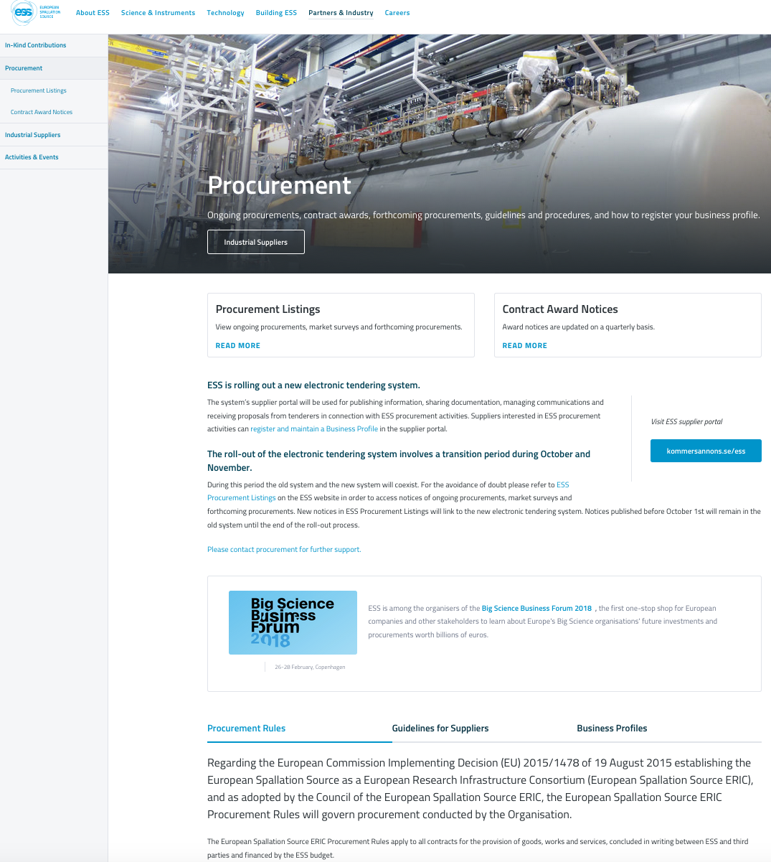
ESS procurement information
ESS Website
(http://europeanspallationsource.se/procurement)
Procurement Listings
Contract Notices >50,000 EUR
Market Surveys / Requests for Information
Forthcoming Procurement
Indicative information published to give greater visibility to industry on ESS’ procurement plans.
Contract Award Notices
For procurements published on the website, published by month of contract signature, updated quarterly
Guidelines for Suppliers on ESS procurement
Official Journal of the European Union
May be used for contract notices >200,000 EUR
Pre-Commercial Procurements and/or Public Procurement of Innovation
Industrial Liaison Offices (ILOs)
Via weekly email and notifications of new call for tenders

Slide 7
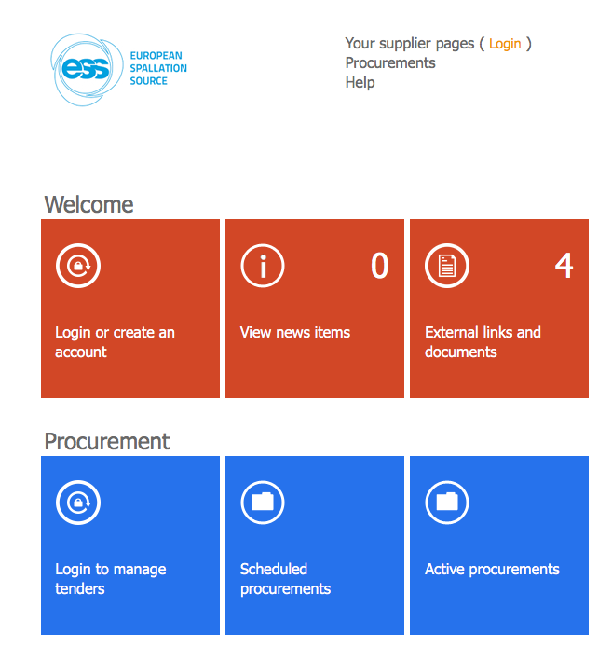
E-Procurement Tool
Rolled-out 1 October 2017
Used for publishing information, sharing documentation, managing communications and receiving proposals
Interested suppliers can register and maintain a business profile in the tool and configure notifications for new tenders

Slide 8
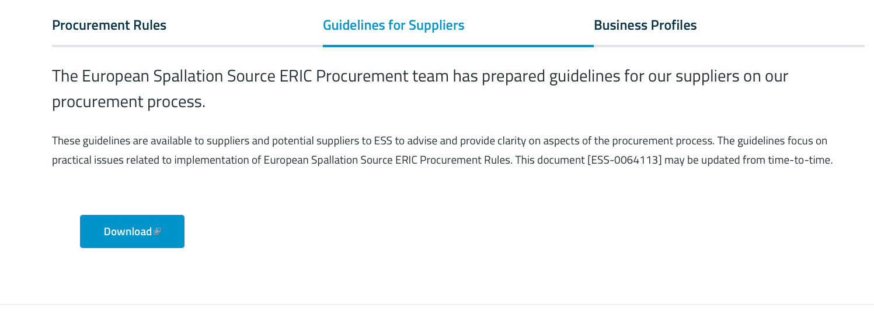
Guidelines for Suppliers
https://europeanspallationsource.se/procurement#guidelines-suppliers

Slide 9
Guideline for Communicating with Current and/or Potential Suppliers (ESS-0064128)
Responsibility of all staff to treat suppliers fairly, transparently and with the highest standards of business ethics
Defines when, how and what information can be communicated with suppliers
  For example:
    Presentation of ESS for companies – ok, but recommended participation of procurement
    Cannot share information that would give one supplier a competitive advantage over another, based on professional judgement
    Solicitation of indicative pricing / technical information – formal involvement of procurement
    Communication during the course of contracts management – ok, but ensuring non-disclosure of information regarding future procurements
    Communication during a procurement process (including preparation of specifications) controlled. Formal involvement of procurement
    No communication with a supplier when the procurement process is open
Applies to all staff and third parties (consultants) working on behalf of ESS
  It is the responsibility of the ESS staff member engaging the third party to ensure they are aware and follow these guidelines.
Reviewed and Approved by the Strategic Procurement Board

Slide 10
Submitting tenders - 1
It is important to follow the instructions in the e-tendering tool and the tender documents!
1st step: Register in e-tendering tool
Make sure to submit in time as stipulated
Make sure to follow form requirements, correct files and file types uploaded in the right areas
Follow requirements for Exclusion, Selection and Award Criteria

Slide 11
Framework Agreement process
Mini competitions for assignments >1000 hours = request to companies in respective Lot
Request to one company for assignment <=1000 hours
ESS aim to balance between FWA holders

Slide 12
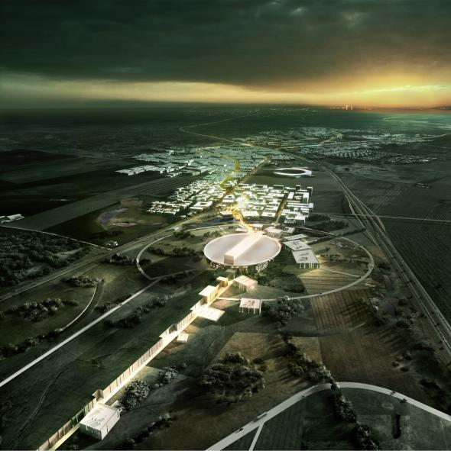
Thank you for your attention

