Slide 1
Integration services framework
Integrated Control Systems
Henrik Carling
ESS/ICS
Date: 2017-12-04

Slide 2
Agenda
Integration services framework
08:30 - 09:00 Registration
09:00 - 09:15 Introduction to ESS [Roland Garoby]
09:15 - 09:30 Round table introduction
09:30 - 10:10 Introduction to ICS [Henrik Carling]
10:10 - 10:25 Coffee
10:25 - 10:45 Procurement at ESS [Mirko Menninga]
10:45 - 11:15 ICS use case #1 [Stuart Birch]
11:15 - 12:00 ICS use case #2 [Hector Novella]
12:00 - 13:00 Lunch
13:00 - 13:15 Panoramic view of the ESS construction site
13:15 - 15:30 Open session
Internet: SSID ”ESS Guestnetwork”

Slide 3
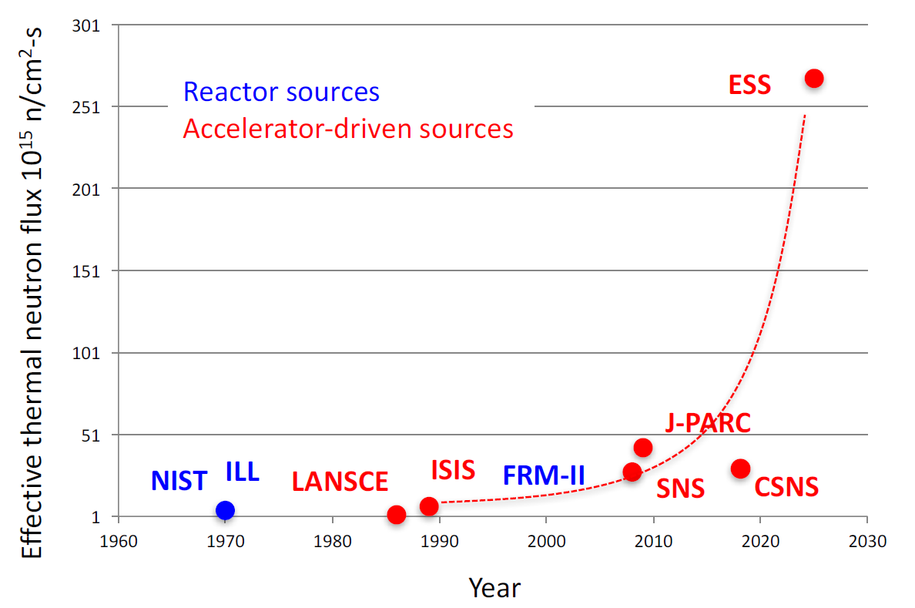
ESS Mission: be the world brightest neutron source

Slide 4
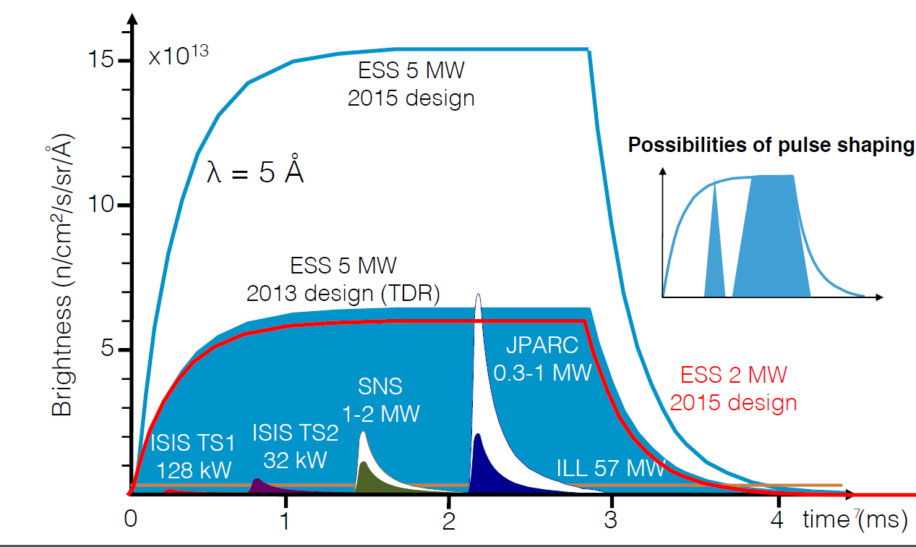
ESS long pulse compared to other sources

Slide 5
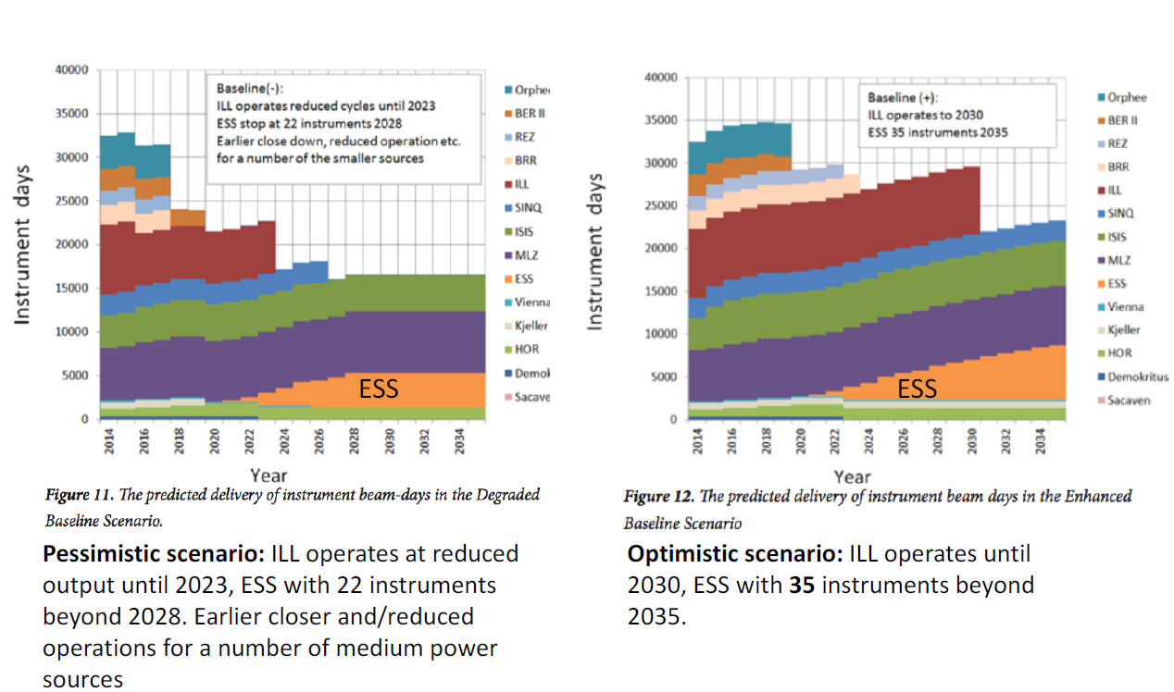
ESS in the European context (cf. ESFRI)

Slide 6
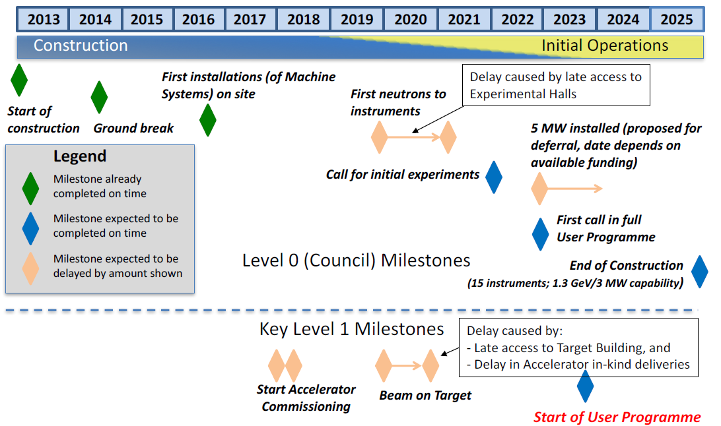
Updated schedule (2017-10)

Slide 7
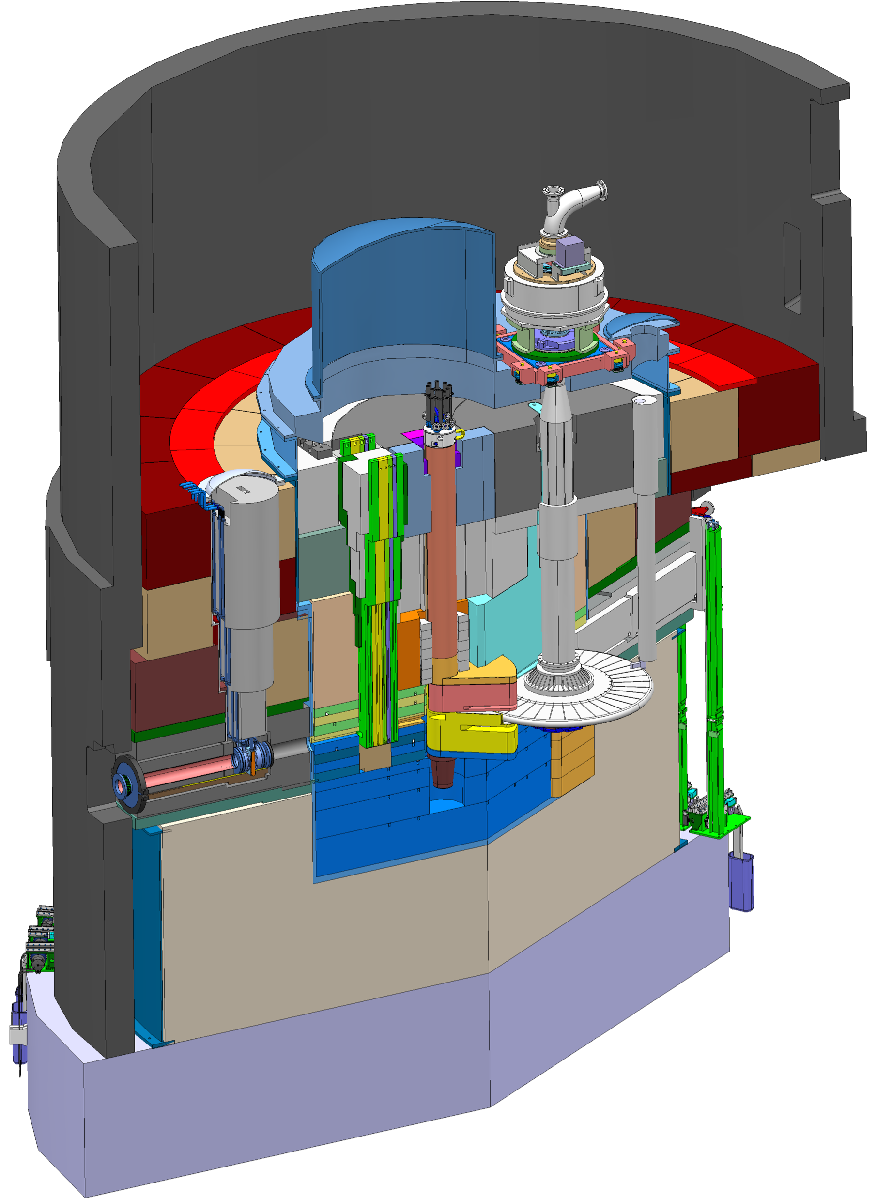
Key features of the ESS Target Station
Moderator and reflector
Target Safety System
Monitors target coolant flow, pressure and temperature, monolith pressure,
& target wheel rotation
Prohibit beam on target if parameters are outside specified limits
proton beam instrumentation plug
Helium cooling of target material
Mass flow 3 kg/s
Pressure 11 bar
Temperature inlet/outlet 40 °C/240 °C
monolith vessel
neutron beam extraction port
Rotating solid tungsten target
36 sectors
Mass, total 11 tonnes, whereof 3 tonnes of W
Rotates 23.3 rpm, synchronized with pulsed proton beam 14 Hz
proton
beam
target wheel
target monitoring plug
proton
beam window
Diagnostics and instrumentation
Controlled and integrated commissioning and operation of the accelerator and target
Fluorescent coating of PBW and target front face
Optical paths, grid profile monitor, aperture monitor
Wheel monitoring including position, temperature, vibration, as well as internal structure
Moderators
Provisional locations of moderators above and beneath the target wheel, i.e. monolith centre
1st MR plug exploits the upper space, offering:
  Cold, 30 mm high, liquid H₂ moderators, 17 K
  Thermal, 30 mm high, H₂O moderator, 300 K

Slide 8
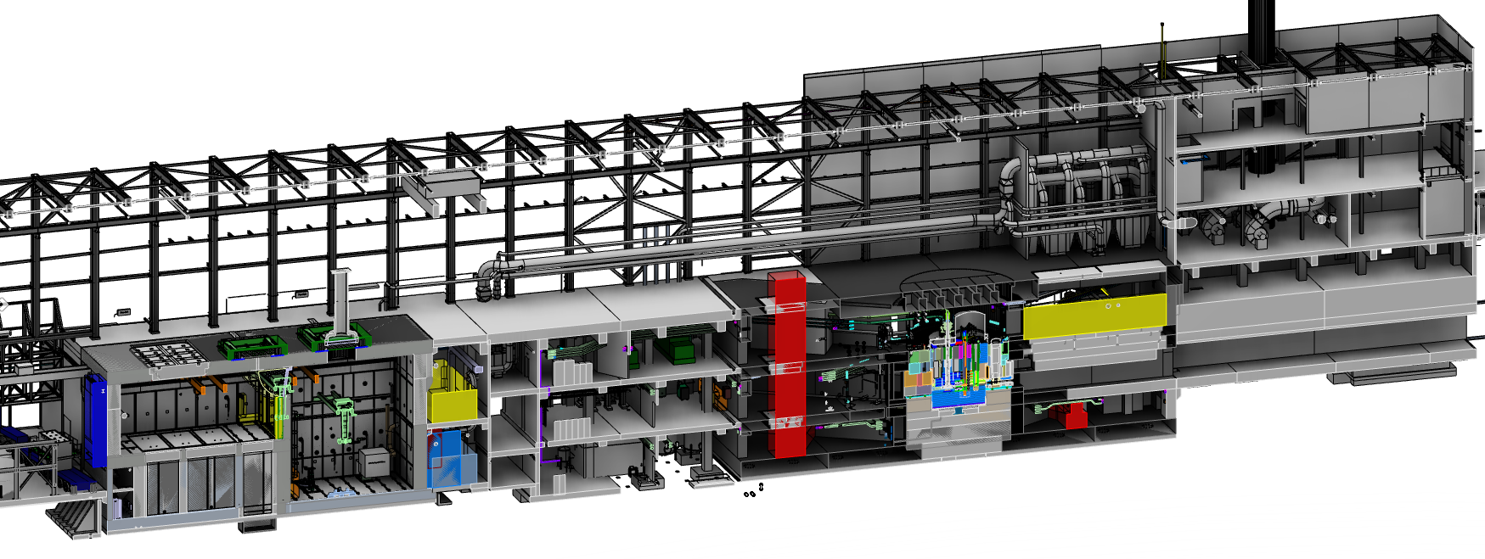
Key features of the ESS Target Building
Utilities and cooling plant
Helium cooling of target wheel
Water cooling of moderators, plugs and shielding
Intermediate water loops between primary circuits and conventional facility utilities
Helium cryoplant for refrigeration of cold moderator system
Nuclear grade HVAC system
Remote handling systems
Large active cells for safe storage and processing of spent radioactive target components
Shielded casks for transfer of spent components from monolith to active cells
High bay
22 m
130 m
Transport hall
37 m
Target
monolith
Active cells
Utilities block
Beam expander hall

Slide 9

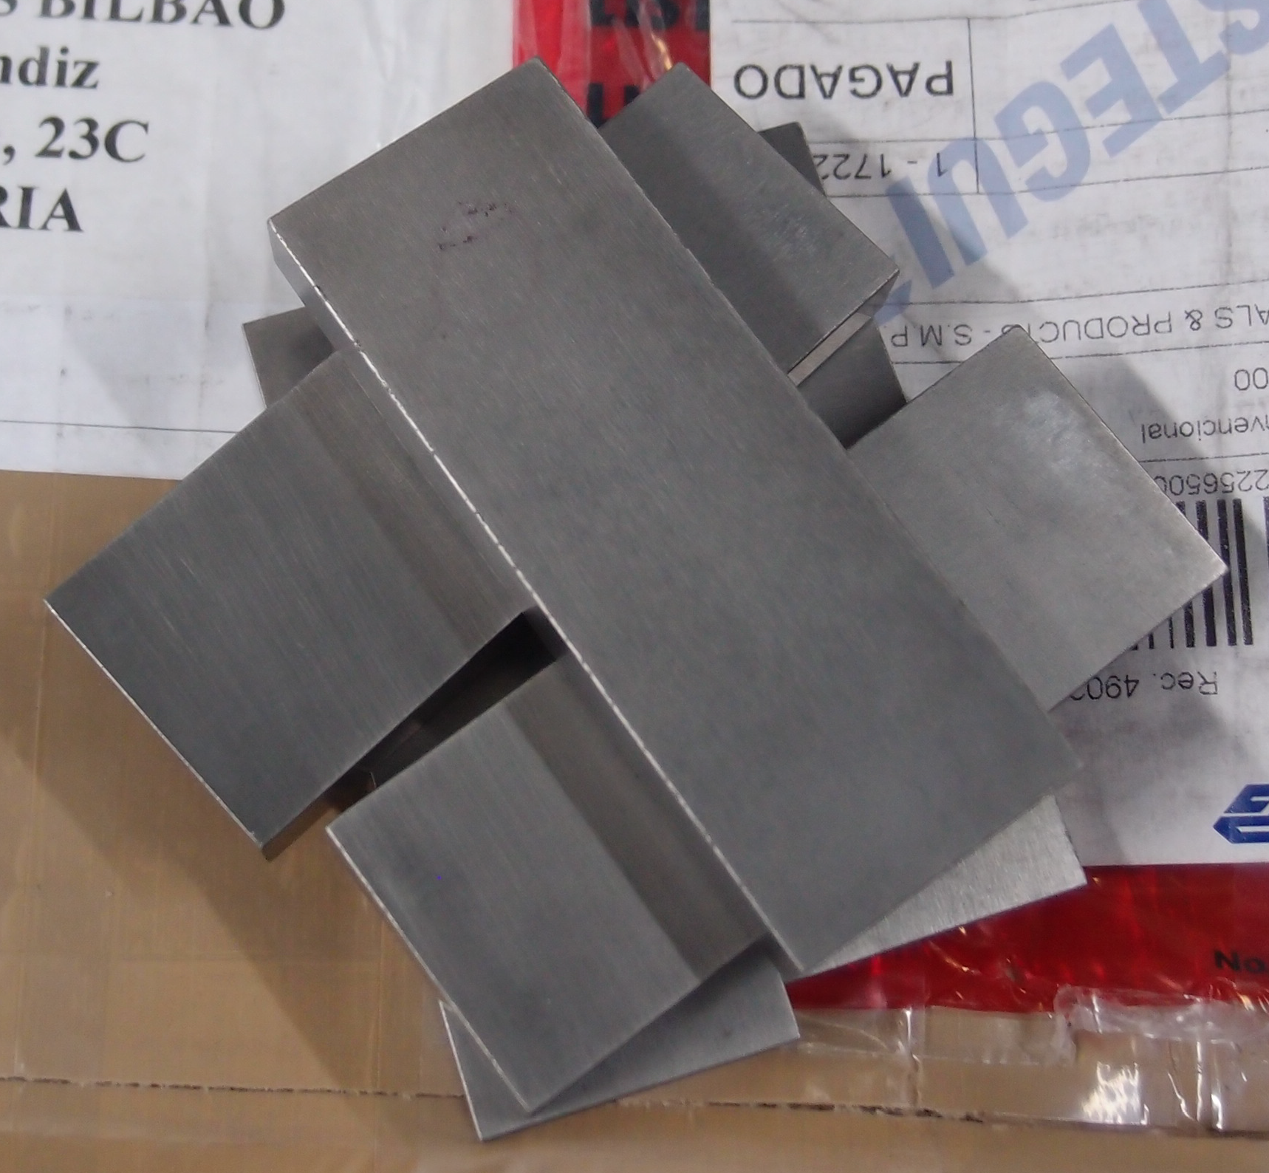
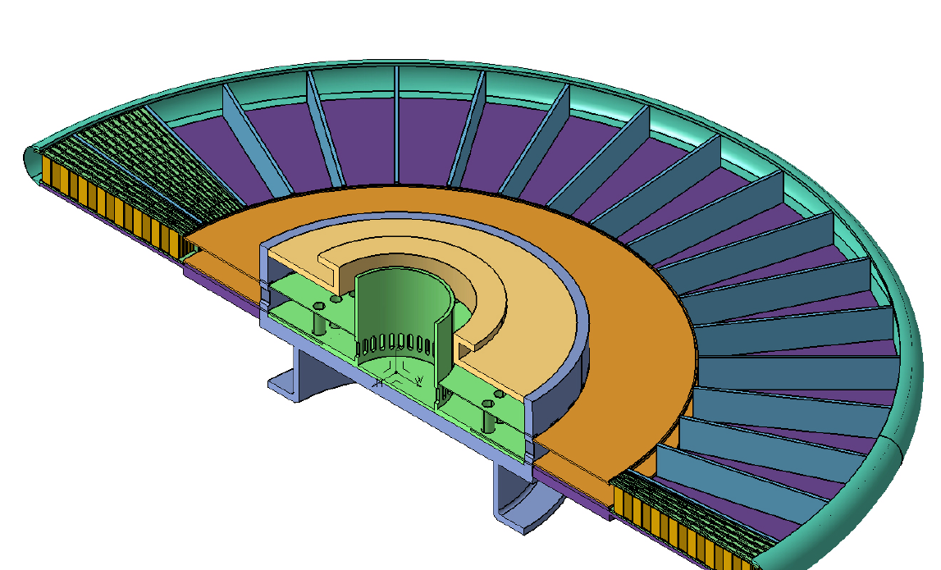
Each 10° sector is loaded with a tungsten-filled cassette
proton
beam
48 cm
Tungsten bricks
Tungsten depth in
the proton beam direction is 45 cm
The range of a 2-GeV proton in tungsten is 74 cm
Brick dimensions: 10 W x 30 D x 80 H mm³
190 bricks per sector, 6840 bricks in total
Helium flows
  radially outward above and below the cassette,
  reverses direction at the wheel rim,
  and returns through the tungsten
Cassette

Slide 10
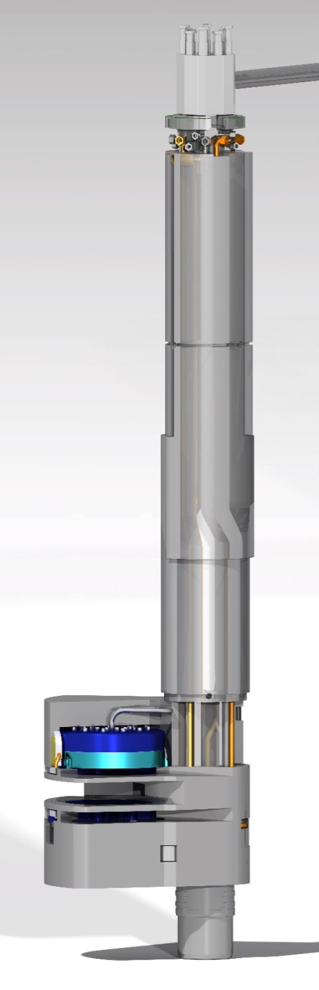
Main functions and design of the ESS
Moderator and Reflector Systems
Moderate neutrons to low energies, thermal and cold, useful for the neutron scattering
Cooling the radiation heat in liquids and solid metal bodies

Slide 11
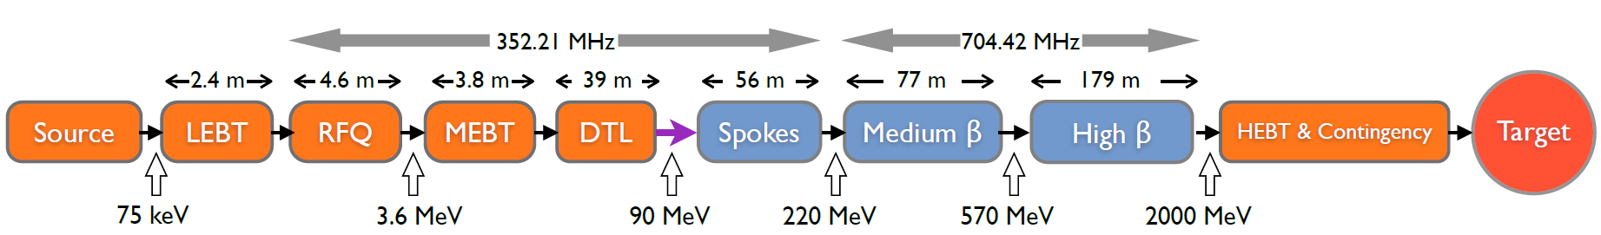
The Accelerator
The ESS linac will be the most powerful proton linac ever built:
  Average beam power of up to 5 MW (ultimate)
  Peak beam power of up to 125 MW (ultimate)
  Acceleration up to 2 GeV (ultimate)
  Peak proton beam current of 62.5 mA
  Pulse length of 2.86 ms at a rate of 14 Hz (4% duty factor)
96% of acceleration will be provided by superconducting cavities supplied by dedicated high power RF sources (one per cavity):
  Scenarios 1 and 3: 1.3 GeV with 11 High β cryomodules (44 x 1.5 MW klystrons)
  Scenario 2: 2 GeV with 21 High β cryomodules (84 x 1.5 MW klystrons)
Constraints:
    Low losses
    Minimimum energy use & energy recovery
    Flexibility for
    mitigation or upgrade

Slide 12
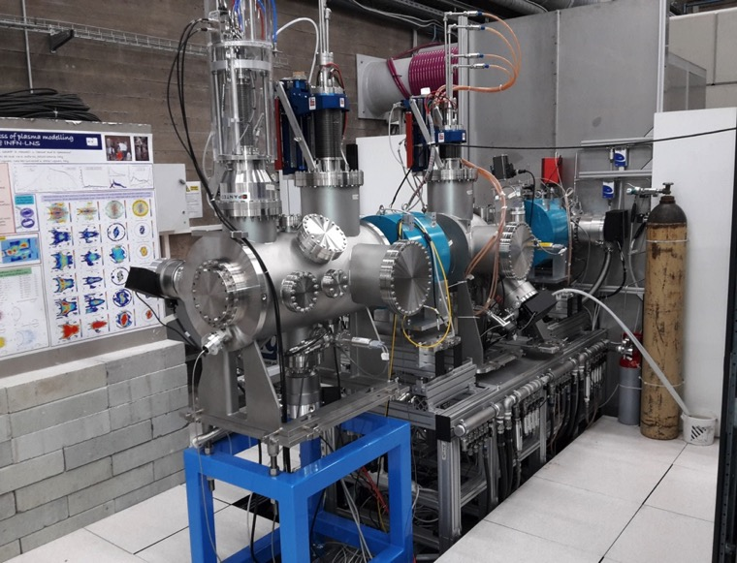
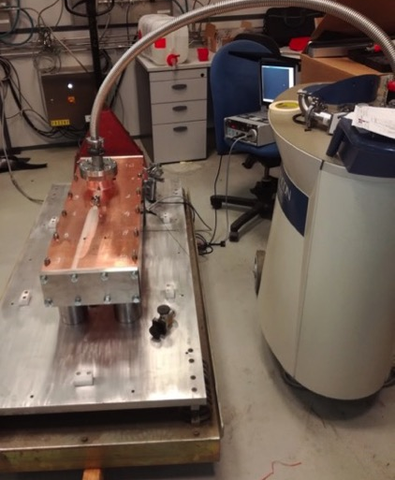
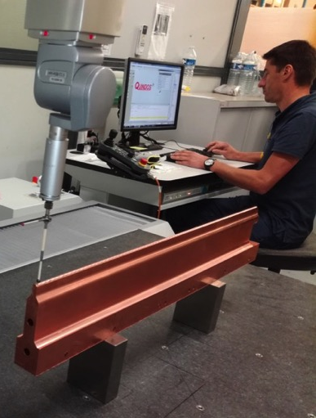
Equipment construction is progressing at in-kind partners (1/6)
Ion source and LEBT (INFN-Catania)
Nominal performance achieved in INFN-Catania.
Successful Installation Readiness Review on September 15
On track to start installation in Tunnel in January 2018.
RFQ (CEA- Saclay):
drilling and brazing mock-ups finished.
Tuner kick-off meeting done on 4th of July.
Couplers and test cavity pick-up received (31/07/2017).
Test cavity control command rack tested and validated.
Machining mock-up vane 3D measurements
Brazing mock-up leak tests

Slide 13
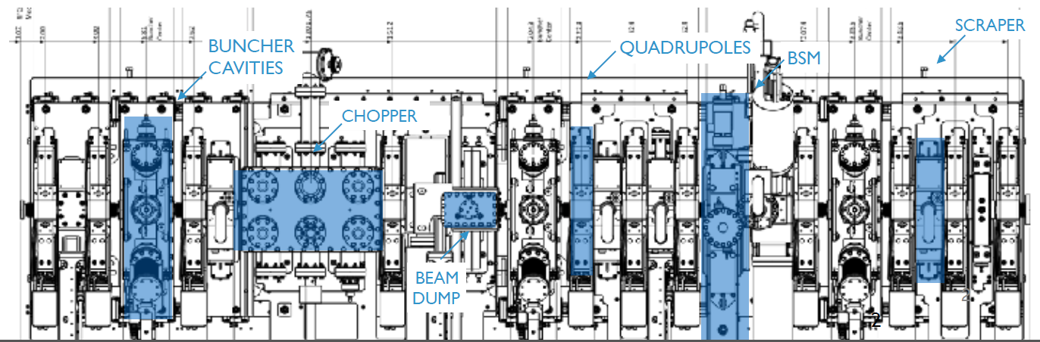
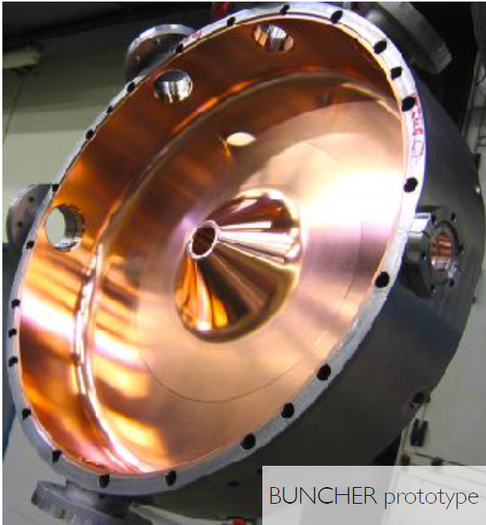
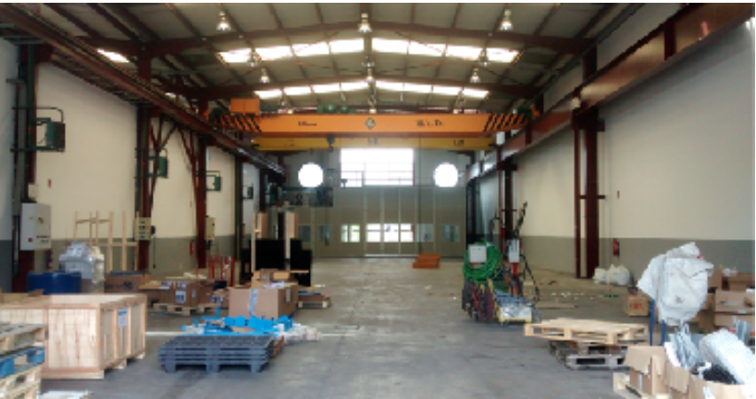
Equipment construction is progressing at in-kind partners (2/6)
MEBT (ESS-Bilbao):
3 buncher cavities,
11 quadrupoles
Scraper
Chopper
Beam instrumentation
MEBT assembly hall
Buncher prototype

Slide 14
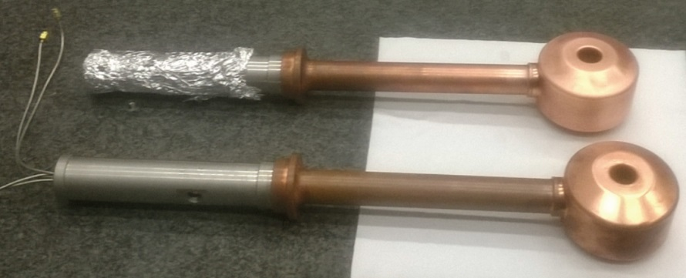
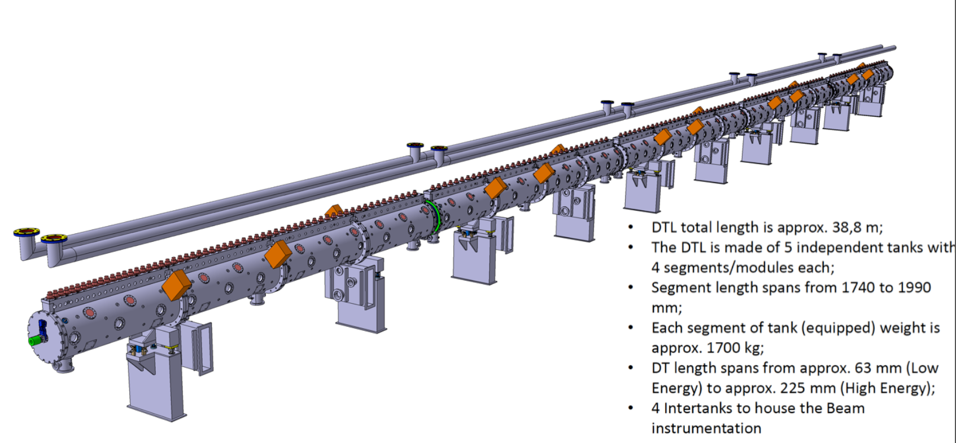
Equipment construction is progressing at in-kind partners (3/6)
DTL (INFN-Legnaro):
Prototype Drift Tubes

Slide 15
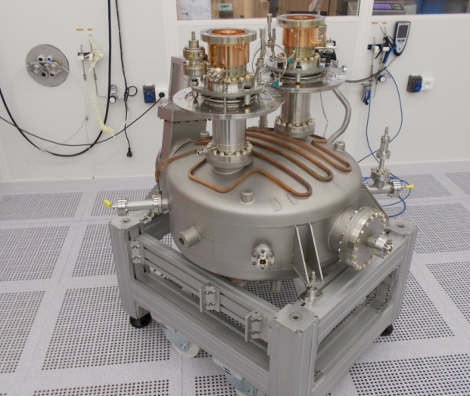
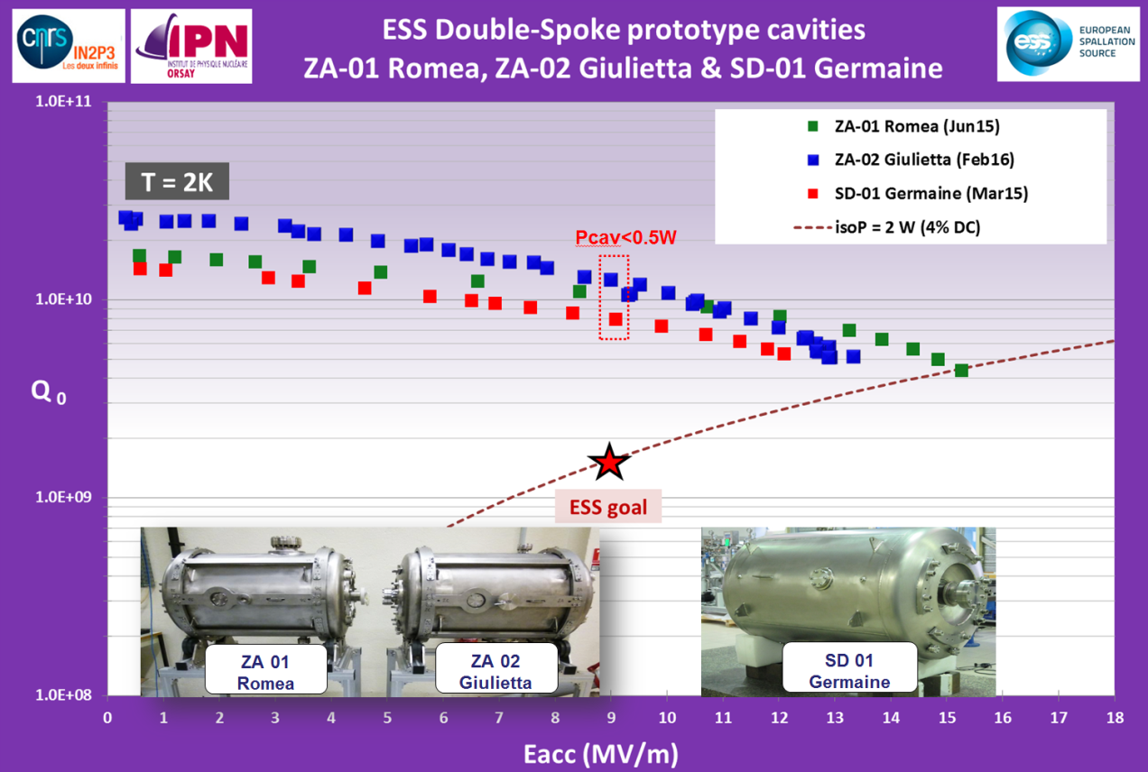
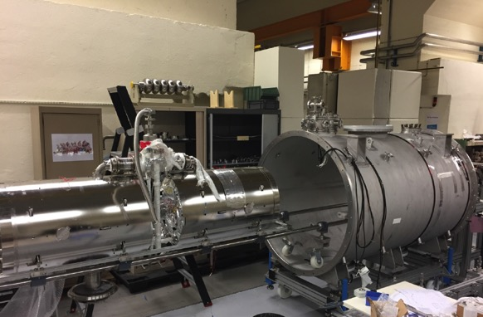
Equipment construction is progressing at in-kind partners (4/6)
Spoke cavities and cryomodules (CNRS-Orsay)
The 3 prototype cavities largely exceeded specs.
RF couplers on test box
Prototype cryomodule assembly

Slide 16
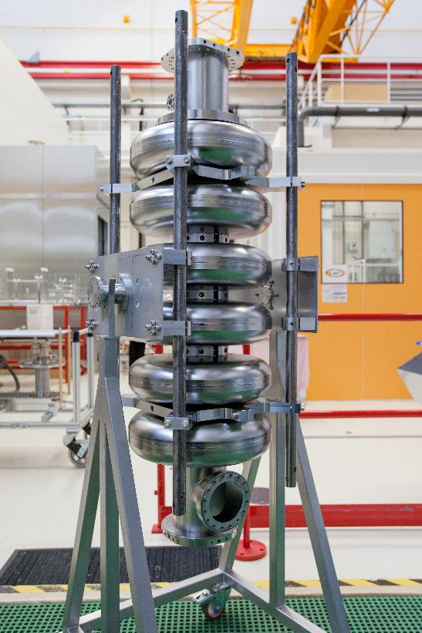
Equipment construction is progressing at in-kind partners (5/6)
Medium β elliptical cavities (CEA-Saclay and INFN-Milano)

Slide 17
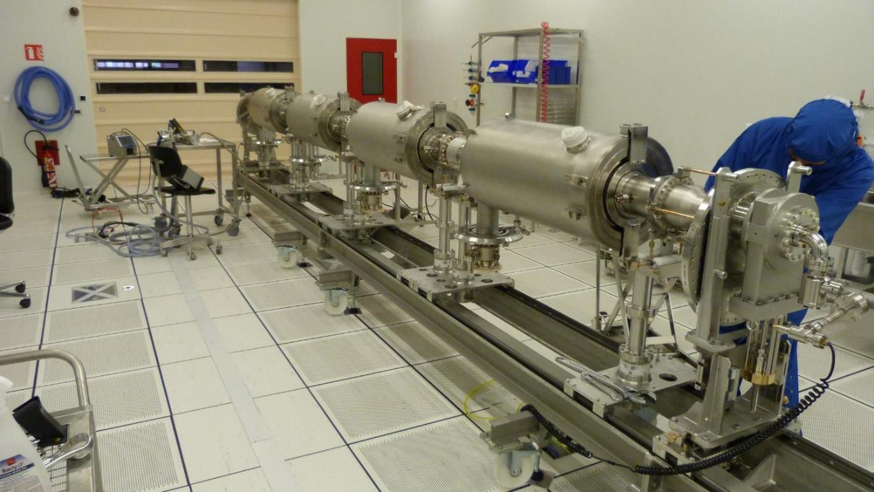
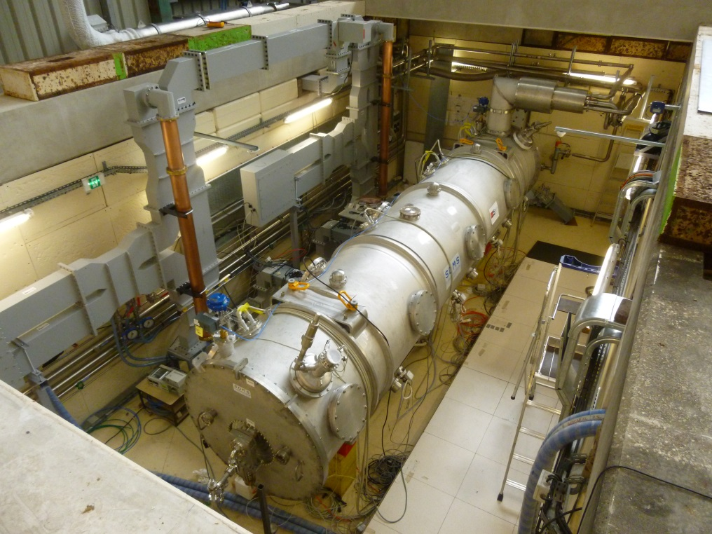
Equipment construction is progressing at in-kind partners (6/6)
Elliptical cavities cryomodule (CEA-Saclay)
Cavity string assembly
Prototype cryomodule with 4 medium β , 6 cell elliptical superconducting cavities in CEA (Saclay) test place – Sept. 2017

Slide 18



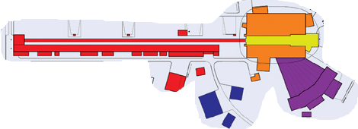


ESS Integrated Control System
Red: Accelerator + Cryogenics zone
Yellow: Target zone
Orange/Violet: 1 zone/instrument
Blue: CF zone
PVGW: EPICS Process Value Gateway
CA Network: Channel Access (EPICS protocol)
ESS Network
~ 1.5 10⁶ control points!
DMZ
PVGW
PVGW
PVGW
PVGW
PVGW
PVGW
PVGW
PVGW
PVGW
PVGW
Core Network
CA network
CA network
CA network
CA network
CA network
CA network
CA network
CA network
CA network
Main Control Room

Slide 19


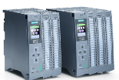
ICS hardware strategy
Three layer strategy based on signal speed:
Custom made platform based on μTCA for applications with data acquisition exceeding 100 kHz. The CPU will run EPICS and the FPGA will have a complete application development environment
For slower signals, EtherCAT will be used as a real-time fieldbus with good price/performance ratio.
Synchronization and event information are key for applications where a full custom platform solution would be too costly.
For low speed signals, commercially available PLC systems from Siemens will be used. - Cost-effective solution addressing ESS reliability and maintainability requirements.
PLCs will be connected to EPICS for further integration into the control system.
Signal speed
~460
10 MHz
1 MHz
Electronic front-end platform
100 kHz
10 kHz
1 kHz
100 Hz
EtherCAT
10 Hz
~290
1 Hz
Industrial automation (PLC)
0.1 Hz

Slide 20

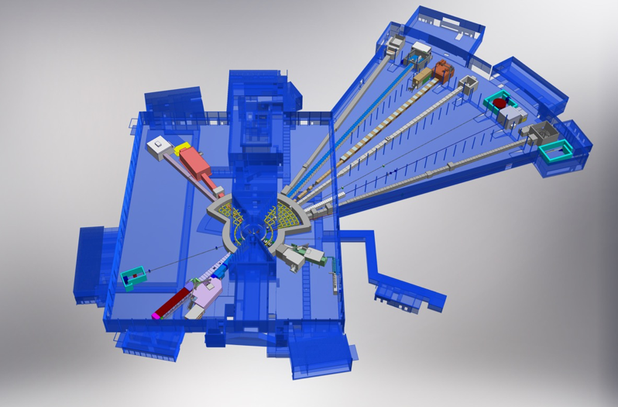











First 15 Neutron Science Instruments
ESS Lead Partners for Instrument Construction
+
Nuclear Physics Institute
Monolith
BEER
NMX
+
C-SPEC
BIFROST
MIRACLES
MAGIC
ODIN
T-REX
DREAM
HEIMDAL
ESS In-Kind Partners also collaborate on sample environment, data management systems etc.
LoKI
VESPA
FREIA
SKADI
ESTIA
+
20
ESS Instrument Layout (December 2016)

Slide 21
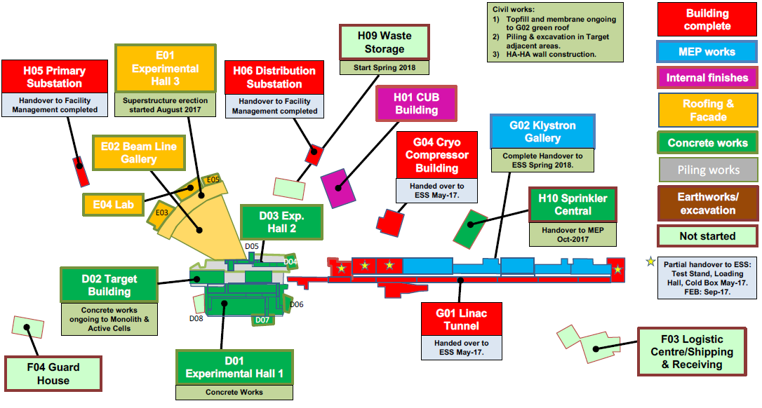
Civil construction status

Slide 22
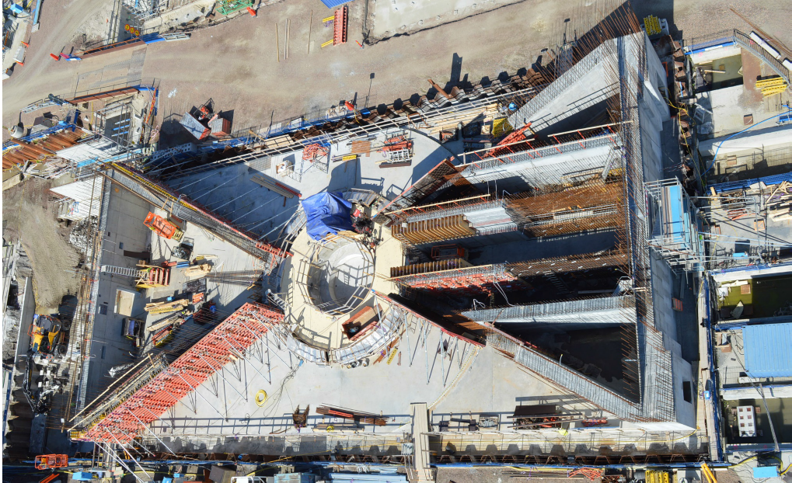
Monolith (August 2017)

Slide 23
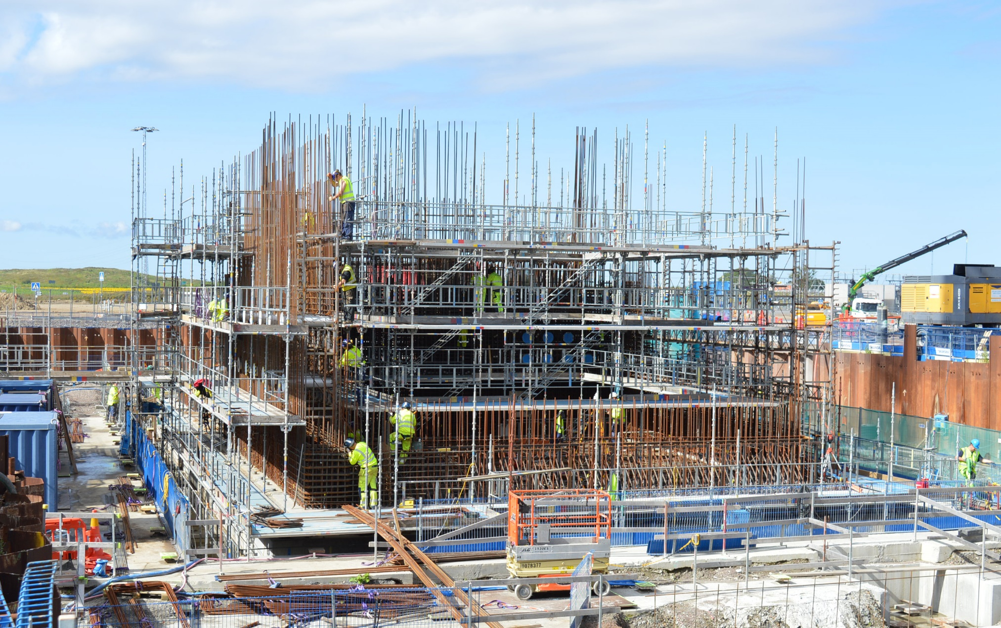
Active Cells

Slide 24
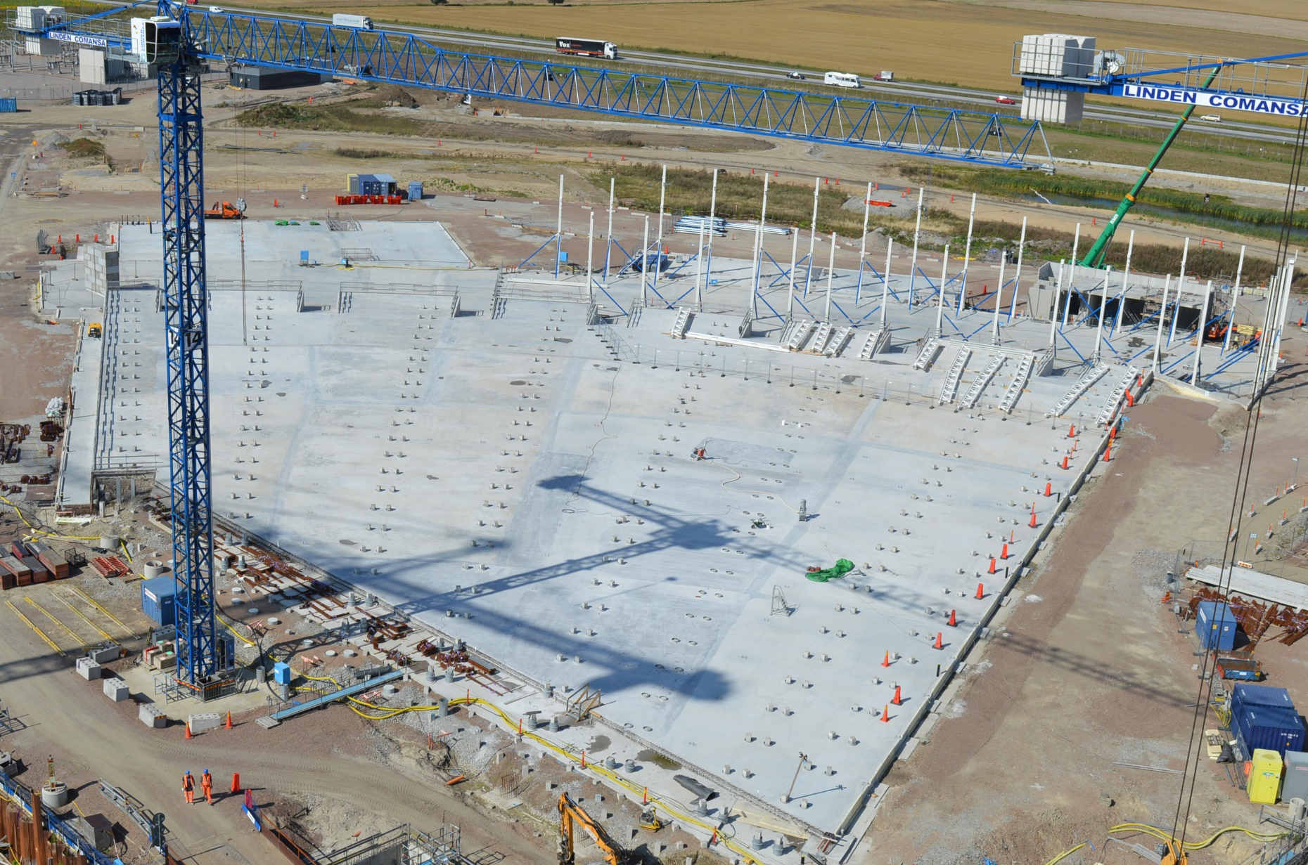
E Buildings (August 2017)

Slide 25
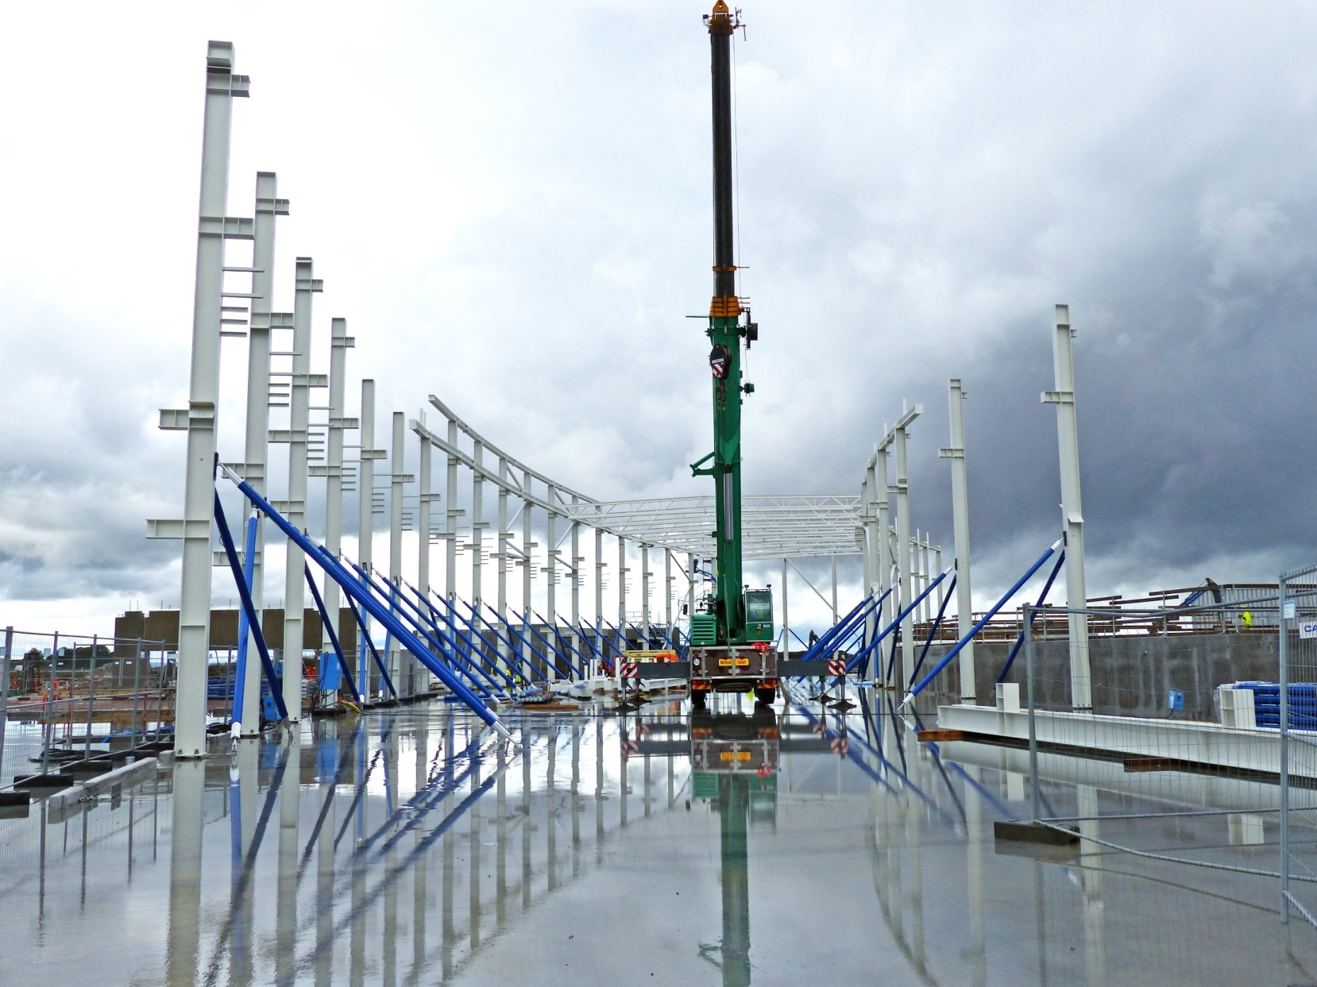
E01 Superstructure (September 2017)

Slide 26
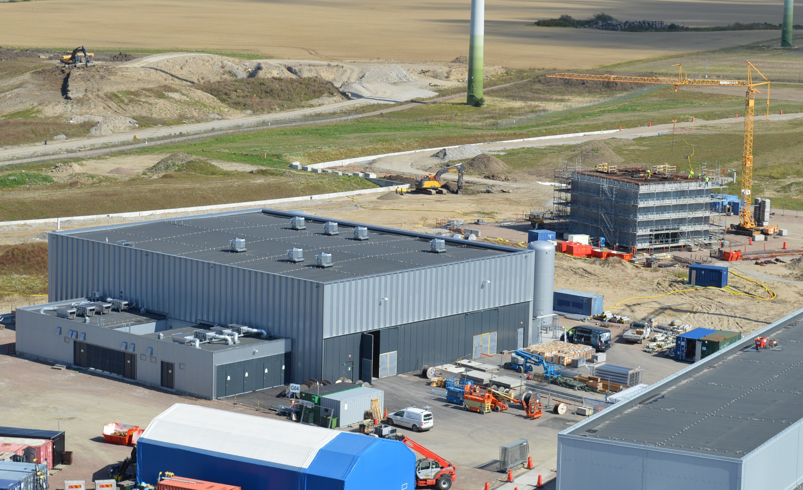
Cryo and Sprinkler Buildings
H10
G04
H01
G02

Slide 27
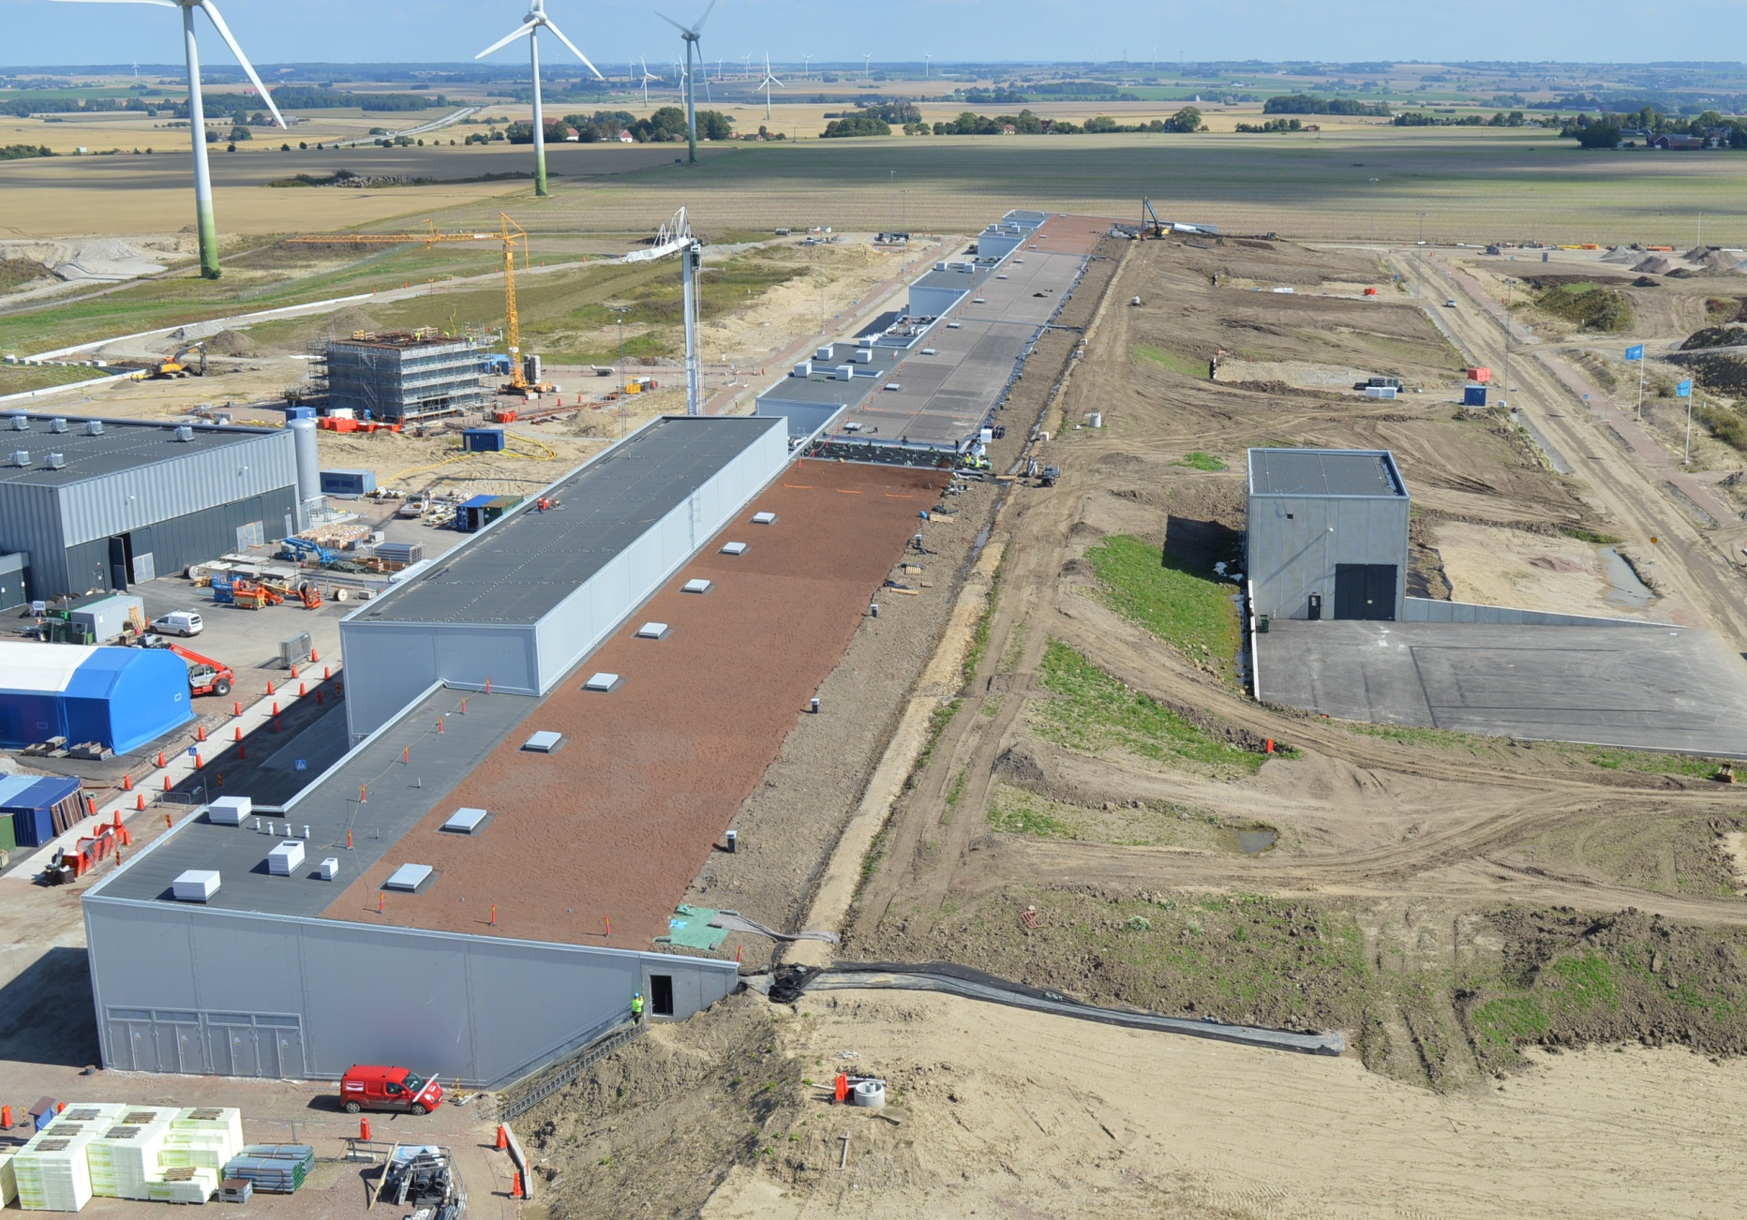
Accelerator & Klystron Gallery

Slide 28
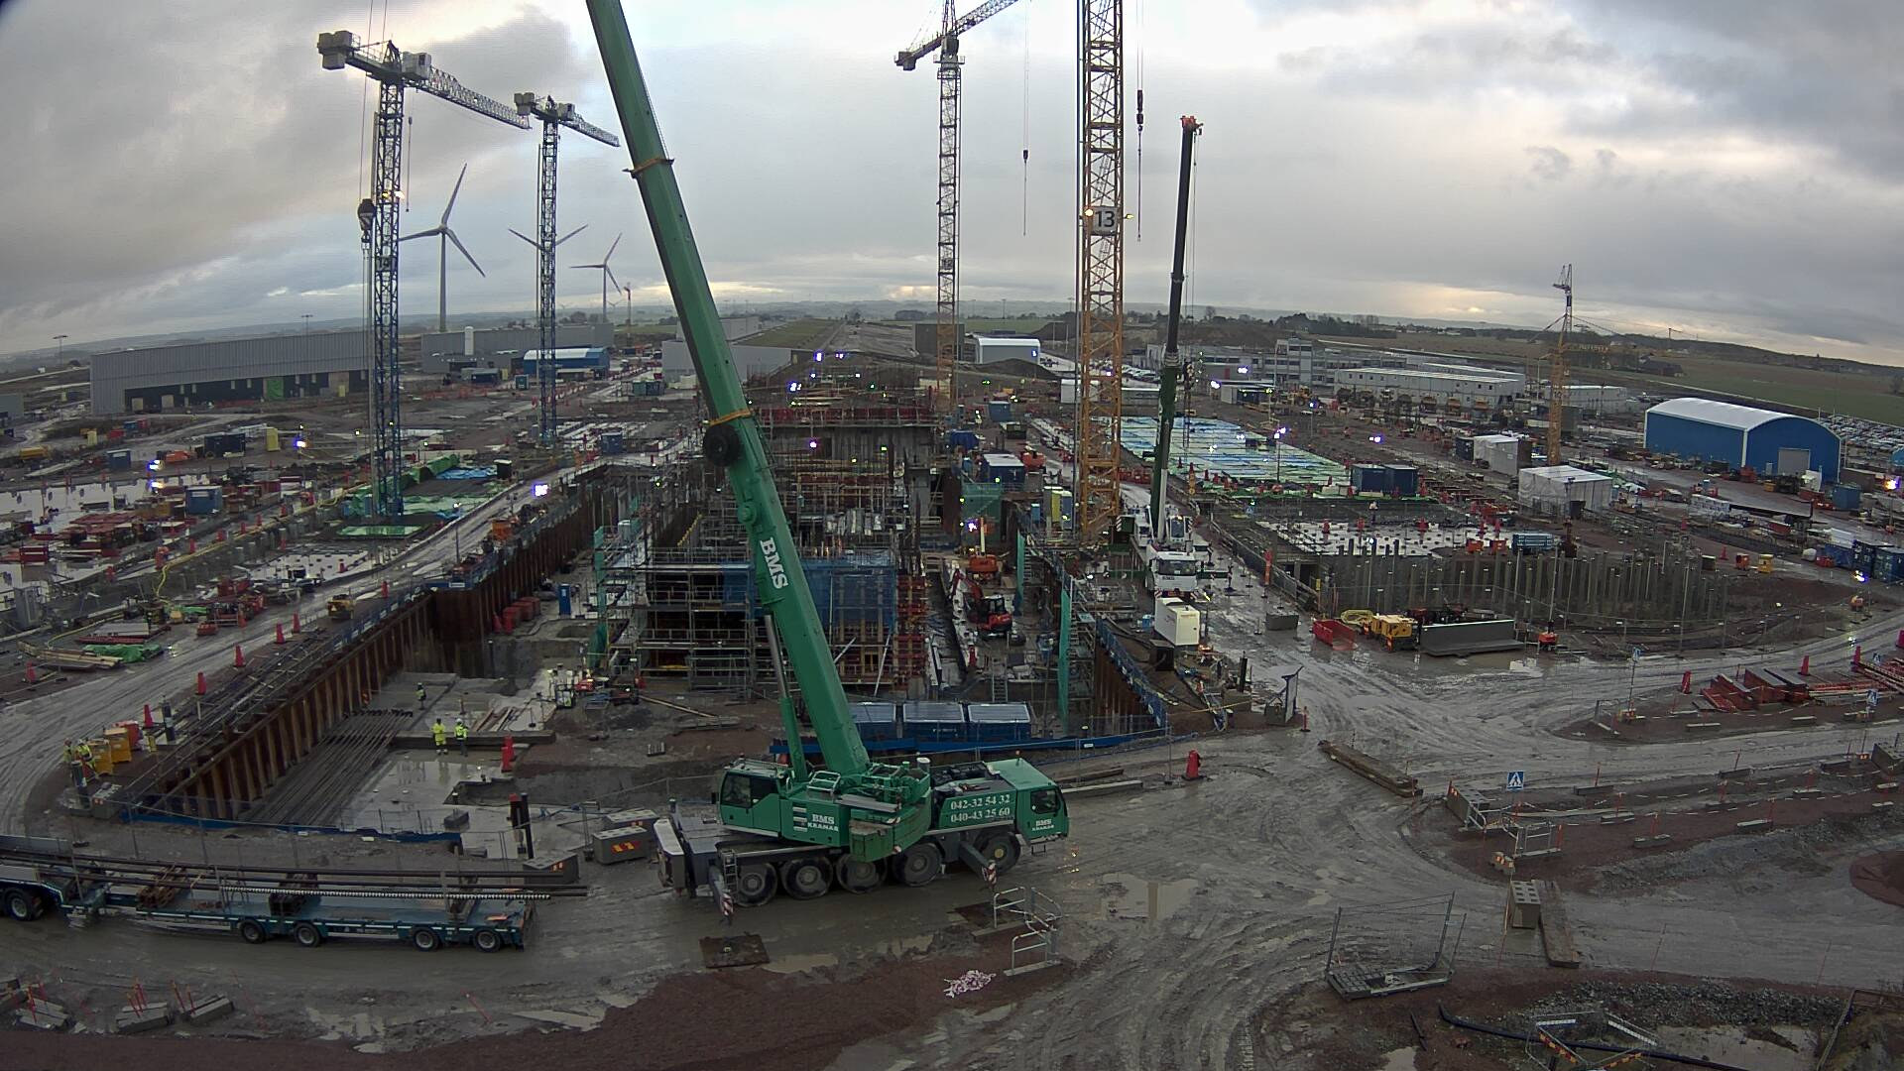
Picture of the construction site 2017-11-29

Slide 29
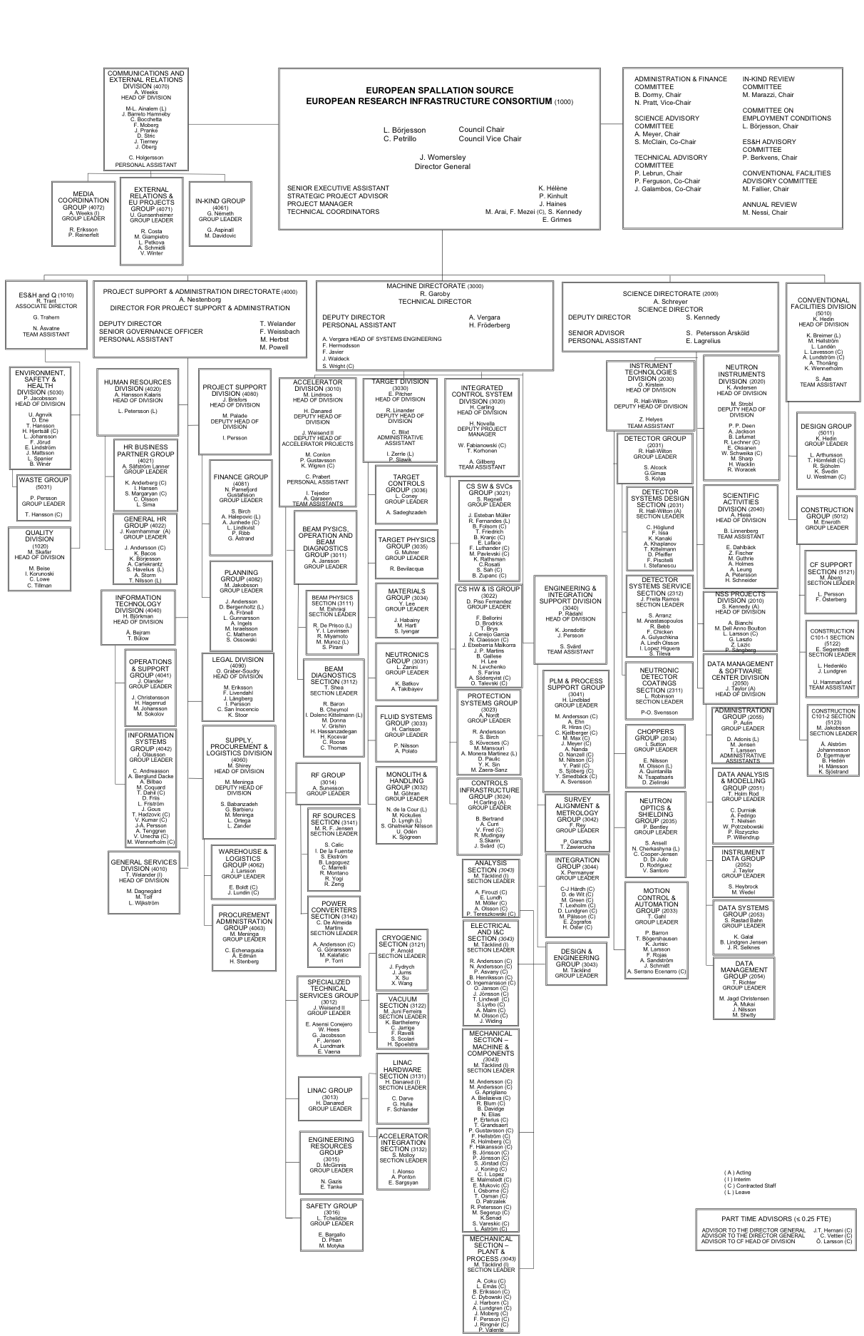


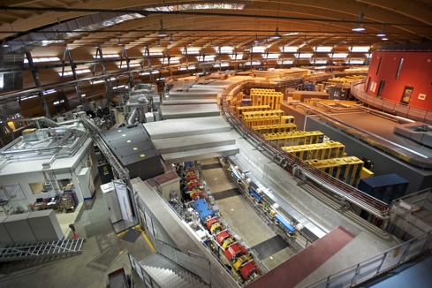
Organisation and People
426
Employees
50
Nationalities
> 45
Collaborating Institutions

Slide 30
Integrated Control Systems
Henrik Carling
Head of ICS division
www.europeanspallationsource.se
2017-11

Slide 31
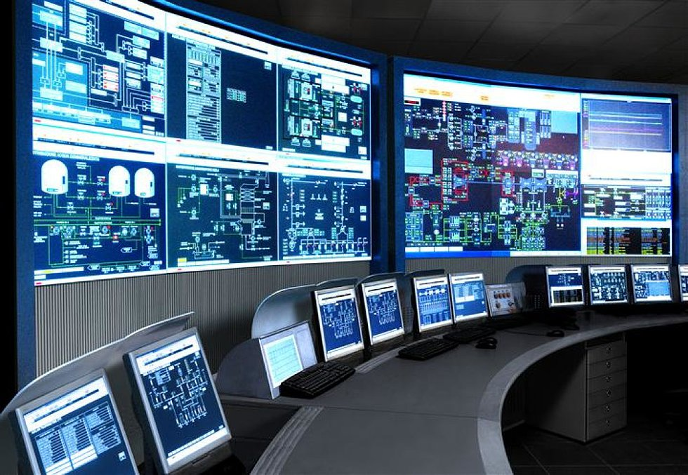
The ESS integrated control system
The ESS facility is a large and complex machine with very much and diverse equipment that needs to work in synchronization and with well-known configurations
For this purpose almost all equipment at the ESS facility is connected to the Integrated Control System
Examples:
  Voltage supplies for magnets
  Vacuum systems
  Cryogenic equipment
  RF equipment
  Air conditioning in the tunnel
The control system is the ”central
nervous system of ESS”
An estimated 1.6 million
control points will be needed

Slide 32
ESS/ICS high level description
The Integrated Control System Division (ICS division) is responsible for the control systems within the ESS facility including controls for accelerator, target, neutron scattering systems and conventional facilities. In addition, the nature of the control system makes it suitable for implementing a Machine Protection System and a Personnel Safety System, protecting personnel from some hazardous situations that can occur in the facility.
The control system complexity is very high: 1600 kPv
  SNS 600 kPv, DLS 2000 kPv, FRIB 400 kPv
Facility availability goals are very high - ICS plays a key role for availability
Some new approaches will be implemented at ESS/ICS
  Full scale deployment of EPICS 7
  Full scale deployment of MTCA.4 - new innovative technology
  Ambitious approach to automation of control system configuration
  High performance requirements on the MPS to ensure availability

Slide 33





ICS Project scope
Work package 01 Management and administration
Work package 02 Software Applications
Work package 03 Software core
Work package 04 Hardware core
Work package 05 Machine protection
Work package 06 Equipment
Work package 07 Control system infrastructure
Work package 08 Physics
Work package 09 Personnel safety systems
Work package 10 Integration - Accelerator
Work package 11 Integration - Target
Work package 12 Integration - Instruments
Work package 13 Integration - Conventional facilities
Work package 14 Test Stands
Work package 20 Installation
Software
Electronics
Infrastructure
Safety & protection

Slide 34
Technology scope for ICS
The overwhelming majority of value within ICS’s scope is represented as manual labor
The span of technical scope and the competencies needed in ICS is very big
From analog signals to Java-based high-end, big-data GUI:s in high performance, high availability
PLC systems; Safety and protection systems
Infrastructure: networking, data centre, control room
Systems integration, Installation
Project management and administration
EPICS
Databases
Availability, performance
Industrialization, maintenance
Development environments
Applicatoins (GUI, Web, Services)
Operating systems (RT)
CSS/Eclipse
Digital communication
Kernel drivers
Test and validation
PCB, packaging
Test and validation
Analog electronics
Digital electronics
FPGA firmware
Electronics hardware
Software
Safety and protection
PLC
Infrastructure

Slide 35
Technology scope for ICS (end of 2017)
The overwhelming majority of value within ICS’s scope is represented as manual labor
The span of technical scope and competencies needed in ICS is very wide
From analog signals to Java-based high-end, big-data GUI:s in high performance, high availability
PLC systems; Safety and protection systems
Infrastructure: networking, data centre, control room
Systems integration, Installation
Project management and administration
EPICS
Databases
Availability, performance
Industrialization, maintenance
Development environments
Applicatoins (GUI, Web, Services)
Operating systems (RT)
CSS/Eclipse
Digital communication
Kernel drivers
Test and validation
PCB, packaging
Test and validation
Analog electronics
Digital electronics
FPGA firmware
Electronics hardware
Software
Safety and protection
PLC
In-house
External
In-kind
Infrastructure

Slide 36
ESS ERIC
BOARD OF DIRECTORS
DIRECTOR GENERAL
MACHINES DIRECTORATE
SCIENCE DIRECTORATE
PROJECT SUPPORT & ADMINISTRATION DIRECTORATE
CONVENTIONAL FACILITIES
ACCELERATOR
NEUTRON INSTRUMENTS
GENERAL SERVICES
ES &H and Q
TARGET
NEUTRON TECHNOLOGIES
HUMAN RESOURCES
COMMUNICATIONS & EXTERNAL RELATIONS
SYSTEMS ENGINEERING
SCIENTIFIC ACTIVITIES
FINANCE
INTEGRATED CONTROL SYSTEM
SCIENTIFIC PROJECTS
INFORMATION TECHNOLOGY
ENGINEERING & INTEGRATION SUPPORT
DATA MANAGEMENT SOFTWARE CENTRE
LEGAL
SUPPLY, PROCUREMENT & LOGISTICS

Slide 37
ICS Organization
2017-11
Henrik Carling
Division head
Wojtek Fabianowski in-kind manager
Maria Romedahl
Technical coordinator
Thilo Friedrich
Systems engineer
Remy Mudingay
Controls infrastructure
Anna Gillberg
Team assistant
Annika Nordt
Safety and protection
Open position
(Henrik Carling acting)
Hector Novella
Deputy project manager
Susanne Regnell
Controls Software
Timo Korhonen
Chief engineer
Start 2017-12
Alessio Curri
System administrator
Alberto Toral
Technician
David Sanchez
Automation engineer
Angel Monera
FPGA Engineer
Benedetto Gallese
Integrator
Ben Folsom
PhD student
Banafsheh Hajinasab
Software engineer
Benjamin Bertrand
Software engineer
Denis Paulic
DGL, PLC engineer
Enric Bargalló
Lead analyst engineer
David Brodrick
Integrator
Faye Chicken
Technician
Emanuele Laface
Accelerator physicist
Claudio Rosati
Software engineer
Johan Christensson
Infrastructure technology engineer
Manuel Zaera-Sanz
Lead engineer slow interlocks
Mattias Eriksson
Technician
François Bellorini
Integrator
Javier Cerejo
PhD Student
Georg Weiss
Software engineer
Fredrik Söderberg
Software engineer
Susann Skarin
Network administrator
Morteza Mansouri
Safety systems engineer
Riccard Andersson
Technical coordinator
John Sparger
Integrator
Joao Martins
Integrator
Jan-Åke Persson
Senior software engineer
Juan Esteban Müller
Software scientist
Anders Harrisson
Software configuration manager
Stephane Gabourin
Lead engineer fast interlocks
Stuart Birch
Senior engineer
Jeong Han Lee
Integrator
Julen Etxeberria
Junior controls engineer
Karin Rathsman
Accelerator scientist
Ricardo Fernandes
Control system software architect
Fredrik Luthander
Software engineer
Peter van Velze
Technician
Start 2018-01
Szandra Kövecses
Lead integrator
Viktor Fred
Lead engineer electrical installations
Saeed Haghtalab
Integrator
Consultants
Open positions (1)
Peter Holgersson
Electriocal engineer
Yong Kian Sin
IEC61508 engineer
Manorma Kumar
PSS analyst
Simone Farina
Embedded systems egineer
Tomasz Brys
Integrator
Open positions (2)
Thomas Fay
Integrator
Krisztián Löki
Integrator
Miklos Boros
Integrator
Mehdi Mohammednezhad
Integrator
Oliver Talevski
Embedded engineer
Nour Akel
ICS Installation coordinator
Employee
Consultant
William Ledda
Integrator
Open positions (3)
Temporary employee
Consultant
off-site
Position under consideration
ESS-0081625

Slide 38
Machine Protection and
Personnel Safety Systems Group
Annika Nordt, PhD
Group Leader,
Work-Package Manager for work package 05
ESS Coordinator for Machine Protection /Chair of the ESS Machine Protection Committee

Slide 39
Group Structure
Machine Protection and Personnel Safety Systems Group
Group Leader: Annika Nordt
Deputy Group Leader: Denis Paulic
Machine Protection
work package 05:
Manuel Zaera-Sanz
Riccard Andersson
Szandra Kövecses
Enric Bargallo
Stephane Gabourin
David Sanchez
Viktor Fred
Personnel Safety Systems
work package 09:
Stuart Birch
Denis Paulic
Morteza Mansouri
Yong Kian Sin
Alberto Toral
Mattias Ericsson
Goal: Build a flexible and strong team, sharing & extending the different skill sets,
Everyone has knowledge relevant for both MP and PSS!
MP and PSS will follow IEC61508.

Slide 40
Scope of Machine Protection
Machine Protection helps in achieving the operational availability requirements for ESS. High availability is achieved through high system reliability, through short preventive and corrective maintenance times and short recovery times after stopping beam operation.
The right strategy to avoid damage leading to long corrective maintenance times, will involve a mix of:
dedicated technical systems stopping operation (not only of beam) to prevent and mitigate damage,
dedicated operational and maintenance procedures to fix things before real damage can occur.
Machine Protection needs to reliably do the following:
protect the “machine” from damage, be it beam-induced or resulting from any other source,
protect the “machine” from unnecessary beam-induced activation.
Machine protection will be implemented in a way to:
minimize unnecessary down-time due to spurious trips,
provide optimal support for failure localization,
support all operational modes of the facility,
support operation in degraded mode.
Notes:
Text according to slide

Slide 41
Resources Needed Across ESS for MP
ESS Machine Protection Committee
A. Nordt
H. Danared, [Target], T. Korhonen, O. Kirstein
Machine Protection / RAMI / Dependability Team (at ESS Facility Level)
A. Nordt, E. Bargallo
Machine Protection Coordinator AD (A.Ponton)
Machine Protection Coordinator ICS
Machine Protection Coordinator TARGET
Machine Protection Coordinator NSS
ACC-Machine Protection WG
A. Ponton, A. Nordt, E. Bargallo,
S. Kövecses
ICS-Machine Protection WG
A. Nordt,
E. Bargallo,
S. Kövecses
TARGET-Machine Protection WG
?, A. Nordt,
E. Bargallo,
S. Kövecses
NSS-Machine Protection WG
?, A. Nordt,
E. Bargallo,
S. Kövecses
ACC-Machine Protection Representatives
Per MP-related work package: 5-10% time
ICS-Machine Protection Representatives
Per MP-related
work package: 5-10% time
TARGET-Machine Protection Representatives
Per MP-related
work package: 5-10% time
NSS-Machine Protection Representatives
Per MP-related work package: 5-10% time

Slide 42
Scope of Personnel Safety Systems
The ESS Personnel Safety Systems are loosely divided into three major systems:
The Accelerator PSS,
The Target PSS,
The Neutron Instruments PSS (one system for each of the 22 Neutron Instruments).
The primary role of the ESS PSS is to prevent personnel from being harmed by exposure to ionizing radiation generated by the proton and neutron beams, under all operating modes.
The ESS PSS will also be used to control and mitigate against the following hazards inside pre-defined controlled areas:
Oxygen depletion (primarily from helium leak from the super conducting sections)
High voltage from assorted equipment
Radio frequency
X-Rays
Mitigation will be achieved by controlling access to the different areas when a potential hazard is present and switching off the equipment generating the hazards.
Notes:
Text according to slide

Slide 43
Control System Infrastructure
Remy Mudingay
Group Leader
Work Package 07 Leader
www.europeanspallationsource.se
4 December, 2017

Slide 44
Control System Infrastructure
Scope
The group’s responsibilities are to Design, Implement and Operate the IT Infrastructure needed to reliably run the Experimental Physics Industrial Control System (EPICS) eco-system. The main activities can be grouped into two parts:
Main Control Room/Data Centre and Networks - The activities include responsibility over the design, installation, configuration and maintenance where applicable:
Human factors analysis and ergonomic design of the ESS Main Control Room.
File and storage services for data produced by the machine for ‘on-line’ and ‘off-line’ analysis.
A secure Technical Network that interconnects the private machine networks for Accelerator, Cryogenics, Neutron Instruments, Target and Utilities (electrical substations and HVAC) to operation consoles located in Control rooms.
Control System Software authorisation tools and services.
Software Infrastructure – The activities include responsibility to design, install, configure and maintain the supporting applications for control specific software development.
Integration services for software development life-cycle for EPICS software.
Software Development environment
Configuration management and software deployment.
Monitoring tools and services of Software applications used to configure the control system.

Slide 45
Group Structure
ESS Staff
Control System Infrastructure Group
Group Leader - Remy Mudingay
Contractor
In-Kind partner
Work Unit 14.07.01
Control Room
Remy Mudingay
Work Unit 14.07.02
Data Centre
Alessio Curri
(System Administrator)
Work Unit 14.07.03
Control System Network
Susann Skarin
Johan Christensson
Work Unit 14.07.05
Infrastructure Applications
Benjamin Bertrand
System Administrator
(Vacant)
Peter Holgersson
Fredrik Luthander
Anders Harrisson
Institute for Energy Technology:
S. Collier
M. Rosenqvist
P. Le Darz
Institute for Energy Technology
Terje Bordal
Thor-Egil Ekeli
Tallinn Institute of Technology
Dr Andro Kull
Dr Rain Ottis –
Dr Hayretdin Bahşi
Dr Olaf Maennel
Dr Risto Vaarandi
Control Room
Equipment
Cybersecurity

Slide 46
Hardware and Integration Group
Henrik Carling,
Acting group leader

Slide 47
Group Structure
Hardware and Integration Group
Acting group leader: Henrik Carling
Work package manager: 04, 10, 14
Embedded systems (MTCA , FPGA, Linux)
Angel Monera
Simone Farina
Oliver Talevski
Mehdi Mohammednezhad
Automation
Benedetto Gallese (work package 11)
Francois Bellorini
Peter van Velze
Miklos Boros
EPICS Integration
David Brodrick (work package 12)
John Sparger
Jeong Han Lee
William Ledda
Faye Chicken
Tomasz Brys
Joao Paulo Martins
Krisztian Löki
Saeed Hagthtalab
Thomas Fay
Motion Control
Julen Etxeberria
Timing System
Javier Cereijo
Other
Nour Akel - Installation coordinator
Upcoming recruitments
  3 positions
  1 or 2 consultants - project management

Slide 48


HW & I Group Mission Statement, Values Soft Skills and Organization
To develop a reliable, high-performance and cost-efficient control system in collaboration with the rest of ICS, stakeholders and the community. To become a reference group for excellent engineering practices in hardware and systems integration.
Openness and honesty
  Honest and clear
  Communication is key
  Try to resolve conflicts quickly and put them behind us
Helpful attitude and team spirit
  Help each other
  No finger pointing - no blaming - no competition
  Adapt to changes quickly
Respect mandate and competence
  Respect other’s mandate
  Respect other’s work
  Respect others competence
One ICS towards stakeholders
  Act as one team, and one ICS
  We stand-in for each other
  Gather information for the team, do not amplify rumors, act based on facts
Flexibility
Team spirit
Ability to manage conflict and imperfection
Ability to influence without power
The team, as the rest of ICS is organize in a classical matrix structure
It provides resources to 6 workpackages representing about 40% of the project value
The matrix allows flexibility in assigning resources and managing prioritization

Slide 49
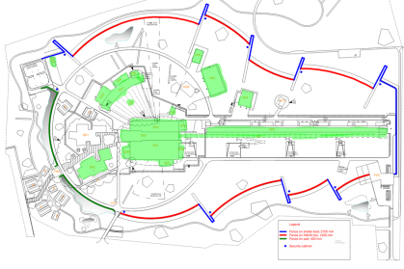
Controls System Integration
The systems under the scope of the Hardware and Integration Group span over 20 buildings, out of a total of 35 in the complex:
Accelerator Control Systems (G01, G02)
Target Control Systems (D02)
Instrument Control Systems(D01-D08, E01-E05)
Site Infrastructure Control Systems (H01, H05, H06)
Hardware and Embedded software Systems (B02)
The Hardware and Integration Group is in charge of the design , installlation, maintenance, support of the Integrated Control System. For the sake of this presentaion ‘Integrated Control System’ refers to the following 5 subsystems:
  Hardware and Embedded software Systems (work package 04)
  Accelerator Control Systems (work package 10)
  Target Control Systems (work package 11)
  Instrument Control Systems (work package 12)
  Conventional Facilities Control Systems (work package 13)
  Test Stands (work package 14)

Slide 50
Hardware and Integration Responsibilities
The scope of the hardware and integration group cover 5 big control systems, which are composed of a big number of subsystems:
    Hardware and Embedded software Systems
    Accelerator Control Systems
    Target Control Systems
    Instrument Control Systems
    Site infrastructure Control Systems
The Hardware & Integration Group shall provide control system integration to all relevant ESS stakeholders (Accelerator, Target, Site Infrastructure, Neutron Instruments).
Integration Support is defined as: the effort provided by ICS that is required for deploying the control system components, which provide monitoring and control functionality to the stakeholder systems.
The integration support includes among others:
    Design of the different control systems and integration in the overall ICS
    Development, upkeep and maintenance of (~500+) IOCs software in the plant
    Development and standardization of hardware technologies: mTCA infrastructure, DAQ Systems, PLCs, etc.
    Troubleshooting and support to operators (on-call) service
    Providing ESS with necessary infrastructure for management of EPICS modules, FPGA firmware, PLC Code etc.
    Support other Divisions with EPICS, PLC programming and FPGA development know-how.

Slide 51
Control System
Software Group
Susanne Regnell,
Group Leader
Work-Package Manager for Work package 03

Slide 52
Group Structure
ICS/Control System Software
work package 03 Software Core Components:
Karin Rathsman
Jan-Åke Persson
Ricardo Fernandes
Claudio Rosati
Georg Weiss
Banafsheh Hajinasabi
Fredrik Söderberg
+ Off-site consultants
Control System Software Group
Group Leader:
Susanne Regnell
work package 08 Physics:
Emanuele Laface
Juan F. Esteban Müller
Ben Folsom (Ph.D Student)

Slide 53
Scope
ICS/Control System Software
Providing control system software applications, providing the following services:
EPICS Control System Studio:
  Operator screens
  Data browser
  Probe
  Archiver (Archiver Appliance)
  Alarms system (BEAST)
  Channel Finder functionality
  Save, Compare & Restore functionality (MASAR)
Post Mortem service/application
Calibration service/application
Diagnostics service/application
Generic information screens
Controls Configuration (ESS Named devices, cables)
Open XAL* framework with Physics online model

Slide 54
ICS in-kind portfolio development
ICS has been expanding the in-kind potential value by identifying and publishing new scope for possible partner contribution
Sometimes in-kind expansion occurs as natural extensions of prior in-kind activities
When analyzing the total in-kindable scope in the plan, we currently seem to see a limit at ~21 M€

Slide 55
ICS In-kind partners
Partner Institutes
Atomki, Hungary
CEA, France
CNRS/IPNO, France
Elettra, Italy
ESS Bilbao, Spain
IFE, Norway
INFN Catania, Italy
INFN Legnaro, Italy
PSI, Switzerland
STFC, UK
Tallinn Technical University, Estonia
ÚJV Řež, Czech Republic
University of Łódź , Poland
Uppsala University, Sweden
ZHAW, Switzerland
Agreement signed
Agreement waiting for signature
Early discussions
Collaboration/other agreement

Slide 56




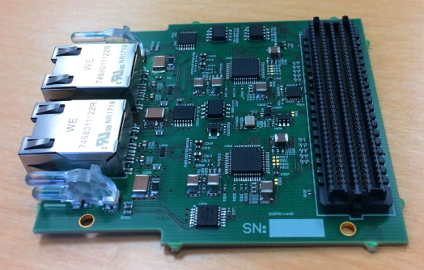






ICS in-kind status
  PSI: Good progress - software and firmware deliveries made - volume deliveries expected 2018-03
  TUT: Ethercat: HW-prototype - delayed. FPGA-IOC: delayed. Cyber security: On track
  IPNO: Discussions ongoing. Signed TA slated for IKRC 14
  CEA: Starting work on the RFQ controls. Discussing how to handle nBLM
  ESS Bilbao: MEBT controls project progressing
  ZHAW: On track - good progress.
  INFN Legnaro: No contract yet. Work has started nevertheless
  IFE: MCR: On track, Software (Logbook/Alarms): On track, Procurment (Network/Compute): On track
  Rez: No activities <- Closed
  Atomki: No activities
  STFC: Several (smaller) TA:s defined but high-level agreement missing
  Łódź: Agreement signed. Work to start 2018-01. Preparations (nBLM have already begun)

Slide 57
Weekly report
Integrated Control Systems
Henrik Carling
ESS/ICS
Date: 2017-11-28

Slide 58
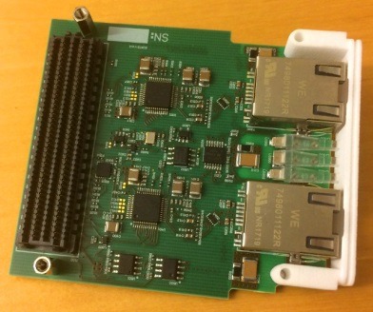
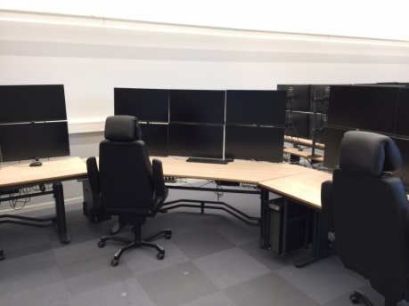
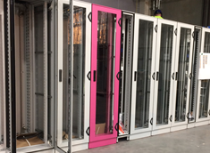
Weekly report
Integrated Control Systems w1748
Achievements
  First prototype EtherCAT slave FMC cards received as in-kind contribution from Technical University of Tallinn, Estonia
  Internal reviews on controls for ion source and LEBT and RF local protection system fast interlock prototype made
  Thirteen ICS employees participated in the new/improved edition of the centralized ESS electrical safety training
  ICS Participation in the fourth beam instrumentation forum and at specific coordination meetings at CEA in Paris [link]
  Recruitment of new hardware and integration group leader ongoing. Mandatory negotiation with unions passed
  ICS installations progress with continuous coordination with stakeholders in the front-end building
  Rotating lights for the personnel safety system installed and factory acceptance tests of ODH monitor racks performed
  Software installation onto workstations in the local control room continues. Some issues detected and resolved
  Slow but steady progress on documents for licensing application [link] to the Swedish radiation safety authority (SSM)
  Progress on development of concept of operations for the fast beam interlock system; more robust, less dependencies
  New version of the ESS cable database deployed in production environment [link]
Issues
  Slow in-kind negotiations delay signatures for contracts beyond in-kind review committee deadlines
  Resource allocation and organization in the hardware and integration group needs to be revisited and improved
  Inadequate coverage for control system integration of cryo-related systems needs urgent attention
  Issues with lightning protection and its possible relation to personnel safety systems needs further attention
  Requirements related to data logging and post-mortem for oxygen deficiency hazard monitoring systems (ODH) missing
  Some ESS risk values for individual risk are not clear, making progress on documents needed for SSM slow and difficult
  Missing access system procedures in the handbook for dosimetry complicates work with the personnel safety systems
  Setup of the Maven [link] build configuration tool used for ICS Java software is more complicated than expected
  Issues with the Tosca framework/driver and ADC3117 FMC modules delay progress on some systems. Supplier involved
  ICS staffing for receiving and implementing systems with the IFC1420 digital platform is too low (see following slides)
  Redefinition of “industrial PCs” to be used for controls is needed but takes longer than expected. Suppliers are invited
Next steps
  Proceed with aligning and re-baselining planning for ICS together with accelerator division
  Proceed with aligning processes and documentation towards the target project
  Continue progress on work for warm linac trial operations licensing permit application with deadlines in 2017-12
  Continue with an installation plan for equipment as well as an installation and validation plan [link]
First prototype EtherCAT slave FMC module delivered from Estonia
Software being installed onto operator stations in the local control room
MPS rack (violet) installation In the Klystron gallery

Slide 59






ICS Project Status by work package
WP-03 Software core - Making progress, but much is yet to do
WP-04 Hardware core - Improvement with in-kind deliverables from Switzerland
WP-05 Machine protection - Difficult to get information from stakeholders
WP-07 Controls infrastructure - Many deadlines still to be met
WP-08 Physics - Good progress for the cavity model
WP-09 Personnel safety systems - Requirements for the stubs have to be retransmitted
WP-10 Integration - Accelerator - Issues with overloaded work package leadership
WP-11 Integration - Target - Discussions on top level to resolve responsibility distribution
WP-12 Integration - Instruments - Good progress
WP-13 Integration - CF - Support needed for OPC UA integration with EPICS
WP-14 Test Stands - Progress - project defined to accelerate
WP-20 Installation - Resuming installation activities

Slide 60
Opportunities
This section of the weekly report is summarizing potential opportunities for external partners such as in-kind and commercial partners.
Please contact Henrik Carling for feedback or more information
Commercial opportunities (see also https://europeanspallationsource.se/partners-and-industry)
  Commercial framework for integration services: Kick-off meeting meeting 2017-12-04 at the ESS construction site [link]
  A commercial opportunity for a ”technical writer” opened through the software framework lot 4. Done
  A commercial opportunity for an integration project manager (software framework lot 4); 12 - 24 month contract. Ongoing
  A commercial opportunity for EPICS training services will soon be available through the software framework lot 4
  A commercial opportunity for MicroTCA infrastructure hardware will be made as a sole source procurement. Done
  A “Public Procurement for Innovation” project [link] has been started for MicroTCA - more information to follow next week
  Commercial opportunities for integration project manager (integration services framework lot 7) to be opened soon
  Commercial opportunities for Embedded systems engineering consultants (integration services framework lot 2) to be opened soon
  Commercial opportunities for EPICS integrator consultants (integration services framework lot 1) to be opened soon
  ESS procurements for a 600kW server room for ESS
    Design and layout of the server room according to TIA 942. Will be published by procurement in Q1 2018
    Implementation of server room in the central utilities building. Open call for tender will be published in Q2 2018.
In-kind opportunities
  There are currently no new in-kind opportunities within the ICS scope
  The next in-kind review committee meeting is scheduled for 2017-12-14
Employment opportunities
  Please visit the official ESS career page https://europeanspallationsource.se/vacancies
  There are currently no open recruitments for ICS

Slide 61
ICS vision and mission statements
ICS vision statement
ESS operated efficiently, reliably and safely, with a control system that everyone loves
ICS mission
The ICS division shall provide and maintain world-class and cost-efficient control, protection and safety systems and services for the ESS facility.
The division shall develop competence and innovative solutions that can be shared in the community through open processes

