Slide 1
Support Frame
Senad Kudumovic
Design engineer
www.europeanspallationsource.se
6 December, 2017

Slide 2
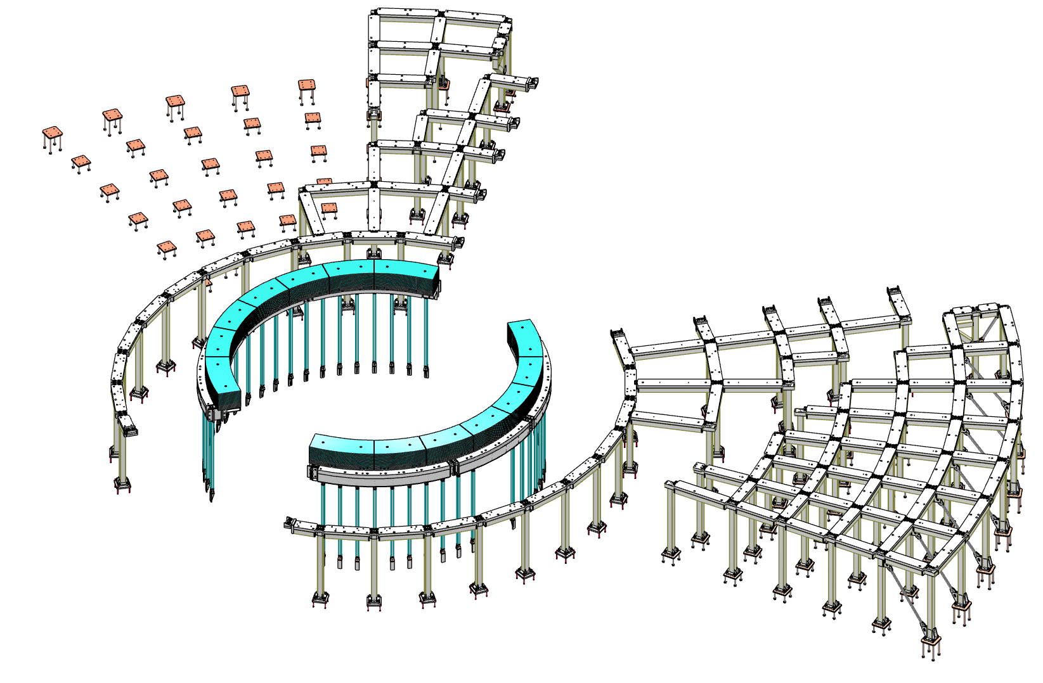
Content
Support Frame
Requirements, geometry, details, interfaces & anchoring, integration.
1. R6m Frame
Wall Brackets
R6m Box Beam
Skirt Shield Blocks
Support Pillars and Brackets
2. Target Building Frame (D02)
Pillars
Wall Brackets
Beams
3. Instrument Hall Frame (D01/D03)
Pillars
Wall Brackets
Beams
Diagonal Braces

Slide 3
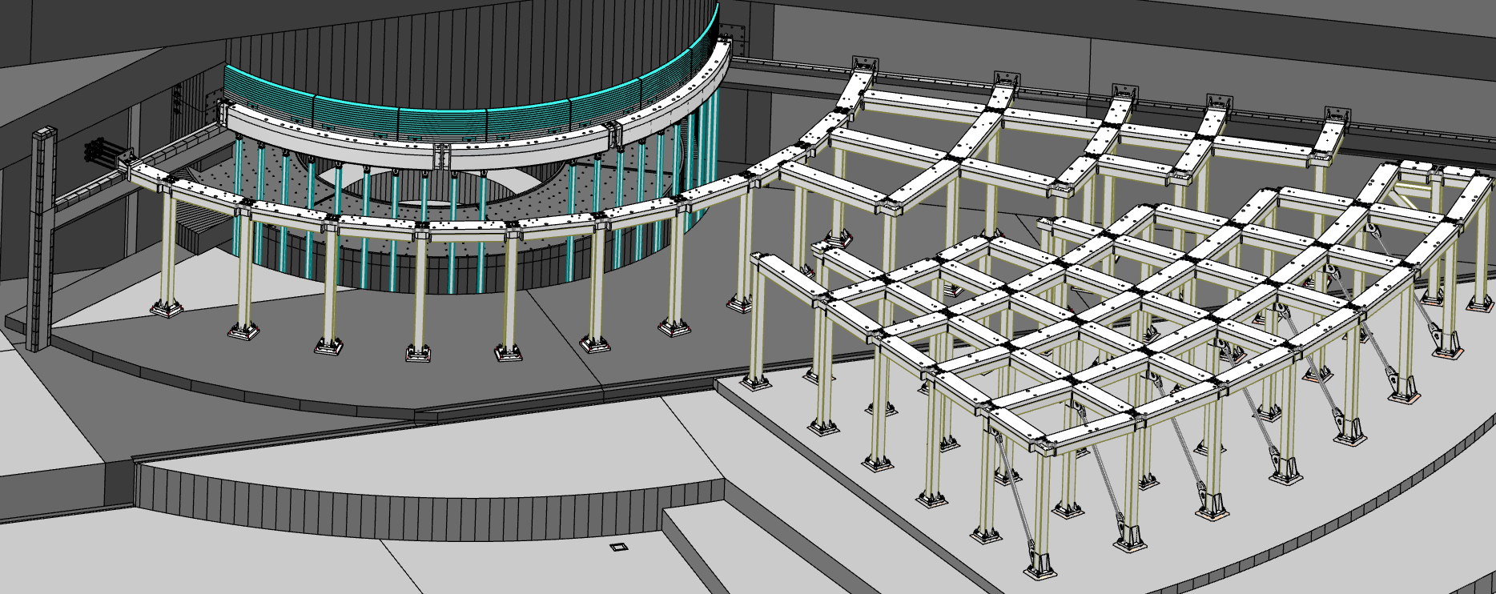
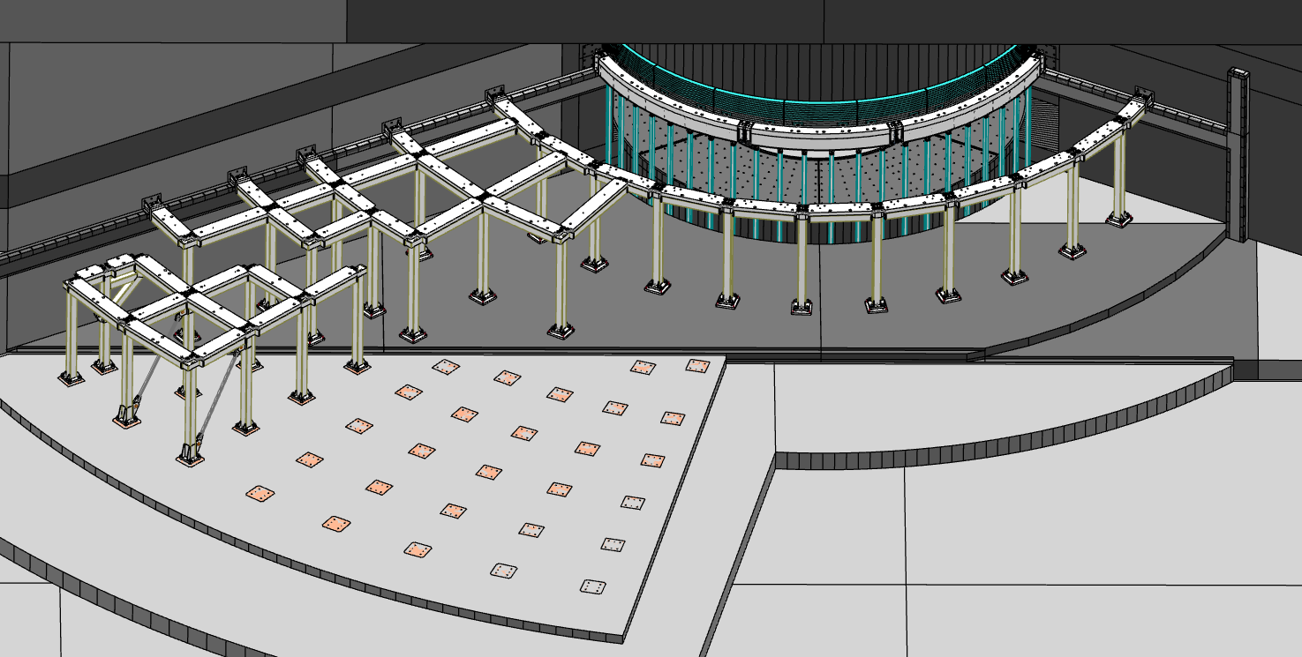
Support Frame
Design considerations:
Support bunker roof load of ~6.6 t/m2
Support additional 3.3 t/m2 for removed roof block placement during maintenance
Prevent roof blocks impacting monolith during
an H4 seismic event
Provide minimal spatial constraints for beamlines & equipment
All elements to be removable as needed during maintenance
R6m Frame
Target building frame
Instrument hall frame
North and West sector
South and East sector

Slide 4
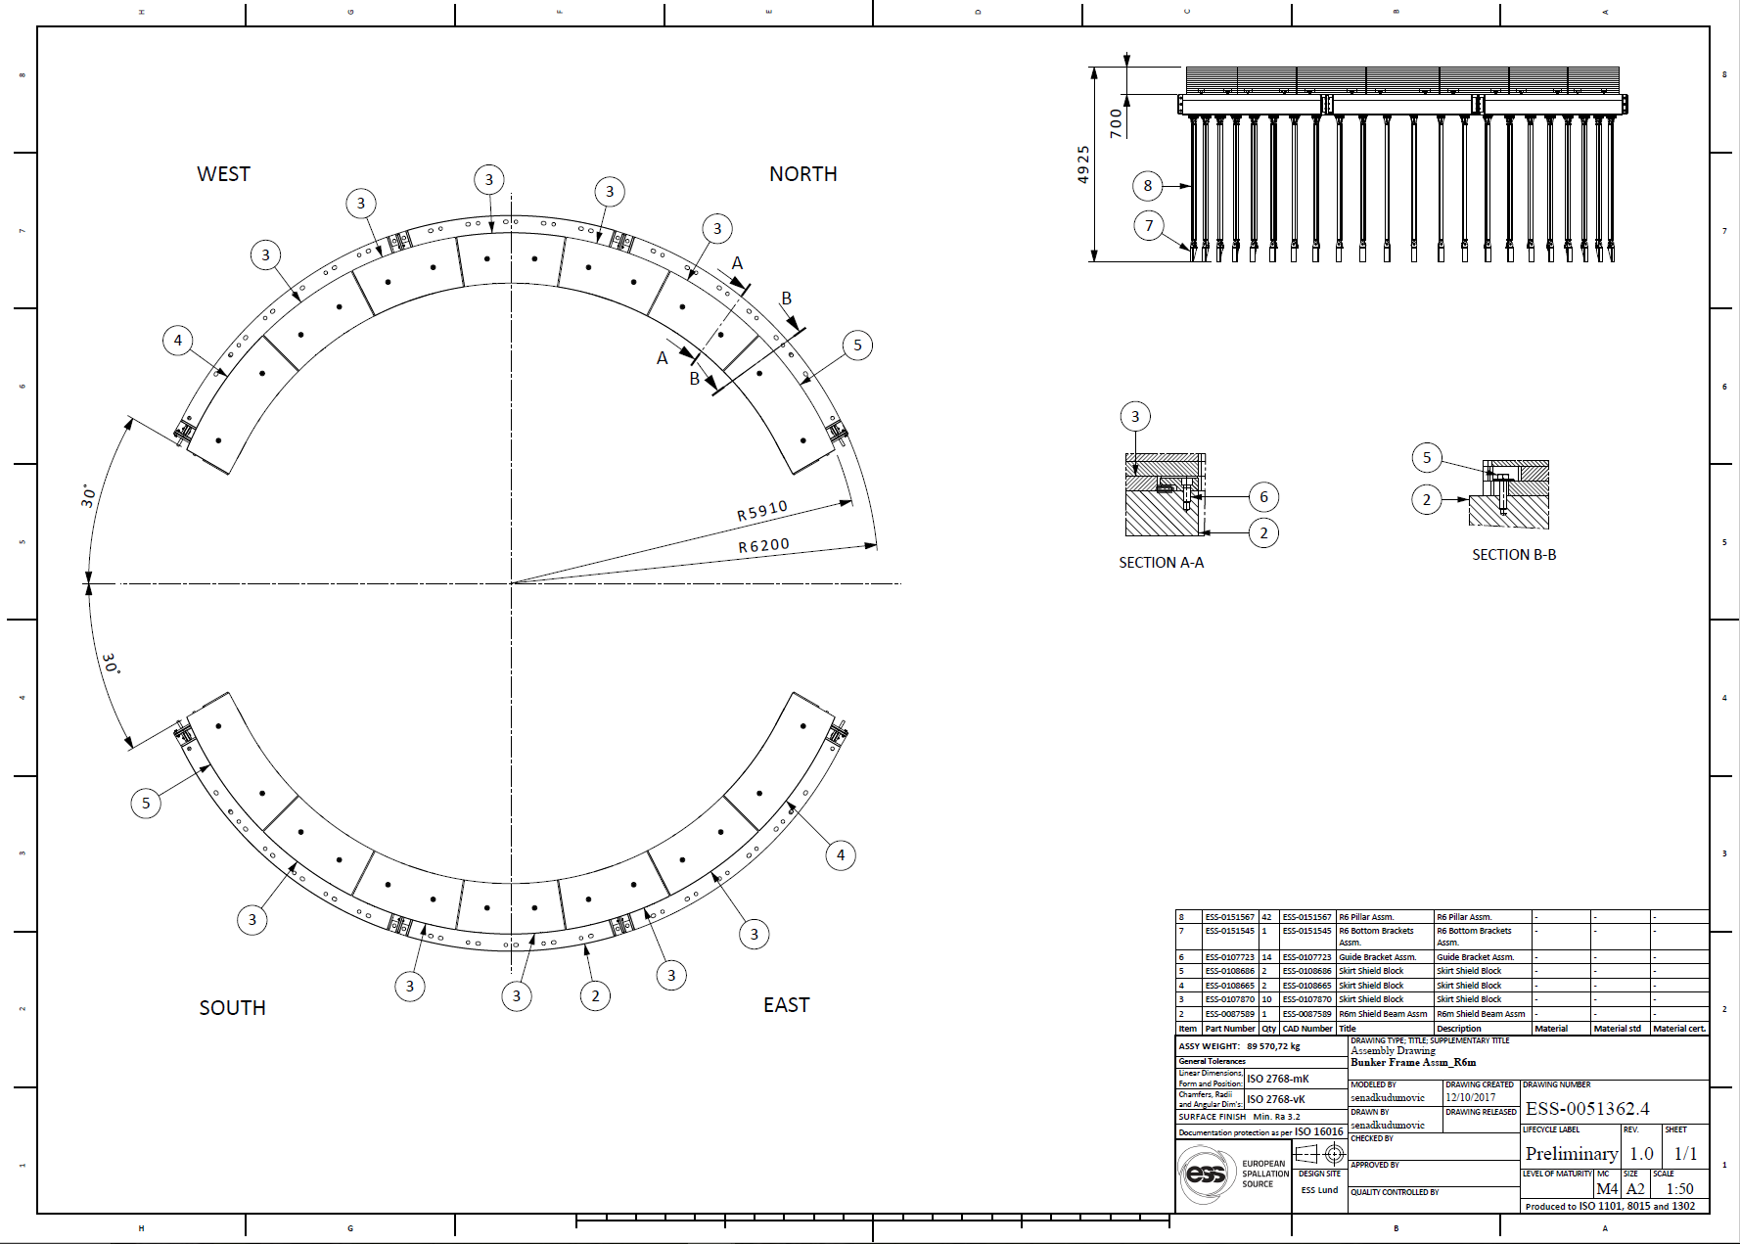
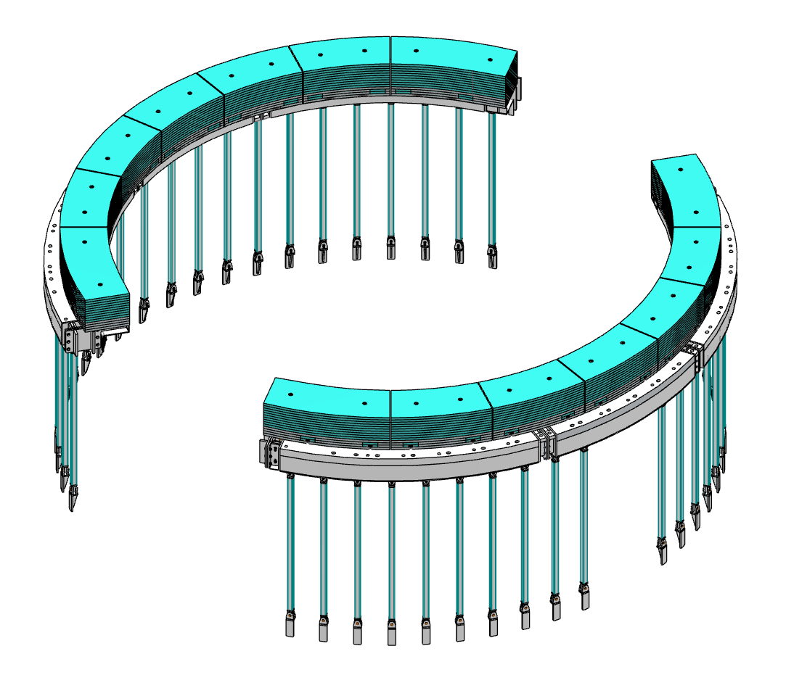
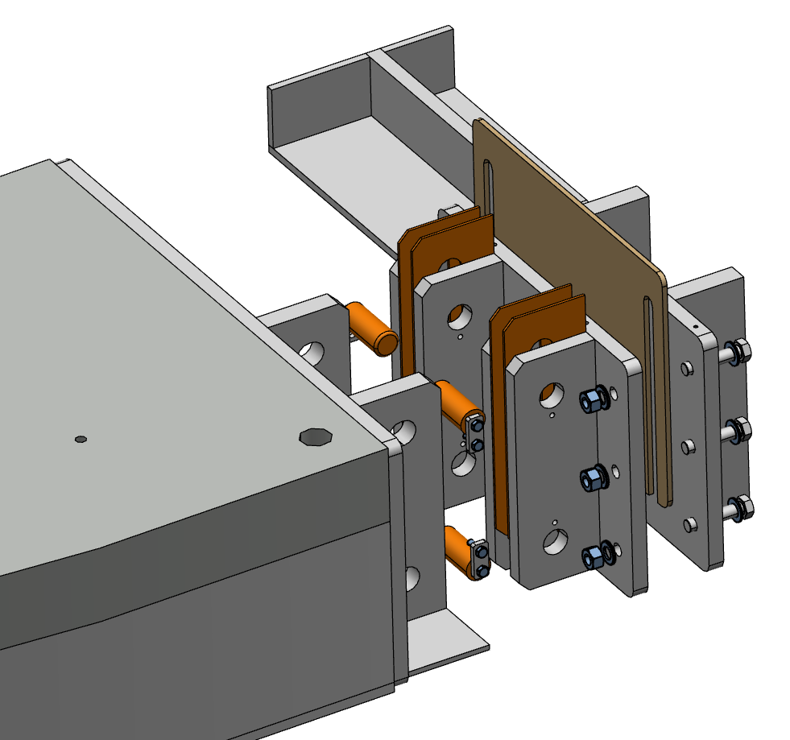
Support Frame-R6m
R6m Frame-Columns attached to large radial box beam.
Wall Brackets
Connection Flanges
R6m Box Beam
Support Pillars and Brackets
Skirt Shield Blocks
ESS-0051362

Slide 5
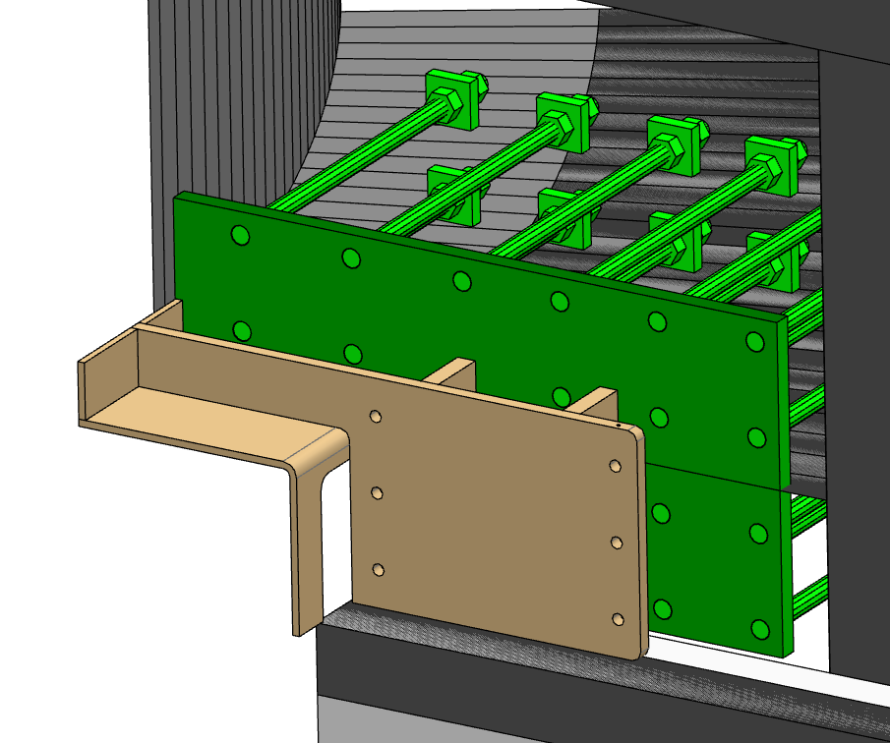
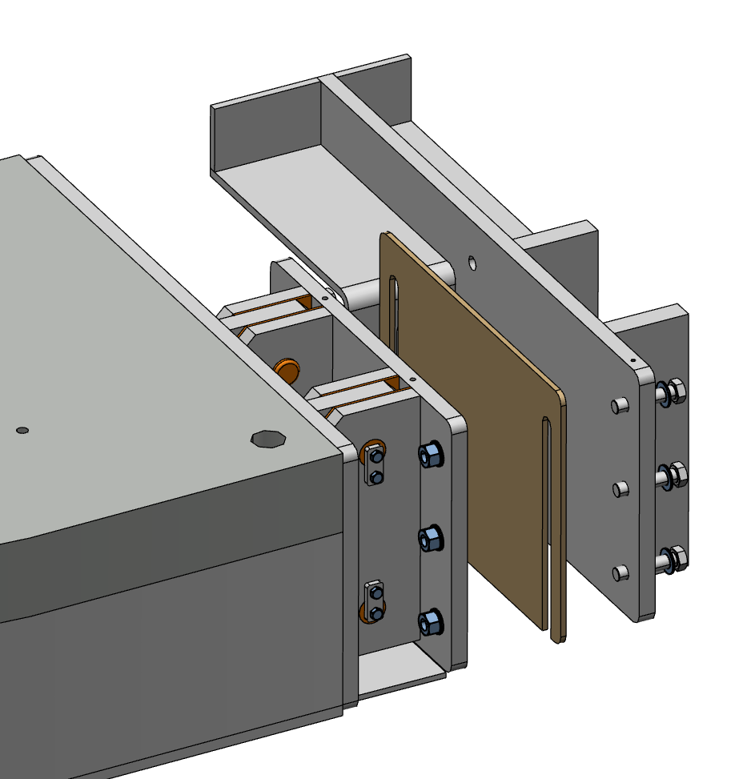
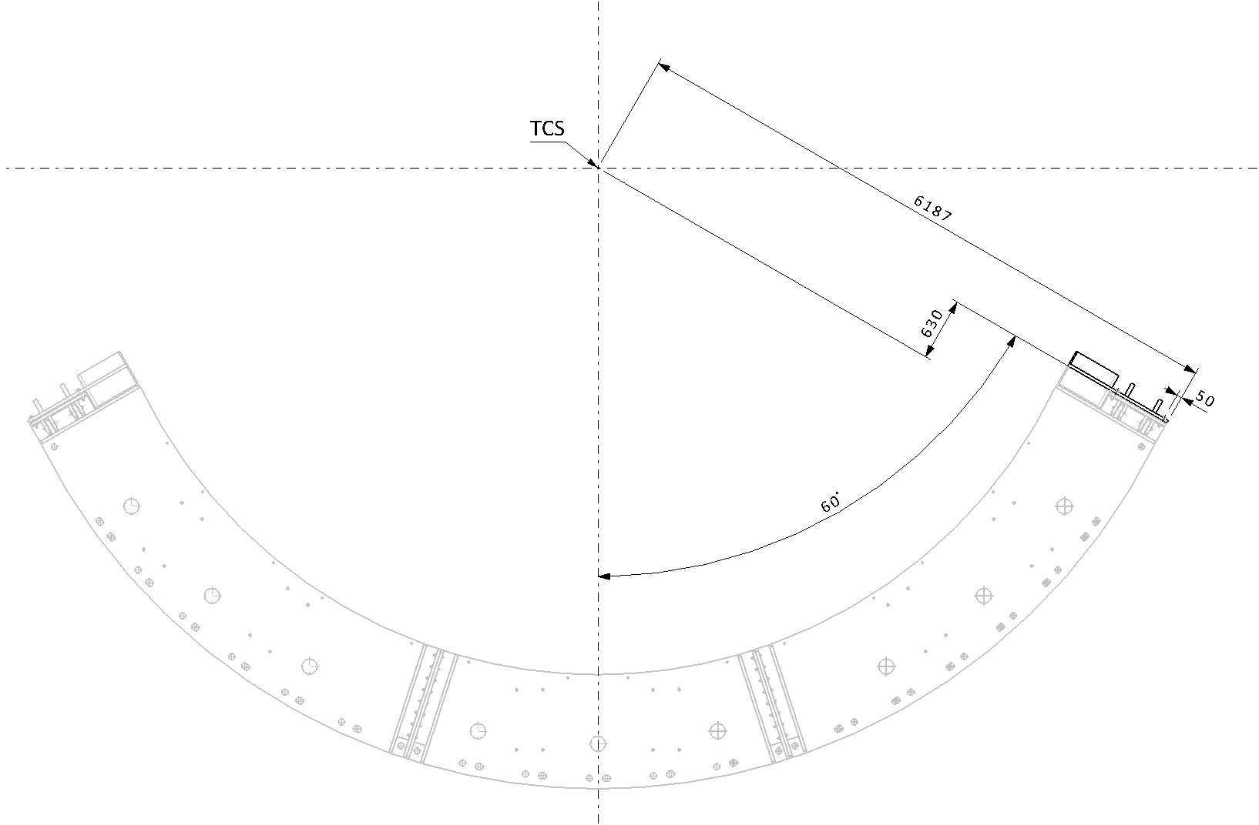
Wall Bracket
Welded to plate in diagonal walls of the Monolith
Provide holes for connetion with beam flange
Positionig to be done respective to TCS

Slide 6
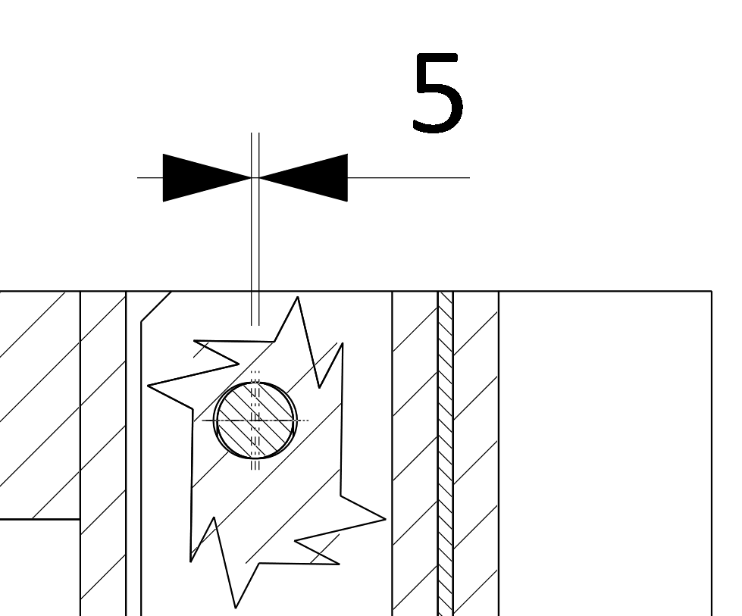
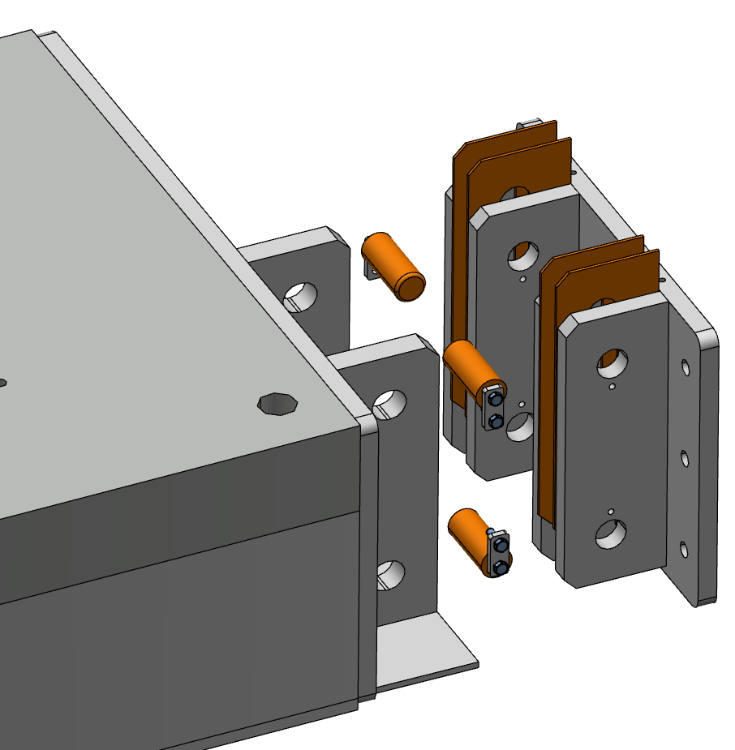
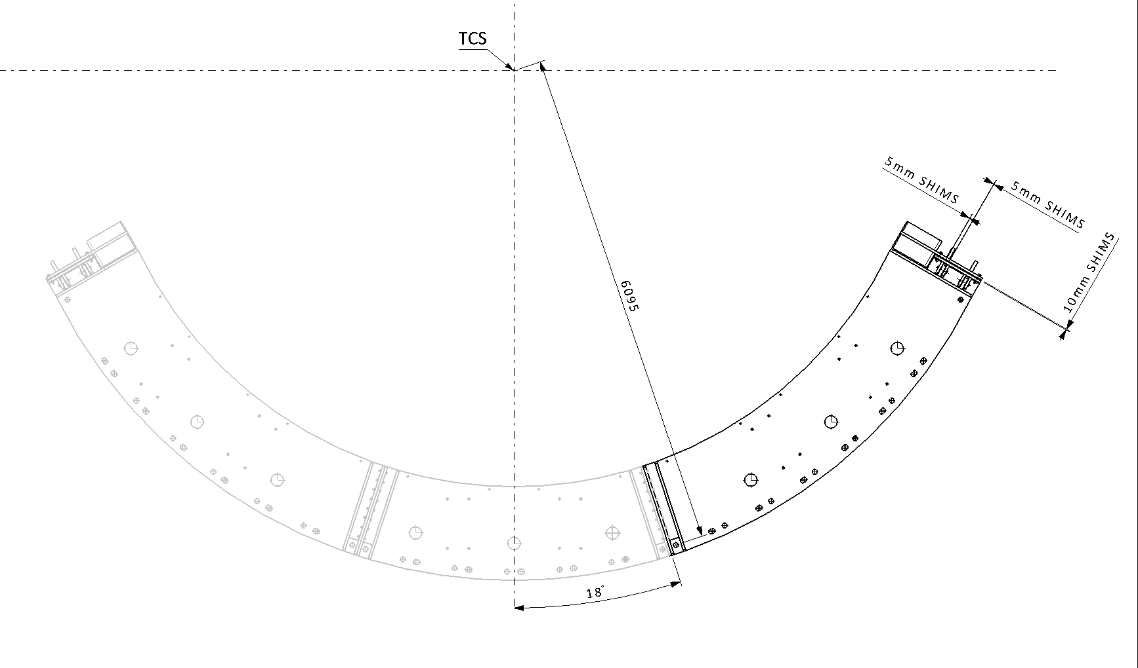
Connection Flange
Connection between R6 Beam and Wall Bracket
Elongated holes provides solution which doesn´t give any axial reaction for slow (static) loads but works for dynamic loads.
Shims will be used to compensate possible misalignment and prevent radial beam displacement .

Slide 7
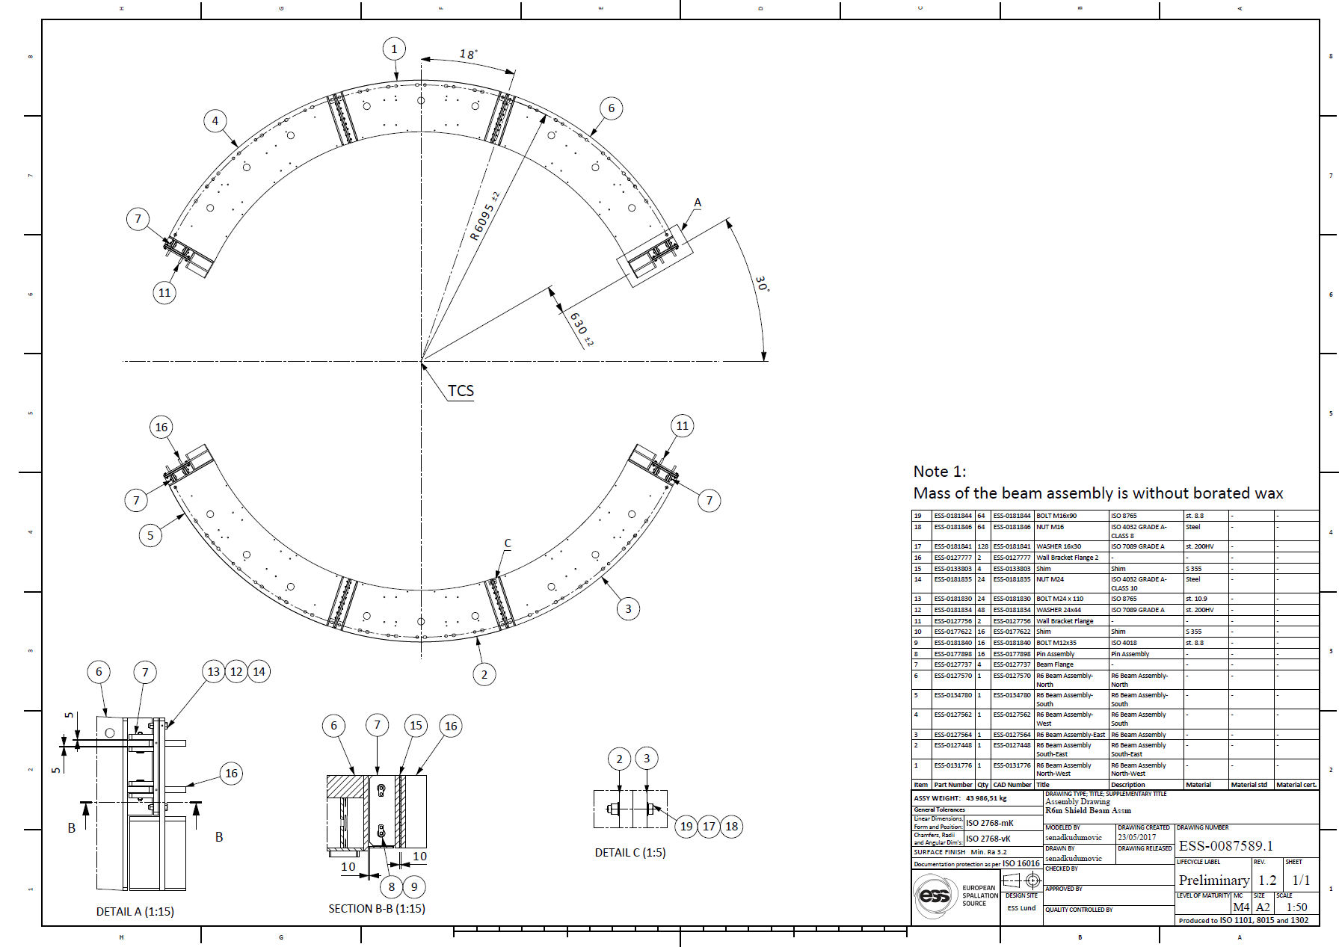
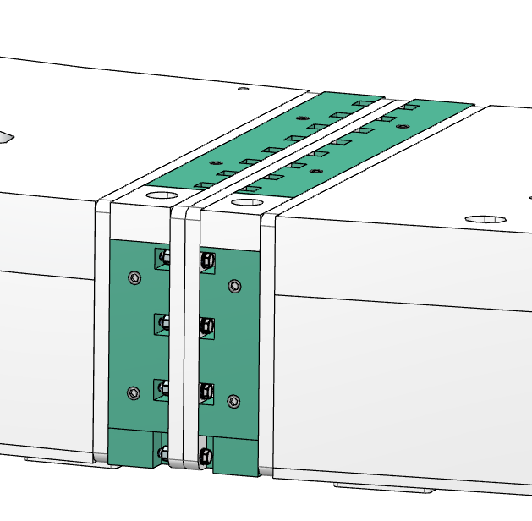
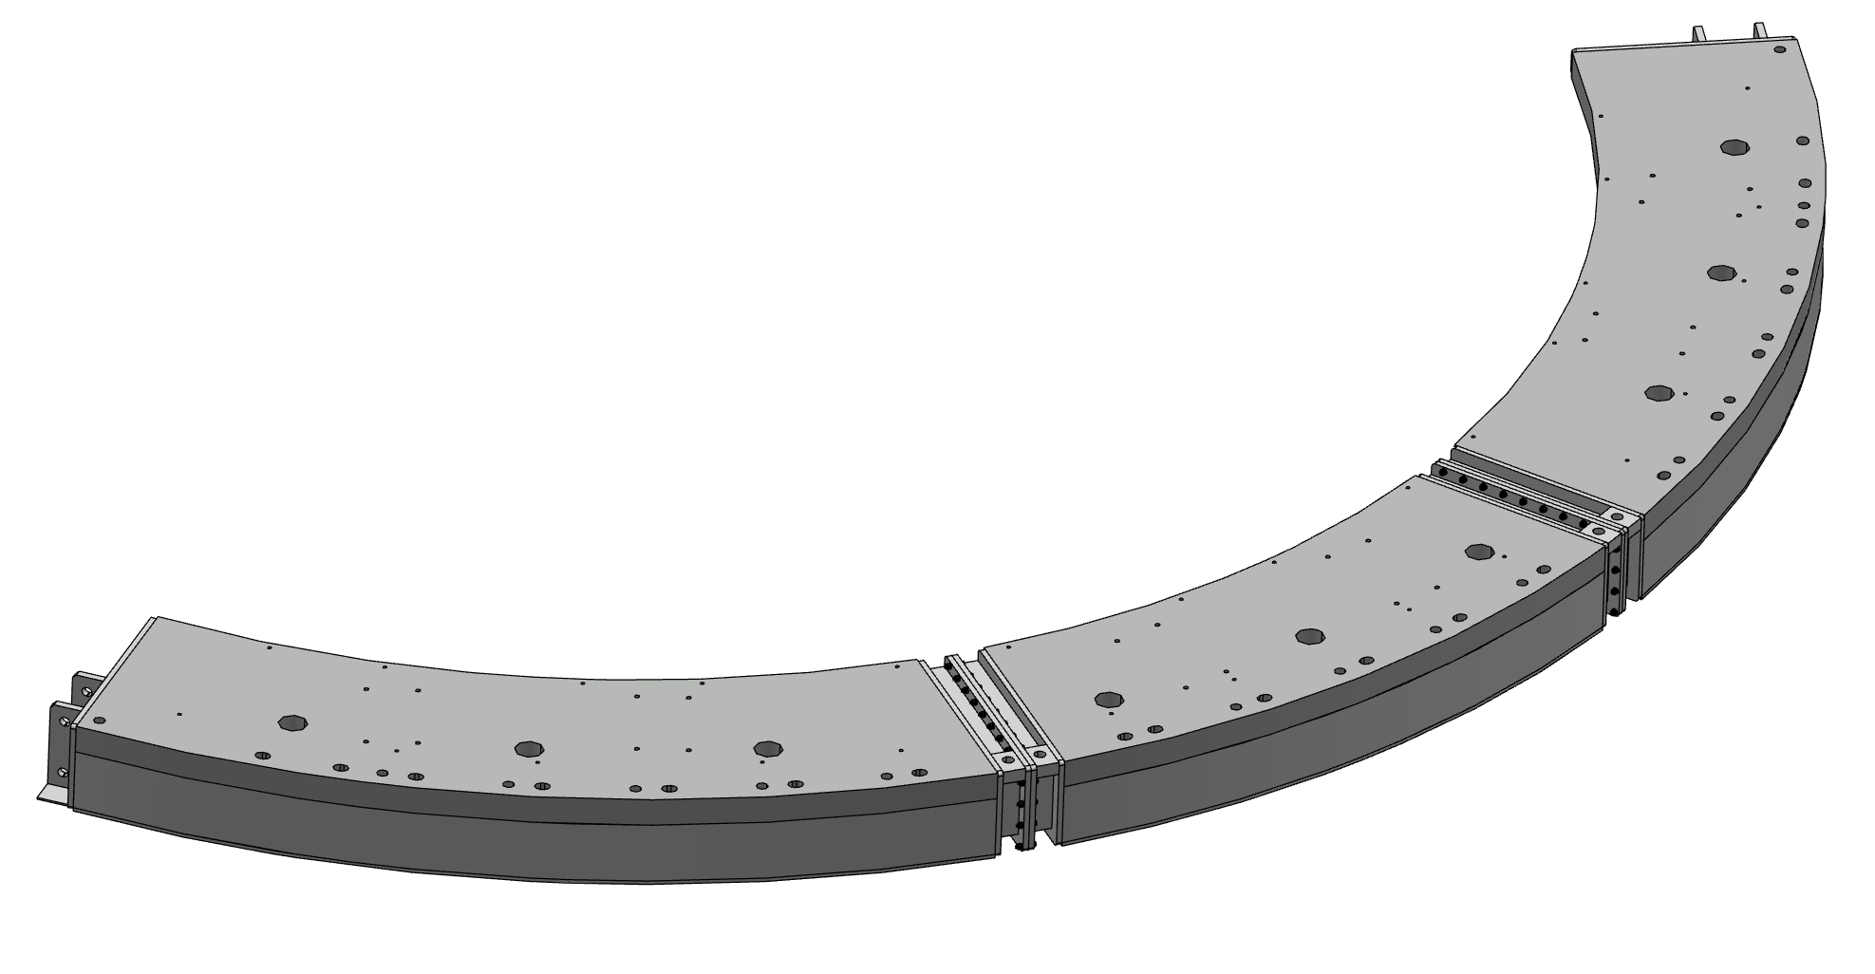
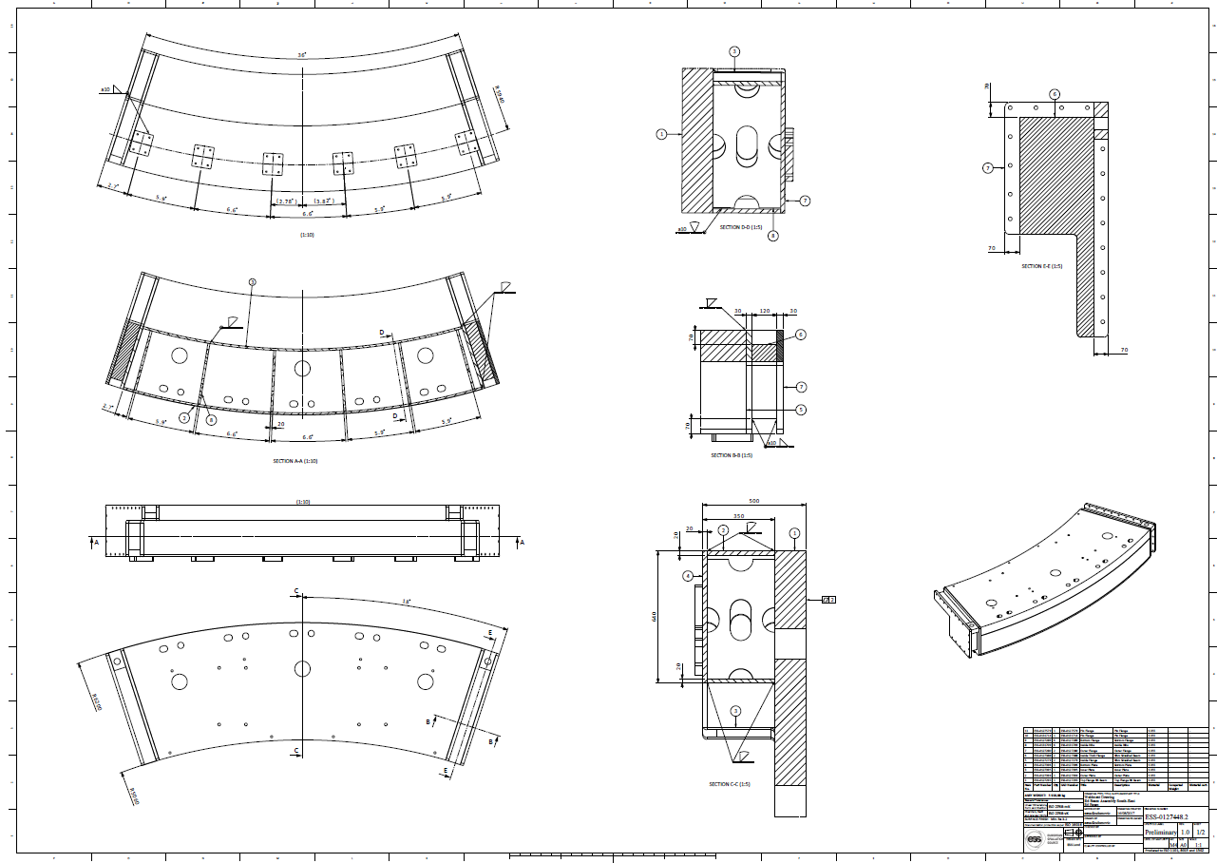
R6 Beam
R6 BEAM:
Made from 3 separate beams for manufacturing and installation reasons.
Filled with grinded HDPE pellets
- Each beam has several different cutouts and threaded holes on top of the thick plate and holes on side flanges.
Ø150 mm holes for filling with grinded HDPE pellets
Ø60 mm holes for pin connection with roof blocks
M24 threaded holes for fixing skirt shield blocks
M30 threaded holes for lifting tool
16 x Ø18 for bolt connections on side flanges
ESS-0087589
ESS-00127448

Slide 8
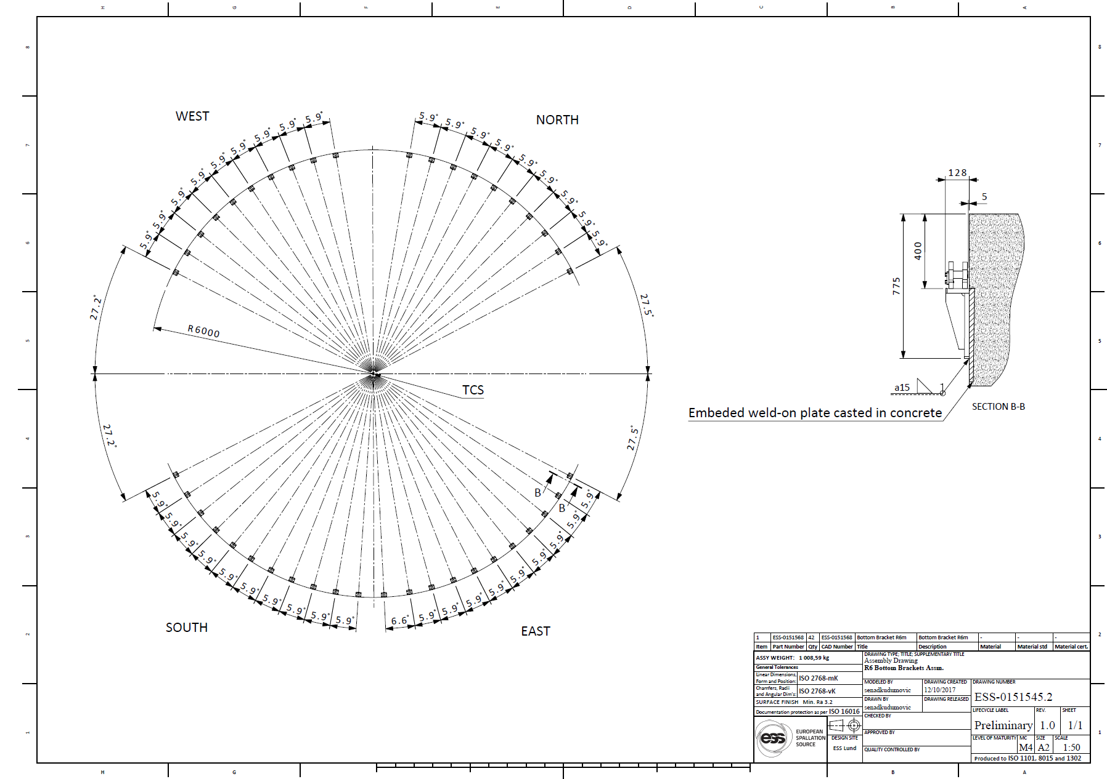
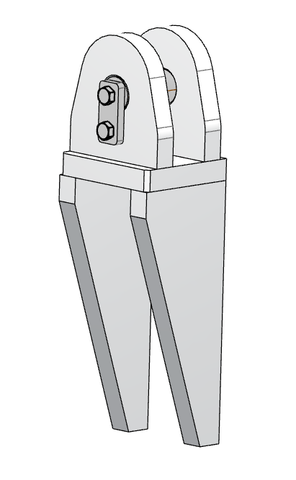
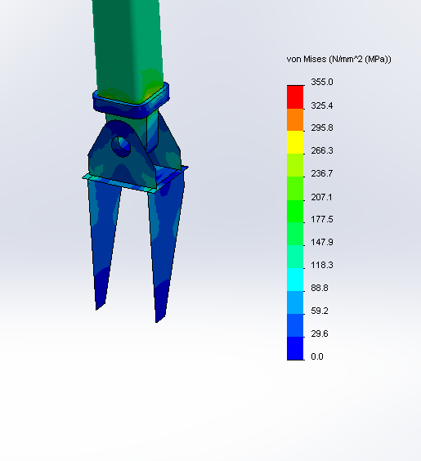
Bottom Brackets
Bottom Brackets:
Bottom brackets will be welded to embaded weld-on plates respective to beam ports
ESS-0151545
Theoretical position of the brackets respective to TCS shown on ESS-0151545

Slide 9
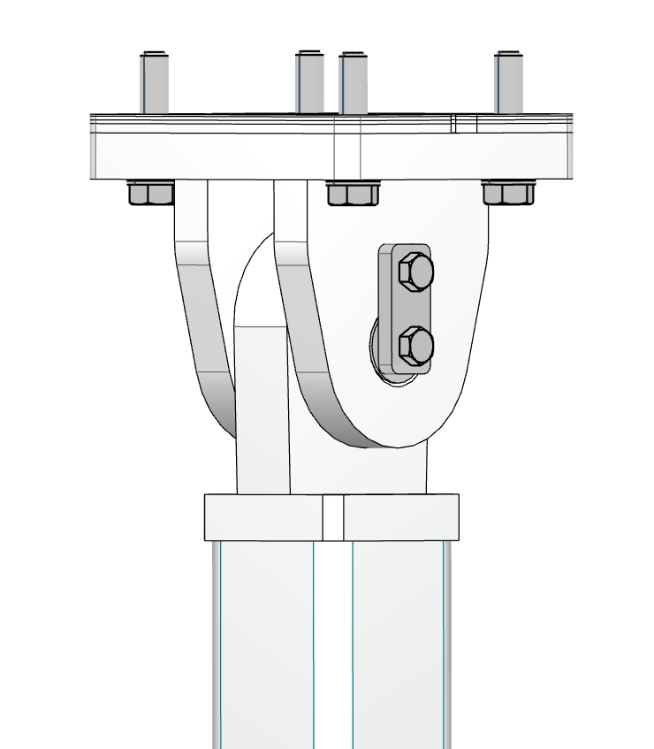
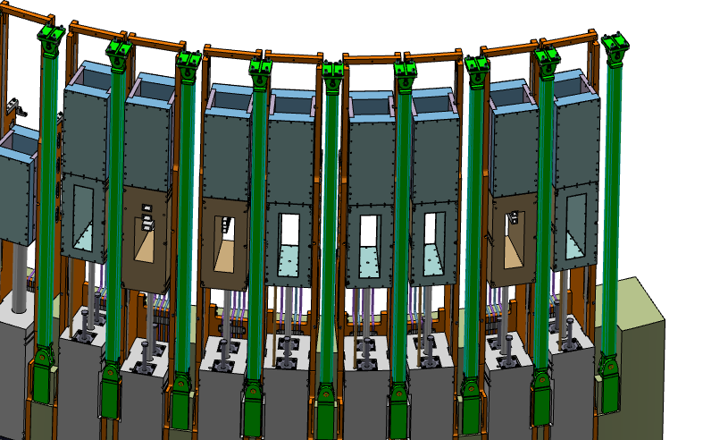
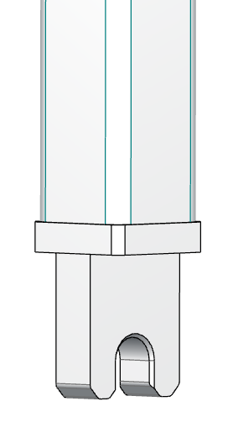
Support Pillars and Top Bracket
The baseline concept is to weld the lower angle brackets to the CF structure during installation. Lower and upper bracket will be hinged. This hinge joint caters for a much larger possible misalignment since pillar position need to be vertical after installation.
Lower hinge connection contain open hole on pillar plate due to lack of space for pin installation, while the upper hinge has standard pin connection
Shims
Top bracket
Pin
Support Pillar

Slide 10
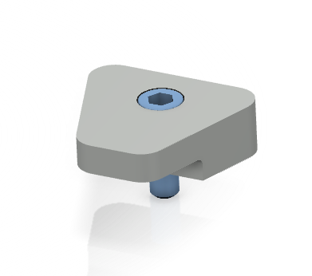
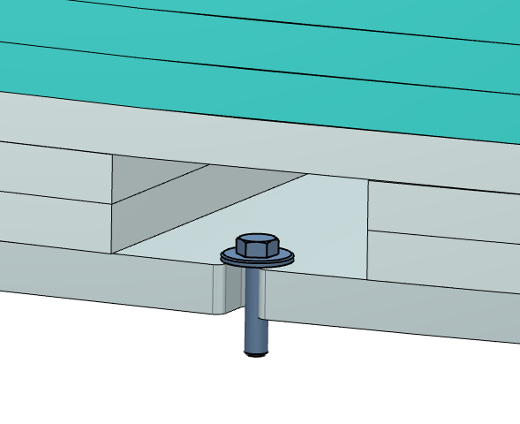
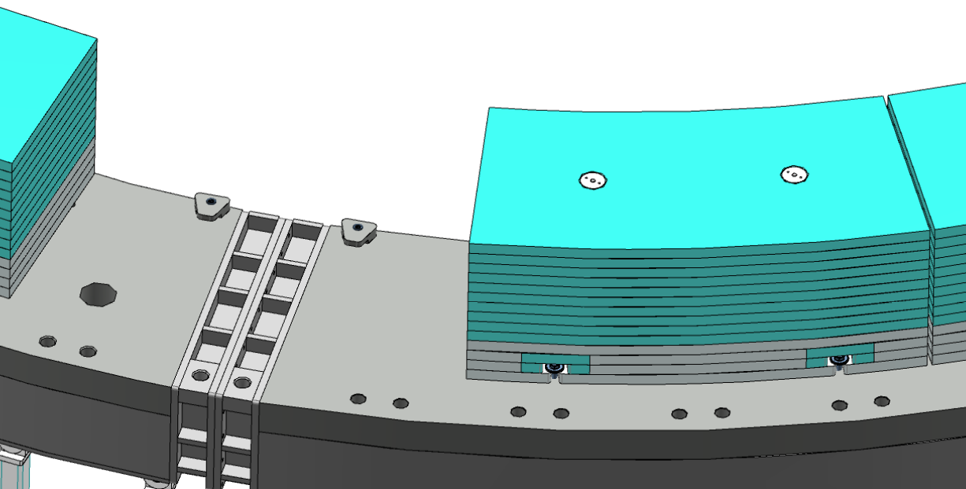
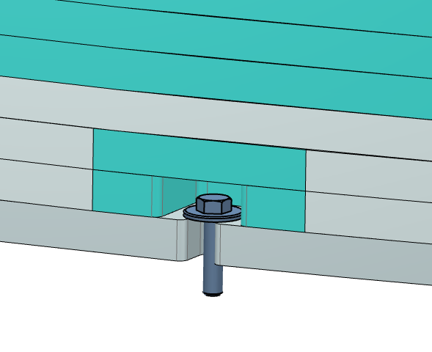
Skirt Shield Blocks
Guide Brackets
Design assuming 200 mm base steel (4 sheets, each 50 mm thick) and 500 mm HDPE (10 sheets, 50 mm thick)
Steel sheets intended to be cutted and welded in order to form cutouts for forklift handling. Cutouts can be filled with HDPE plates after installation.
Assembly of the HDPE and steel sheets has been provided with threaded rod and nuts
Forklift cutout
HDPE Plates
Fixing Bolt
Steel plates
HDPE Plates

Slide 11
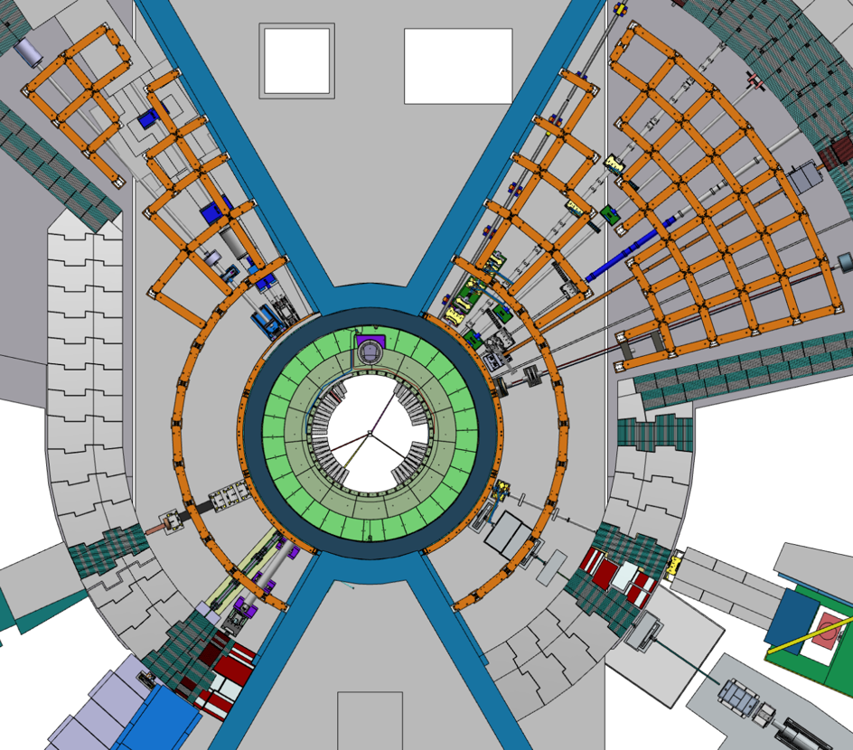
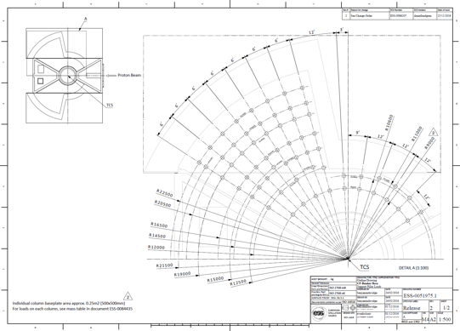
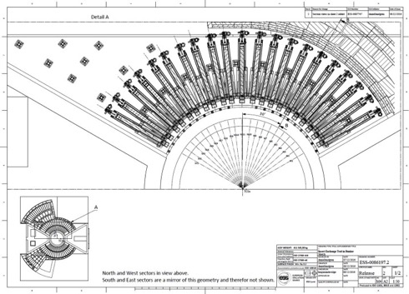
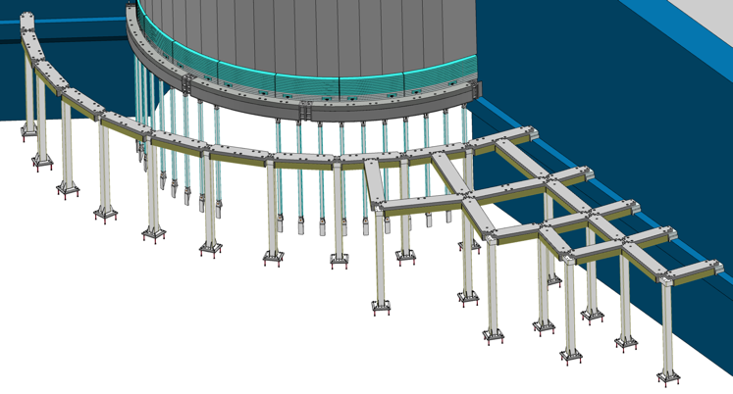
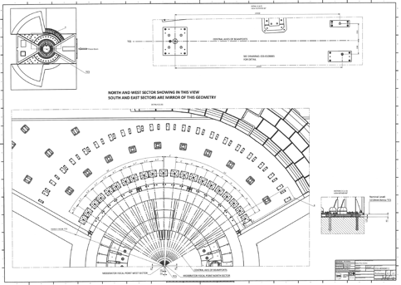
Target Building Frame
Pillar position unchanged from PDR since they provide no clashes and required clearance in R9 with revised IET.
Also placement of pillars radiating outward from R9m selected based on load distribution onto floor.
Pillars positioned in between beamlines
Support pillar positions ESS-0051975
IET – Column interface ESS-0086197
NBX – Floor alignment plates
ESS-0108885

Slide 12
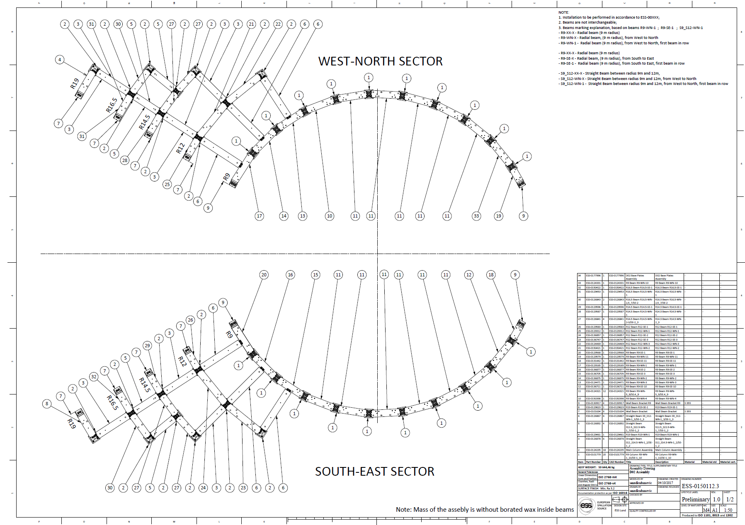
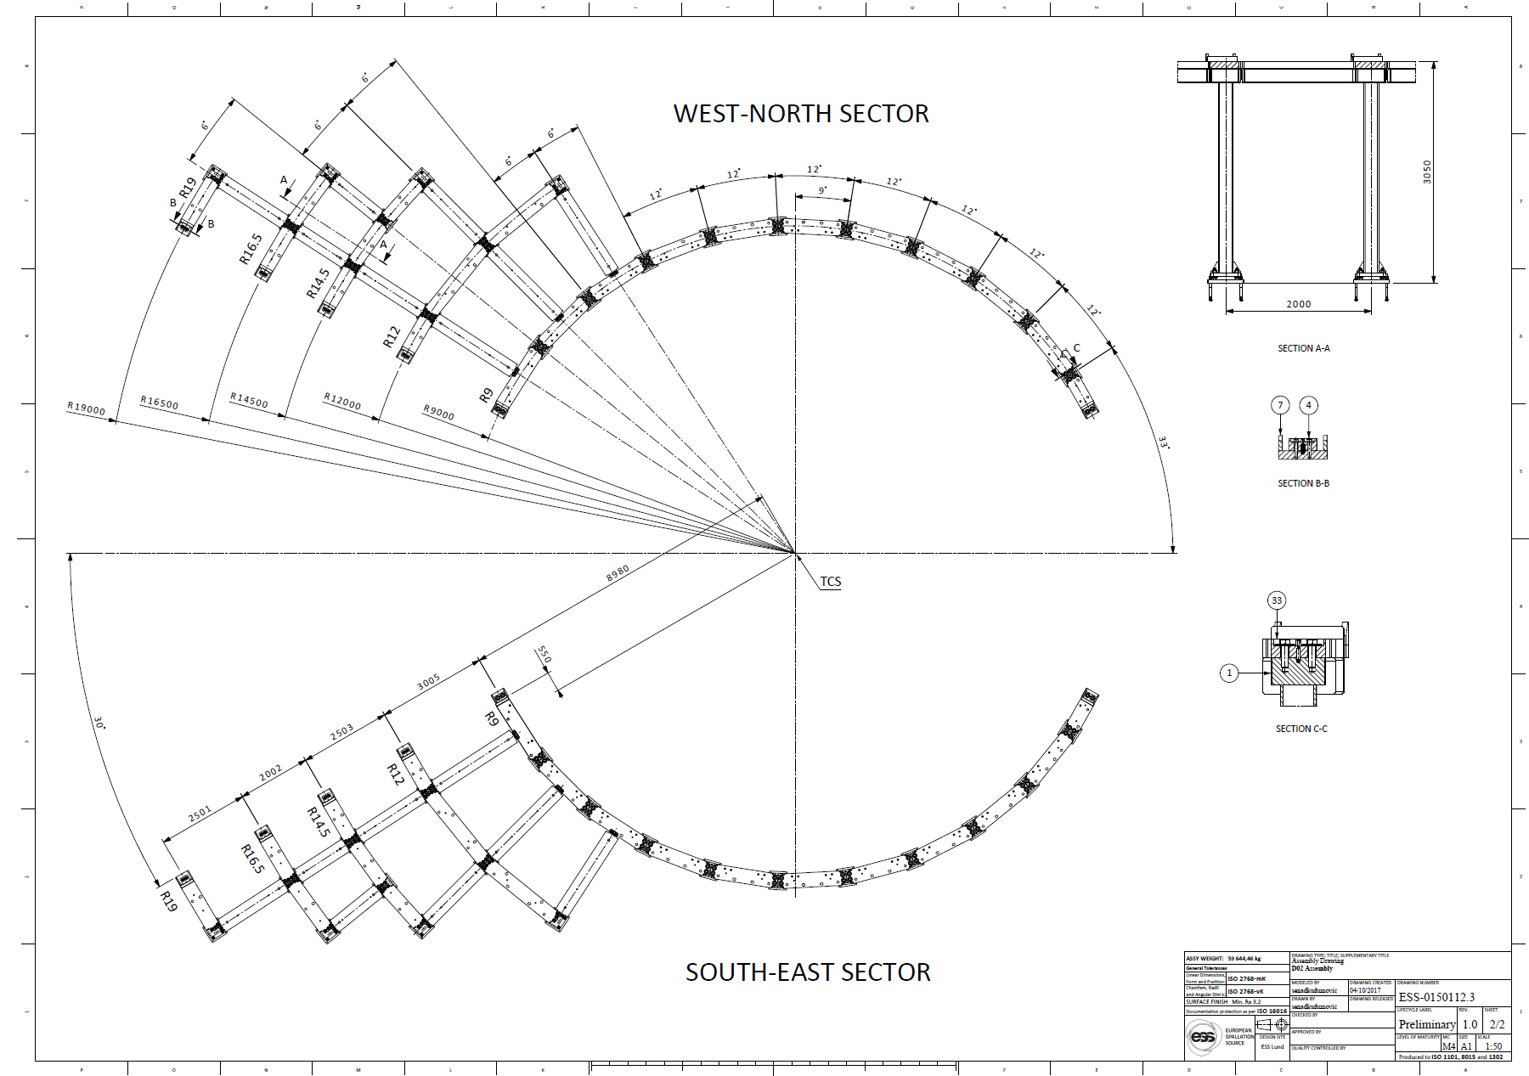

Target Building Frame (D02)
Base plates anchored to the floor
Remote handling connection between pillars and base plates
Top beams bolted to the columns
Identical mirrored structure for South-East sector
ESS-0150112
ESS-0150112

Slide 13
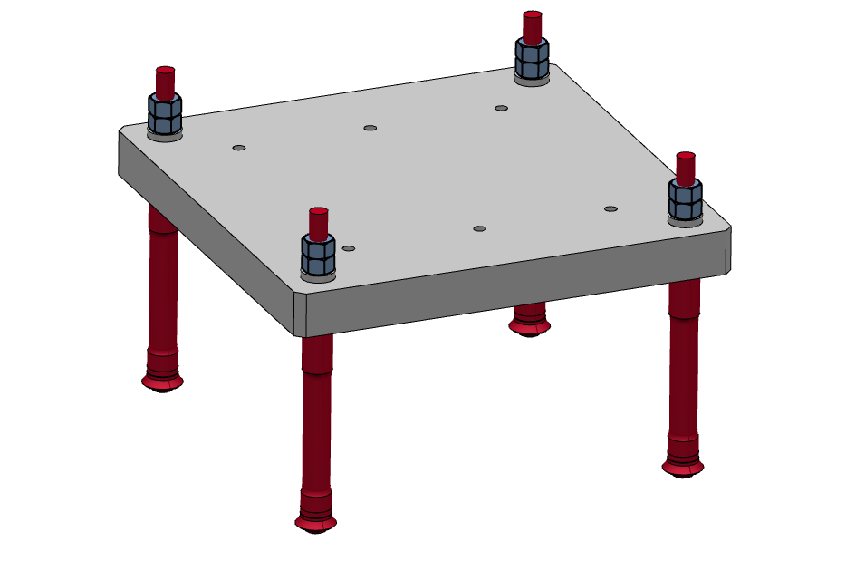
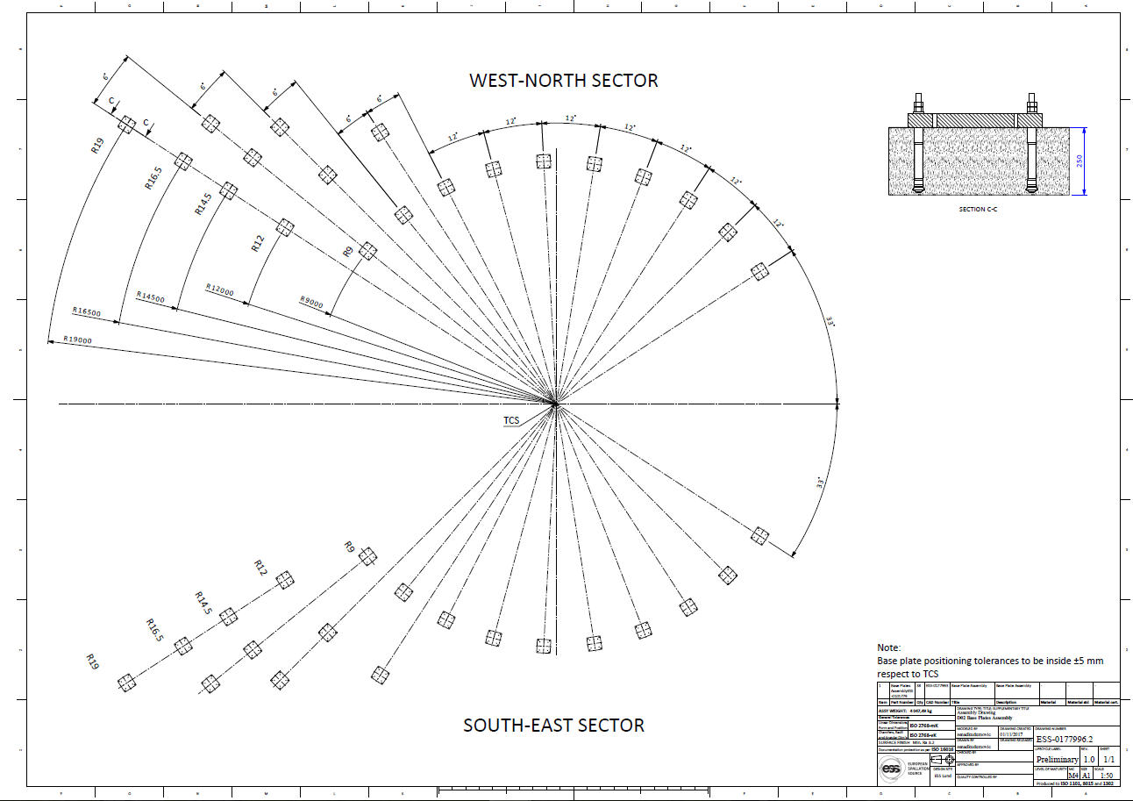
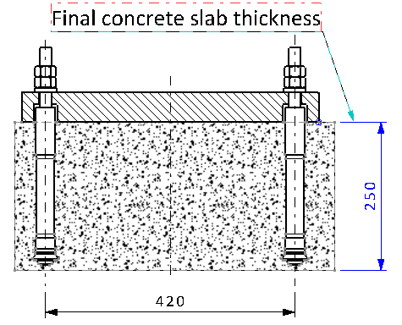
Target Building Frame (D02)
Positioning and anchoring base plates acc. ESS-0177996
Positioning to be done inside ±5 mm
ESS-0177996

Slide 14
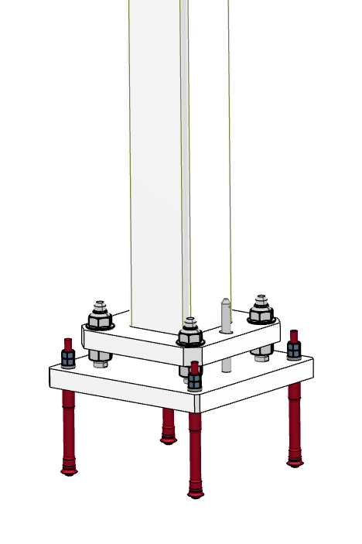
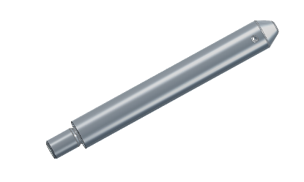
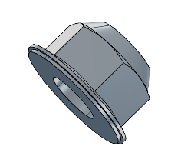
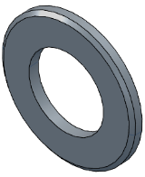
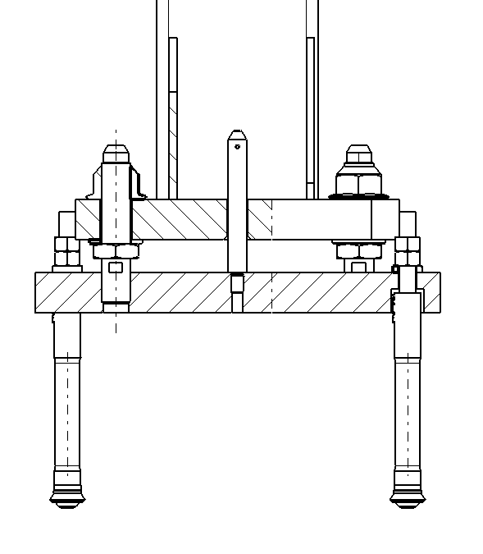
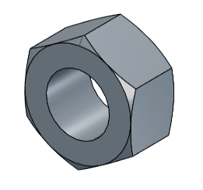
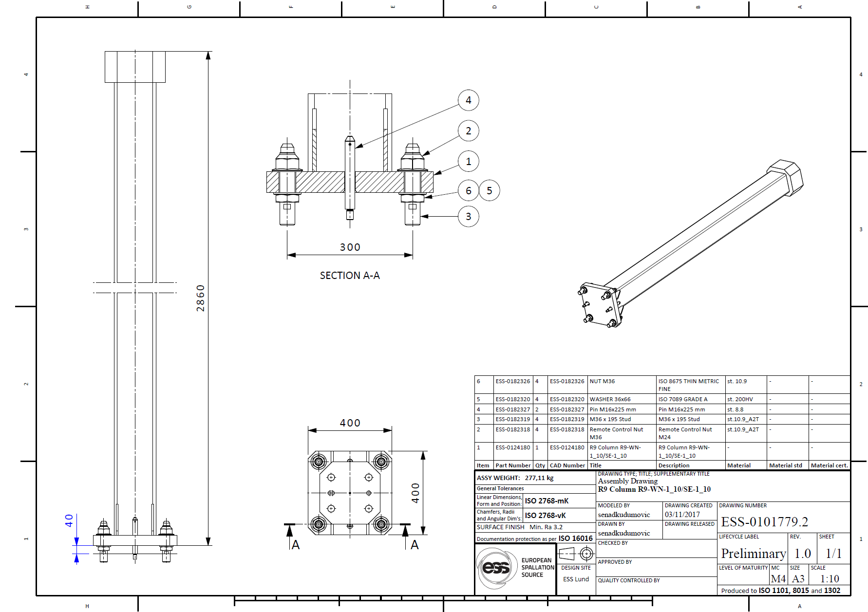
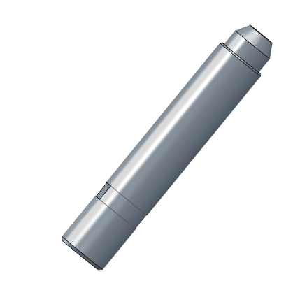
Target Building Frame (D02)
Remote handling connection between pillars and base plates
Guide Pin
M36 Remote Control Nut
M36 Nut and Washer
ESS-0101779
M36 Stud

Slide 15
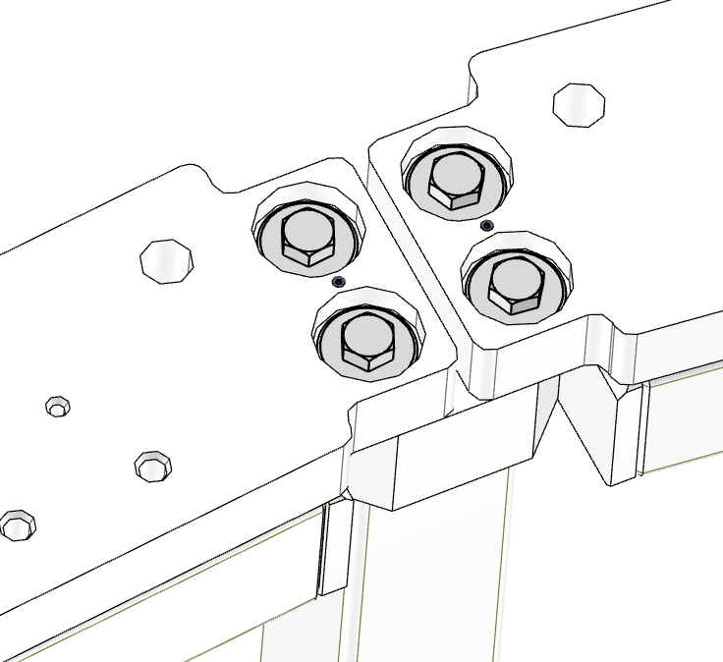
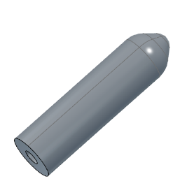
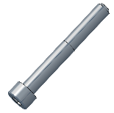
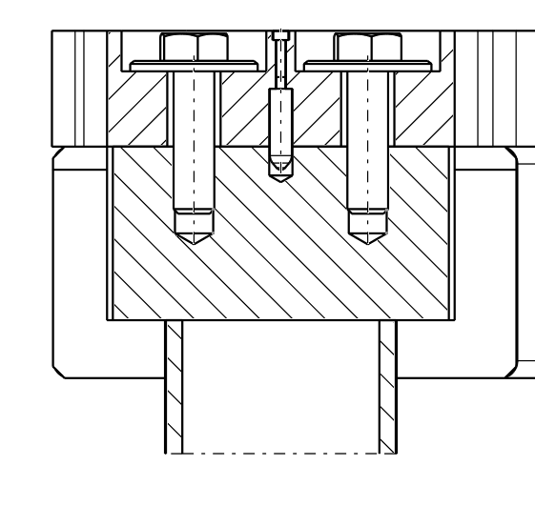
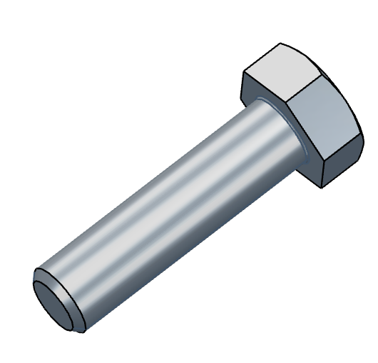
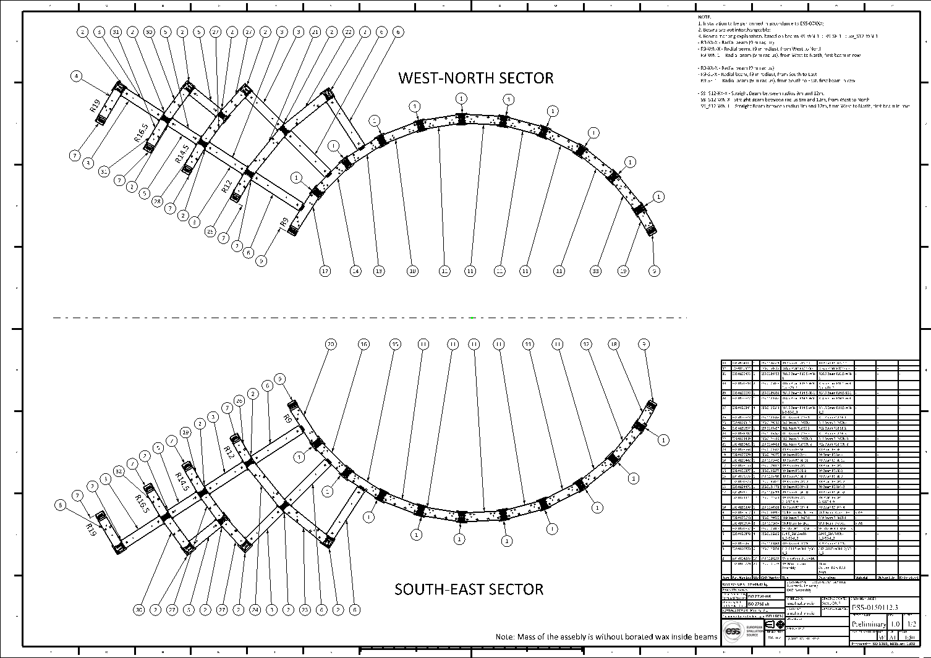

Target Building Frame (D02)
Beams have guide pins between bolts. These pins providing easy and accurate positioning, installation and deinstallation.
Guide Pin and Bolt
Beams position and marking instruction shown on ESS-0150112 and ESS-0192735
Bolt and oversized washer

Slide 16

Target Building Frame (D02)
Bunker frame is built of nearly 200 pillars/beams and every pillar/beam has its own, unique destination. In order to avoid errors during an installation, each beam and pillar must be labelled - painted numbers on sides and on top of each beam and painted number on side of each pillar.
Every label gives tree information about a beam/pillar position and it is defined as follows:
[sector]. [row]. [beam#]
[sector] – NW (North-West), or SE (South-East)
[radius] – beam/pillar radius number counted outwards from the TCS
[beam#] – beam/pillar number counted clock wise in the NW sector, and counter clockwise in the SE sector
For the sake of an example, NW-R9-1 label stands for:
North-West Sector
Radial Beam (9 m radius)
First beam in row

Slide 17



Target Building Frame (D01/D03)
Base plates will be casted in concrete by COWI
Remote handling connection between pillars and base plates (same as D02)
Top beams bolted to the columns (same as D02)
Diagonal bracing at last row
ESS-0150301
ESS-0150301

Slide 18



Target Building Frame (D01/D03)
Base plates will be casted in concrete by COWI
Positioning will be done inside building tolerances (±20 mm) – ESS-0123253
ESS-0123253

Slide 19






Target Building Frame (D01/D03)
To ensure the bunker do not fall inwards, bracing is arranged that makes the structure much stronger inwards than outwards
Top Connection Point
Connection Pin
ESS-0191430
Bottom Connection Point

Slide 20





Target Building Frame (D01/D03)
Pillar position in collision with dillatation gap
Top Connection Point
Connection Pin
Dilatation gap
Bottom Connection Point
ESS-0191430

Slide 21

Q/A
Questions/Comments/Ideas ??
Senad Kudumovic
senad.kudumovic@esss.se

